Slide 1
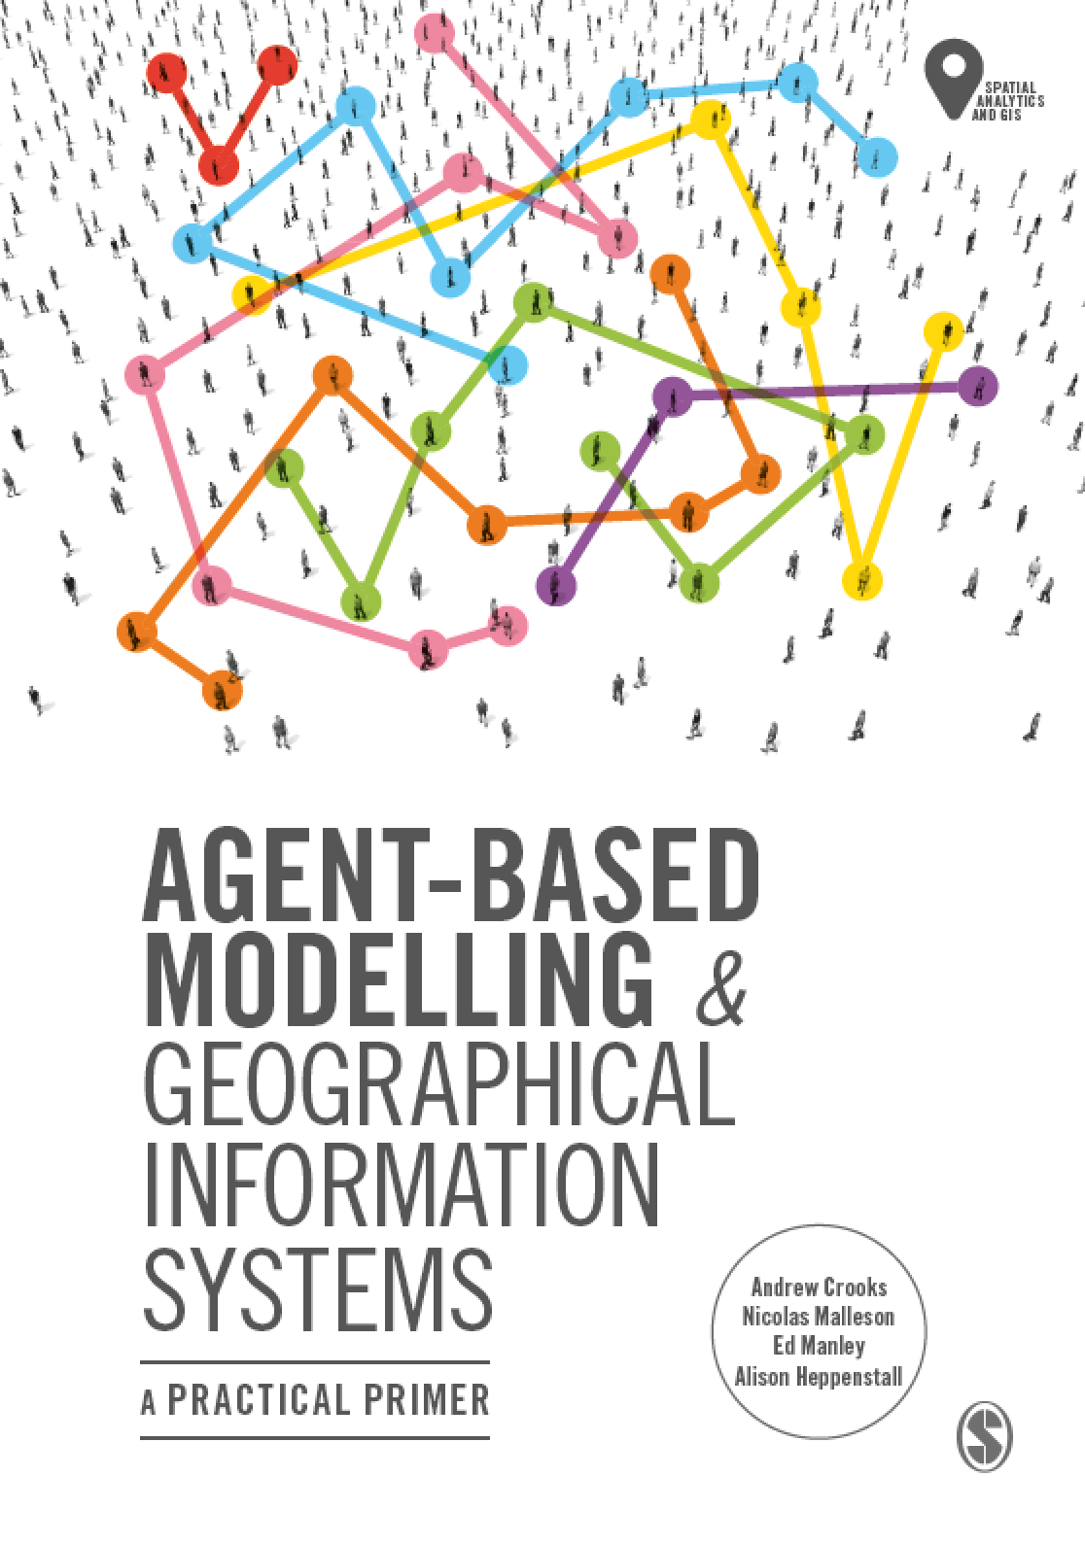
Chapter 9
Spatial Statistics
Notes:
In this Chapter we introduce the key concepts behind agent-based modelling. What is an agent, and what are rules? These are discussed along with a consideration of the main advantages and disadvantages for simulating spatial systems. A range of established applications are presented to give a flavour of how agent-based models can be successfully applied. The overarching aim of this chapter is to give the reader an understanding of what an agent-based model is. This knowledge will be built upon in subsequent chapters.

Slide 2
Learning Objectives

Slide 3
Introduction

