Slide 1
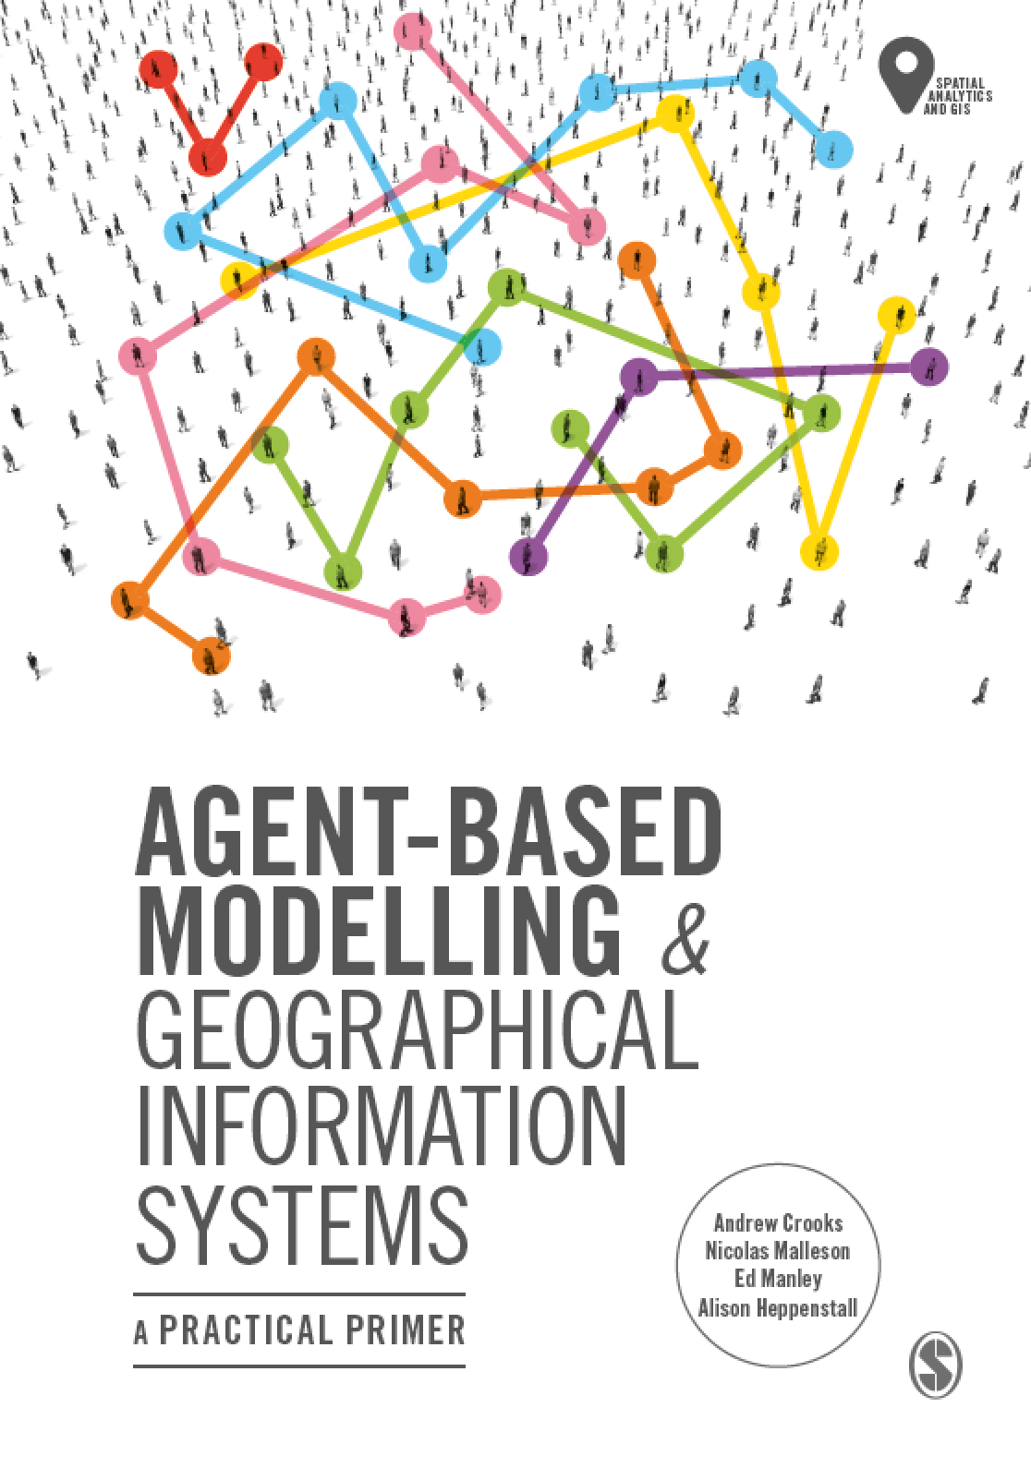
Chapter 1
Agent-based Modelling and Geographical Information Systems
Notes:
The overarching aim of this chapter is to give the reader a contextual background and general overview of the major developments in geographical modelling for the simulation of the individual. The reader is introduced to a discussion around the purpose of modelling as well how complexity theory has influenced the way that we view (and simulate) geographical systems. We end the chapter by discussing the benefits of bringing together agent-based modelling and GIS.

Slide 2
Learning Objectives
Introduce the textbook, structure and online resources.
Provide contextual background and general overview of the major developments in geographical modelling for the simulation of the individual.
What is a model
Introduce complexity theory
Set the scene for the upcoming chapters
Provide a brief overview of the main topics covered in the book.

Slide 3
Introduction
Geographers have always been interested in the role and influence of the individual within geographical systems.
Specifically what are the consequences of individual behaviors and decision-making over space and time?
In the last 20 years we have seen an explosion in computer processing power and storage and micro-level data sets
Coinciding with this, ideas from complexity science now influence our thinking geographical systems.
How individuals interact and shape geographical systems from the bottom up.

Slide 4
Complexity and Geographical Systems
Complexity arises when a small number of rules or laws, applied at a local level and among many entities, are capable of generating complex global phenomena:
Collective behaviors, extensive spatial patterns, hierarchies, etc.

Slide 5
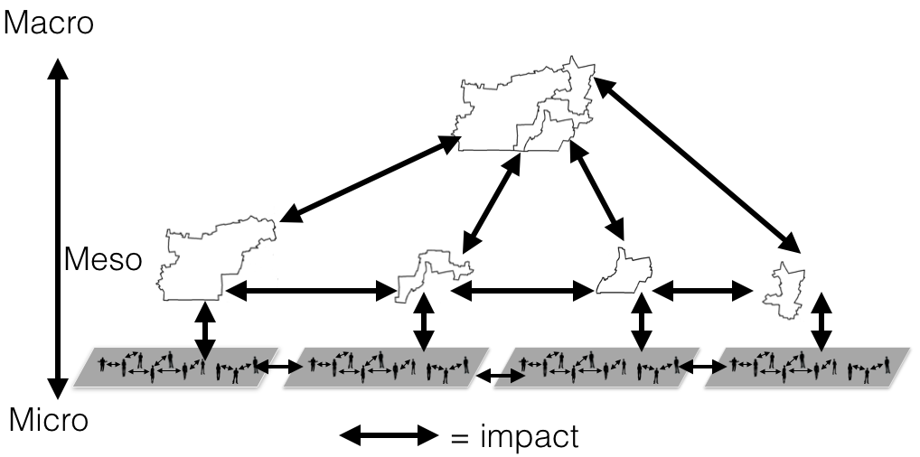
Hierarchies and Interactions
A simple hierarchical structure of a city composed of multiple neighborhoods which form a hierarchy at the more macro level but also have interactions (e.g. commuter flows) amongst each other.

Slide 6
Complexity and Geographical Systems
Term | Explanation | Example
Self-organisation | The system’s ability to self-organise – without higher-level direction. | In economics, national and global markets evolve from locally interacting agents all pursuing what they want.
Non-linear | Outputs do not have to be proportional to their inputs. | Increasing education and employment opportunities for the people does not stop rioting (Appendix A13).
Feedback | Self-organisation results from feedback mechanisms (positive & negative) as a result of interactions between individual entities. | Negative: thermostat that attempts to regulate the temperature in a room. Positive: a run on a bank which can cause it and other banks to fail.
Path Dependence | How history dictates how systems evolve and restructure. | Rank size distribution of cities or residential decisions impact land markets.
Key terms used in complexity theory

Slide 7
Models
In seeking to understand the complexity of the world around us, we require methods that can capture and regenerate the characteristics of complex systems.
We do this through modelling.
A model is a simplified representation of a complex reality, to the point that the reality is understandable and analytically manageable.
A model can be constructed as a computer program that uses a simplified digital representation of one or more aspects of the real world, transforming them to create a new representation.
There are many reasons and purposes for modelling, from description and explanation to prediction.

Slide 8
Data
While models provide one route towards understanding geographical complexity, we are also rapidly gaining a richer understanding of the world through the vast amount of new data becoming available and enabling new veins of research.
By the year 2020, many predict the global universe of accessible data to be of the order of 44 zettabytes or 44 trillion gigabytes
Data now not only comes from government and commercial organizations (e.g. US Census Bureau) but also from individual users.
However, data alone does not give us the ‘why’, only the ‘what’, in the sense that it gives us the patterns but not the processes that cause them to emerge. For this, we need to model social interaction and the individuals involved in such interactions.
Notes:
note that data and data analysis techniques do
not replace the scientific method of hypothesis, model and test. Data (and data
science techniques) can help with answering research questions but often fails to
reveal the casual effects (Mazur and Manley, 2016). Data does not give us the ‘why’,
only the ‘what’, in the sense that it gives us the patterns but not the processes that
cause them to emerge. For this, we need to model social interaction – this is the
broader view of CSS (Torrens, 2010b; Cioffi-Revilla, 2014).

Slide 9
Individuals
There has been a marked change over the past sixty years in how we simulate the individual within geographical systems.
Previous generations of researchers did not have either the computational power or access to data that today’s researchers do.
Lack of data and tools for simulating individuals meant that models examined the systems as a whole, based on aggregate analysis offering a limited way to examine the dynamics taking place within such systems
The increase in computation, individual-level data sources and the infusion of ideas from complexity theory allow us to look at how geographical systems emerge from the “bottom up”
E.g. , it is the local-scale interactive behavior (commuting, moving) of many individual objects (vehicles, people) from which structured and ordered patterns emerge, such as peak-hour traffic congestion and the large-scale spatial clustering of socio-economic groups by residence.
Understanding how geographical systems grow and evolve from the bottom up allows us to understand how uncoordinated local decision-making gives rise to coordinated global patterns which define the shape of the world around us and how these global patterns then influence the local decisions of individuals.

Slide 10
Agent-Based Modelling and Geographical Information Systems
While data can take us some of the way towards understanding the world around us, only models allow us to build a comprehensive understanding of the mechanisms and behaviors that shape complex geographical phenomena.
In the remaining chapters we will explore how we can model geographical systems from the “bottom up” using agent-based models
The overarching aim of the book is to facilitate the in-depth learning of both the fundamental knowledge and practical skills required for building and running agent-based models for simulating geographical systems.

Slide 11
Book Outline

Slide 12
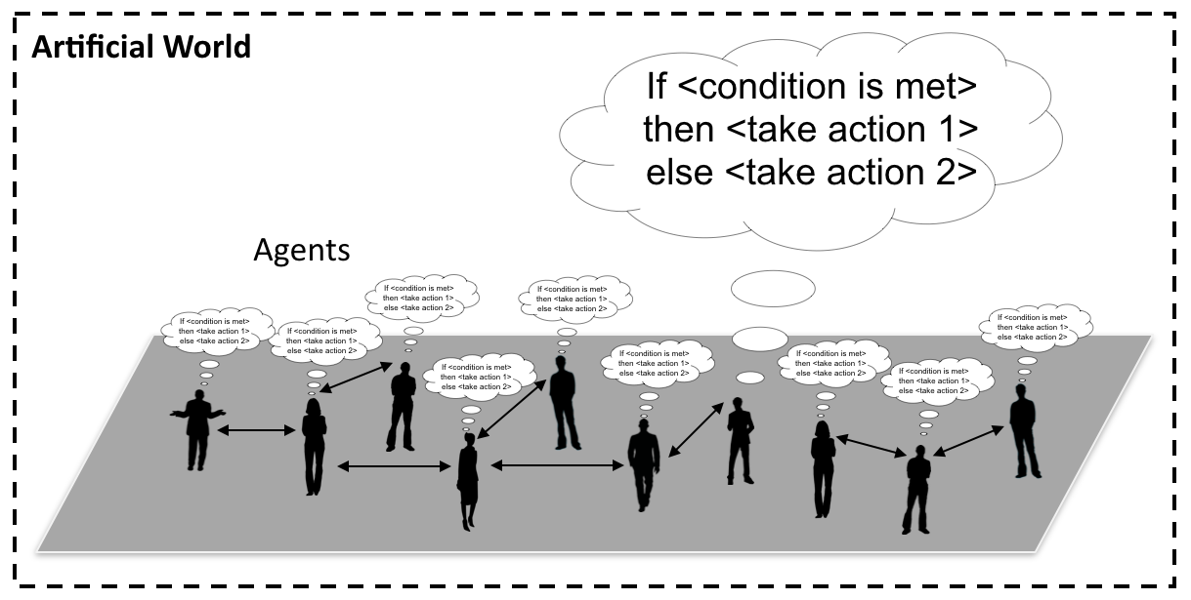
Chapter 2: Introduction to Agent-based Modelling
Introduce key concepts behind agent-based modeling (ABM):
What is an agent?
Advantages and limitations of ABM
Applications of ABM:
E.g. Residential movement, transportation
How ABM has been used in decision making?
Notes:
Figure: Conceptualization of an agent-based model where people are connected to each other and take actions when a specific condition is met

Slide 13
Chapter 3: Designing and Developing an Agent-based Model
This chapter will introduce the core concepts and frameworks that can be used to plan, implement and disseminate geographical agent-based models.
What are the questions that social scientists and geographers need to consider when designing and building an agent-based model?
What design frameworks and software toolkits are available to use? What are their relative pros and cons?
What methods are available for documenting design concepts and why are they useful to modelers?
Notes:
What are the questions that social scientists and geographers need to consider when designing and building an agent-based model? What design frameworks and software toolkits are available to use? What are their relative pros and cons? What methods are available for documenting design concepts and why are they useful to modellers? This chapter will introduce the core concepts and frameworks that can be used to plan, implement and disseminate geographical agent-based models.

Slide 14
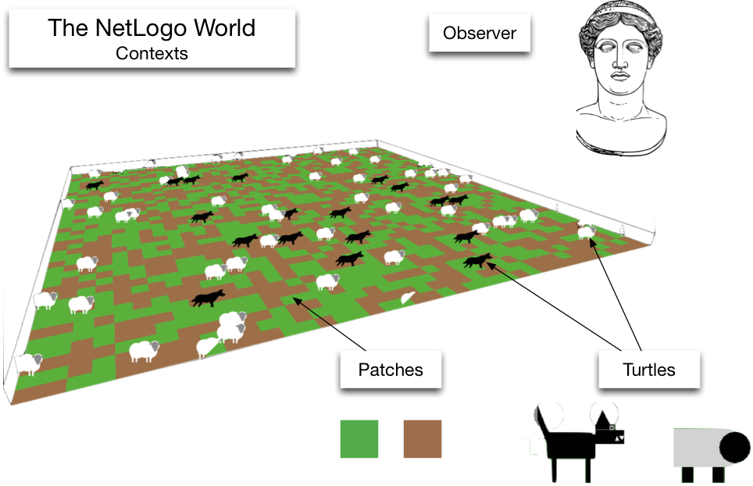
Chapter 4: Building Agent-Based Models with NetLogo
Provides an overview of the programming language and concepts that are used within NetLogo (Wilensky, 1999):
How to create a simple environment.
Step-by-step instructions for creating a simple model.
Subsequent chapters build upon the basics presented here.
Notes:
Picture: NetLogo contexts: the observer, patches and turtles

Slide 15
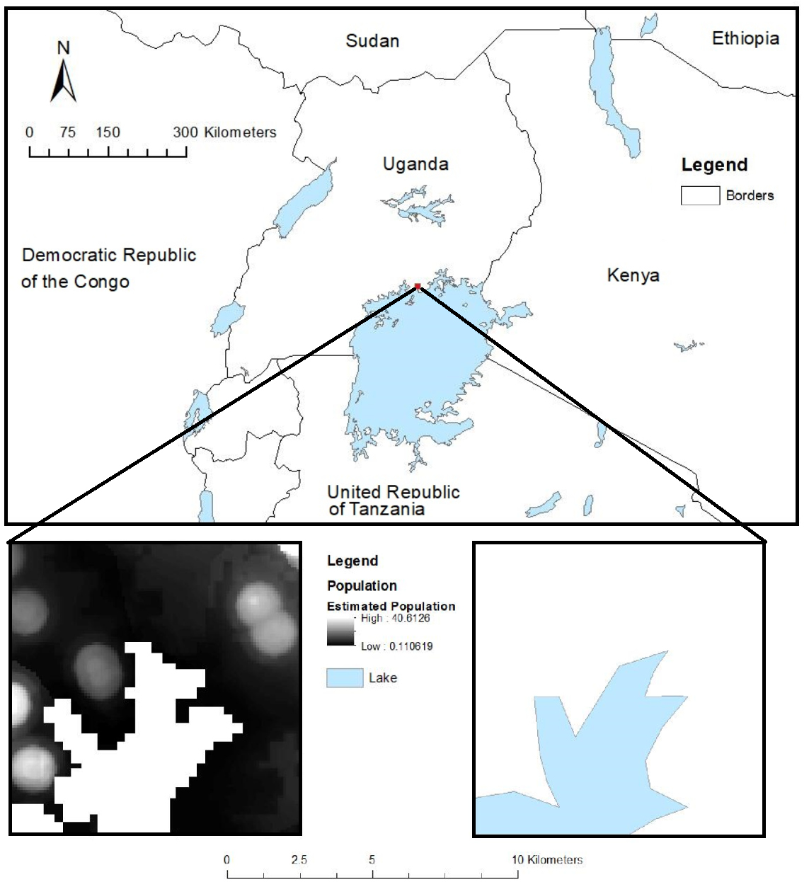
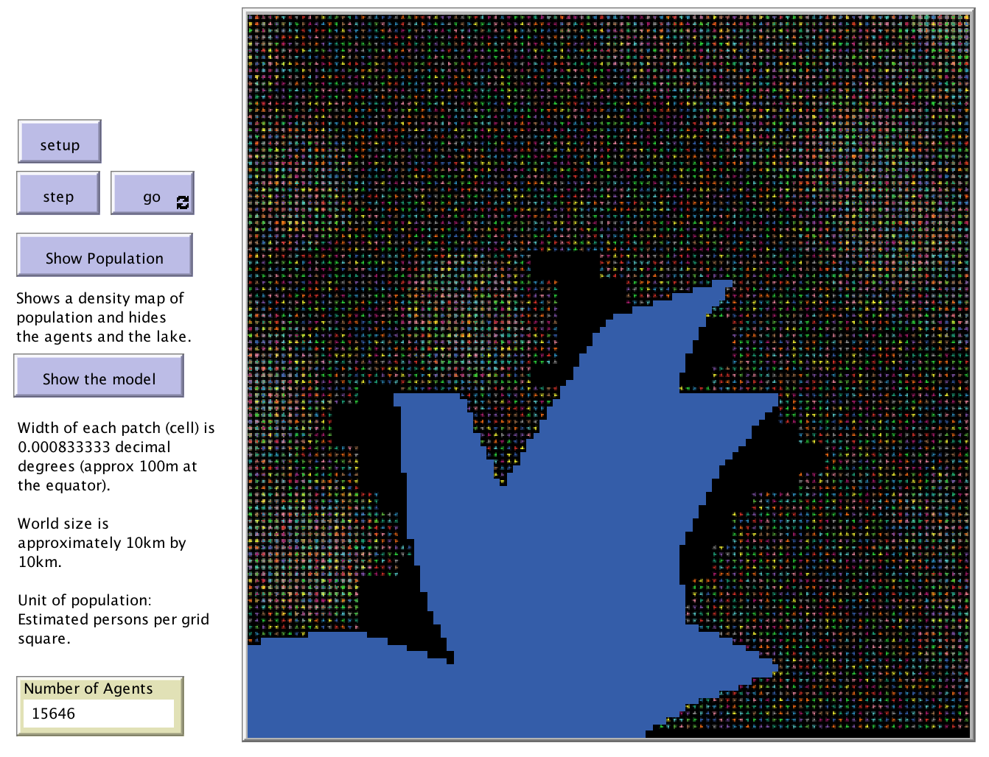
Chapter 5: Fundamentals of Geographical Information Systems
Presents the main concepts and terminology that are required to understand geographical information systems. E.g.:
Data types (i.e. raster & vector).
Accuracy and precision.
Provide a brief overview of the development of GIS.
Using QGIS, we demonstrate how to prepare and manipulate example GIS data and how to integrate it into an agent-based models.

Slide 16
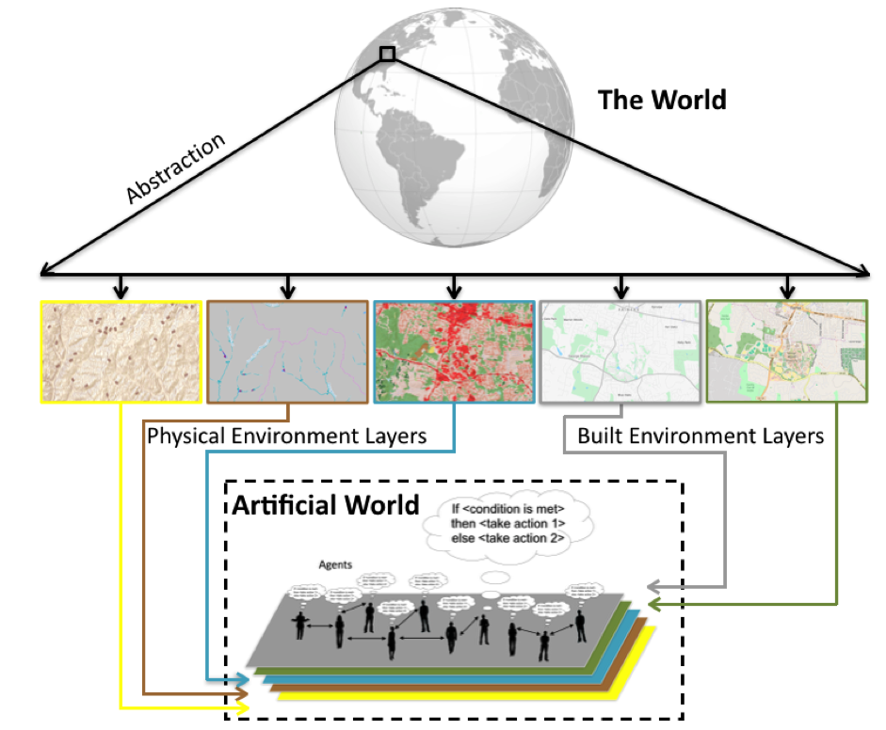
Chapter 6: Integrating Agent-Based Modelling and GIS
Building on previous chapters outlining the fundamentals of GIS and agent-based modelling, what are the benefits to linking these approaches? How is this undertaken? This chapter will explain loose and tight coupling, critiquing the relative advantages and disadvantages of both. We present an overview of open source toolkits that can be used for the creation of geographically explicit agent-based models, before providing a critical look at where and how GIS and ABM should be combined, offering practical advice on best practice.
Notes:
Figure: Abstracting from the real world to a series of layers to be used in the artificial world upon which the agent-based model is based

Slide 17
Building on previous chapters outlining the fundamentals of GIS and agent-based modelling, what are the benefits to linking these approaches? How is this undertaken? This chapter will explain loose and tight coupling, critiquing the relative advantages and disadvantages of both. We present an overview of open source toolkits that can be used for the creation of geographically explicit agent-based models, before providing a critical look at where and how GIS and ABM should be combined, offering practical advice on best practice.

Slide 18
Chapter 7: Modelling Human Behaviour
Notes:
This chapter explores the most common approaches by which researchers incorporate human behaviour into agent-based models. We explain why it can be necessary to model human behaviour and the main considerations that the researcher needs to be aware of when developing an agent-based model. From this, we present an overview of the two main broad approaches, mathematical and conceptual cognitive models when it comes to modelling human behaviour in agent-based models. We supplement this discussion with two case-studies that provide examples of how these approaches can be implemented, both examples have the model code available that can be downloaded and experimented with. The chapter finishes with a discussion of some of the thorny issues that researchers need to be aware of when attempting to simulate behaviour within agent-based models.

Slide 20
Chapter 8: Networks
Notes:
Networks play a critical role in our lives in terms of physical networks we use to navigate upon, our social networks and more recently how we communicate via cyber networks (e.g. social media). This chapter provides a brief introduction to such networks and shows how they can be integrated into agent-based models. Importantly, a model is also introduced that demonstrates how to navigate agents along a physical road network (this is a common requirement for spatially-explicit agent-based models).

Slide 22
Chapter 9: Spatial Statistics
Notes:
This chapter presents a range of statistics and algorithms that can be used to compare two spatial data sets. These are important for modelling because, at some point, it will be necessary to compare a model outcome to some real-world data in order to assess how reliable the model is. This chapter examines the statistics themselves, before Chapter 10 elaborates on how to evaluate the success of a model more broadly, part of which includes making use of the methods discussed here.

Slide 24
Chapter 10: Evaluating Models: Verification, Calibration, Validation
Notes:
Model evaluation is one of the central challenges associated with agent-based models. A key question that all modellers face is “how well does this model simulate the phenomenon of interest?”. While there are no universally accepted methods for evaluating agent-based models, researchers often adopt the same three stage process of verification, calibration and validation. This chapter presents an overview of the methods that are commonly used within each of these stages. The overarching aim of this chapter is to provide the reader with the knowledge to design their own approach to evaluating agent-based models.

Slide 26
Chapter 11: Alternative Modelling Approaches
Notes:
Agent-based modelling is one of the most popular approaches used in social and spatial simulation. However, there are several other alternative approaches that are available to the researcher including Cellular Automata (CA), Microsimulation, Discreet Event Simulation (DES), System Dynamics (SD) and Spatial Interaction models.
This chapter presents an overview of these other approaches giving simple examples on how they can be used and summarising the main differences between them. To compare these models, they are applied to the same issue, the spread of a disease using a Susceptible-Infected-Recovered (SIR) epidemic model. This shows that while the same general patterns emerge, the reasons for this are very different.

Slide 28
Chapter 12: Summary and Outlook
Notes:
This chapter reflects on the current state of the art of agent-based models and factors that may shape the future of this discipline. Specifically we discuss the key challenges for developing robust agent-based models of geographical systems as well as potential solutions. We argue that we need to make progress on these challenges if these models are to be used to offer insight into key societal challenges, for example climate change, urban growth and migration.

Slide 30
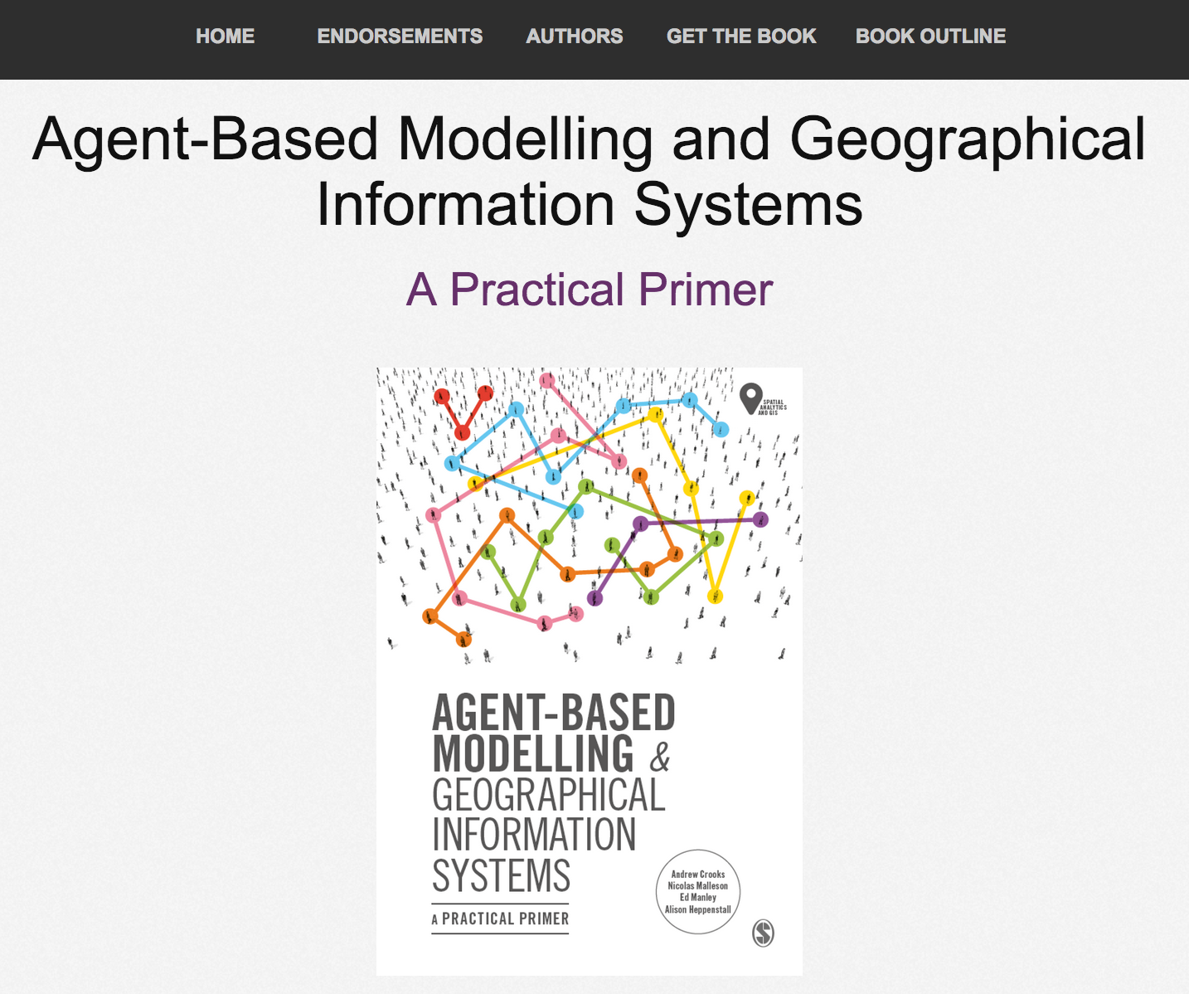
Online Resources
Visit: https://www.abmgis.org/ for models, tutorials and data used in this book.
Each chapter has a specific page with more information.

