Slide 1
Chapter 8
Networks
Notes:
Networks play a critical role in our lives in terms of physical networks we use to navigate upon, our social networks and more recently how we communicate via cyber networks (e.g. social media). This chapter provides a brief introduction to such networks and shows how they can be integrated into agent-based models. Importantly, a model is also introduced that demonstrates how to navigate agents along a physical road network (this is a common requirement for spatially-explicit agent-based models). The chapter concludes with a discussion about how networks can be combined to study real world phenomena and highlight future areas of research.

Slide 2
Introduction

Slide 3
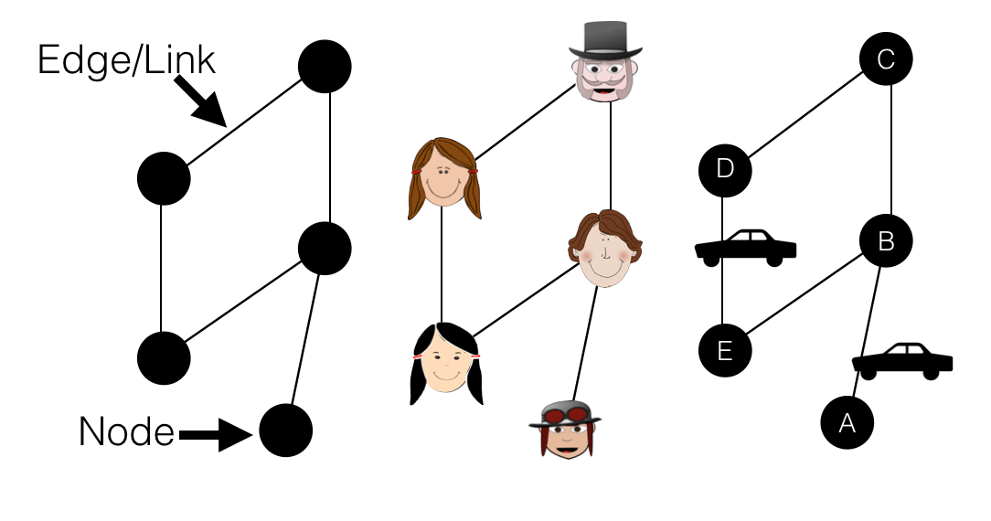
Graphs and Networks
Figure 8.1: From left to right, a basic graph, a social network and a simplified transportation network.

Slide 4
Basic Network Properties

Slide 5
Defining Graphs Mathematically

Slide 6
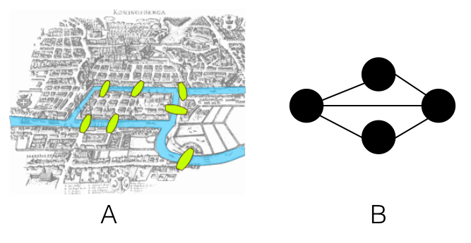
The Seven Bridges of Konigsberg problem
Figure 8.2: The Seven Bridges of Konigsberg problem. A: the physical depiction of the bridges (Source: Giusca, 2017) and B: the graph representation

Slide 7
Building Graphs in NetLogo

Slide 8
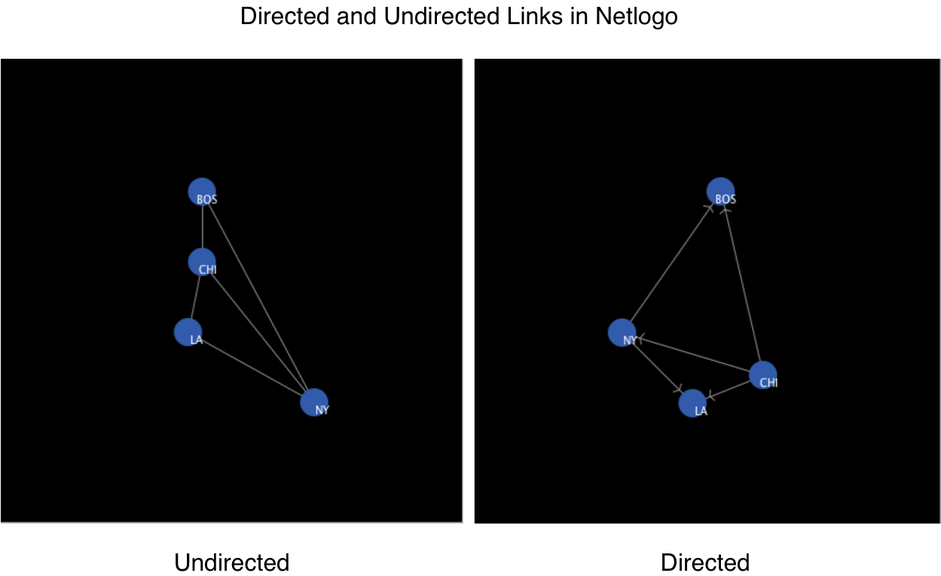
Directed and Undirected Links in NetLogo
Figure 8.3: Directed and undirected links as displayed in NetLogo. These examples are from the ‘Undirected Network Demo’ and ‘Directed Network Demo’ at: https://github.com/abmgis/abmgis/tree/master/Chapter08-Networks/Models.

Slide 9
Adjacency Matrices and Node Degree

Slide 10
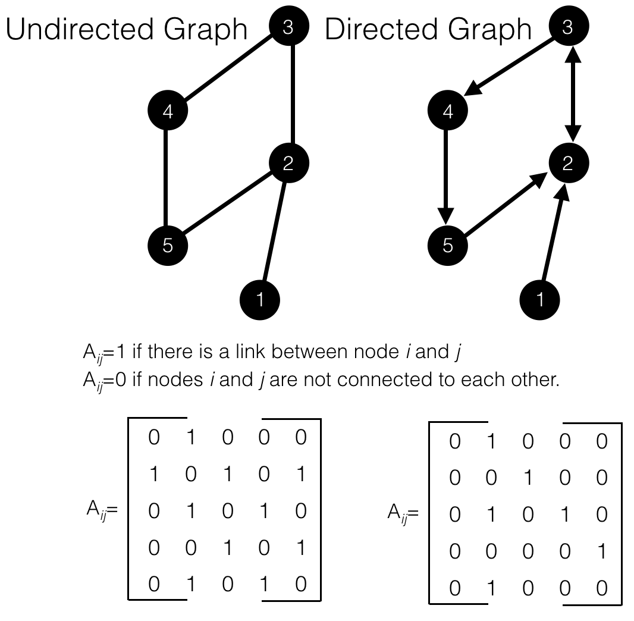
Adjacency Matrix for a undirected and directed graph.
Figure 8.4: Adjacency Matrix for a undirected and directed graph.

Slide 11
Traversing Graphs

Slide 12
Graph Density

Slide 13
Calculating Node Importance

Slide 14
