Slide 1
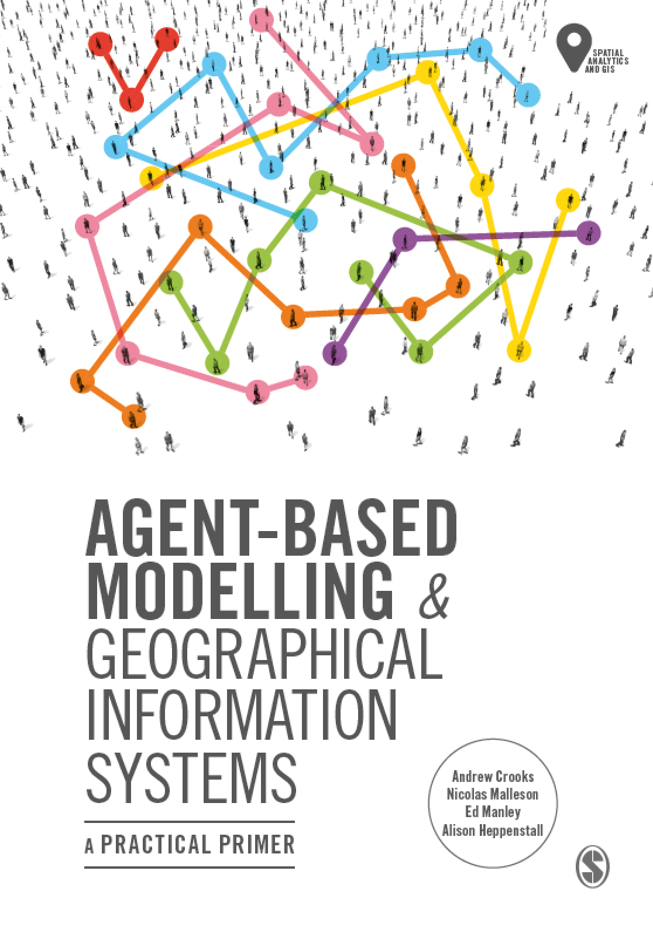
Chapter 3 Tutorial
Designing and Developing an Agent-based
Model
Notes:
Model evaluation is one of the central challenges associated with agent-based models. A key question that all modelers face is “how well does this model simulate the phenomenon of interest?”. While there are no universally accepted methods for evaluating agent-based models, researchers often adopt the same three stage process of verification, calibration and validation. This chapter presents an overview of the methods that are commonly used within each of these stages. The overarching aim of this chapter is to provide the reader with the knowledge to design their own approach to evaluating agent-based models.

Slide 2
Learning Objectives
By the end of this practical lab you will be able to:
Understand how to set up NetLogo
Run a basic ABM
Understand how altering a parameter can impact a model.

