Slide 1
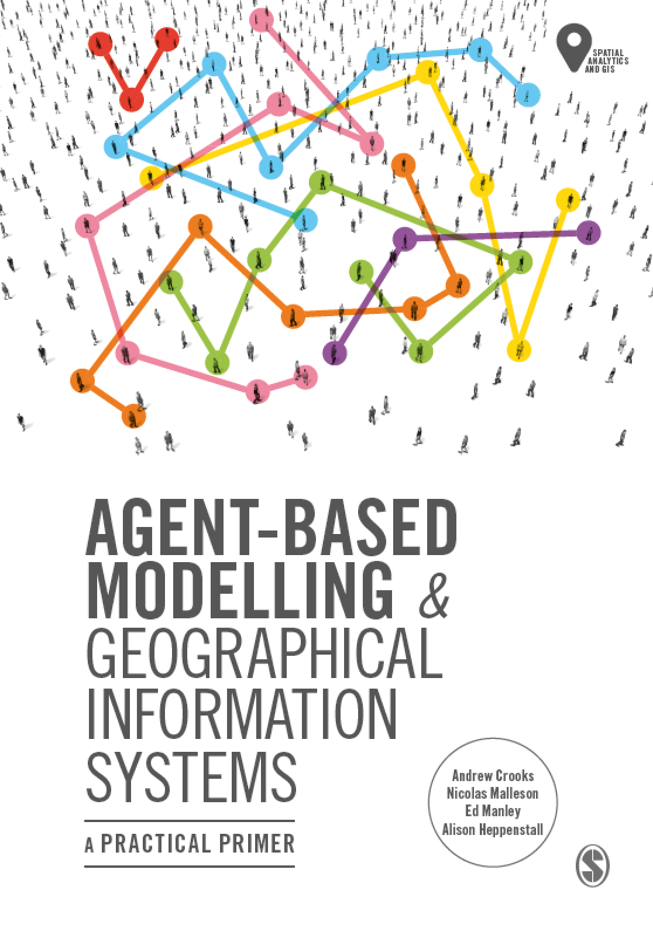
Chapter 5 Tutorial
Preparing GIS Data using QGIS
Notes:
Model evaluation is one of the central challenges associated with agent-based models. A key question that all modelers face is “how well does this model simulate the phenomenon of interest?”. While there are no universally accepted methods for evaluating agent-based models, researchers often adopt the same three stage process of verification, calibration and validation. This chapter presents an overview of the methods that are commonly used within each of these stages. The overarching aim of this chapter is to provide the reader with the knowledge to design their own approach to evaluating agent-based models.

Slide 2
Chapter 5
Preparing GIS Data using QGIS

Slide 3
Performing Spatial Operations

Slide 4
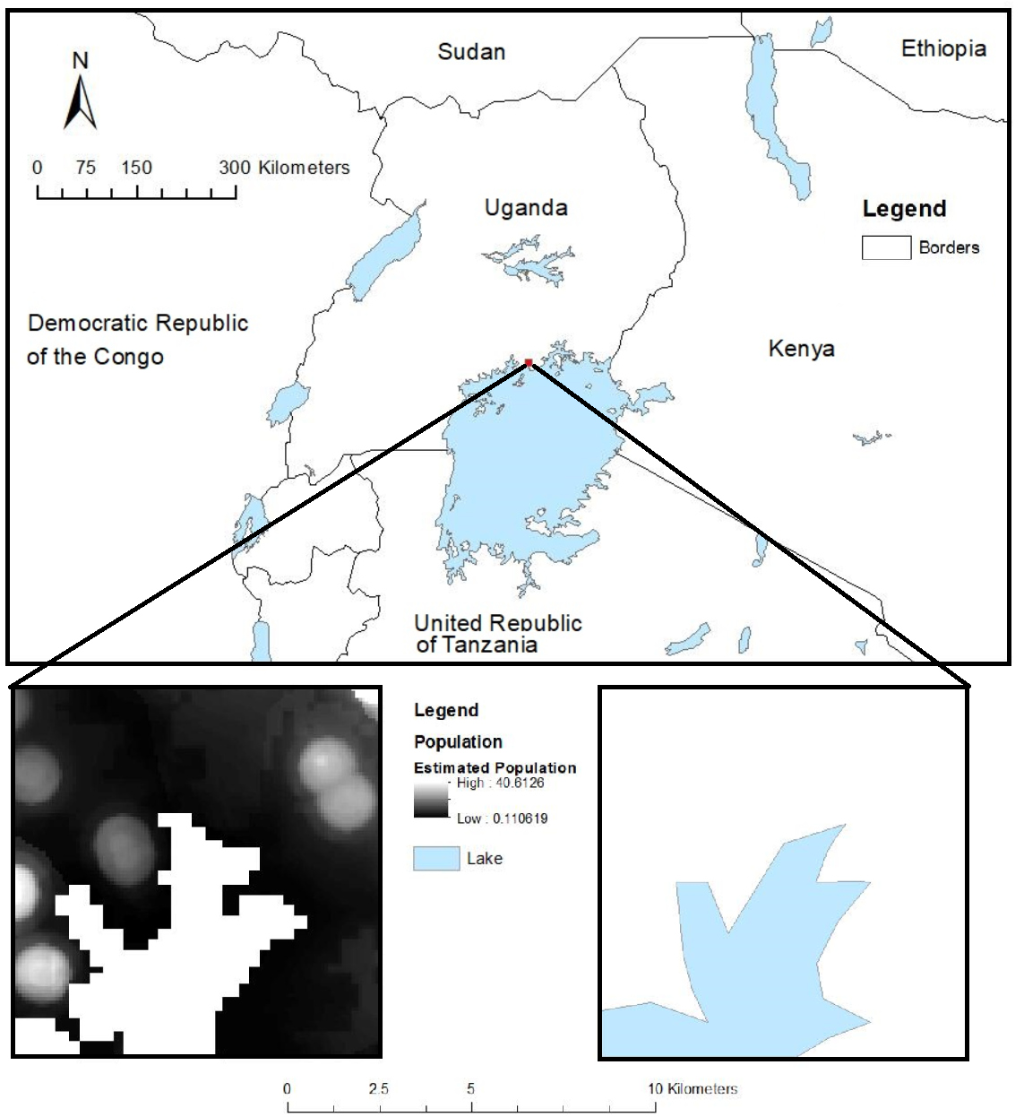
Figure 5.8: An example of using open data in this case data Natural Earth Data and Worldpop for a 10 by 10 km area near the city of Makindye in Uganda.

Slide 5
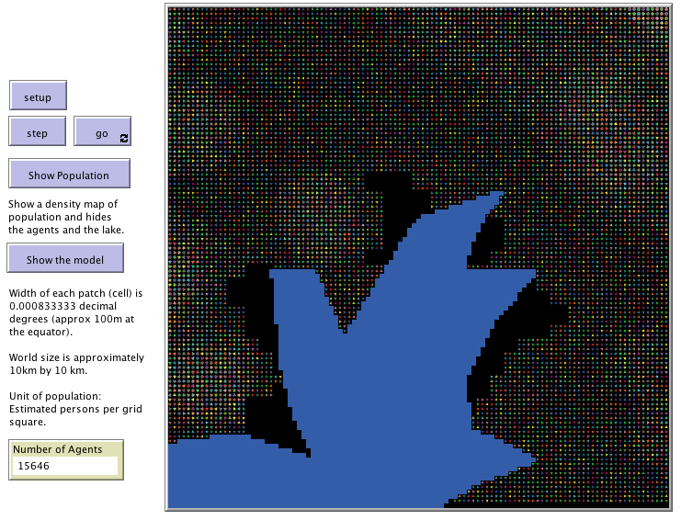
Figure 5.9: An example of using open data for the initialization of a agent-based model.
Notes:
UgandaExample

Slide 6
Manipulating Vector Table Data

Slide 7
Figure 5.10: An example of how to load and ‘clip’ vector and raster data files using QGIS.

Slide 8
Figure 5.11: Instructions for opening the attribute table for a vector layer using QGIS
Notes:
Chapter 6 (Section 6.6.1) the NetLogo model itself will be discussed;
DC.shp in DC folder.

Slide 9
Figure 5.12: How to add a new column to the attribute table that underpins a vector layer using QGIS and calculate new values for the column.

