Slide 1
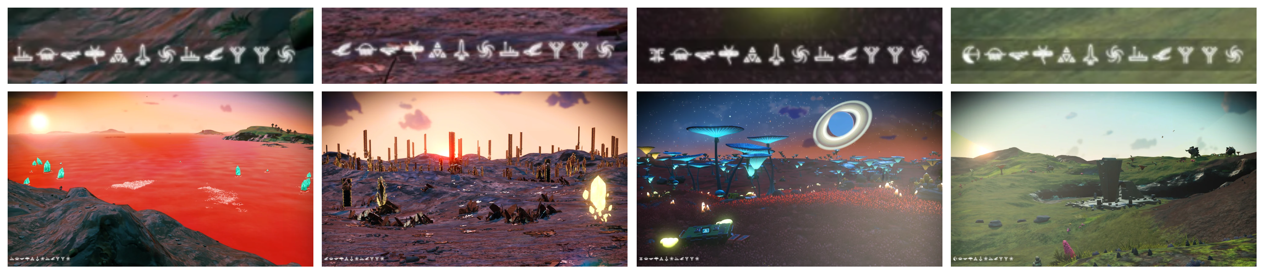
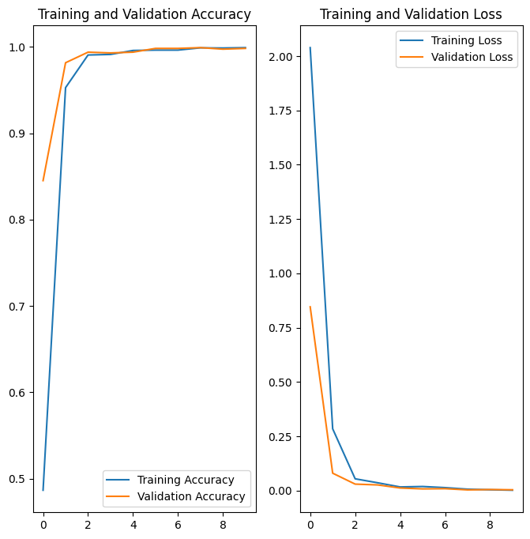
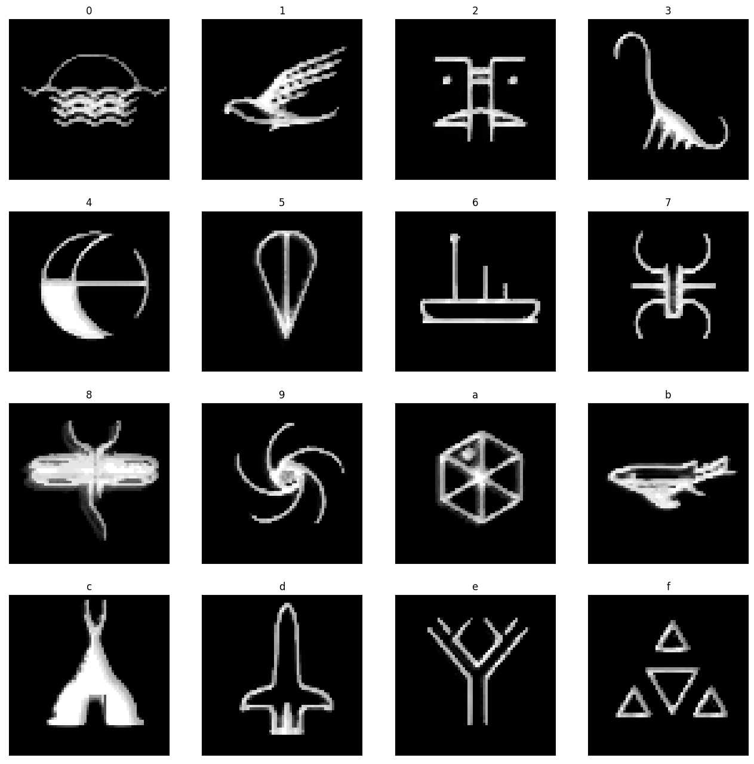
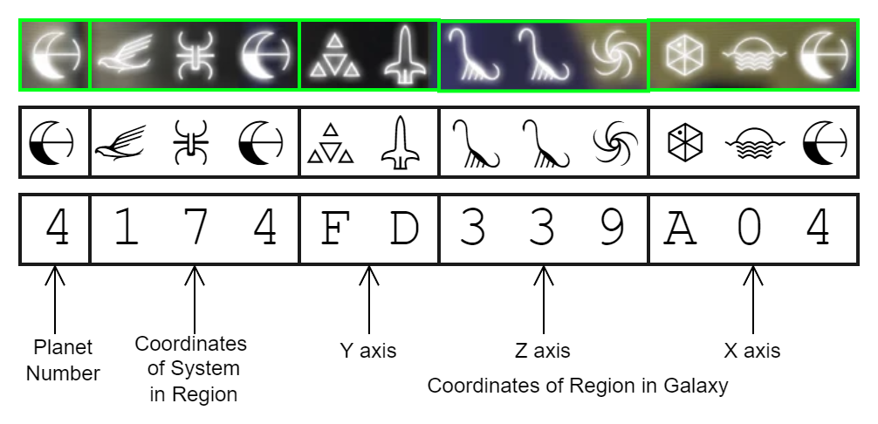
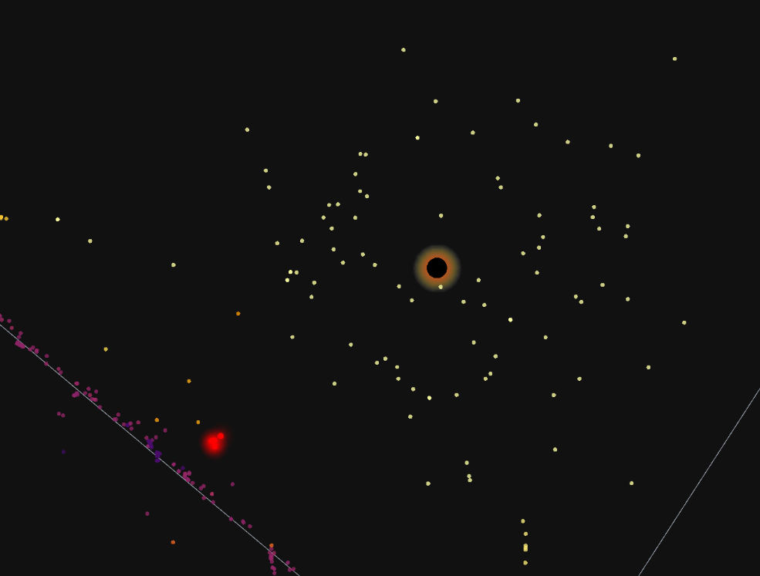
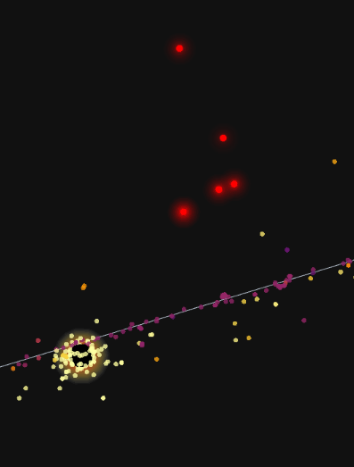
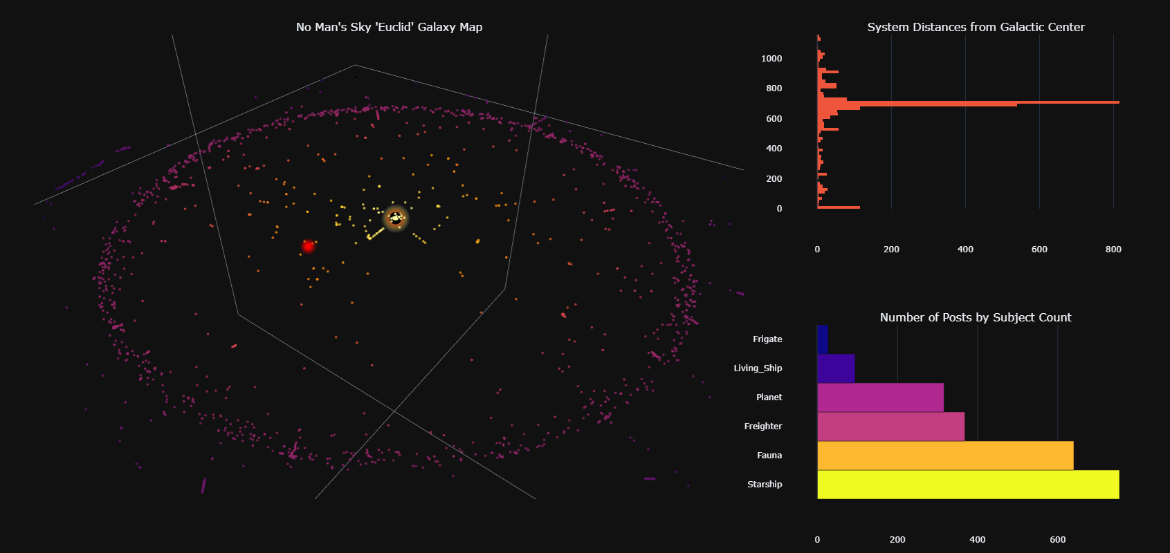
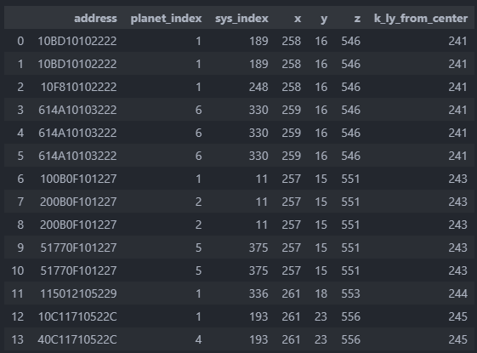





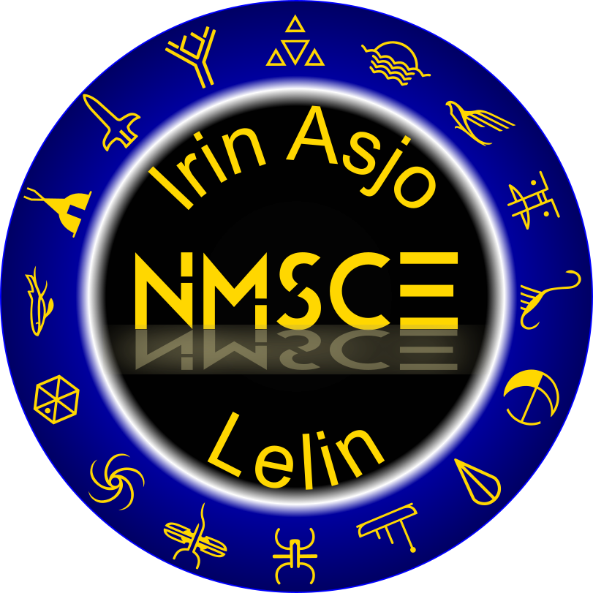


No Man’s Sky Interactive Galactic Map
Boldly Go where Almost No One has Gone Before!
Derek Borders
Overview
The NMS Interactive Galactic Map is a small Plotly Dash visualization tool for exploring a dataset of fictional planets from the game No Man’s Sky that were shared by the NMSCE player community on Reddit at r/NMSCoordinateExchange alongside a few of my personally explored planets.
The bulk of the project involved generating the NMSCE dataset of 2492 planets and creating a model to extract coordinates from the coded address embedded in screenshots from the game.
No Man’s Sky Screenshots with Glyph Addresses Enlarged Above
Translating Glyph Addresses to Hex Equivalent
Methodology
Scrape Screenshots from Reddit
Extract 12-glyph address portion of images.
Split addresses into sequence of glyphs
Manually sort ~1000 glyphs into training set
Train a neural network to classify glyphs
Classify thousands of additional glyphs
Manually curate results, add to training data
Extract 3d coordinates from target images:
Classify each glyph
Generate hex string for 5 sections
Convert to decimal value
Take ones-compliment
Plot both sets in a 3d scatter plot
Create interactive dashboard with additional exploratory data analysis plots
Average of Processed Training Glyphs
5719 images of 17 classes, 0-F hex + non-glyph
(Actual coordinates are ones-complement of these)
Galaxy Center
My Systems
Results
This interactive 3d galaxy map displays a small sample of 2492 systems known to the NMSCE community (colored by distance to center) alongside a handful of systems originally explored by me (red).
Check out the interactive dashboard at derekborders.pythonanywhere.com
My System Addresses, Coordinates & Distance to Center
California State University Chico
Computer Science & Data Science
Fall 2022
Advisor: Dr. Todd Gibson

