Slide 1


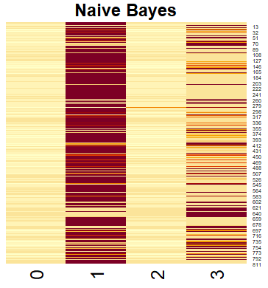
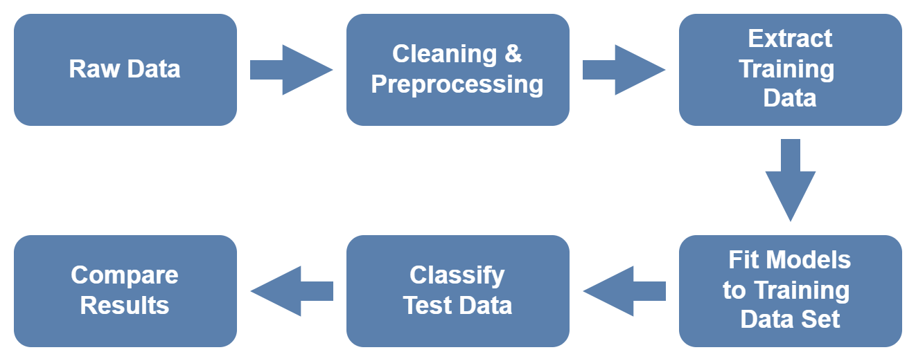
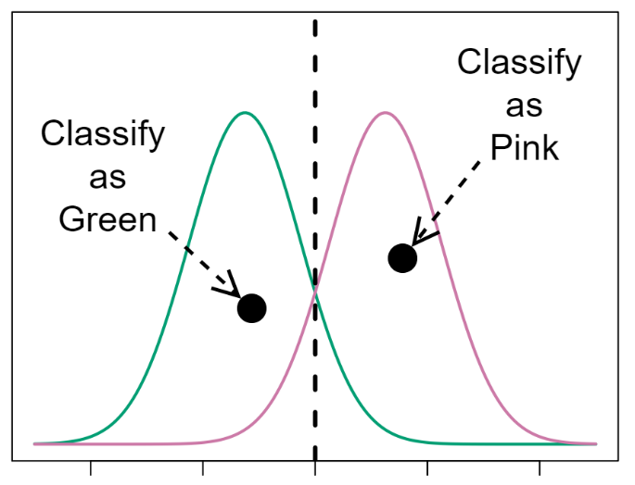
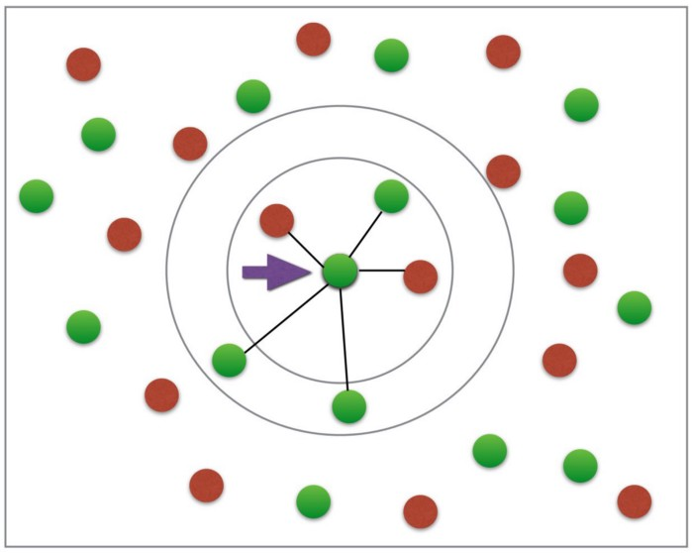
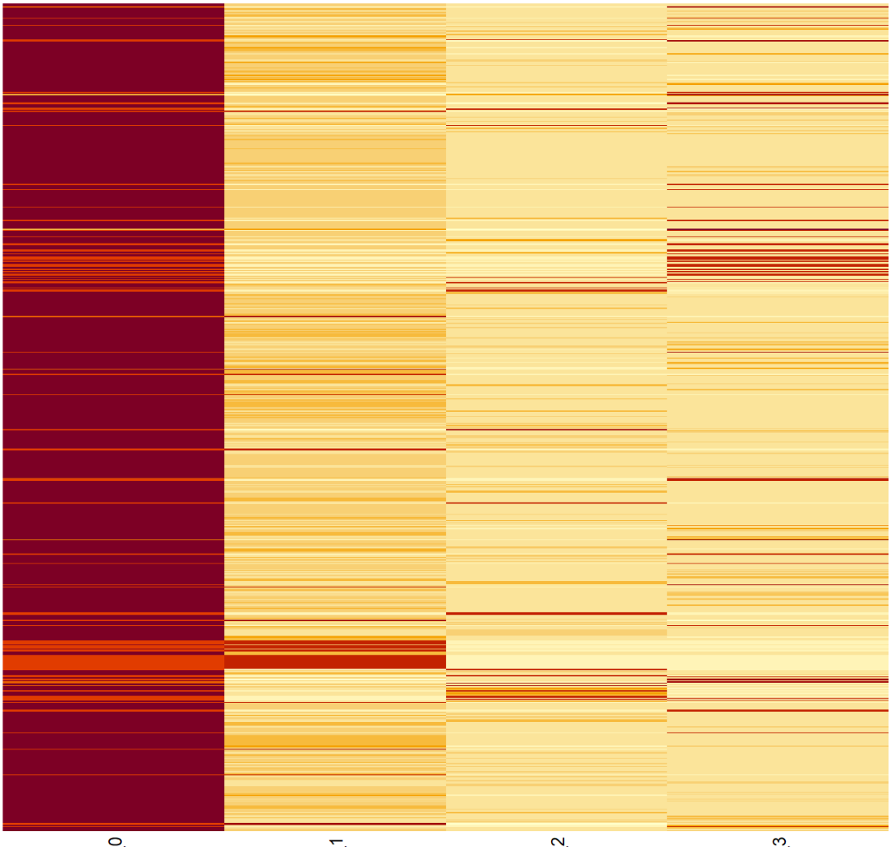
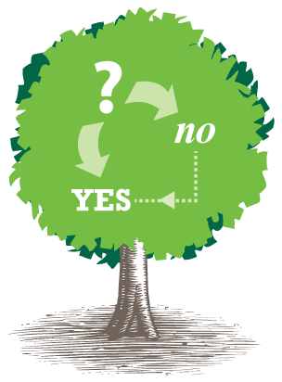
Outreach Activity Level Modeling using Naive Bayes, K-Nearest Neighbors, and Random Forest Text Classification
Derek Borders, Brandon Trahms
Department of Computer Science, Department of Mathematics & Statistics
University of California, Chico, CA
Introduction
Methods
Models
Results
The Center for Healthy Communities (CHC) is a leader in nutrition education, food security and physical activity programs and policies addressing the needs of diverse populations locally, regionally, and internationally.
This research focuses on CalFresh Outreach, a CHC program to create awareness for Californians who may be eligible for CalFresh Food benefits, also known as SNAP. CFO meetings and training activities are reported back to CHC as written descriptions, then manually labeled as pertaining to level 1, level 2, and level 3.
General Approach
Naïve Bayes
Naïve Bayes classifies almost every description as level 1 or 3. This is not overly surprising NB is known to struggle when trained with unbalanced training classes.
Compares the density of each class in the parameter space based on the density training points of each class at the point matching the target.
Cleaning & Preprocessing
K-Nearest Neighbor
kNN struggles because of the ‘curse of dimensionality’. When there are few samples and many parameters the neighborhood similarity breaks down.
Convert to all lowercase
Remove excess whitespace and punctuation
Remove common ‘stop words’ (using snowball list)
Decides based on the most common class of the nearest k points from the training set.
Partnership Levels
Training Data
Random Forest
Update plots
Raise awareness of CalFresh for potential applicants
Spread information targeted at applicants directly
Directly help with application process
Combines individual results from many decision tree classifiers. Decision trees make a series of splits (decisions) based on how many training points fall into each group for a potential split.
Random forest looks closest to our expected distribution with relatively few (but not zero) level 3s, more level 2s, and mostly level 1s.
Filter using keyword lists to find descriptions having words from only one level’s list. (Exclusive Match)
Find long (>7 word) descriptions having no keywords
Have non-match list labeled manually (Hand Labeled)
Training = Exclusive Match + Hand Labeled
Objective
The overall goal of this project was to the use text classification models to predict partnership levels based on activity record descriptions.
Word Frequency
Conclusions
Future Research
Though three different models were employed, each followed the basic approach of comparing word frequency in a test description to word frequency in the different levels of the descriptions in the training data. The models treat the words in the full training set as dimensions and the counts for descriptions as coordinates along these dimensions. The models diverge in how they classify entries based on this high dimensional parameter space.
The random forest model resulted in classifiers that most closely matched our expectations. The distribution is roughly pyramid shaped, with many level 1 activities, fewer at level 2, and very few at level 3. This matches our expectations for a growing program with partners at various stages of maturity. Further validation of the model might include a sanity check read-through by CFO staff to look for any obviously misclassifications.
Automating this level classification will allow for further analysis of the relative effectiveness of the various CFO contracts.
Data
Acknowledgments
1000 activity record descriptions (660 unique)
50 hand-labeled by CFO staff
38 Keywords associated with levels 1, 2, 3
Center for Healthy Communities
CalFresh Outreach Program Staff
Include individual names?

Slide 2
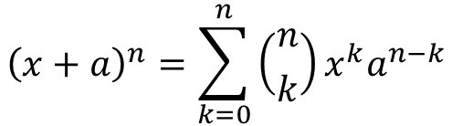
Outreach Activity Level Modeling using Naive Bayes, K-Nearest Neighbors, and Random Forest Text Classification
Derek Borders, Brandon Trahms
Dept. of Natural Sciences, University of California, Chico, CA
TODO: Tighten up spacing to fit a couple more small sections
Introduction
Methods
Models
Results
The Center for Healthy Communities (CHC) is a leader in nutrition education, food security and physical activity programs and policies addressing the needs of diverse populations locally, regionally, and internationally.
This research focuses on CalFresh Outreach, a CHC program to create awareness for Californians who may be eligible for CalFresh Food benefits, also known as SNAP. CFO meetings and training activities are reported back to CHC as written descriptions, then manually labeled as pertaining to level 1, level 2, level 3.
General Approach
Naïve Bayes
Naïve Bayes classifies almost every description as level 1 or 3. NB is known to struggle when trained with unbalanced training classes.
Brief explanation of Naïve Bayes, equation if there is room.
Make room for me in column 1?
Placeholder:
$${\left(x+a\right)}^{n}=\sum_{k=0}^{n}{\left({n \atop k}\right)x^{k}a^{n−k}}$$
TODO: Nail down concise explanations of each model.
Cleaning & Preprocessing
K-Nearest Neighbor
kNN struggles because of the curse of dimensionality. Even with removing stop words, there are just too many dimensions and not a large enough sample.
Convert to all lowercase
Remove excess whitespace and punctuation
Remove common ‘stop words’ (using snowball list)
Brief explanation of kNN, equation if there is room. High level, no equations.
Objectives
Training Data
Random Forest
Filter using keyword lists to find descriptions having words from only one level’s list. (Exclusive Match)
Find long (>7 word) descriptions having no keywords
Have non-match list labeled manually (Hand Labeled)
Training = Exclusive Match + Hand Labeled
Brief explanation of decision trees and random forest.
The overall goal of this project was to the use text classification models to predict partnership levels based on activity record descriptions. Automating this level classification will allow for further analysis of the relative effectiveness of the various CFO contracts.
Discuss results, show heatmap. Still need to do this model
Conceptual images would be nice if I can find room
Data
Word Frequency
Though three different models were employed, each followed the basic approach of comparing word frequency in a test description to word frequency in the different levels of the descriptions in the training data.
References & Tools
Conclusions
1000 activity record descriptions (660 unique)
50 hand-labeled by CFO staff
38 Keywords associated with levels 1, 2, 3
ISLR
CHC
R, Tidymodels?
A couple blogs and tutorials
TODO: Add overall conclusions (forest good, knn bad) Add Tools/References/Acknowledgments
TODO: Make room to fit NB explanation after this

Slide 3
Outreach Activity Level Modeling using Naive Bayes, K-Nearest Neighbors, and Random Forest Text Classification
Derek Borders, Brandon Trahms
TODO: Tighten up spacing to fit more small sections.
Dept. of Natural Sciences, University of California, Chico, CA
Saved for layout idea on right two columns See next slide for current version
Introduction
Methods
Models
Results
The Center for Healthy Communities (CHC) is a leader in nutrition education, food security and physical activity programs and policies addressing the needs of diverse populations locally, regionally, and internationally.
This research focuses on CalFresh Outreach, a CHC program to create awareness for Californians who may be eligible for CalFresh Food benefits, also known as SNAP. CFO meetings and training activities are reported back to CHC as written descriptions, then manually labeled as pertaining to level 1, level 2, level 3.
General Approach
Naïve Bayes
Naïve Bayes classifies almost every description as level 1 or 3. NB is known to struggle when trained with unbalanced training classes.
Brief explanation of Naïve Bayes, equation if there is room.
Make room for me in column 1?
Placeholder:
$${\left(x+a\right)}^{n}=\sum_{k=0}^{n}{\left({n \atop k}\right)x^{k}a^{n−k}}$$
TODO: Nail down concise explanations of each model.
Cleaning & Preprocessing
K-Nearest Neighbor
Convert to all lowercase
Remove excess whitespace and punctuation
Remove common ‘stop words’ (using snowball list)
kNN struggles because of the curse of dimensionality. Even with removing stop words, there are just too many dimensions and not a large enough sample.
Brief explanation of kNN, equation if there is room. High level, no equations.
Objectives
Training Data
Filter using keyword lists to find descriptions having words from only one level’s list. (Exclusive Match)
Find long (>7 word) descriptions having no keywords
Have non-match list labeled manually (Hand Labeled)
Training = Exclusive Match + Hand Labeled
The overall goal of this project was to the use text classification models to predict partnership levels based on activity record descriptions. Automating this level classification will allow for further analysis of the relative effectiveness of the various CFO contracts.
Random Forest
Brief explanation of decision trees and random forest.
Discuss results, show heatmap. Still need to do this model
Data
Word Frequency
Though three different models were employed, each followed the basic approach of comparing word frequency in a test description to word frequency in the different levels of the descriptions in the training data.
1000 activity record descriptions (660 unique)
50 hand-labeled by CFO staff
38 Keywords associated with levels 1, 2, 3
TODO: Add overall conclusions (forest good, knn bad) Add Tools/References/Acknowledgments
TODO: Make room to fit NB explanation after this

