Slide 1
E-Commerce Customer Churn Prediction
Under the Guidance of
Professor Dr. Chaojie Wang
Presented by
Sai Krishna Jakkampudi
AP29057

Slide 2
Outline
Introduction/Background
Project Objectives
Results
Observations and discussions
Reference

Slide 3
Introduction
Customer churn is a significant concern for businesses: It represents the loss of customers and directly impacts revenue and profitability.
Understanding churn reasons and predicting behavior is crucial: This enables companies to proactively retain valuable customers and reduce revenue loss.
Anticipating churn empowers businesses to implement targeted retention strategies: This helps minimize customer acquisition costs, make data-driven decisions, maintain a competitive edge, and maximize profitability.
By understanding and addressing customer churn, businesses can foster long-term customer relationships and achieve sustainable growth.

Slide 4
Project Objectives
Predictive analytics using machine learning can help businesses retain customers and mitigate revenue loss.
By understanding and anticipating customer churn, companies can make strategic decisions to improve retention, reduce costs, and enhance profitability.

Slide 5
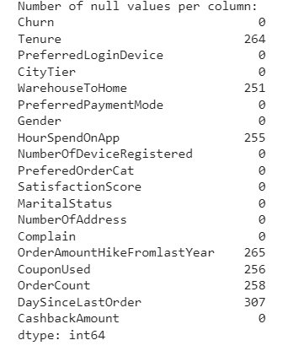
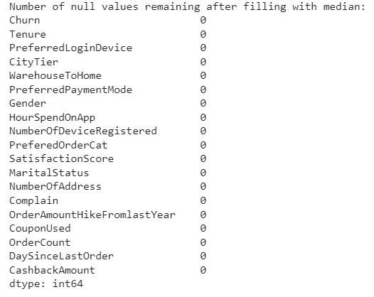
EDA Analysis

Slide 6
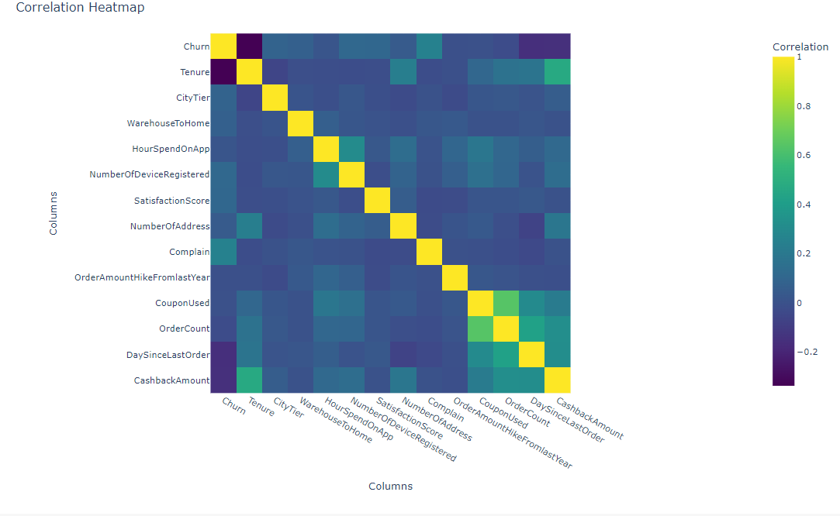
Co-relation Heatmap

Slide 7
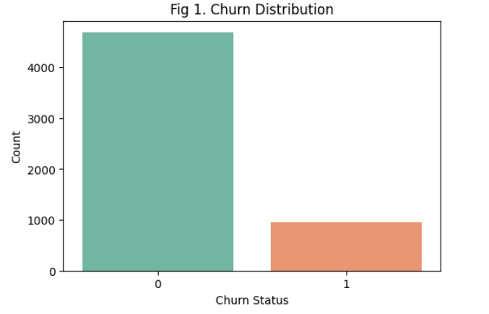
Churn Status

Slide 8
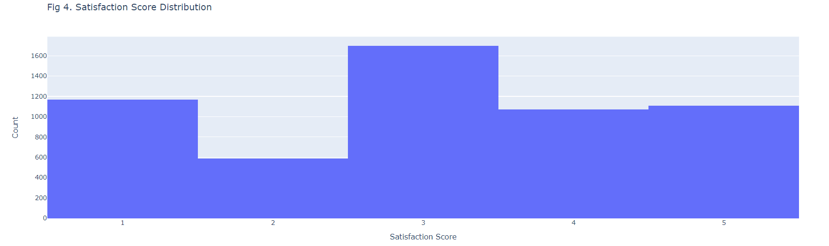
Customer Satisfaction Score

Slide 9
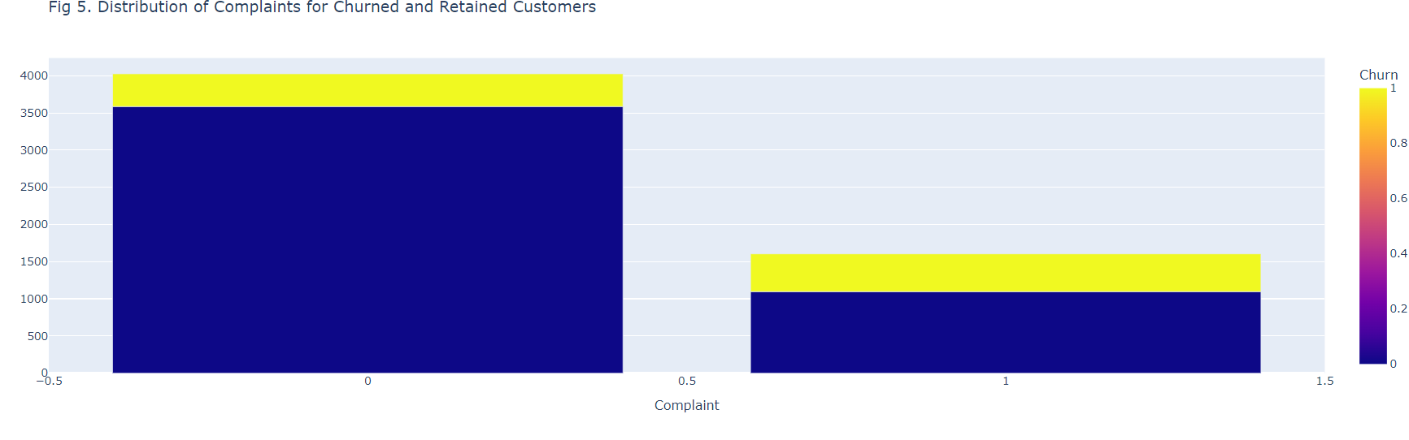
Complaints

Slide 10
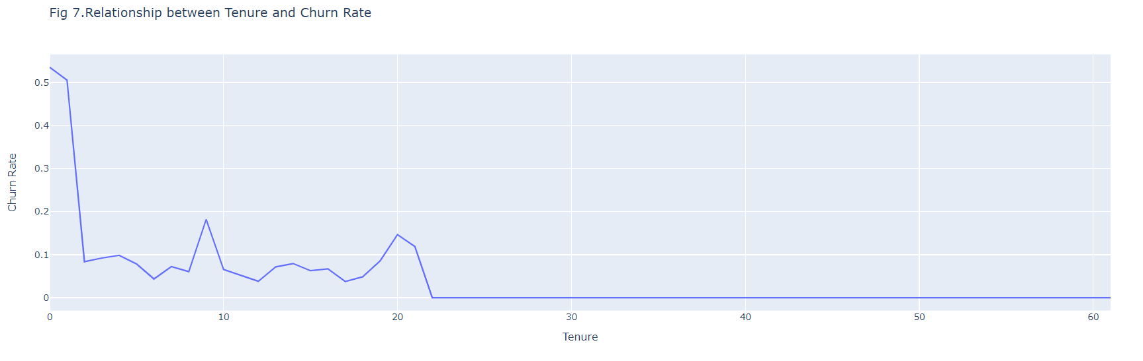
Association of Customer

Slide 11
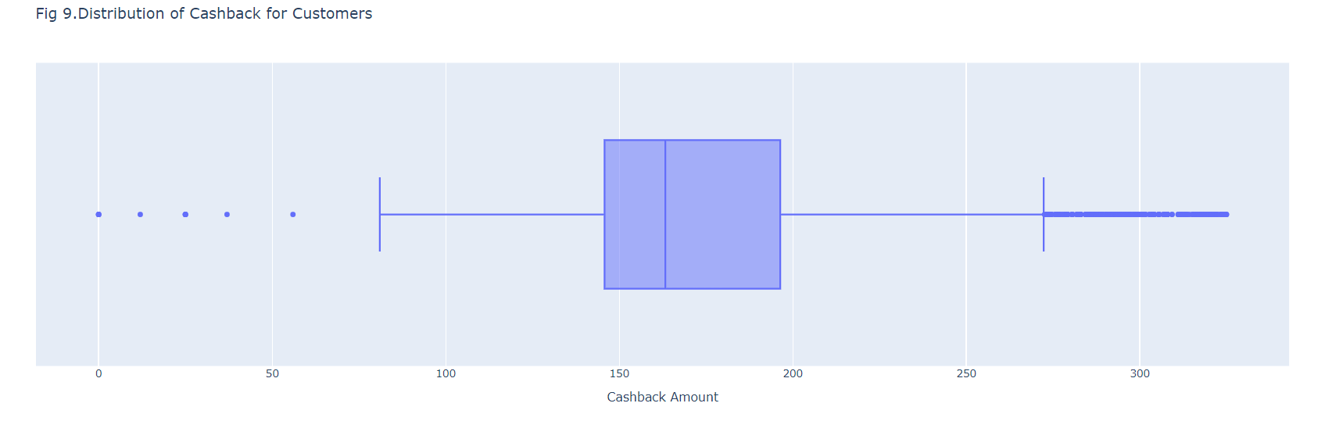
Average Cashback

Slide 12
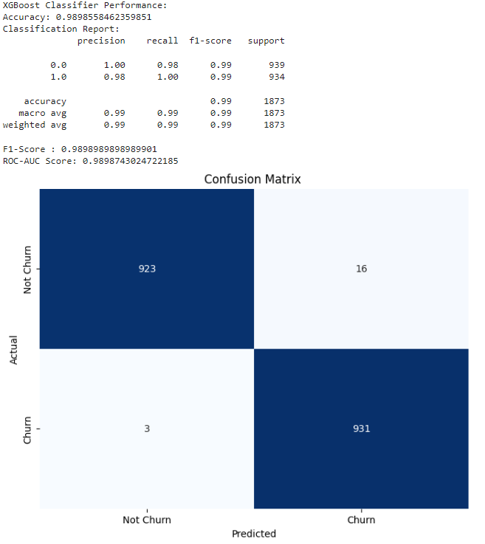
Model Building

Slide 13
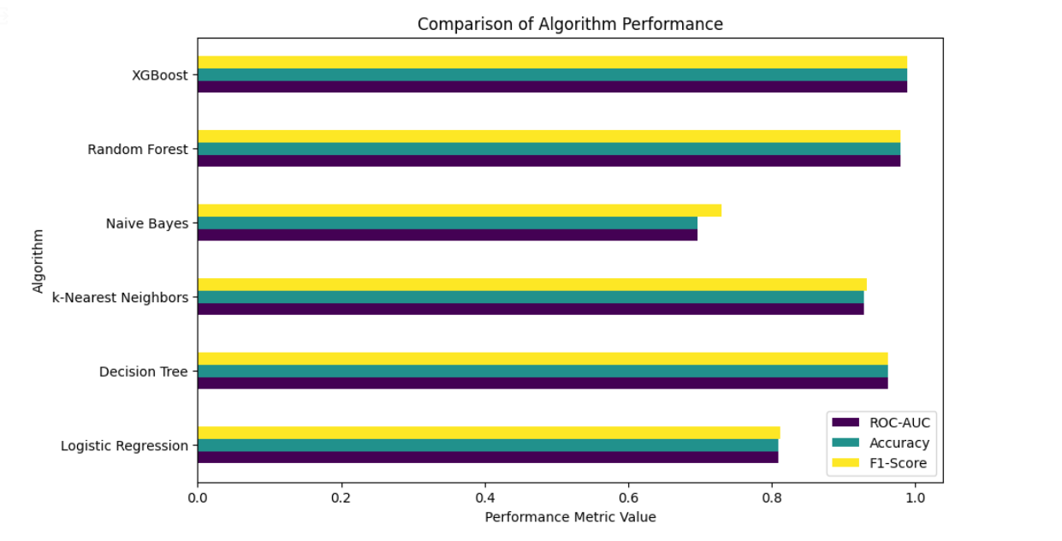
Model Evaluation

Slide 14
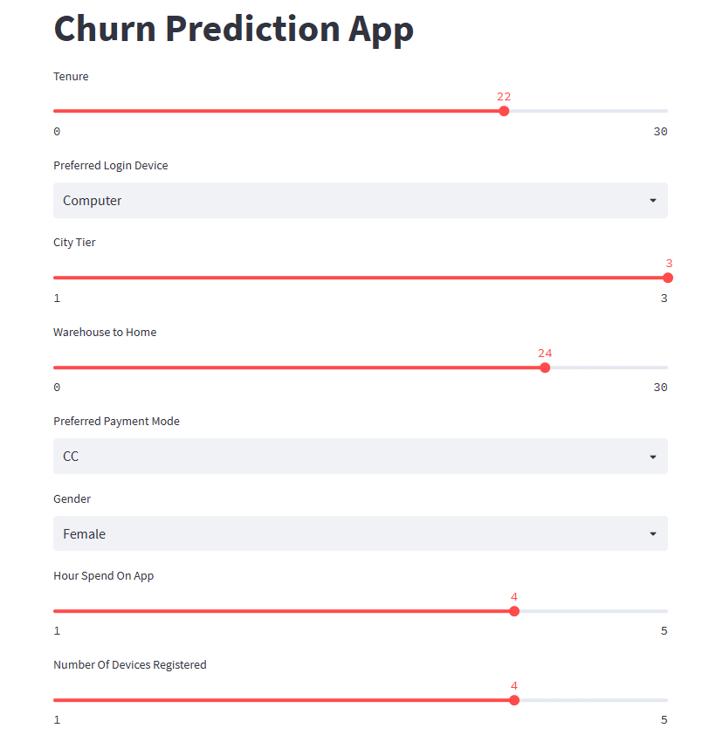
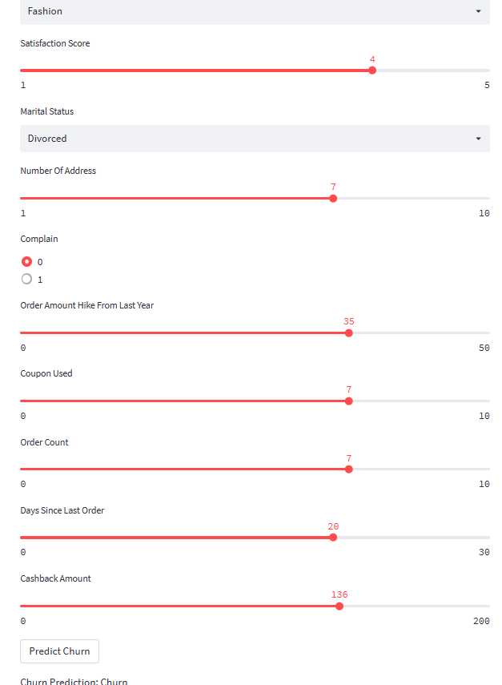
Model Deployment

Slide 15


