Slide 1
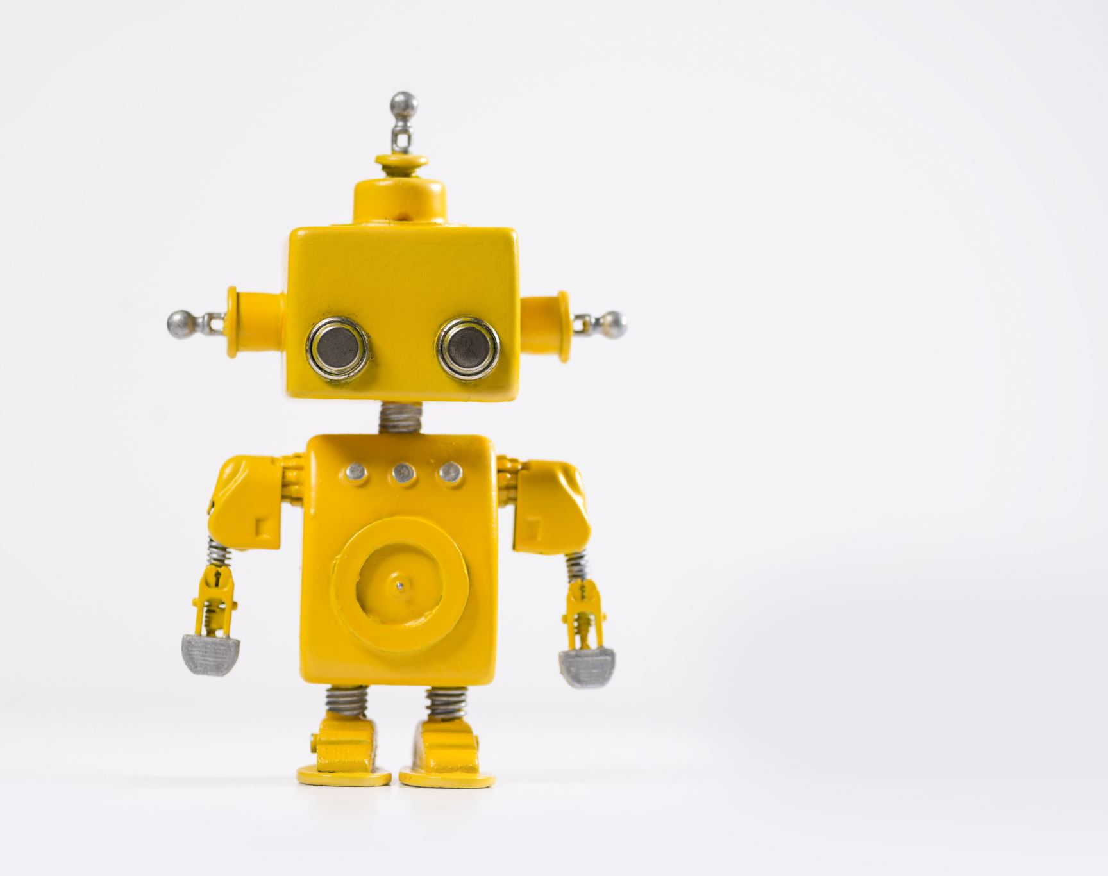
Fin-bot
UMBC DS-606,
Supervisor - Dr. Chaojie Wang Presenter - Pooja Kangokar Pranesh

Slide 2
Problem Statement
In the dynamic landscape of the financial sector, individuals ranging from finance professionals to newcomers often face challenges in accessing reliable and personalized guidance.
This absence can be addressed by the bot created by generative AI technology.

Slide 3

What is Generative AI?
Generative AI refers to deep-learning models that can take raw data — say, all of Wikipedia or the collected work knowledge — and “learn” to generate statistically probable outputs when prompted.

Slide 4
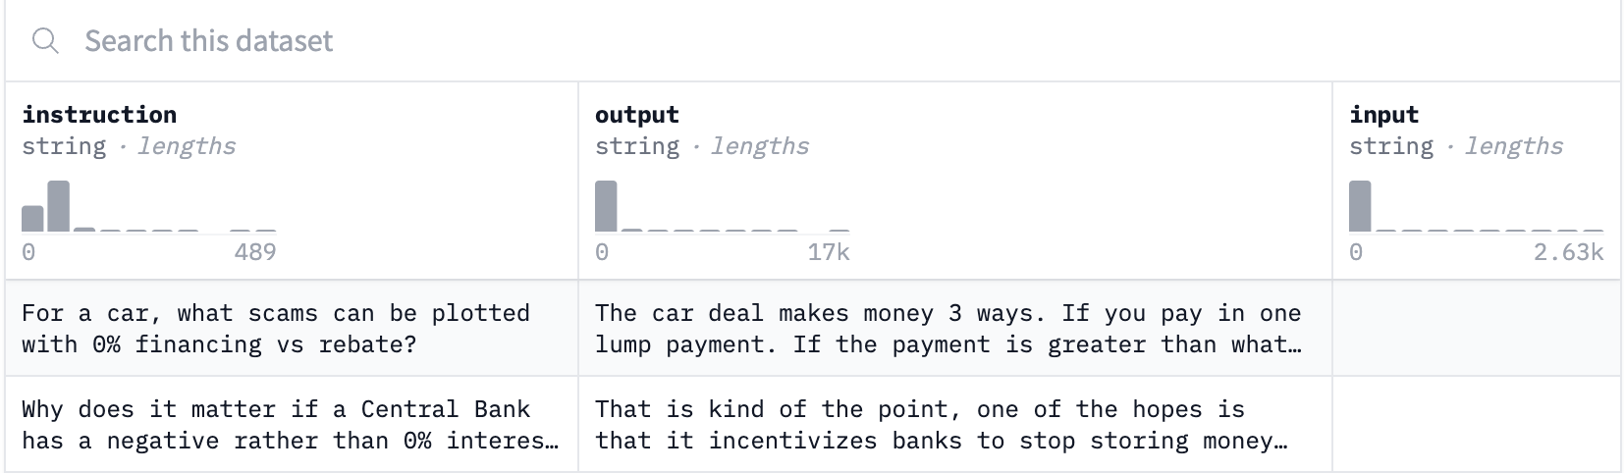
Dataset
Data size: 31.3 MB
Data shape: (44341, 3)
Target Column: Output

Slide 5
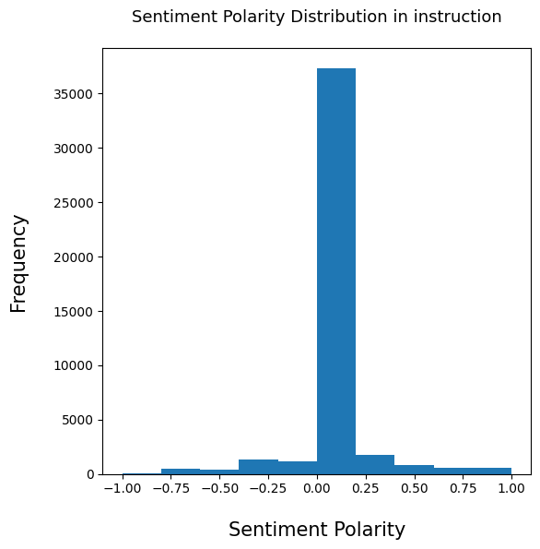
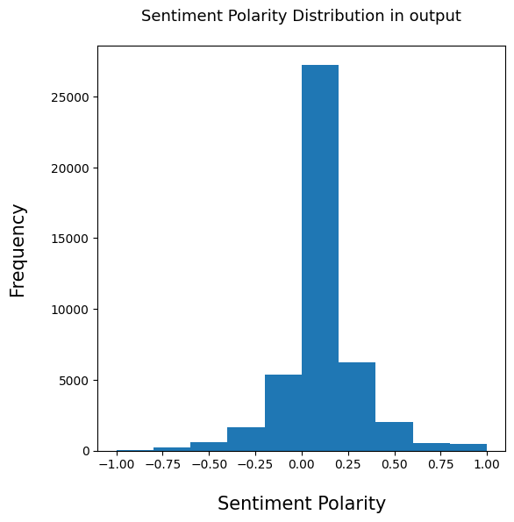
EDA - 1
Sentiment Polarity check indicates that the data is ‘UNBAISED’

Slide 6
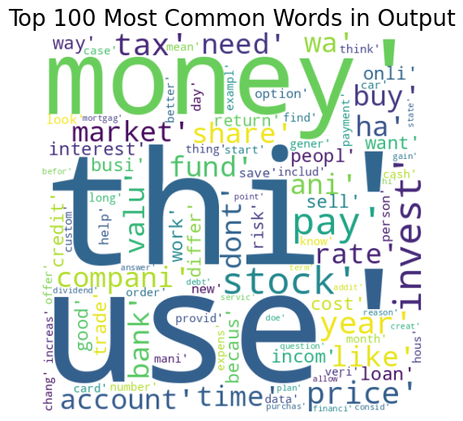
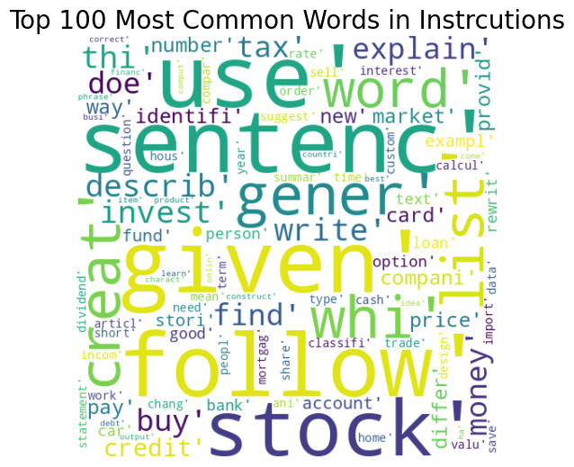
EDA - 2
Most common words indicate
that the data is specific to finance.

Slide 7
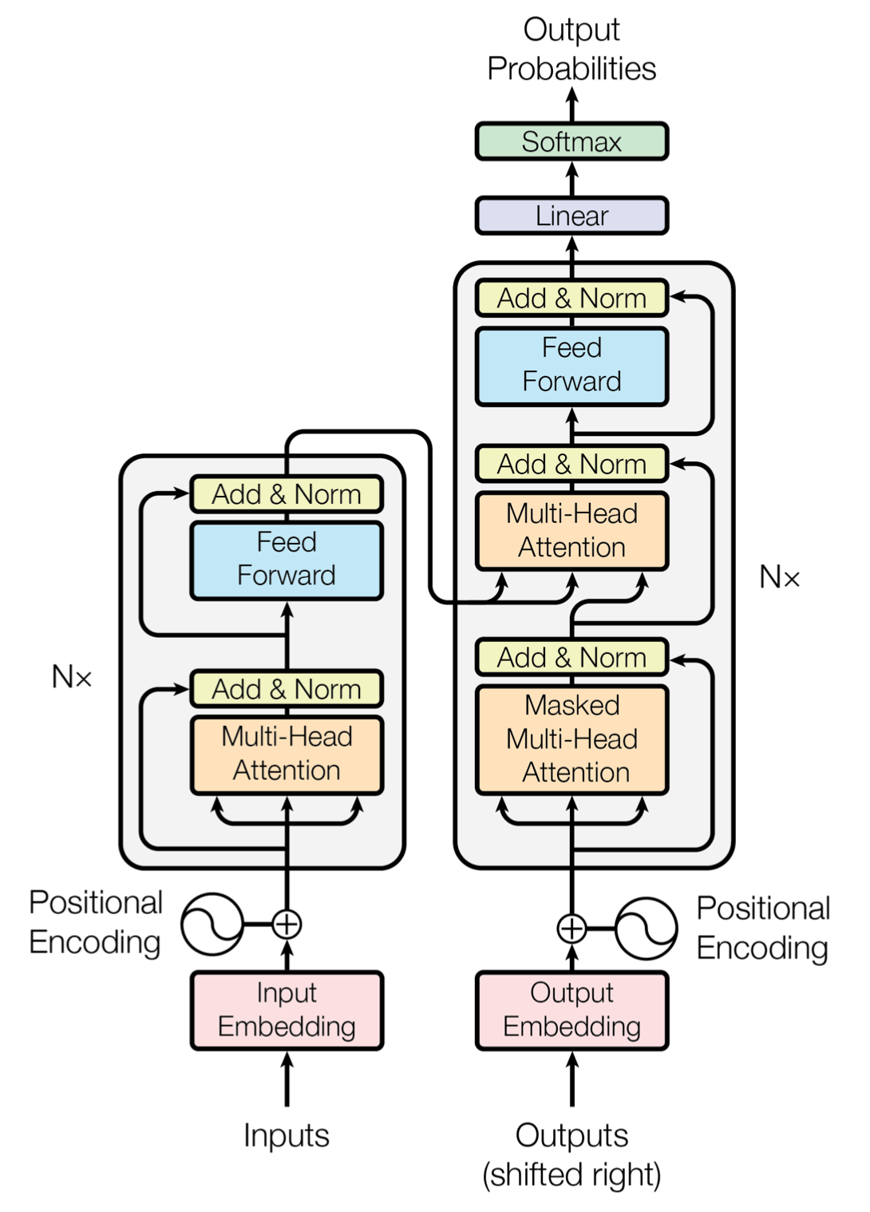
Journey of GenAI Model’s
Traditional NLP Algorithms with labelled data
RNN – didn’t work for long sentences (memory loss)
LSTM – It might work for ~100 words but not ~1000
Transformers – Attention Is All You Need!

Slide 8
Model
Falcon 7B Open Source LLM is used (Attention all you need architecture)
The dataset is used to fine-tune the model
PEFT and Q-LORA config are used for efficient training

Slide 9
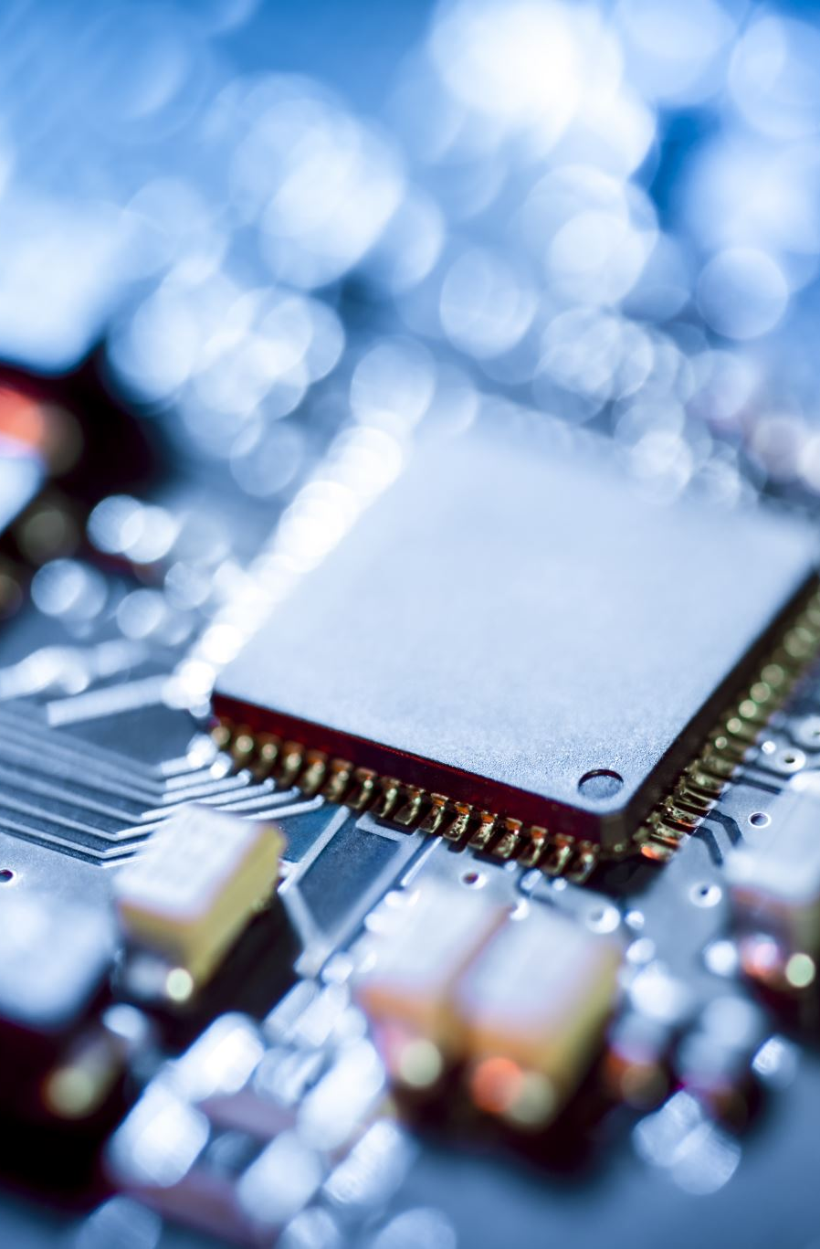
Computational Challenges
LLM needs GPU capabilities
Training & Testing 7B model with 2 epochs on A100 GPU costs ~$200 just for fine-tuning
This Model also requires higher RAM power.

Slide 10
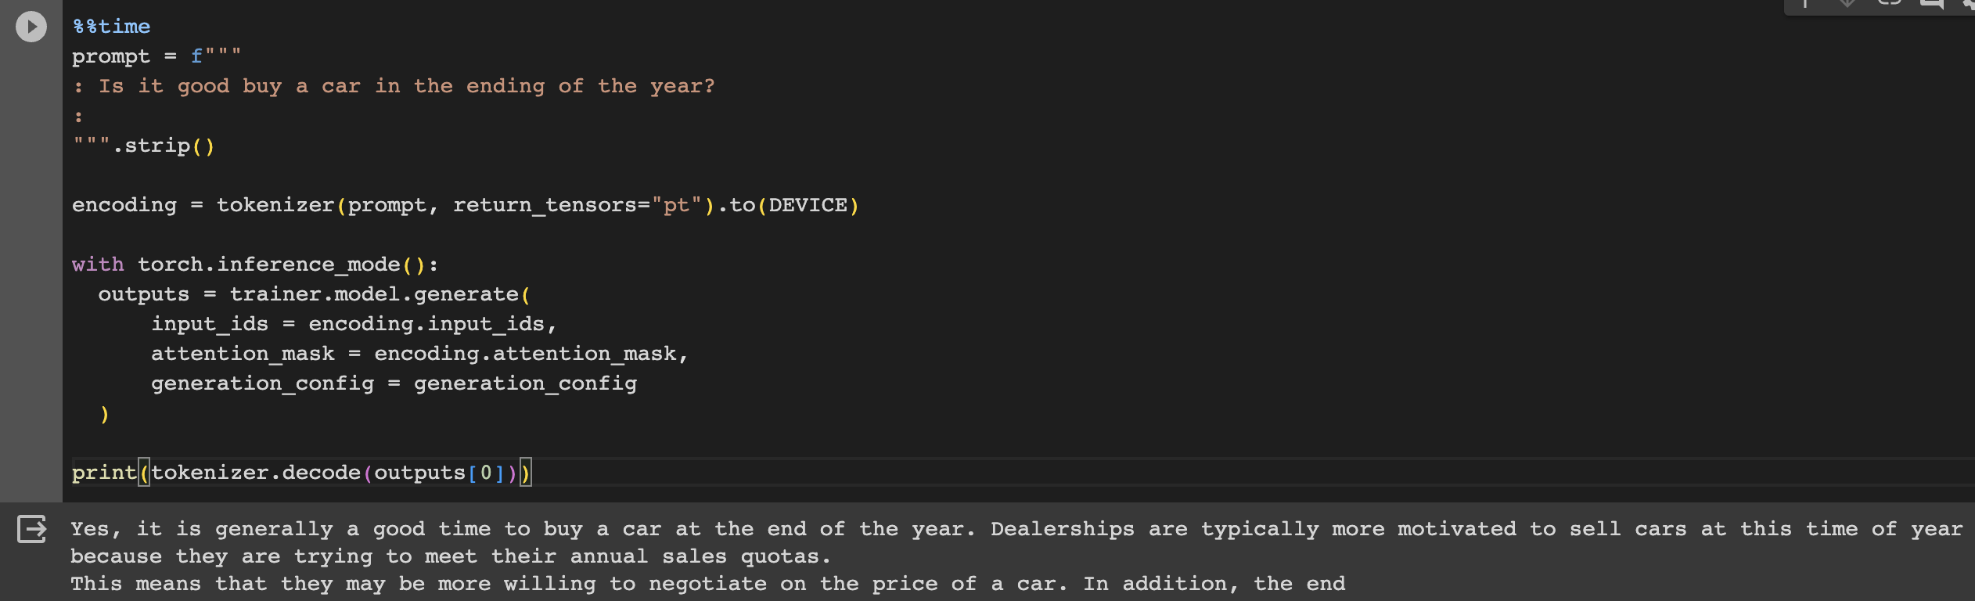
Results
The output is descent
The answer is cut in the middle – context length
Higher number of epochs more detailed answers

Slide 11

Future Work
Context length correctness
Addition of memory capabilities
Update with more data

Slide 12


