Slide 1
Default of Credit Card Clients
Submitted to
Professor Dr. Chaojie Wang
By Aditya Sirangi

Slide 2
PROBLEM STATEMENT
Financial institutions, notably banks, have a pivotal role in delivering essential financial services to the public.
The challenge lies in financial institutions, particularly banks, maintaining integrity and minimizing risks by improving credit scoring methods. A pressing need exists for precision in assessing creditworthiness to enhance risk management and ensure financial stability.

Slide 3
Project Motive
1. The model employs diverse factors to predict customer behavior, distinguishing between potential defaulters and non-defaulters for the upcoming month.
2. The primary objective is to assess clients' ability to fulfill credit obligations in the subsequent month
3. The model aims to evaluate the timely payment capability of customers.

Slide 4
DATASET DESCRIPTION
Dataset Reference: https://archive.ics.uci.edu/dataset/350/default+of+credit+card+clients
The credit card company has acquired information on 30,000 clients.
The dataset includes data on 25 variables, including demographic information.
Identifier ID
Credit Information Limit Bal
Demographics SEX, EDUCATION, MARRIAGE, AGE
Payment History Sep_History, Aug_History, Jul_History, Jun_History, May History, Apr_History
Balance Information Sep_Balance, Aug_Balance, Jul_Balance, Jun_Balance, May_Balance, Apr_Balance
Payment Information Sep_Pmt, Aug_Pmt, Jul_Pmt, Jun_Pmt, May_Pmt, Apr_Pmt
Default Indicator DEF_PAY

Slide 5
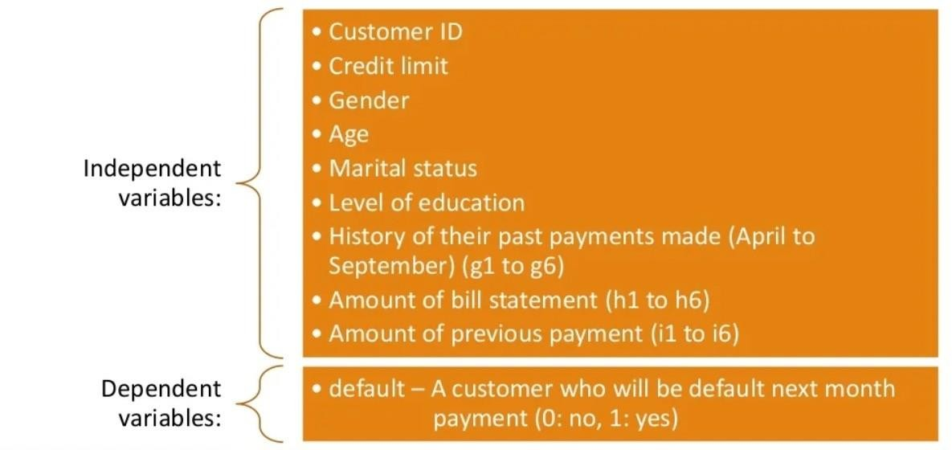
Data Description

Slide 6
Understanding the Data
1. Replaced column names (X1, X2, ...) with their corresponding variable names.
2. Checked the data type of variables and observed that all were in the 'object' type. Consequently, changed the data type of the variables to 'Int.'
3. Detected undocumented values in certain categories.

Slide 7
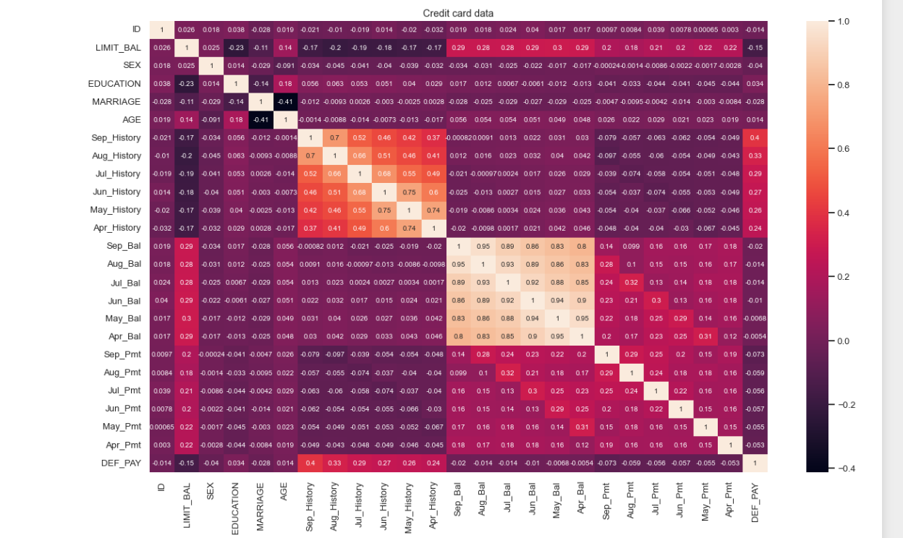
Correlation of variables using heatmap:

Slide 8
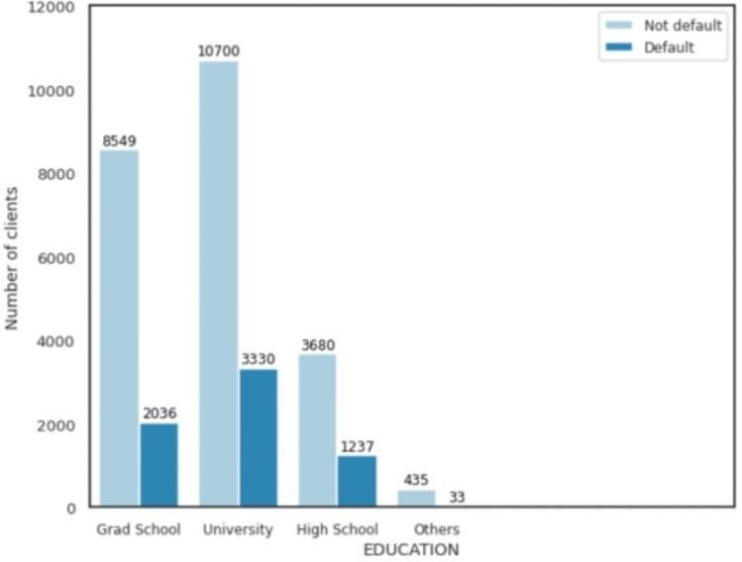
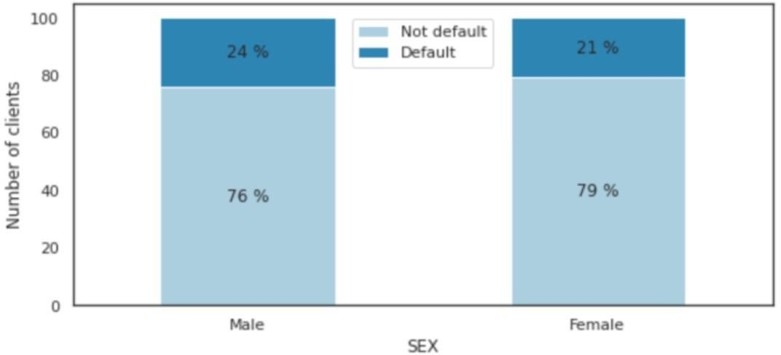
Distribution of defaulters among the dataset

Slide 9
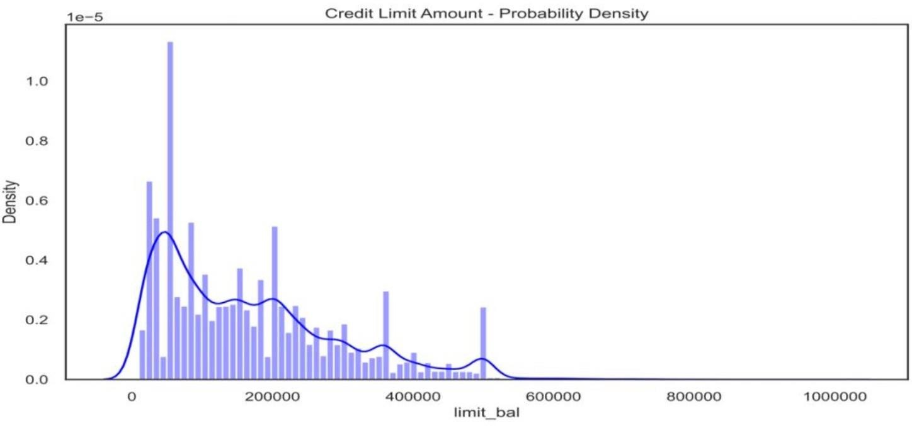
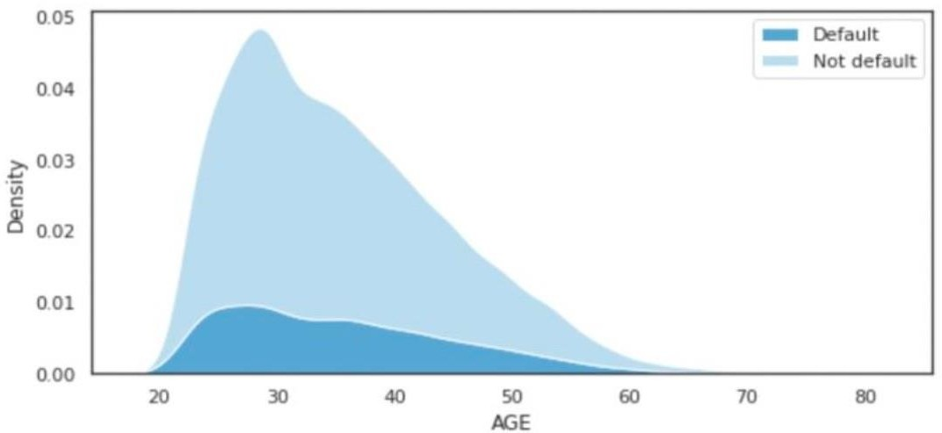
We can observe that most of the people in our dataset belong to the age group between 25 to 40 years.

Slide 10
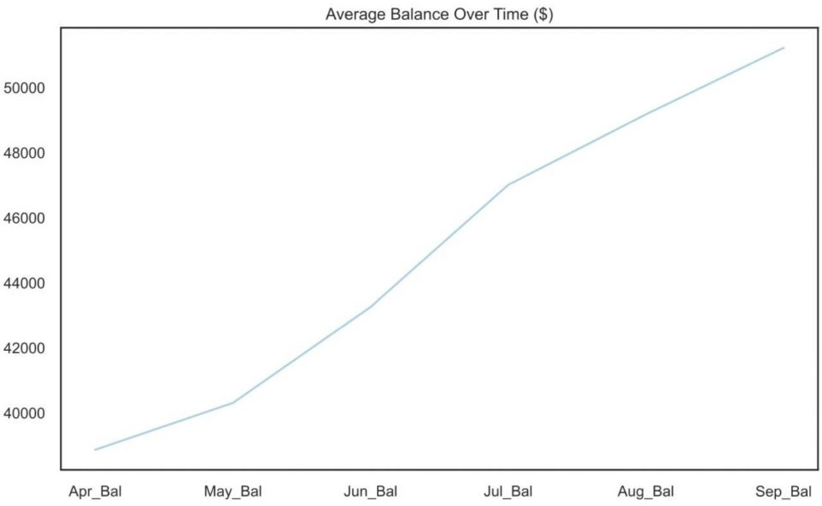
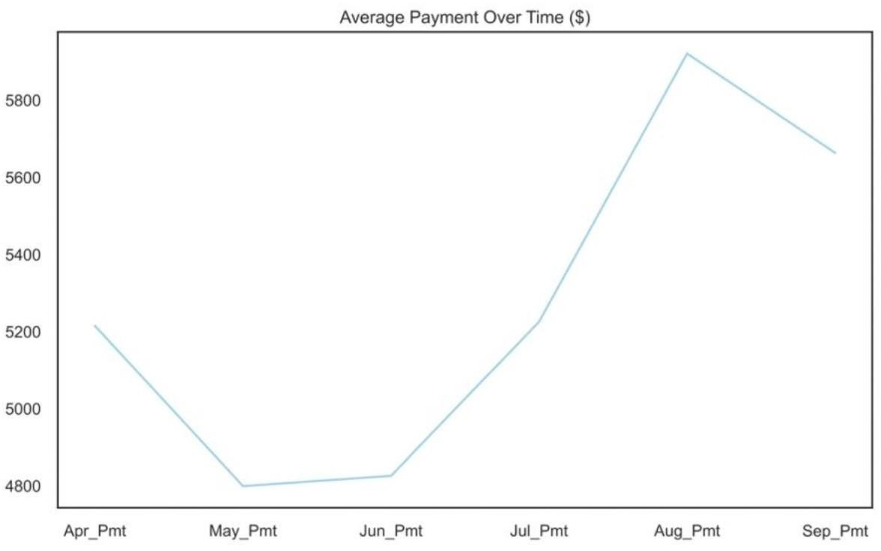
Average Balance & Payment Overtime

Slide 11
Handling Imbalances in dataset
Oversampling
Synthetic Minority Over-sampling Technique (SMOTE)

Slide 12
Proposed models
We have implemented the following machine learning models to solve the classification problem of Default of Credit Card clients.
They are:
Logistic Regression
Neural Networks
Mixed Naive Bayes
Support Vector Machines

Slide 13
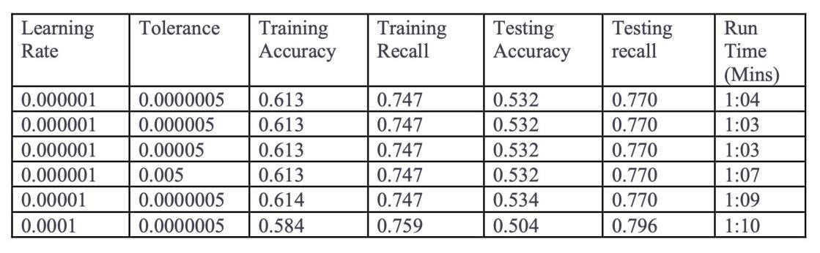
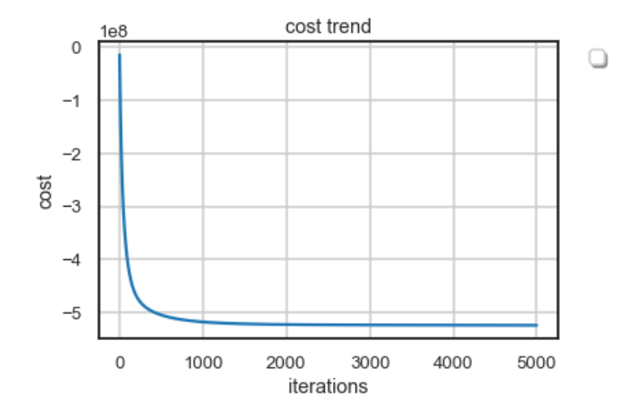
Logistic Regression Model Performance

Slide 14
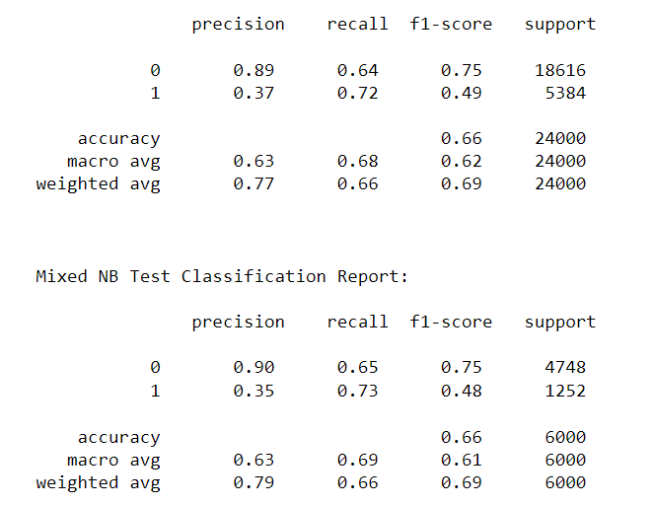
Mixed Naive bayes Model Performance

Slide 15
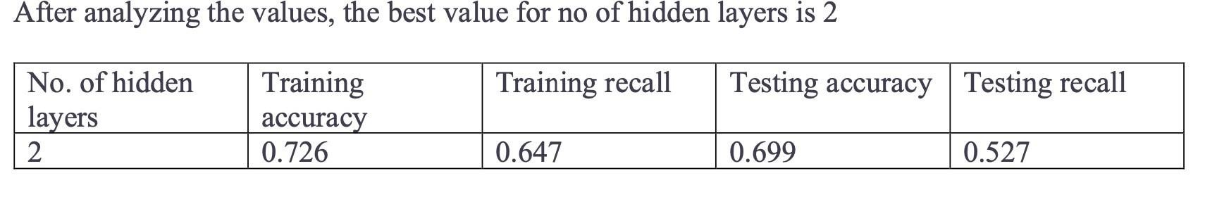
Neural Networks Model Performance
Below parameters decided tuned parameters
Activation function: Rectified Linear
Unit(ReLU) and Sigmoid
SGD: adam
Epochs: 1000
Input layer : 26, Hidden layer : 2, Output: 1

Slide 16
Conclusion
As we consider Recall as our main performance metric, we observe that it has obtained a value of 0.770 which is better than the other models' results and took less time.
For the Neural networks and Support vector machines, we can further tune the hyperparameters for better accuracy and recall values.
We would like to propose the mixed naïve Bayes as our best model.

Slide 17
Thank you

