Slide 1
Medical Named Entity Recognition
Presented by
Shraddha Sundaresan
DATA 606 Capstone Project
Prof Dr.Chaojie Wang

Slide 2
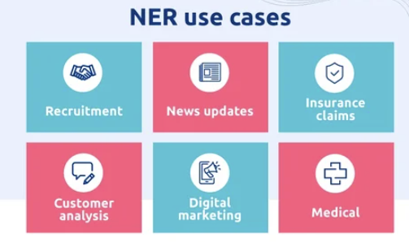
What is NER?
Task: Identify and classify entities in text.
Purpose: Extract structured information from
unstructured text.
Types: Persons, organizations, locations, dates, diseases etc.
Evaluation Metrics: Precision, recall, F1 score evaluate model performance.
Approaches: Rule-based, ML, deep learning (RNNs, Transformers),LLM

Slide 3
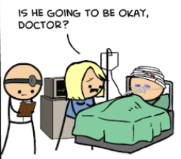
NER for disease identification
Clinical Applications:
Acts as a vigilant assistant in clinical settings.
Extracts disease mentions from patient records.
Facilitates swift access to crucial patient
information.
Enhances decision-making and ensures timely care, minimizing errors.

Slide 4
About the Data
Size: 1.55 MB
Dataset Split:Train: 5433 rows,Validation: 924 rows,Test: 941 rows
Categories (for categorical variables):
id: Sentence identifier
tokens: Array of tokens composing a sentence
ner_tags: Array of tags
0: No disease mentioned,1: First token of a disease,2: Subsequent disease tokens

Slide 5
Input and Output Variables
Target/Label:
ner_tags: Predicted based on the tokens, indicating the presence and structure of disease entities.
Features/Predictors:
tokens: Array of tokens composing a sentence.
Pre-trained BiomedNLP model as a tokenizer: Utilized for extracting contextualized representations of words.

Slide 6
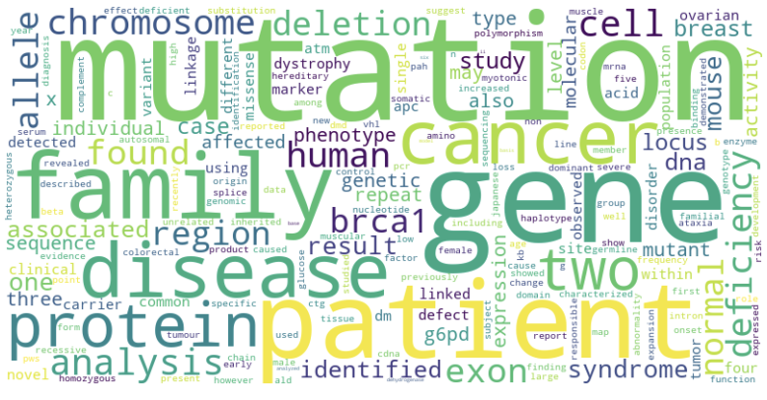
EDA
Most frequently occurring words
across the training set

Slide 7

FINE TUNING
Objective: Refine a pre-trained generative AI model for specific tasks or domains.
Process:Adjust model parameters during training on task-specific data.
Data:Use task-specific datasets to enhance model understanding.
May include additional labeled data related to the target task.

Slide 8
Components
Tokenizer - Word-piece tokenizer(BioMed)
Data_collator - Data collator that will dynamically pad the inputs received, as well as the labels.
Model - BiomedNLP - PubMedBERT-base-uncased-abstract-fulltext model
TrainingArguments - Contains all hyperparameters
Trainer - Consists of the model, the training_args, the training and test datasets, our data_collator, and our tokenizer

Slide 9
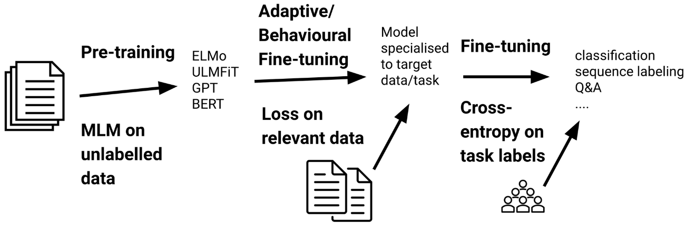
Model Building

Slide 10
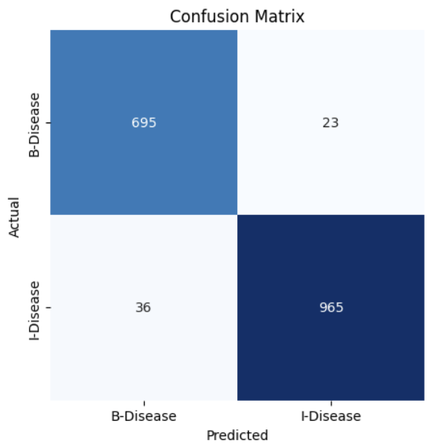
Model Evaluation
Using Confusion matrix
F1
Recall
Precision
The model performed considerably well!

Slide 11
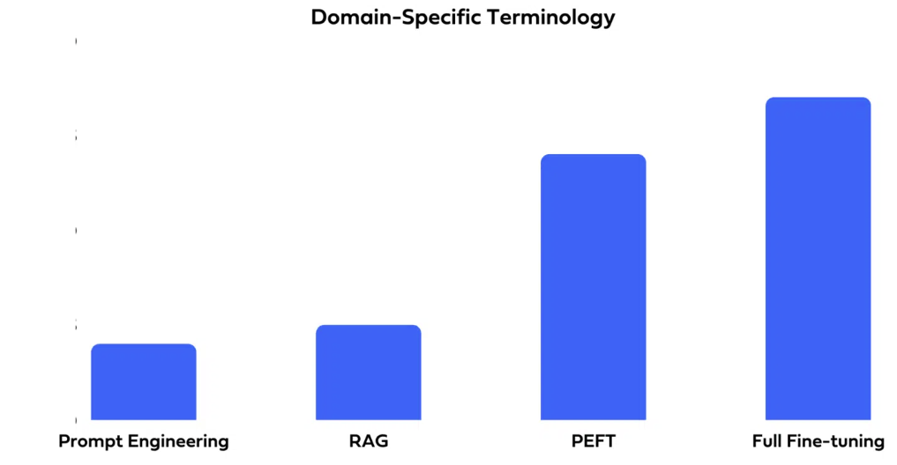
Advantages of NER using Fine tuning
Improved Performance
Use the same baseline LLM model across tasks
Reduces carbon footprint
Model becomes portable
Saves time
Requires smaller dataset

Slide 12
Conclusion
Good Training and Validation score
of the Disease matrix(Only the
I-disease and B-disease were
considered).
Trained over 3 epochs, the model gave optimal results.
Metrics | Validation | Test
Precision | 0.96 | 0.95
Recall | 0.95 | 0.93
F1 | 0.95 | 0.94

Slide 13

Future Enhancements
Utilization of PEFT instead of full fine tuning
Training on multiple related tasks similar to NER
(A multi-task learner)
Build a UI, to feed documents and retrieve the entities.

Slide 14
References
https://huggingface.co/docs/transformers/main_classes/data_collator
https://huggingface.co/docs/transformers/main_classes/trainer
https://huggingface.co/learn/nlp-course/chapter3/3?fw=pt

Slide 15
THANK
YOU

