Slide 1

Accident Prediction on Different Conditions
REPORT!
Under Guidance of: Dr. Chaojie Wang Data 606-Capstone in Data Science
Submitted by:
Krutal Patel (JX65291)
Notes:
Hello My name is krutal patel and I am going to my final project which is accident prediction on different conditions

Slide 2
Agenda
01
02
03
04
05
06
Introduction
About Project
Dataset Source and description
EDA
07
Feature Engineering
Model Training
Future Works
Notes:
Here is an Agenda of my project.

Slide 3
Introduction
Safety is topmost priority.
People spend in car 597 hours per year (25 days).
Government invested billions of dollars building excellent roads.
Accidents happened even if having strict rules.
Predicting accidents is most extensively studied area and help to build and optimize transportation infrastructure.
Notes:
As you know safety is top most priority for everyonr wheater it’s related to health, financial or road safety. Road safety is one of the to most priority nowadays.
On an average, we spend 597 hours per year on dayy-to-day commute - that’s 25 days.
To make driving safer government investes billions of dollers in building excellent roads and certifying the safety of automobiles.
However, Thousands of accidents are happening after having strict rules and regulations.
Today, Predicting accidents has thus developed into one of the most extensively studied areas, which various agencies could use to improve overall transportation infrastructure and optimize traffic conditions.

Slide 4
About Project
Data mining techniques on traffic and meteorological data to create a prediction model for accident severity.
anticipating the risk of accidents by examining historical data regarding traffic patterns, road conditions, and meteorological conditions.
develop a valuable tool for enhancing traffic safety and maybe averting accidents through early warning systems or focused interventions.
Notes:
The project aims to do data mining techniques on traffic and meteorological data to create a prediction model for accidents. The study looks for trends and correlations that might assist in anticipating the risk of accidents by examining historical data regarding traffic patterns, road conditions, and meteorological conditions.
The long-term objective is to develop a valuable tool for enhancing traffic safety and maybe averting accidents through early warning systems or focused interventions.

Slide 5
Research Questions
01
02
03
Q. What methods or techniques help to achieve high accuracy in severity prediction and accidents?
Q. What kind of weather, road and temperature could cause an accidents?
Q. How do these findings increase roadway safety and reduce accident risks?
Notes:
Here are some research questions.

Slide 6
Dataset Source and description
Dataset contain the Accidents in UK from 2005 to 2014. The accident is based on different kind of traffic patterns, road conditions, and meteorological conditions.
In dataset each rows represent accidental information.
Data Link | https://www.gov.uk/government/collections/road-accidents-and-safety-statistics
Size | 428 MB
Observations | 1504150
Columns | 33
Target Column | Accident Severity
Notes:
speak abt data

Slide 7
Data Cleaning
Removing unwanted columns and null values.
Feature Split: Get some more data from existing features (Hours, Month, Days from datetime column.)
Consolidated accident severities from three type to two types (0-Slight, 1-fatal).
Notes:
This dataset dosen’t requrire too much cleaning.
In initial phases I remove some unwanted columns also remove some null values from columns.
I also do some feature split method to get some more data from existing features (like hours, month, days from datetime column)
Within the dataset, three distinct levels of accident severity were originally categorized as "1 - fatal," "2 - serious," and "3 - slight."
However, for analysis purposes, these have been consolidated into two categories: “0 - slight" and “1- fatal/serious."

Slide 8
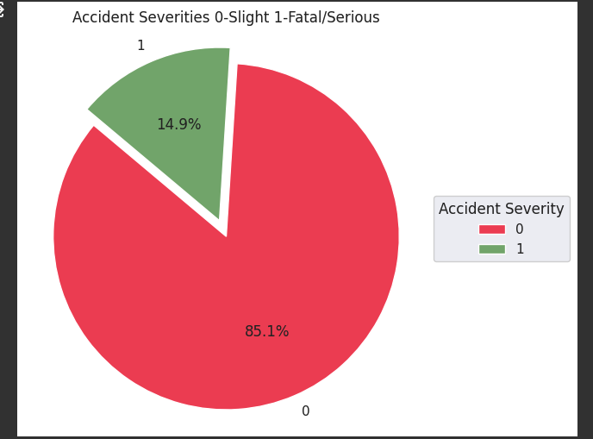
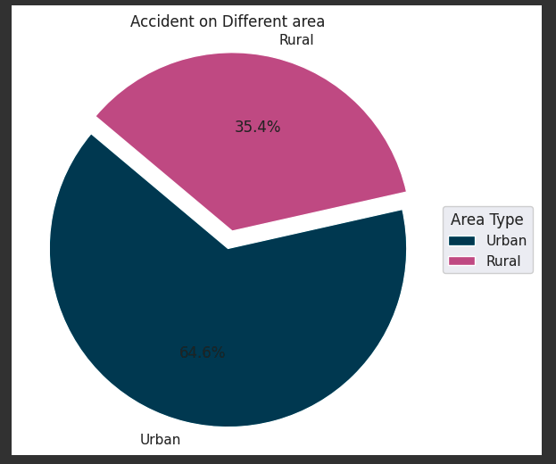
Exploratory Data Analysis
Accident Severity
Accidents based on area types
Notes:
Let's starts with EDA Here you can see the accident_severity graph and accident based on area types. The first graph shows accident severity. 85% of accidents notes as slight where 15% of accidents are fatal. As you can see there is a huge difference between the classes of data. Now move on to the second picture, It shows accident of diffferent areas. as you can see two third of accidents happend on urban area and rest of accidnets are done in rural part of UK.

Slide 9
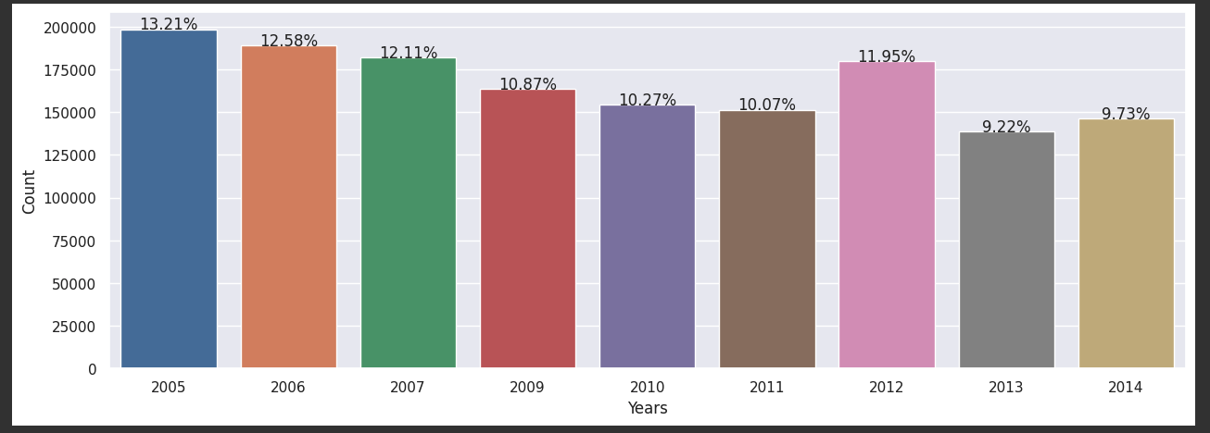
Exploratory Data Analysis Cont.
Accidents Over the years
Notes:
Here you can see the graph of accidents done over the years. You can clearly see that accidents are decreasing over the years.

Slide 10
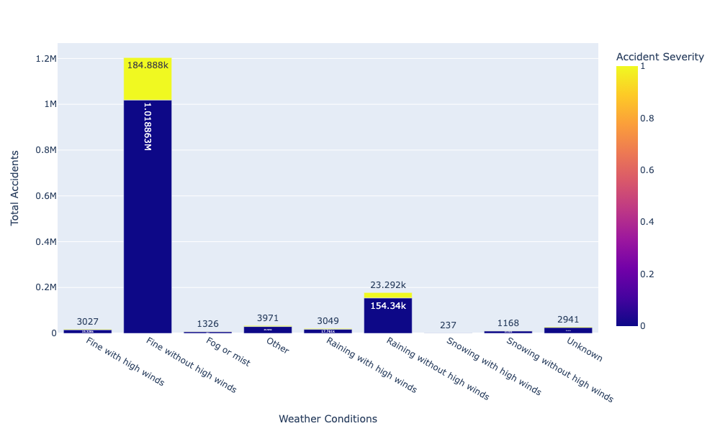
Exploratory Data Analysis Cont.
Accidents on different weather conditions
Notes:
Here, This graph shows accidents severity based on weather conditions. You can clearly see that Fine weather without High winds has highest number of accidents where there are less number of accidents during snow.

Slide 11
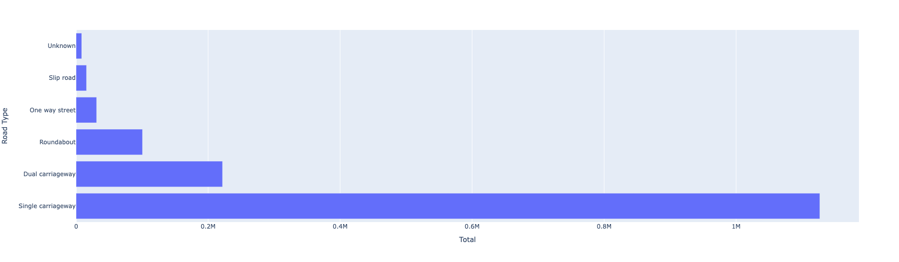
Exploratory Data Analysis Cont.
Accidents on different road types
Notes:
This graph shows the accidents on different types of roads. Here single carrage way road has more accidnets compare to dual carriage way, which means single carriage way road is more dangerous the dual carriage roads.

Slide 12
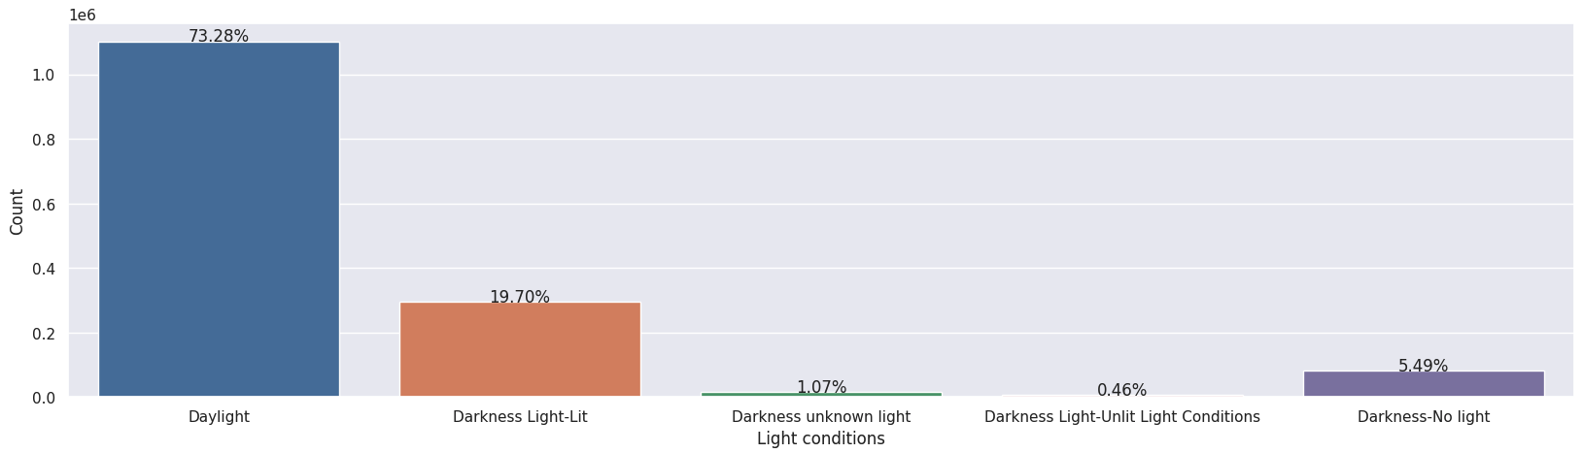
Exploratory Data Analysis Cont.
Accidents on different light conditions.
Notes:
In this last graph you can see the accidents on different light conditions.
Most of the accidents are occured on daylight conditions which is 73% of total accidnets.

Slide 13
Summary of EDA
Amount of accidents are decreasing over the years.
Most of the accidents occured in Peak hours of the day.
Most of the accidents are happened in urban areas.
Most of the accidents are done on single carriageway roads.
Most accidents occur during dry weather, in daylight conditions, and when the weather is fine.
Notes:
Here is the summary of EDA,

Slide 14
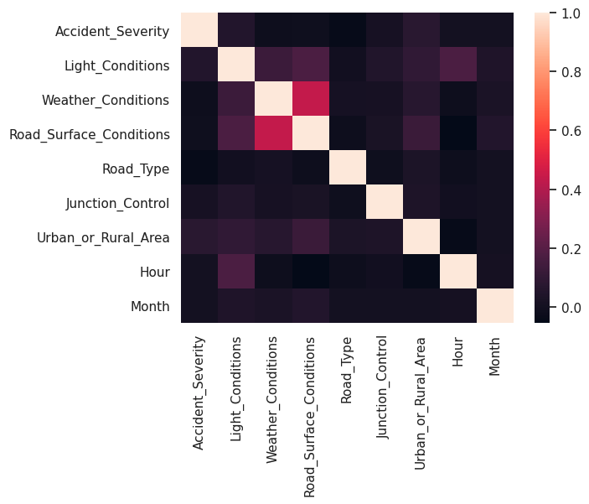
Feature Engineering
Data Transformation
Transform the data into scaling variables.
Feature selection
Select most relevant features from the dataset using correlation analysis.
Notes:
I already done with data cleaning and feature split in previous steps
Data tranformation:
I transform the data into scaling veriables to make more useful for machine learning.
Feature selection:
Selectiong most relevent features from the dataset using coorelation analysis to train the model.
the goal of feature engineering is to create a set of informative and relevant features that can be used to train a machine learning model and improve its accuracy and performance.

Slide 15
Model Training
1. XgBoost Alogorithm
Classification Report:
 | Precision | Recall | F1-Score | Support
0 | 0.85 | 1.00 | 0.92 | 320064
1 | 0.23 | 0.00 | 0.00 | 55909
Accuracy |  |  | 0.85 | 375973
Macro avg | 0.54 | 0.50 | 0.46 | 375973
Weighted avg | 0.76 | 0.85 | 0.78 | 375973
Confusion Matrix:
320047 | 17
55904 | 5
Cross Validation Score:
Cross-validated scores: [0.8506041, 0.85047776,0.8508601, 0.85203373, 0.85151175]
Average Accuracy: 0.8510974871832382
Notes:
In model training i have used 2 models Xgboost and Randomforest classifier First Question is why I choose these models?
So, They are both tree-based ensemble methods, which means that they combine the predictions of multiple individual models to make a more accurate prediction.
I choose gradient boosting algorithm because it's an improvemnt of Gradient Boosting Decision Trees (GBDT) algorithm, also helps to prevent overfitting. This makes XGBoost a good choice for accident severity prediction, as it is able to handle complex and large datasets and make accurate predictions without overfitting.
the confusion matrix shows that the model is very good at identifying class 0 instances, but very poor at identifying class 1 instances.
When it turns to classification report accuracy shows 0.85 which means 85% of all predictions made by the model were correct.
The provided output indicates that the Xgboost model achieved an average accuracy of 0.8511 across five cross-validation folds. This suggests that the model can predict accidents with a good degree of accuracy. The cross-validated scores are relatively consistent, ranging from 0.8504 to 0.8520, further supporting the model's generalizability.
Precision for class 0 is 0.85, which means that 85% of the instances that the model predicted as class 0 were actually class 0.
Recall for class 0 is 1.00, which means that the model correctly identified all of the actual class 0 instances.
F1-score for class 0 is 0.92, which is the harmonic mean of precision and recall, and provides a balanced measure of the model's performance on class 0.
Precision for class 1 is 0.23, which means that 23% of the instances that the model predicted as class 1 were actually class 1.
Recall for class 1 is 0.00, which means that the model did not correctly identify any of the actual class 1 instances.
F1-score for class 1 is 0.00, which is the harmonic mean of precision and recall, and reflects the poor performance of the model on class 1.
Accuracy is 0.85, which means that 85% of all predictions made by the model were correct.
Macro average precision, recall, and F1-score are 0.54, 0.50, and 0.46, respectively. These metrics are calculated by taking the average of each metric across the two classes, without considering the class distribution.
Weighted average precision, recall, and F1-score are 0.76, 0.85, and 0.78, respectively. These metrics are calculated by taking the average of each metric across the two classes, weighted by the support (number of instances) of each class.

Slide 16
Model Training
2. Random Forest Classifier
Classification Report:
Confusion Matrix:
 | Precision | Recall | F1-Score | Support
0 | 0.85 | 1.00 | 0.92 | 320064
1 | 0.21 | 0.00 | 0.00 | 55909
Accuracy |  |  | 0.85 | 375973
Macro avg | 0.53 | 0.50 | 0.46 | 375973
Weighted avg | 0.76 | 0.85 | 0.78 | 375973
319537 | 527
55771 | 138
Cross Validation Score:
Cross-validated scores: [0.8495003, 0.84953354, 0.84963661, 0.85099974, 0.85046779]
Average Accuracy: 0.8500275951033652
Notes:
I choose Random Forest because it is another tree-based ensemble method that is also known for its accuracy and robustness. Also, It is less prone to overfitting than XGBoost, and it is also able to handle missing, handle the noisy and incomplete data well.
Here you can see the confucion matrix which is simliar to XGboost.
After watching this classification report, Xgboost classifier is perfom slightly well.
Here, The cross-validation scores you obtained suggest that your Random Forest Classifier model has an average accuracy of 0.850. This means that, on average, the model is able to correctly classify 85% of the instances in the dataset.
Cross-validated scores: These are the accuracy scores for each fold of the cross-validation experiment. The scores are all very close to each other, which suggests that the model is not overfit.
Average accuracy: This is the mean of the cross-validated scores. It is a good estimate of the model's true accuracy on unseen data.
Generalizability: The fact that the cross-validated scores are consistent suggests that the model is likely to generalize well to unseen data. This means that the model is not overfit and is likely to perform well on new data that it has not seen before.
Precision for class 0 is 0.85, which means that 85% of the instances that the model predicted as class 0 were actually class 0.
Recall for class 0 is 1.00, which means that the model correctly identified all of the actual class 0 instances.
F1-score for class 0 is 0.92, which is the harmonic mean of precision and recall, and provides a balanced measure of the model's performance on class 0.
Precision for class 1 is 0.23, which means that 23% of the instances that the model predicted as class 1 were actually class 1.
Recall for class 1 is 0.00, which means that the model did not correctly identify any of the actual class 1 instances.
F1-score for class 1 is 0.00, which is the harmonic mean of precision and recall, and reflects the poor performance of the model on class 1.
Accuracy is 0.85, which means that 85% of all predictions made by the model were correct.
Macro average precision, recall, and F1-score are 0.54, 0.50, and 0.46, respectively. These metrics are calculated by taking the average of each metric across the two classes, without considering the class distribution.
Weighted average precision, recall, and F1-score are 0.76, 0.85, and 0.78, respectively. These metrics are calculated by taking the average of each metric across the two classes, weighted by the support (number of instances) of each class.

Slide 17
Outcome of research questions
Based on provided information XgBoost appears to be the better model for severity prediction and accidents. It has slightly higher accuracy and higher F-1 score compared to RandonForestClassifier.
Most accidents occur on single-carriage highways during daylight conditions with fine and dry weather.
Optimizing traffic, informing policies, evaluating interventions, improving vehicle features, and promoting safe driving habits.
Notes:
1. Based on provided information XgBoost appears to be the better model for severity prediction and accidents. It has slightly higher accuracy and higher F-1 score compared to RandonForestClassifier.
2. Most accidents occur on single-carriage highways during daylight conditions with fine and dry weather.
3. Accident prediction models help improve road safety by identifying hotspots, understanding causes, predicting risks, optimizing traffic, informing policies, evaluating interventions, improving vehicle features, and promoting safe driving habits.

Slide 18



Conclusion & Future Scope
Conclusion 1
Future Scope 1
Predicted accident severity using weather, light, road conditions.
Add some more conditions like driver condition, speed of car, car damage index
Conclusion 2
Future Scope 2
Dataset has lesser amount of severity class 1; model didn’t perform in class 1
Opportunities in Future
collect more data and train model well
Many other aspects can be researched and explored
Conclusion 3
Future Scope 3
Xgboost appears to have slightly better generalizability than RandomForestClassifier.
Real-time Traffic Management Systems
Notes:
1 conclusion: Accident severity was predicted on weather, light, and road conditions.
Conclusion 2: Dataset has lesser amount of severity class 1; model didn’t perform in class 1
Conclusion 3: Based on the cross-validated scores, Xgboost appears to have slightly better generalizability than RandomForestClassifier. This suggests that Xgboost may be less prone to overfitting and may perform better on unseen data.
Future scope 1: Add some more conditions like driver condition, speed of car, car damage index
Future scope 2: collect more data and train model well.
Future scope 3: Real-time Traffic Management Systems: Accident prediction models can be integrated with real-time traffic management systems to dynamically adjust traffic signals, lane closures, and speed limits based on predicted accident risk.

Slide 19
Thank you!
Notes:
Thank you. Any Questions?

