Slide 1

Breast Cancer Prediction
Sai Chand Kurre
Guided by: Prof. Dr. Chaojie Wang

Slide 2

Objective
To predict whether the cancer tumor is benign or malignant

Slide 3

Data Description
Data Size: the size of our data is 128 KB
Data Shape: Our Data Set consists of 570 rows and 33 columns
Data Dictionary :
1) ID number {Int}
2 )Diagnosis (M = malignant, B = benign){object}
3-32) Ten real-valued features are computed for each cell nucleus{float}

Slide 4
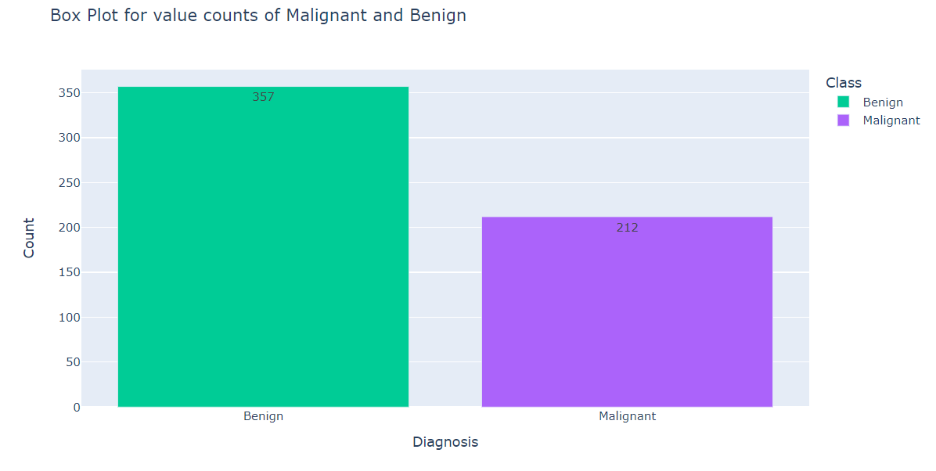
Target Variable
Diagnosis is our target variable.
It has two categories.
Benign (Not Cancerous)
Malignant (Cancerous)

Slide 5
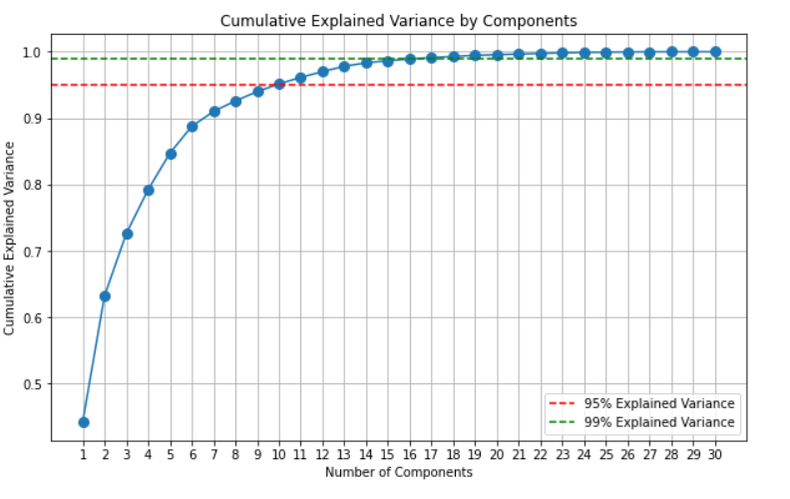
Feature Engineering
Normalization
Standardization
Principle Component Analysis

Slide 6
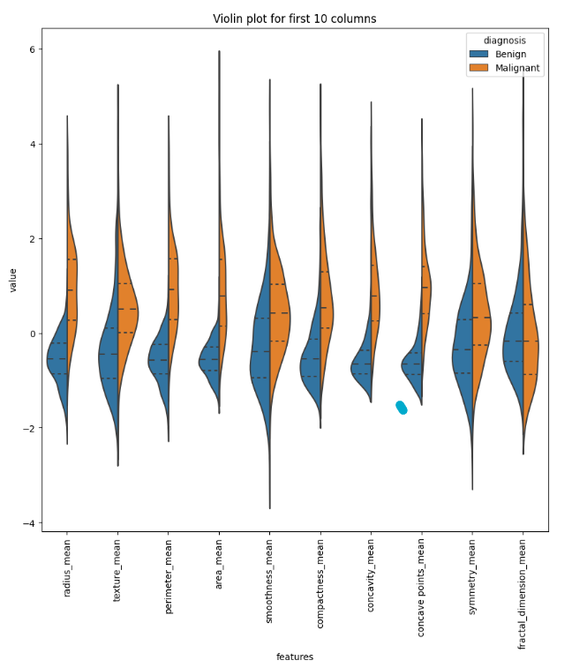
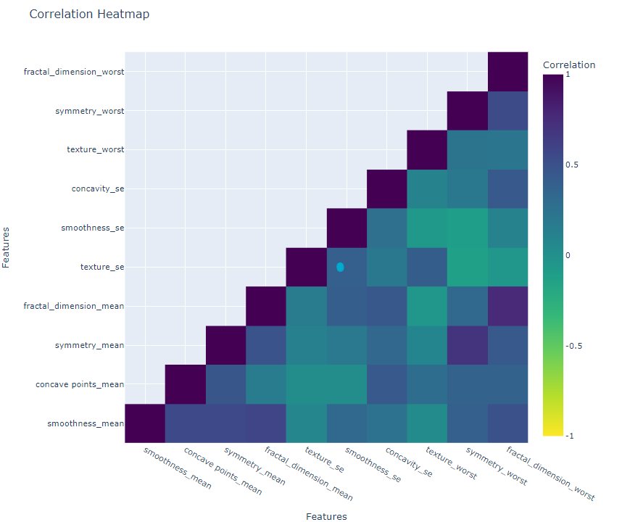
Violin Plot & Heat Map

Slide 7
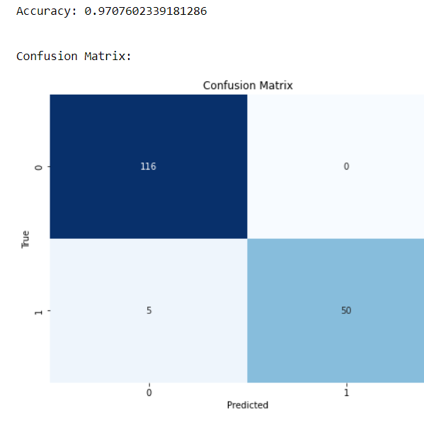
Logistic Regression
Logistic regression provides a straightforward and easily interpretable way to analyze the relationship between a binary outcome variable and one or more independent variables.
Logistic regression is particularly effective when the data is linearly separable, meaning that a hyperplane can be drawn to separate the two classes.

Slide 8
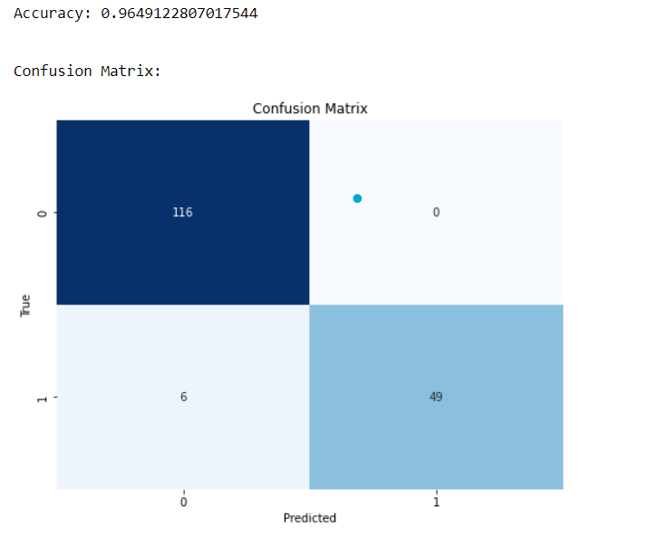
K Nearest Neighbor
It operates on the principle of proximity, making predictions based on the majority class or average of the k-nearest data points in the feature space.
KNN is a versatile algorithm applicable to both classification and regression tasks.

Slide 9

Random Forest Classifier
Random Forest is an ensemble learning technique that combines the predictions of multiple decision trees to improve overall model accuracy and reduce overfitting.
Random Forest provides a valuable feature importance measure, allowing users to assess the significance of each input variable in the model's decision-making process.

Slide 10
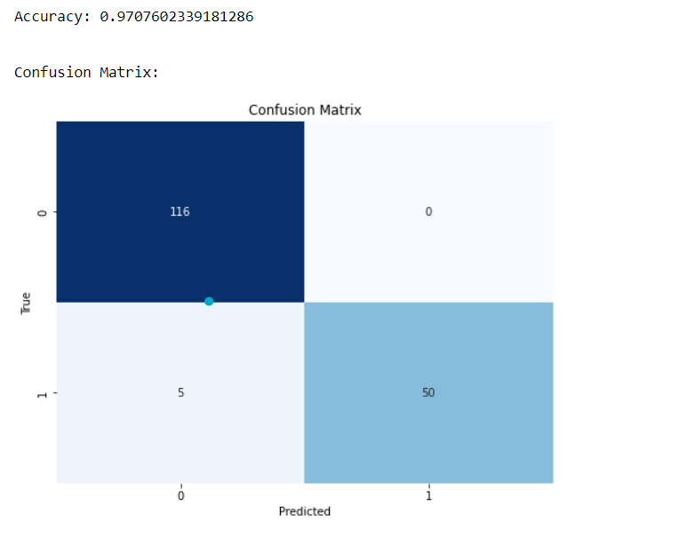
Support Vector Classifier
SVCs provide a robust and accurate classification model. This ability to create well-defined boundaries enhances the model's generalization performance on new, unseen data.
SVCs are equipped with kernel functions that enable them to handle complex, non-linear relationships within the data. SVCs can adapt to diverse datasets, making them a valuable tool in scenarios where linear models may fall short.

Slide 11
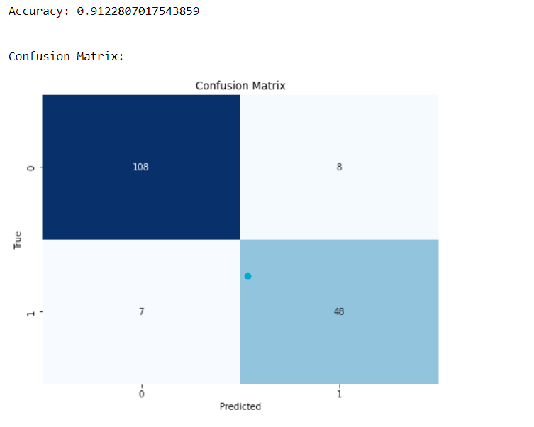
Decision Tree Classifier
Decision Tree Classifier is renowned for its intuitive and easily interpretable nature. transparency facilitates effective communication and collaboration in decision-making processes.
The Decision Tree Classifier is adept at handling both numerical and categorical data, making it a versatile choice for a wide range of datasets.

Slide 12
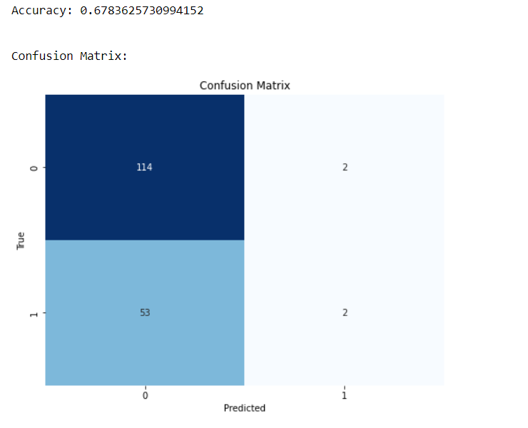
Gaussian Naive Bias
The algorithm assumes that features are independent given the class label, making it computationally efficient and easy to implement. This simplicity makes it suitable for quick and reliable classification in various real-world scenarios.
Gaussian Naive Bayes is well-suited for datasets with continuous features, as it models the distribution of each feature using a Gaussian (normal) distribution.

Slide 13
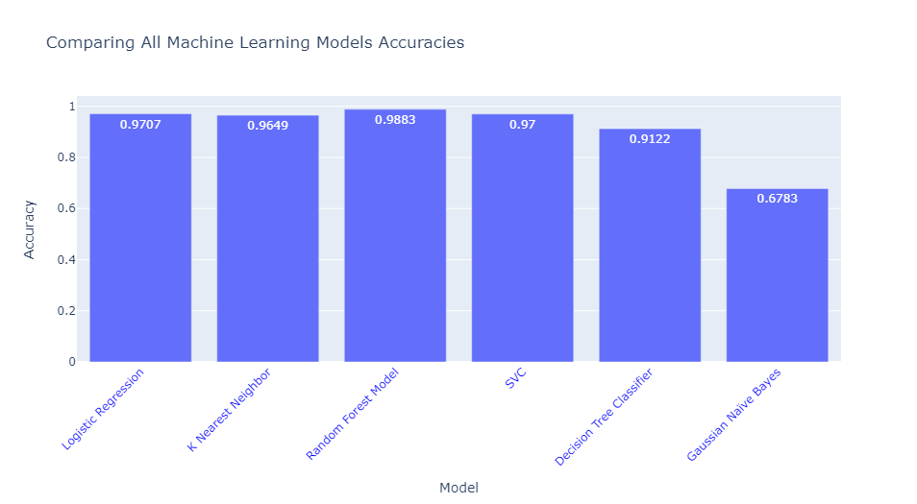
Comparing Accuracies

Slide 14

Conclusion
The Random Forest model gives us the best accuracy in comparison with other models.

Slide 15

Thank you

