Slide 1

Fraud Detection in Financial Transactions, an Anomaly Detection Approach
DATA 606 CAPSTONE
Durga Venkata Phanindra kumar Mulamreddy
ex00931

Slide 2
background
Financial fraud is a pervasive and costly issue in today's digital age. As the world increasingly relies on electronic payment systems and online transactions, the risk of fraudulent activities has grown significantly. Fraudulent activities can take various forms, including credit card fraud, identity theft, money laundering, and insider trading, among others. These activities not only result in significant financial losses for individuals and organizations but also erode trust and confidence in financial systems.
To address this critical issue, the field of data science and machine learning has been instrumental in developing sophisticated techniques for fraud detection. These techniques leverage the power of data to identify suspicious patterns and behaviors, helping financial institutions and businesses detect and prevent fraudulent transactions in real-time.
The primary objective of this project is to develop a state-of-the-art fraud detection system for financial transactions using data science and machine learning (Anomaly detection) techniques.

Slide 3
Research questions
What are the most common types of fraud in financial transactions, and how have they evolved over time?
The key challenges that are going to be faced during the development and implementation of the project.
Applying different machine learning techniques to compare and improve the proficiency of the model.
How does the insights derived from the past historical data helps the model in detecting a better accurate prediction?
Does the size or extent of data will pose any changes in the accuracy of a model for prediction and how can the scalability challenges be addressed?

Slide 4
Data
The data is not a real data but a simulated data which was synthesized by the PaySim Simulator based on the real world mobile transactions. This simulator utilizes aggregated data from private sources to generate a synthetic dataset that closely mimics the typical patterns of real transactions. What sets it apart is its ability to inject instances of malicious behavior, simulating fraudulent activities. This synthetic dataset serves as a valuable resource for evaluating the effectiveness of various fraud detection methods.
The Data is simulated based on a sample of real transactions extracted from one month of financial logs from a mobile money service implemented in an African country. The original logs were provided by an europen company which has their services ongoing in almost 14 countries throughout the world.
[Link to the data] (https://www.kaggle.com/datasets/ealaxi/paysim1)
The Data set is of pretty big size (493.5 MB) and it contains many columns which were all explained below for clear understanding.
Data shape (6362620 of Rows and 11 Columns)

Slide 5
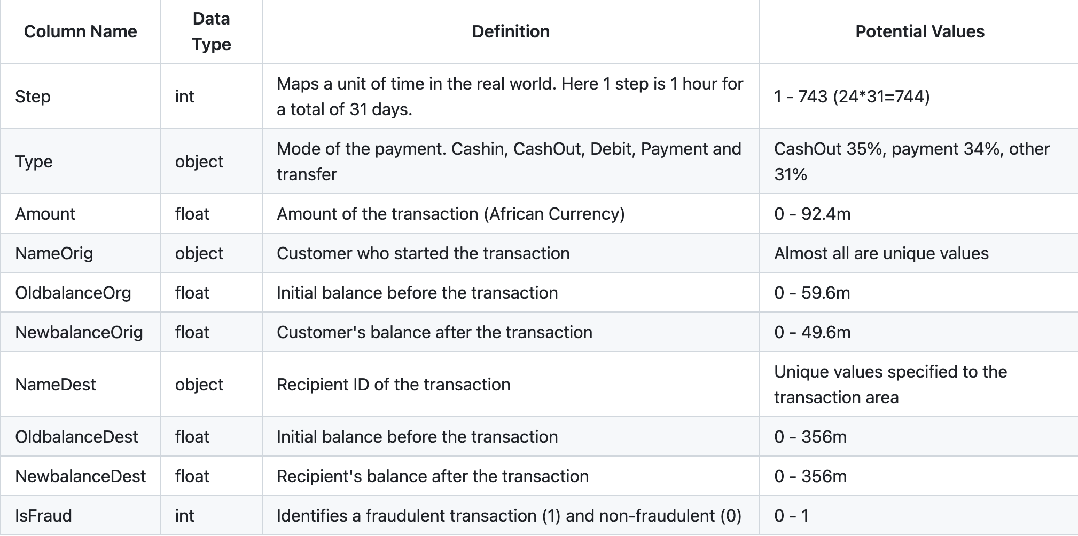

Slide 6
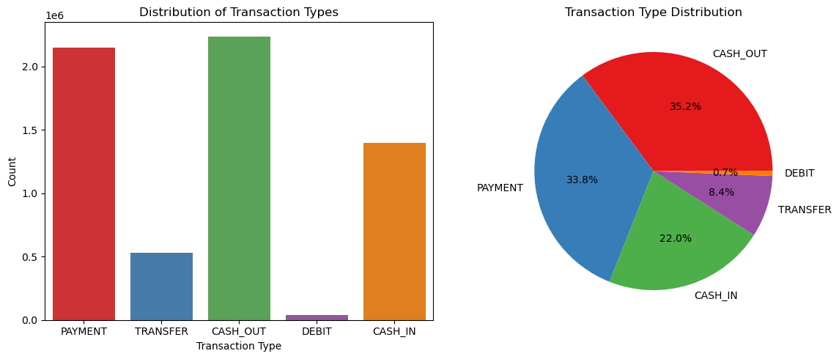
EDA & visualizations

Slide 7
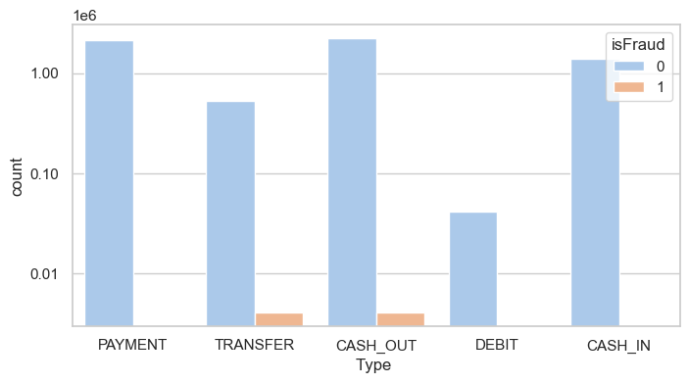
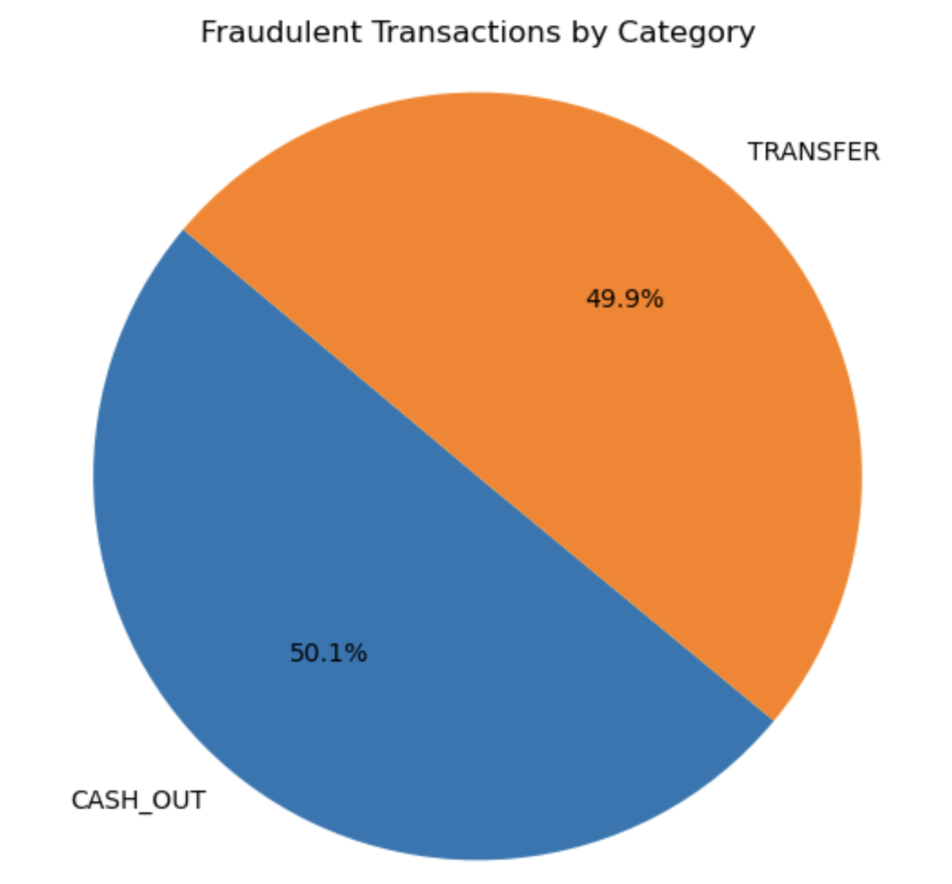
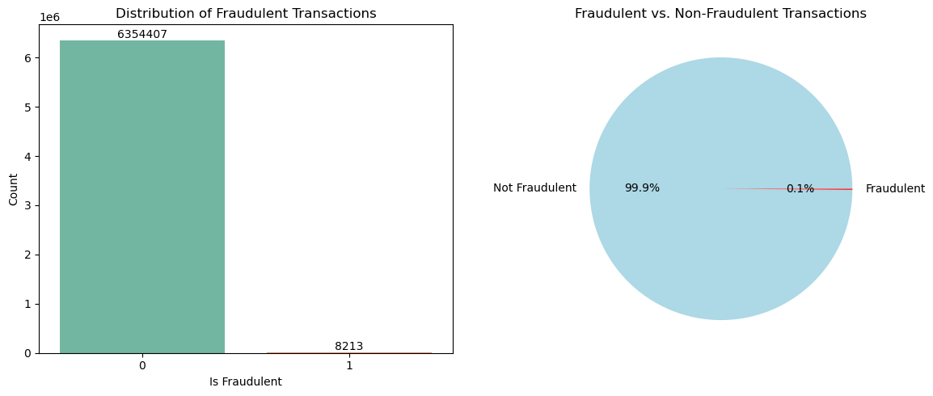

Slide 8
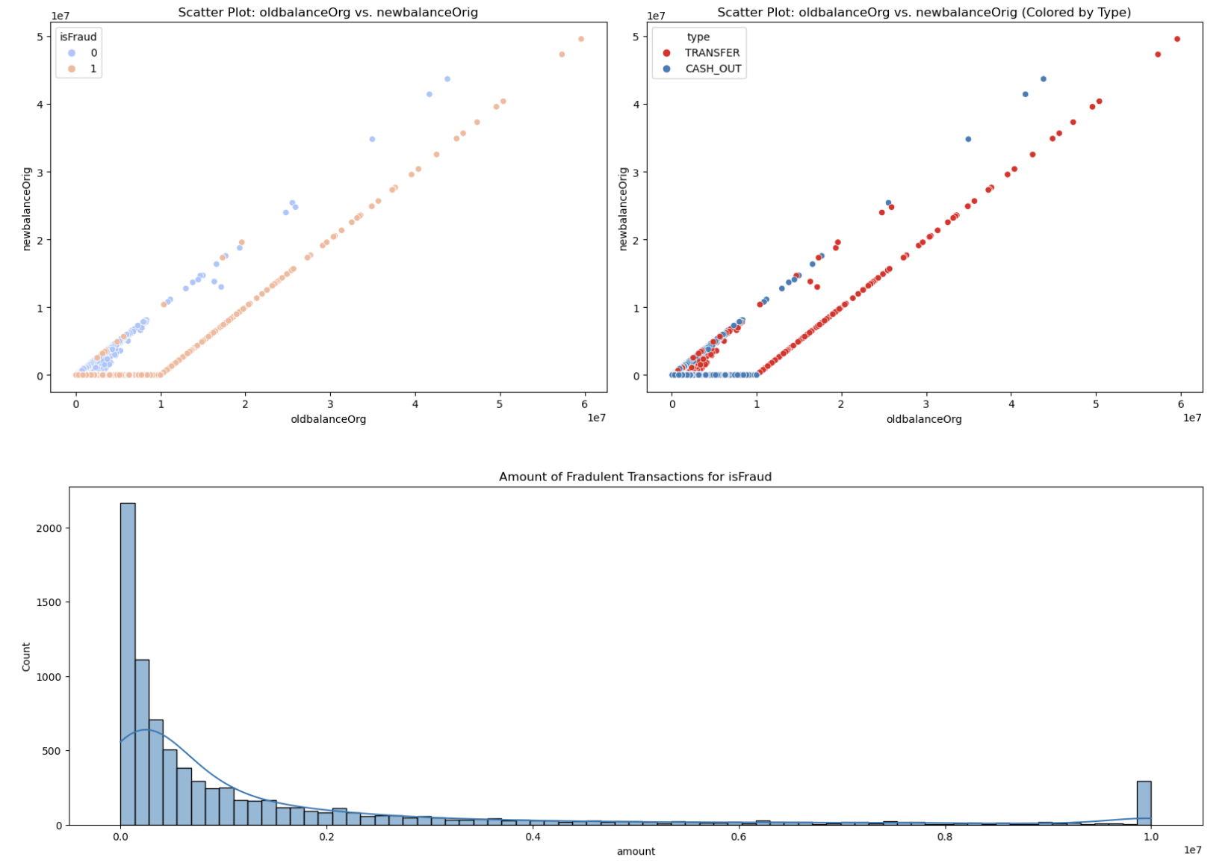

Slide 9

Models and evaluation

Slide 10
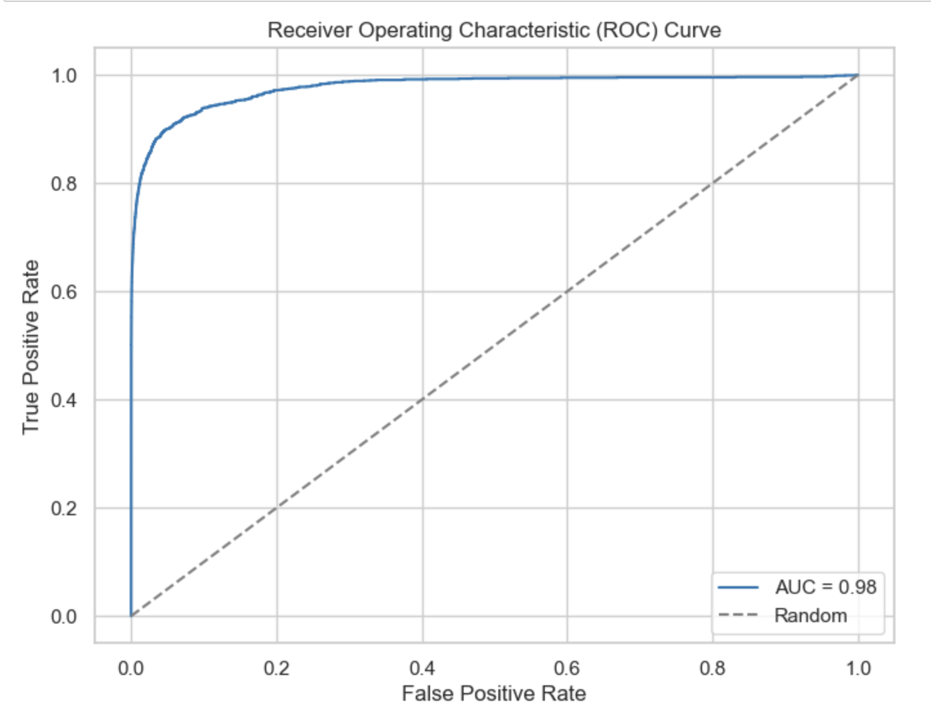
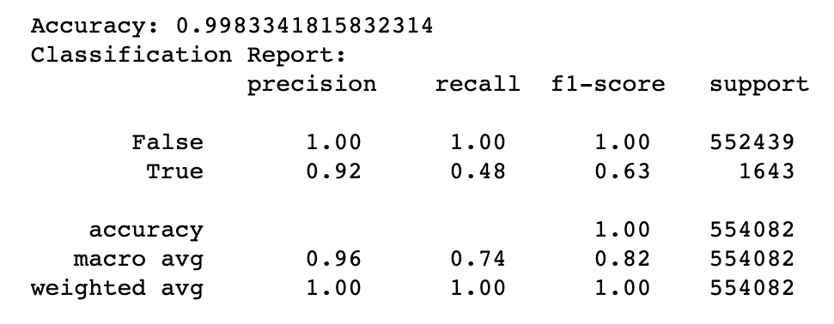
Logistic regression

Slide 11
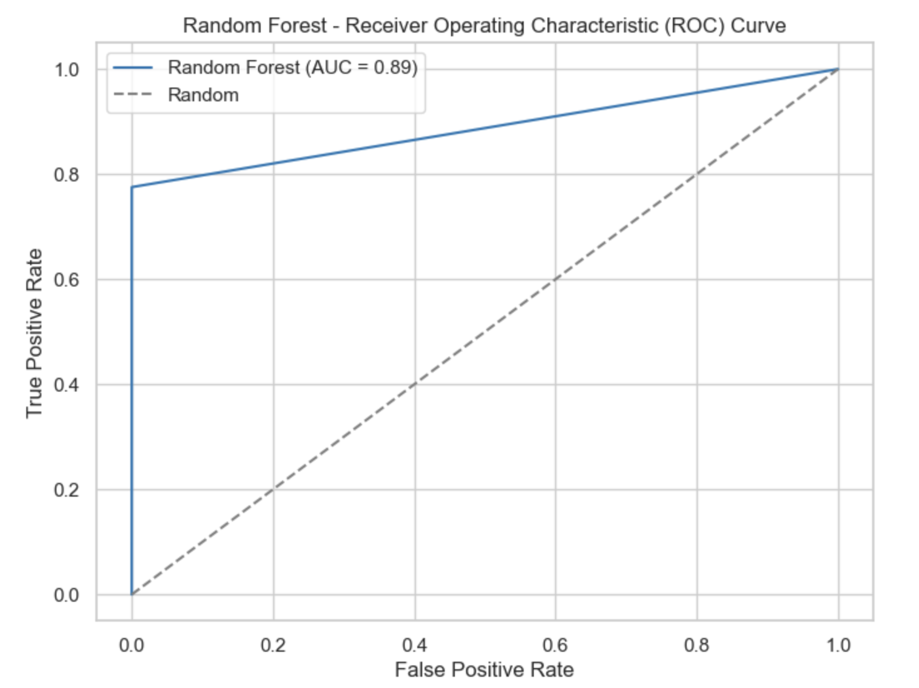
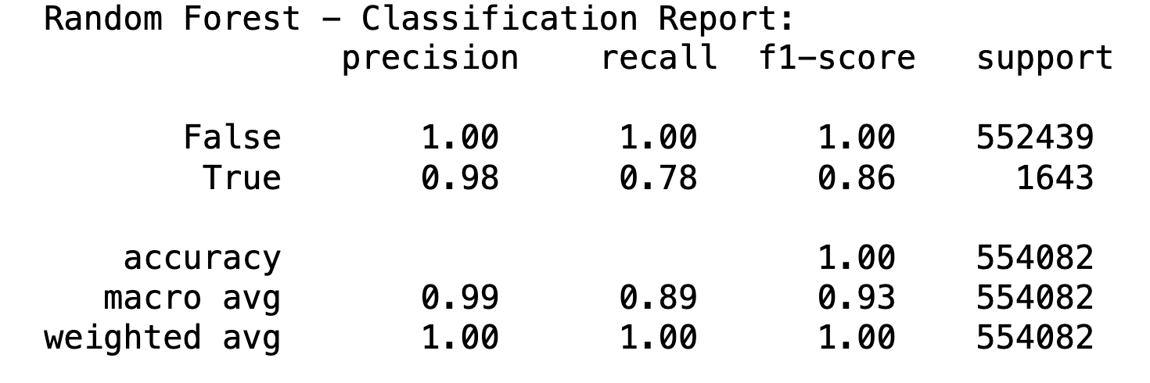
Random forest classifier

Slide 12
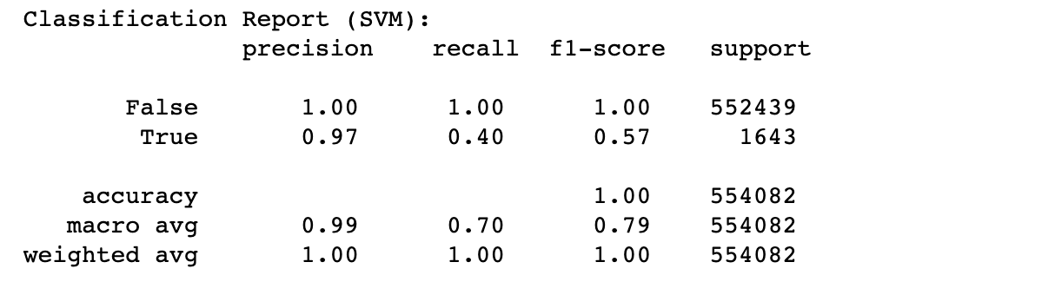
svm

Slide 13
Over Sampling and Under Sampling
Class imbalance in Classification
There are two ways to balance classes - by increasing the smaller class with random duplication, or by decreasing the larger class by randomly removing observations.
SMOTE | Overcoming Class Imbalance Problem Using SMOTE
SMOTE is an oversampling technique where the synthetic samples are generated for the minority class. This algorithm helps to overcome the overfitting problem posed by random oversampling.

Slide 14
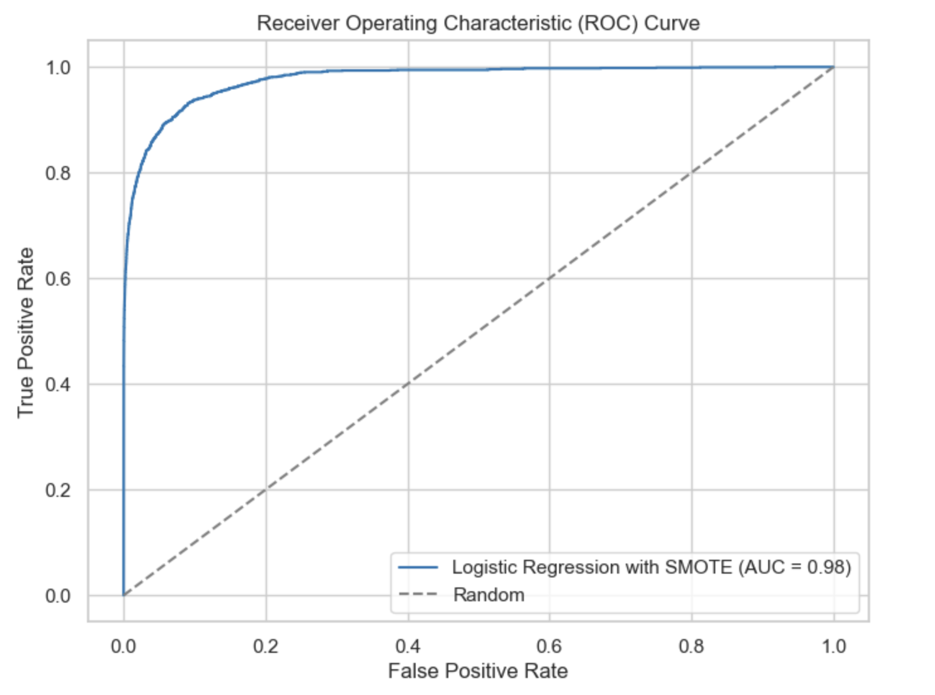
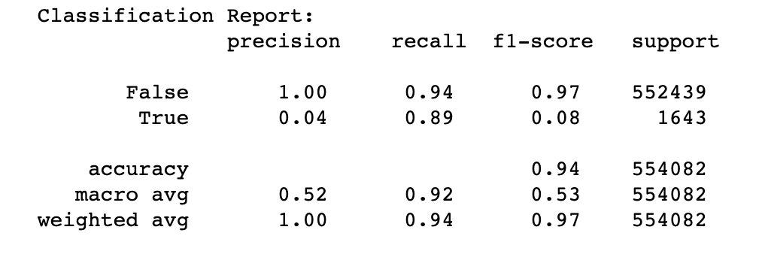
Logistic regression with smote

Slide 15
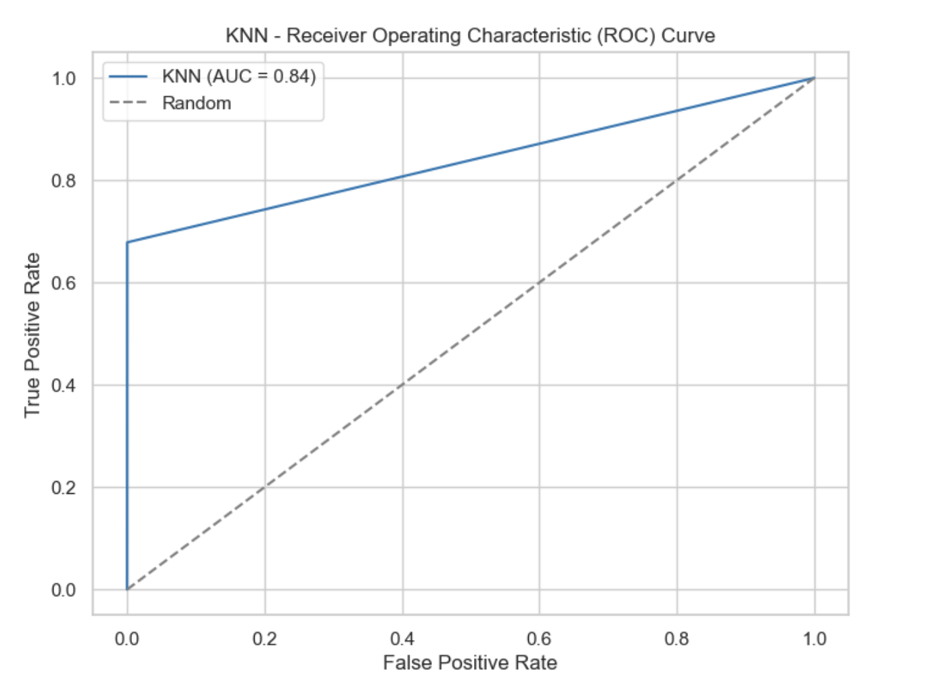
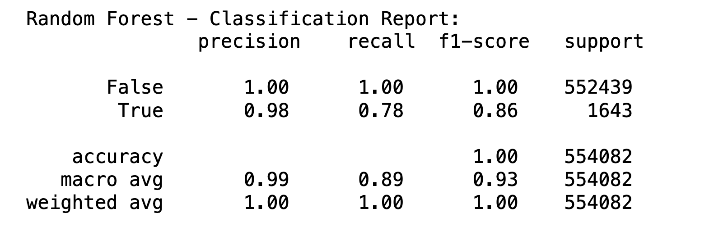
K - Nearest Neighbor

Slide 16
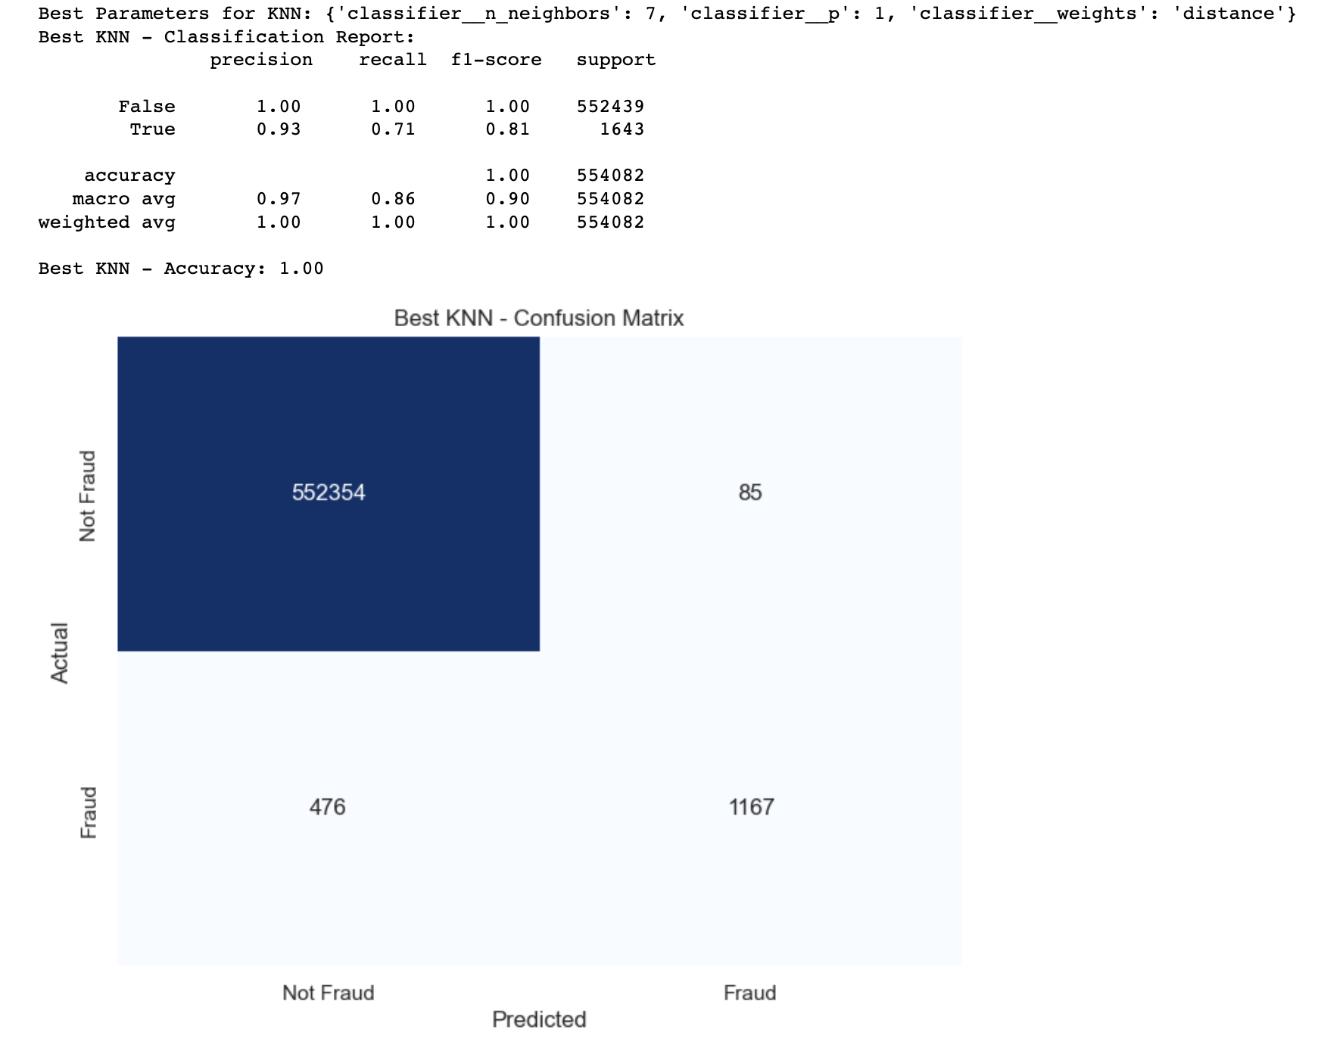
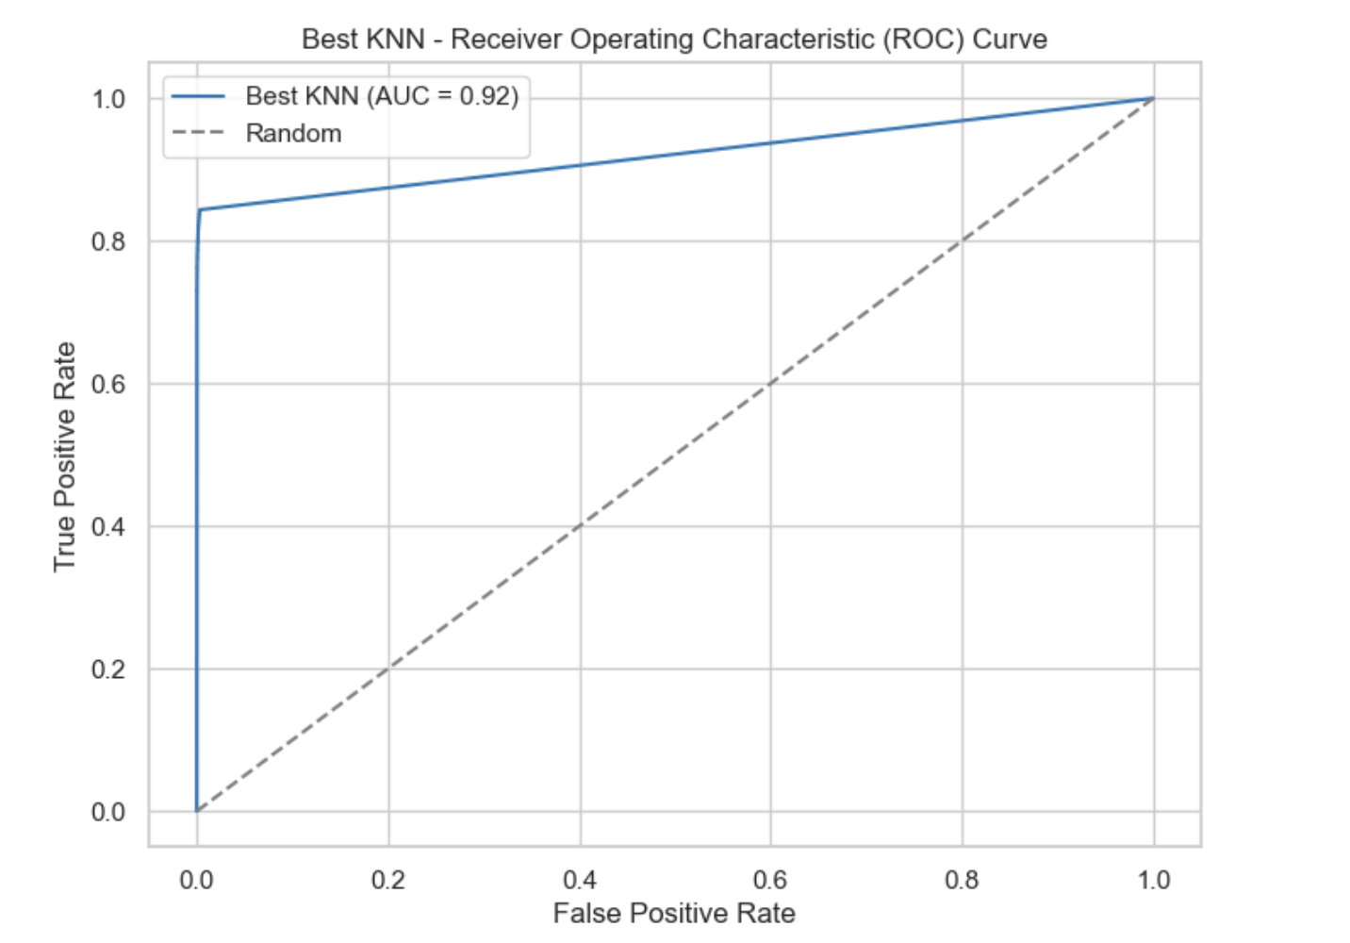
Hyper parameter tuning

Slide 17
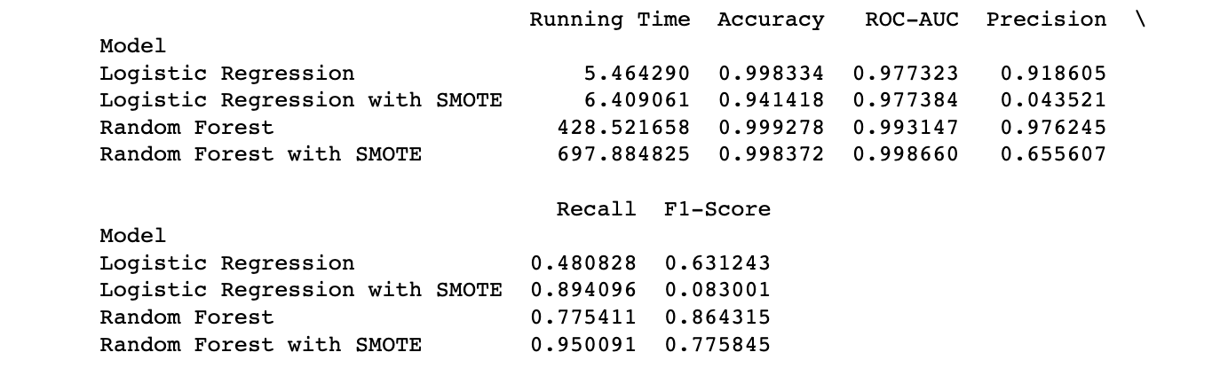
Results and comparision

Slide 18
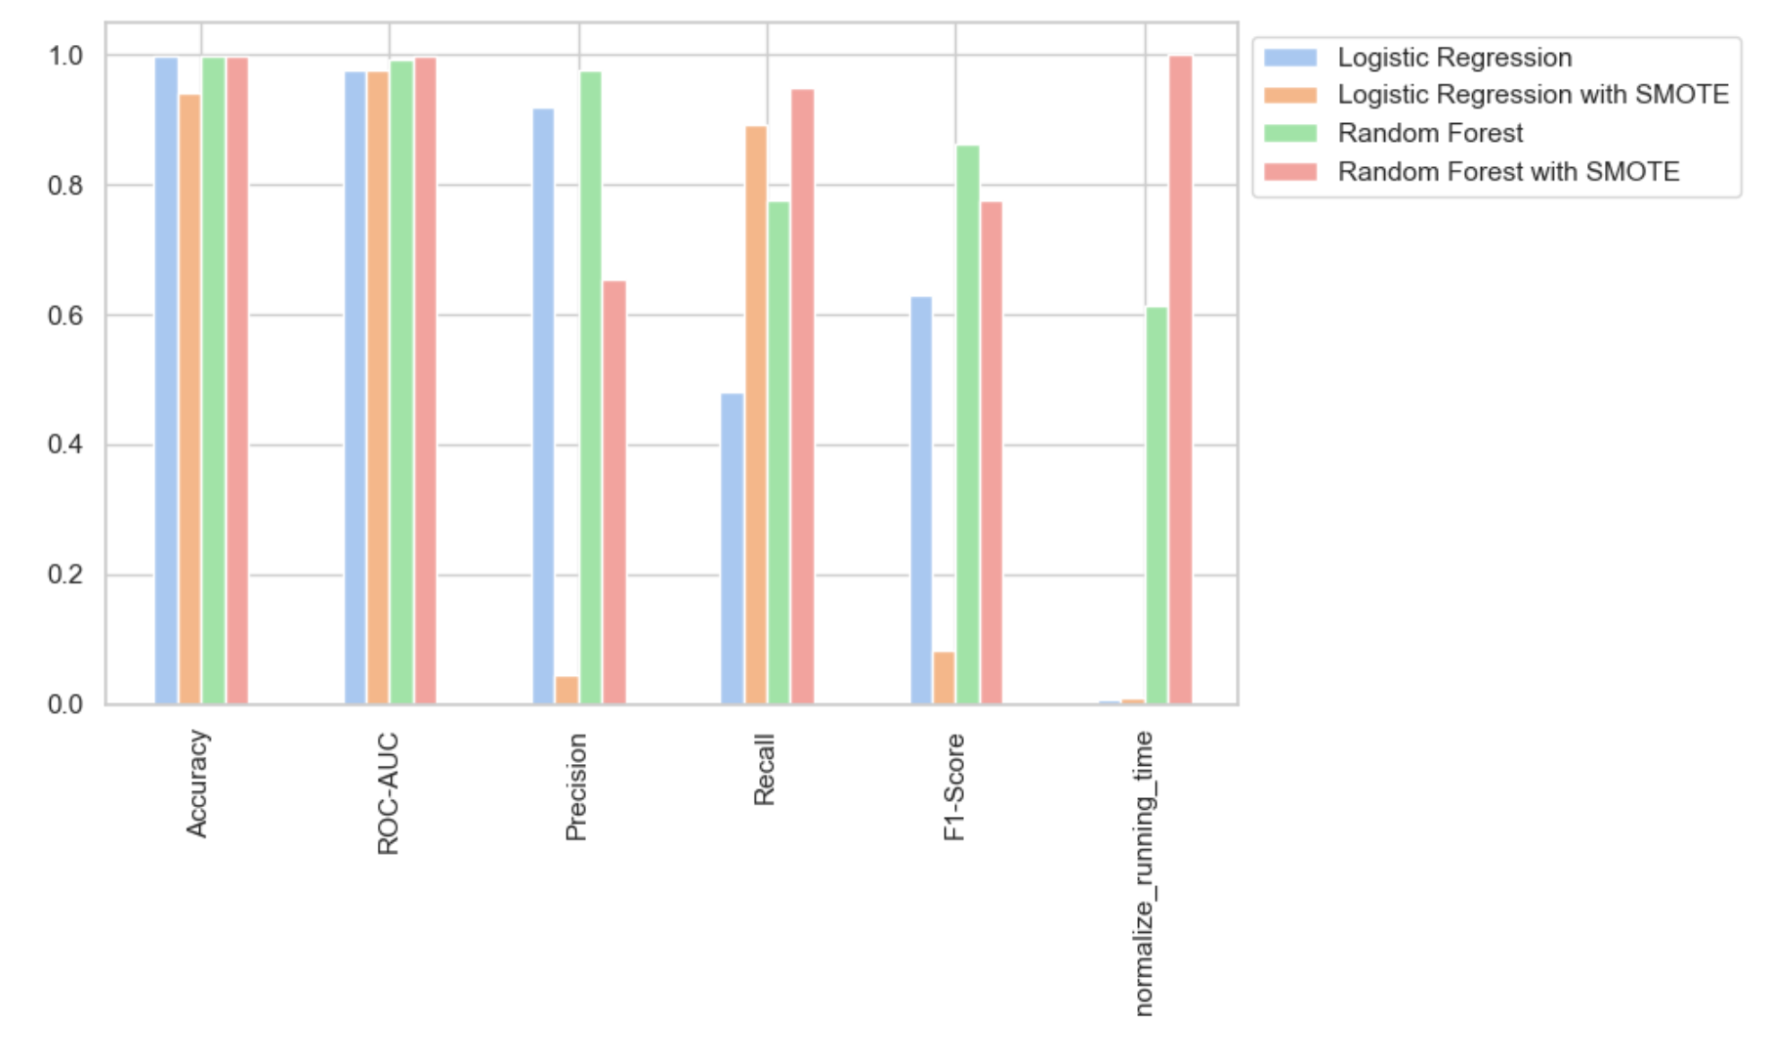

Slide 19
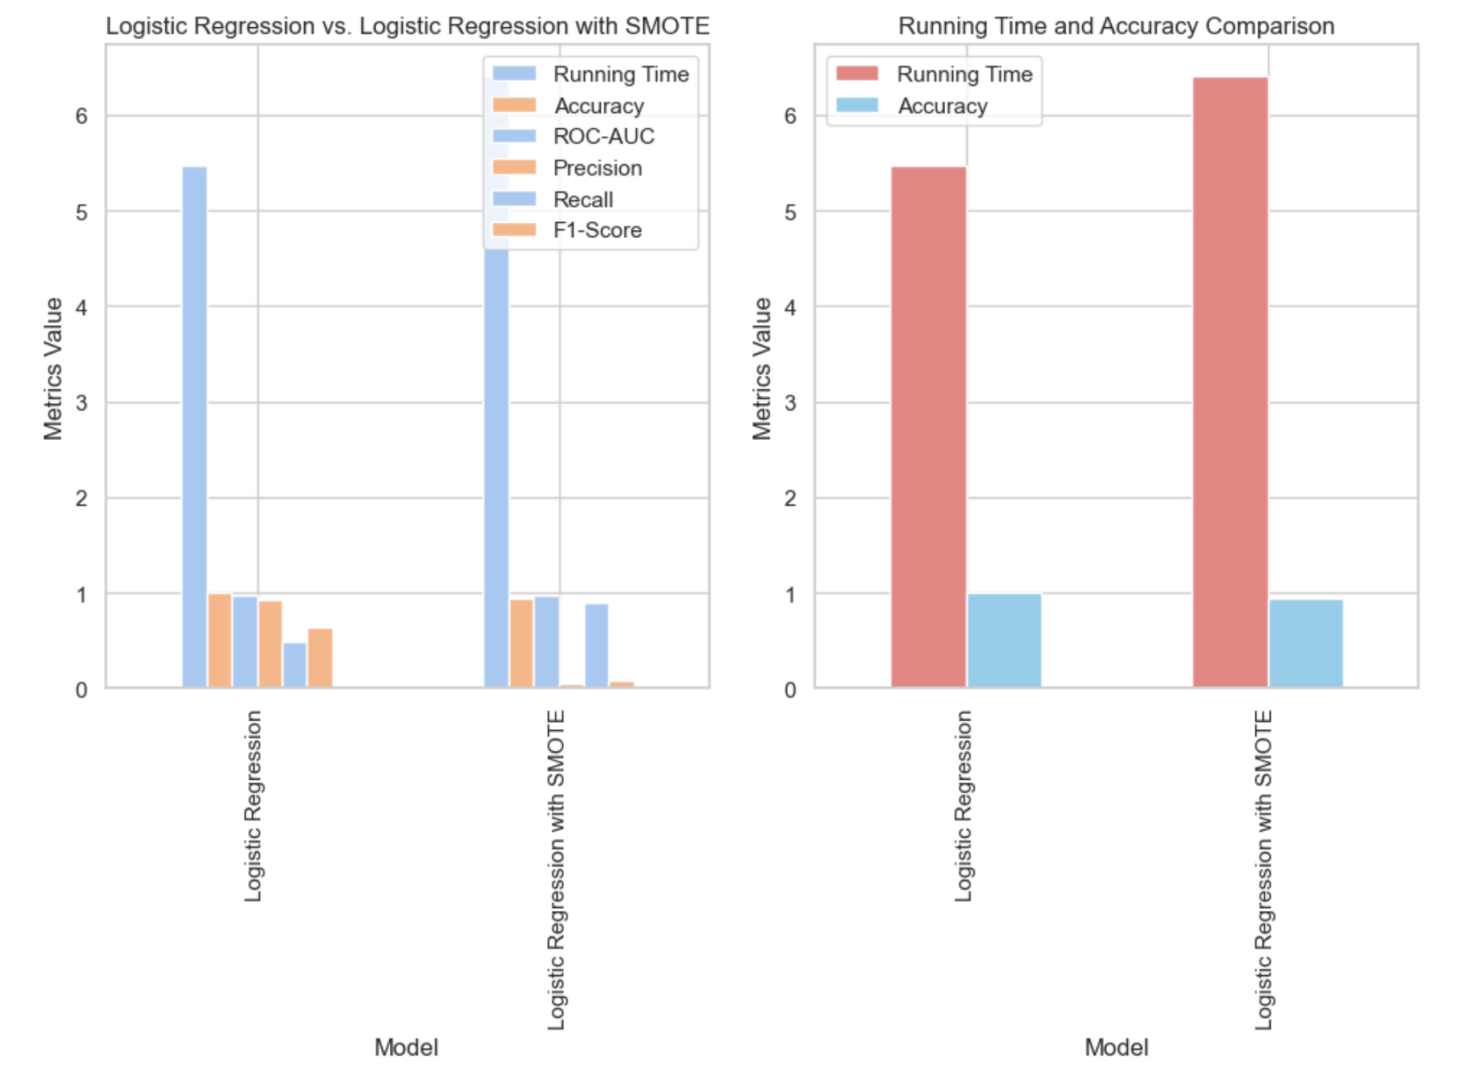

Slide 20
Conclusion
The Random Forest demonstrates robust performance, especially in the harmony of Precision and Recall, as reflected by the F1-score. However, it takes a longer runtime than Logistic Regression.
With SMOTE, while the precision for frauds decreases, the recall experiences a significant boost, indicating fewer missed frauds.
The trade-off between Precision and Recall is evident, and the choice of model would depend on the specific requirements of detection.
The KNN performed much better after applying the hyperparameter tuning and that give a good and balanced precision and f1 score whereas the other models are either good at precision or recall not both.

Slide 21
Feature scope
Develop a user-friendly and innovative web interface for seamless interaction with the fraud detection system.
Implement machine learning algorithms within the web application to enhance fraud detection capabilities continuously.
Create an interactive dashboard to empower financial institutions and users with real-time monitoring capabilities.

