Slide 1
DEEP FAKE IMAGE DETECTION – REAL AND FAKE
(DATA 606: Capstone Project)
Professor – Chaojie Wang (Jay)
Vishal Yadav Paspula ( II69388)

Slide 2
AGENDA
Our project focuses on utilizing a curated dataset comprised of 256x256 pixel human facial images, address pivotal research questions in the space of digital image authentication.
Our methodology centers on the deployment of advanced convolutional neural networks (CNNs), to recognize subtle discrepancies between authentic and doctored images.
Preliminary results, obtained from meticulous data preprocessing and model training, indicate a promising direction in using deep learning for the detection of manipulated images.

Slide 3
DATASET
Source - https://www.kaggle.com/datasets/manjilkarki/deepfake-and-real-images/data
The dataset, integral to our deep learning project, focuses on images of human faces. It comprises a mix of real and manipulated images, each formatted as 256x256 pixel jpg files.
The manipulated images include faces altered through various digital means.
This dataset is ideal for studying image manipulation detection.

Slide 4
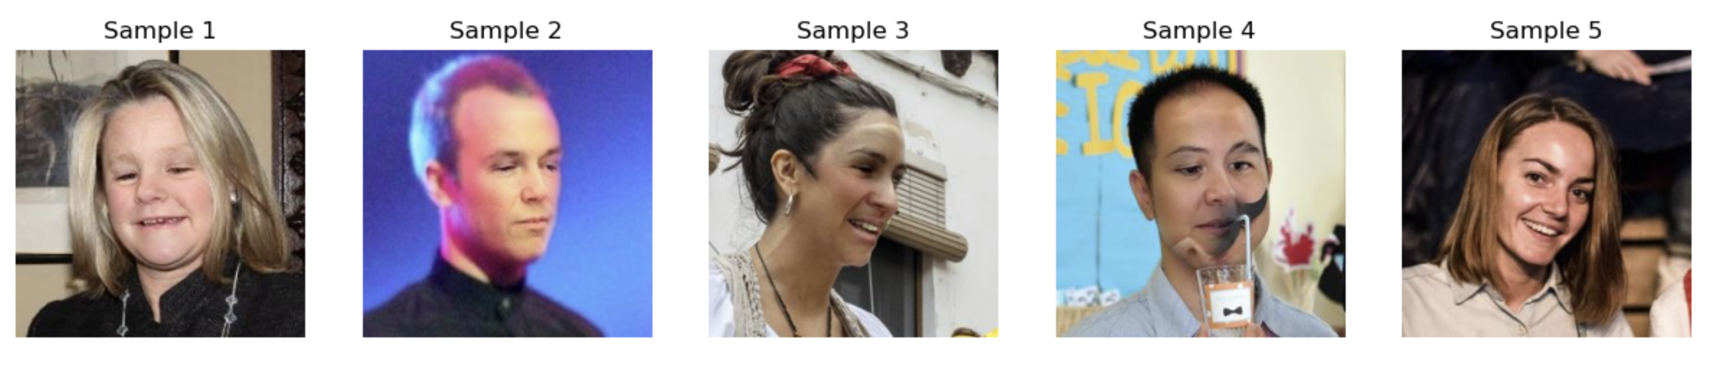
Data Preprocessing
Step 1 – Data Cleaning:
This involves removing corrupt or irrelevant files and ensuring consistency across the dataset and also to obtain high quality images.
Step 2 – Data Normalization
This is to ensure uniformity in terms of scale and color distribution. This standardization is crucial for deep learning models, as it reduces the computational complexity and improves the model’s ability to learn features effectively.
Notes:
We analyze the datasets, we looked missing values and dulipate values, we parsed through the data which I didn’t find which shows the data is authentic and complete.

Slide 5
Step 3 – Data Augmentation
To enhance the robustness of the model and prevent overfitting, data augmentation techniques are employed. These techniques include rotating, flipping, and zooming the images, thereby artificially expanding the diversity of the dataset.
Through these preprocessing steps, the dataset is transformed into a format that is more conducive for training deep learning models, ensuring that the subsequent stages of model building and training are built on a strong foundation of quality data.
Notes:
We looked for the outliers and found many outliers, and we used one of the methods called interquartile range to detect and remove the outliers in the data, here is the one of the examples of the outliers in one of the columns, so after the data is refined for analysis.

Slide 6

METHODOLOGY
Convolutional Neural Network Architecture and Training:
The model utilizes a convolutional neural network (CNN) architecture, primarily designed for image classification tasks.It includes sequential layers, starting with convolutional layers that have 32 and 64 filters with a (3, 3) kernel size, followed by ReLU activation functions and MaxPooling layers with a (2, 2) pool size.
The architecture concludes with fully connected (dense) layers, integrated with a dropout layer set at a rate of 0.5 to prevent overfitting.
The training process leverages the ImageDataGenerator class from TensorFlow's Keras API for efficient image data handling and augmentation.
A binary cross-entropy loss function and an RMSprop optimizer are used, with batch size and number of epochs configured based on the convergence of loss and accuracy.
Notes:
Rest of the data being very insifincant so I had convert the problem into classification model rather than regression.
So, the next graph represents the three different catorgories where is type 60 haas the highest number of trees.

Slide 7
Model Development and Evaluation
Training the Model: We trained our model by running it through several rounds (epochs) of our training data. This involved adjusting settings like how fast the model learns (learning rate) and how it improves its accuracy over time.
Building the Model: Our model was built using 27 different steps. Here, we set up the structure of the model, deciding on the layers and how they should work together to process images.
Handling the Data: A major part of our work (33 steps) was preparing our image data for use. This meant organizing the images, making sure they were in the right format, and dividing them into training, validation, and testing groups.
Evaluating the Model: After training, we tested our model with a new set of images it hadn’t seen before. We checked how accurately it could identify the images, and measured its performance using criteria like accuracy, precision, and recall.
Notes:
Reducing the number of columns in the dataset while preserving essential variance- we are not affecting the original essence of the data.
One of the efficient techniques for parameter optimization.
To quicker solutions, we have used pca and gridsearch together at once for all the models, for all the models we have used the same gridsearch.

Slide 8
RESULTS AND DISCUSSION
The implemented model exhibits a promising accuracy in differentiating between real and manipulated images. The performance metrics are as follows:
Model Accuracy: 0.81
Model Precision: 0.80
Model Recall: 0.82
Model F1-Score: 0.81
These scores indicate a robust capability of the model to distinguish real images from manipulated ones, with balanced precision and recall, which is critical in such classification tasks.

Slide 9
CHALLENGES AND LEARNING
The primary challenge in this project was to achieve a balance between precision and recall, ensuring that the model neither misses too many real images nor falsely flags them as manipulated. We have overcome it upon multiple iterations.
The limited diversity in the dataset may impact the model's ability to generalize across unseen types of manipulations.
Another limitation is the binary classification approach, which may not account for images with subtle manipulations.

Slide 10
USER INTERFACE DEVELOPMENT
Flask Application: The Flask app, app.py, serves as the backend for the web interface. It manages requests and responses, enabling users to upload images for manipulation detection.
Model Integration: The trained deep learning model is integrated into the Flask application, allowing real time analysis of the images that we had uploaded.
Image Processing and Prediction: When a user uploads an image, the Flask application processes it and feeds it to the model for prediction. The image is converted to an array and then evaluated by the model to determine if it's real or manipulated.

Slide 11
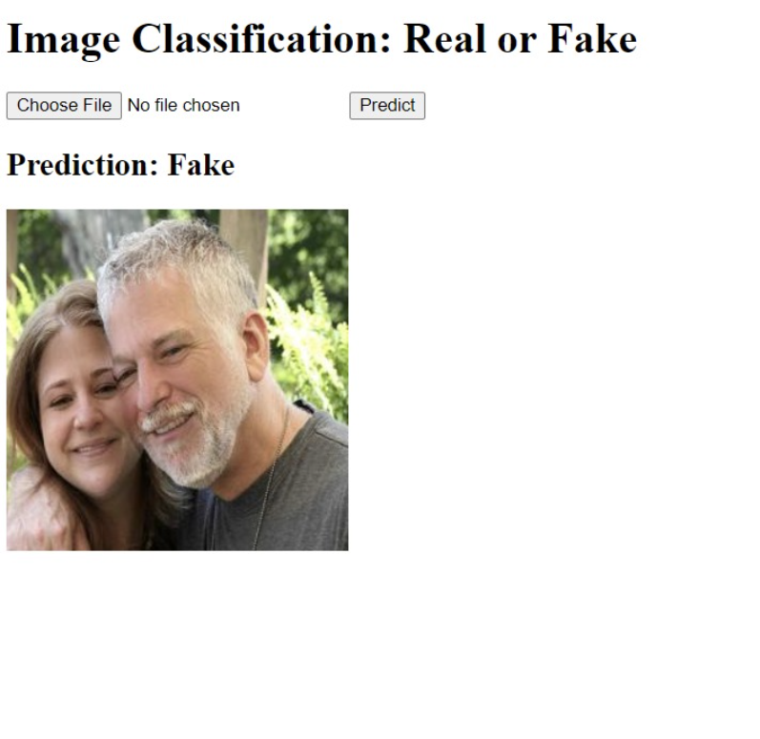


Slide 12
CONCLUSION
The study successfully implemented a deep learning model to differentiate between real and manipulated images.
Our model, based on advanced neural network architectures, demonstrated a significant capability in identifying features indicative of image manipulations.
Through rigorous training and evaluation, using a dataset comprising both real and manipulated human face images, the model achieved 81% accuracy.

Slide 13
FUTURE WORK
Dataset Expansion: Incorporating a more diverse and larger dataset, possibly including images with varying degrees of manipulation and from different sources, can further validate and improve the model's robustness.
Model Enhancement: Exploring other deep learning architectures, such as Generative Adversarial Networks (GANs), could offer insights into more sophisticated manipulation detection methods.
Real-world Application: Testing the model in real-world scenarios, such as social media platforms or digital newsrooms, can provide practical insights and highlight areas for improvement.

Slide 14
References
Deepfake and real images. (2022, February 3). Kaggle. https://www.kaggle.com/datasets/manjilkarki/deepfake-and-real-images/data
Deepfakes creation and detection using deep learning. (2021, May 26). IEEE Conference Publication | IEEE Xplore. https://ieeexplore.ieee.org/abstract/document/9447642
Deepfake face detection using Deep InceptionNet learning algorithm. (2023, February 18). IEEE Conference Publication | IEEE Xplore. https://ieeexplore.ieee.org/document/10063128
Deepfake Detection using Deep Neural Networks - NORMA@NCI Library. (n.d.). https://norma.ncirl.ie/5131/
Le, T. (2021, July 30). OpenForensics: Large-Scale Challenging Dataset For Multi-Face Forgery Detection And Segmentation In-The-Wild. arXiv.org. https://arxiv.org/abs/2107.14480

Slide 15
THANK YOU

