Slide 1
Text Analysis of Amazon Grocery and Gourmet Food Product Reviews
Dr. Chaojie Wang
Department of Data Science
Presenter Manimadhuri Edara AH28458

Slide 2

ABSTRACT:
The Text Analysis of Amazon Grocery and Gourmet Food Product Reviews will provide a comprehensive analysis of customer reviews and ratings for food products on the Amazon Fresh platform. By delving into this dataset, through natural language processing and machine learning techniques, seek to uncover trends and patterns that can inform businesses, consumers, and the broader food industry.
Text analysis of Amazon grocery product reviews has significance since it can provide businesses, consumers, and the food industry with valuable insights by identifying trends and patterns in Amazon food product reviews.

Slide 3



PROJECT OVERVIEW:
Review Text Preprocessing.
Topic modeling using Latent Dirichlet Allocation (LDA).
Topic modeling using the BERTopic model.
Sentiment analysis using TextBlob.
Sequential convolutional neural network (CNN).

Slide 4
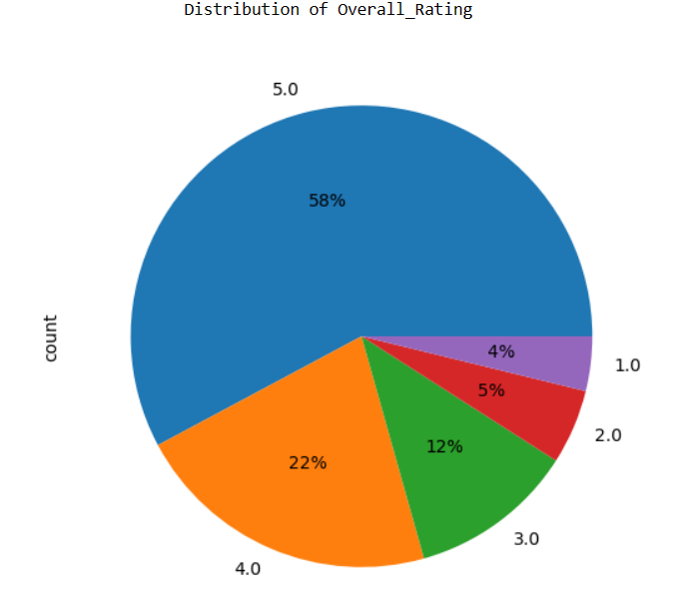
Dataset and Feature Engineering:
The Amazon Grocery and Gourmet Food Reviews dataset consists of reviews of foods from Amazon. The data span a period of more than 10 years, including all ~151,254 reviews. Reviews include product and user information, ratings, and a plaintext review.
Data sources: https://cseweb.ucsd.edu/~jmcauley/datasets/amazon_v2/
The overall rating of the products in the dataset is high, with an average rating of 4.24 out of 5.
The most recent review was posted in July 2014.
The distribution of the overall ratings shows that more products have higher ratings.

Slide 5

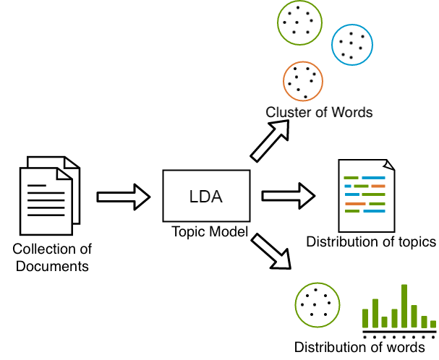
Text Preprocessing and Topic Modeling:
Normalization of text using NLTK Standard Library.
Defined a function preprocess_text to tokenize the text and remove stopwords.
Performed LDA topic modeling using Gensim's LdaModel.
Performed topic modeling using BERTopic.

Slide 6
Latent Dirichlet Allocation (LDA):
LDA Model Creation: The code initializes an LDA model by specifying the number of topics as 15 (num_topics = 15).
Displaying Topics and Top Words: After training the model, it prints the top 10 words for each of the 15 topics generated by the LDA model. Each line displays a topic number along with the most influential words and their associated weights in the given topic, For instance:
Topic 2 seems to be related to positive reviews about gluten-free products like cheese and taste.
Topic 11 might relate to organic and natural fruit juices.
Topic 14 involves discussions about water, sugar, milk, and additives.
In this case, we obtained a moderate coherence score of 0.4935, indicating moderate coherence among the topics.

Slide 7
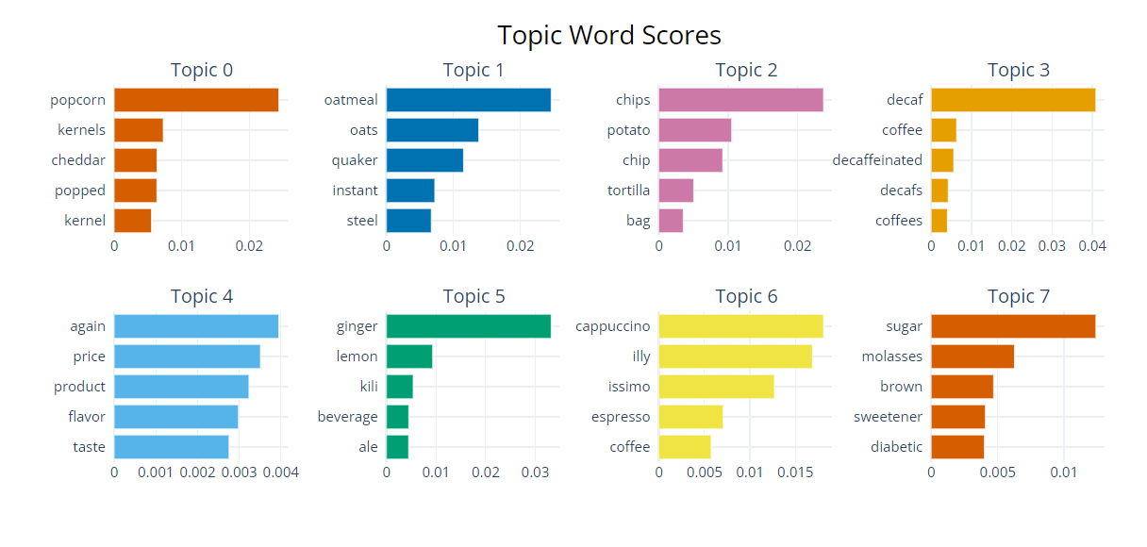
BerTopic Model
The BERTopic model uses word embeddings and graph-based clustering to identify topics in text data. Topic word scores of Amazon Grocery Review Data using the Transformer BERT model.

Slide 8
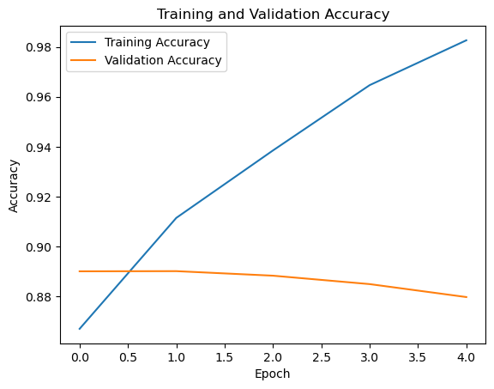

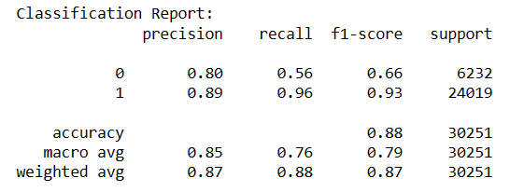
Sequential convolutional neural network model:
Sequential models are a type of neural network that is built by stacking layers of neurons in a linear sequence. The model was evaluated on a held-out test set of Amazon Grocery reviews. The model achieved an accuracy of 88% on the test set. However, the plot suggests that the training accuracy is slightly higher than the validation accuracy. This means the model is overfitting the training data to some extent.

Slide 9
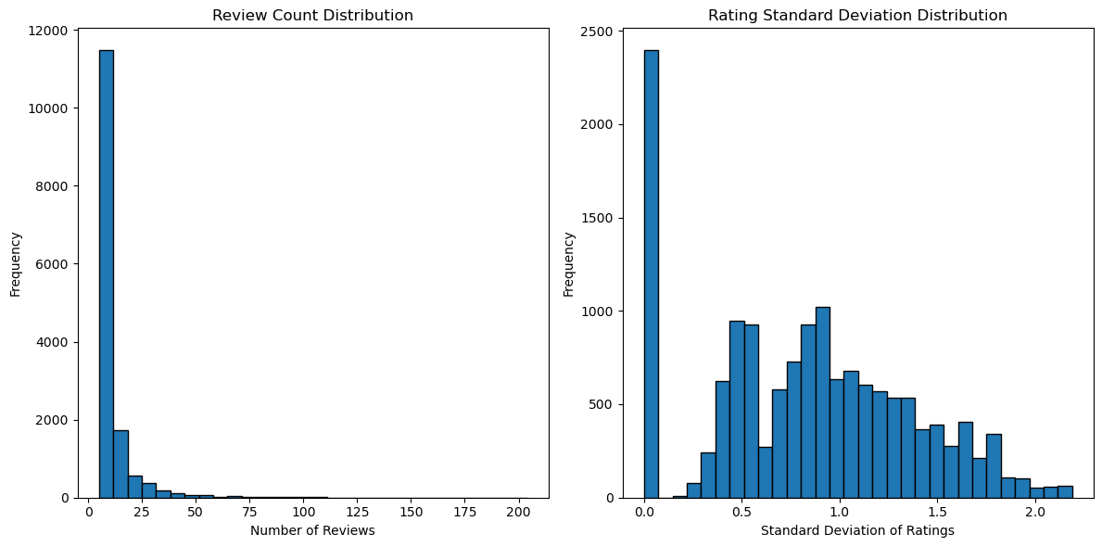
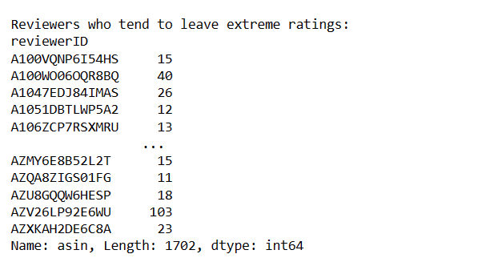
Key Findings Related to the Research Questions:
Reviewer Behaviour:
There is a small group of frequent reviewers.
Frequent reviewers are more likely to leave extreme ratings than infrequent reviewers.

Slide 10
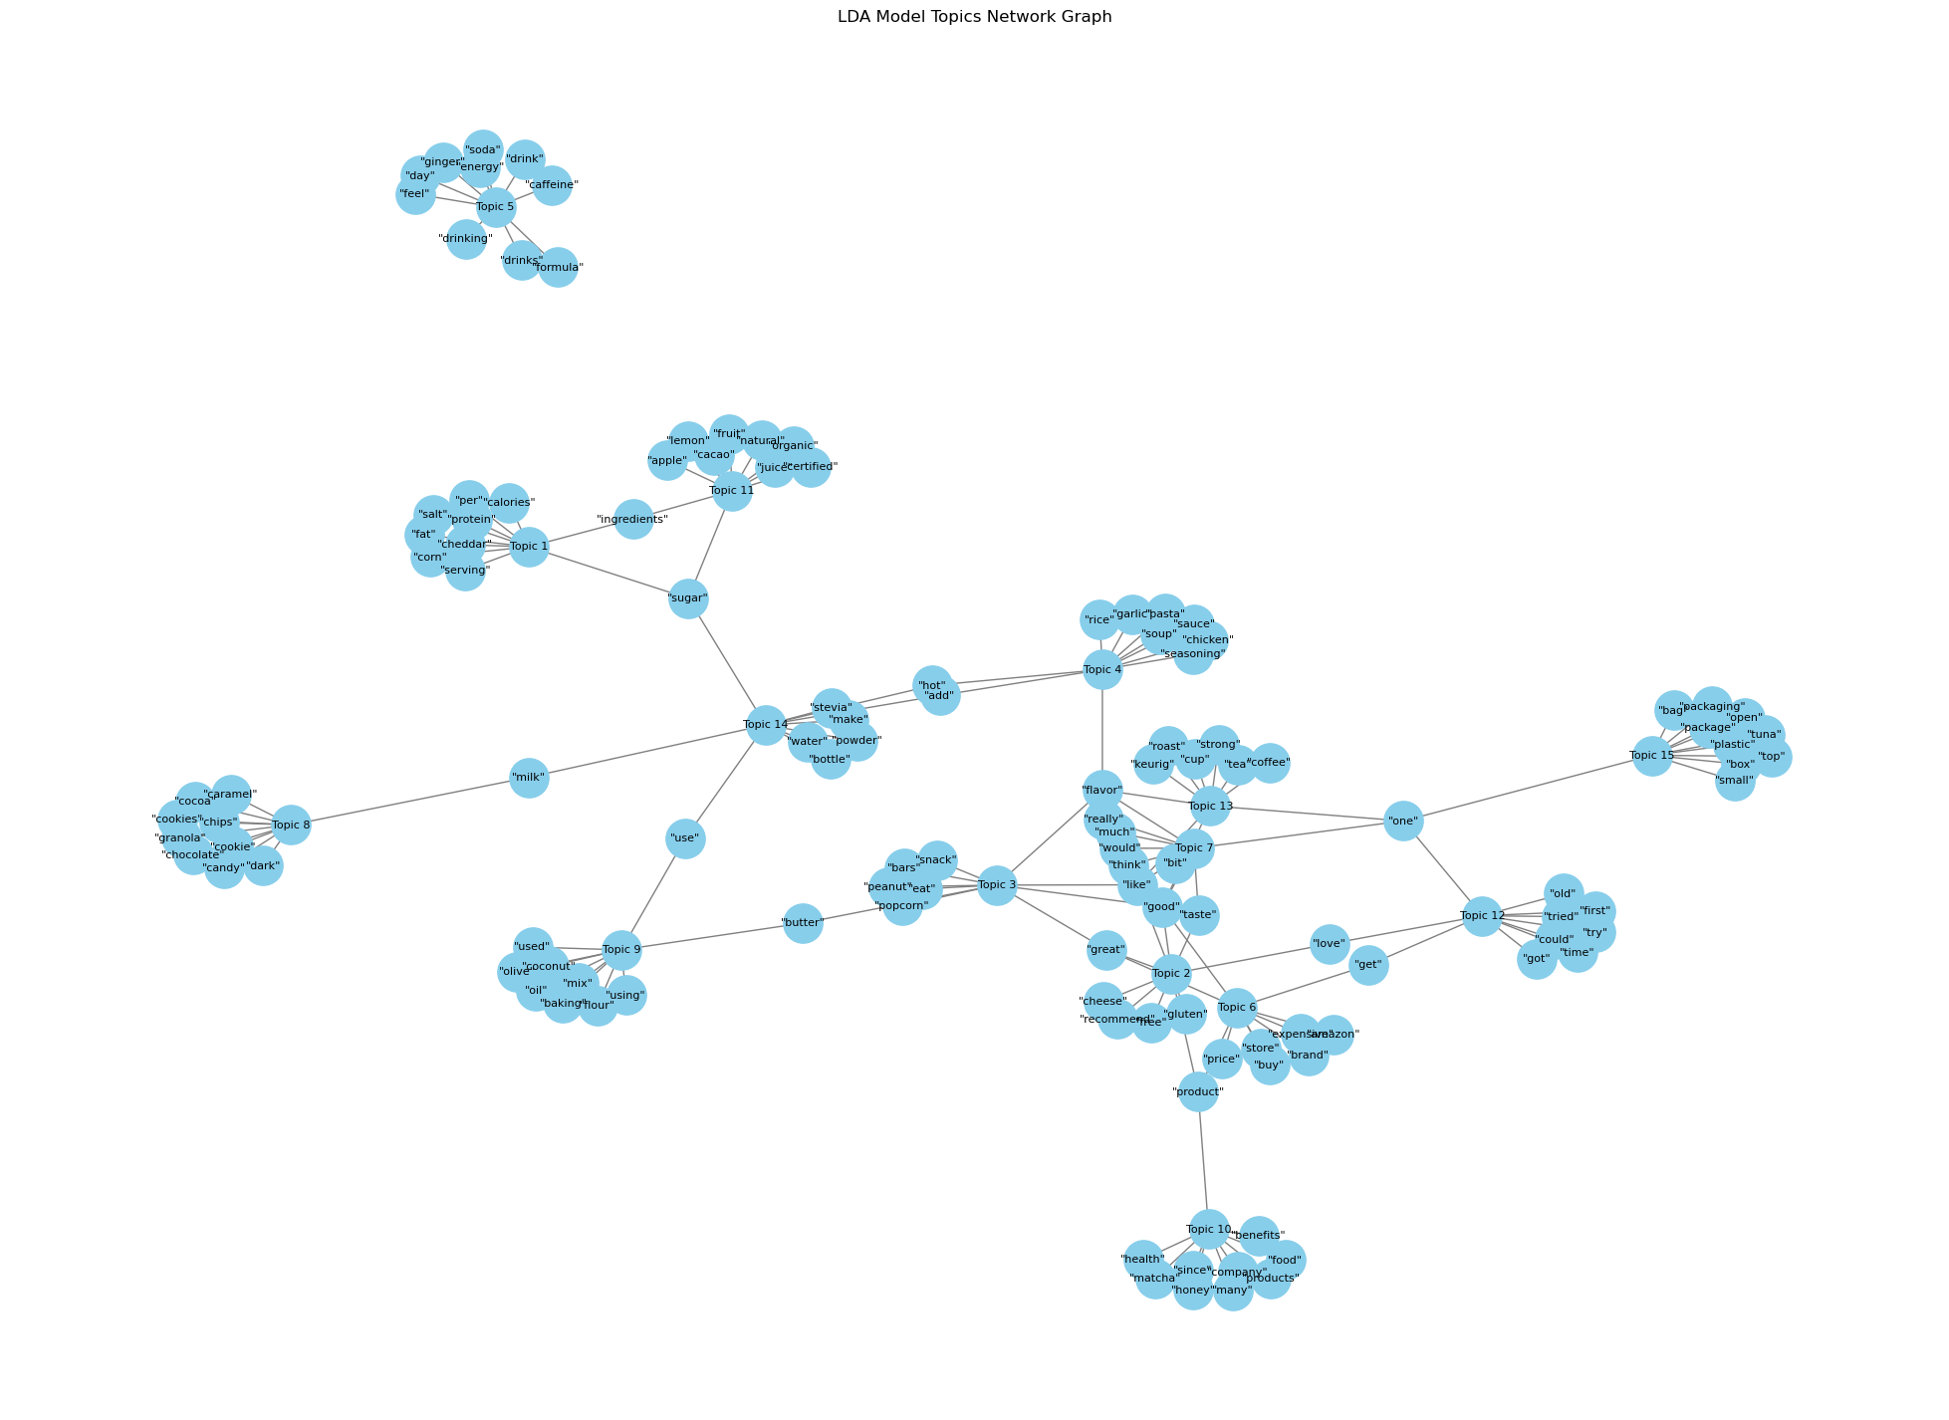
Most common topics discussed in Amazon Grocery reviews:
Product Quality
Price
Customer service
Freshness
Taste
Variety
Convenience
Value for money
Packaging
Delivery

Slide 11
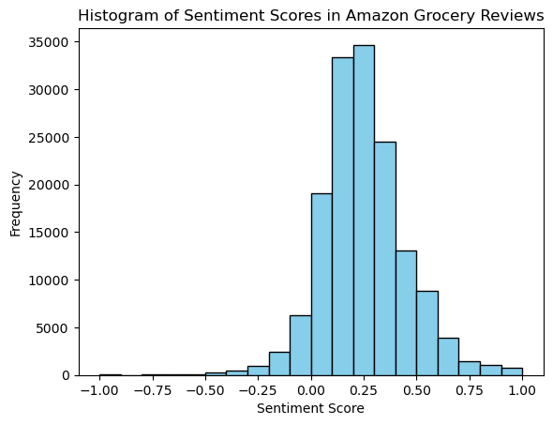
Sentiment Analysis:
Amazon Grocery has a high average sentiment score. This suggests that customers are overall satisfied with the products, services, and prices offered by Amazon Grocery.
The distribution of sentiment scores is skewed to the right. This suggests that there are more positive reviews than negative reviews.
The most common sentiment scores are 5.0 and 4.0 (positive).
The least common sentiment scores are 1.0 and 2.0 (negative).

Slide 12
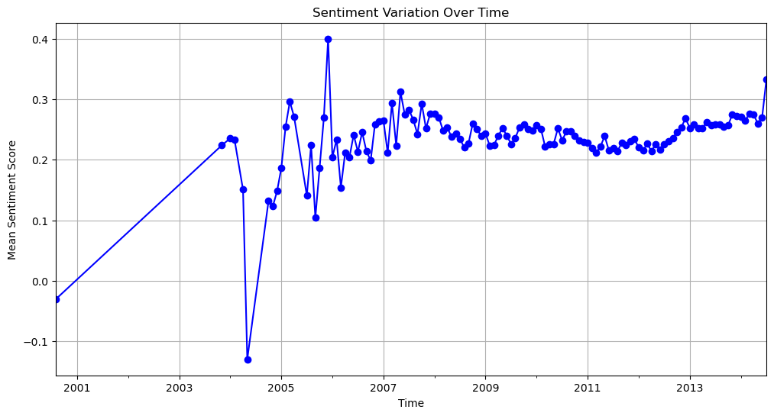
The plot shows that the sentiment score of grocery reviews has been increasing over time. This suggests that customers are becoming more satisfied with grocery shopping overall.
Overall, the plot of the Grocery Review sentiment variation over time suggests that customers are becoming more satisfied with grocery shopping overall. This is likely due to several factors, including the rising quality of grocery products, greater convenience, and increased competition.

Slide 13
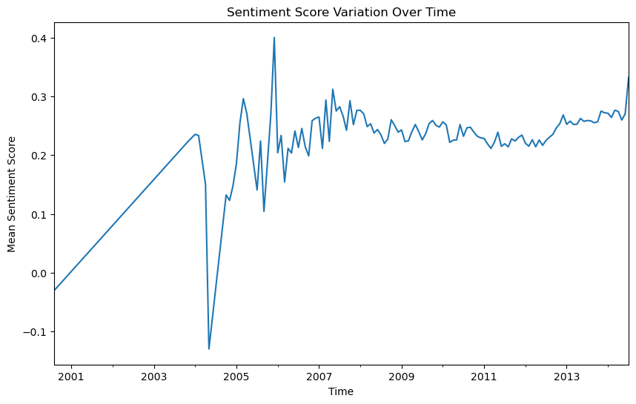
Overall trend:
The plot shows that the sentiment score of Amazon Grocery reviews has been increasing over time, from an average of 4.2 in 2001 to an average of 4.6 in 2013. This suggests that customers are becoming more satisfied with Amazon Grocery overall

Slide 14
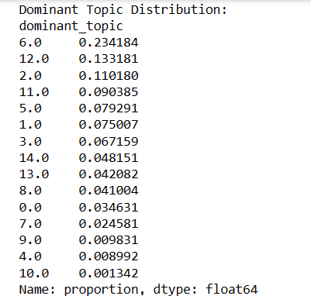
Key Factors Influencing Customer Satisfaction:
Dominant Topics: Topics labeled 6.0(Shopping Experience), 12.0 (Customer Experience), and 2.0(Positive Feedback) seem to be the most dominant, as they have the highest proportions in the dataset.
Influence on Customer Satisfaction: Topics 7.0(Taste Preferences), 13.0(Coffee and Tea), and 3.0 (Snack Preferences) seem to have a more significant impact on customer satisfaction, given their higher influence values in relation to satisfaction.

Slide 15
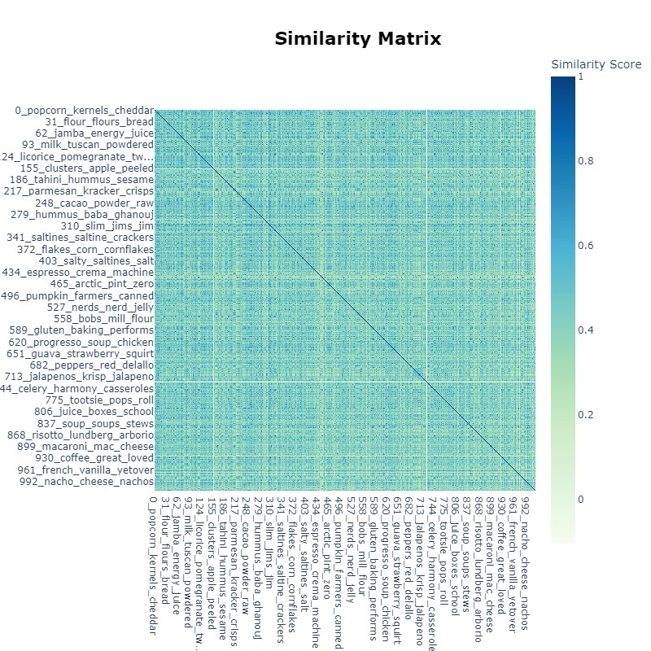
Based on the plot, the following topics are similar:
Fresh produce and dairy products
Coffee and breakfast cereal
Decaffeinated and instant coffee
Processed foods and snacks

Slide 16
Recommendations:
Amazon Grocery can use this information to improve its products and services in the following ways:
Focus on product quality.
Offer competitive prices.
Ensure the freshness of the products.
Focus on taste
Improve variety and convenience
Ensure accurate and on-time delivery

Slide 17
References
Sentiment Analysis on Amazon Product Reviews using Text Analysis and Natural Language Processing Methods, April 2023, https://www.researchgate.net/publication/369997867_Sentiment_Analysis_on_Amazon_Product_Reviews_using_Text_Analysis_and_Natural_Language_Processing_Methods
Bi-RNN and Bi-LSTM Based Text Classification for Amazon Reviews, April 2023, https://www.researchgate.net/publication/370062640_Bi-RNN_and_Bi-LSTM_Based_Text_Classification_for_Amazon_Reviews
Performance Evaluation of Feature Selection Methods for Sentiment Classification in Amazon Product Reviews, July 2023, https://www.researchgate.net/publication/373266249_Performance_Evaluation_of_Feature_Selection_Methods_for_Sentiment_Classification_in_Amazon_Product_Reviews
Justifying recommendations using distantly-labeled reviews and fined-grained aspects, 2019, https://cseweb.ucsd.edu//~jmcauley/pdfs/emnlp19a.pdf

Slide 18
Thank You

