Slide 1

ADDRESSING THE OPIOID EPIDEMIC
A National Public Health Challenge
Sushma Jettem
MC49178

Slide 2

INTRODUCTION
Opiates, like heroin, derived from natural sources, are illegal substances.
Conversely, synthetic versions known as opioids are legally available, often prescribed for pain relief despite a heightened risk of addiction and overdose, contributing to a national epidemic of opioid-related deaths.
San Francisco, known for pioneering progressive public health initiatives such as the early adoption of medical cannabis and needle exchange programs, continues its innovative approach.
California’s recent legislation empowers San Francisco to establish groundbreaking solutions, showcasing a commitment to addressing public health challenges with forward-thinking strategies.

Slide 3

Data set/INFO
2129525 Rows and 35 Columns
Data Size: 220 MB
Data Sources:
https://data.sfgov.org/Public-Safety/Police-Department-Incident-Reports-Historical-2003/tmnf-yvry/data
https://data.sfgov.org/Public-Safety/Police-Department-Incident-Reports-2018-to-Present/wg3w-h783/data
Period: Jan 2003 – May 2018
Target Variable: Category

Slide 4
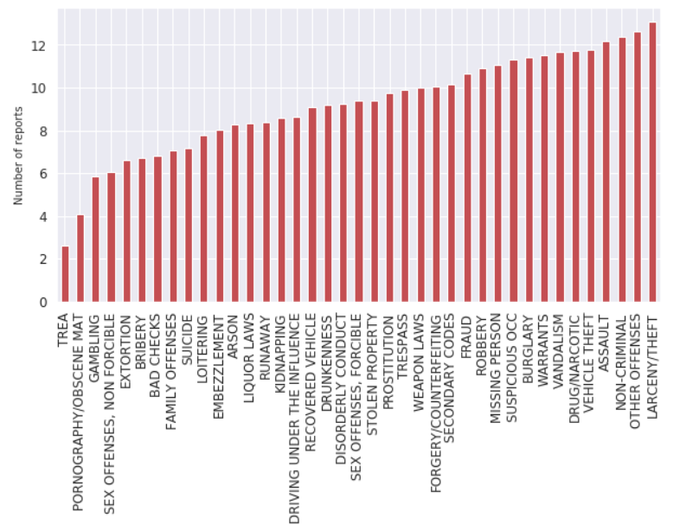
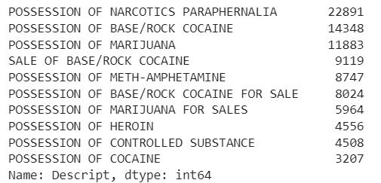
The most common types of descriptions for drugs
Different Categories of Crimes and Their Reports.
Focusing on Drugs.

Slide 5
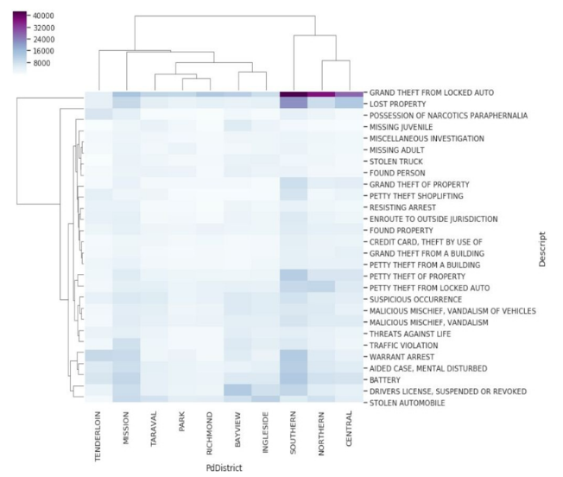
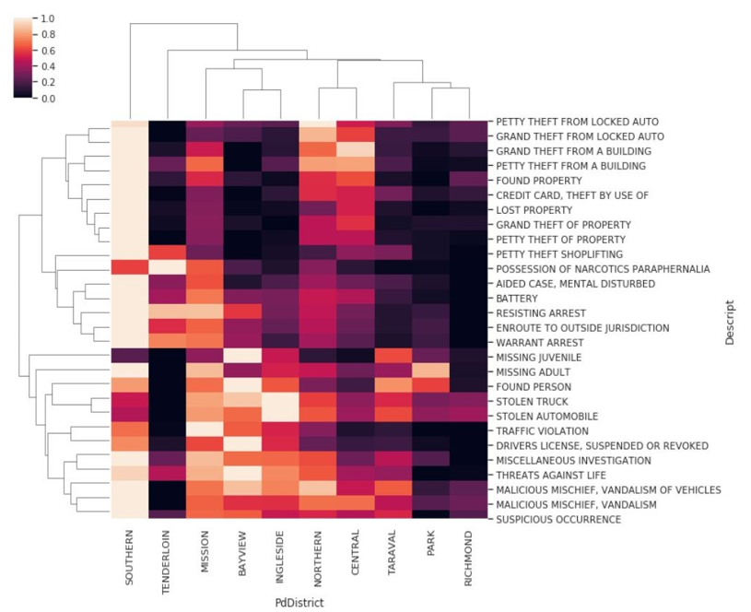
Normalized cluster maps.

Slide 6
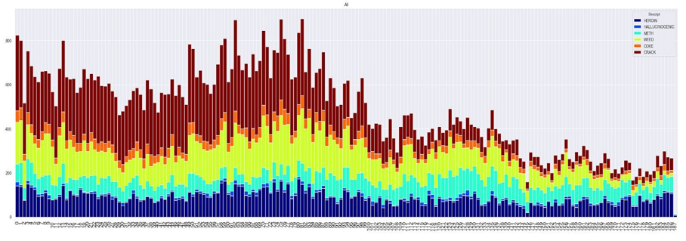
TIME SERIES ANALYSIS.
Examining opioid patterns over time.

Slide 7
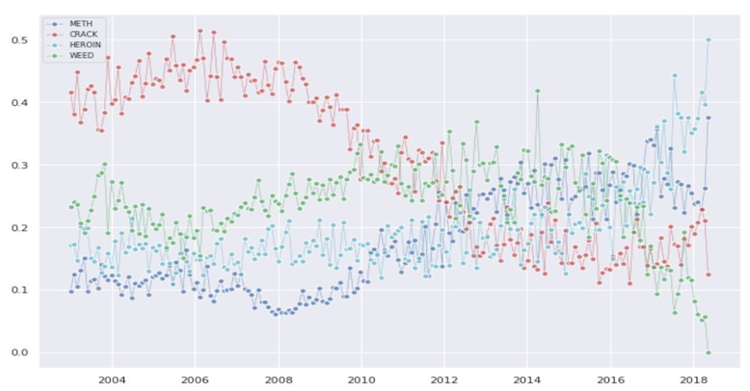
Normalized distribution of opioid trends.
over this time, the number of crack-related incidents decreased. idents decreased.

Slide 8
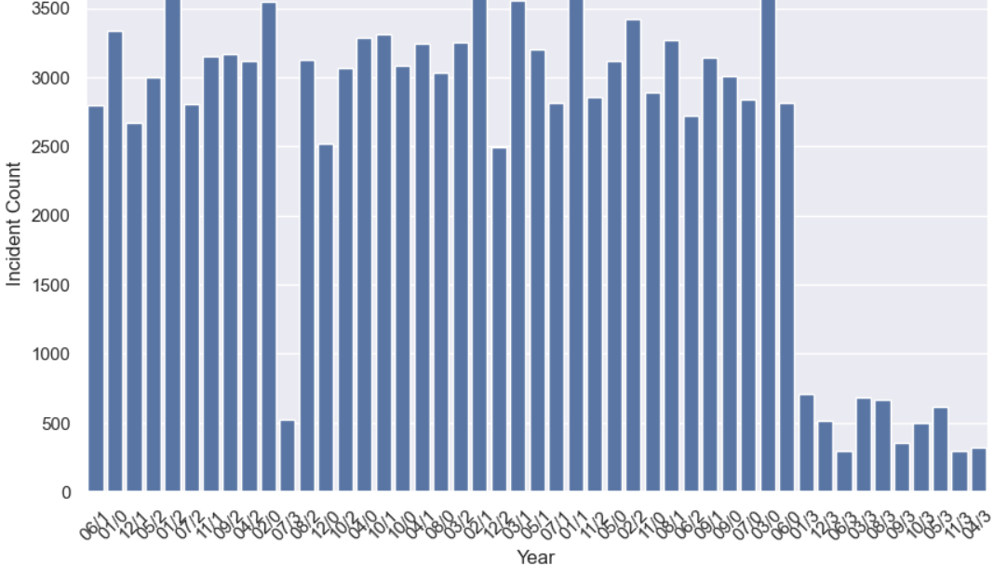
Count Plot of Incidents per year.

Slide 9
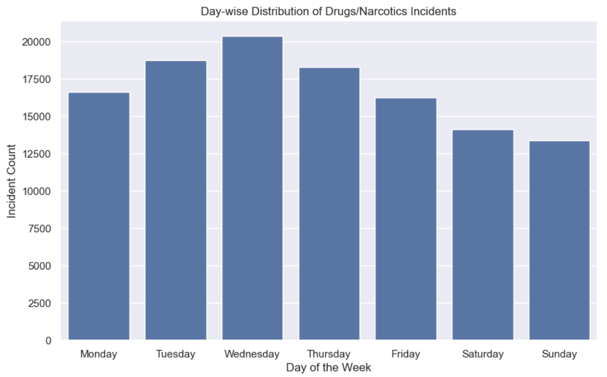
Day-wise distribution of incidents.

Slide 10
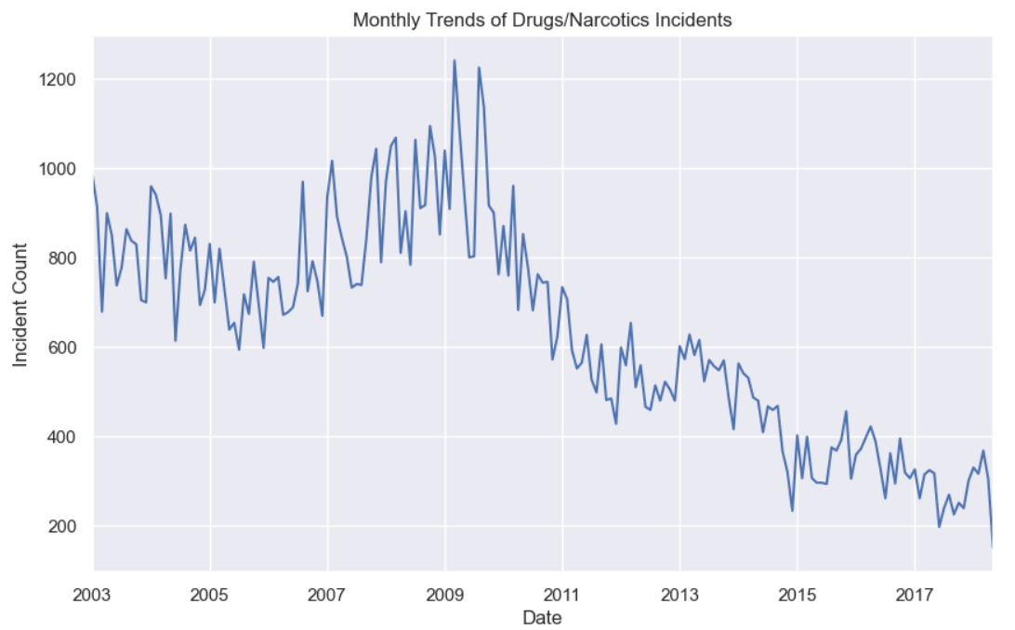
Monthly trends over the years.

Slide 11
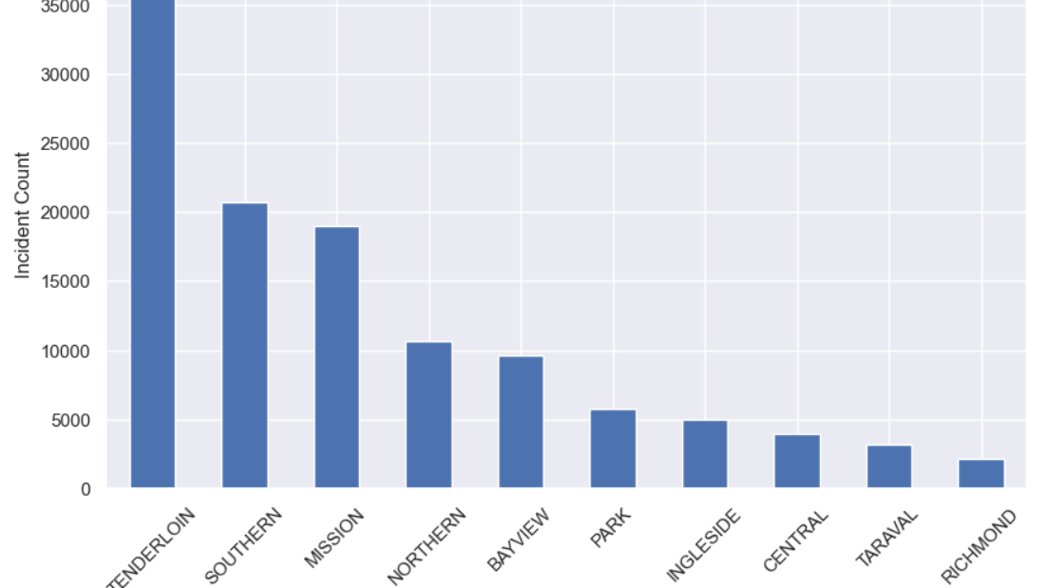
Top 10 districts with the highest number of incidents

Slide 12
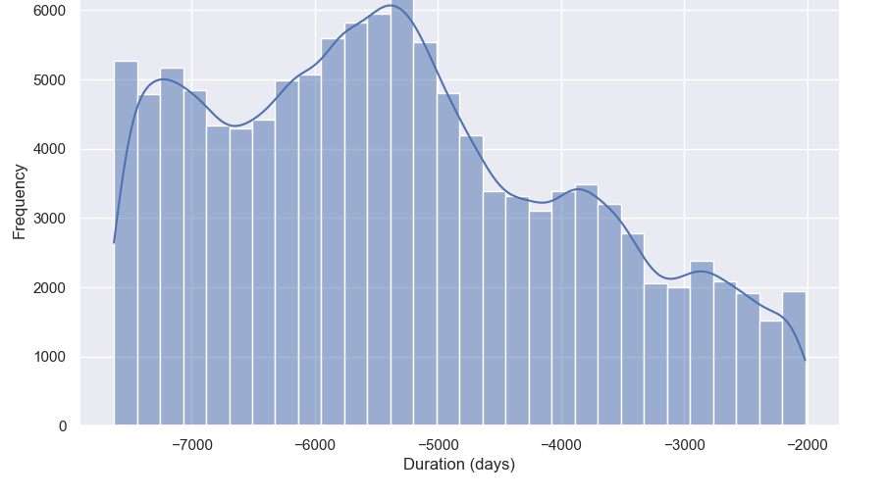
Duration between reported and occurred dates

Slide 13
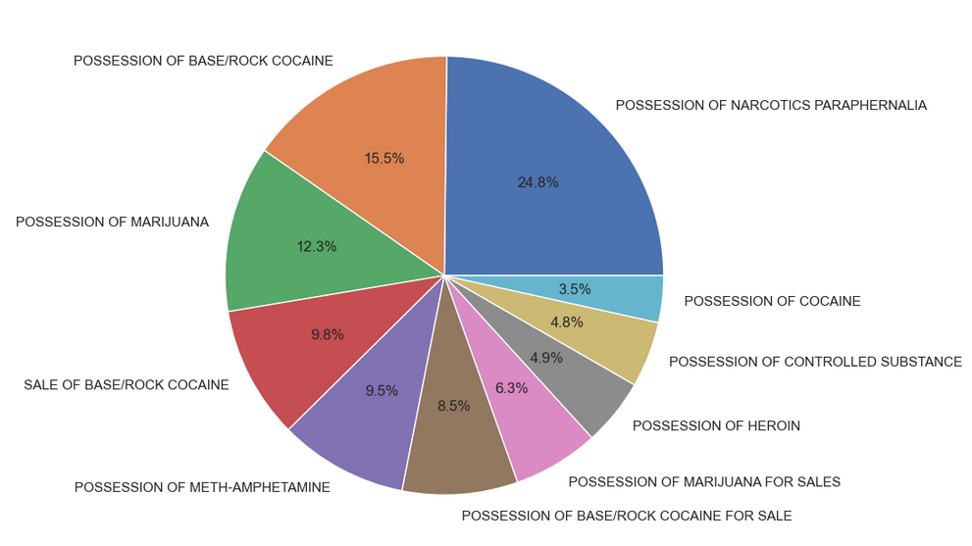
Pie chart of incident categories

Slide 14
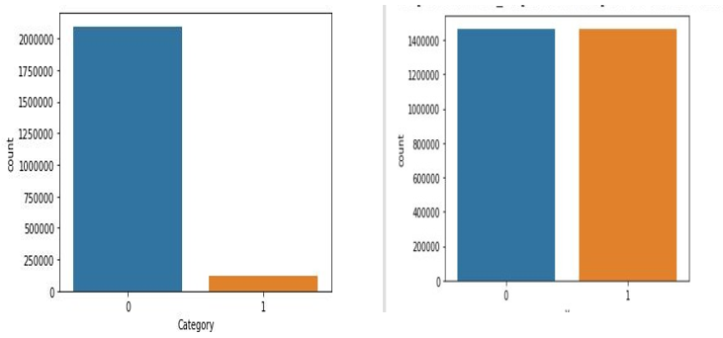
BINARY LOGISTIC REGRESSION MODEL
First, a Binary logistic regression model was used to predict drug-related crimes based on geo-coordinates, achieving a surprisingly high 94% accuracy. Detecting an imbalance in the target class, we addressed it by oversampling using SMOTE for more robust model training.

Slide 15
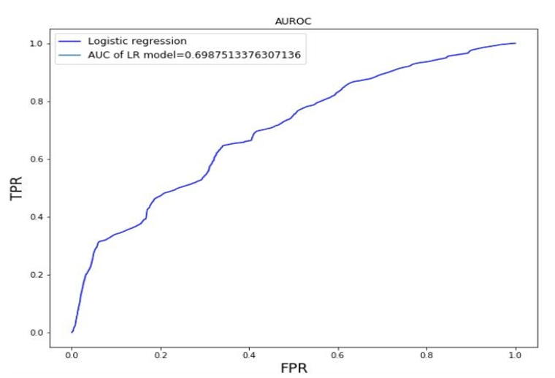
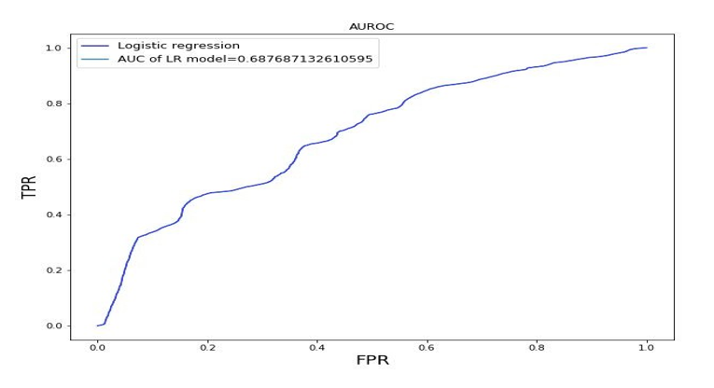
Area under the curve
To address unequal distribution, oversampling is preferred over under-sampling due to its ability to retain valuable data, with logistic regression finding significance. Synthetic Minority Oversampling Technique (SMOTE) stands out as an effective method, enhancing model generalization by considering characteristics in the vicinity of minority data points.

Slide 16
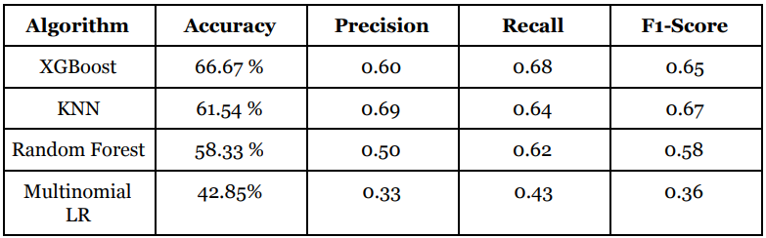
Resuls and evaluation.

Slide 17
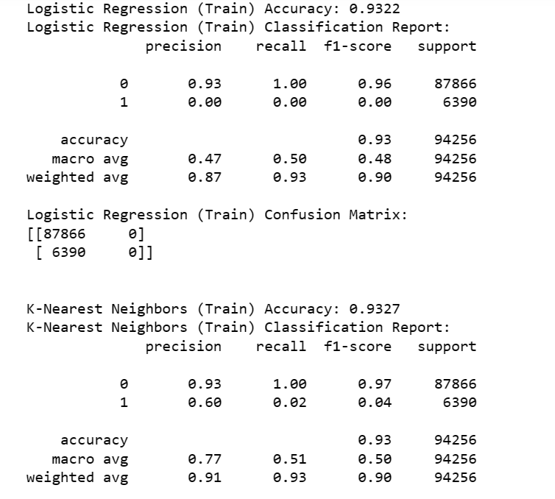
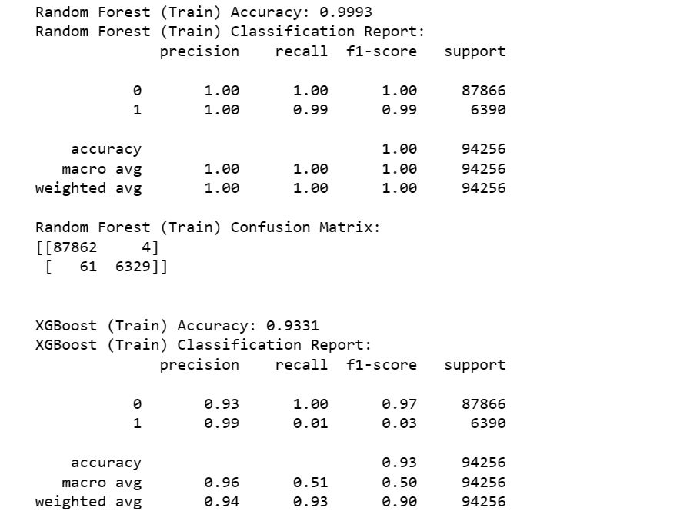
Training dataset:

Slide 18
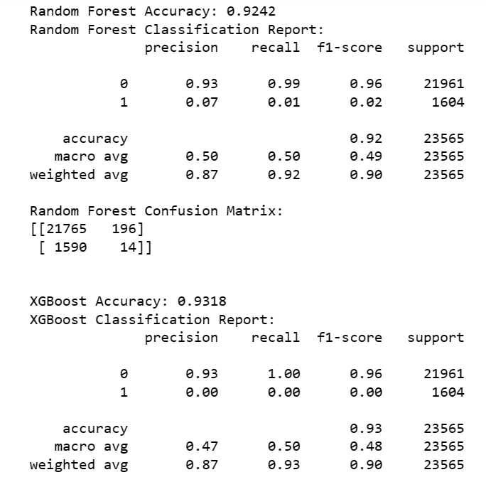
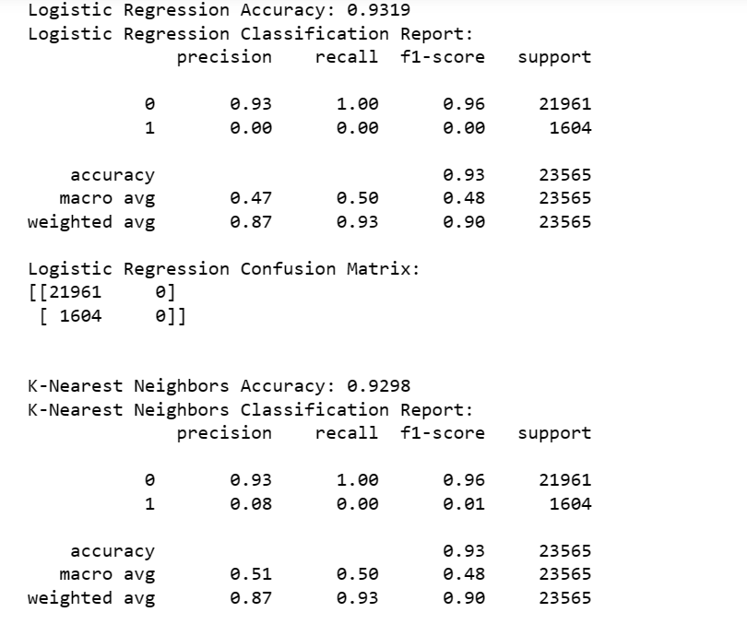
Testing dataset:

Slide 19
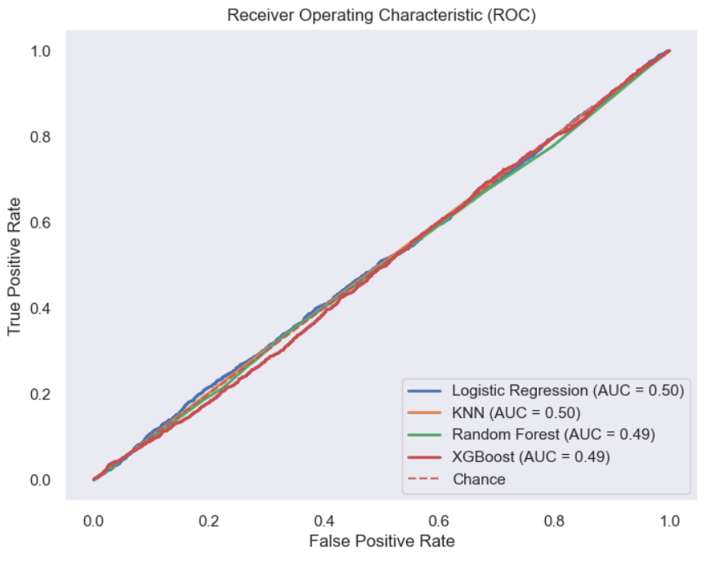
AS I TRAINED DATA WITHOUT OVERSAMPLING, GOT BETTER RESULTS:
The classifier demonstrates a tendency to correctly identify positive examples more often than it misclassifies negative examples but struggles to effectively distinguish between positive and negative examples, with potential influence from class imbalance in the data.

Slide 20
CONCLUSION:
In conclusion, the study on addressing the opioid epidemic in San Francisco has provided valuable insights. Through advanced analytics and machine learning, I identified high-risk areas, proposed Safe Injection Site locations, and predicted crime likelihood. Recognizing the limitations of Binary Logistic Regression, I transitioned to multi-class models like Random Forest and XGBoost, with XGBoost proving most effective. These findings underscore the importance of nuanced approaches in resource allocation to effectively combat the opioid crisis.

Slide 21

THANK YOU.

