Slide 1
Integration of Deep Learning Techniques for Enhanced Patient Diagnostics in Healthcare: Chest X-Rays
Data 606: Capstone Project
Professor: Dr.Chaojie Wang
Name: Harmankaranjit Singh Lohiya
ID: QO38890

Slide 2
Introduction & Objective:
Evolution of Medical Diagnostics
Life & Death situation
Role of Deep Learning in Medical Sciences
Enhanced Diagnosis of Deep Learning model CNN’s to improve the accuracy and Speed of diagnosis

Slide 3
Why Deep Learning Models?
Enhancing healthcare diagnostics using deep learning, especially CNNs, for precise, effective, and rapid disorder identification.
In healthcare, precise assessment is crucial. Conventional methods rely on experts, but AI, especially deep learning, offers automated, accurate diagnosis, revolutionizing healthcare outcomes and reducing costs significantly.

Slide 4
Research Questions:
What can be done to improve the precision and effectiveness of illness detection from medical images using deep learning techniques, particularly CNNs?
What current issues in medical diagnostics need to be addressed, and how may deep learning help?
What steps can we take to make sure that healthcare practitioners can understand and justify the predictions that deep learning models make and How can we do it with the current system?
How will integrating deep learning techniques affect the whole healthcare system, particularly in terms of patient outcomes and treatment effectiveness?

Slide 5
Data:
Data Source: Kaggle
Data Size: 2GB
DataSet Format : Image- JPEG,PNG Etc,.
Data TimeFrame: 10 years (2010-2020).
Data Category Division : Normal and Pneumonia Images

Slide 6
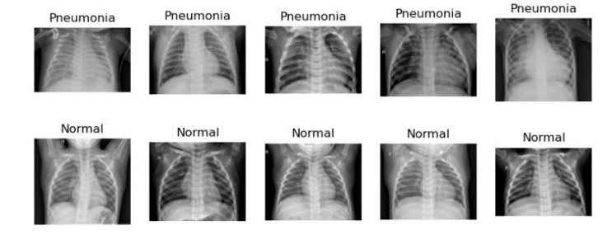
EDA:
Normal Lung X-Ray
Pneumonia Lung X-Ray

Slide 7
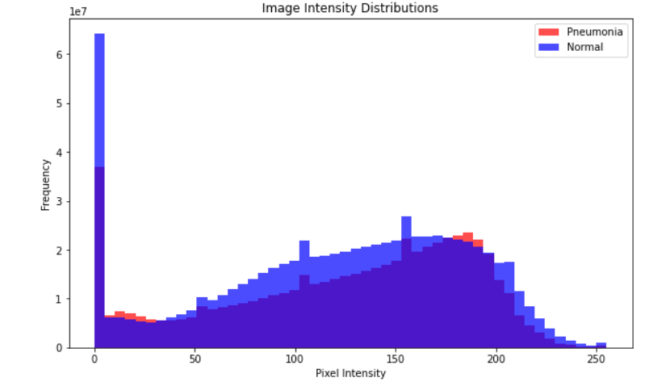
EDA:

Slide 8
ML Model: CNN
Convolutional neural network with Keras API
CNN excels in chest X-ray classification, leveraging hierarchical structure for precise feature extraction, enhancing diagnostics.
We split the data in 80-20 Ratio.

Slide 9
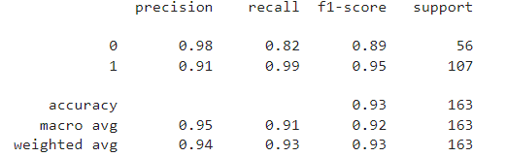
ML Model:
Precision represents the accuracy of the positive predictions.
Recall (sensitivity) represents the ability to correctly identify positive instances.
F1-score is the harmonic mean of precision and recall.
Support helps us understand the distributions of classes in the dataset and also model performance of each class.

Slide 10
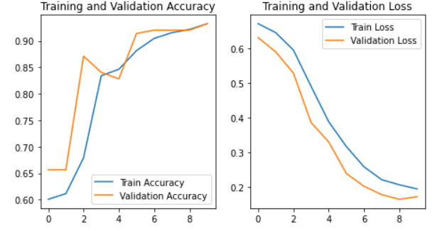
ML Model:

Slide 11
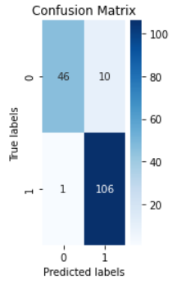
ML Model: Confusion Matrix
Confusion Matrix provides a summary of the model's performance by showing the number of true positives, true negatives, false positives, and false negatives.
True Negative (TN): 46
False Positive (FP): 10
False Negative (FN): 1
True Positive (TP): 106

Slide 12
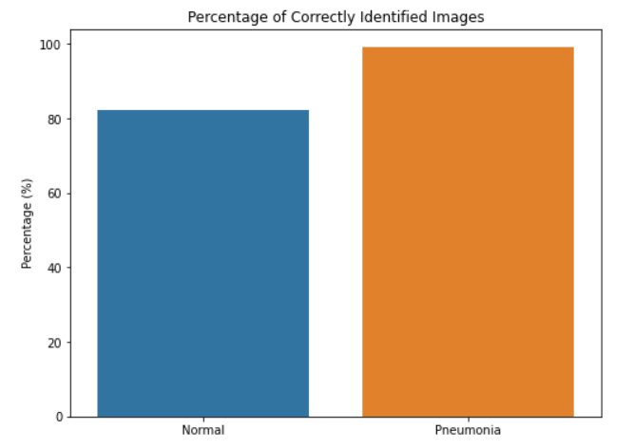
ML Model: Prediction Bar Graph

Slide 13
Lessons Learned:
We have emphasized the importance of data quality and preprocessing in determining how well deep learning model function.
The significance of model evaluation to receive a whole picture of the model's performance, including precision, recall, and F1 score in addition to measures like accuracy.
Deep learning's promise and skills to revolutionize medical diagnosis

Slide 14
Web Application
STREAMLIT

Slide 15
Thank you!

