Slide 1
Household Garbage Classification for Recycling
Subject: Data 606 (Capstone Project) Professor: Chaojie Wang Presenter: Alekhya Narala

Slide 2
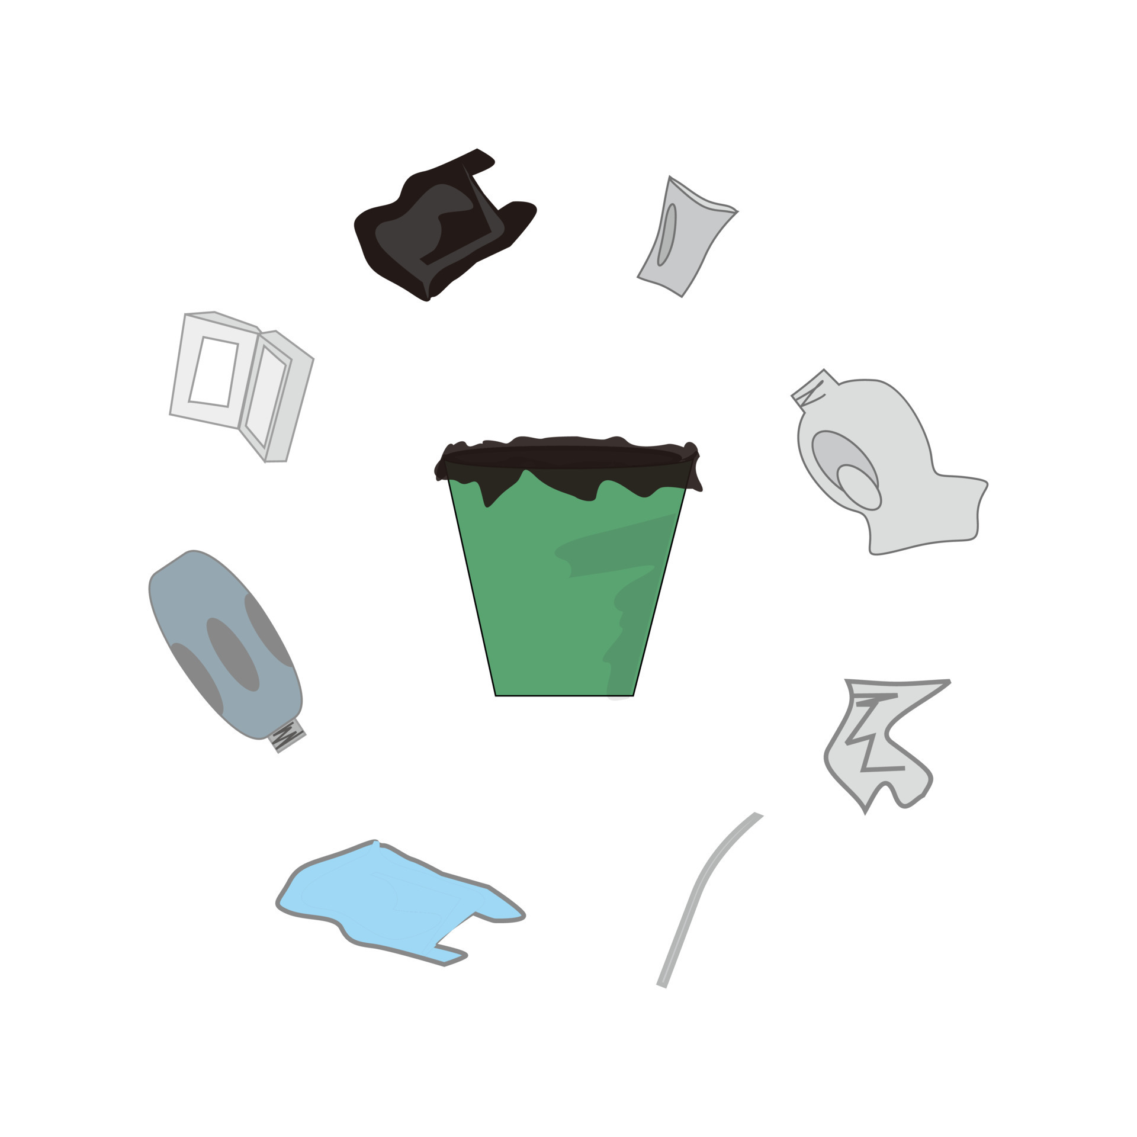
INTRODUCTION
The household garbage classification for recycling project aims to revolutionize waste management through machine learning techniques. With an emphasis on environmental sustainability and waste optimization, this initiative seeks to enhance recycling processes by accurately categorizing household waste. By leveraging image classification models, the project aims to streamline recycling efforts, reduce environmental impact, and promote responsible waste disposal practices.

Slide 3

RESEARCH QUESTIONS
Effectiveness of Image Classification
Real-world Application
Image Resolution and Classification
Transfer Learning

Slide 4

DATASET
Data Sources
https://www.kaggle.com/datasets/mostafaabla/garbage-classification?resource=download
Data Shape
Data Dictionary
Data Size
Image_ID
Image
Category
Image_Size
251 Mb
Contains 15k .jpg files

Slide 5
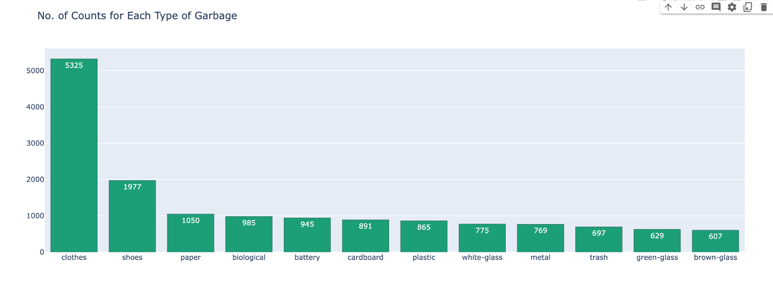
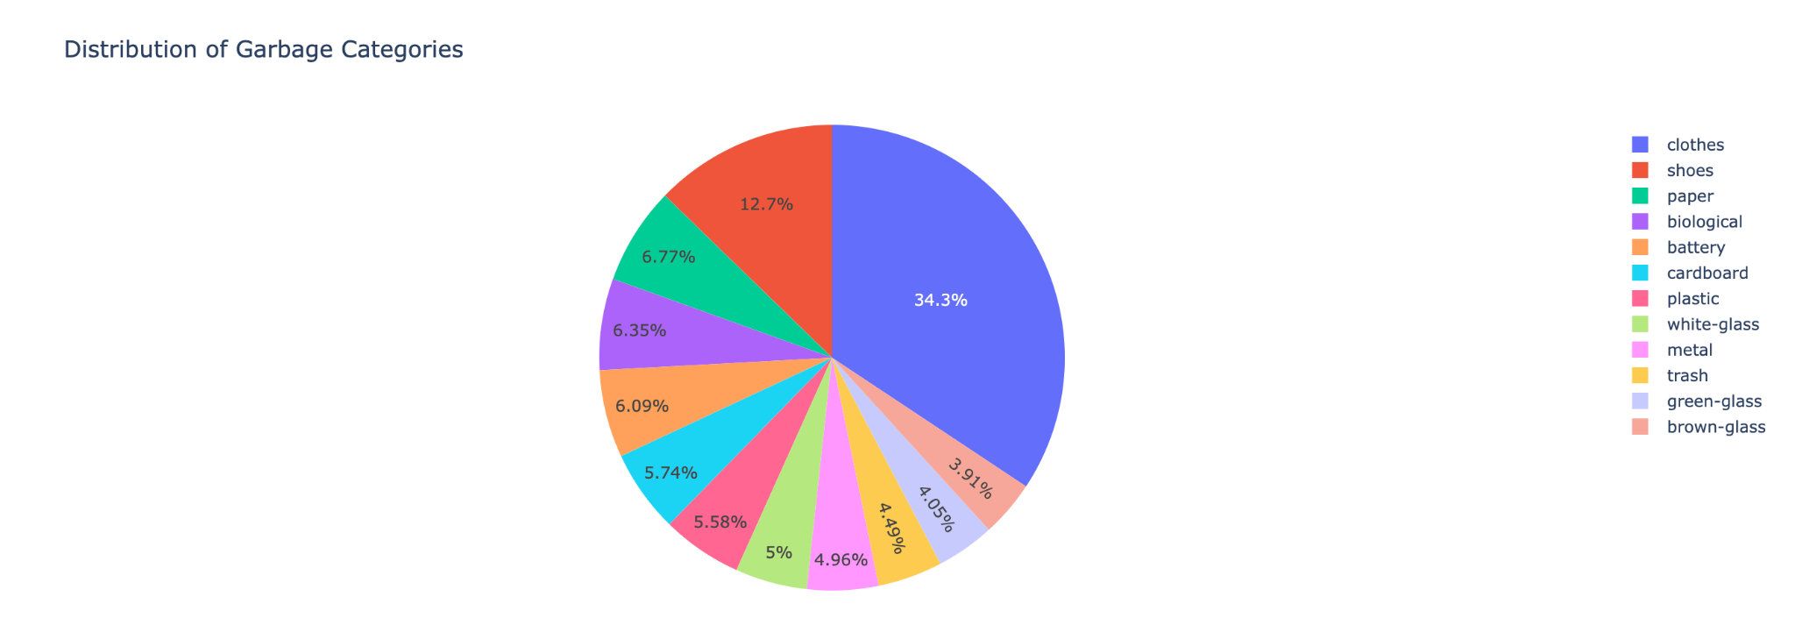
EDA

Slide 6

USING ML MODELS
VGG16: A deep convolutional network known for its simplicity and depth, VGG16 likely played a crucial role in your project for its ability to effectively capture image features, making it suitable for classifying detailed image data like garbage photos.
VGG19: An extension of VGG16 with more layers, VGG19's increased depth may have provided enhanced feature extraction capabilities, potentially leading to more accurate classifications in your image dataset.
DenseNet: With its unique densely connected layers, DenseNet in your project would have offered efficient feature propagation and reuse, possibly improving model accuracy and reducing the risk of overfitting on your image data
Resnet50: Known for its residual learning framework, Resnet50 might have been particularly useful in your project for avoiding the vanishing gradient problem in deep networks, thereby ensuring effective learning even with complex image classifications.

Slide 7
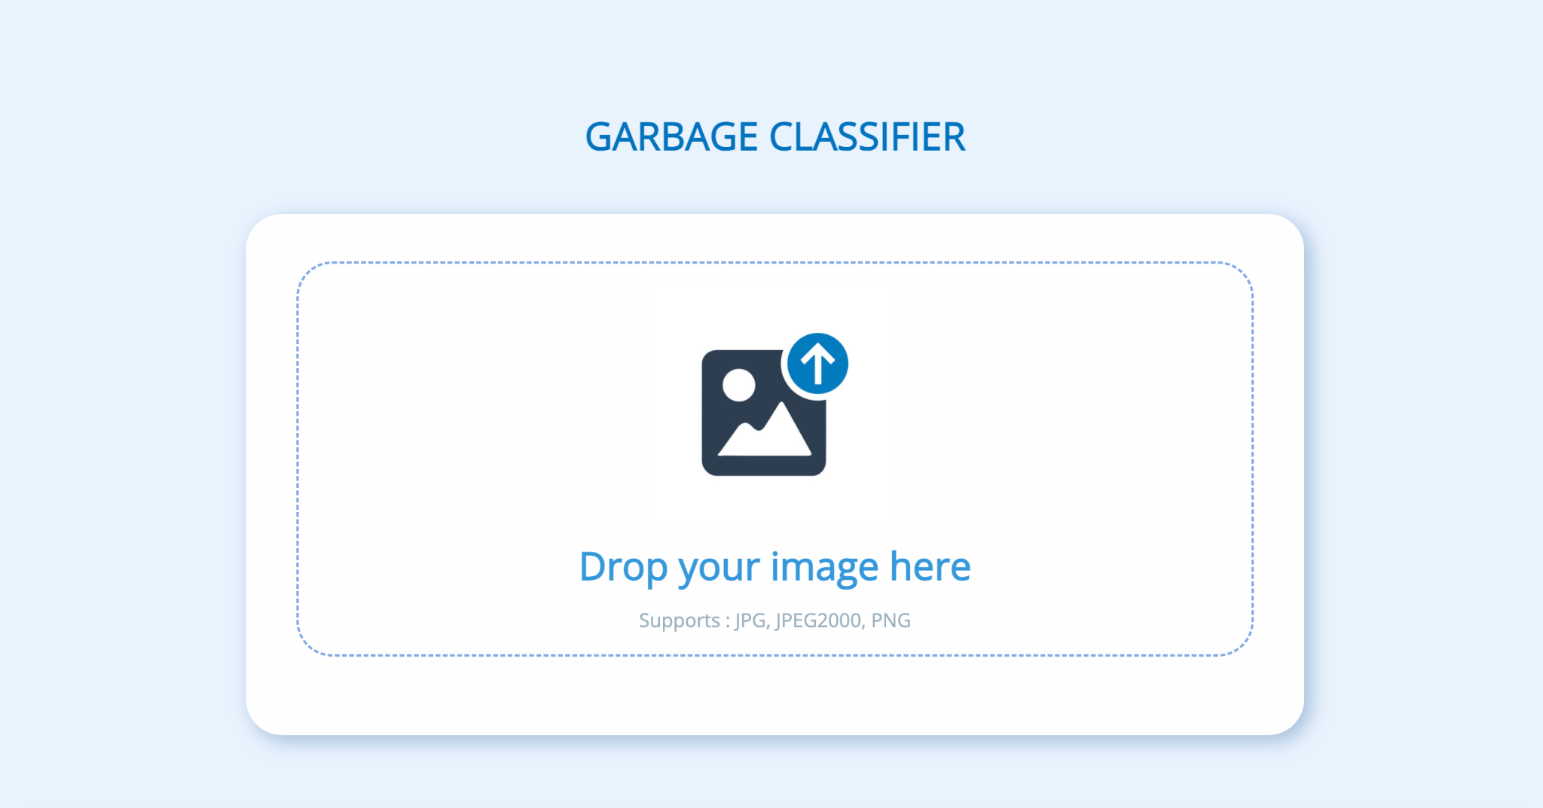
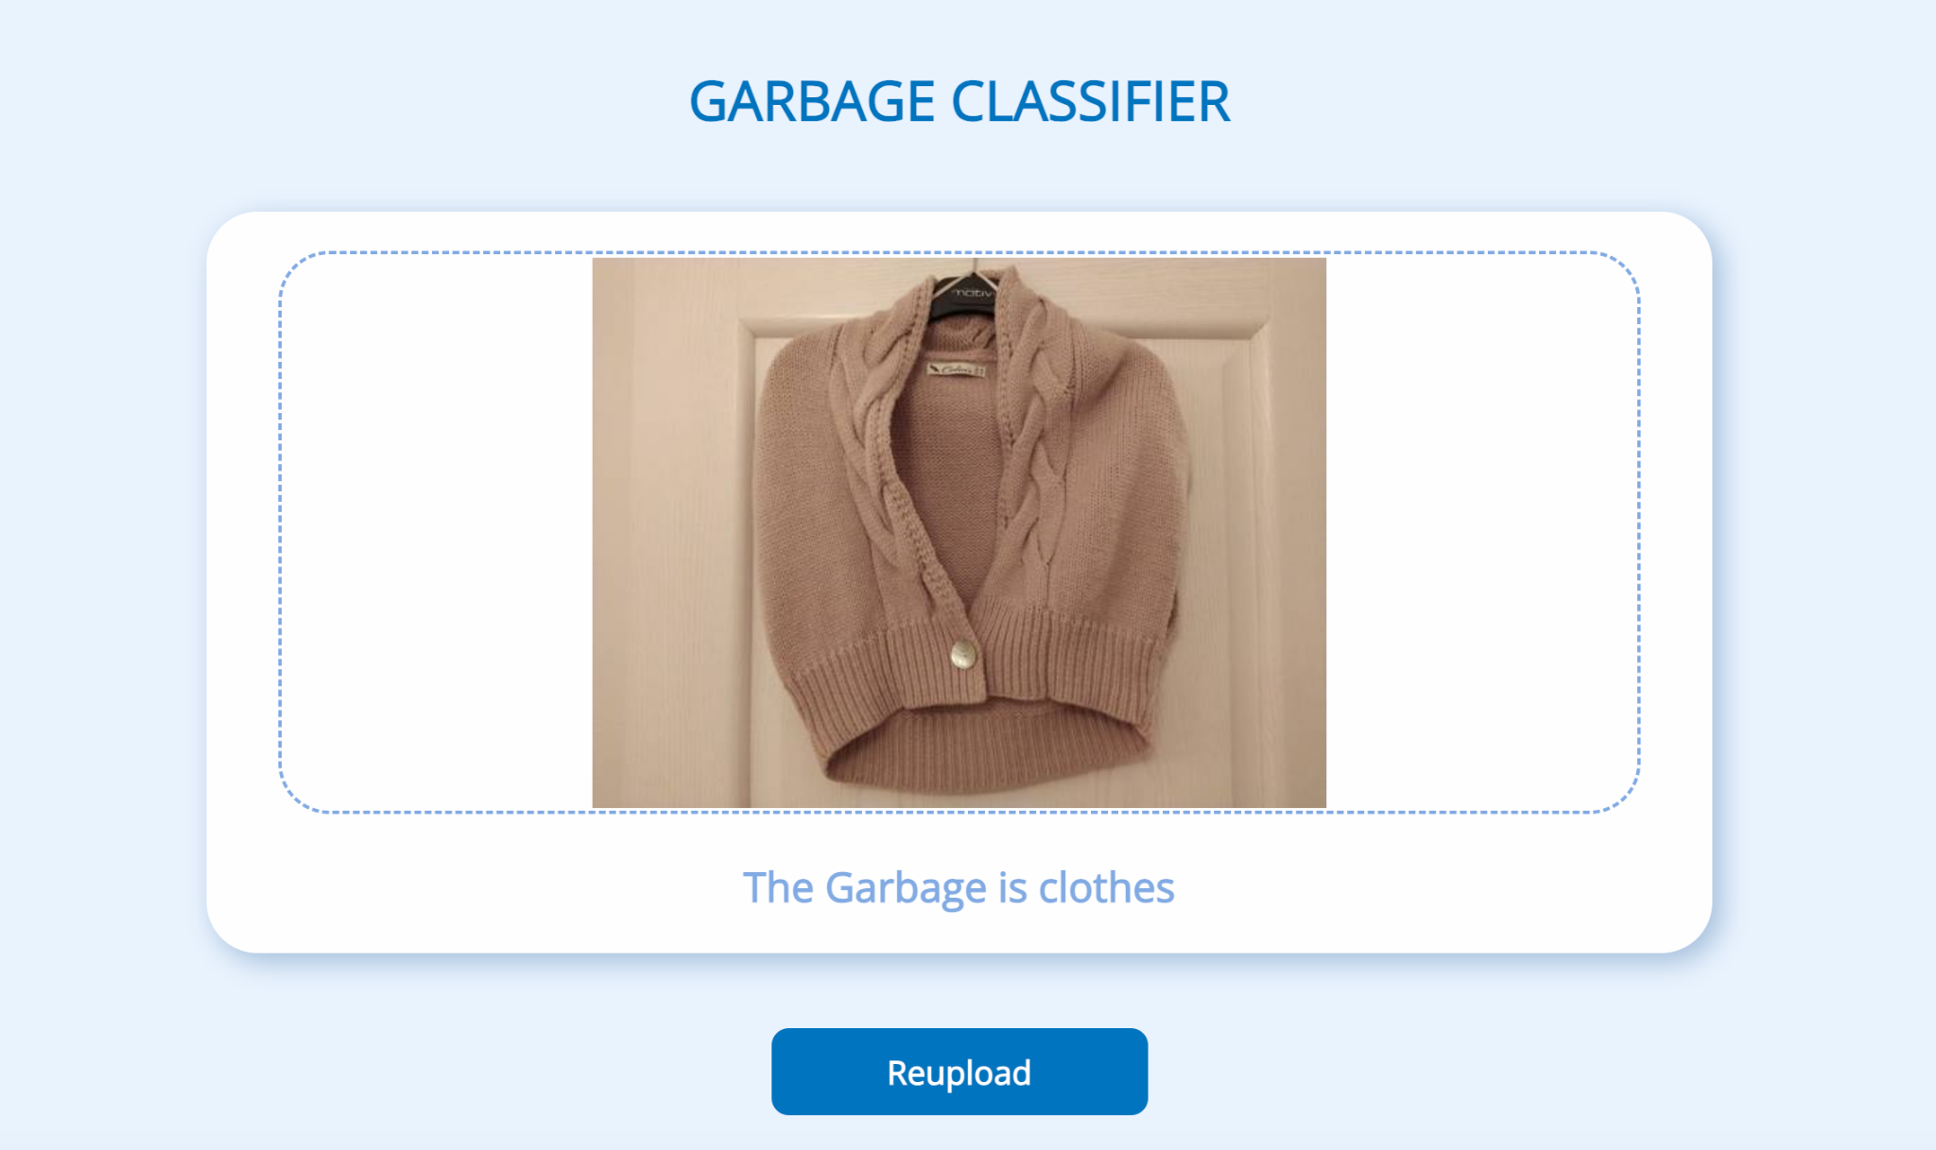
WEB PAGE

Slide 8

FUTURE SCOPE
Data Augmentation: Exploring data augmentation techniques to increase the diversity of the training dataset, potentially improving the model's ability to generalize.
Model Optimization: Investigating ways to optimize these deep learning models for better performance and efficiency.
Real-world Testing: Applying the models in real-world scenarios for further validation and to understand practical challenges.
Exploring New Architectures: Experimenting with emerging neural network architectures or custom models tailored for specific types of waste images.

Slide 9
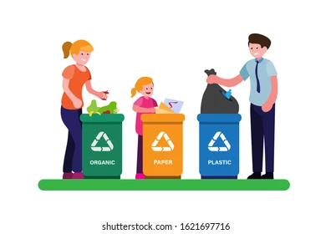
CONCLUSION
In summary, this project represents a crucial step in revolutionizing waste management through machine learning.
By addressing key research queries and deploying advanced image classification models, our project aims to streamline household garbage sorting for more effective recycling. This initiative contributes to a sustainable future by reducing environmental impact and promoting responsible waste disposal practices.
The outcomes and methodologies presented herein set the stage for ongoing advancements in waste management, signaling a promising path towards a greener, more efficient tomorrow.

Slide 10
THANK YOU

