Slide 1
InspectionGuard - Predictive Analytics for Food Safety
Improving Public Health through Efficient Inspection Resource Allocation
Abhishek Thamatam
TF53379

Slide 2
Problem
Food safety is a critical public health concern affecting millions globally.
Traditional health inspections often fall short in ensuring the constant safety of food served in restaurants.
Inefficiency of Traditional Inspections
Impact on Public Health
Notes:
Inefficiency of Traditional Inspections:
Traditional inspections are time-consuming and may not occur frequently enough to prevent potential issues.
Resource allocation for inspections is often not optimized, leading to inefficiencies.
Impact on Public Health:
Foodborne illnesses continue to pose a significant threat to public health.
Immediate intervention is crucial to mitigate risks and protect consumers.

Slide 3
Solution - InspectionGuard
Solution:
Utilizing predictive modeling to revolutionize health inspections.
Allocation of inspection resources based on data-driven risk assessments.
Early identification of establishments at higher risk, leading to improved public health outcomes.
Objectives:
Resource Allocation
Early Intervention
Public Health Improvement
Notes:
A need for a proactive approach led to the development of InspectionGuard, leveraging data science and machine learning.
Objectives:
Resource Allocation:
Optimize inspection resources by prioritizing high-risk establishments.
Ensure effective utilization of limited resources for enhanced outcomes.
Early Intervention:
Identify establishments with a higher likelihood of violations.
Enable health departments to intervene early, ensuring compliance with food safety regulations.
Public Health Improvement:
Reduce the incidence of foodborne illnesses and related hospitalizations.
Contribute to a healthier community through proactive food safety measures.

Slide 4
InspectionGuard Dataset Overview
Data sources: NYC OpenData Dataset link
Data size: 92 MB
Data shape: # of rows - 205K and # columns - 27
Time period: 2014 - 2023
Each row represent - Inspection values(Restaurant Citations)
Target Variable: CRITICAL FLAG
Notes:
Target Variable:
CRITICAL FLAG:
A crucial classification variable indicating the nature of violations (Critical/Non-Critical/Not Applicable).

Slide 5
Preparing & Transforming Data for Predictive Modeling
Data Cleaning Process: Null Values Handling, Duplicate Rows
Selected Columns: Focused on Relevant Features, Dropped Columns
Impact of Cleaning: Data Size Reduction - Reduced to 64,658 rows
Transformation Steps:
Filtering
Mapping
Extraction
Notes:
Note:
"Effective data cleaning is the foundation of successful predictive modeling. By addressing null values, removing duplicates, and focusing on relevant features, I've prepared the dataset for accurate and meaningful insights."
Data Cleaning Process:
Null Values Handling:
Identified and addressed null values in crucial columns.
Dropped rows with null values to maintain data integrity.
Duplicate Rows:
Detected and removed duplicate entries.
Ensured the dataset's accuracy by eliminating redundant information.
Selected Columns:
Focus on Relevant Features:
Streamlined the dataset for predictive modeling.
Selected key columns based on domain knowledge and data understanding.
Dropped Columns:
'BUILDING,' 'STREET,' 'PHONE,' 'Community Board,' and others were dropped.
Decision based on domain knowledge and the absence of meaningful information.
Data Size Reduction:
Impact of Cleaning:
Original dataset: 204,779 rows.
After cleaning: Reduced to 64,658 rows.
Preparation for Modeling:
Clean and Focused Data:
Ensured a well-prepared dataset for subsequent predictive modeling.
Eliminated noise and irrelevant information.
Note:
"Data transformation plays a pivotal role in creating a dataset tailored for predictive insights. Filtering, mapping, and extraction have refined our data, setting the stage for accurate and meaningful modeling."
Transformation Steps:
Filtering:
Removed rows with 'Not Applicable' values in the target variable.
Ensured a clear classification for predictive modeling.
Mapping:
Converted Yes/No and types of violations into numeric values.
Facilitated easier interpretation for machine learning algorithms.
Extraction:
Extracted Month and Year from the 'Inspection Date.'
Enhanced the dataset with additional temporal features for better analysis.
Importance of Feature Engineering:
Enhanced Predictive Power:
Leveraged feature engineering to create more relevant input for models.
Extracted meaningful information from existing data.
Focused Dataset:
Transformation Impact:
Reduced noise and irrelevant information.
Enhanced the dataset's suitability for predictive modeling.
Preparation for Modeling:
Structured Data:
Transformed data to align with specific requirements for predictive modeling.
Optimized dataset for improved model performance.

Slide 6
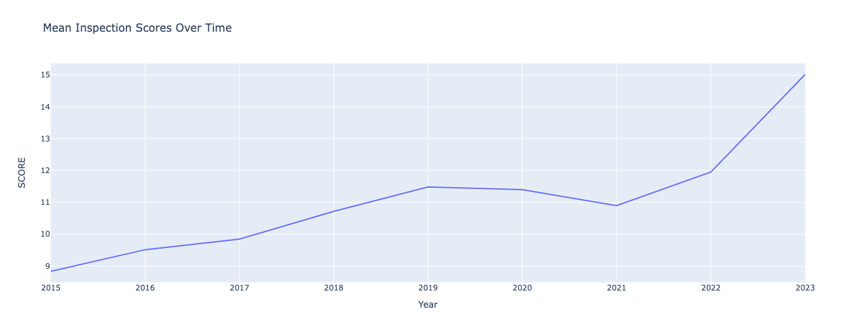
Unveiling Insights through Data Exploration
Notes:
"Exploratory Data Analysis has unveiled patterns and trends in our dataset. Insights from time series analysis, inspection score distributions, and borough-wise comparisons provide a foundation for our predictive modeling."
Revealed an overall increase in inspection scores over the years.
Indicated potential improvements in food safety practices.

Slide 7
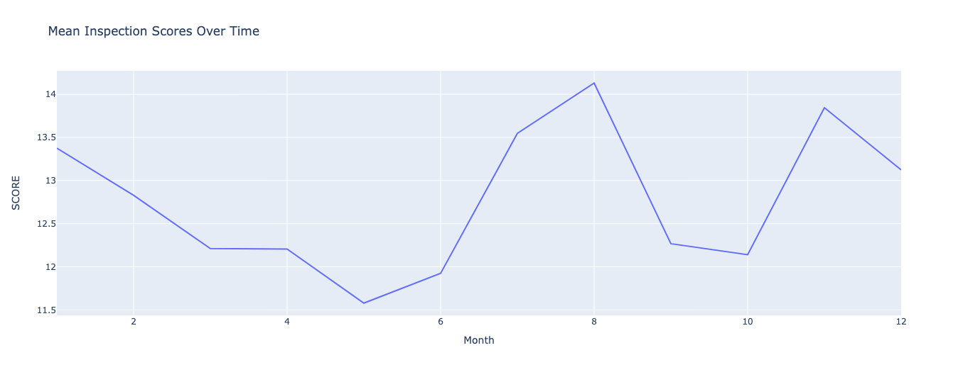
Notes:
Displayed monthly variations in inspection scores.
Peaks in August and dips in May suggested seasonal patterns.

Slide 8
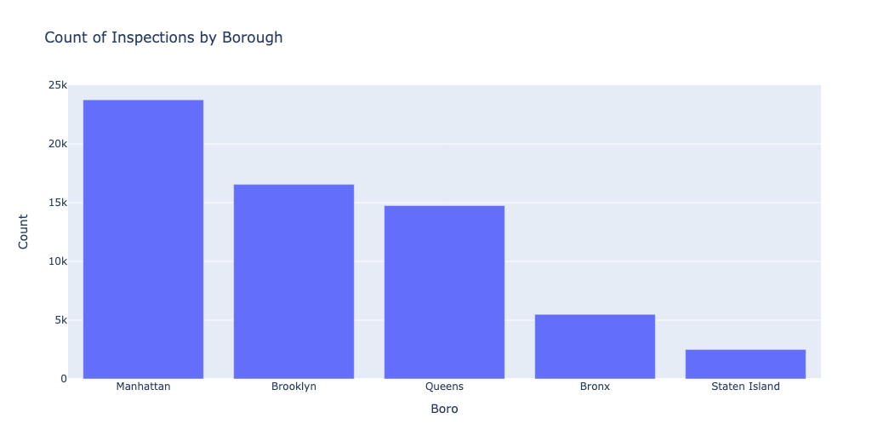
Notes:
Highlighted the varying number of inspections in different boroughs.
Manhattan leading, followed by Brooklyn, Queens, Bronx, and Staten Island.
The lowest number of inspections happen in Staten Island(which is almost 1/10th of Manhattan).

Slide 9
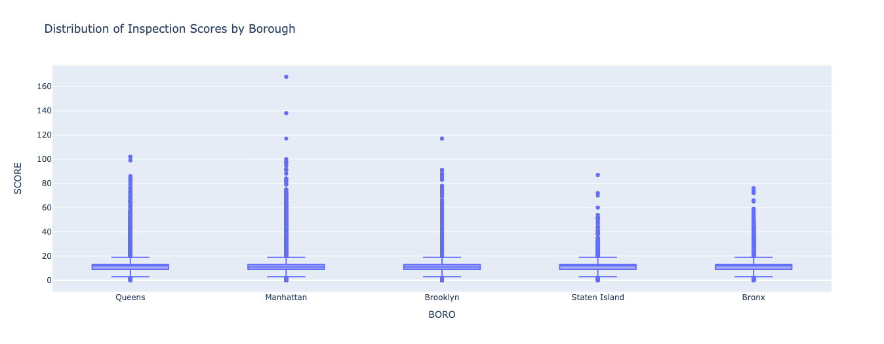
Notes:
Mean Scores in Each Borough:
Displayed the mean inspection scores across different boroughs.
Showed relatively consistent mean scores across boroughs.
The mean score is approximately the same in each borough.

Slide 10
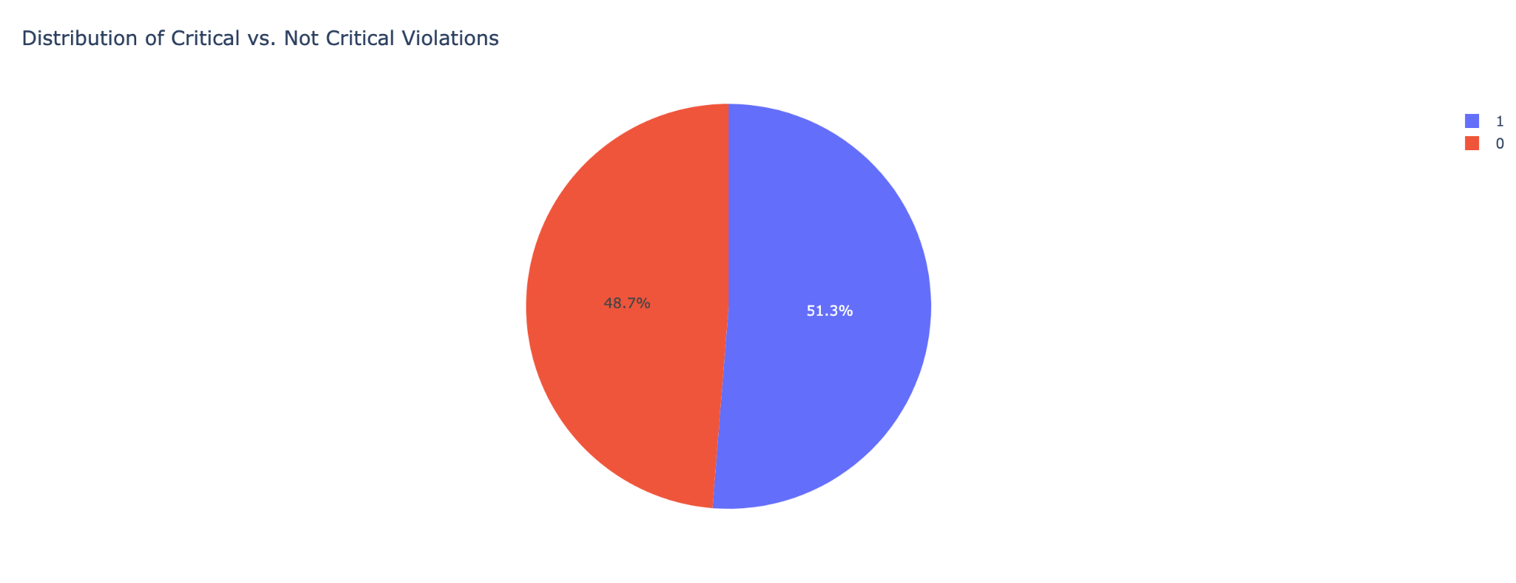
Notes:
This pie chart displays the proportion of critical and non-critical violations in your dataset.We have an almost equal number of critical and noncritical violation data in our cleaned data set.

Slide 11
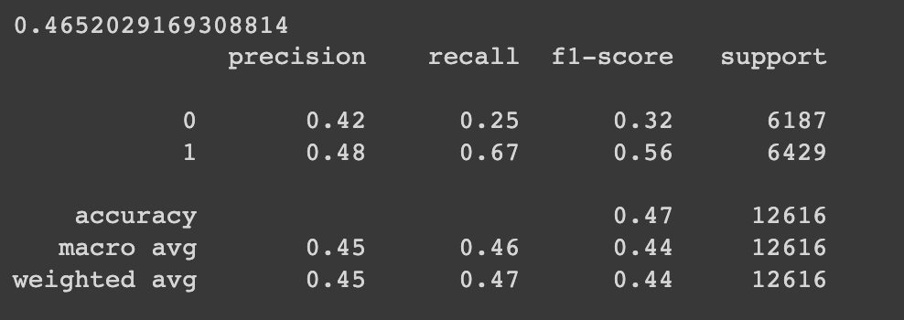
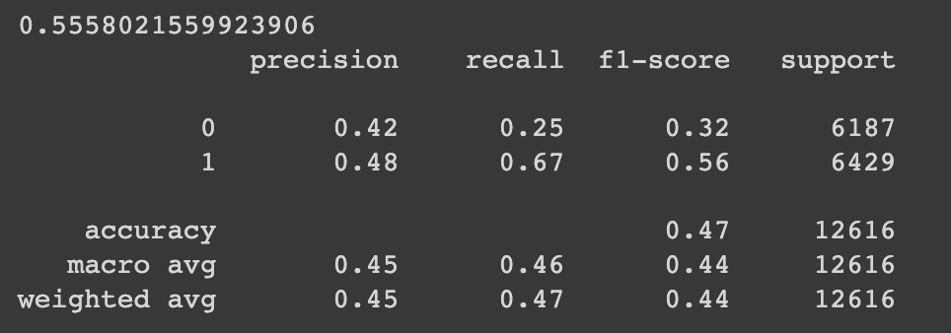
Predictive Modeling for Health Inspection Outcomes
Random Forest Model (RF):
Logistic Regression Model:
Decision Tree Model: 45.39%
XGBoost Model: 53.28%
Notes:
Note:
"Our predictive models showcase varying degrees of accuracy. Logistic Regression stands out, while ensemble methods and decision trees offer unique strengths. Further exploration includes additional metrics and feature importance analysis."
Random Forest Model (RF):
Accuracy: 46.52%
Strengths:
Robust handling of complex relationships in data.
Solid baseline performance.
Considerations:
Moderate accuracy compared to other models.
Logistic Regression Model:
Accuracy: 55.58%
Strengths:
Simplicity and efficiency in binary classification.
Outperformed other models in accuracy.
Considerations:
Excellent accuracy but may not capture complex relationships.
Decision Tree Model:
Accuracy: 45.39%
Strengths:
Interpretable and visually clear decision-making.
Identifies important features.
Considerations:
Lower accuracy compared to other models.
XGBoost Model:
Accuracy: 53.28%
Strengths:
Ensemble learning for efficiency.
Balances bias-variance trade-off.
Considerations:
Moderate accuracy, falls between Random Forest and Logistic Regression.
Insights:
Logistic Regression Outperforms:
Logistic Regression emerged as the most accurate model in our analysis.
Ensemble Methods Show Promise:
Random Forest and XGBoost provided competitive results, leveraging ensemble learning.
Decision Tree's Interpretability:
Decision Tree, while less accurate, offers interpretability in decision-making.

Slide 12
User-Friendly Insights with Streamlit
Demonstration of Web App using Streamlit
Notes:
"The integration of Streamlit brings our predictive insights to life, providing a user-friendly platform for stakeholders to explore and understand health inspection outcomes in real-time."
Rapid Prototyping:
Streamlit enables rapid development and prototyping of data applications. With minimal code, users can turn data scripts into shareable web apps.
Pythonic Syntax:
Since it is built on Python, Streamlit leverages a Pythonic syntax that is fNo Web Development Expertise Required:
Users don't need extensive web development skills to create powerful and interactive web applications. Streamlit abstracts away many complexities of web development.
amiliar to many data scientists and machine learning practitioners.
Wide Range of Widgets:
Streamlit provides a variety of widgets for user input, including sliders, buttons, and text inputs. These widgets make it easy to create interactive elements in the app.
Integration with Data Science Libraries:
Streamlit seamlessly integrates with popular data science libraries and frameworks such as Pandas, Matplotlib, Plotly, and more, making it convenient for data analysis and visualization.

Slide 13
Conclusion - Transforming Food Safety with InspectionGuard
Call to Action
Key Findings
Model Insights
Improving Accuracy
Next Steps
Notes:
Call to Action:
"InspectionGuard is more than a predictive modeling project; it's a step toward proactive food safety practices. As we move forward, the commitment to enhancing public health remains at the forefront. Let's continue this journey together."
Key Findings:
Highlighted the significance of predictive modeling in revolutionizing health inspections.
Explored factors influencing inspection outcomes and efficient resource allocation.
Model Insights:
Logistic Regression emerged as the most accurate model, providing a strong foundation for predictive analytics.
Ensemble methods and Decision Trees showcased unique strengths, contributing to the overall predictive power.
Web App Impact:
Introduced a user-friendly web app powered by Streamlit.
Democratized access to predictive insights, fostering informed decision-making for health departments and restaurant owners.
Achievements:
Successful data cleaning and transformation laid the groundwork for accurate predictive modeling.
Explored trends through exploratory data analysis, providing valuable insights into inspection outcomes.
Next Steps:
Further exploration of metrics, including precision, recall, and F1-score.
Feature importance analysis to identify critical factors influencing predictions.
Ongoing refinement and optimization through hyperparameter tuning.

Slide 14
Thank You!!

