Slide 1


Data Science Capstone: Using Regression to Predict Wine Price
Presented By: Steph Zhang
This Photo by Unknown Author is licensed under CC BY-ND

Slide 2
Background
Wine Enthusiast is a very popular magazine for wine consumers, ranging from the curious consumer to the master sommelier.
Wine is important because it has a lot of significance in many different cultures around the world.
Many people enjoy and consume wine, making this a highly desirable commodity.
In the interest of the wine consumer, I would like to analyze wine reviews to predict its purchase price.

Slide 3
Structure & Artifacts
GitHub Repository Link: https://github.com/DATA-606-FALL-2022/Steph_Zhang_Capstone
Contains:
- Markdown files of initial proposal and final report
- All Jupyter notebooks (EDA, Machine Learning)
- Data File Link
- PowerPoint Presentation
- Video Link

Slide 4
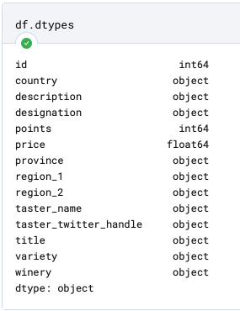
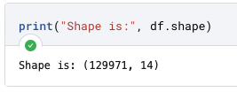
Exploratory Data Analysis

Slide 5
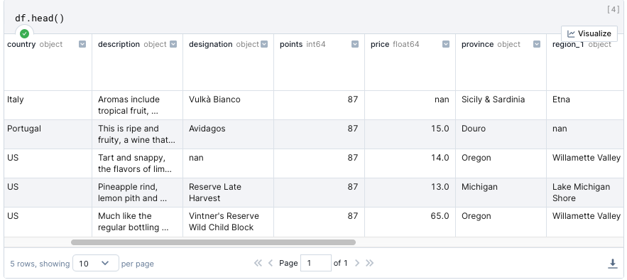

Slide 6
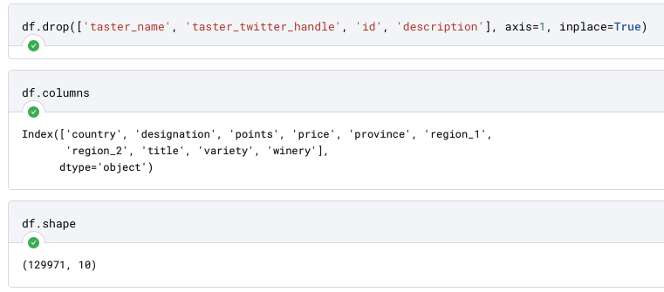
Data Cleaning

Slide 7
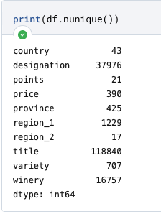
Number of Unique Values for Categorical Variables

Slide 8

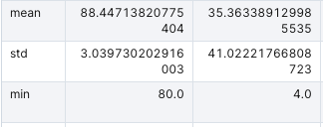
Descriptive Takeaways
Price range is $4 to $3300.
Average price is $35.
Average review is 88 points.

Slide 9
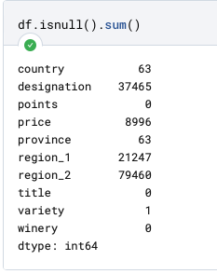
Number of Missing Values
We lose too much data (it becomes 34k rows) if I were to drop rows with nulls.
Thus, for machine learning, we will impute missing values for independent variables and only drop rows that are missing price.

Slide 10
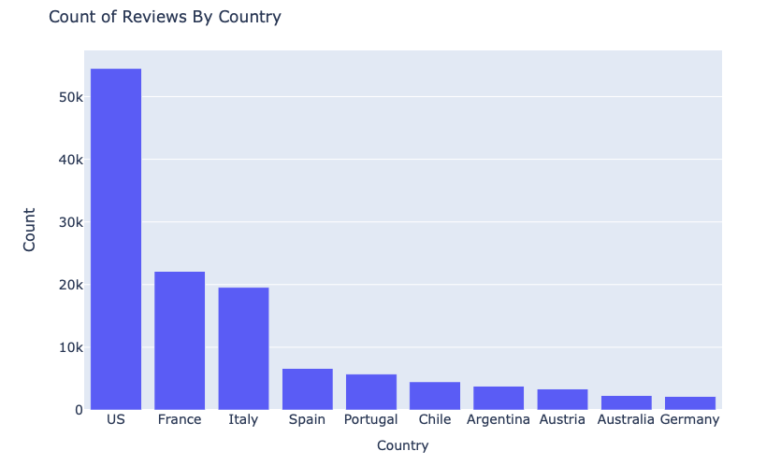

Slide 11
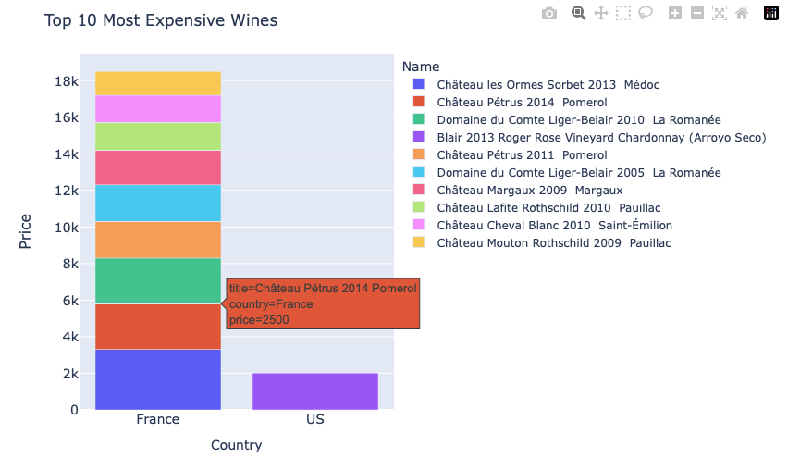

Slide 12
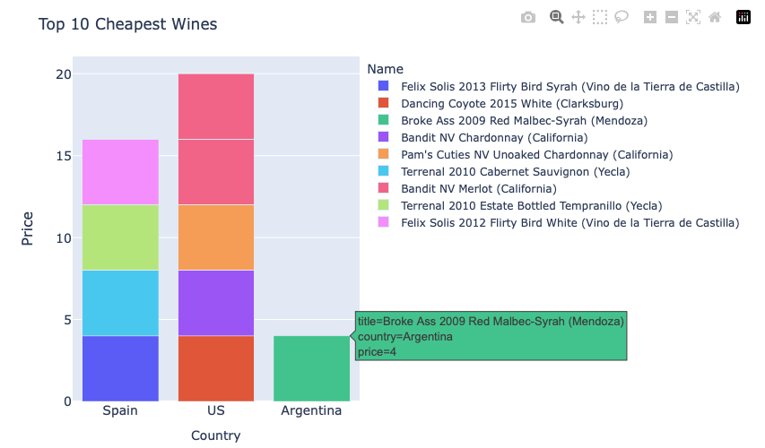

Slide 13
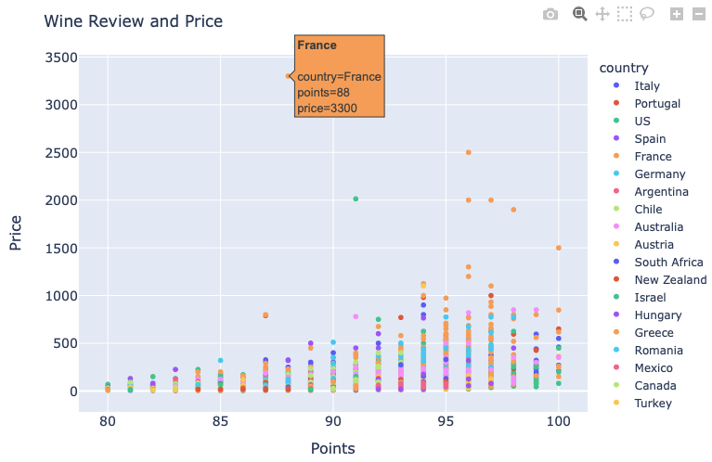
Do higher reviews lead to higher price? What kind of relationship do they have?
This implies yes, but up to around 500 dollars. After 500 dollars the positive relationship plateaus.
Limitation: The points appear to be structured; they are uniformly distributed a few points apart.

Slide 14
Machine Learning: Simple and Multivariate Linear Regression
As discussed earlier, there are a lot of missing values.
If I dropped all rows with nulls, data set will reduce to 34K rows.
Shape of original dataset →

Slide 15
Independent and Dependent Variables
Target variable is the wine price.
Predictive features include country, designation, points, province, region_1, region_2, title, variety, and winery.
Features that will not be used include id, description, taster_name, and taster_twitter_handle.

Slide 16
Handling Nulls
For categorical independent variables, we will impute missing values with the most frequent value.
Points is the only numerical independent variable, so we will impute with the mean.
Drop rows missing the target variable Price.

Slide 17
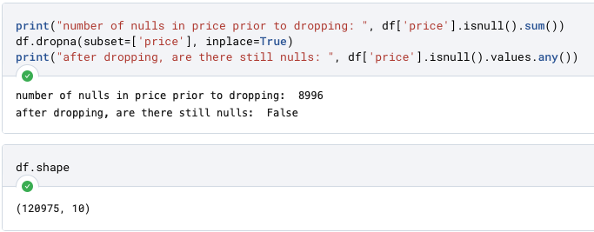

Slide 18
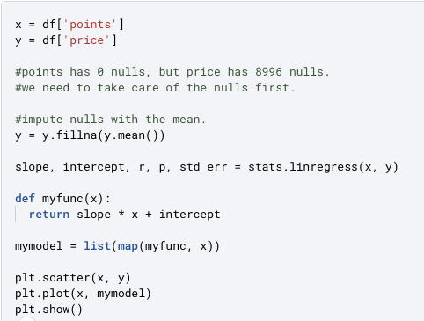
Simple Linear Regression

Slide 19
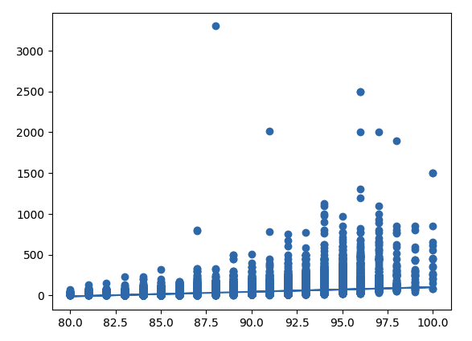

Slide 20

R Coefficient
With a correlation coefficient of .4, this shows a slight positive relationship.
This is not the best relationship but is still decent considering there is only one independent variable.

Slide 21
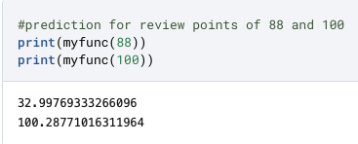
Example Predictions

Slide 22
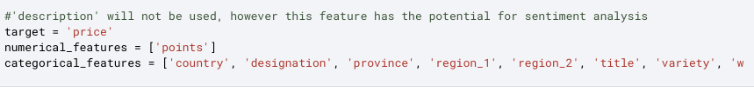
Multivariate Regression
Using the machine learning package Sklearn is better for more complex models.
To measure the model’s accuracy, I will use Train 80% | Test 20% Split.

Slide 23
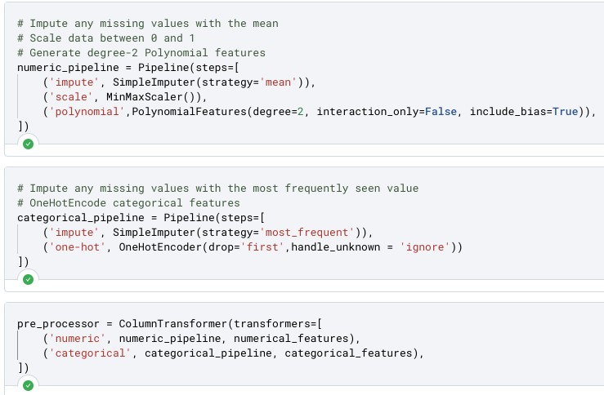
Feature Engineering Pipeline

Slide 24
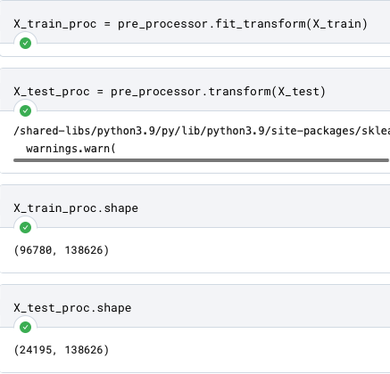
Implementing Pipeline

Slide 25
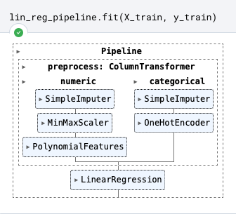
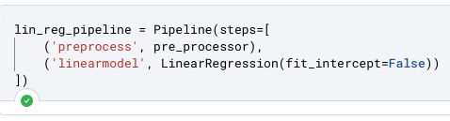
Model Fitting

Slide 26
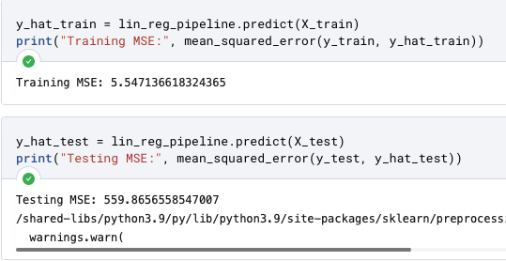
Train and Test MSE

Slide 27
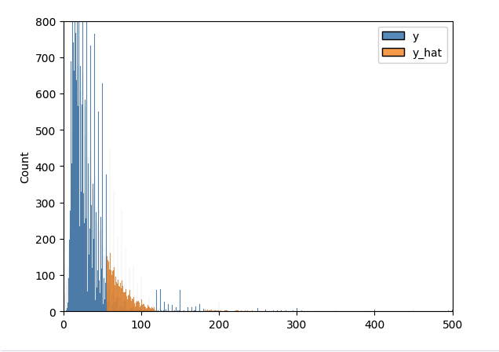
Distribution of Predicted vs. Actual Values

Slide 28
Conclusion
An average R coefficient for the simple linear model
Extremely high MSE for multivariate model
Suggests simple linear model is a better fit than the more complicated multivariate model
Is there a relationship between review points and price? Yes, but it’s not strong
Review points, nor any other variable (country, province, title etc.) is indicative of price

