Slide 1

Object detection and localization
Tahereh Hematian pour fard
Data 606: Capstone
Dr. Chaojie Wang, Nov 22nd, 2022

Slide 2
Outlines
Data generator
Machine Learning Dataset preparation
Neural Network architecture
Hyper-parameters for training the model
Predictions
Challenging objects
References

Slide 3
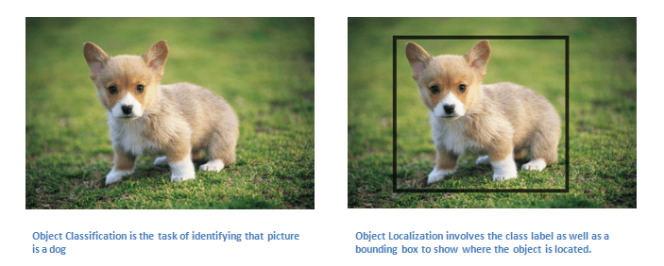
Object Detection and Localization

Slide 4
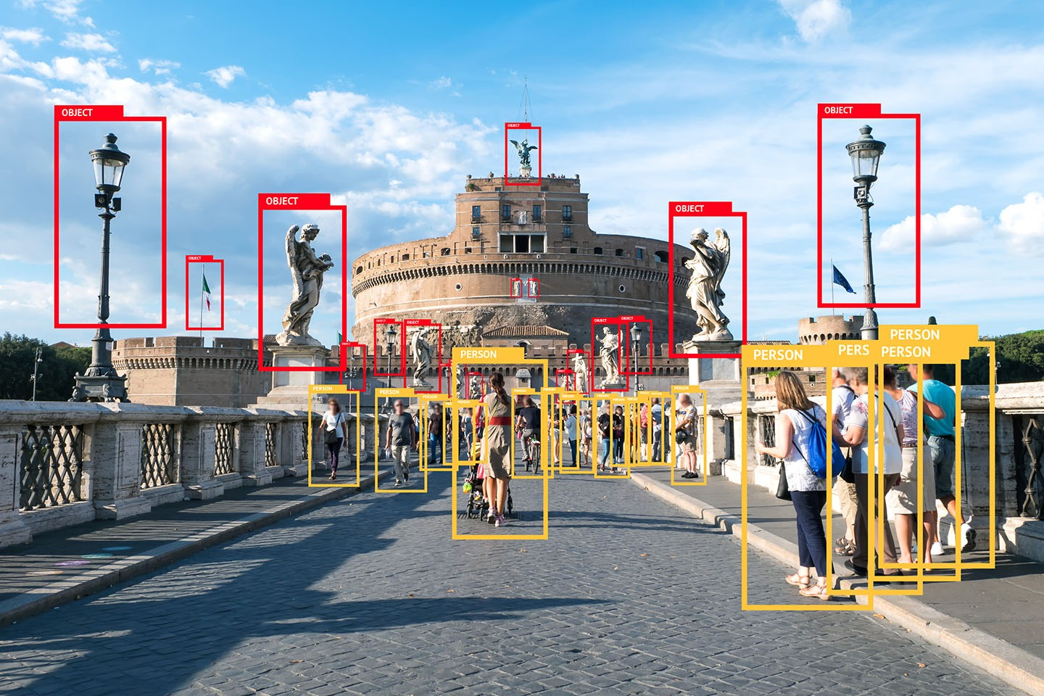
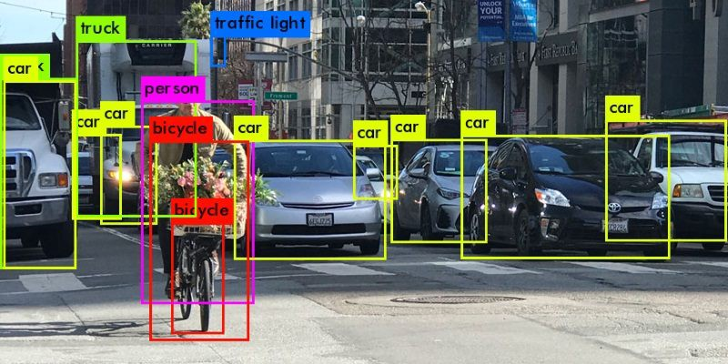
Application
Self-driving cars
Video surveillance
Climate change
And …

Slide 5
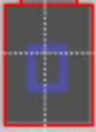


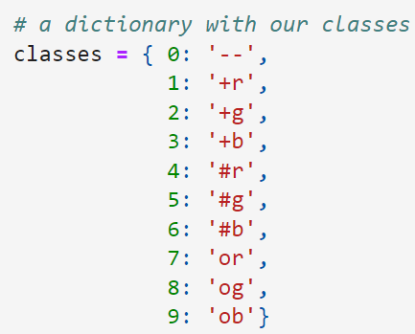



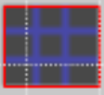
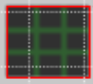


Data Generator
Synthetic data
10000 images
Size of each image is 64*64
At most 3 objects

Slide 6
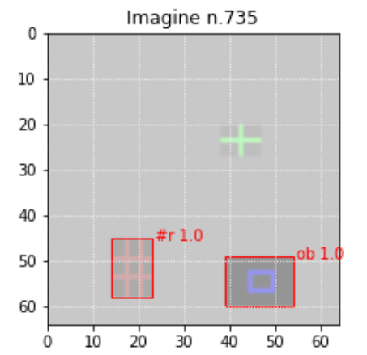
Data Generator

Slide 7
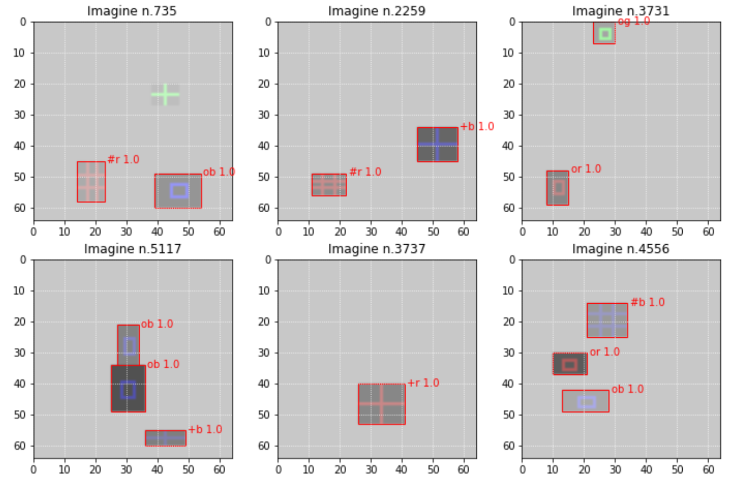
Data Generator

Slide 8
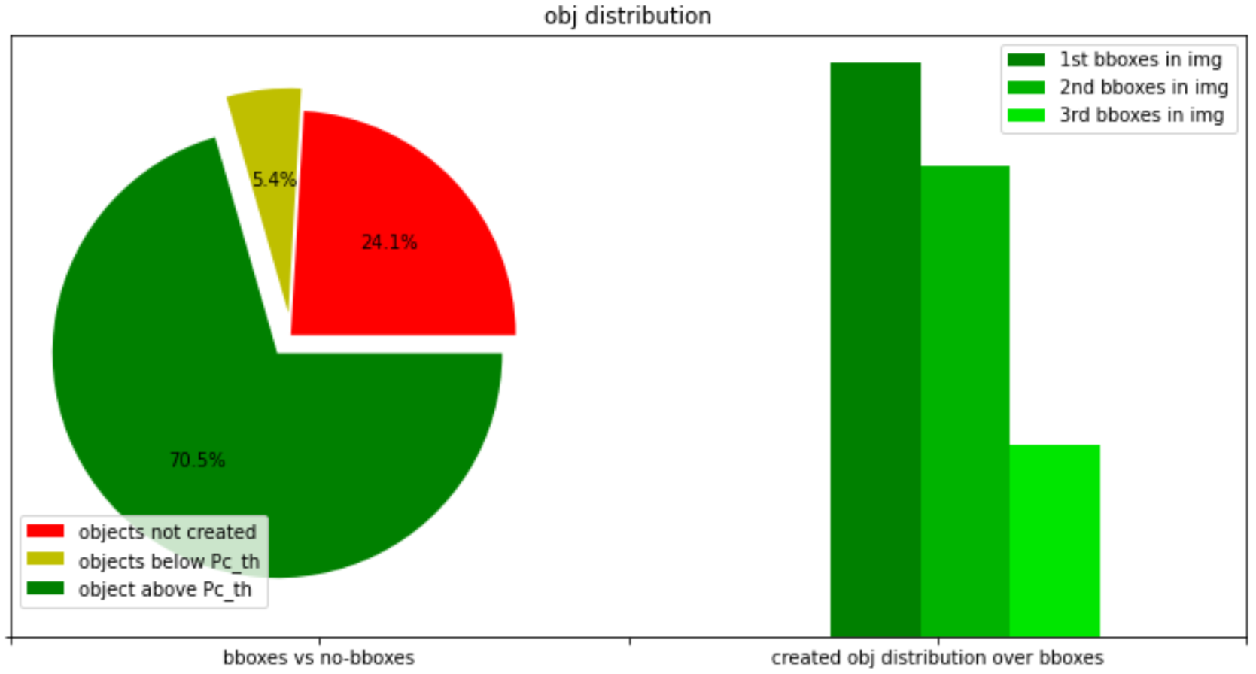
Data Generator

Slide 9
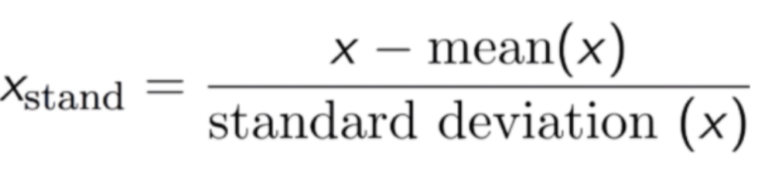
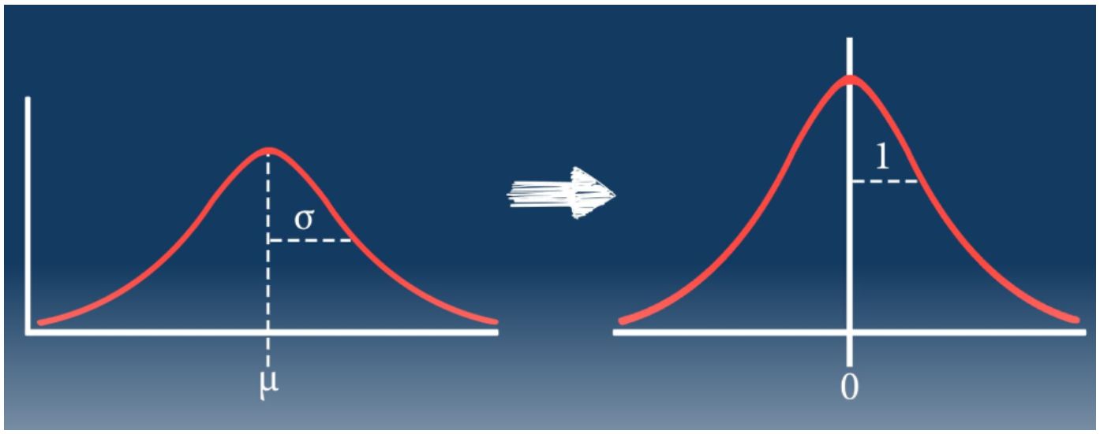
Machine Learning Dataset preparation
Average value: 196.25
Standard deviation: 18.41

Slide 10
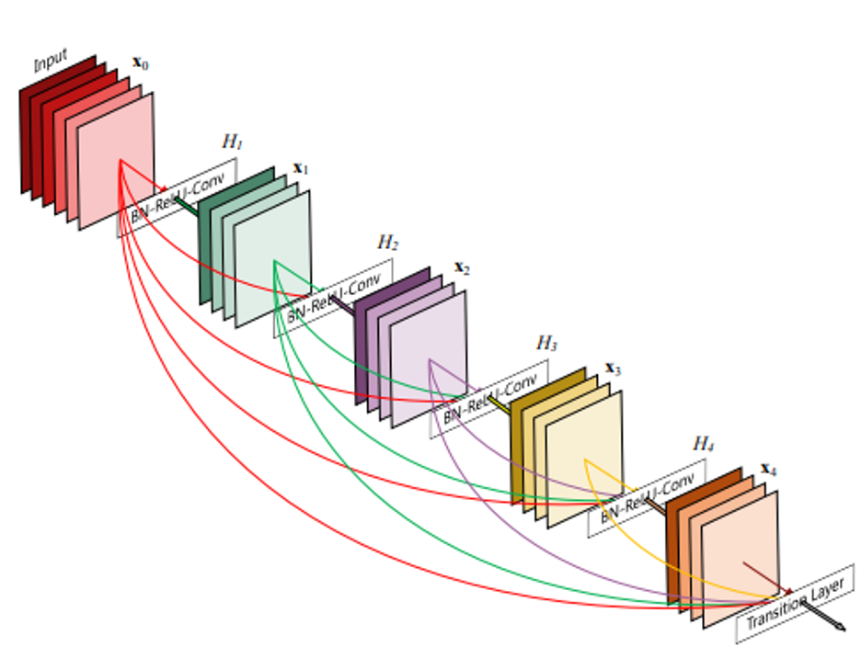
Neural Network Architecture
DenseNet 200
Cornell University
Tsinghua University
Facebook AI Research (FAIR)

Slide 11
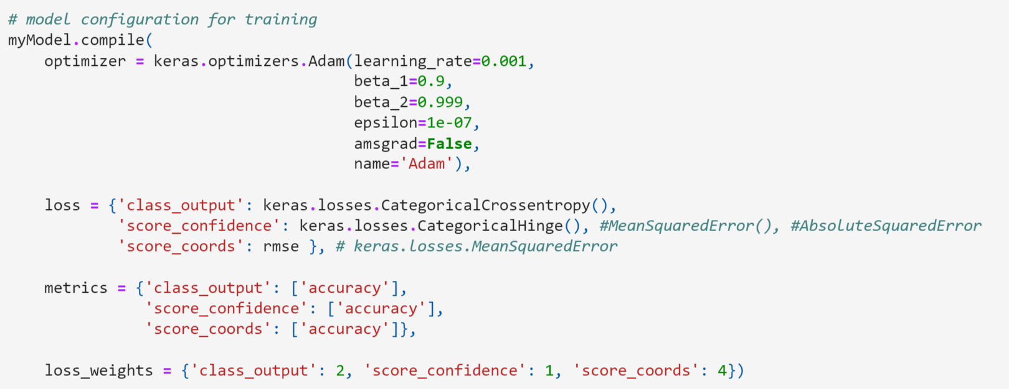
Hyper-parameters for training the model
N-ep = 100
Batches = 64
Learning rate = 0.001
Optimizer = Adam

Slide 12
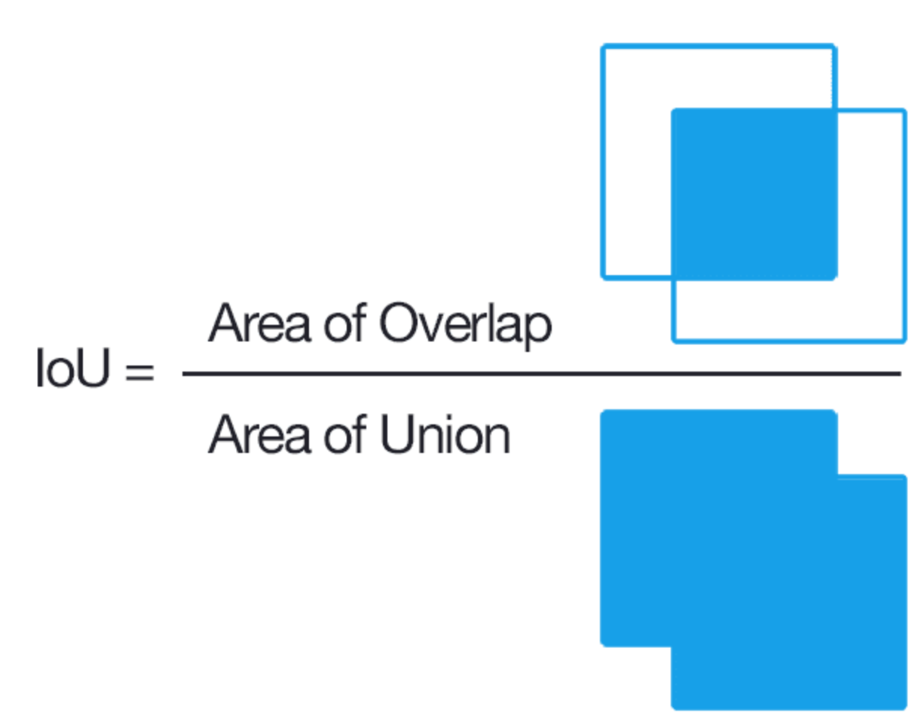
Predictions
Identification of bounding boxes, intersection over union (IoU)
Classification of the identified object (Confusion matrix)

Slide 13
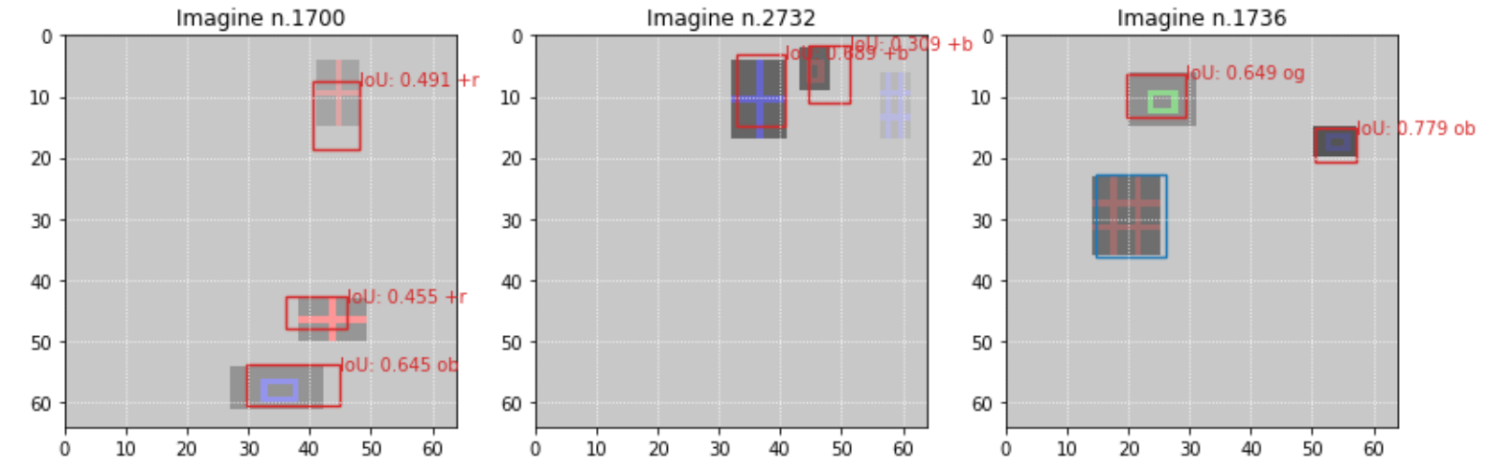
Bounding box predictions
Intersection over Union (IoU)

Slide 14
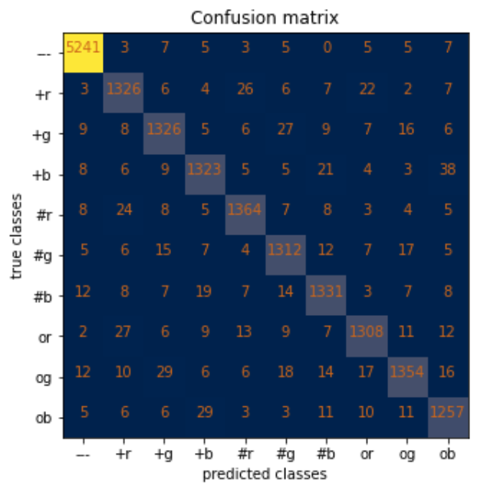
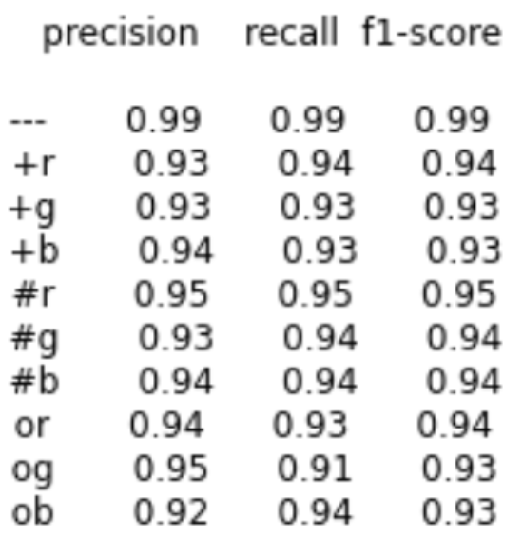
Classification Metric
Confusion matrix

Slide 15
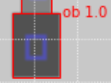




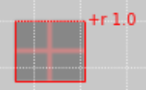
Challenging objects
Recurrent Neural Network
38 errors
29 errors
27 errors

Slide 16
Conclusion
Synthetic data with 10000 images and at most 3 objects
DensNet200: deep neural network with 200 layers
IoU metric : 70%
Confusion matrix: 92%

Slide 17
References
https://arxiv.org/abs/1608.06993
https://github.com/MarcoFosci/Computer_Vision/blob/master/Shape_Detection/Different_CNN_architectures/test_Part_II_.ipynb
Thank you

