Slide 1

Maryland vehicle crashes using Machine learning models
DATA 606 - Capstone in Data Science

Slide 2
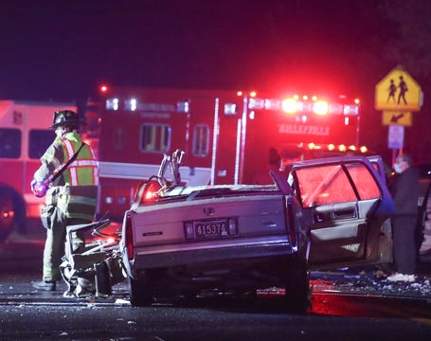
Introduction and Motivation
This project is about the analysis of Maryland Statewide Vehicle Crashes using Machine learning algorithms.
Motivation: When I came to United States of America in 2021. I saw many vehicles on the road and at the same time many accidents too. I was curious why these accidents are happening and I want to get few analysis from the data. Hence, I chose this topic

Slide 3
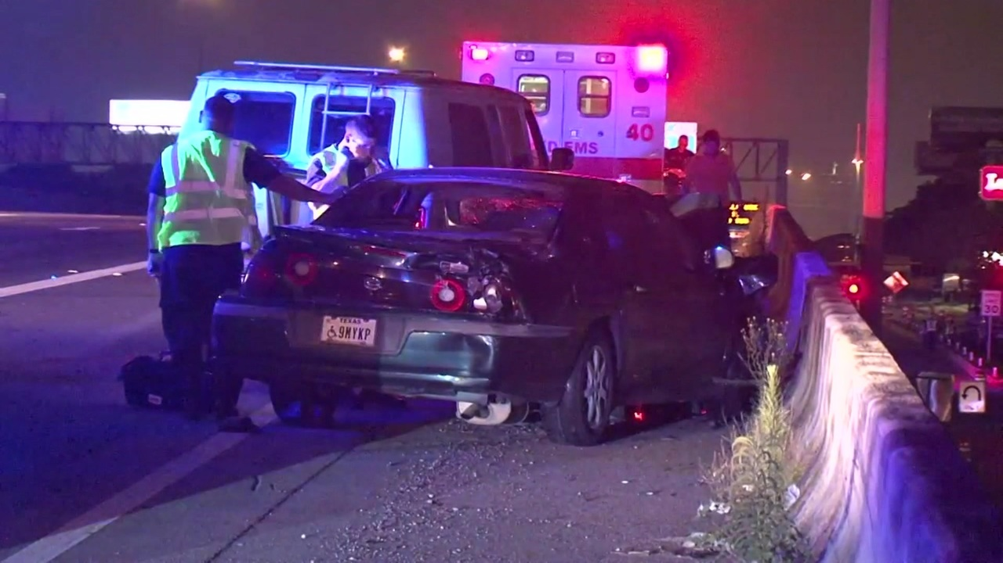
Data Set
This is the public dataset from the Maryland open information source(https://opendata.maryland.gov/).
Here is the Data Source link: https://opendata.maryland.gov/widgets/65du-s3qu
There are 56 columns and 8,22,412 rows in the dataset.
The columns include : 'YEAR', 'QUARTER', 'LIGHT_DESC', 'LIGHT_CODE', 'COUNTY_DESC', 'COUNTY_NO', 'MUNI_DESC', 'MUNI_CODE', 'JUNCTION_DESC', 'JUNCTION_CODE', 'COLLISION_TYPE_DESC', 'COLLISION_TYPE_CODE', 'SURF_COND_DESC', 'SURF_COND_CODE', 'LANE_DESC', 'LANE_CODE', 'RD_COND_DESC', 'RD_COND_CODE', 'RD_DIV_DESC', 'RD_DIV_CODE', 'FIX_OBJ_DESC', 'FIX_OBJ_CODE', 'REPORT_NO', 'REPORT_TYPE', 'WEATHER_DESC', 'WEATHER_CODE', 'ACC_DATE', 'ACC_TIME', 'LOC_CODE', 'SIGNAL_FLAG_DESC', 'SIGNAL_FLAG', 'C_M_ZONE_FLAG', 'AGENCY_CODE', 'AREA_CODE', 'HARM_EVENT_DESC1', 'HARM_EVENT_CODE1', 'HARM_EVENT_DESC2', 'HARM_EVENT_CODE2', 'RTE_NO', 'ROUTE_TYPE_CODE', 'RTE_SUFFIX', 'LOG_MILE', 'LOGMILE_DIR_FLAG_DESC', 'LOGMILE_DIR_FLAG', 'MAINROAD_NAME', 'DISTANCE', 'FEET_MILES_FLAG_DESC', 'FEET_MILES_FLAG', 'DISTANCE_DIR_FLAG', 'REFERENCE_NO', 'REFERENCE_TYPE_CODE', 'REFERENCE_SUFFIX', 'REFERENCE_ROAD_NAME', 'LATITUDE', 'LONGITUDE', 'LOCATION'.

Slide 4
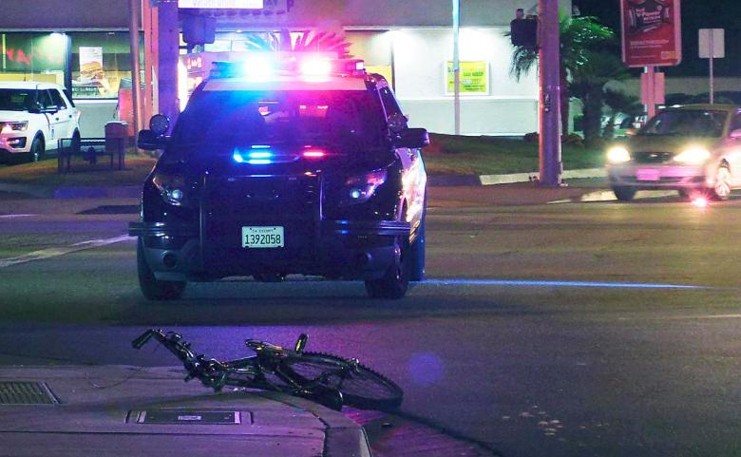
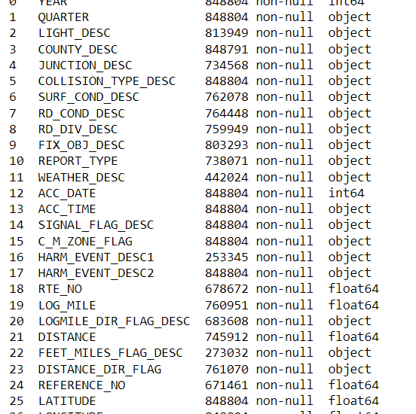
Data Cleaning
There are several categories that numerically correspond identically to other columns. Furthermore, the dataset removes those columns. We are unable to comprehend anything or make any conclusions from some of those numerical columns individually. Hence, I dropped all those columns from the dataset.
There are about 19 object type variables,2 int type Variables, and 6 float type variables.

Slide 5
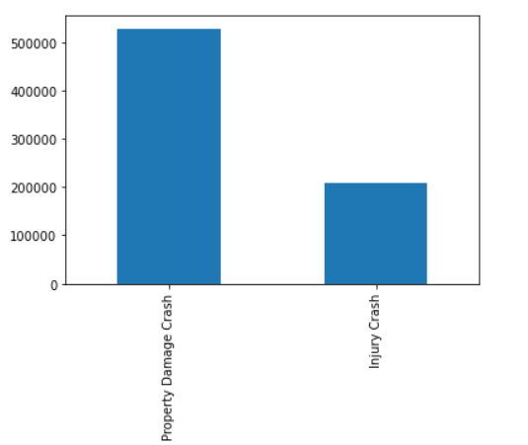
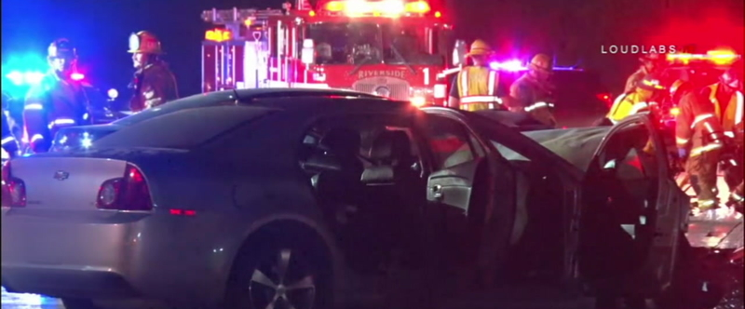
Target Variable
I chose "REPORT TYPE" as my target column. There are three classes are represented in the target variable: "Property Damage Crash," "Injury Crash," and "Fatal Crash." To minimize a conflict with multiple classes, those three classes are reduced into two by altering Fatal Crash into Injury Crash. This is likewise done for the alternative explanation that Fatal Crash corresponds to accidents that result in death, being a subclass of an Injury crash. As more than just a result, the final target variable only has two classes.

Slide 6
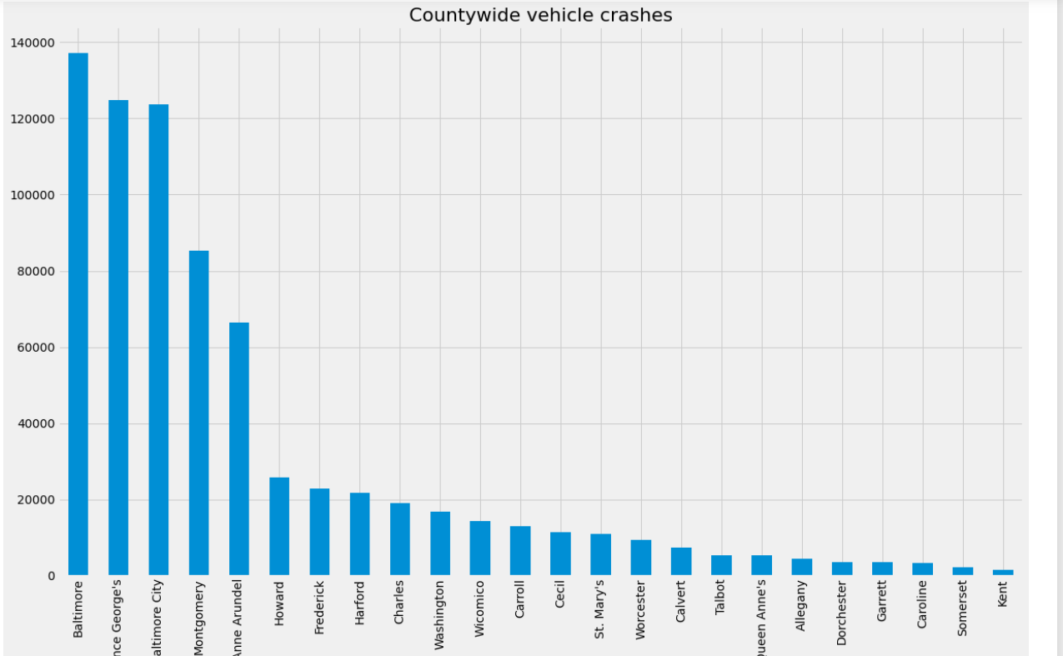
In the bar graph we can clearly see that in Baltimore county there are more than 120000 crashes.

Slide 7
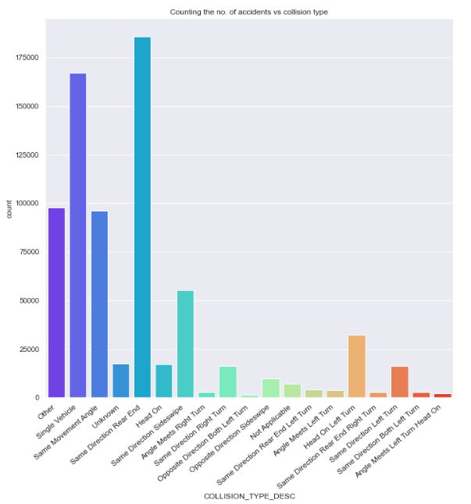
In the plot most of the crashes happened in the same direction rear end and it is very Rare for the crashes to happen opposite direction both taking a left turn.

Slide 8
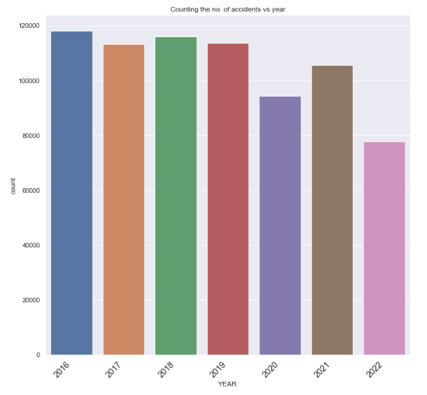
In the plot, we can see the number of accidents occurred with respect to year .

Slide 9
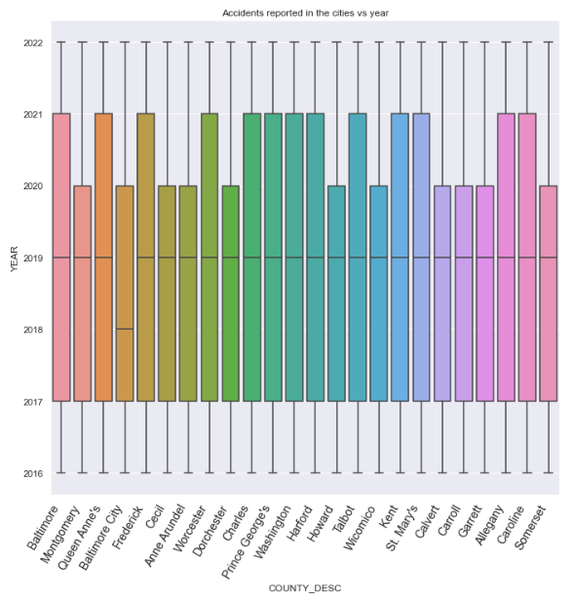
Here is the boxplot for Countywise with respect to year.

Slide 10
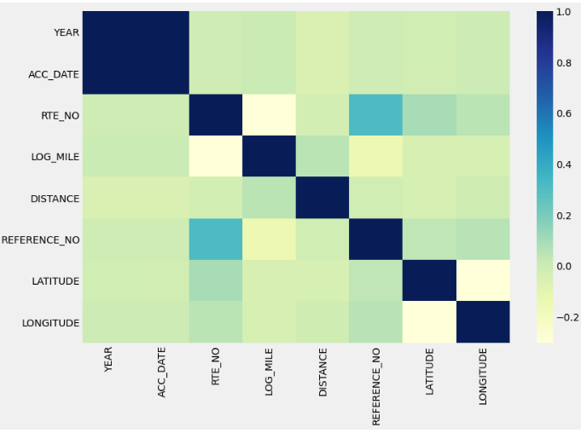
Used heatmap to plot the columns, to understand the correlation between each one of them before we implement the Machine Learning models. This map helps us in understanding the positive, negative, and uncorrelated columns from the dataset.
Correlation Matrix

Slide 11
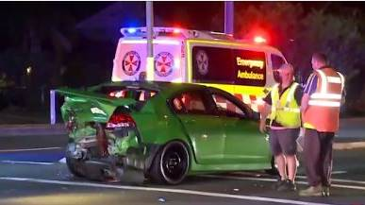
Modeling
Numerical Variables: 'ACC_DATE','DISTANCE','LOG_MILE','RTE_NO','YEAR’
Categorical Variables:
'QUARTER','LIGHT_DESC','COUNTY_DESC','JUNCTION_DESC','COLLISION_TYPE_DESC','SURF_COND_DESC','RD_COND_DESC','RD_DIV_DESC','FIX_OBJ_DESC','WEATHER_DESC','ACC_TIME','SIGNAL_FLAG_DESC','C_M_ZONE_FLAG','HARM_EVENT_DESC1','HARM_EVENT_DESC2','LOGMILE_DIR_FLAG_DESC','FEET_MILES_FLAG_DESC','DISTANCE_DIR_FLAG’
These columns are processed using simple imputer and One Hot encoder and stored in the processing pipeline that can be used for further modeling process.

Slide 12
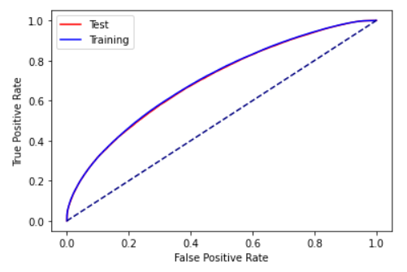
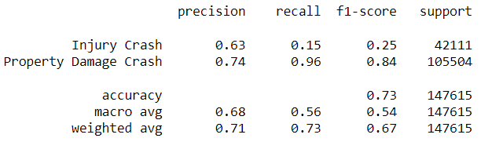
Logistic Regression
Logistic Regression is applied with l2 penalty and Gridsearchcv is applied with [0.01, 0.1, 1, 10]. Then performed classification report and accuracy rate and Test score is predicted. I chose this algorithm, because it will be helpful in understanding the relation among dependent and independent variables.
The accuracy is about 73%
The area under roc_auc_score 69.9%

Slide 13
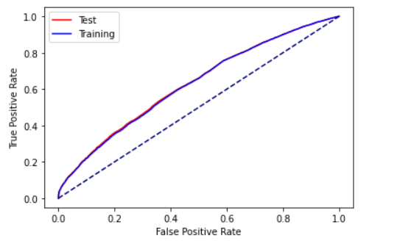
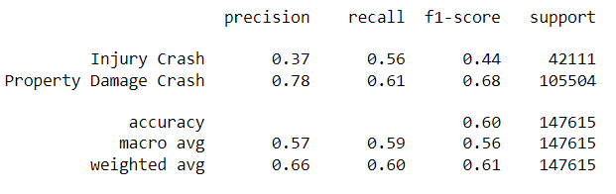
Random Forest
Random Forest is applied with max_depth: [5, 8, 10] and n_estimators : [10, 50] and max_samples: [878] which is the best parameters. Then performed classification report and accuracy rate and Test score is predicted.
The accuracy is about 60%
The area under roc_auc_score 62.7%

Slide 14
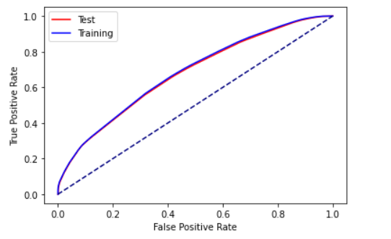
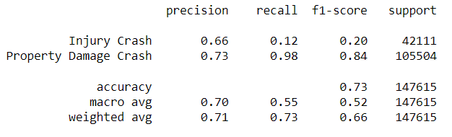
Decision Tree
I used max_depth: [3, 5, 6, 8,10], min_samples_split :[2,4,6,8] and min_samples_leaf: [3, 7] as the parameters. Then performed classification report and accuracy rate and Test score is predicted.
The accuracy is about 73%
The area under roc_auc_score 67.6%

Slide 15
Results
Among those three classification Algorithms, Logistic Regression is performing better than remaining Three algorithms. Random forest is giving the least Performance. Decision Tree and Logistic regression are giving almost the same results.
After analyzing the three models, I think Logistic Regression Classifier has ROC_AUC score is 70% can classify better compared to others. We can improve the accuracy by dealing the dataset imbalance through better modeling techniques.

Slide 16
Thank you

