Slide 1
Risk Management using data analytics and Natural Language processing
Name: Sai Karteek Edumudi
Professor: Dr Chaojie (Jay) Wang
Department of Data Science
University of Maryland Baltimore county

Slide 2
Introduction
Machine learning is a method of data analysis that automates analytical model building to identify patterns and make decisions with minimal human intervention. With appropriate analysis, one can mitigate risk and build a strategy to make profits. The information used for this technical analysis consists mainly of the website traffic, news articles, and twitter data. This kind of analysis is not new, and different financial institutions are examining it. While analyzing risk, it is essential to analyze the intrinsic value of stocks, news articles performance of the industry, economy, political climate, etc., to analyze the risk involved in a certain time and potential future risks involved based on current and past data.

Slide 3

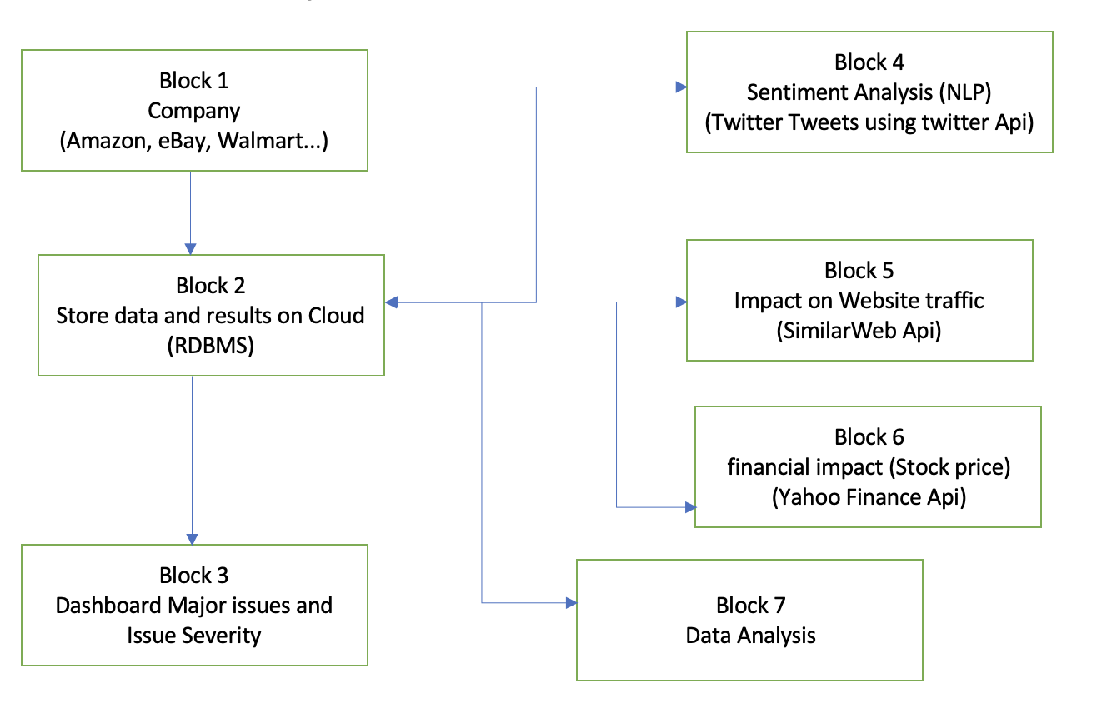
Flow Diagram
Block 1 Any company can be selected based on stock name
Block 2 Store data in cloud for easy access and prevent information loss
Block 3 Real time webpage-based dashboard providing sentiment, summery of news articles, other important webpage links.
Block 4 Sentiment analysis on news and twitter tweets
Block 5 Impact on website traffic
Block 6 Financial impact like stock price and trend.
Block 7 Data analysis based on all the data acquired for possible risk mitigation.

Slide 4
Data sources
The twitter tweets data used for this project is fetched from Snscrape python API
SimilarWeb API for website traffic information.
yfinance API to scrape news articles and stock information.
These are API's which are legally allowed to scrape data from websites.

