Slide 1
Amazon Product
Recommender System
Jin Hui Xu

Slide 2


1
Introduction
2
Research Questions
3
Data Sources
Contents
4
Research Process
5
Exploratory Data Analysis
6
Machine Learning Models
7
Expected Outcomes

Slide 3
1
Introduction

Slide 4
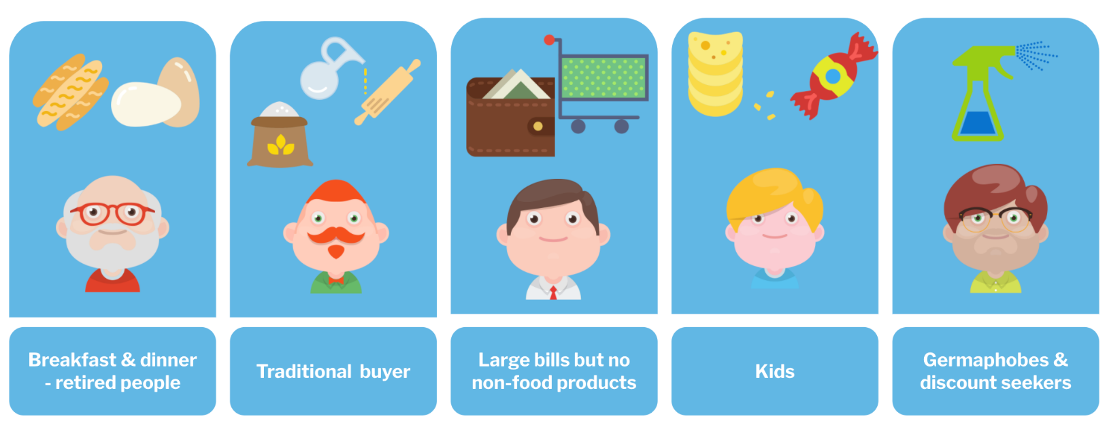
Introduction
Why recommender system is important?
It can drive traffic through personalized email messages to the store site and increase average order value.
It also enhances the shopping experience by delivering relevant content based on personalized preferences.
It can reduce workload for inventory management and boost work effectiveness.
It can create comprehensive reports to support making the right decision for business direction.
Overall, product recommender systems not only boost the companies’ revenue but also increase customer satisfaction and loyalty.

Slide 5
2
Research Questions

Slide 6
Research Questions
What characteristics are useful to generate personalized recommendations?
Which recommender systems algorithms/methods are most successful and practical?
Can textual data improve recommender systems' performance?

Slide 7
3
Data Sources

Slide 8
Data Sources
The data for this project is the Amazon Review Data (2018) which is collected by the University of California San Diego (https://nijianmo.github.io/amazon/index.html).
The dataset includes reviews data and product metadata.
It contains a total number of 233.1 million real reviews with the size of 34 gigabytes from Amazon.
Due to the computing resource limitation, a subset in Appliances category will be used for this project.

Slide 9
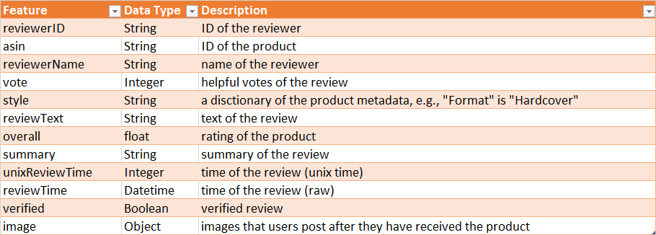
Review Data
There are a total of 602,777 review records in the Appliances category, and the dataset has 12 different.
The interested feature are overall, reviewTime, reviewerID, asin, reviewText, summary.

Slide 10
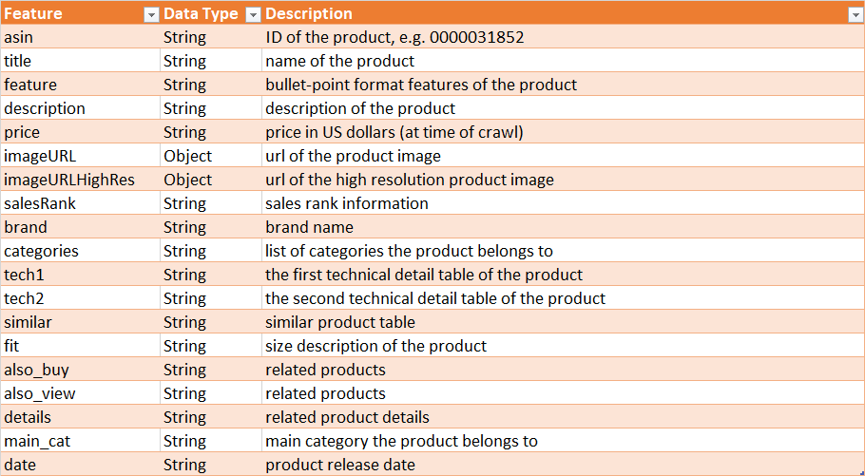
Product Data
There are a total of 30,445 product records in this category, and the dataset has 19 different features.
The interested feature are category, description, title, brand, feature, main_cat, date, price, asin, imageURLHighRes.

Slide 11
4
Research Process

Slide 12
Research Process
System Integration and Deployment
EDA
Models Development
Collect Data

Slide 13
Research Process
Product Recommender Systems
Collect Data
EDA
ML Models
User Interface
01
02
03
04
Collect necessary data for the recommender systems.
Discover insights of the review and product data, and prepare for ML models.
Content-based Filtering model, Collaborative Filtering model and Hybrid model.
Website and Chabot to interact with users and to provide a list of recommendations.

Slide 14
5
Exploratory Data Analysis

Slide 15
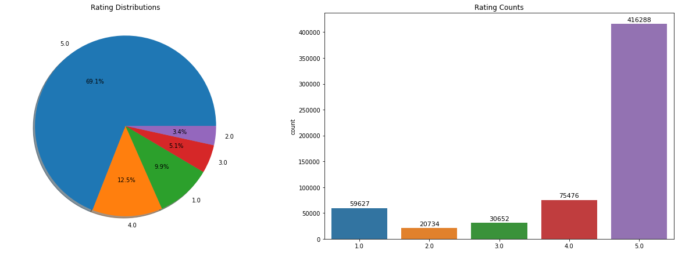
EDA – Review Data
Notes:
The rating distribution graphs show that the overall ratings in this review data set are highly imbalanced, which contains more than 69% of 5 stars rating.
Thus, in the following model development, we need to keep in mind that the accuracy metric may not be useful for evaluating the machine learning models; instead, precision, recall, and F1 score values could be suitable for model evaluation.

Slide 16
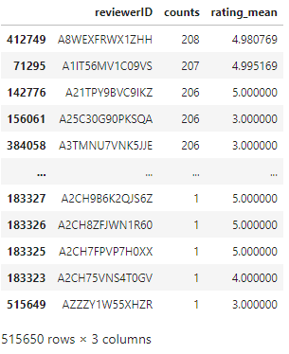
EDA – Review Data
There are a total of 515,650 distinct reviewers in this dataset, and the most active reviewer had reviewed 208 products with an average 4.98 rating score.

Slide 18
Add your text
Add your text
Add your text
Add your text
Add your text
Add your text
Add your text
Add your text
Add your text

Slide 19
Add your text
Add your text
Add your text
Add your text
Add your text
Add your text
Add your text
Add your text
Add your text
Add your text
Add your text
Add your text
Add your text
Add your text
Add your text
Add your text
Add your text
Add your text

Slide 20
Add your title
Add your words here,according to your need to draw the text box size.Please read the instructions and more work at the end of the manual template.
Add your title
Add your words here,according to your need to draw the text box size.Please read the instructions and more work at the end of the manual template.

Slide 21
Add your text
Add your text
Add your text
Add your words here,according to your need to draw the text box size.
Add your text
Add your title
Add your text
Add your words here,according to your need to draw the text box size.
Add your text
Add your words here,according to your need to draw the text box size.

Slide 22
KEYWORD
KEYWORD
Add your text
Add your text
01
02
03
04
Add your title
Add your title
Add your title
Add your title
Add your text
Add your text
Add your text
Add your text
KEYWORD
KEYWORD
Add your text
Add your text

Slide 23
Text
Text
text
text
01
02
03
04
text
text
Add your title
Add your text
Add your text
Add your text
Text
Text

Slide 24
KEYWORD
Add your text
KEYWORD
KEYWORD
KEYWORD
Add your text
KEYWORD
Add your text
KEYWORD
KEYWORD
KEYWORD
Add your text

Slide 25
KEYWORD
KEYWORD
KEYWORD
KEYWORD
Add your text
Add your text
Add your text
Add your text
Add your text
Add your text
Add your text
Add your text

Slide 26
6
Machine Learning Models

Slide 27
7
Expected Outcomes

Slide 28

Add your title
Add your words here
Add your words here
Add your title
Add your words here
Add your words here
Add your title
Add your words here
Add your words here
Add your words here
Add your title
Add your words here
Add your words here
Add your title
Add your words here

Slide 29
Add your words here,according to your need to draw the text box size.Please read the instructions and more work at the end of the manual template.
Add your words here,according to your need to draw the text box size.
Add your words here,according to your need to draw the text box size.
Keyword
Keyword
Keyword

Slide 30
References
Jianmo Ni, Jiacheng Li, Julian McAuley Empirical Methods in Natural Language Processing (EMNLP), 2019 http://cseweb.ucsd.edu/~jmcauley/pdfs/emnlp19a.pdf
Doshi, S. (2019, February 20). Brief on Recommender Systems. Medium. Retrieved February 13, 2022, from https://towardsdatascience.com/brief-on-recommender-systems-b86a1068a4dd

Slide 31
Thanks

