Slide 1
Amazon Product
Recommender System
Jin Hui Xu

Slide 2


1
Introduction
2
Research Questions
3
Data Sources
Contents
4
Research Process
5
Exploratory Data Analysis
6
Machine Learning Models
7
Expected Outcomes

Slide 3
1
Introduction

Slide 4
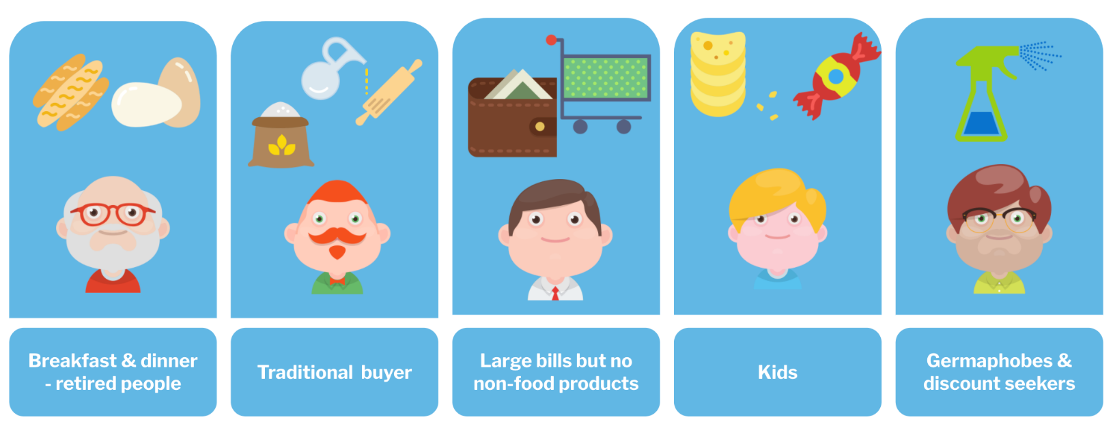
Introduction
Why recommender system is important?
It can drive traffic through personalized email messages to the store site and increase average order value.
It also enhances the shopping experience by delivering relevant content based on personalized preferences.
It can reduce workload for inventory management and boost work effectiveness.
It can create comprehensive reports to support making the right decision for business direction.
Overall, product recommender systems not only boost the companies’ revenue but also increase customer satisfaction and loyalty.

Slide 5
2
Research Questions

Slide 6
Research Questions
What characteristics are useful to generate personalized recommendations?
Which recommender systems algorithms/methods are most successful and practical?
Can textual data improve recommender systems' performance?

Slide 7
3
Data Sources

Slide 8
Data Sources
The data for this project is the Amazon Review Data (2018) which is collected by the University of California San Diego (https://nijianmo.github.io/amazon/index.html).
The dataset includes reviews data and product metadata.
It contains a total number of 233.1 million real reviews with the size of 34 gigabytes from Amazon.
Due to the computing resource limitation, a subset in Appliances category will be used for this project.

Slide 9
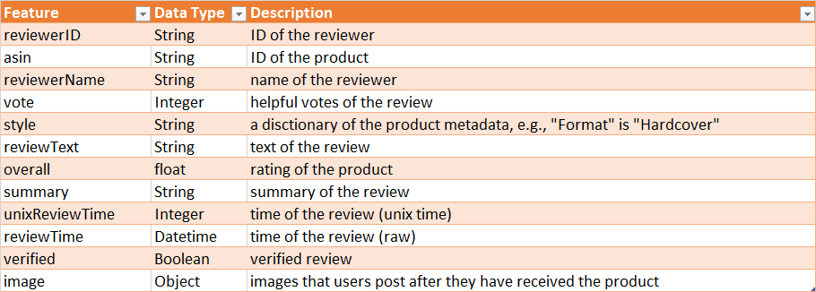
Review Data
There are a total of 602,777 review records in the Appliances category, and the dataset has 12 different.
The interested feature are overall, reviewTime, reviewerID, asin, reviewText, summary.

Slide 10
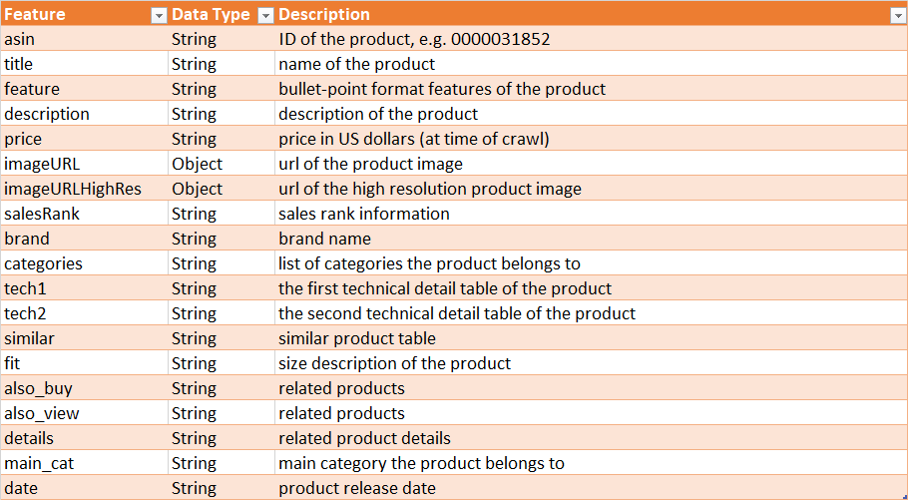
Product Data
There are a total of 30,445 product records in this category, and the dataset has 19 different features.
The interested feature are category, description, title, brand, feature, main_cat, date, price, asin, imageURLHighRes.

Slide 11
4
Research Process

Slide 12
Research Process
System Integration and Deployment
EDA
Models Development
Collect Data

Slide 13
Research Process
Product Recommender Systems
Collect Data
EDA
ML Models
User Interface
01
02
03
04
Collect necessary data for the recommender systems.
Discover insights of the review and product data, and prepare for ML models.
Content-based Filtering model, Collaborative Filtering model and Hybrid model.
Website and Chabot to interact with users and to provide a list of recommendations.

Slide 14
5
Exploratory Data Analysis

Slide 15
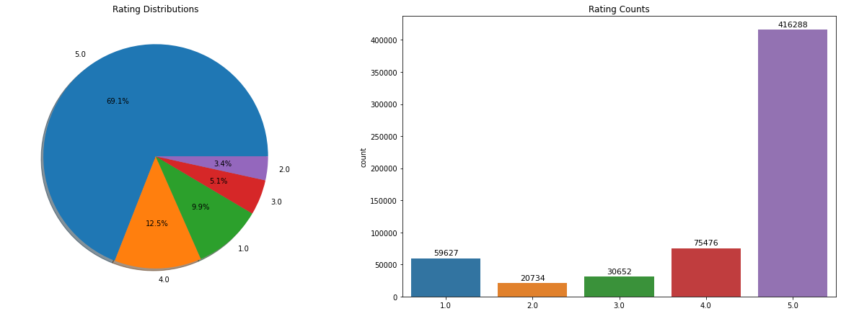
EDA – Review Data
The rating distribution graphs show that the overall ratings in this review data set are highly imbalanced, which contains more than 69% of 5 stars rating.
Notes:
The rating distribution graphs show that the overall ratings in this review data set are highly imbalanced, which contains more than 69% of 5 stars rating.
Thus, in the following model development, we need to keep in mind that the accuracy metric may not be useful for evaluating the machine learning models; instead, precision, recall, and F1 score values could be suitable for model evaluation.

Slide 16
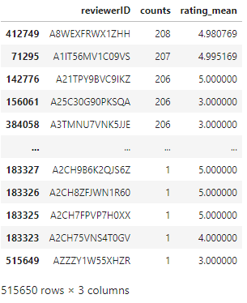
EDA – Review Data
There are a total of 515,650 distinct reviewers in this dataset, and the most active reviewer had reviewed 208 products with an average 4.98 rating score.

Slide 17
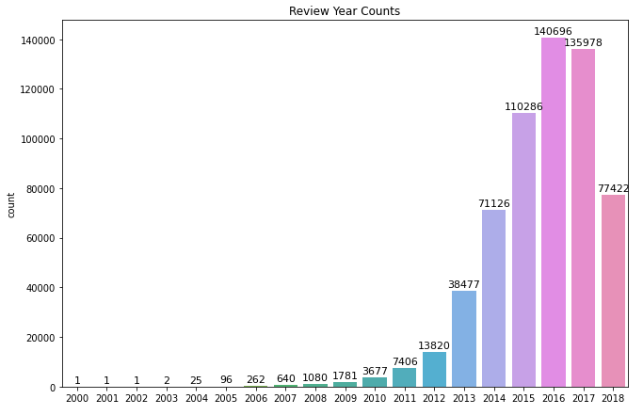
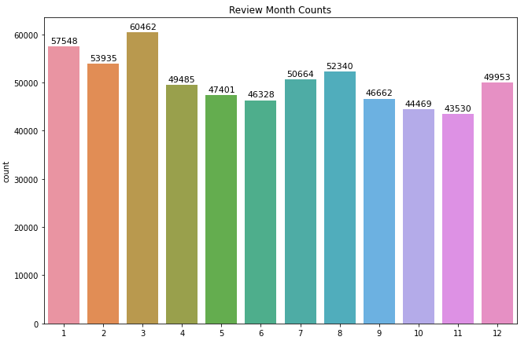
EDA – Review Data
The review year distribution graphs show that the reviews in this dataset are heavily collected after the year 2013, which can quite well represent the current generation customers' preferences.
The review month distribution graphs show that the months are quite evenly distributed in the dataset, which we can conclude that the season doesn't play a significant role in the influence of the purchase of the appliances.

Slide 18
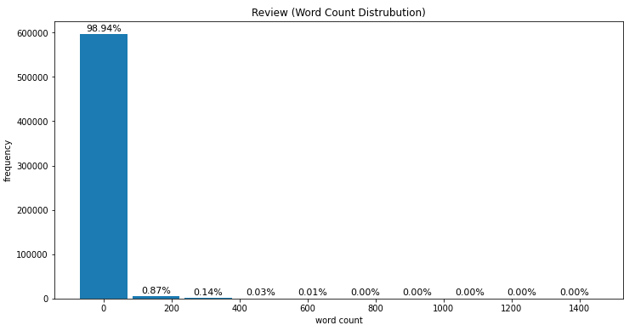
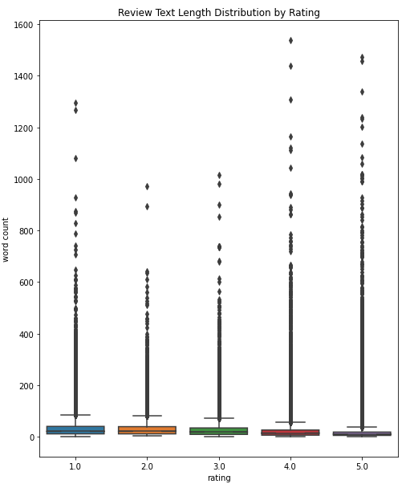
EDA – Review Data
Most of the reviews contain less than 100 words.
The word counts distributions for each star rating review are similar. The box plot shows that the 5 stars rating reviews have the lowest interquartile range (IQR) compared to the other 4 ratings, which implies that it has average the shortest review text.
Notes:
Most of the reviews contain less than 100 words. The word counts distributions for each star rating review are similar, but if we look in to the detail of the box plot graph, we could see that negative or low star rating reviews have more texts entered. The box plot shows that the 5 stars rating reviews have the lowest interquartile range (IQR) compared to the other 4 ratings, which implies that it has average the shortest review text.

Slide 19
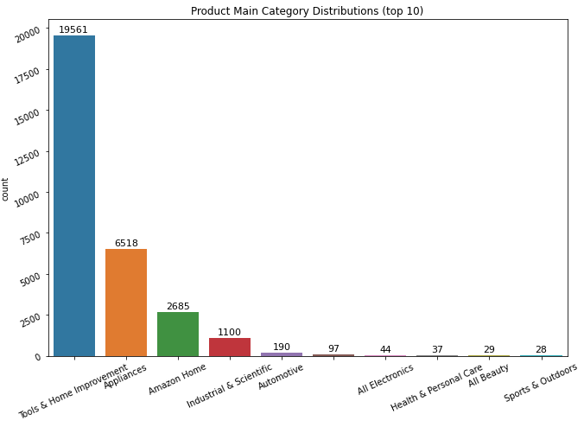
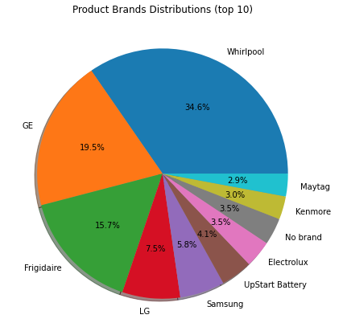
EDA – Product Data
The majority of the products (64.6%) are in the Tools & Home Improvement category, and the Appliances category also holds 21.5%.
There are a total of 2,762 brands, and Whirlpool is at the rank 1 position of amount of products.

Slide 20
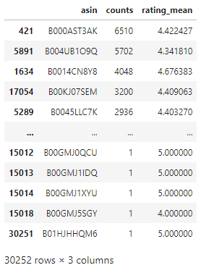
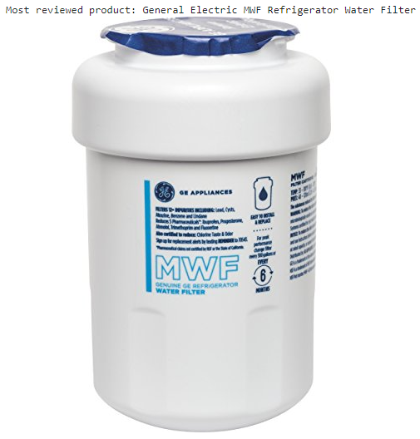
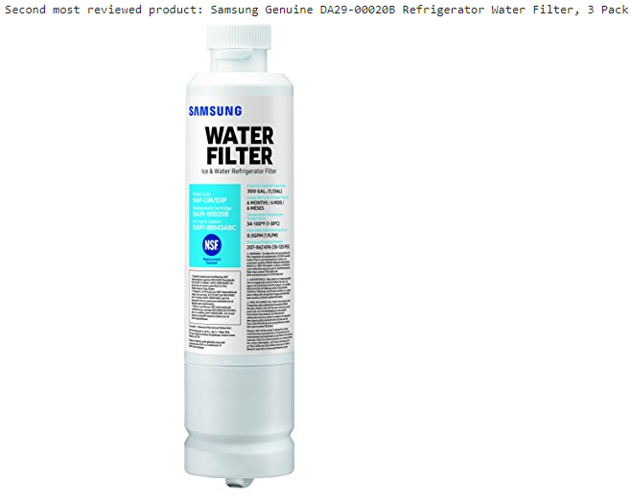
EDA – Product Data
This is the list of the ranking of most reviewed products and their average ratings. Among 30,445 Appliances products, there are only 30,252 products were reviewed.
Within this list, the most reviewed product is General Electric MWF Refrigerator Water Filter, and the second most reviewed product is Samsung Genuine DA29-00020B Refrigerator Water Filter, 3 Pack. Both of them are Refrigerator Water Filters.

Slide 21
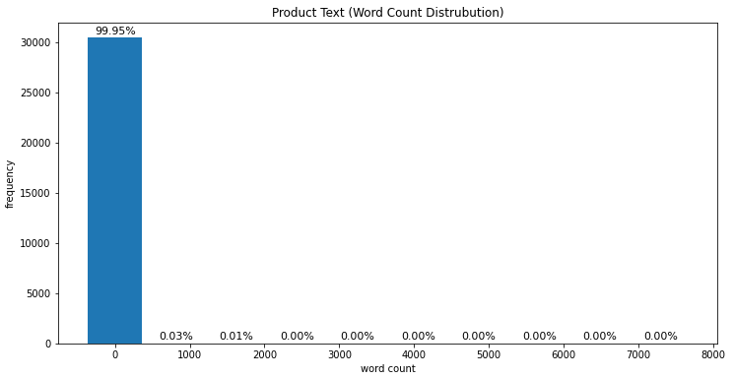
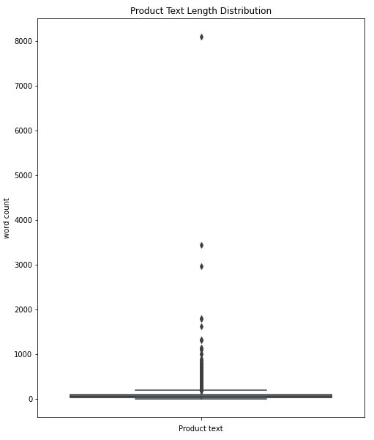
EDA – Product Data
The product text distribution histogram and box plot show that majority of the product text is less than 1000 words. There are only a few outliers that are greater than 2000 words, so for future NLP model development, in order to reduce the padding size, we can consider a smaller number instead.

Slide 22
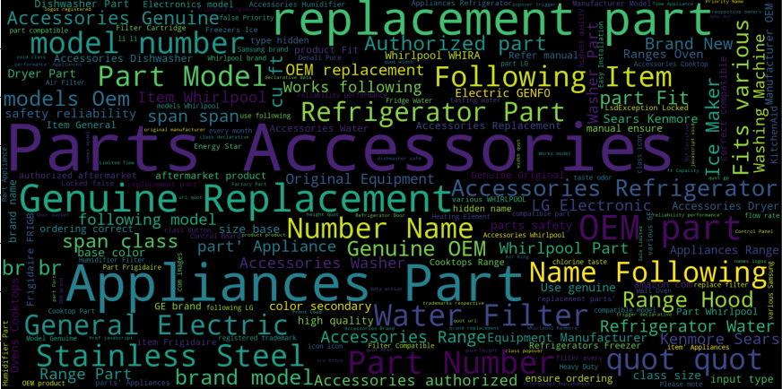
EDA – Product Data
The word cloud shows that the most frequently used words for Appliances products are related to replacement, part, and model number.

Slide 23
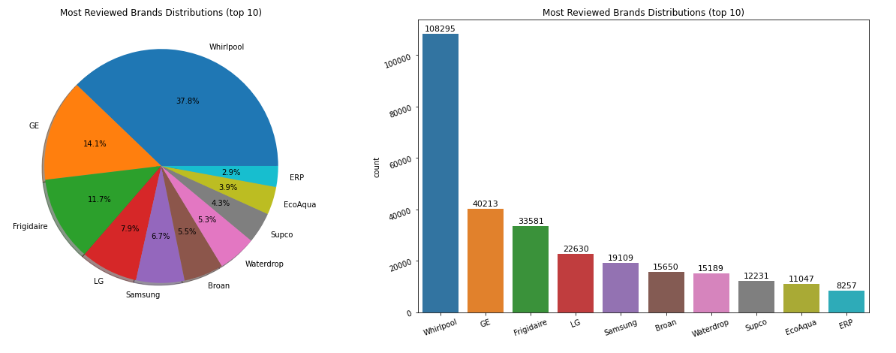
EDA – Merged Data
Most Reviewed Brands Distributions (top 10) graphs show that Whirlpool products have the rank 1 position of amount of reviews.
There are some other brands in the list that are not in the list of top 10 product numbers, which means offering more products doesn't imply more sales and revenue.
Notes:
To find out more insights within this dataset, we can merge the cleaned review and product datasets.
Most Reviewed Brands Distributions (top 10) graphs show that Whirlpool products have the rank 1 position of amount of reviews. However, there are some other brands in the list that are not in the list of top 10 product numbers, which means offering more products doesn't imply more purchasing and revenue.

Slide 24
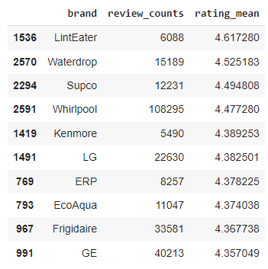
EDA – Merged Data
This table shows the top 10 average rating brand (reviews > 5000) in the dataset.
The result show that brand LintEater has the highest average rating 4.62 with over 6,000 reviews. Whereas Whirlpool has the rank 4 in this list.
Notes:
This table shows the top 10 average rating brand (reviews > 5000) in the dataset. There are many brand only have a few reviews, and their average rating will definitely be higher than other brands with more reviews, so we only consider the brands with at least 5,000 reviews for this analysis.
The result show that brand LintEater has the highest average rating 4.62 with over 6,000 reviews. Whereas Whirlpool has the rank 4 in this list, however; it also has the most review number and most products offered in the Appliance category. It means Whirlpool is doing great in offering both overall product quality and quantity.

Slide 25
6
Machine Learning Models

Slide 26
Add your text
Add your text
Add your text
Add your text
Add your text
Add your text
Add your text
Add your text
Add your text

Slide 27
Add your text
Add your text
Add your text
Add your text
Add your text
Add your text
Add your text
Add your text
Add your text
Add your text
Add your text
Add your text
Add your text
Add your text
Add your text
Add your text
Add your text
Add your text

Slide 28
Add your title
Add your words here,according to your need to draw the text box size.Please read the instructions and more work at the end of the manual template.
Add your title
Add your words here,according to your need to draw the text box size.Please read the instructions and more work at the end of the manual template.

Slide 29
Add your text
Add your text
Add your text
Add your words here,according to your need to draw the text box size.
Add your text
Add your title
Add your text
Add your words here,according to your need to draw the text box size.
Add your text
Add your words here,according to your need to draw the text box size.

Slide 30
KEYWORD
KEYWORD
Add your text
Add your text
01
02
03
04
Add your title
Add your title
Add your title
Add your title
Add your text
Add your text
Add your text
Add your text
KEYWORD
KEYWORD
Add your text
Add your text

Slide 31
Text
Text
text
text
01
02
03
04
text
text
Add your title
Add your text
Add your text
Add your text
Text
Text

Slide 32
KEYWORD
Add your text
KEYWORD
KEYWORD
KEYWORD
Add your text
KEYWORD
Add your text
KEYWORD
KEYWORD
KEYWORD
Add your text

Slide 33
KEYWORD
KEYWORD
KEYWORD
KEYWORD
Add your text
Add your text
Add your text
Add your text
Add your text
Add your text
Add your text
Add your text

Slide 34
7
Expected Outcomes

Slide 35

Add your title
Add your words here
Add your words here
Add your title
Add your words here
Add your words here
Add your title
Add your words here
Add your words here
Add your words here
Add your title
Add your words here
Add your words here
Add your title
Add your words here

Slide 36
Add your words here,according to your need to draw the text box size.Please read the instructions and more work at the end of the manual template.
Add your words here,according to your need to draw the text box size.
Add your words here,according to your need to draw the text box size.
Keyword
Keyword
Keyword

Slide 37
References
Jianmo Ni, Jiacheng Li, Julian McAuley Empirical Methods in Natural Language Processing (EMNLP), 2019 http://cseweb.ucsd.edu/~jmcauley/pdfs/emnlp19a.pdf
Doshi, S. (2019, February 20). Brief on Recommender Systems. Medium. Retrieved February 13, 2022, from https://towardsdatascience.com/brief-on-recommender-systems-b86a1068a4dd

Slide 38
Thanks

