Slide 1
Amazon Product
Recommender System
Jin Hui Xu
UMBC Data Science Capstone
Notes:
Hello everyone, in this presentation I will go over the second phase of my data science capstone project about the Amazon Product Recommender System.

Slide 2


1
Introduction
2
Research Questions
3
Data Sources
4
Contents
Research Process
5
Exploratory Data Analysis
6
Machine Learning Models
7
System Integration
8
Conclusion
Notes:
Since we have already gone through the detail of sections one to five in the previous presentation, in this one, I will mainly focus on sections 6 to 8 which are Machine learning models, System Integration, and conclusion of the project.

Slide 3
1
Introduction

Slide 4
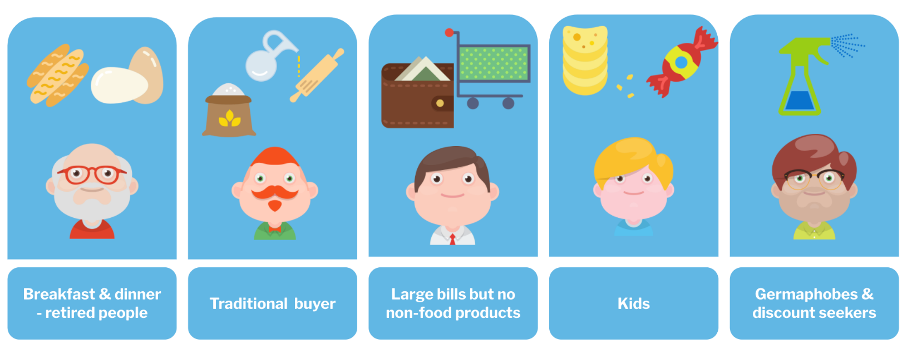
Introduction
Why recommender system is important?
It can drive traffic through personalized email messages to the store site and increase average order value.
It also enhances the shopping experience by delivering relevant content based on personalized preferences.
It can reduce workload for inventory management and boost work effectiveness.
It can create comprehensive reports to support making the right decision for business direction.
Overall, product recommender systems not only boost the companies’ revenue but also increase customer satisfaction and loyalty.
Notes:
As E-commerce becomes more and more popular in recent years, especially by the impact of the COVID-19 pandemic, many retailers and companies are switching their business models to adapt to the trend. In addition, with the rapid growth of big data technology, the cost of storage capacity to store enormous amounts of data decreases gradually. No matter the tech giant or start-up, all companies can make use of the gathered data to boost their business success.
So why recommender system is important in the current era? There are several benefits that businesses can achieve using product recommender systems.
The objective of this project is to analyze the reason for a product to be recommended and explore different data science methods and algorithms to implement product recommender systems. It will provide business owners or start-up companies a better idea of how recommender systems work and the related advantages.

Slide 5
2
Research Questions

Slide 6
Research Questions
What characteristics are useful to generate personalized recommendations?
Which recommender systems algorithms/methods are most successful and practical?
Can textual data improve recommender systems' performance?
Notes:
Before jump into the machine learning section, let’s review the research questions. Through this project, I would like to figure out
What characteristics are useful to generate personalized recommendations?
Which recommender systems algorithms/methods are most successful and practical?
Can textual data improve recommender systems' performance?

Slide 7
3
Data Sources

Slide 8
Data Sources
The data for this project is the Amazon Review Data (2018) which is collected by the University of California San Diego (https://nijianmo.github.io/amazon/index.html).
The dataset includes reviews data and product metadata.
It contains a total number of 233.1 million real reviews with the size of 34 gigabytes from Amazon.
Due to the computing resource limitation, a subset in Appliances category will be used for this project.
Notes:
The reason why I chose the Appliances subset for this project is that it has a moderate number of products and reviews, so it is a great representation of the entire dataset and shows how the recommender system works. Future studies can leverage my project to the different product categories in this dataset or even apply it to the entire dataset if they have sufficient computing resources.

Slide 9
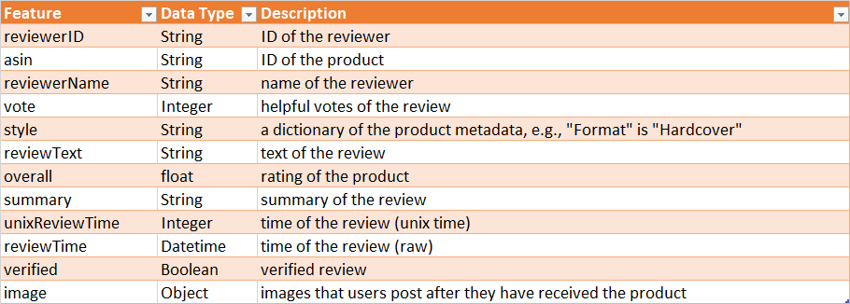
Review Data
There are a total of 602,777 review records in the Appliances category, and the dataset has 12 different features.
The interested feature are overall, reviewTime, reviewerID, asin, reviewText, summary.

Slide 10
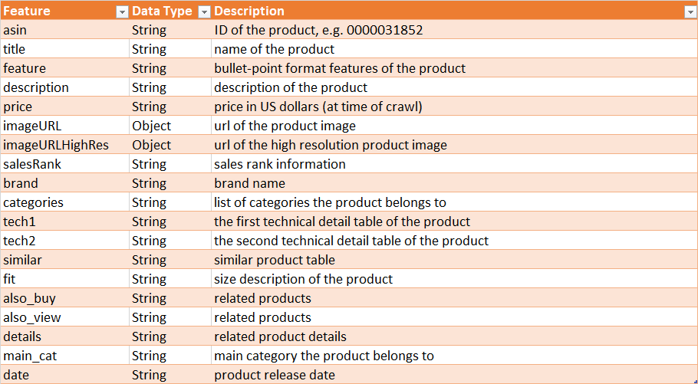
Product Data
There are a total of 30,239 product records in this category, and the dataset has 19 different features.
The interested feature are category, description, title, brand, feature, main_cat, date, price, asin, imageURLHighRes.

Slide 11
4
Research Process

Slide 12
Research Process
System Integration and Deployment
EDA
Models Development
Collect Data
Notes:
In addition, let's recap what the research process for this project, my goal is to develop a recommender system and also provide a friend user interface. We have covered collect data and EDA sections, so now I will demonstrate the models development and system integration process.

Slide 13
Research Process
Product Recommender Systems
Collect Data
EDA
ML Models
User Interface
01
02
03
04
Collect necessary data for the recommender systems.
Discover insights of the review and product data, and prepare for ML models.
Content-based Filtering model, Collaborative Filtering model and Hybrid model.
Website and Chabot to interact with users and to provide a list of recommendations.

Slide 14
5
Exploratory Data Analysis

Slide 15
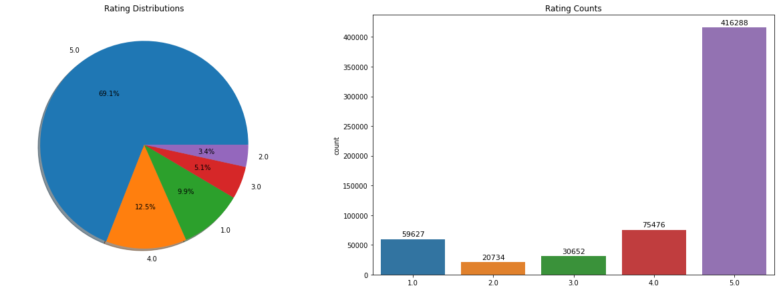
EDA – Review Data
The rating distribution graphs show that the overall ratings in this review data set are highly imbalanced, which contains more than 69% of 5 stars rating.
Notes:
The rating distribution graphs show that the overall ratings in this review data set are highly imbalanced, which contains more than 69% of 5 stars rating.
Thus, in the following model development, we need to keep in mind that the accuracy metric may not be useful for evaluating the machine learning models; instead, precision, recall, and F1 score values could be suitable for model evaluation.

Slide 16
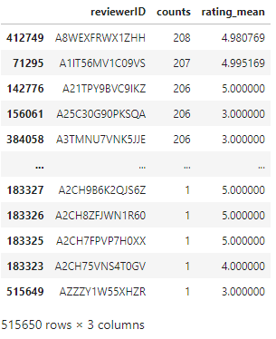
EDA – Review Data
There are a total of 515,650 distinct reviewers in this dataset, and the most active reviewer had reviewed 208 products with an average 4.98 rating score.

Slide 17
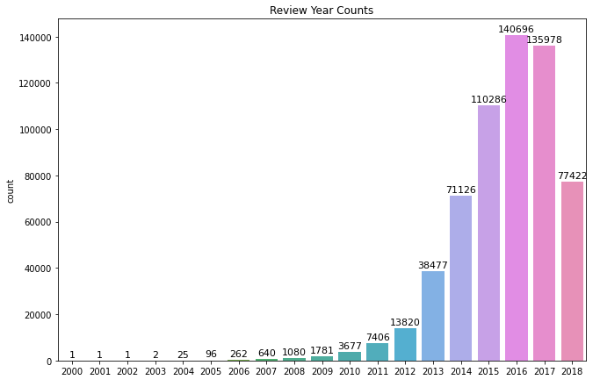
EDA – Review Data
The review year distribution graphs show that the reviews in this dataset are heavily collected after the year 2013, which can quite well represent the current generation customers' preferences.

Slide 18
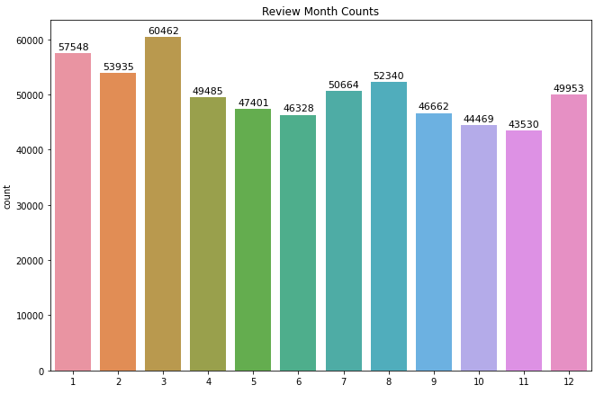
EDA – Review Data
The review month distribution graphs show that the months are quite evenly distributed in the dataset, which we can conclude that the season doesn't play a significant role in the influence of the purchase of the appliances.

Slide 19
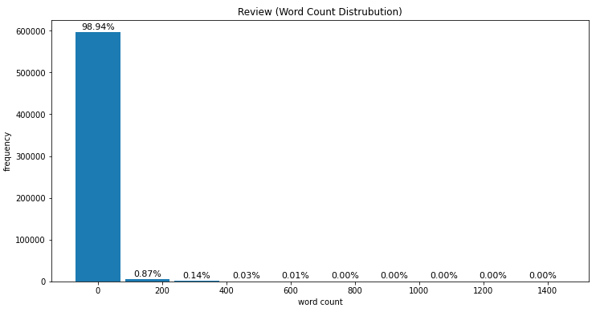
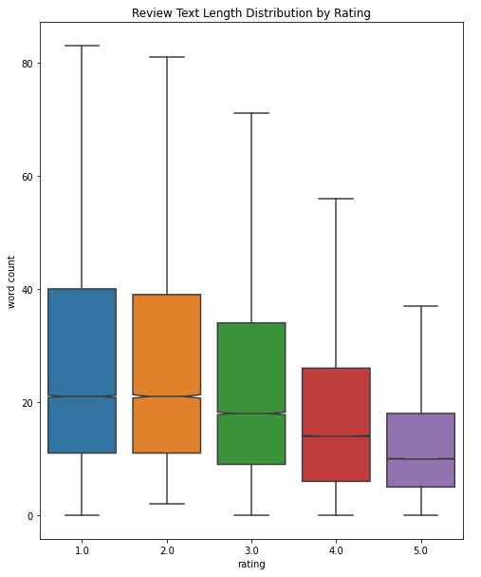
EDA – Review Data
Most of the reviews contain less than 100 words.
The word counts distributions for each star rating review are similar. The box plot shows that the 5 stars rating reviews have the lowest interquartile range (IQR) compared to the other 4 ratings, which implies that it has average the shortest review text.
Notes:
Most of the reviews contain less than 100 words. The word counts distributions for each star rating review are similar, but if we look in to the detail of the box plot graph, we could see that negative or low star rating reviews have more texts entered. The box plot shows that the 5 stars rating reviews have the lowest interquartile range (IQR) compared to the other 4 ratings, which implies that it has average the shortest review text.

Slide 20
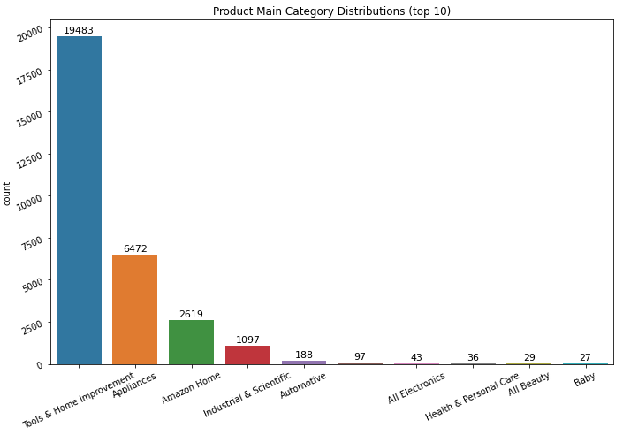
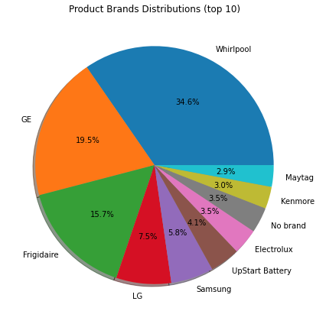
EDA – Product Data
The majority of the products (64.7%) are in the Tools & Home Improvement category, and the Appliances category also holds 21.5%.
There are a total of 2,762 brands, and Whirlpool is at the rank 1 position of amount of products.

Slide 21
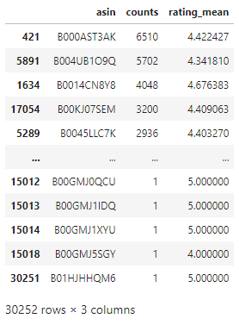
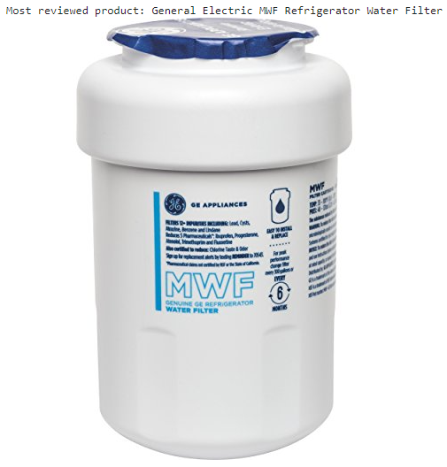
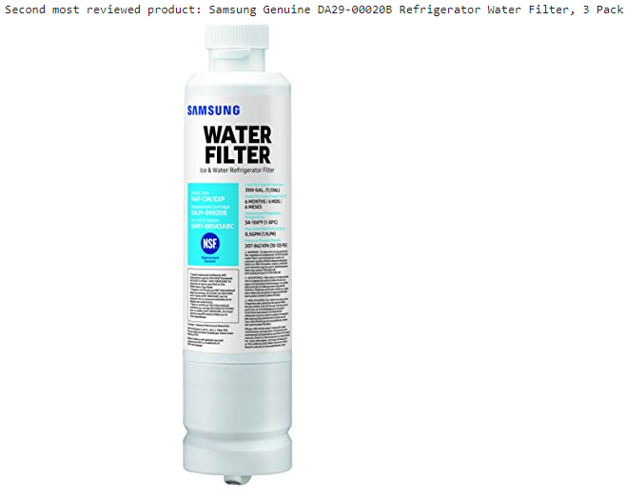
EDA – Product Data
This is the list of the ranking of most reviewed products and their average ratings. Among 30,239 Appliances products, there are 30,252 products were reviewed. So there are some products are not included in the product dataset.
Within this list, the most reviewed product is General Electric MWF Refrigerator Water Filter, and the second most reviewed product is Samsung Genuine DA29-00020B Refrigerator Water Filter, 3 Pack. Both of them are Refrigerator Water Filters.

Slide 22
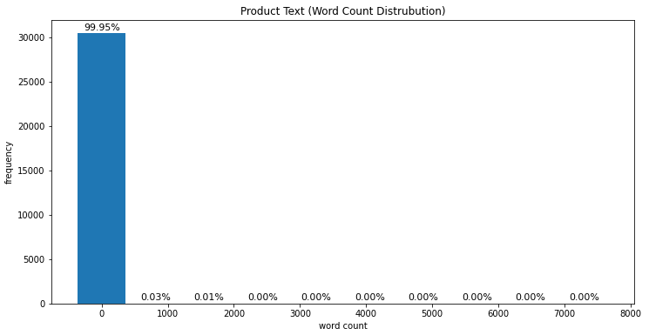
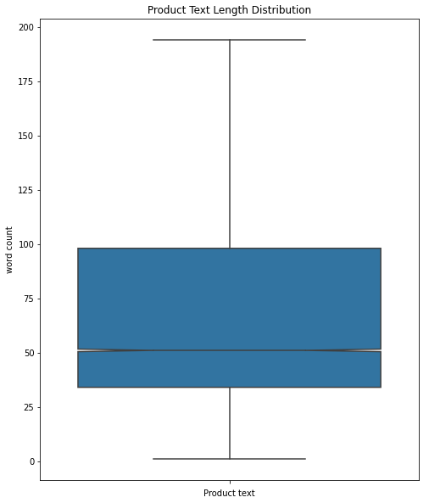
EDA – Product Data
The product text distribution histogram and box plot show that majority of the product text is less than 1000 words. There are only a few outliers that are greater than 2000 words, so for future NLP model development, in order to reduce the padding size, we can consider a smaller number instead.

Slide 23
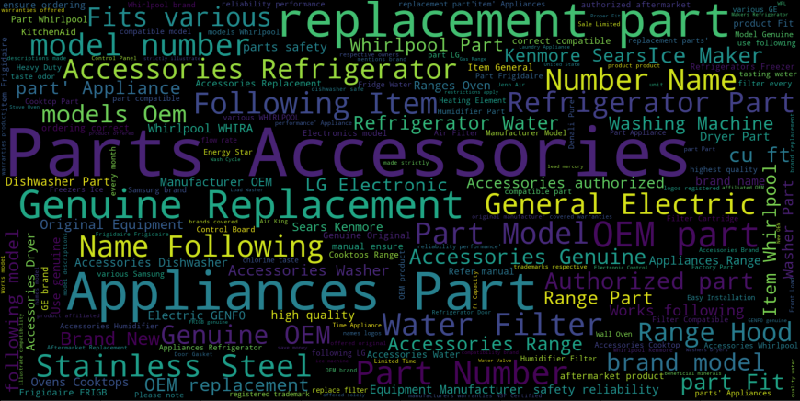
EDA – Product Data
The word cloud shows that the most frequently used words for Appliances products are related to replacement, part, and model number.

Slide 24
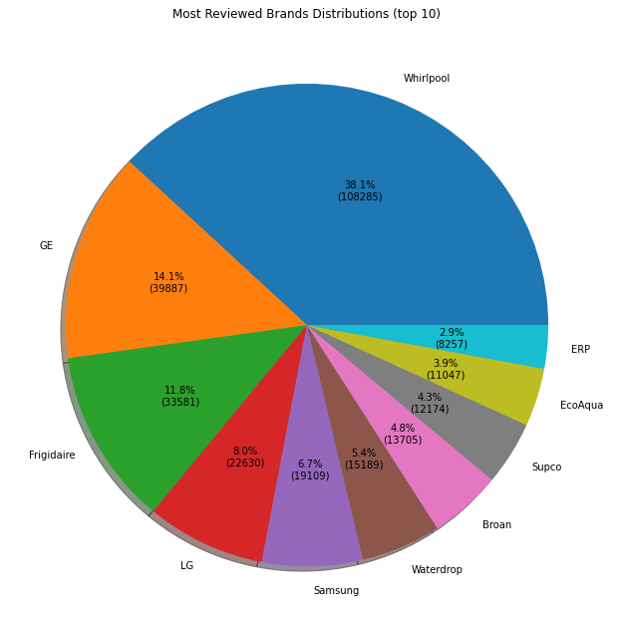
EDA – Merged Data
Most Reviewed Brands Distributions (top 10) graphs show that Whirlpool products have the rank 1 position of amount of reviews.
There are some other brands in the list that are not in the list of top 10 product numbers, which means offering more products doesn't imply more sales and revenue.
Notes:
To find out more insights within this dataset, we can merge the cleaned review and product datasets.
Most Reviewed Brands Distributions (top 10) graphs show that Whirlpool products have the rank 1 position of amount of reviews. However, there are some other brands in the list that are not in the list of top 10 product numbers, which means offering more products doesn't imply more purchasing and revenue.

Slide 25
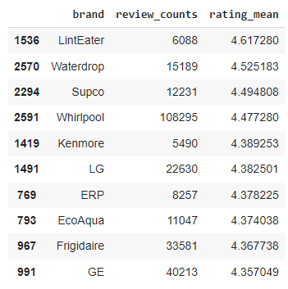
EDA – Merged Data
This table shows the top 10 average rating brand (reviews > 5000) in the dataset.
The result show that brand LintEater has the highest average rating 4.62 with over 6,000 reviews. Whereas Whirlpool has the rank 4 in this list.
Notes:
This table shows the top 10 average rating brand (reviews > 5000) in the dataset. There are many brand only have a few reviews, and their average rating will definitely be higher than other brands with more reviews, so we only consider the brands with at least 5,000 reviews for this analysis.
The result show that brand LintEater has the highest average rating 4.62 with over 6,000 reviews. Whereas Whirlpool has the rank 4 in this list, however; it also has the most review number and most products offered in the Appliance category. It means Whirlpool is doing great in offering both overall product quality and quantity.

Slide 26
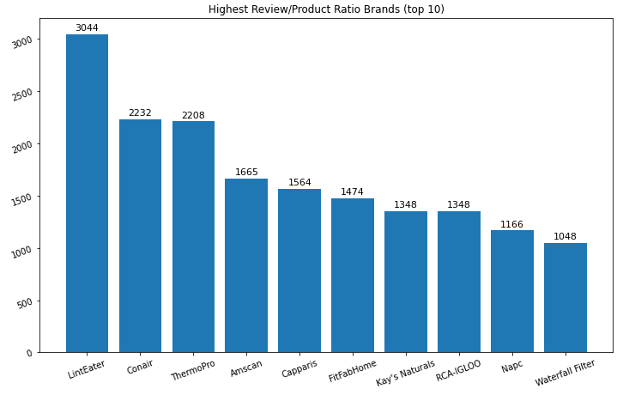
EDA – Merged Data
This graph shows that LintEater has the best review per product ratio in the dataset. And most of the brands are not in the top ranking of the number of products, which again proves that offering more products doesn't imply more sales and revenue.

Slide 27
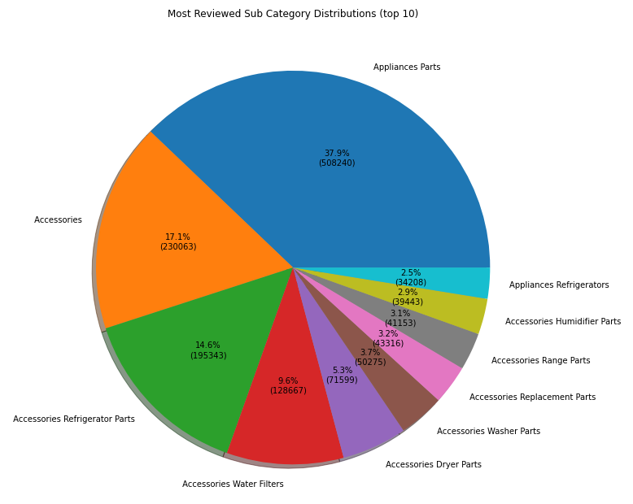
EDA – Merged Data
Most Reviewed Sub Category Distributions (top 10) graphs show that 37.9% of the reviews are in the Appliances Parts sub category, and the Accessories sub category also holds 17.1% in the dataset.
Notes:
Since the majority of the products’s main category is the Tools & Home Improvement, so we are likely to get the similar result for the most reviewed main category distribution. Instead, we can create product sub category graphs to see more detail about the category of the reviewed products.
Most Reviewed Sub Category Distributions (top 10) graphs show that 37.9% of the reviews are in the Appliances Parts sub category, and the Accessories sub category also holds 17.1% in the dataset.

Slide 28
6
Machine Learning Models

Slide 29

Base Model
A base model is a simple knowledge-based recommender that takes user inputs such as product category, brand, release year, and targeted price to search for matching products. It usually doesn't leverage machine learning to provide recommendations.
Notes:
First of all, we need a base model that can generate recommendations with the least input information.
A base model can be a simple knowledge-based recommender that takes user inputs such as product category, brand, release year, and targeted price to search for matching products. It usually doesn't leverage machine learning to provide recommendations.
For this project, we are not deploying a model that takes user inputs like mentioned. Instead, we sort the product lists by the rating mean and the review counts for generating a recommendation. This is the base model we would use if the users don't have a customer ID and product ID for the system.

Slide 30
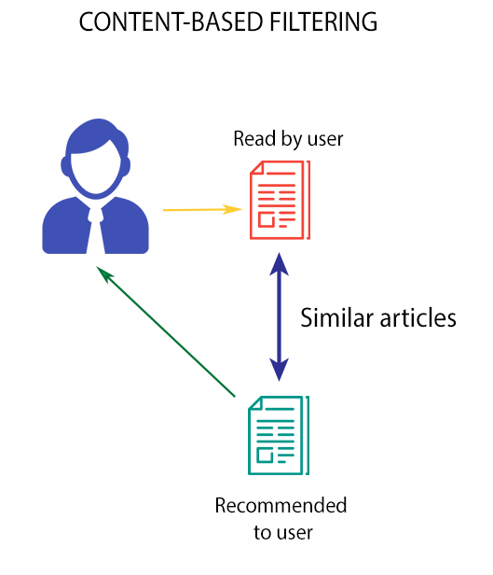
Content-Based Filtering
The idea of content-based filtering is to find the similarity products based on either metadata or product description. The most feasible approach is to apply the cosine similarity method against the textual data to find the most similar products.
Notes:
The next model would be the content-based filtering. The idea of content-based filtering is to find the similarity of products based on either metadata or product description. The most feasible approach is to apply the cosine similarity method against the textual or categorical data to find the most similar products.

Slide 31
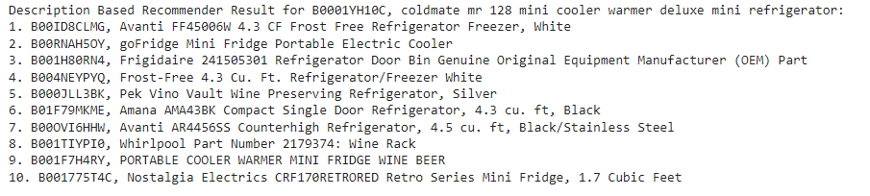
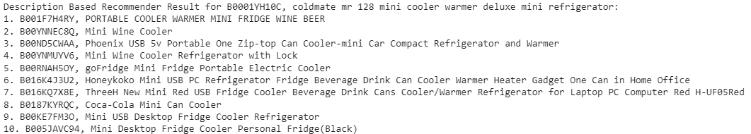
Content-Based Filtering
Product Description Cosine Similarity Model
Product Metadata Cosine Similarity Model
Notes:
I have applied this approach against both product description and metadata, and their recommendation results are very convincing. As you can see, the results from both model are returning similar product for the input mini refrigerator. However, this approach is not a good fit for Web API because the matrix size is too large for web hosting service storage and RAM, so we have to try using another method for Web API deployment for the content-based filtering.

Slide 32
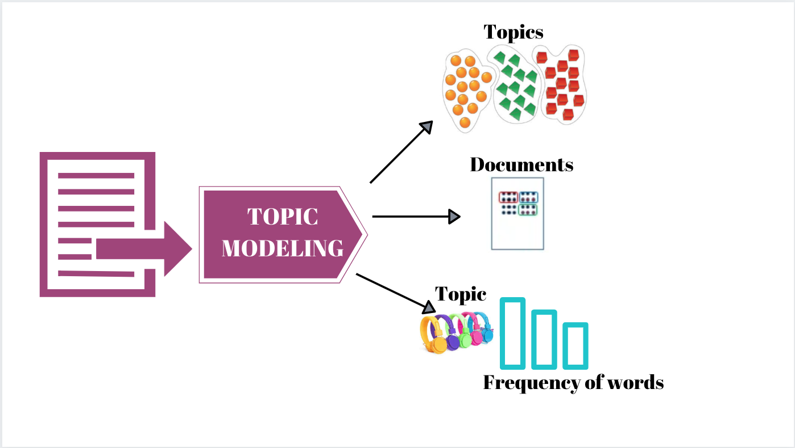
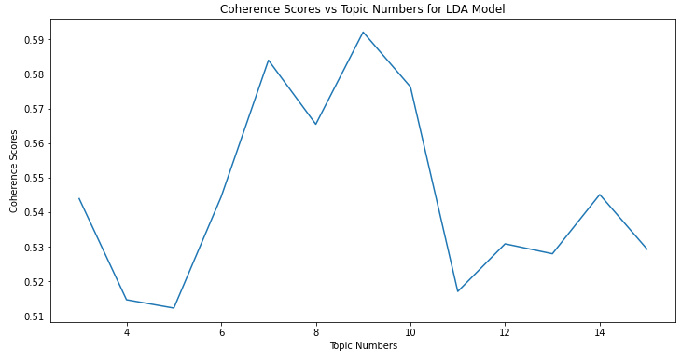
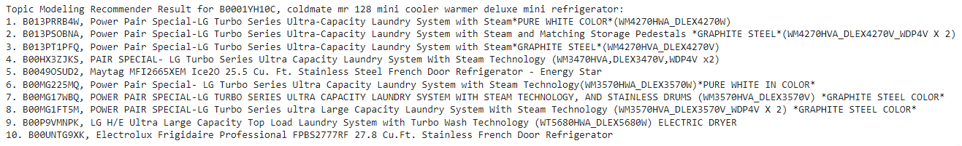
Content-Based Filtering
Notes:
After some research, I found that the topic modeling approach could be an alternative solution. Instead of computing the huge similarity matrix, leveraging a probabilistic topic model like LDA can divide the entire product set into different topics or categories in our case. For creating recommendations, we can find the products that share the same topics among the product list and output the products with the highest probability scores. Although the output will be less precise than the cosine similarity models, it can be a good fit for Web API deployment.
To find out how many topics exist in our product dataset, coherence values analysis is applied and the output shows that topic number 9 has the best coherence score, so we will use 9 topics for the final LDA model.
The Final LDA model has a Coherence Score: 0.606, and the topic modeling recommender did a fairly good job. Compare to the cosine similarity models, it is generating less precise recommendations, but the data file size would be much smaller because it is just adding extra topic number and probability columns to the dataset. Thus, we use the LDA model output for Web API depoyment.

Slide 33
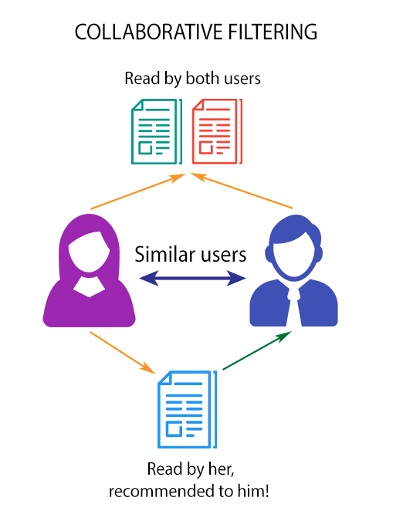
Collaborative Filtering
The idea of collaborative filtering for recommender systems are methods based on past interactions recorded between users
and items to generate new recommendations. The past user-item interactions represent the bases to detect similar users and/or similar items and to make predictions based on estimated proximities
Notes:
The next model would be the Collaborative filtering. The idea of Collaborative methods for recommender systems are based on past interactions recorded between users and items to generate new recommendations. The past user-item interactions represent the bases to detect similar users and/or similar items and to make predictions based on estimated proximities.
The class of collaborative filtering algorithms is divided into two sub-categories called memory-based and model-based.
Memory-based approaches directly work with values of recorded interactions and based on nearest neighbors search or KNN (find the closest users from a referenced user and suggest the most popular items among these neighbors)
Model-based approaches assume there is an underlying generative model that explains the user-item interactions and tries to identify it in order to make new predictions

Slide 34
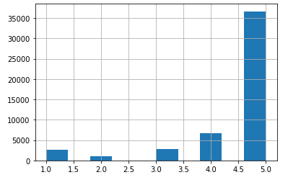
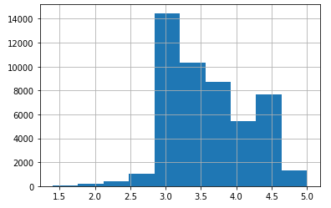
Collaborative Filtering
Review Rating Distribution
Review Sentiment Score Distribution
Notes:
For training the collaborative filtering model, the most useful feature is review rating score in the review dataset. For this project, we only consider the customer with at least 3 review records in our dataset. This will increase the recommendation output accuracy.
On the left-hand side, the graph shows the rating distribution for our selected training data. Since one of the objectives of this project is to find out if textual data can improve recommender systems' performance, I have also performed sentiment analysis against the review text and converted the sentiment polarity score into the same range as the review rating. The graph on the right shows that based on the sentiment of the review text, the rating distribution should not be that imbalanced.
Becasue of the sentiment data is tend to be more normally distributed, I choose to use it for the machine learning models instead of the original rating.

Slide 35
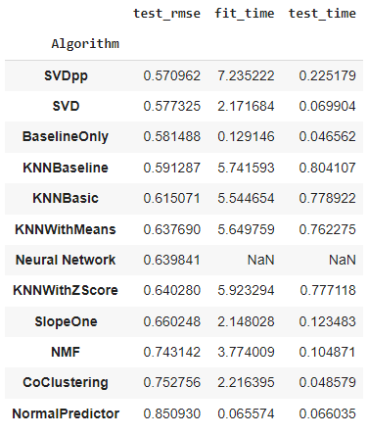
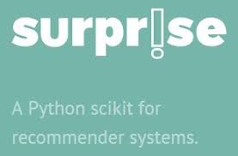
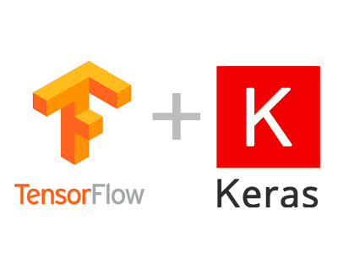
Collaborative Filtering
Notes:
Surprise is a good Python library to build collaborative recommendation system for both memory based and model based models.
I have applied all the algorithms supported by Surprise and developed a deep neural network by TensorFlow and Keras to compare their performance results. The result table shows that SVDpp and SVD have a very close performance, but the training and testing time of SVDpp is longer than SVD. Thus, the SVD is our choice for the collaborative filtering recommendation model deployment.

Slide 36
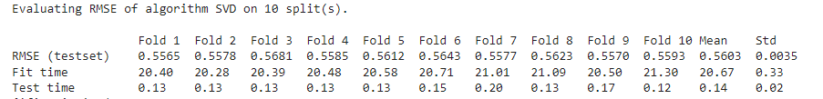
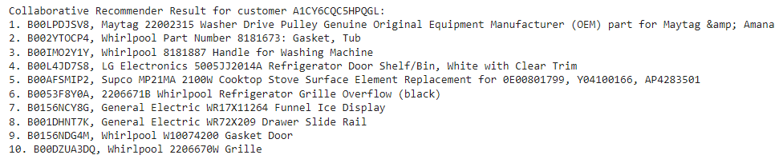
Collaborative Filtering
Notes:
After the algorithm is picked, I have performed some parameter tuning using GridSearchCV to improve the performance as much as possible, and the final SVD model for deployment has a average 0.56 rmse testing score which is the best among all the collaborative filtering models.
And the collaborative filtering model will take a reviewer ID as input to generate recommendation like this. Unlike content-based filtering, the results are personalized specifically for this customer.

Slide 37
Hybrid Model
Content-based Filtering Model
Collaborative Filtering Model
Hybrid Recommenders Model
Notes:
The above two types of filtering have their own drawbacks such as the novelty problem of Content-based Filtering and the cold start problem of Collaborative Filtering, so in reality, more robust recommender systems like hybrid recommenders are often used. I have built a hybrid recommender that combines Content-based Filtering and Collaborative Filtering to overcome the drawbacks and improve overall performance.
Our Hybrid Model will take both reviewer ID and product ID as input, and first get 100 recommendation results from the content-based filtering model, then input the reviewer ID and the recommended product IDs from the Content-based filtering model to the Collaborative filtering model. This model will generate recommendations that meet product similarities and customer personality as much as possible.
Of course, if either ID is missing from the input, our system can handle it by calling its "Child Models" to generate recommendations respectively. If no input IDs are entered, then it will use our base model for the recommendation.

Slide 38
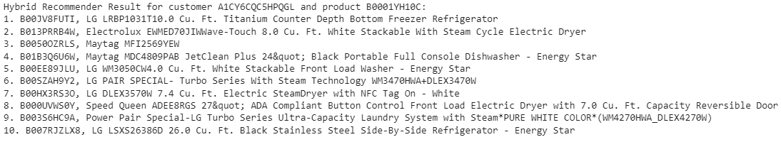
Hybrid Model
The recommendation result shows that the hybrid model is suggesting more products that are similar to the product ID B0001YH10C for customer ID A1CY6CQC5HPQGL
Notes:
As you can see, the recommendation result shows that the hybrid model is suggesting more products that are similar to the input product ID mini refrigerator for the input customer ID because this model takes individual advantage of content-based and collaborative filtering.

Slide 39
7
System Integration
Notes:
For recommendation system deployment, a user interface was developed by integrating with multiple platforms and servers. This section will illustrate the system integration details and provide a live recommendation website at the end.

Slide 40



System Integration
Develop a Flask website and use PythonAnywhere web hosting service to host our recommender system.
Develop a Chabot using DialogFlow platform to assist users for product recommendation and integrate it with the Flask website.
Notes:
First of all, let’s introduce some key components of the system.
The first one is the web hosting service that runs our web application and recommendation models. I chose PythonAnywhere because it is free and it provides the ability to run and execute Python codes within the environment from any machine, any location. The only drawback is the free version has limited computing and storage power.
The second tool is the chatbot development platform that connect user input with recommendation models. I chose DialogFlow because it is powered by Google’s machine learning, easy to use, and supports fulfillment request.
So now we have our machine learning model, web application, web hosting service, and chatbot ready, let’s integrate them into a functioning system

Slide 41
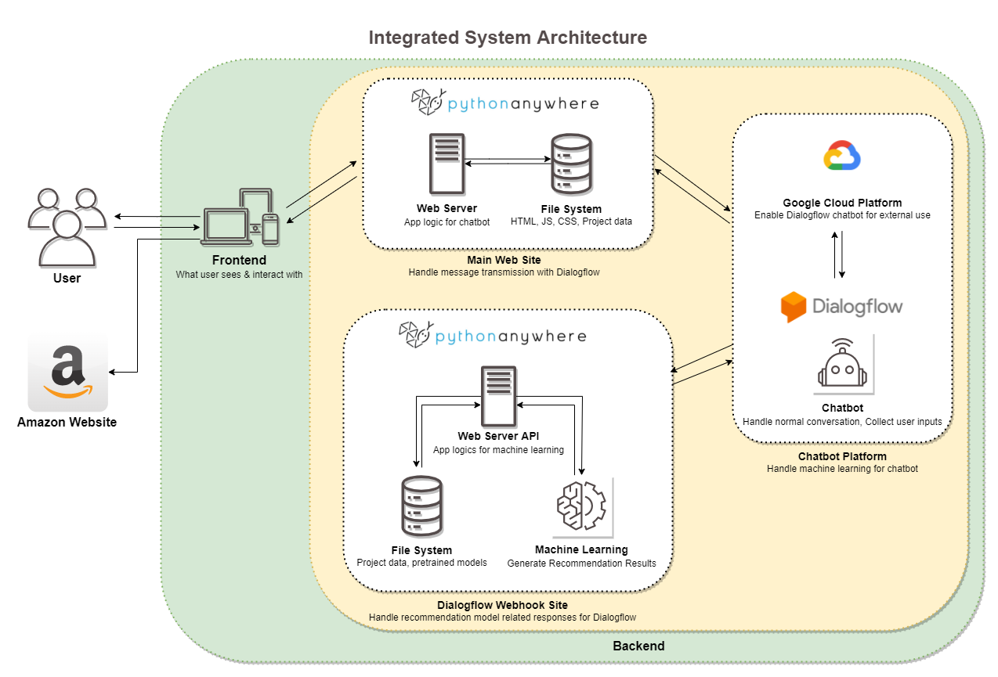
Notes:
This is a system architecture diagram for this project, it shows the interaction flow between each component and their roles in this integrated system.
Let’s start with the backend where our core components reside on. We have two web servers, one is hosting our web application, which handles message transmission with Dialogflow. another one is hosting our webhook API for handling recommendation model-related responses. Then we have a chatbot in the middle to connect these two web servers. The chatbot utilizes Google Cloud Platform for external use and it handles conversation and collects user inputs. Normally, the standalone chatbot can handle the regular conversation, but if any chat responses require machine learning results, it will send a request with user input IDs to our web API. Then our web API will run the pretrained model and send back the result.
Finally, all chat responses will go through our first web server and to be displayed on the frontend to the user.
The architecture is pretty straightforward, but our chatbot doesn’t know when to call our web API unless we tell it to do so, so the next step is to design our chatbot conversation flow to set conditions for collecting the necessary input from the users for calling our recommendation models.

Slide 42
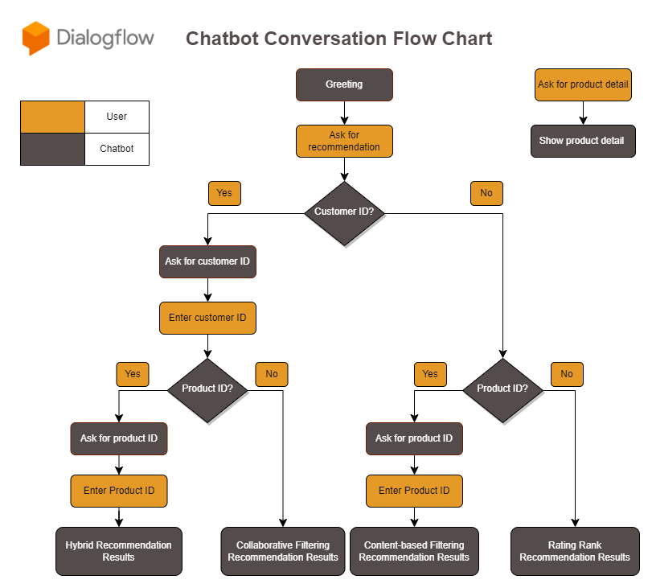
Notes:
This is the chatbot conversation flow chart for the project, it bascially illustrate how the chatbot help us to collect information through the conversation.
In this chart, the orange color represents users and the black color represents the chatbot agent. If users ask for recommendations, the agent will ask if they have a customer ID, if they respond yes, then the agent will take the left path and vice versa. With the subsequent similar conversations, the agent will collect the necessary customer ID and product ID and store them as parameters.
After the information is collected, the chatbot will send those parameters to our machine learning models Web API, and the API will generate recommendations using the appropriate model based on the input data.

Slide 43
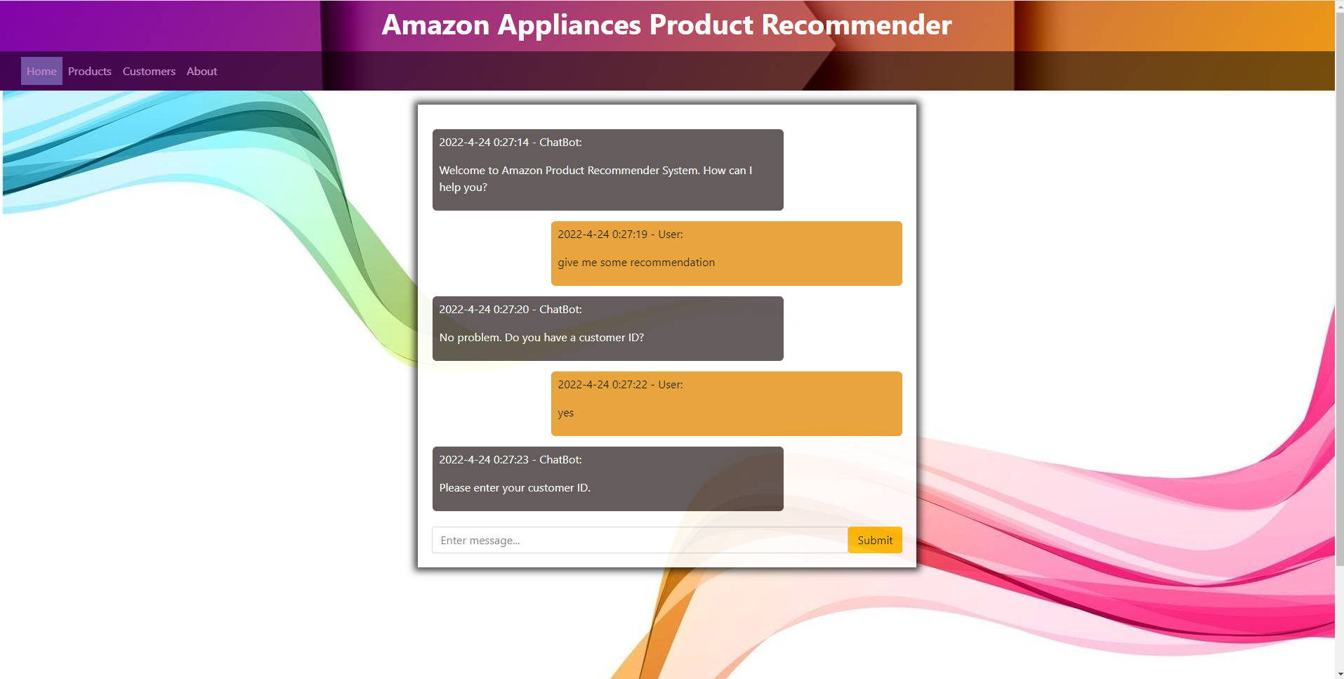
Live Recommender System
The recommendation chatbot website is hosted at: https://data606project.pythonanywhere.com
Notes:
Now we understand the system infrastructure and chatbot conversation flow, let’s see the integrated system in action.
The live recommender system website is hosted at this address. It contains a chatbot on the home page, and in the navigation bar, it has a product and customer tab that will redirect users to the ID lookup tables, so we can use these tables for testing the chatbot.

Slide 44
8
Conclusion

Slide 45

Outcomes
Developed a product recommender system that can accurately predict customers' preferences
There is no optimal recommendation algorithm/method
The most useful characteristics to promote certain products to customers are product description and review rating/text
Textual data plays a significant role in recommender systems
Provide a website and Chatbot to assist amazon users to make purchase decisions.
Notes:
Through the research process for this project, I have developed a comprehensive product recommender system that can accurately predict customer’s preferences.
By the EDA and machine learning model development, we can conclude that there is no optimal recommendation algorithm/method, all algorithms are practical but also come with their own drawback. That’s why in real-world scenarios, a hybrid model is more likely to be used.
However, we find that the most useful characteristics to promote products are based on what recommendation method we use. For content-based filtering, product description is the key feature. For collaborative filtering, review rating/text is the most important factor.
Besides, textual data plays a significant role in recommender systems, either content-based or collaborative filtering can leverage textual data and its sentiment to generate precise recommendations.
And to offer a better user experience, I kinda explored the software and chatbot development, and build a integrated system to assist amazon users to make purchase decisions.
Overall, this project gives a comprehensive report of how recommender systems work. It demonstrates every aspect from collecting data, EDA, machine learning, to system deployment, and hopefully, it can help any audience better understand why and how to create such a system.

Slide 46

Limitation
The data used for this project is a subset of the original data
The deployed models are not optimal
Offline Recommender System
Notes:
There are some limitation for this project.
One of them is the data we used, it is only a subset of the original dataset, so the recommender systems will not work for other products category in the dataset.
Another one is the deployed machine learning models. The optimal models are not able to be deployed due to the limited budget and resources, otherwise, users can get more accurate recommendation results.
And the developed recommender system is an offline recommender which means it cannot generate recommendations for any new customer and product that doesn’t originally exist in the dataset, and it will not update synchronously with new purchases.

Slide 47

Future Research
Cross-domain recommender system
Online Recommender Methods
Notes:
Since we have some limitations for this project, we can extend this project by researching in these directions.
One future research option could be to utilize the entire dataset to develop a cross-domain recommender system, it will definitely require more computing resources for handling big data, but the final recommender system can be powerful to recommend any product on the Amazon website.
Another research direction is to explore online recommender system approaches, one could be session-based recommender system which rely on the user’s most recent interactions rather than on the user’s historical preferences. Another one could be to utilize reinforcement learning to train the recommendation models based on the most recent user interactions, so the system could be updated synchronously to generate more accurate results.

Slide 48
References
Jianmo Ni, Jiacheng Li, Julian McAuley Empirical Methods in Natural Language Processing (EMNLP), 2019 http://cseweb.ucsd.edu/~jmcauley/pdfs/emnlp19a.pdf
Doshi, S. (2019, February 20). Brief on Recommender Systems. Medium. Retrieved February 13, 2022, from https://towardsdatascience.com/brief-on-recommender-systems-b86a1068a4dd
Engineering@ZenOfAI. (2019, August 7). Creating chatbot with Webhooks using python (FLASK) and dialogflow. Medium. Retrieved March 5, 2022, from https://medium.com/zenofai/creating-chatbot-using-python-flask-d6947d8ef805
BANIK, R. O. U. N. A. K. (2018). Hands-on recommendation systems with Python: Start building powerful and personalized, ... recommendation engines with python. PACKT Publishing Limited.
Kapadia, S. (2020, December 29). Topic modeling in Python: Latent dirichlet allocation (LDA). Medium. Retrieved April 24, 2022, from https://towardsdatascience.com/end-to-end-topic-modeling-in-python-latent-dirichlet-allocation-lda-35ce4ed6b3e0
Tanner, G. (n.d.). Building a book recommendation system using Keras. Gilbert Tanner. Retrieved April 24, 2022, from https://gilberttanner.com/blog/building-a-book-recommendation-system-usingkeras

Slide 49
Thanks

