Slide 1

H1B CASE STATUS ANALYSIS
Presented by
Rohith Ram Maringanti
Sai Divyanjali Muddasani
Under guidance of
Dr. Chaojie Wang
UMBC

Slide 2
Slide Distribution
Sai Divyanjali Rohith Ram
Introduction
Dataset
Research Questions
Framework
EDA Results
EDA Results
Visualization
Machine Learning Models
Deployment
References
UMBC

Slide 3
Introduction
The H-1B is a visa in the United States under the Immigration and Nationality Act, section 101(a)(15)(H) that allows U.S. employers to temporarily employ foreign workers in specialty occupations. A specialty occupation requires the application of specialized knowledge. (Wikipedia)
Our project aims to predict if a case will be certified or denied.
The dataset of past 5 years is taken from the official government website – Department of Labor.
https://www.dol.gov/agencies/eta/foreign-labor/performance
In the process of achieving our goal, we discovered many insights from the data.
We visualized results using ‘plotly’ and will apply various machine learning algorithms to predict the result of the case status.
UMBC

Slide 4
Dataset
The data contains case files corresponding to 190,000 applicants over 5 years. The data contains 30+ columns which constitutes few important attributes as follows.
Attribute | Data Type | Description
EMPLOYER_NAME | String Type | The company which sponsors H1B for the applicants
EMPLOYER_PROVINCE | String Type | The state in which employee works
SOC_TITLE | String Type | The field of work type
WAGE | Integer Type | Annual income of employers
MINIMUM_EDUCATION | String Type | High School, Bachelors or Masters
MAJOR_FIELD_OF_STUDY | String Type | Applicant's academic major
COUNTRY_OF_CITIZENSHIP | String Type | Applicant's Home Country
UMBC

Slide 5
Research Questions
Our project aims to find answers to the following questions
Will a particular case status be certified or denied?
What is the approval rate each year?
What is the percentage of approved cases?
Which state has higher tendencies of H1B approvals?
What are the top-most companies sponsoring H1B?
Does salary have any influence on H1B approvals?
What is majority of applicants’ educational background?
Which job roles are offered H1B the most?
Which countries do the immigrants come from?
UMBC

Slide 6
Framework
Data Collection from DOL website
Data Preprocessing
EDA
Visualization
Implementing Machine Learning Algorithms
Predicting Output
UMBC

Slide 7
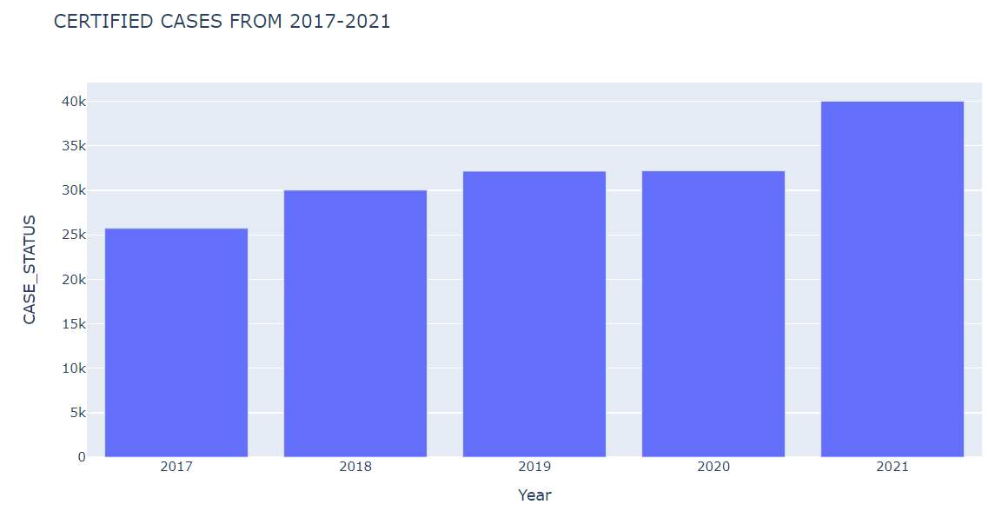
EDA Results
Number of H-1B certified applications are increasing every year
In the recent past, number of H-1B applications nearly doubled to that of 2017
With the given trend, we can conclude that number of certified cases will increase leaps and bounds in the year 2022
UMBC

Slide 8
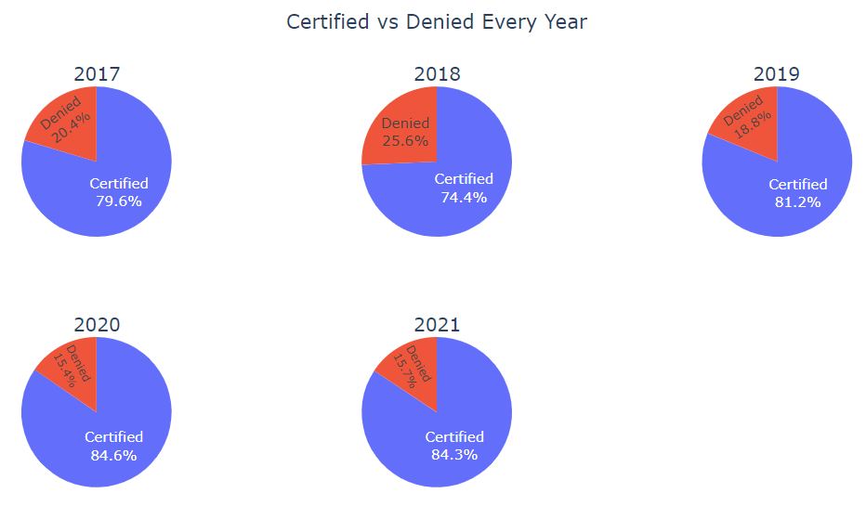
Certified vs Denied
In the year 2018, highest number of H1B cases were denied.
1 out of every 4 application was denied.
While 2018 was the year with highest denial rate, 2020 and 2021 have highest approval rate.
UMBC

Slide 9
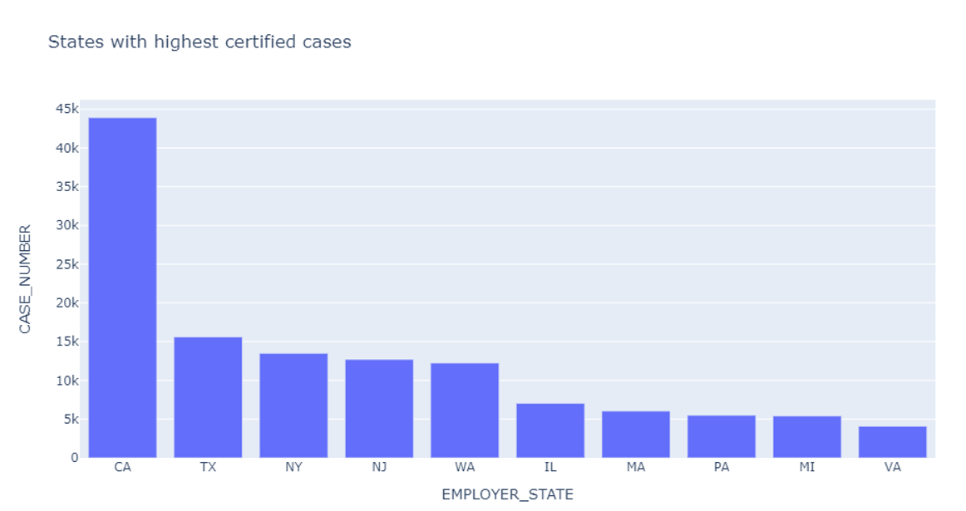
States with highest certified cases
California is the state which has highest number of certified H-1B cases leading by a large margin.
The state next to California is Texas with less than half approvals of California.
Other states among top 10 include New York, New Jersey, Washington, Virginia etc. Refer to the image below.
UMBC

Slide 10
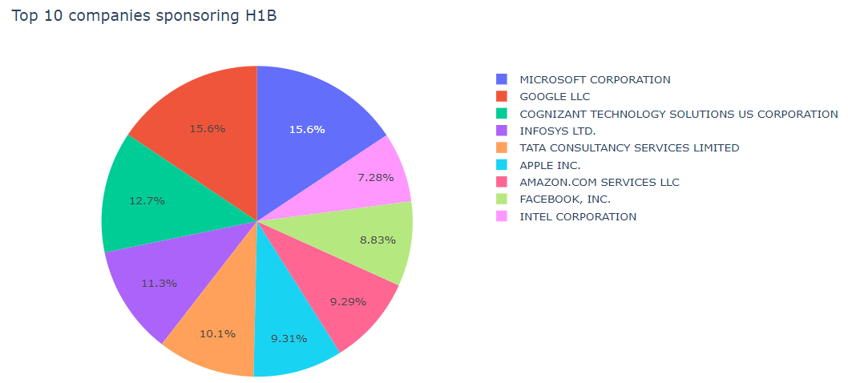
Top 10 companies sponsoring H1B
Tech Giants such as Microsoft, Google, Facebook, Amazon tops the list of H-1B sponsors.
Service based consulting companies which sponsor H-1Bs include Tata Consultancy Services, Infosys, Cognizant etc.
UMBC

Slide 11
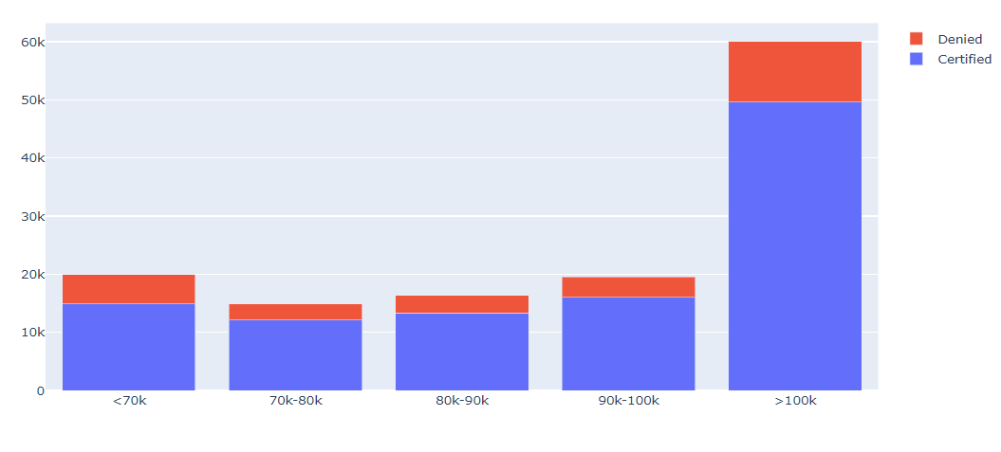
Salary Statistics
H1B sponsorship corresponds to renowned established companies like Amazon, Microsoft, Google Apple etc.
Almost every employee working in these companies receive salaries greater than 100k.
Hence, H1B sponsorship for salaries greater than 100k is much higher compared to salaries less than 100k.
UMBC

Slide 12
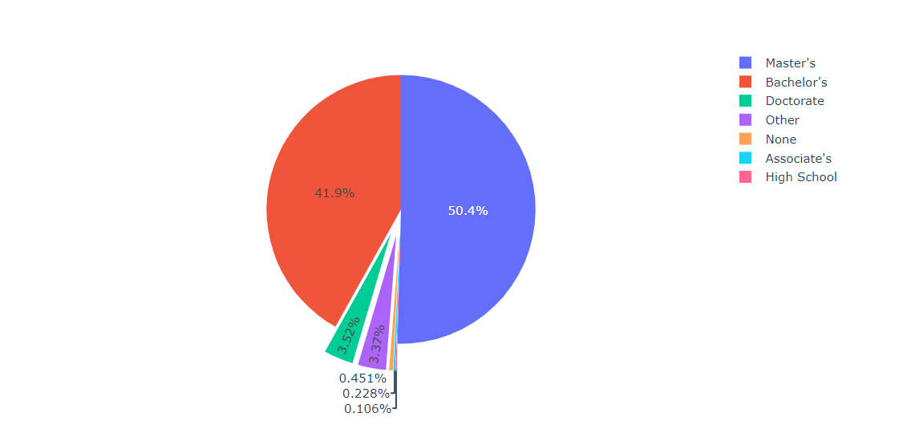
Educational Background
More than 90% of H1B applicants have either earned a Masters or a Bachelors degree.
Masters quota is leading with 50.4% while the Bachelors quota has nearly 42% applications.
Other educational backgrounds include Doctorate, High School grads etc.
UMBC

Slide 13
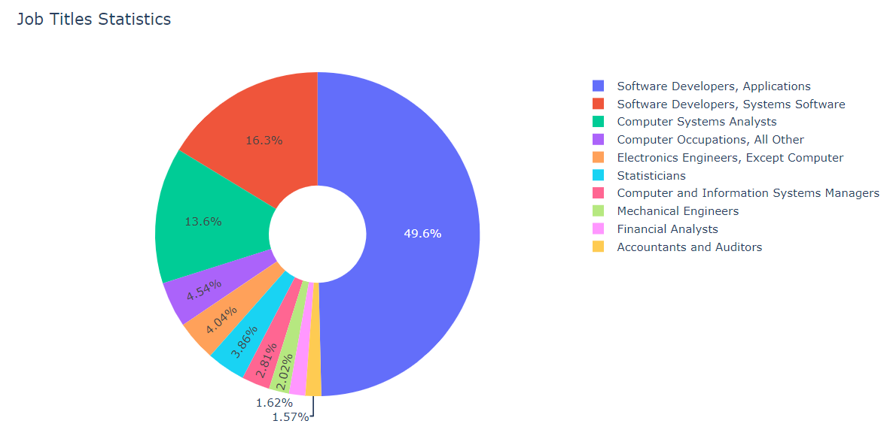
Job Title Statistics
Job titles corresponding to Software Industry lead the race of H1B approvals.
Majority of applicants are Software Developers. Other job titles include System Engineers, Data Analysts, Statisticians etc.
Few other industries include Electronics, Mechanical and Accounting sectors.
UMBC

Slide 14
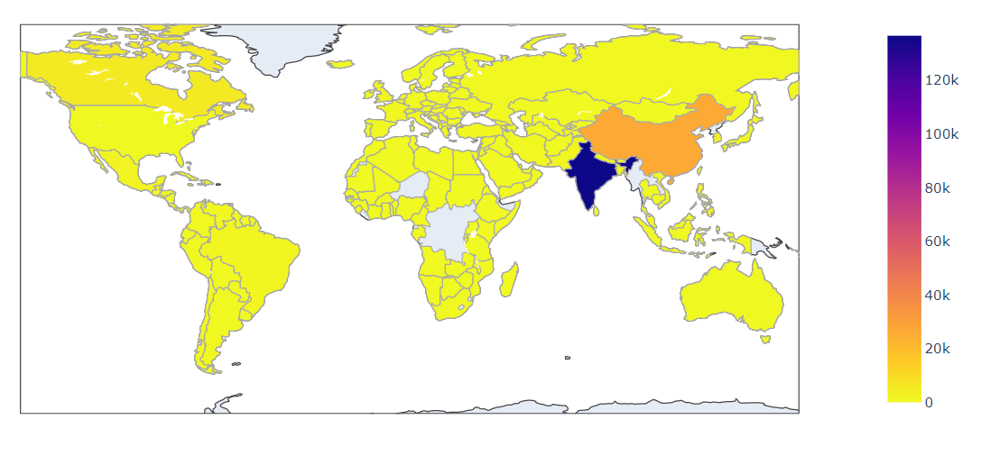
Immigrants home country
India is the leading country with utmost majority followed by China.
As per the statistics, the population of India and China are very high. We can hence assume that the population dreaming about studying abroad is higher.
Other top countries include Canada, South Korea etc. A choropleth map has been plotted to understand the results.
UMBC

Slide 15
Machine Learning Models
Planning to implement classification algorithms such as Support Vector Machine, KNN classifier, Random Forest.
Support vector machine works well with data with high dimensionality. It gives us faster prediction with better accuracy. Since H1B process application process is random. There would be possibility of outliers and hence, SVM would handle any outliers better than other models.
KNN Classifier works well in making real time predictions. It is very important to scale all features to the same level. Hence, will use standard scalar technique while building a model with KNN.
Implementing grid search for optimal parameter selection.
Building an ensemble model such as Random Forest which reduces variance in the data. Random Forest will work well with the data if there is any possibility of overfitting. The data contains many categorical values and hence, working with Random Forest would be a better choice.
Will use lazy predict to find if any additional algorithms would work well with the given data.
UMBC

Slide 16
Deployment
Planning to create a webpage for deployment of the model using ‘streamlit’.
By the development of the model, it would be easy for end user to utilize the application.
Users can predict their chances of their of being certified or denied.
The project will be very useful for individuals who are planning to relocate to US.
End users can access the data using the web page developed in streamlit.
UMBC

Slide 17
References
https://plotly.com/python/choropleth-maps/
https://plotly.com/python/subplots/
https://support.sisense.com/kb/en/article/donut-charts-%E2%80%94-plotly
https://support.sisense.com/kb/en/article/donut-charts-%E2%80%94-plotly
https://pypi.org/project/pycountry/
https://stackoverflow.com/questions/16253060/how-to-convert-country-names-to-iso-3166-1-alpha-2-values-using-python
UMBC

Slide 18

UMBC

