Slide 1

H1B CASE STATUS ANALYSIS
Presented by
TEAM B
Rohith Ram Maringanti
Sai Divyanjali Muddasani
Under guidance of
Dr. Chaojie Wang
UMBC

Slide 2
Slide Distribution
Sai Divyanjali Rohith Ram
Introduction
Research Questions
Framework
EDA Results
Streamlit Intro
Model Implementation Intro
Machine Learning Models
Deployment
Streamlit Demo
References
UMBC

Slide 3
Introduction
The H-1B is a visa in the United States under the Immigration and Nationality Act, section 101(a)(15)(H) that allows U.S. employers to temporarily employ foreign workers in specialty occupations. A specialty occupation requires the application of specialized knowledge. (Wikipedia)
Our project aims to predict if a case will be certified or denied.
The dataset of past 5 years is taken from the official government website – Department of Labor.
https://www.dol.gov/agencies/eta/foreign-labor/performance
In the process of achieving our goal, we discovered many insights from the data.
We visualized results using ‘plotly’ and will apply various machine learning algorithms to predict the result of the case status.
UMBC

Slide 4
Dataset
The data contains case files corresponding to 190,000 applicants over 5 years. The data contains 30+ columns which constitutes few important attributes as follows.
Attribute | Data Type | Description
EMPLOYER_NAME | String Type | The company which sponsors H1B for the applicants
EMPLOYER_PROVINCE | String Type | The state in which employee works
SOC_TITLE | String Type | The field of work type
WAGE | Integer Type | Annual income of employers
MINIMUM_EDUCATION | String Type | High School, Bachelors or Masters
MAJOR_FIELD_OF_STUDY | String Type | Applicant's academic major
COUNTRY_OF_CITIZENSHIP | String Type | Applicant's Home Country
UMBC

Slide 5
Research Questions
Our project aims to find answers to the following questions
Will a particular case status be certified or denied?
What is the approval-rate each year?
What is the percentage of approved cases?
Which state has higher tendencies of H1B approvals?
What are the top-most companies sponsoring H1B?
Does salary have any influence on H1B approvals?
What is majority of applicants’ educational background?
Which job roles are offered H1B the most?
Which countries do the immigrants come from?
UMBC

Slide 6
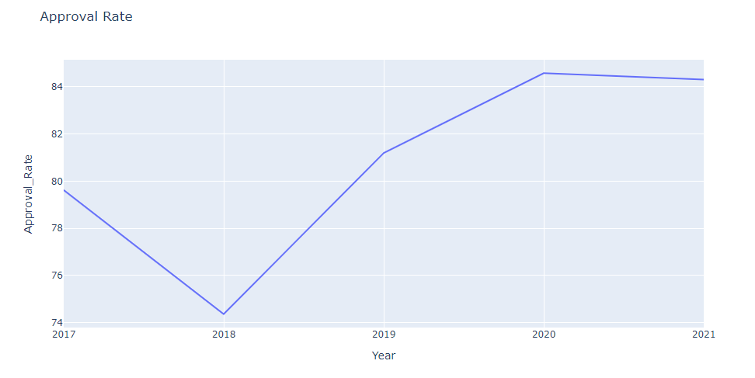
Certified vs Denied
In the year 2018, highest number of H1B cases were denied.
1 out of every 4 applications was denied.
While 2018 was the year with highest denial rate, 2020 and 2021 have highest approval rate.
UMBC

Slide 7
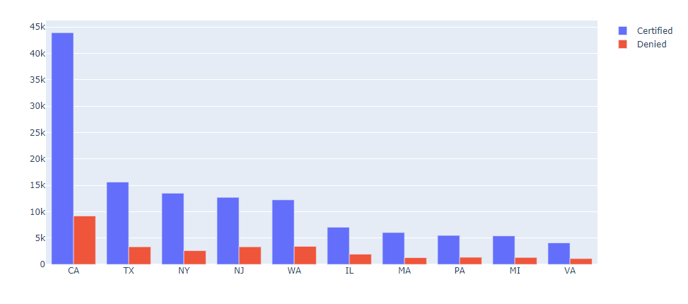
States with highest certified cases
California is the state which has highest number of certified H-1B cases leading by a large margin.
The state next to California is Texas with less than half approvals of California.
Other states among top 10 include New York, New Jersey, Washington, Virginia etc. Refer to the image below.
UMBC

Slide 8
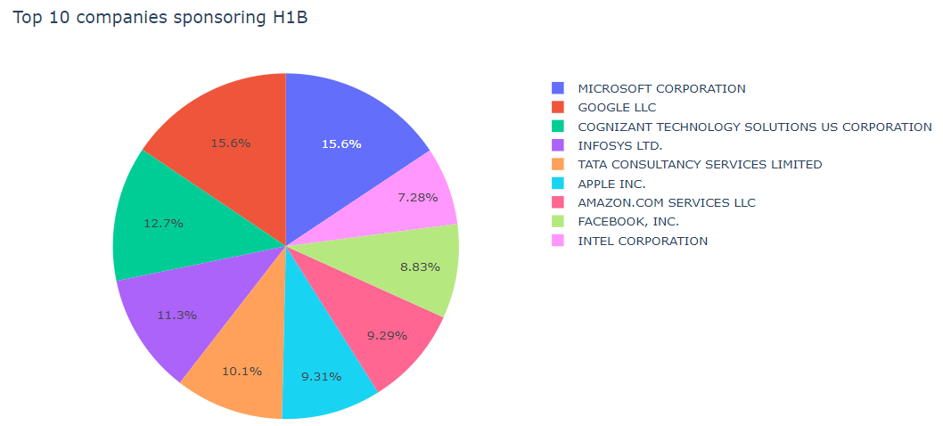
Tech Giants such as Microsoft, Google, Facebook, Amazon tops the list of H-1B sponsors.
Service based consulting companies which sponsor H-1Bs include Tata Consultancy Services, Infosys, Cognizant etc.
Top 10 companies sponsoring H1B
UMBC

Slide 9
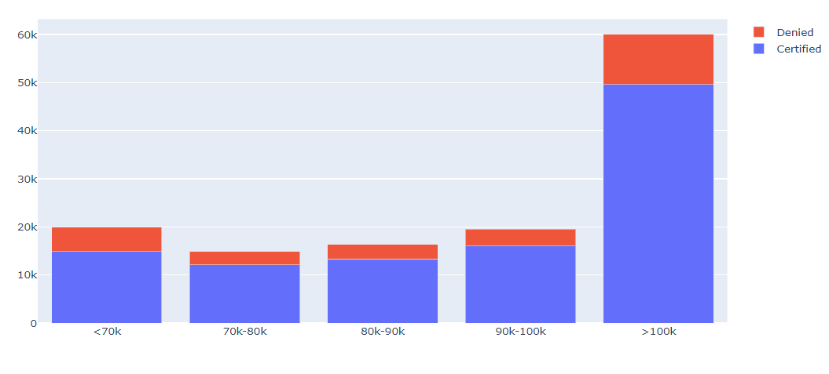
H1B sponsorship corresponds to renowned established companies like Amazon, Microsoft, Google Apple etc.
Almost every employee working in these companies receive salaries greater than 100k.
Hence, H1B sponsorship for salaries greater than 100k is much higher compared to salaries less than 100k.
Salary Statistics
UMBC

Slide 10
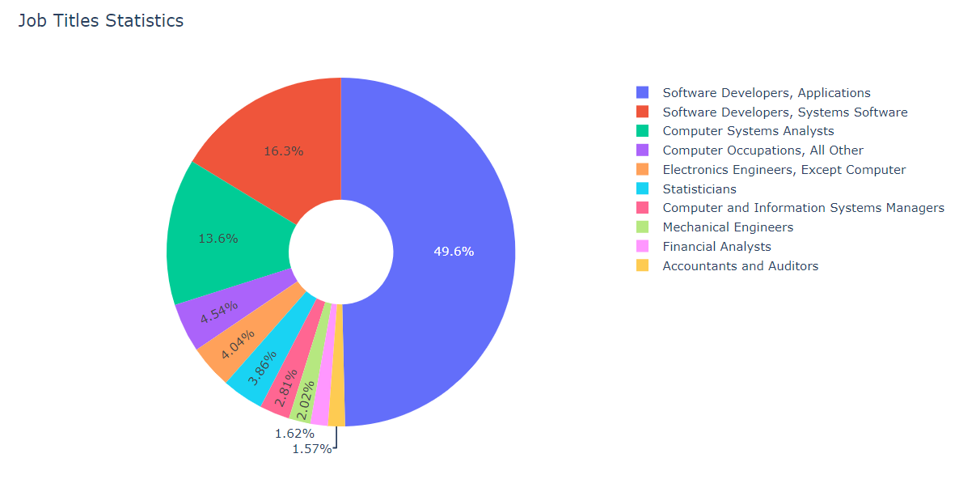
Job Title Statistics
Job titles corresponding to Software Industry lead the race of H1B approvals.
Majority of applicants are Software Developers. Other job titles include System Engineers, Data Analysts, Statisticians etc.
Few other industries include Electronics, Mechanical and Accounting sectors.
UMBC

Slide 11
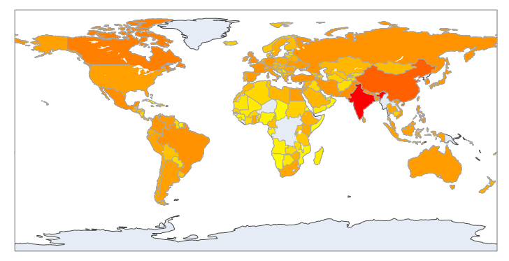
India is the leading country with utmost majority followed by China.
As per the statistics, the population of India and China are very high. We can hence assume that the population dreaming about studying abroad is higher.
Other top countries include Canada, South Korea etc. A choropleth map has been plotted to understand the results.
Immigrants home country
UMBC

Slide 12
Machine Learning Models
Implemented the following classification algorithms
Support Vector Machine
KNN classifier
Random Forest.
Support vector machine works well with data with high dimensionality. It gives us faster prediction with better accuracy. Since H1B process application process is random. There would be possibility of outliers and hence, SVM would handle any outliers better than other models.
KNN Classifier works well in making real time predictions. It is very important to scale all features to the same level. Hence, will use standard scalar technique while building a model with KNN.
Implementing grid search for optimal parameter selection.
Building an ensemble model such as Random Forest which reduces variance in the data. Random Forest will work well with the data if there is any possibility of overfitting. The data contains many categorical values and hence, working with Random Forest would be a better choice.
UMBC

Slide 13
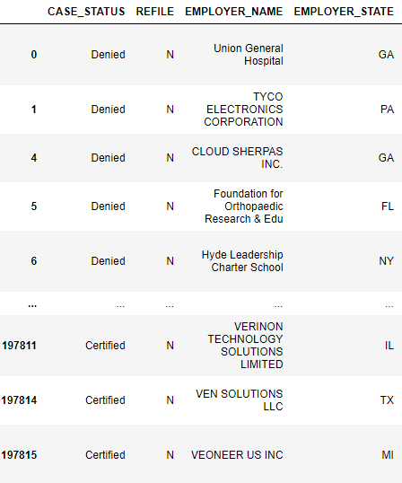
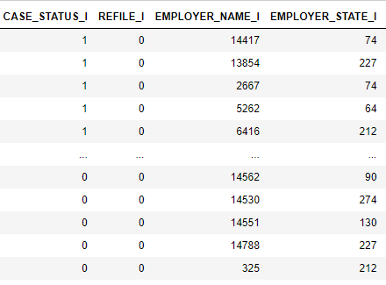
Indexing Categorical Variables
The data contained many categorical features such as EMPLOYER_NAME, EMPLOYER_STATE etc.
These features are indexed using ’String Indexer’ so that models take numerical values as the inputs.
UMBC

Slide 14
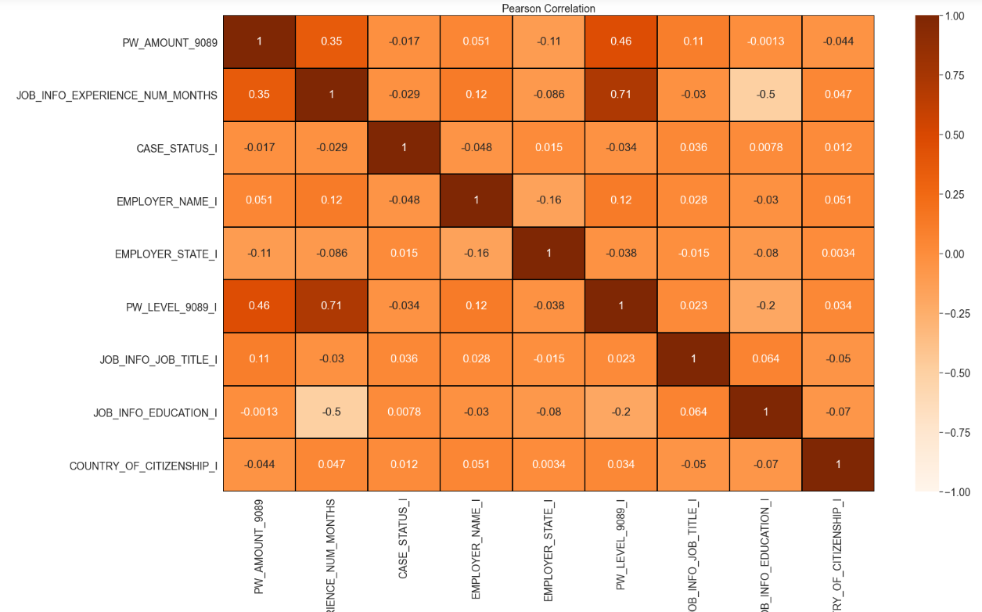
Pearson Correlation
Used to determine the correlation between the features
Features like Experience and Level have negative correlation
Features like Salary, Employer State have positive correlation
UMBC

Slide 15
Support Vector Machine
After splitting the data into training and testing with the ratio of 70:30, standard scalar technique has been implemented to standardize the features.
SVM model proved to be very biased even after using the standard scalar.
Though the accuracy score (81.04%) was good, precision and recall scores weren’t satisfactory.
Model is highly imbalanced towards the class ‘Approved’.
Target Class | Precision | Recall
0 (Approved) | 0.81 | 0.92
1 (Denied) | 0.21 | 0.13
UMBC

Slide 16
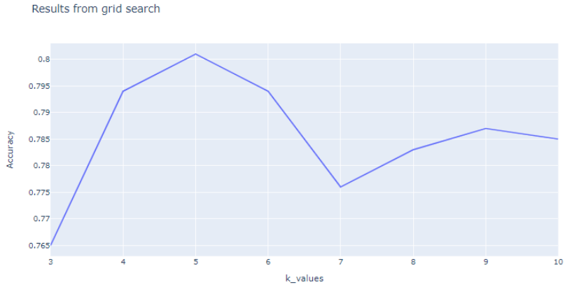
K Neighbors Classifier
Grid Search has been implemented to find the optimal parameter.
The highest accuracy of 80.7% was recorded when the value of k=5.
Target Class | Precision | Recall
0 | 0.84 | 0.95
1 | 0.48 | 0.22
UMBC

Slide 17
Random Forest
Random Forest is based on the bagging algorithm and uses Ensemble Learning technique. It creates as many trees on the subset of the data and combines the output of all the trees.
Ensemble model is used to reduce the variance in the data. It handles overfitting well.
Produced the best results out of all the models with accuracy of 83.1%
The model is hence deployed into ‘Streamlit’.
Target Class | Precision | Recall
0 (Approved) | 0.85 | 0.96
1 (Denied) | 0.72 | 0.67
UMBC

Slide 18
Deployment
Webpage 1
Webpage 2
Used for H1B case status analysis
Displays the insights with respect to the years
Holistic approval rate
State-wise statistics
Dynamic Choropleth map
for immigrant’s home country
Used for H1B case status prediction
Users can know if their case status would be approved or denied.
Employer Name
State of residency
Annual Wage
Educational Background
UMBC

Slide 19
References
https://plotly.com/python/choropleth-maps/
https://plotly.com/python/subplots/
https://support.sisense.com/kb/en/article/donut-charts-%E2%80%94-plotly
https://support.sisense.com/kb/en/article/donut-charts-%E2%80%94-plotly
https://pypi.org/project/pycountry/
https://stackoverflow.com/questions/16253060/how-to-convert-country-names-to-iso-3166-1-alpha-2-values-using-python
UMBC

Slide 20

UMBC

