Slide 1

LOAN DEFAULT CLASSIFICATION
Narendra Thumma
Rakesh reddy Pulichinthala
Vaishnavi Vejella

Slide 2

Introduction
Lending money has long been a popular way to make money from money. This activity is being pursued by financial banking institutions and numerous individuals in order to gain money. After conducting extensive research, we discovered that, with technologies such as decentralization finance and other technologies in place, a data-driven approach is required to close the gap in the banking sector in terms of lowering the burden of bad debts and improving the credit history of applicants.

Slide 3


Peer-to-peer loan services such as Business Organizations now allow users to invest in personal loans. Loan Program allows investors to review consumer loan applications, which include the applicant's credit history, loan details, work status, and other self-reported personal information, in order to decide which loans to fund.
As a result, a machine learning model that can effectively predict a loan's default risk using data that might assist financial managers in maximizing their capital growth by approving loans based on credit score of users.
To incorporate an end-to-end data science project which could address the existing gaps in the banking sector by powering them with a web-based dashboard to access the creditworthiness of the customer.

Slide 4
Dataset
Data source: https://www.kaggle.com/yasserh/loan-default-dataset
The Dataset contains of 20 columns namely:
ID: Customer ID of Applicant
year: Year of Application
loan_limit: Cash Flow or Net Cash Flow type
gender: Applicant's gender
approv_in_adv: Is loan pre-approved or not
loan_type: Type of loan
loan_purpose: Purpose of loan
Credit_Worthiness: Credit worthiness of the applicant
open_credit: Type of Credit (Open credit or Non open credit)
business_or_commercial: Usage type of the loan amount
loan_amount: The exact loan amount

Slide 5
rate_of_interest: Rate of interest of the loan
Interest_rate_spread: Spread of interest rate by banks
Upfront_charges: Up front loan sanctioning charges
lump_sum_payment: Down payment for the loan
property_value: Collateral value
construction_type: Collateral construction type
age: Age of applicant
Security_Type: Type of Collatoral
status: Loan status (Approved/Declined)
Unit of Analysis: Loan record of applicant.
Number of observations to be analyzed: 148671
Output Variable: Loan status

Slide 6

Literature review
The literature on estimating default risk in Finance can be divided into two categories based on the strategy used. Conventional mathematical models including as ordinary least squares (OLS) are used in the primary area of research to investigate the various factors determining the risk .
Researches have investigated a significant amount of study in the area of Finance using data from various platforms to predict the likelihood of effective financing, loan interest rates, and payment difficulties. As the research utilizes machine learning algorithms to predict the factors that influence payment failure.

Slide 7
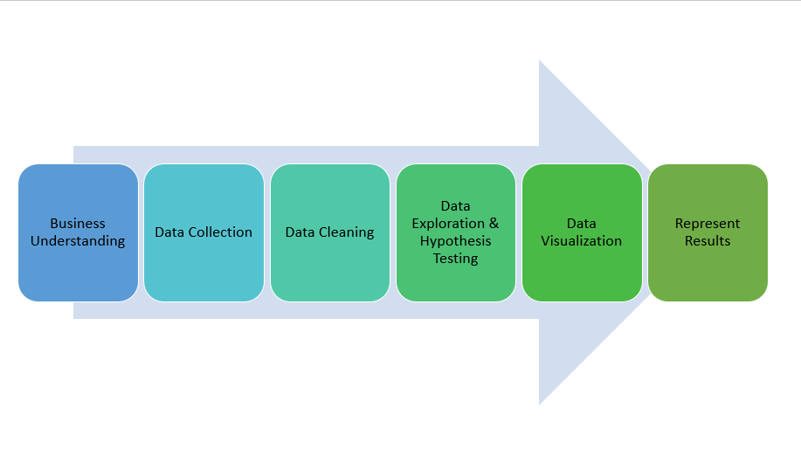
Research Process

Slide 8
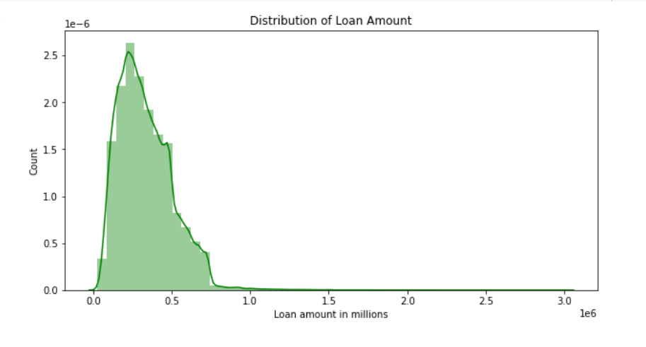
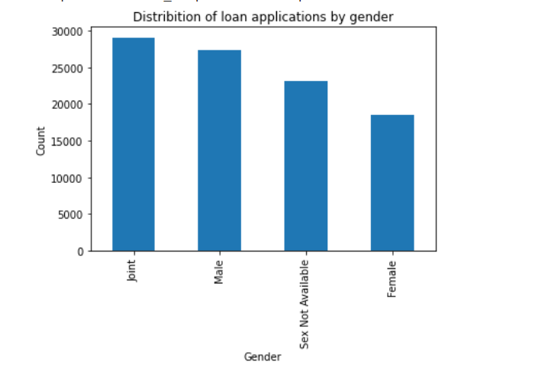
Exploratory data analysis
1. Analysis on distribution of loan amounts:
Most of the values of loan applications are in the ranges between 250 K to 500 K
2. Analysis on Distribution of loan applications by gender:
We can conclude that the joint applications (i.e., both male and female) are the highest and individually male applications are higher than females.

Slide 9
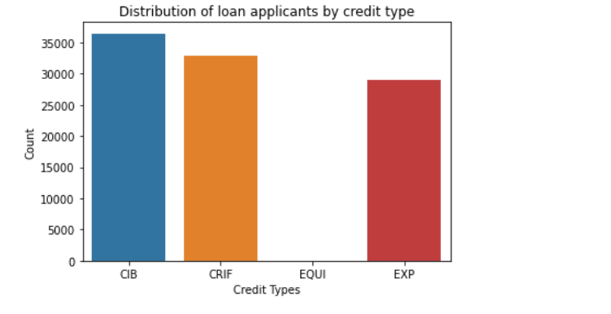
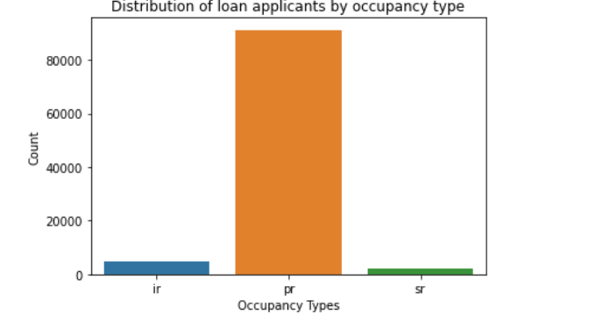
3. Analysis on Distribution of loan applicants by credit type:
The loan applications with 'CIB' & 'CRIF' are the highest when compared to other two types.
4. Analysis on Distribution of loan applicants by occupancy type:
The loan applications with occupany_type 'pr' are the highest when compared to the other types of occupancies.

Slide 10
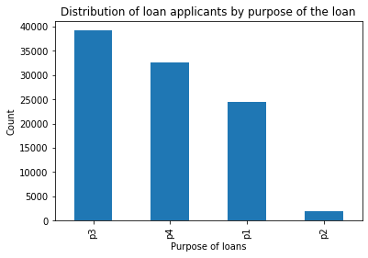
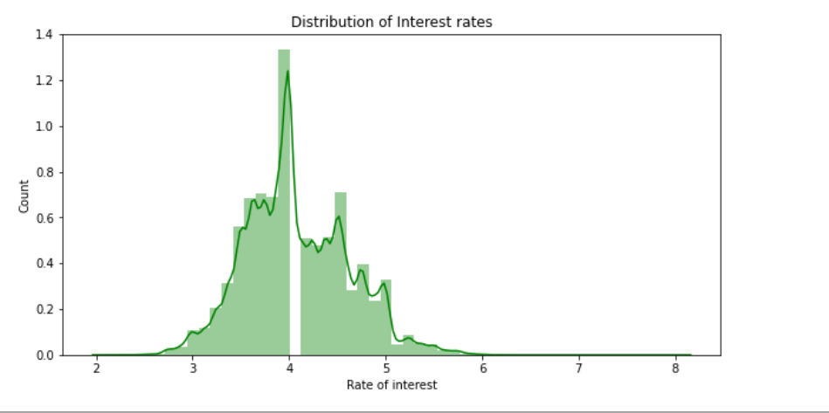
5. Distribution of loan applicants by purpose of the loan:
The purposes 'p3','p4' types are the highest among other loan applications.
6. Analysis on distribution of Interest rates:
The interest rates for most of the loans are in the range between 3 and 5.

Slide 11
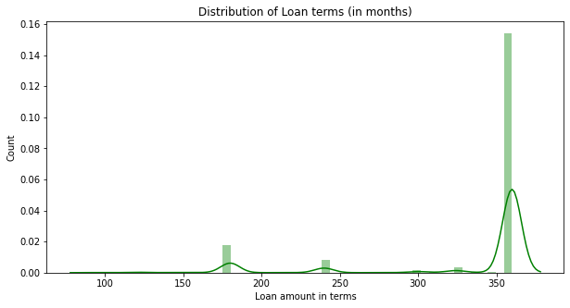
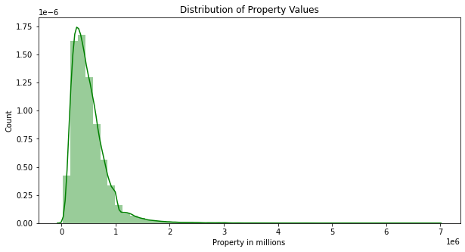
7. Distribution of Loan terms(in months):
Most of the loan terms are in the range of 300 to 400
8. Distribution of Property values:
The values of the collateral properties for loan applications are in the ranges of 100k to 1000K

Slide 12
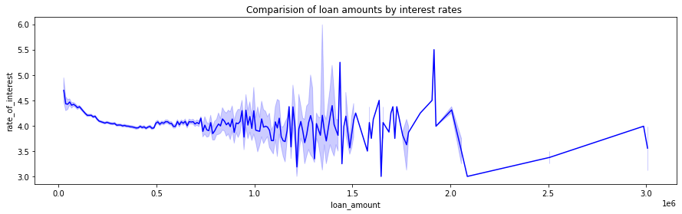
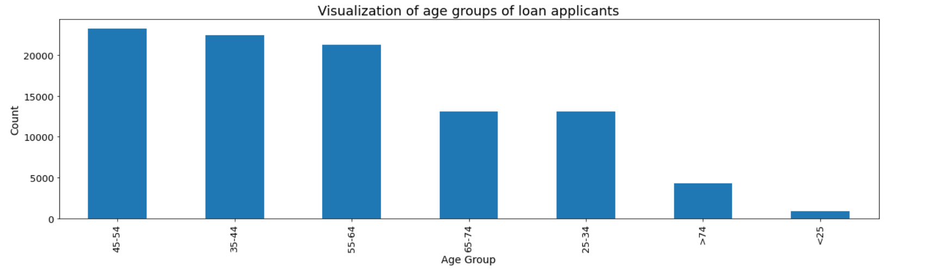
9. Comparison of loan amounts by interest rates :
The is no steady interest rates. We can see that the interest rates floats with respect to the loan amounts.
10. Analysis on age groups of loan applicants:
The age of the loan applicants are in the range of 45-54 followed by applicants are of the ages 35-44.

Slide 13
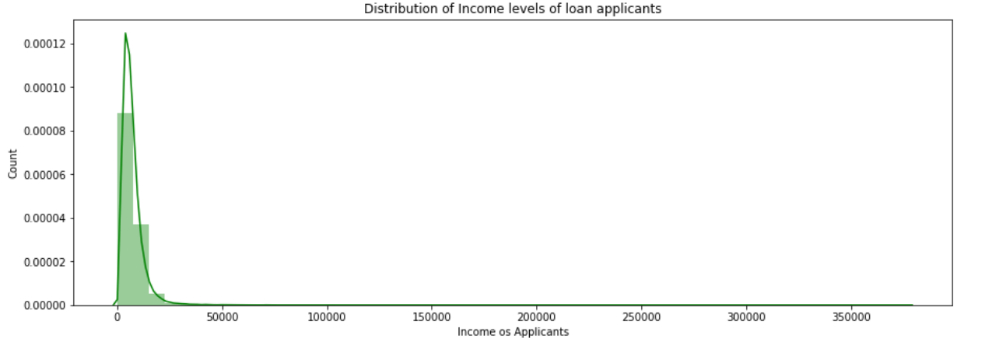
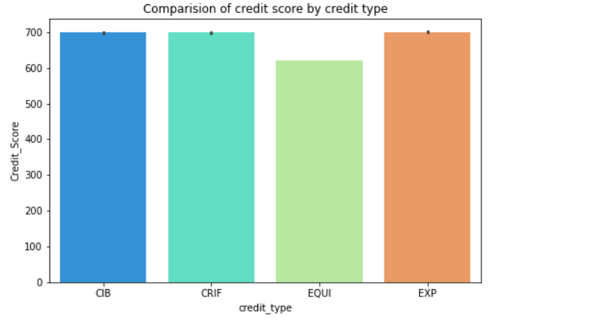
7. Distribution of Income levels of loan applicants:
The income ranges of loan applicants are in the range of 0 to 20000 per months
8. Analysis on credit score by credit type:
The credit scores of the credit type CRIF is higher then followed by credit type EXP.

Slide 14
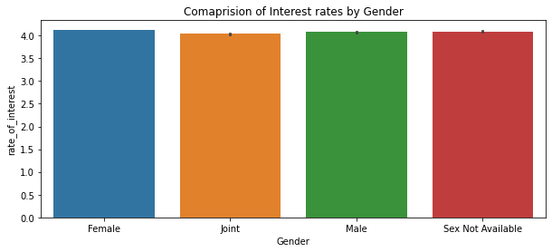
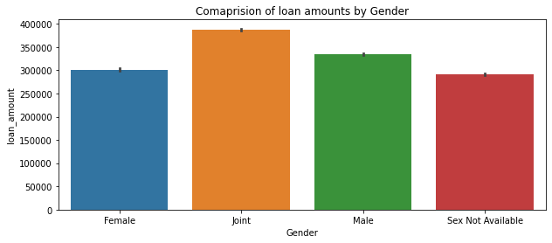
11. Comparison of Interest rates by Gender:
We can determine that the interest rates for loan applications does not vary by gender.
12. Comparison of loan amounts by Gender:
We can understand that the loan amount for joint loan applications are higher then followed by male applicants.

Slide 15
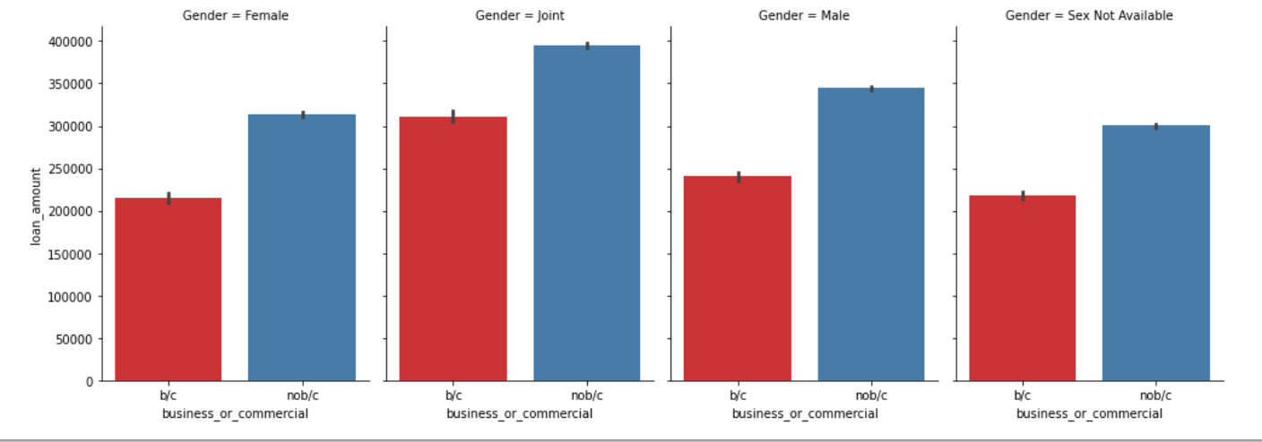
13. Analysis on loan amount by the gender of applicants type and nature of loan availability:
We can infer that most of the loan applicants are for commercial purposes in any genders. We can also infer that there are male applicants for business purposes than females.

Slide 16
Machine learning Techniques:
Random Forest with Grid search CV
Logistic Regression with Grid search CV
Support Vector Machine with Grid search CV
K-Nearest Neighbors with Grid search CV
Bagging with Base estimator as Random Forest
Bagging with Base estimator as Logistic Regression
AdaBoost Classifier
Multilayer Perceptron Classifier
Neural Networks
Tensor Flow.
By evaluating the metrics such as recall, accuracy, precision, f-1 score, confusion matrix, ROC-AUC scores. After determining the metric to evaluate the model with the help of the business understanding of the domain of the data, we'll figure out the ways to improve the performance of the model.

Slide 17
Expected Outcomes
Importance of business domain understanding in choosing and evaluating the model.
To apply various machine learning models to classify the outcome.
Usage of Various evaluating metrics to determine the performance of the model.
Importance of Various Statistical Analysis Understanding the Dimensionality Reduction.
Understanding the Bias-Variance trade-off.
Application of Principal component analysis.
Usage of Grid search Validations.
Understanding of Various activation functions.
Effectively handling the outliers.
Usage of various hyperparameters.
Analyzing & Visualizing the data.
Building a dashboard which helps banking stakeholders to access the status of creditworthiness.

Slide 18
References:
Heitzmann, P. (n.d.). Predicting loan defaults using Machine Learning Classification models. Data Science Blog. Retrieved February 27, 2022, from https://nycdatascience.com/blog/student-works/predicting-loan-defaults-using-machine-learning-classification-models/
Banerjee, T. (2019, December 24). Classification model for loan default risk prediction. Medium. Retrieved February 27, 2022, from https://medium.com/analytics-vidhya/classification-model-for-loan-default-risk-prediction-98c2cc7ef1bf
Xu, Z. (J. (2022, February 10). Loan default prediction for profit maximization. Medium. Retrieved February 27, 2022, from https://towardsdatascience.com/loan-default-prediction-for-profit-maximization-45fcd461582b
Notes:
1.

