Slide 1
Real Estate Market in DC
CAPSTONE PROJECT SPRING 2022
Tchuissi Mbu Nyamsi

Slide 2
Introduction
Civil engineer passionate about construction and real estate
Analyze the housing market price with regards to structural characteristics
Houses are becoming more and more expensive.
Notes:
Currently living in the DC area and passionate about real estate and construction, I want to analyze and understand the different criteria that define the selling price for residential properties. The real estate market is ever growing with properties more and more expensive. The goal of this study is to identify the parameters that influence the selling price and map the area in DC with the most expensive houses.

Slide 3
Research Questions
How well can this dataset predict houses prices?
04
03
Is the COVID-19 accelerating the price increase faster than before?
Are structural characteristics playing a role in the selling price?
02
01
What are the attributes that affect the selling prices in DC downtown for houses?

Slide 4
Agenda
01
Exploratory Data Analysis (EDA)
02
Machine Learning Models
03
Advanced Machine Learning
04
Conclusion

Slide 5
01 Exploratory
Data Analysis

Slide 6
Exploratory Data Analysis
Dataset | Attribution on housing and structural characteristics for residential properties
Location | https://opendata.dc.gov/datasets
Rows and columns | 108,197 rowas and 39 columns
Rows and columns (after removing missing values) | 92,056 rows and 13 columns
Column names and description | SSL: Short Sale Listing BATHRM: Number of bathrooms ROOMS: Number of rooms BEDRM: Number of bedrooms STORIES: Number of stories GBA: Gross building area STRUCT_D: House Structure EXTWALL_D: Exterior Wall Type INTWALL_D: Interior Wall Type ROOF_D: Roof Type HEAT_D: Heat Type SALEDATE: Sale Date Price: Selling Price

Slide 7
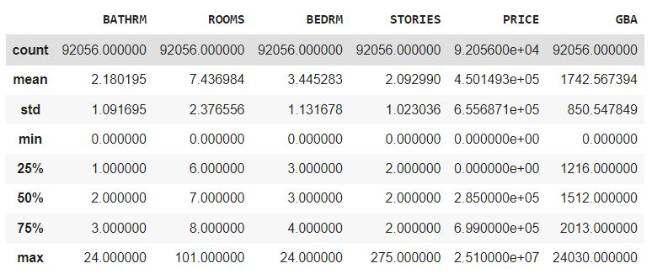
Exploratory Data Analysis
Max selling price:
$25,100,000
Average selling price:
$450,000
Average bathrooms: 2
Average bedrooms: 3
Average stories: 2
Average GBA: 1742 sqft

Slide 8
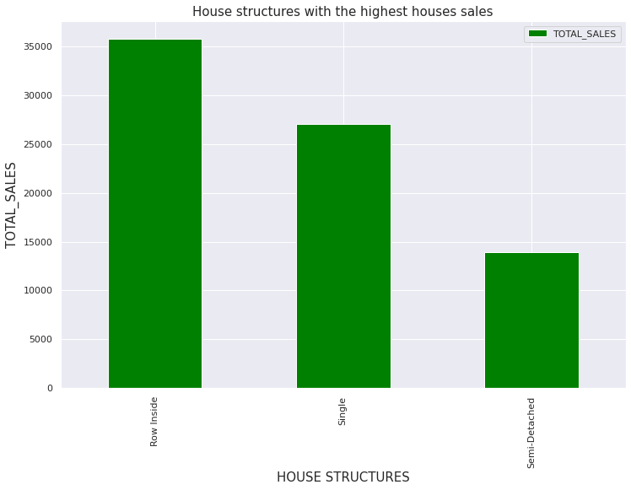
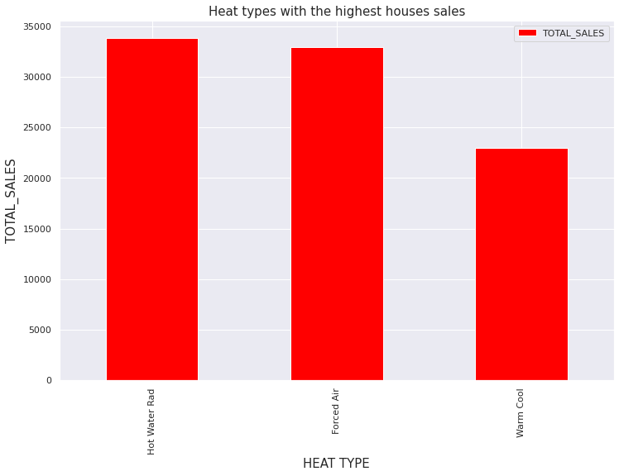
Exploratory Data Analysis
The three most common heat type are:
Hot Water Rad (36.8%)
Forced Air (35.8%)
Warm Cool (25%)
The three most common house structures are:
- Row houses (50.6%)
- Single houses (29.4%)
- Semi-detached houses (15%)

Slide 9
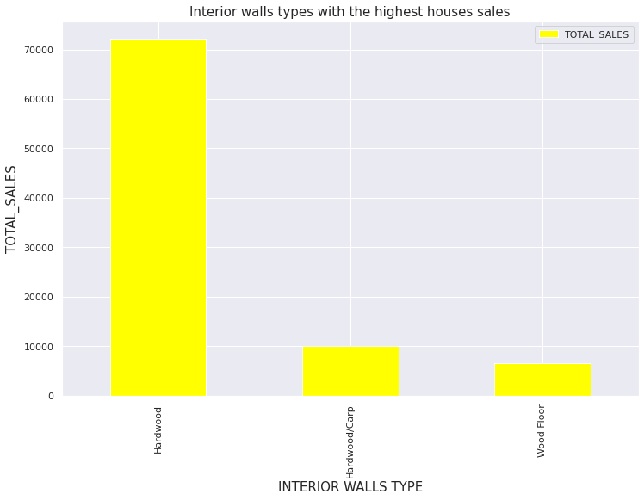
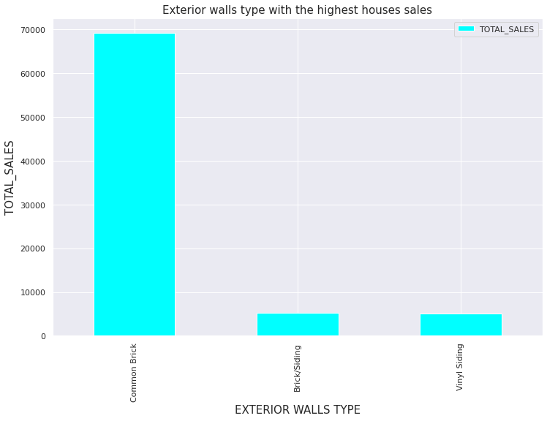
Exploratory Data Analysis
The three common exterior walls are:
Common brick (75%)
Brick/Siding (5.7%)
Vinyl Siding (5.4%)
The three common interior walls are:
Hardwood (78.3%)
Hardwood/carp (10.9%)
Wood floor (7.1%)

Slide 10
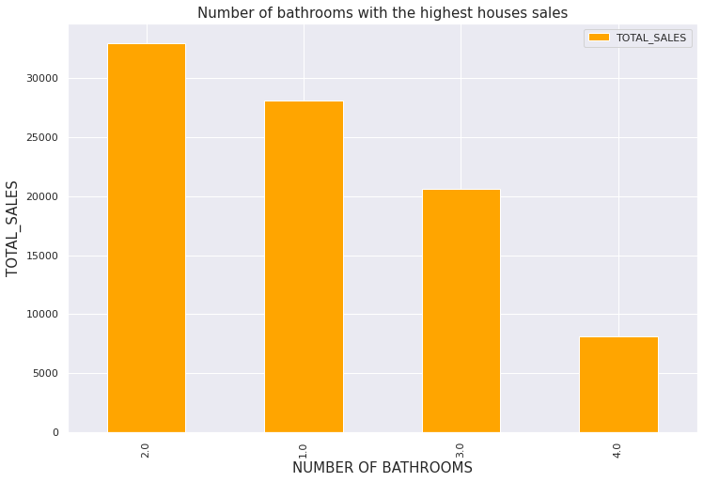
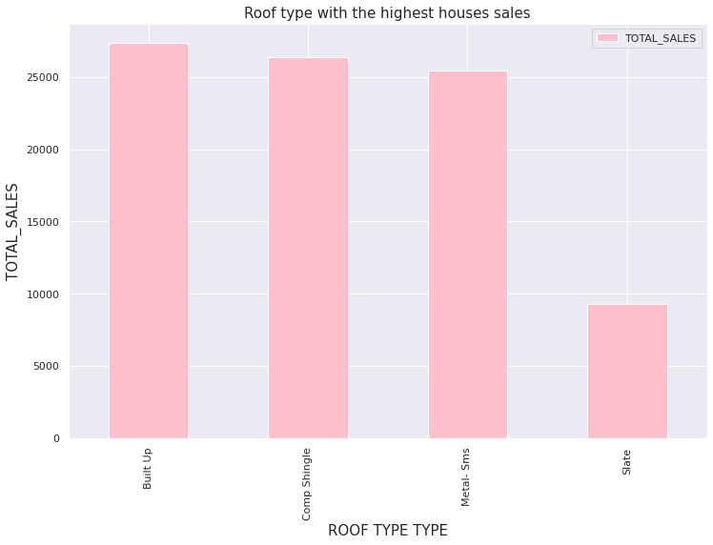
Exploratory Data Analysis
The four most common roof types are:
Built up (29.7%)
Comp Shingle (28.7%)
Metal-sms (27.7%) (standing seam metal)
Slate (10.1%)
Most of the houses have:
2 bathrooms (35.8%)
1 bathroom (30.6%)
3 bathrooms (22.4%)
4 bathrooms (8.8%)

Slide 11
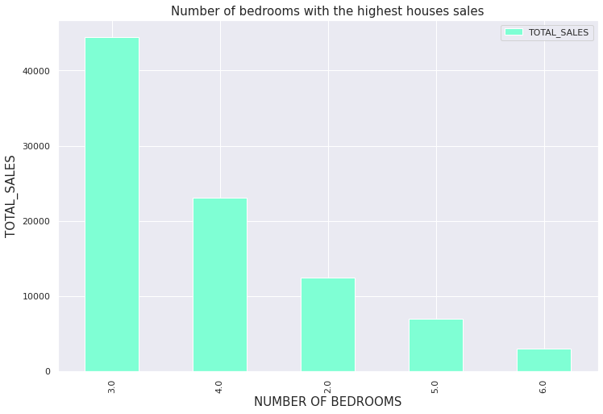
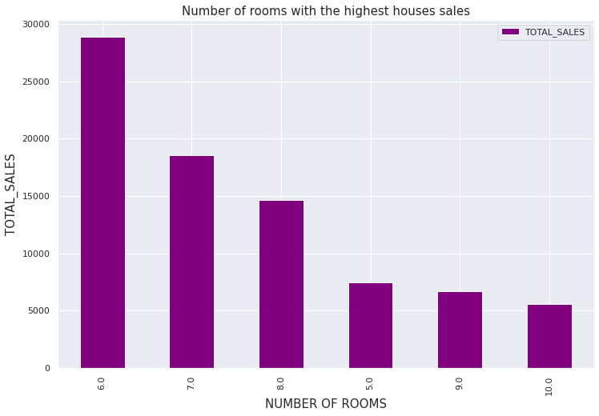
Exploratory Data Analysis
The most common rooms numbers are:
6 rooms (31.4%)
7 rooms (20.2%)
8 rooms (15.9%)
The most common bedrooms numbers are:
3 bedrooms (48.3%)
4 bedrooms (25%)
2 bedrooms (13.5%)

Slide 12
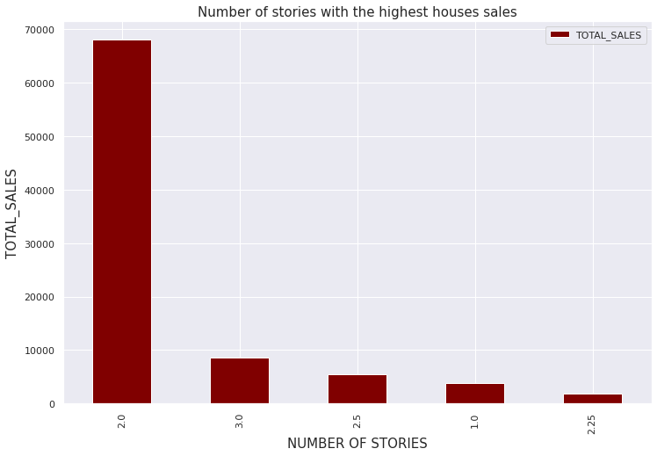
Exploratory Data Analysis
The most common stories numbers are:
2 stories (73.9%)
3 stories (9.4%)
2.5 stories (5.9%)

Slide 13
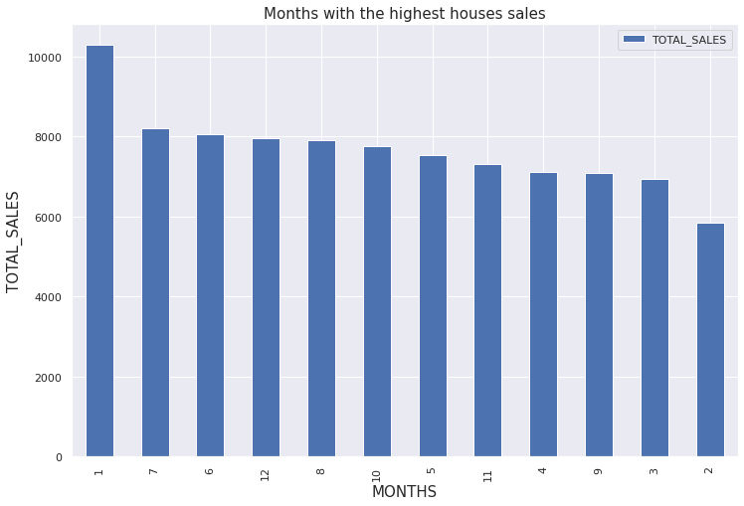
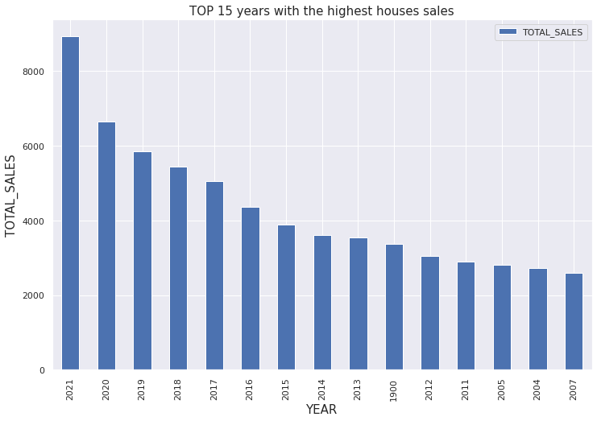
Exploratory Data Analysis
2021 (8935), 2020 (6650) and 2019 (5857) are the top years
More houses sold in January (10294), July (8217) and June (8062)

Slide 14
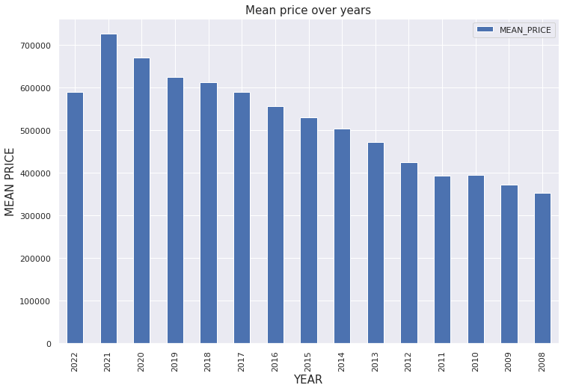
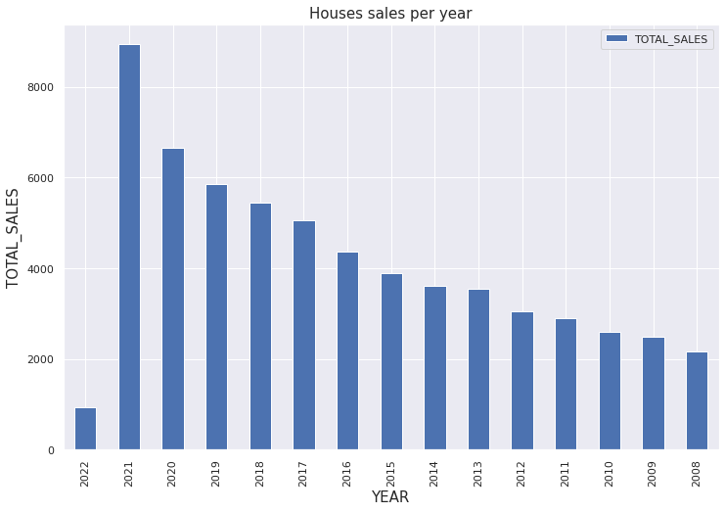
Exploratory Data Analysis
2014-2015: +8,2 %
2015-2016: +12 %
2016-2017: + 15,7%
2017-2018: + 7,9%
2018-2019: + 7,4%
2019-2020: + 13,5%
2020-2021: + 34,4%
2021: $726,258 (+8,4 %)
2020: $670,103 (+ 7,3 %)
2019: $624,484 (+ 2%)
2018: $612,418 (+ 3,8%)
2017: $589,815

Slide 15
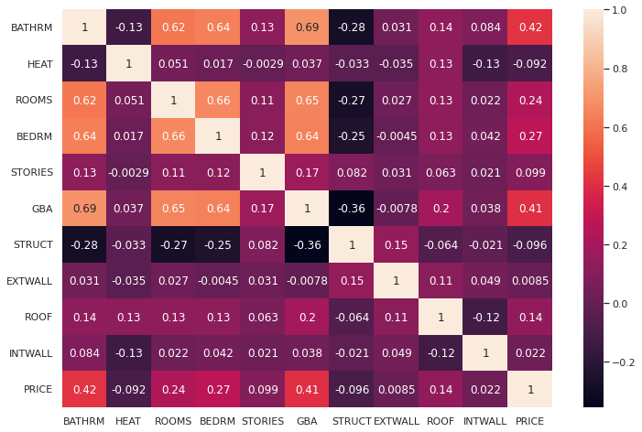
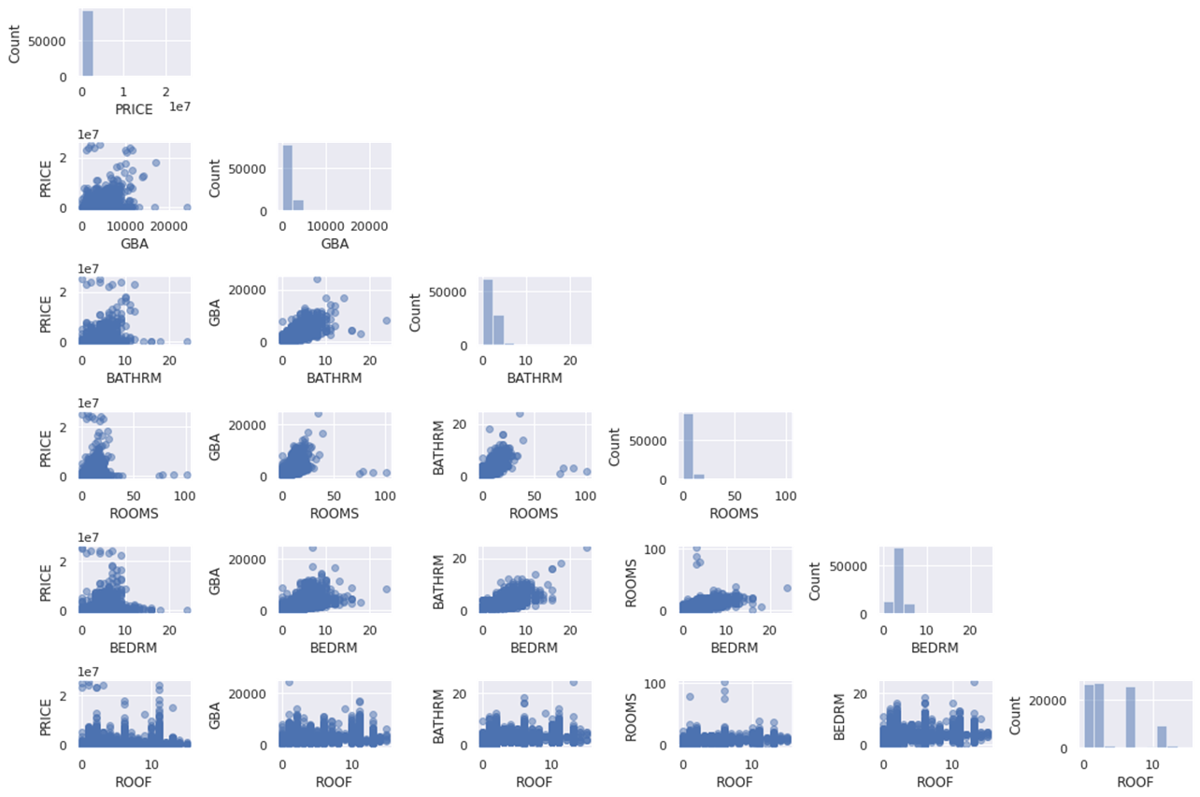
Exploratory Data Analysis
GBA, BATHRM and ROOMS have a linear correlation with the price.
There is no linear correlation for ROOF
The variables that are more correlated
to the price are:
Gross Building Area (GBA) (0.41)
Number of bathrooms (0.42)
Number of bedrooms (0.27)
Number of rooms (0.24)
Roof type (0.14)

Slide 16
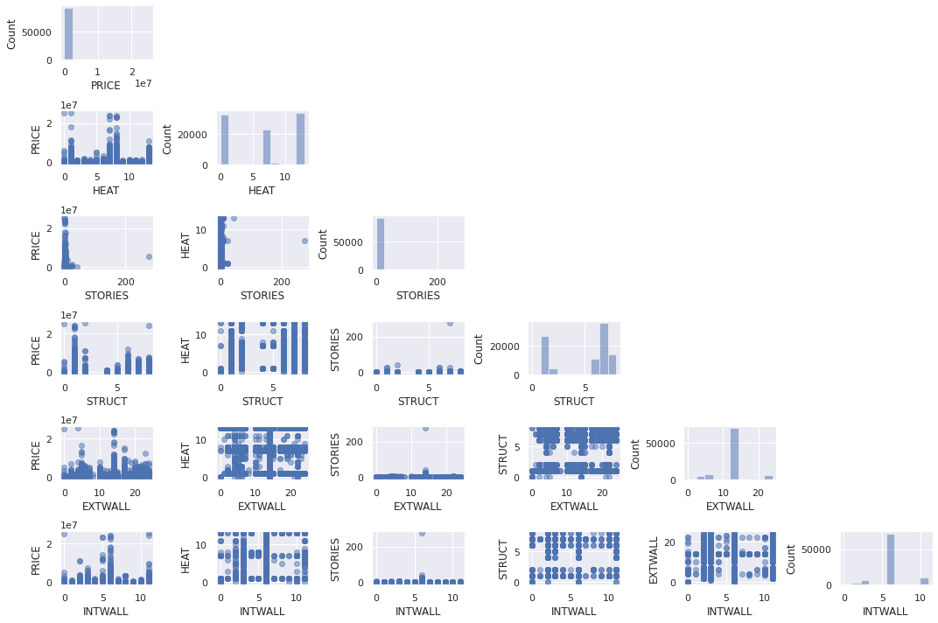
Exploratory Data Analysis
There is no linear correlation with the price for the other structural characteristics

Slide 17
02 Machine Learning

Slide 18
Machine Learning
A
Machine Learning Initialization
B
Feature importance with Random Forest
C
Linear Regression Models
D
Decision Tree Regressor
E
Random Forest Regressor

Slide 19
1. Machine Learning Initialization
Step 1
Split the Dataset
80% for the test data
20% for the training data
Step 2
Encode Categorical Variables
The method used is one hot encoder
Step 3
Standardize the features
By subtracting the mean and then scaling to unit variance.

Slide 20
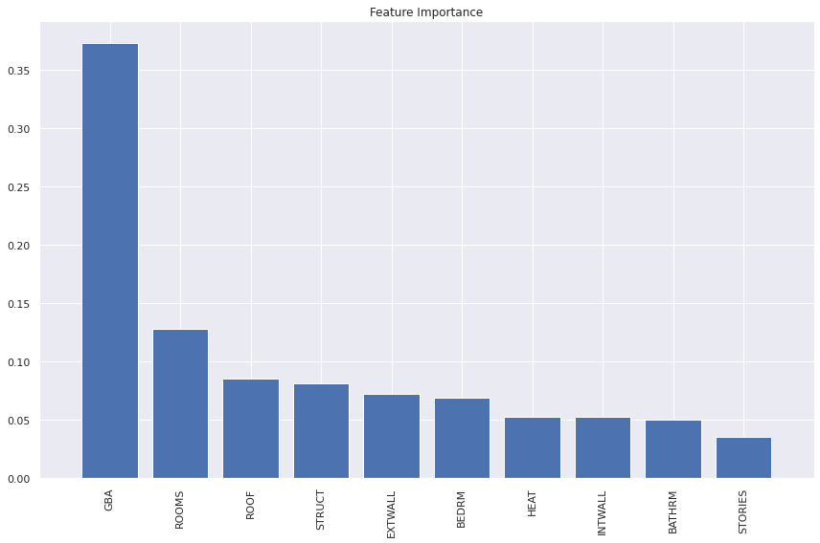
2.Feature Importance Random Forest
The Gross Building Area (GBA) (37%)
The number of rooms (13%)
The roof type (8,6%)
Structure type (8,2%)
External wall type (7,2%)

Slide 21
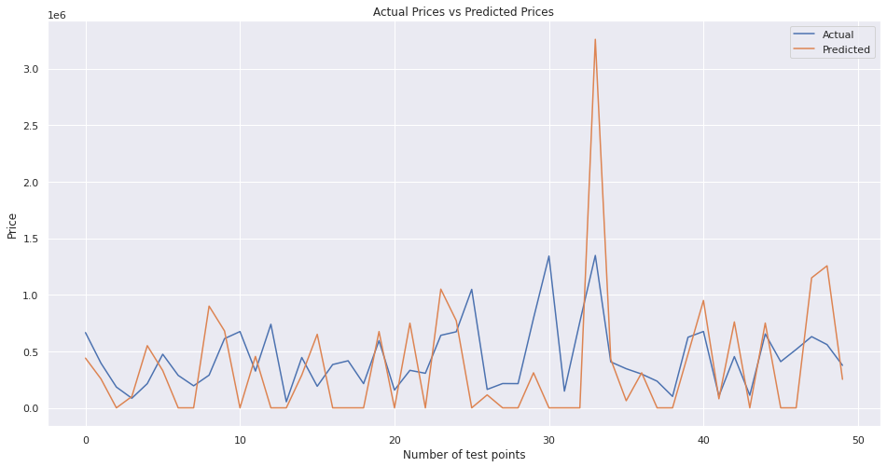
3.a Linear Regression Model OLS
Ordinary Least Square: statistical method of analysis that estimates the relationship between one or more independent variables and a dependent variable; the method estimates the relationship by minimizing the sum of the squares in the difference between the observed and predicted values of the dependent variable configured as a straight line
R-squared or Coefficient of Determination (R2): This metric represents the part of the variance of the dependent variable explained by the independent variables of the model. It measures the strength of the relationship between your model and the dependent variable
Mean Absolute Error (MAE): This metric evaluates the mean of the absolute values of each prediction error on all instances of the test data-set. Prediction error is the difference between the actual value and the predicted value for that instance.
Metrics | R2 | MAE
Results | 0.288 | 596.87
Conclusion: the model is not performing very well

Slide 22
3.b Other Linear Regression Models
Ridge: Ridge regression is a method of estimating the coefficients of multiple-regression models in scenarios where linearly independent variables are highly correlate
Lasso: Lasso regression is a type of linear regression that uses shrinkage. Shrinkage is where data values are shrunk towards a central point, like the mean. The lasso procedure encourages simple, sparse models (i.e. models with fewer parameters)
- Bayesian: Bayesian regression is an approach to linear regression in which the statistical
analysis is undertaken within the context of Bayesian inference. When the regression model has errors that have a normal distribution, and if a particular form of prior distribution is assumed, explicit results are available for the posterior probability distributions of the model's parameters
- ElasticNet: Elastic Net is a regularized regression method that linearly combines the L1 and L2 penalties of the lasso and ridge methods
 | Ridge | Lasso | Bayesian | Elastic Net
R2 | 0.211 | 0.211 | 0.212 | 0.212
MAE | 609.61 | 609.61 | 609.67 | 609.65
Conclusion: the other linear regression models perform less well than OLS regression

Slide 23
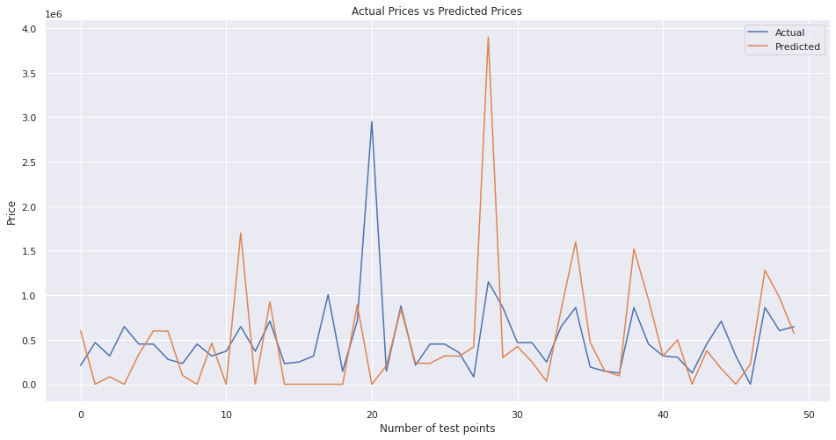
4. Decision Tree Regressor
Decision Tree: The goal of using a Decision Tree is to create a training model that can use to predict the class or value of the target variable by learning simple decision rules inferred from prior data(training data)
Metrics | R2 | MAE
Results | 0.209 | 601.93
Conclusion: The decision tree model performs less well than the OLS regression.

Slide 24
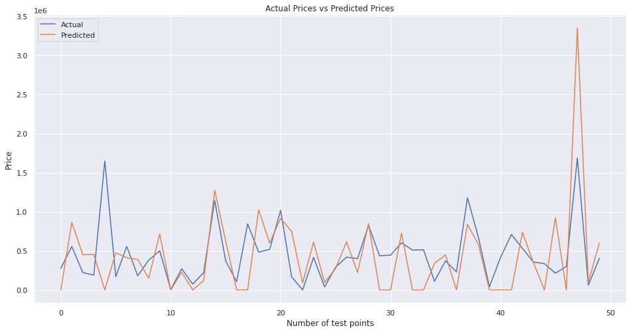
5. Random Forest Regressor
Random Forest: Random Forest is a “Tree”-based algorithm that uses the qualities features of multiple Decision Trees for making decisions
Metrics | R2 | MAE
Results | 0.265 | 603.47
Conclusion: The model performs better than the decision tree but not as well as the OLS method

Slide 25
Given our results, we can use advanced machine learning techniques to improve the performance

Slide 26
03 Advanced Machine Learning

Slide 27
Advanced Machine Learning
A
K-fold cross-validation
B
Tuning hyperparameters via grid search
C
Ensemble methods: bagging and boosting
D
Random Forest Classifier
E
Gradient Boosting Regressor

Slide 28
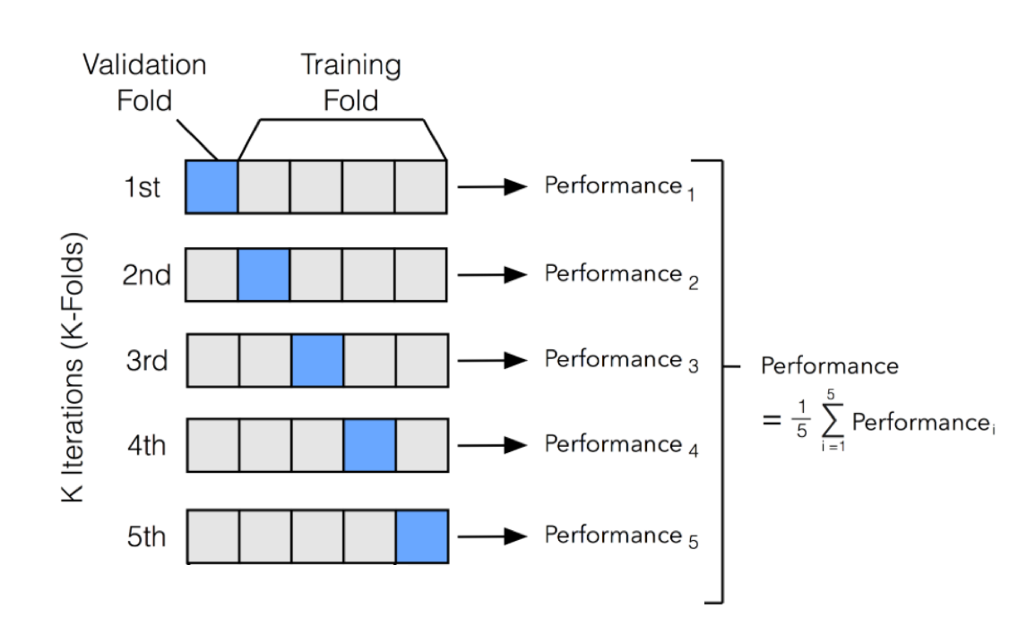
1. K-fold Cross-Validation
In k-fold cross-validation, we randomly split the training dataset into k folds without replacement, where k-1 folds are used for the model training, and one fold is used for performance evaluation. This procedure is repeated k times so that we obtain k models and performances.
The test dataset is used to calculate the accuracy score of the model, which is collected in the scores list to calculate the average accuracy and the standard deviation of the estimate.

Slide 29
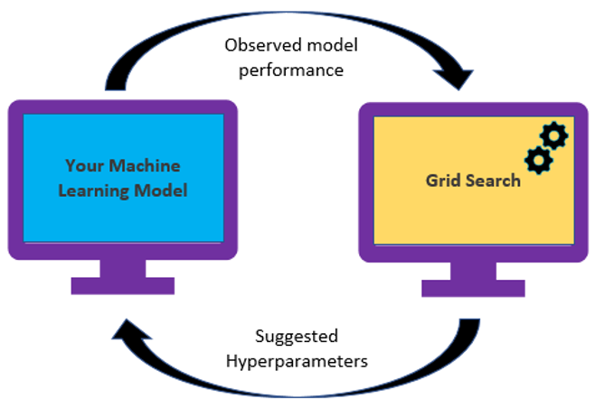
2. Tuning hyperparameters via grid search
The grid search approach is a brute-force exhaustive search paradigm where we specify a list of values for different hyperparameters, and the computer evaluates the model performance for each combination to obtain the optimal combination of values from this set

Slide 30
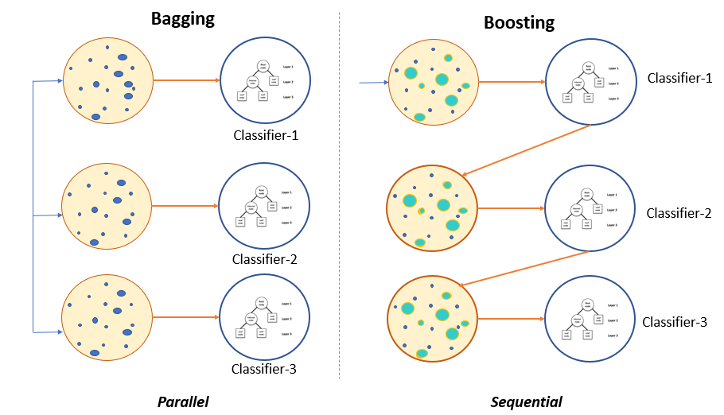
3.Ensemble methods: bagging and boosting
The goal of ensemble methods is to combine different classifiers into a meta-classifier that has better generalization performance than each individual classifier alone
In bagging, the objective is to create several subsets of data from training sample chosen randomly with replacement. Each collection of subset data is used to train their decision trees. As a result, we get an ensemble of different models. Average of all the predictions from different trees are used which is more robust than a single decision tree classifier
In boosting, the ensemble consists of very simple base classifiers, also referred to as weak learners. The key concept behind boosting is to focus on training examples that are hard to classify, that is, to let the weak learners subsquently learn from missclassified training examples to improve the performance of the ensemble

Slide 31
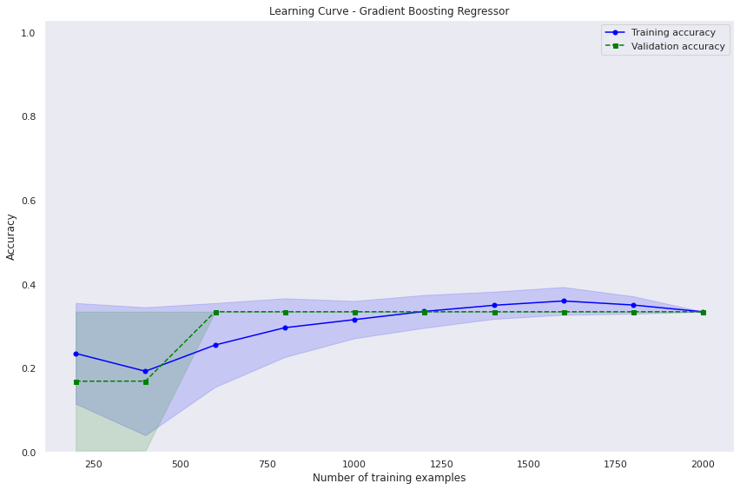
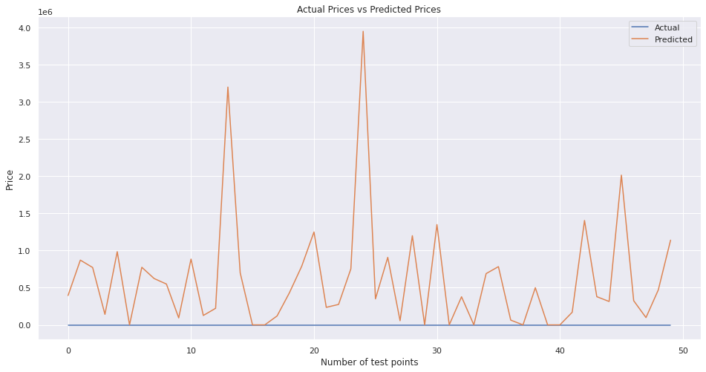
4.Random Forest Classifier
Bagging method
K=5
Best parameters: Max_depth=1 N_estimators= 50
The model did not work well on my dataset.

Slide 32
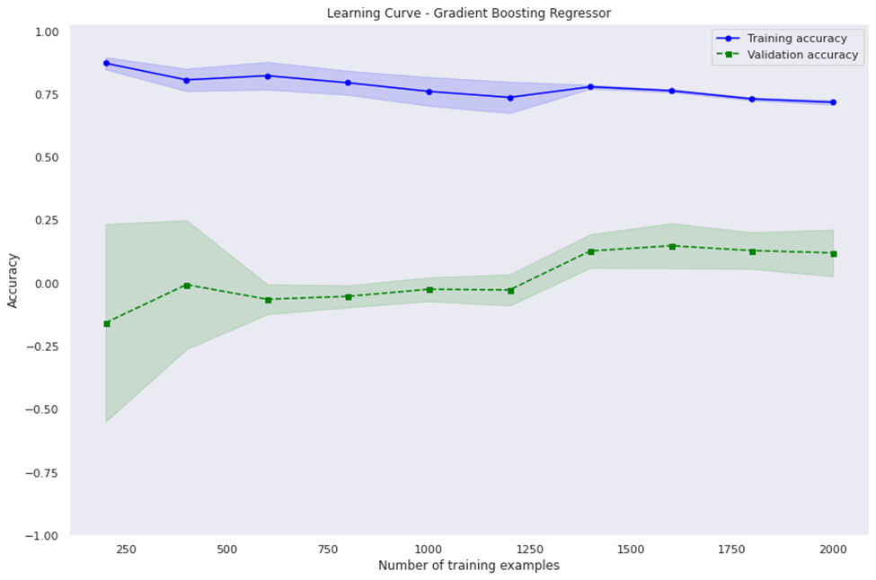
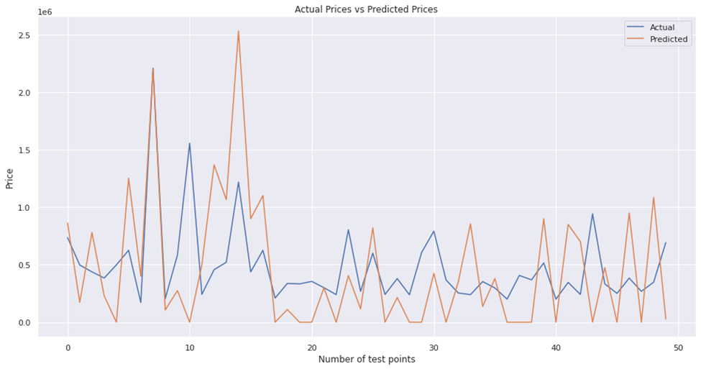
4.Gradient Boosting Regressor
Boosting method
K-5
Best parameters: Learning Rate=0.01 Max_depth=5, N_estimators= 250
Metrics | R2 | MAE
Results | 0.679 | 573.81
Conclusion: The performance improved . The model is overfitting: it performs better on training data than unseen

Slide 33
SUMMARY
 | OLS | Other Regression models | Decision Tree | Random Forest | Gradient Boosting Regressor
R2 | 0.288 | 0.211 | 0.209 | 0.265 | 0.679
MAE | 596.87 | 609.61 | 601.93 | 603.47 | 573.81
Conclusion: The application of advanced machine learning improved the performance by more than 100% for the R2.
The model can be further improved by adding more hyperparameters and and by addressing overfitting issue.

Slide 34
04 Conclusion

Slide 35
Research Questions- Answers
How well can this dataset predict houses prices? With normal ML model R2 <0.30
With Advanced model, R2>0.65
04
03
Is the COVID-19 accelerating the price increase faster than before? Tne COVID-19 was an accelerator : both the number of houses sold, and the selling price increased
Are structural characteristics playing a role in the selling price? The top 3 structural characteristics are the roof type, the structure type and the external wall type
02
01
What are the attributes that affect the selling prices in DC downtown for houses? The top 5 attributes are
The Gross Building Area (GBA) (37%)
The number of rooms (13%)
The roof type (8,6%)
Structure type (8,2%)
External wall type (7,2%)

Slide 36
THANK YOU

