Slide 1
DATA 606 Capstone Project: Predicting Maryland Home Prices and Finding their Value
Zach Vance
Notes:
Hi, I’m Zach Vance and this is my project on predicting home prices in Maryland and Finding their Value.

Slide 2

The Problem / Why it is Important
The housing shortage has created a very competitive housing market.
As either / both a home buyer and an investor there is a lot to weigh when purchasing property.
Buyers want to make decisions to buy properties for the best value in what they want – the problem is: How do they best go about doing that?
Notes:
The housing shortage has created a very competitive housing market and there are so many things to consider when buying a home. They’re important things to think about no matter whether you are buying for a permanent home or from an investing standpoint. Buying a home is one of the biggest purchases a person makes in their life, and it is important to understand the different aspects of the property in order to get the most value out of it. Weighing all the different aspects can be difficult to do. That is the problem I solve in this project - at least to help home buyers with weighing the features of a home before making the purchase so they can uncover what effect the different features have on the price they pay.

Slide 3
The Data
Dumped from a Real Estate Agent.
Contains the sold residential homes in Anne Arundel, Baltimore, Harford and Howard counties over the last 5 years for a total of 90,758 homes.
Fields I intend to use:
List date, off market date, settlement date
Original price, list price, sold price
Address
Acres total, age, square footage, style, # of floors,
# of bedrooms, # of full / half bathrooms
Waterfront, new construction
Notes:
The data I use comes directly from the dump provided to me by a real estate agent from the MLS (Multiple Listing Service) software. Coming straight from the records themselves, it is credible, and relatively clean. I was able to get the data for sold residential homes in Maryland for Anne Arundel, Baltimore, Harford, and Howard counties over the last 5 years, for a total of 90,758 homes. There are a lot of good features in the data I intend to use such as the list date, list price and sold price, location, acres, age, features like number of bedrooms and bathrooms, as well as whether it is new construction and or waterfront, among others.

Slide 4
Research Process / Steps
Gathered the data from the Real Estate Agent.
Read in and clean the data after doing some initial profiling on it.
Perform EDA to answer exploratory questions, analyzing trends and patterns in the data.
Create and tune ML models to predict a home’s price based on its features.
Analyze results and summarize findings.
Create an interactive user interface for predicting a home’s price.
Think about future work and the potential for further improvements.
Notes:
The steps in this process consist of gathering the data from the real estate agent, cleaning it with some initial profiling, followed by doing the EDA to answer exploratory questions. I then created and tuned ML models to predict home prices as well as possible as well as analyzing the results in context. In doing so, I used the results from EDA to inform some of my decisions I made in the machine learning process. Then I created an interactive user interface to allow for a user to input desired features and be provided with an estimated cost. And finally, putting together some ideas on how this can be expanded and improved upon with future work.

Slide 5
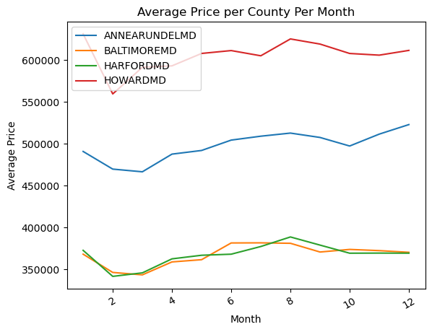
EDA Results: Prices By Month
February – March seem like the best months to buy a house based on the lowest average prices.
All counties follow the same trend.
Notes:
The first question I sought to answer is what month is the best one to buy a home in? Here we see that February to March seem like the best months based on the lower average prices. Another thing to note here is the clear discrepancy in prices based on county that we will also see going forward, Howard being the most expensive, followed by Anne Arundel with Harford and Baltimore being the cheapest. All counties followed the same general pattern with the cheapest months to buy being February and March.

Slide 6
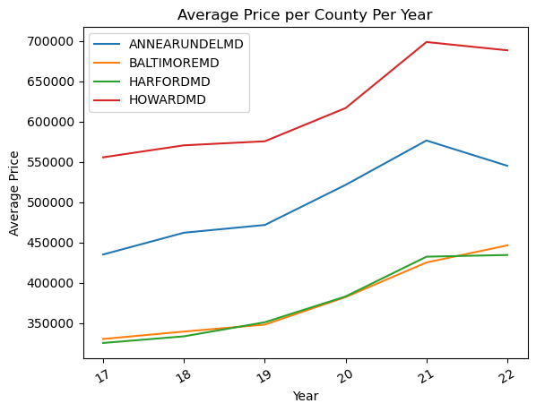
EDA Results: Prices over the Years
Prices increased, in general at similar rates across all counties.
Notes:
Next, we look at the average home prices over the years. From the chart we can easily see the upward trend in the cost of homes over the years, with a faster rate of increase from 2019 to 2021. We see again the same ordering of price levels of the 4 counties and increases at similar rates. Home prices look to have peaked in 2021 and have so far about leveled off or decreased slightly thus far into 2022.

Slide 7
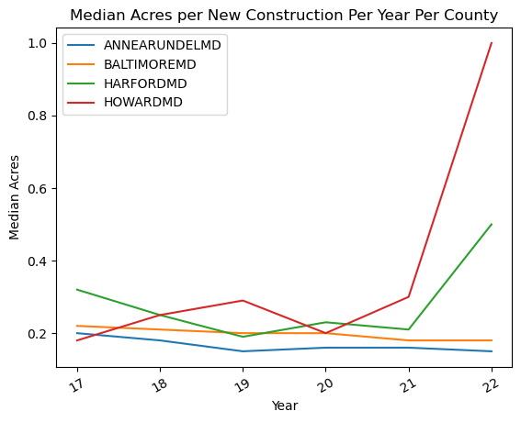
EDA Results: New Construction Acres
Slight downward trend in acres for new construction lots.
Some outliers in Harford and Howard counties.
Notes:
Next, looking at the lot acres for new construction, we see that there has been a slight downward trend in the size of new construction lots, more steadily for Anne Arundel and Baltimore counties. The median in those counties has stayed in the 0.2-acre range, and that is already small, so it makes sense that the downward trend has only been slight - it is tough to get too much smaller than that. Interestingly, Howard, which we saw as the most expensive, and Harford, which we saw as the least expensive alongside Baltimore County look to have their new construction lot sizes being slightly larger, and the downward trend is not as clear or evident for those counties. Howard and Harford counties have more land, and thus their new homes also come with more land, which we will see does make them more expensive. This data is only up though early February of 2022 when I received it, and so for Howard in 2022, there were only 5 new construction home sales, 3 of which were 1 acre lots, the other 2 being 0.14 and 0.24 acres, so I'd expect that as data would be added further into 2022 that number would come down. Harford and Howard also have a lesser volume of homes than Anne Arundel and Baltimore counties, making their numbers less consistent. For all of these graphics, the small sample size of 2022 is a good thing to keep in mind as some outliers may exist.

Slide 8
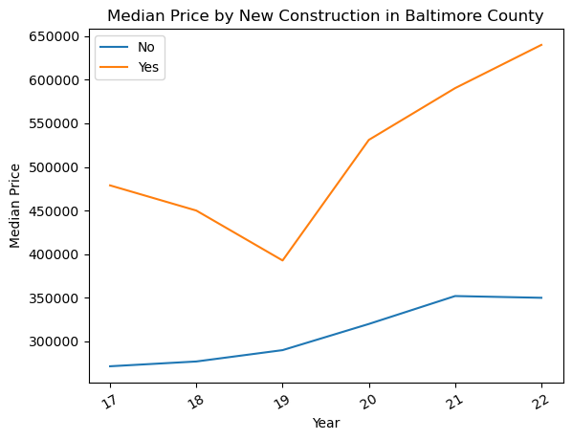
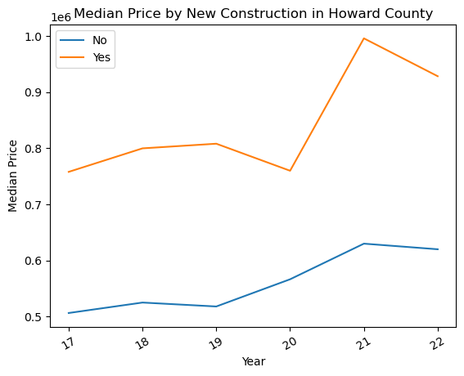
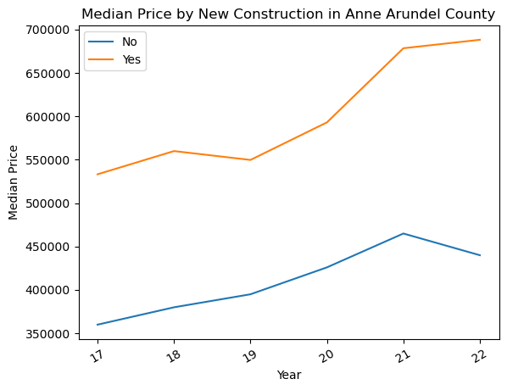
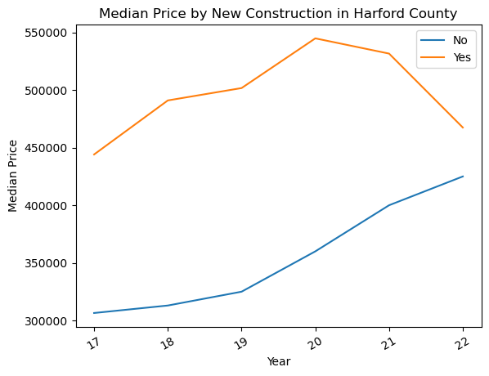
EDA Results: New Construction Cost
New construction homes are more costly than non new construction in every county.
Baltimore the cheapest, Howard the most expensive.
Notes:
When it comes to new construction cost, here we see that new construction is consistently more expensive than non new construction in each county, to different degrees in each. Again Baltimore, non new construction shows as the cheapest option, and we see Howard new construction as the most expensive option. This is consistent with the overall average prices we saw per county earlier in the analysis and we again see the same general increase in prices across the board over the years. But, clearly new construction is related to the sale price.

Slide 9
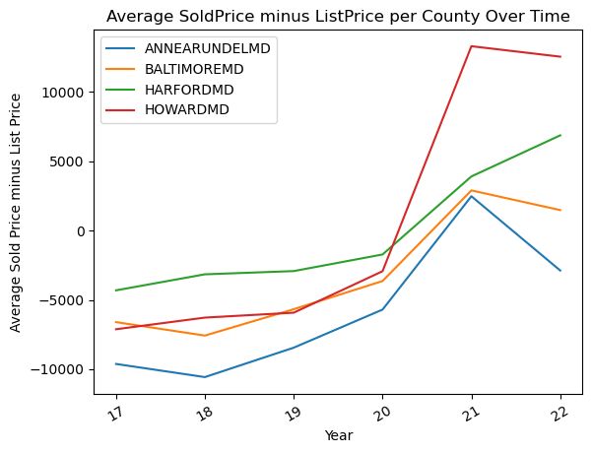
Initial EDA Results: Sold – List Price
Housing market has become much more of a seller’s market recently.
World events such as COVID-19 affect the market.
Notes:
Looking at the average of the sold price minus the list price over time, we see that the housing market has become much more of a seller's market as of recently. Up until 2020 homes were selling for under their list price, then with markets becoming more competitive in 2020 with the development of the COVID-19 pandemic, residential homes have been selling at or above their list price. This can imply that home price is dependent on more than just the features of the house - it depends on world events as for demand and market fluctuation. So far into 2022 the average difference has come down in 3 of the 4 counties, only going up in Harford.

Slide 10
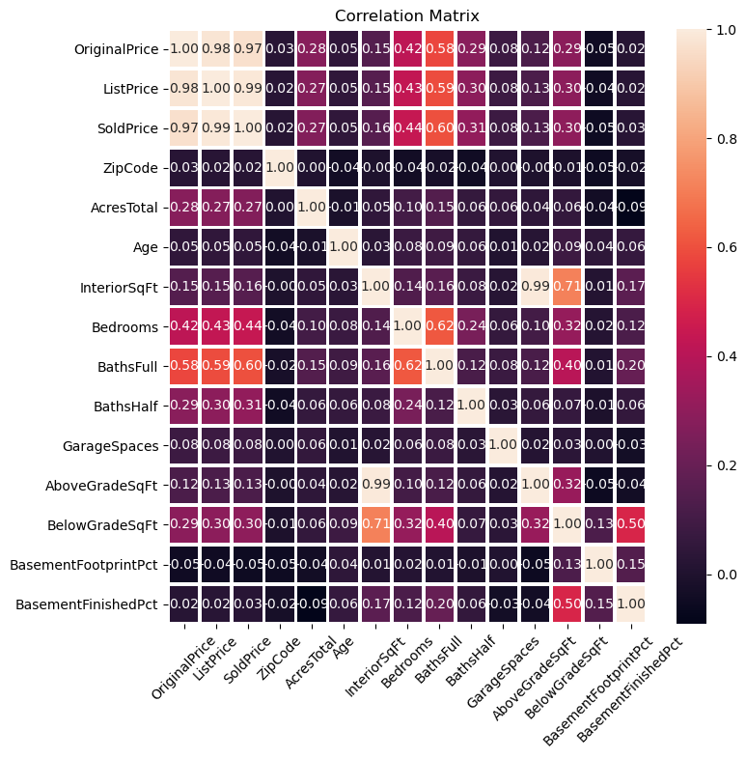
Initial EDA Results: Correlation Matrix
Obvious strong correlation between original, list, and sold prices.
Interior square feet highly correlated to above and below grade square feet. It is the sum of those two.
Number of full bathrooms, bedrooms, and half bathrooms appear to be the highest correlated to the price of the home.
Notes:
In the above correlation matrix, there are a few things to note. First, obviously there is a strong correlation between the prices - original, list, and sold prices. They are all similar and tend to change with each other which makes sense, the higher the list price, the higher the sold price. The sold price is what we are trying to predict, and clearly the original and list prices help get us closer to the sold price. However, the goal here was to be able to predict the sold price based on solely the home's features rather than using its original or list price as an indicator. Another couple things that are highly correlated are the interior square feet to the above grade square feet, and below grade square feet to interior square feet. The interior square feet is the sum of the below and above grade square feet and thus it makes sense that these are highly coordinated. With that, in my machine learning analysis I use only the interior square feet so that I'm not using highly correlated information that is repetitive to the algorithms. Looking for what is highly coordinated to the sold price and perhaps a good predictor, we see that the number of full baths, number of bedrooms and the number of half bathrooms are highest coordinated to the sold price and so we’d expect that those are some of the most important predictors for the machine learning algorithms to use. And it turns out that they are.

Slide 11
Machine Learning Models
I experimented with numerous models:
Linear regression
Decision tree
Support Vector Regression
XGBoost Regression
The coefficients found in linear regression as well as the splits found in decision trees help us gain knowledge on what is most important when determining the value of a home.
Support Vector Regression and XGBoost better for the accuracy of the model.
Notes:
I experimented with several models in predicting home price, including linear regression, decision trees, Support Vector Regression, and XGBoost. Linear Regression places weights on the features for which I analyze to see what the model placed the highest weights on thus corresponding to being more important for predicting price. Decision trees are typically more widely used in classification problems, but good for analysis in our context here as the top level first decision will be the one it chooses to eliminate the most error and thus the factor it sees as most important for determining price. So, by looking at the top couple of splits it is telling in terms of what its modeling sees as being the most telling about the sold price. Support Vector Regression and XGBoost are less interpretable but their workings are better for the accuracy of the model.

Slide 12
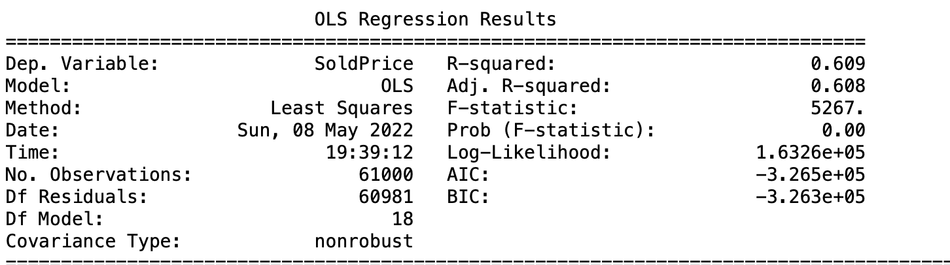
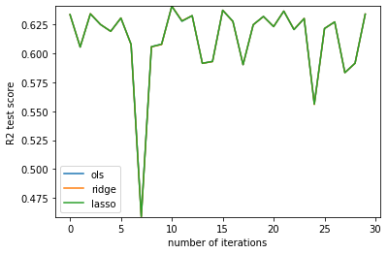
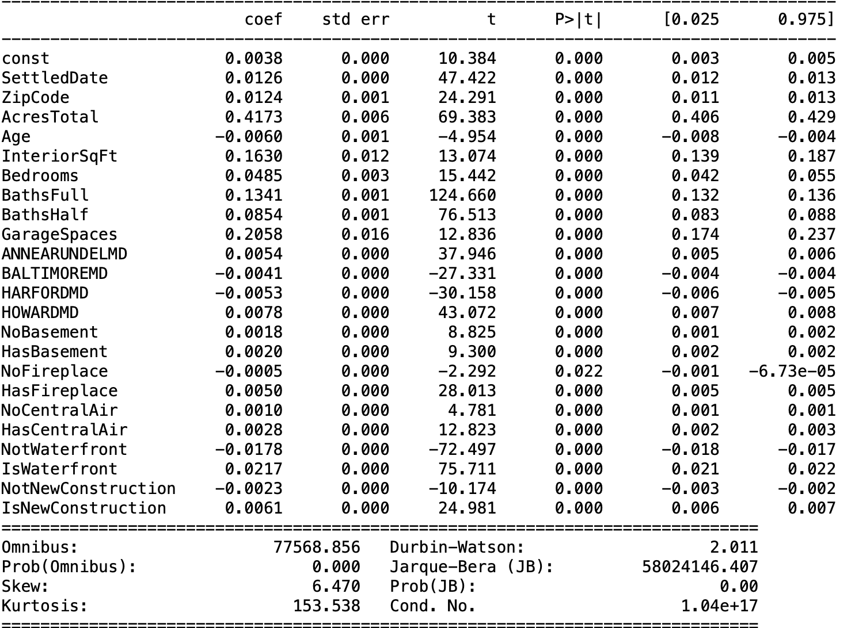
Linear Regression
~61% of the variation in sold price explained by the variation in our variables here.
Number of acres the home sits on has the highest coefficient and effect on sold price.
Ols, ridge, and lasso regression all performed the exact same when rounded to two decimals.
Notes:
With linear regression I achieved a r-squared value of 0.608, telling us that approximately 61% of the variation in the sold price could be explained by the variables in the model. Here, I normalized the variables using sklearn’s preprocessing MinMaxScaler in order to normalize the variable’s values between 0 and 1 for each, and therefore compare the coefficients to whereas the larger ones are the ones that have the higher effect on the sold price. With that, interestingly, the variable with the highest coefficient was the number of acres the home sits on. It is then followed by the number of garage spaces, amount of interior square feet, number of full bathrooms, number of half bathrooms, then by number of bedrooms. The variables found to have negative coefficients also make sense intuitively – looking at the county factor, Baltimore and Harford counties are cheaper areas and thus have negative coefficients. The value of the home is also reduced when it has no fireplace, isn’t waterfront, or isn’t new construction. I ran the linear regression models of ols, ridge and lasso to determine which performed the best over 30 iterations of different random splits of the data. On the graph we see only 1 line because all three methods performed to the exact same r squared value when rounded to two decimal points. When looking at the p values of the results here, all the variables included are statistically significant and proven to have an impact on the sold price. I also tried this with different variables involved, as well as one-hot-encoding the style of home which is whether it is a rancher, colonial, capecod or so on and many of those were statistically insignificant which is why I decided to not include them in my model here.

Slide 13
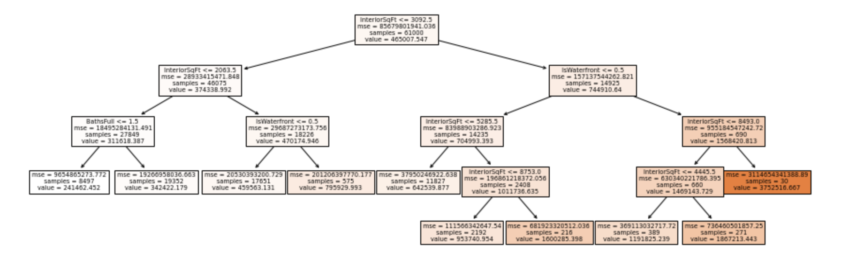
Decision Tree Regression
With max depth of 15, R-Squared value is ~0.65 on average when run with cross validation
Found interior square feet, number of full bathrooms, and whether the home is waterfront as the top features to split on in terms of minimizing loss.
Notes:
With decision trees after tuning the parameters I ended up achieving a R-Squared score of about 0.65 when using a max tree depth of 15 which is slightly better than achieved with linear regression. Decision trees tend to be more widely used in classification instances as things are sorted into buckets rather than being continuous. For our purposes here the main thing I wanted to get out of the decision tree was the application of which features it split on early to minimize loss early on. Interestingly, it split on interior square feet, number of full bathrooms, and waterfront when limited to 10 leaf nodes. The amount of interior square feet and number of full bathrooms were also highly valued in linear regression, but the waterfront feature was not as much. Perhaps telling us that linear regression did not value waterfront as much as it should have.

Slide 14
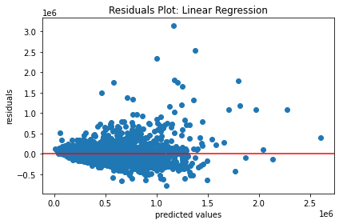
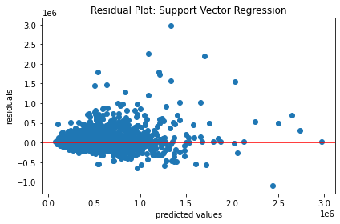
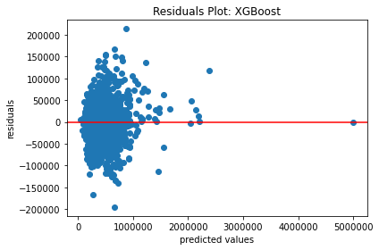
Comparing Models
Linear Regression R2: ~0.609
Cone shaped residuals
SVR R2: ~0.736
Less of a pattern in residuals but wider error.
XGBoost R2: ~.923
Less pattern in residuals and smaller error, most predicted within 50k, pretty much all within 100k.
Notes:
When it comes to comparing the models, I mainly used a combination of the R Squared values and the residual plots. With it being a lot of data, the residual plot can be a little difficult to read since the points closer to having a residual of 0 are not so differentiable. First, looking at the residuals for linear regression, clearly there is a pattern with it being somewhat cone-shaped where for homes that sell for less, the predictions are more accurate. As the predicted price goes up, it gets less and less accurate. For the support vector regression residuals, we see a little bit less of that pattern. For both linear regression and support vector regression mostly, all predictions are within 500k of the actual price, which is not that great given most homes in the dataset are selling for less than a million dollars. Most are more accurate than that but by the look of it, a fair number of predictions are off by a couple hundred thousand dollars. Looking at the residuals for XGBoost, they are much better, and I achieved a R squared of .976. There is no apparent pattern in the residuals, and most are within 50k, nearly all are within 100k, only with a few outliers. The R squared values went from 0.609 to 0.736 to 0.923 – the XGBoost model was by far the most accurate and certainly the one to use when it comes to predicting the sold price of new homes on the market.

Slide 15
Interpretations / Key Takeaways
Most determining of home price is the amount of land / house you get.
The number of bathrooms in the home is more valued than the number of bedrooms.
Whether a home is waterfront or not is more impactful than the other location features.
Notes:
In conclusion of interpreting the models, it appears that the most telling features for home price begin with the number of acres the home sits on and how much interior square feet it has. This makes sense as these are the most telling features as for how much house you are getting for the price. Secondly, the number of full bathrooms is the next most valued feature of a home. Homes typically tend to have less bathrooms than bedrooms and it seems that a lot of value is put on a home with a good number of bathrooms. The more bathrooms the home has, the more value it has. A bathroom per bedroom is something that people may not find too often and is something that there seems to be a lot of demand for. There are a relatively small number of waterfront homes compared to the total number of homes out there, and waterfront is a feature that adds a lot of value to a home.

Slide 16

Model Interface
Demo of model interface.

Slide 17
Future Work
Turn the interface into a recommender
Have the user differentiate between features that are must haves, nice to haves, and things they really don’t want.
For nice to haves, have the user rank how much they want it on a scale of 1-10.
Develop algorithm to supply the user with their optimal home.
Could use recommender for optimal home (made-up house) or for the best fit for them currently on the market.
Could have a real estate agent use the model, collect data on how well it does for home buyers, make improvements based on feedback.
Setup data pipeline.
Pull more data on crime rates and school districts to see if I can make it even more accurate.
Notes:
Now for the future work, the first thing I’d like to do is turn the interface into a recommender. With this, I would have the user differentiate between features that are must haves, nice to have and things that they really don’t want. For the nice to haves, I would have them rate on a scale of 1-10 of how bad they want it, then develop an algorithm to provide them with their optimal home based on their inputs and budget. If they can get all their must haves under their budget, great! If not, tell them they can’t and try to get them the best balance of their nice to haves. Another thing to do with the recommender would be to have a real estate agent use it for a time and collect data on how it does in terms of people liking the home it recommends for them. Lastly, for use of this model over time a data pipeline should be setup so that as new historical data comes in, it is added into the pipeline and thus incorporated into the model to keep the model as accurate as possible based on the latest market trends. I could also pull in more data like crime rates and school districts to add those features into home price and see if I can make the model even more accurate. I think with a model like this, and recommending an optimal home based on a buyer's desires, it gives a buyer more confidence that they are getting as much for their money as they can and can be happy with what is one of the biggest purchases of their life.

Slide 18
Thank You

Slide 19
Potential Future References
https://reader.elsevier.com/reader/sd/pii/S1877050920316318?token=A74EEE09688E8DDA48B0F7465DD096008D0D41D721C5C4535C9D219BB6254F15E394F6F4E42A26A966B189B623C1C674&originRegion=us-east-1&originCreation=20220228000902
Notes:
Thank you.

