Slide 1
DATA 606 Capstone Project: Predicting Maryland Home Prices and Finding their Value
Zach Vance
Notes:
Hi, I’m Zach Vance and this is my project on predicting home prices in Maryland and Finding their Value.

Slide 2

The Problem / Why it is Important
The housing shortage has created a very competitive housing market.
As either / both a home buyer and an investor there is a lot to weigh when purchasing property.
Buyers want to make decisions to buy properties for the best value in what they want – the problem is: How do they best go about doing that?
Notes:
The housing shortage has created a very competitive housing market and there are so many things to consider when buying a home both personally and from an investor standpoint. Buying a home is one of the biggest purchases a person makes in their life and now more than ever it is important to understand the different aspects of the property in order to get the most value out of it and weighing all the different aspects can be difficult to do. That is the problem I intend to solve in this project - at least to help home buyers with weighing the features of a home before making the purchase.

Slide 3
What is the Project
Guide buyers in their home buying decisions by uncovering more about what features of a home drive its value.
Use exploratory data analysis to analyze trends and patterns in the data.
Use machine learning to predict a home’s price based on its features.
Through this, uncover which features of the home drive its price the most.
Notes:
In this project, I will first explore the data to uncover patterns and trends within it that may help home buyers understand it better. To be able to see the price differential between homes in certain areas, during different periods of time, based on different features such as new construction or whether or not they are waterfront, as well as other features such as the number of acres the house sits on all help to understand where the value of the home actually comes from. Following, the second half of the project will be to use machine learning to predict a homes value as accurately as possible based on its features. Through this, weights can be placed on features and they can be ranked. At the same time, we can more easily determine houses that appear under and over valued.

Slide 4
The Data
Dumped from a Real Estate Agent.
Contains the sold residential homes in Anne Arundel, Baltimore, Harford and Howard counties over the last 5 years for a total of 90,758 homes.
Fields I intend to use:
List date, off market date, settlement date
Original price, list price, sold price
Address
Acres total, age, square footage, style, # of floors,
# of bedrooms, # of full / half bathrooms
Waterfront, new construction
Notes:
The data I use comes directly from a dump the MLS (Multiple Listing Service) software. Coming straight from the records themselves, it is credible, and relatively clean. I was able to get the data for sold residential homes in Maryland for Anne Arundel, Baltimore, Harford, and Howard counties over the last 5 years, for a total of 90,758 homes. There are a lot of good features in the data I intend to use such as the list date, list price and sold price, location, acres, age, features like bed and baths, as well as whether or not it is new construction and or waterfront, among others.

Slide 5
Research Questions / Hypothesis
What is the best month to buy a home in?
Have home prices gone up faster in certain areas over others?
How much do waterfront homes cost in comparison to non-waterfront?
Has the number of acres for new construction homes gone down over time?
How much does new construction cost in comparison to non new construction?
Is there more new construction in certain areas?
Did homes tend to go more above or below listing price during any specific time period?
Notes:
Here are some of the questions I wish to answer, and that I have focused on answering in my initial exploratory data analysis. Things I mentioned like what month is best for buying, the increase in prices over different areas, how different features like new construction and waterfront affect price, and how the sale price has measured with the list price over time.

Slide 6
Research Process / Steps
Gathered the data from the Real Estate Agent.
Read in and clean the data after doing some initial profiling on it.
Perform EDA to answer exploratory questions, analyzing trends and patterns in the data.
Create and tune ML models to predict a home’s price based on its features.
Analyze results and summarize findings.
Think about future work and the potential for further improvements.
Notes:
The steps in this process consist of gathering the data from the real estate agent, cleaning it with some initial profiling, doing the EDA to answer exploratory questions, creating and tuning ML models to predict home prices, analyzing the results, and thinking about how this can be expanded upon with future work.

Slide 7
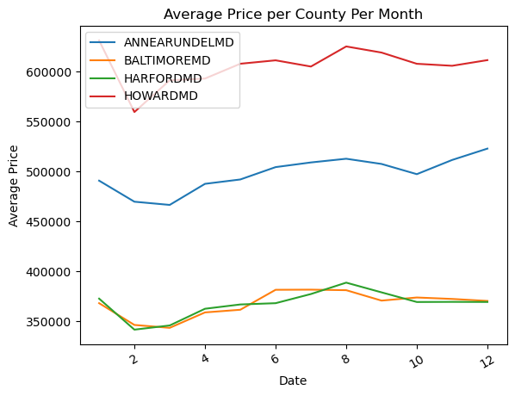
Initial EDA Results: Prices By Month
February – March seem like the best months to buy a house based on the lowest average prices.
All counties follow the same trend.
Notes:
The first question seeked to be answered is what month is the best one to buy a home in? Here we see that Ferburary to March seem like the best months based on the lower average prices. Another thing to note here is the clear discrepancy in prices based on county that we will also see going forward, Howard being the most expensive, followed by Anne Arundel with Harford and Baltimore being the cheapest. All counties followed the same general pattern with the cheapest months to buy being Ferbruary and March.

Slide 8
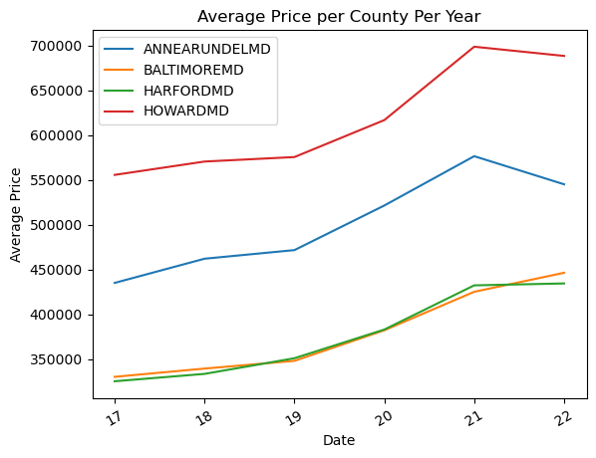
Initial EDA Results: Prices over the Years
Prices increased, in general at similar rates across all counties.
Notes:
Next we look at the average home prices over the years. From the chart we can easily see the upward trend in the cost of house prices over the years. We see again the same ordering of price levels of the 4 counties and increases at similar rates. Home prices look to have peaked in 2021 and have so far leveled off or decreased slightly so far into 2022.

Slide 9
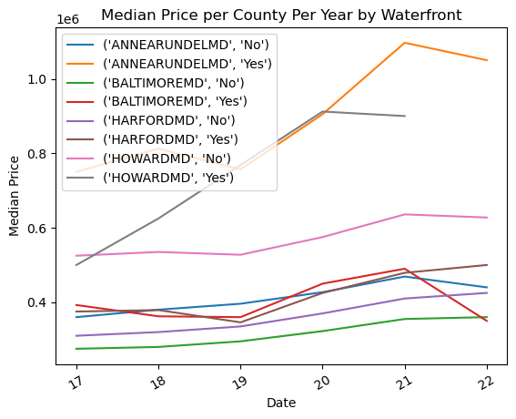
Initial EDA Results: Waterfront Differences
Anne Arundel County waterfront home prices increased dramatically from 2019 – 2021.
Waterfront homes are more costly than non waterfront in every county.
Notes:
Looking into waterfront homes now, it is clear that Anne Arundel County waterfront homes look to have increased pretty dramatically from 2019 to 2021. In Anne Arundel county, the price difference between the medians of waterfront and non waterfront is also pretty significant with the median for non waterfront being down around 400k and waterfront up over 1 million. The cheapest is non waterfront in Baltimore county, and the difference between waterfront and non waterfront in Baltimore county is not as significant. Waterfront is consistently more expensive than non waterfront in all of the counties, but to different degrees. As a side note, when looking at 2022, in all of these graphics, I would engourage to see it as valuable information but at the same time not to the same extent as the other years as there is not as much data for it only two months into the year.

Slide 10
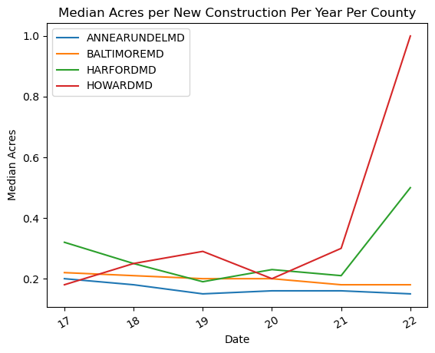
Initial EDA Results: New Construction Acres
Slight downward trend in acres for new construction lots.
Some outliers in Harford and Howard counties.
Notes:
Next, looking at the lot acres for new construciton, we see that there has been a slight downward trend in the size of new construction lots, more steadily for Anne Arundel and Baltimore counties. The median in those counties has stayed in the 0.2 acre range, and that is already really small so it makes sense that the downward trend has only been slight - it is tough to get much smaller than that. Interestingly, Howard, which we saw as the most expensive, and Harford, which we saw as the least expensive alongside Baltimore County look to have their new construction lot sizes being slightly larger, and the downward trend is not as clear or evident for those counties. Howard and Harford counties have more land, so it will be interesting to see where the price difference between the two comes from whether it be mainly rooted in location or if homes in Howard tend to be larger than that of Harford. For Howard, in 2022, there have only been 5 new construction home sales, 3 of which were 1 acre lots, the other 2 being 0.14 and 0.24 acres, so I'd expect that as we get further into 2022 that number come down. Harford and Howard also have a lesser volume of homes than Anne Arundel and Baltimore counties, making their numbers less consistent.

Slide 11
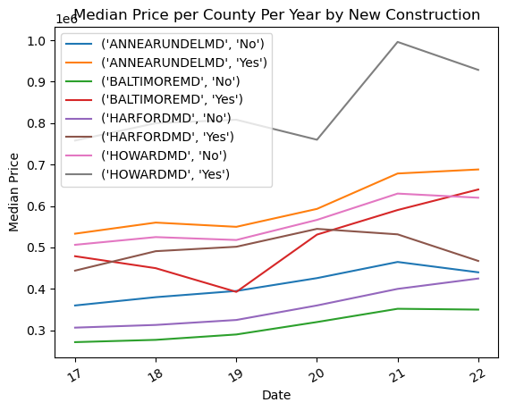
Initial EDA Results: New Construction Cost
New construction homes are more costly than non new construction in every county.
Baltimore the cheapest, Howard the most expensive.
Notes:
When it comes to new construction cost, here we see that new construction is consistently more expensive than non new construction in each and every county, to different degrees in each county. Again Baltimore, non new construction shows as the cheapest option and we see Howard new construction as the most expensive option. This is consistent with the overall average prices we saw per county earlier in the analysis and the same general increase in prices across the board.

Slide 12
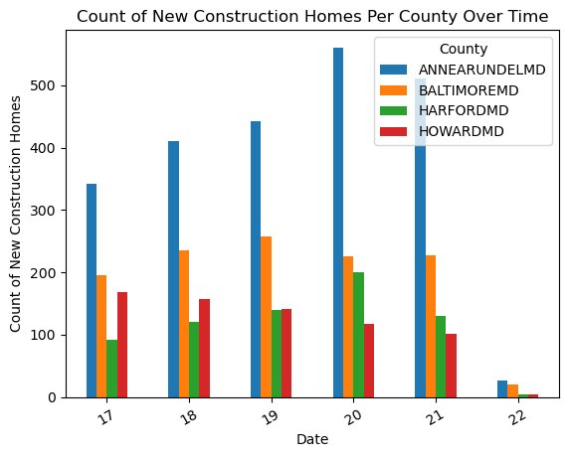
Initial EDA Results: New Construction by County
Anne Arundel has the most new construction and it followed the most steady increase through 2020.
New construction decreased slightly across the board in 2021.
Notes:
The count of new construction homes looks to be favored in Anne Arundel - it has the most new construction homes and the counts of new construction there have increased over the years. The least amount is between Harford and Howard. New construction decreased slightly across the board in 2021 in the midst of the COVID-19 pandemic and has consistently decreased gradually in Howard county. 2022 is low again because it is not a full years worth of data.

Slide 13
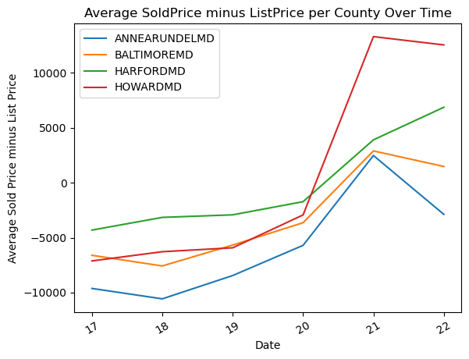
Initial EDA Results: Sold – List Price
Housing market has become much more of a seller’s market recently.
World events such as COVID-19 affect the market.
Notes:
Looking at the average of the sold price minus the list price over time, we see that the housing market has become much more of a sellers market as of recently. Up until 2020 homes were selling for under their list price, then with markets becoming more competitive in 2020 with the development of the COVID-19 pandemic, residential homes have been selling at or above their list price. This can imply that home price is dependent on more than just the features of the house - it depends on world events and market fluctuation. So far into 2022 the average differenc ehas come down in 3 of the 4 counties, only going up in Harford.

Slide 14
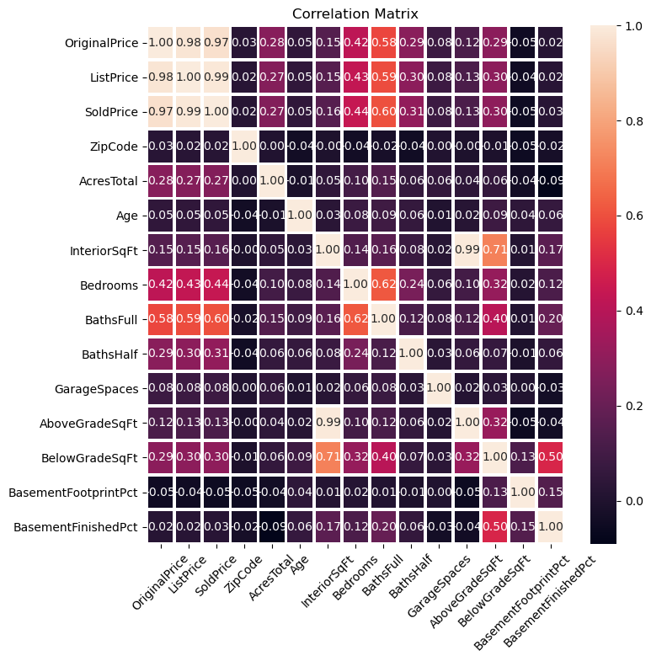
Initial EDA Results: Correlation Matrix
Obvious strong correlation between original, list, and sold prices.
Interior square feet highly correlated to above and below grade square feet. It is the sum of those two.
Number of full bathrooms, bedrooms, and half bathrooms appear to be the highest correlated to the price of the home.
Notes:
In the above correlation matrix there are a few things to note. First, obviously there is a strong correlation between the prices - original, list, and sold prices. They are all similar and tend to change with each other which makes sense, the higher the list price, the higher the sold price. The sold price will be what we are trying to predict, and clearly the original and list prices help get us closer to the sold price. However, I'd like to be able to predict the price based on soley the home's features rather than using its original or list price as an indicator. Another couple things that are highly correlated are the interior square feet to the above grade square feet, and below grade square feet to interior square feet. The interior square feet is the sum of the below and above grade square feet and thus it makes sense that these are highly coordinated. With that, in my machine learning analysis I will probably with to use either the combination of above and below grade or just the interior square feet so that I'm not using highly correlated information that is repetitive to the algorithms. What I am mainly concerned about is how things are correlated to the sold price since that is what we'd like to predict. With that, we see that the features the highest correlated to sold price are the number of full baths, number of bedrooms and the number of half bathrooms and so I'd expect that those are some of the most important predictors for the machine learning algorithms to use.

Slide 15
Machine Learning Models
I plan to use a combination of models in predicting home price:
Support Vector Regression
Linear regression
Decision tree
Random forest
With these I will be able to output information about how each of the features are used within the models.
In other analysis, I'd like to use k means clustering to see if certain price ranges are more prevalent in certain areas. I plan to run k means clustering on all the homes, or on select homes specifically to try to keep their features relatively constant to narrow down on what areas are the priciest for a similar home.
Notes:
I plan to use a combination of models in predicting home price - Support Vector Regression, linear regression, decision tree, random forest. With these I will be able to output information about how each of the features are used within the models. Regression will place weights on the features for which I can analyze to see what the regression models placed the highest weights on thus corresponding to being more important for predicting price. In the decision trees, the top level first decision will be the one it chooses to eliminate the most error and thus the factor it sees as most important for determining price. The factors being ranked by the levels of the tree and /or forest (collection of decision trees). In other analysis, I'd like to use k means clustering to see if certain price ranges are more prevalant in certain areas. I could run k means clustering on all the homes, or on select homes specifically to try to keep their features relatively constant to narrow down on what areas are the priciest for a similar home.

Slide 16
Expected Outcomes
Gain a better understanding of the problem by learning the trends and patterns in the data and visualizing the results.
Determine which features of a home have the largest impact on the home’s value.
I think I will also find that there is plenty of fluctuation in price that will not be explained by this data. Factors such as humans placing more value on what they value, the current state of the economy, COVID forcing people to suburbs, and so on.
Notes:
I think the overarching problem of everything mentioned here is how best to find the most value in homes for perspective home buyers. Via the predicting of home prices I can perform predictive analytics while using the results to gain a better understanding of the problem. I'll be able to visualize which factors of the home have the biggest effect on its cost. Another thing I think I will find is that there may be plenty of error, different people place different values on homes and the sale price may not be a 100% good true value number. There may also be factors that are not be captured well in the data such as the current condition of the home, whether it has well water or public, and so on. What I'm creating is a tool to help solve the problem, and I think gaining a better understanding of the problem by running predictive analytics accomplishes that goal and I, as well as anyone reading this will learn a lot about home values and key factors involved.

Slide 17
Potential Future References
https://reader.elsevier.com/reader/sd/pii/S1877050920316318?token=A74EEE09688E8DDA48B0F7465DD096008D0D41D721C5C4535C9D219BB6254F15E394F6F4E42A26A966B189B623C1C674&originRegion=us-east-1&originCreation=20220228000902
Notes:
Thank you.

