Slide 1
DATA 606 Capstone Project: Predicting Maryland Home Prices and Finding their Value
Zach Vance

Slide 2

The Problem / Why it is Important
The housing shortage has created a very competitive housing market.
As either / both a home buyer and an investor there is a lot to weigh when purchasing property.
Buyers want to make decisions to buy properties for the best value in what they want – the problem is: How do they best go about doing that?

Slide 3
What is the Project
Guide buyers in their home buying decisions by uncovering more about what features of a home drive its value.
Use exploratory data analysis to analyze trends and patterns in the data.
Use machine learning to predict a home’s price based on its features.
Through this, uncover which features of the home drive its price the most.

Slide 4
The Data
Dumped from a Real Estate Agent.
Contains the sold residential homes in Anne Arundel, Baltimore, Harford and Howard counties over the last 5 years for a total of 90,758 homes.
Fields I intend to use:
List date, off market date, settlement date
Original price, list price, sold price
Address
Acres total, age, square footage, style, # of floors,
# of bedrooms, # of full / half bathrooms
Waterfront, new construction

Slide 5
Research Questions / Hypothesis
What is the best month to buy a home in?
Have home prices gone up faster in certain areas over others?
Has the number of acres for new construction homes gone down over time?
Did homes tend to go more above or below listing price during any specific time period?
How much do waterfront homes cost in comparison to non-waterfront?
How much does new construction cost in comparison to non new construction?

Slide 6
Research Process / Steps
Gathered the data from the Real Estate Agent.
Read in and clean the data after doing some initial profiling on it.
Perform EDA to answer exploratory questions, analyzing trends and patterns in the data.
Create and tune ML models to predict a home’s price based on its features.
Analyze results and summarize findings.
Think about future work and the potential for further improvements.

Slide 7
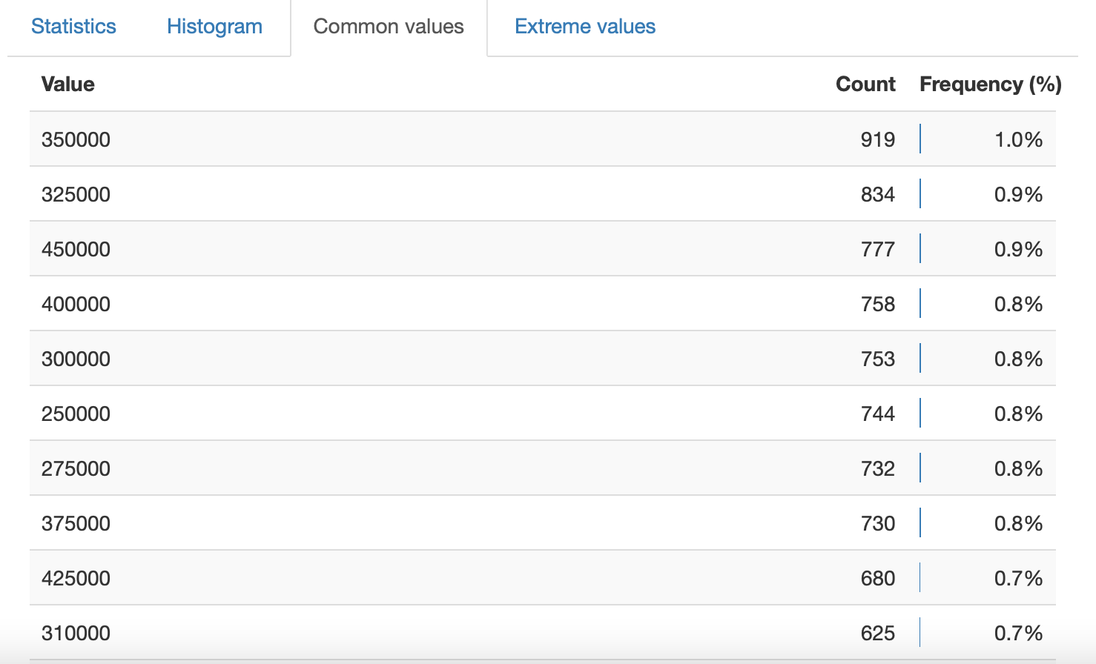
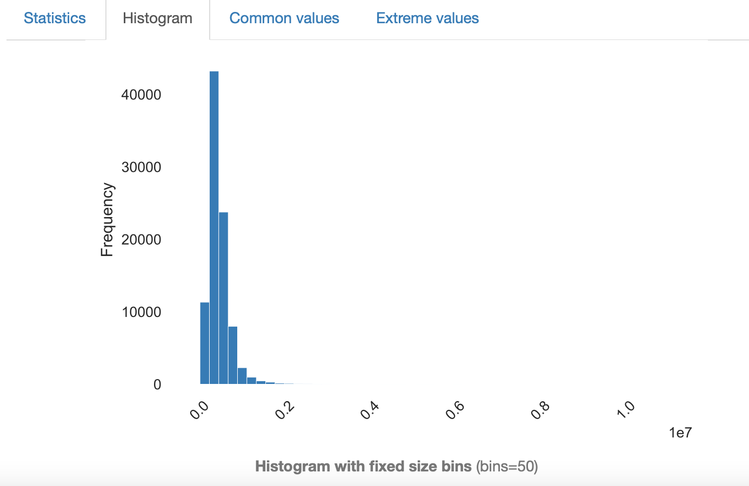
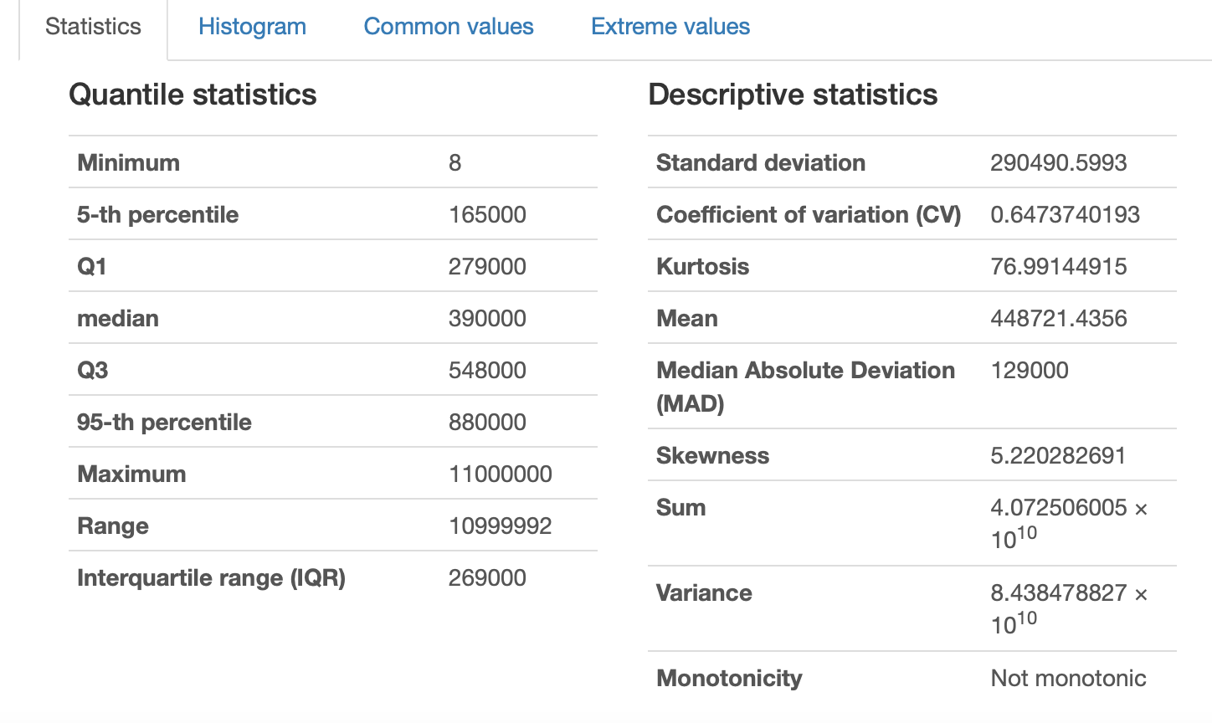
Initial EDA Results: Sold Price

Slide 8
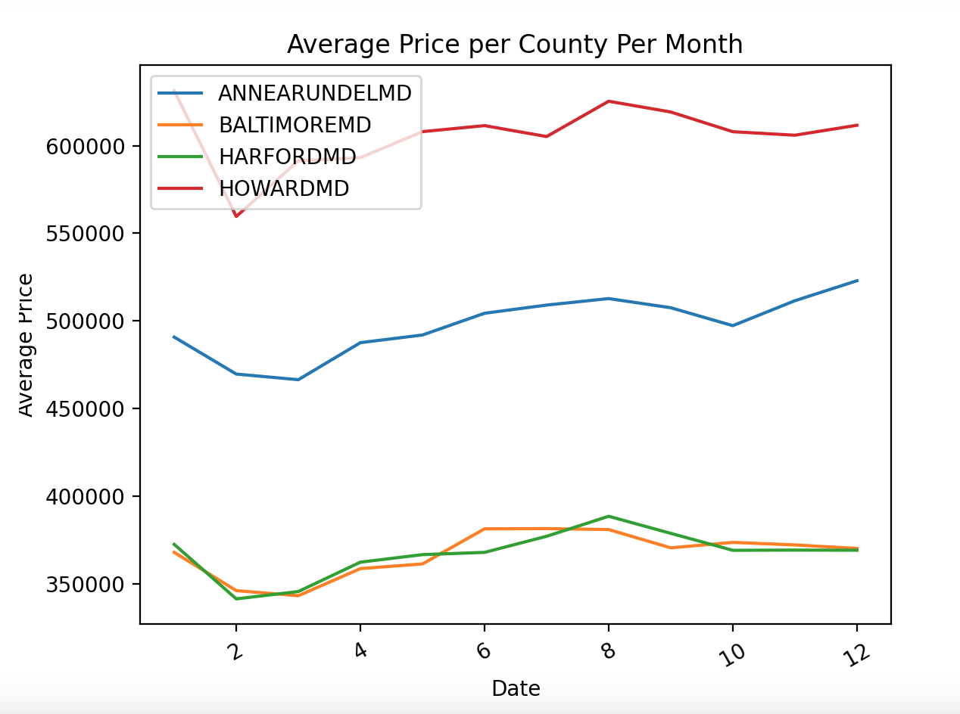
Initial EDA Results

Slide 9
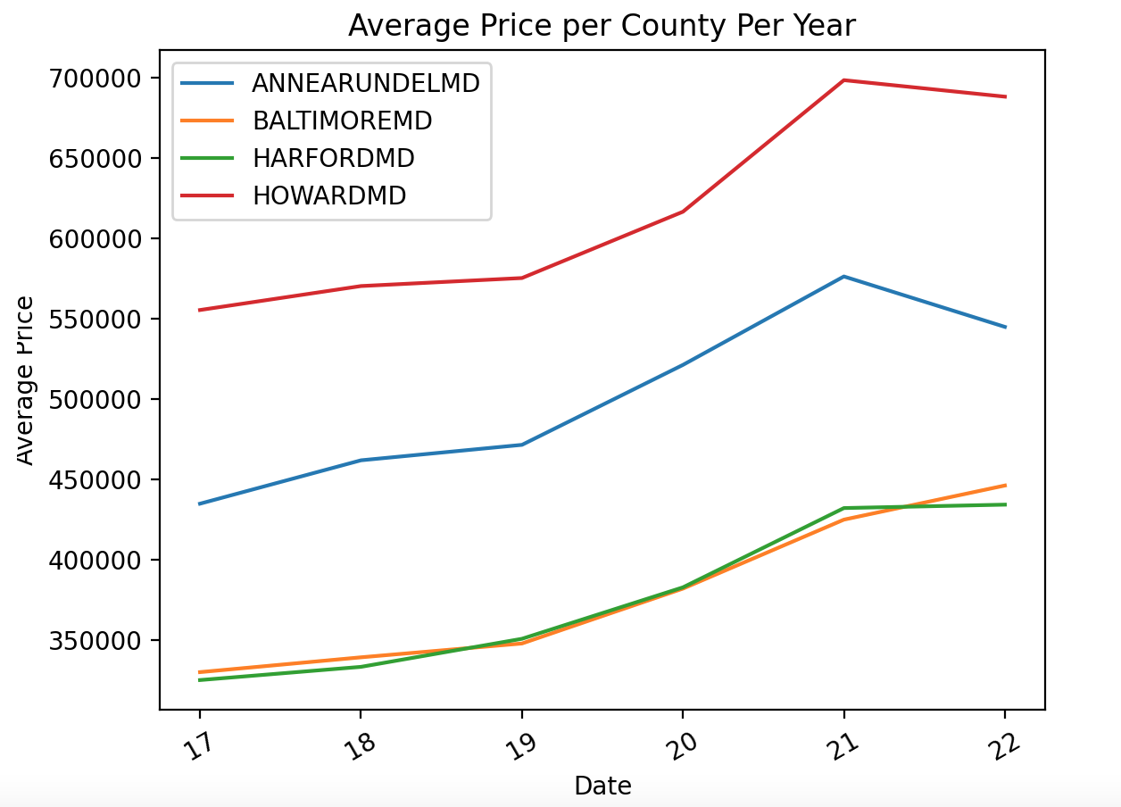
Initial EDA Results

Slide 10
Machine Learning Models
I plan to use a combination of models in predicting home price:
Support Vector Regression
Linear regression
Decision tree
Random forest
With these I will be able to output information about how each of the features are used within the models.
In other analysis, I'd like to use k means clustering to see if certain price ranges are more prevalent in certain areas. I plan to run k means clustering on all the homes, or on select homes specifically to try to keep their features relatively constant to narrow down on what areas are the priciest for a similar home.
Notes:
Regression will place weights on the features for which I can analyze to see what the regression models placed the highest weights on thus corresponding to being more important for predicting price. In the decision trees, the top level first decision will be the one it chooses to eliminate the most error and thus the factor it sees as most important for determining price. The factors being ranked by the levels of the tree and /or forest (collection of decision trees).

Slide 11
Expected Outcomes
Gain a better understanding of the problem by learning the trends and patterns in the data and visualizing the results.
Determine which features of a home have the largest impact on the home’s value.
I think I will also find that there is plenty of fluctuation in price that will not be explained by this data. Factors such as humans placing more value on what they value, the current state of the economy, COVID forcing people to suburbs, and so on.
Notes:
What I'm creating is a tool to help solve the problem, and I think gaining a better understanding of the problem by running predictive analytics accomplishes that goal and I, as well as anyone reading this will learn a lot about home values and key factors involved.

Slide 12
Potential Future References
https://reader.elsevier.com/reader/sd/pii/S1877050920316318?token=A74EEE09688E8DDA48B0F7465DD096008D0D41D721C5C4535C9D219BB6254F15E394F6F4E42A26A966B189B623C1C674&originRegion=us-east-1&originCreation=20220228000902

