Slide 1
Capstone Project DATA-606 Android App Analyzer
Name : Abdul Salam Kagaji
Campus Id : XH61938
Mail : abdulsk1@umbc.edu

Slide 2

Hello!
I am Abdul Salam Kagaji
I am here to present you my Capstone project regarding an android app analyzer.

Slide 3
1.
Introduction

Slide 4
Objective
This project analyzes 10,000+ Android apps across categories to provide insights on market demand, estimated reach, and competition. It will aid in developing growth plans and decision-making for app development.

Slide 5
Literature Survey
Android app market is growing, with 2.87 million apps in 2020 and projected to reach 3.4 million in 2023
High competition in the Android app market
Uninstall rate of Android apps worldwide was approximately 30% in 2020
Developers must deliver high-quality apps that meet users' needs and expectations to succeed

Slide 6
Data Collection
apps.csv
This Dataset provides preliminary data regarding the apps on the google play store
AppDescriptions.csv
This Dataset is generated using webscraping a
Dataset columns
App : name of the app
Category : category of the app
Rating : Rating of the app
Reviews : number of reviews for the app
Size : size of the app
Installs : number of installations done / count of downloads
Type : Free or paid
Price : price of the app
Content Rating : age group of users who rated the app
Genres : gener of the app / similar to category
Last Updated : last updated date and time
Current Ver : version of the app
Android Ver : android supported version
Dataset Columns
App : name of the app
Description : description of the app

Slide 7
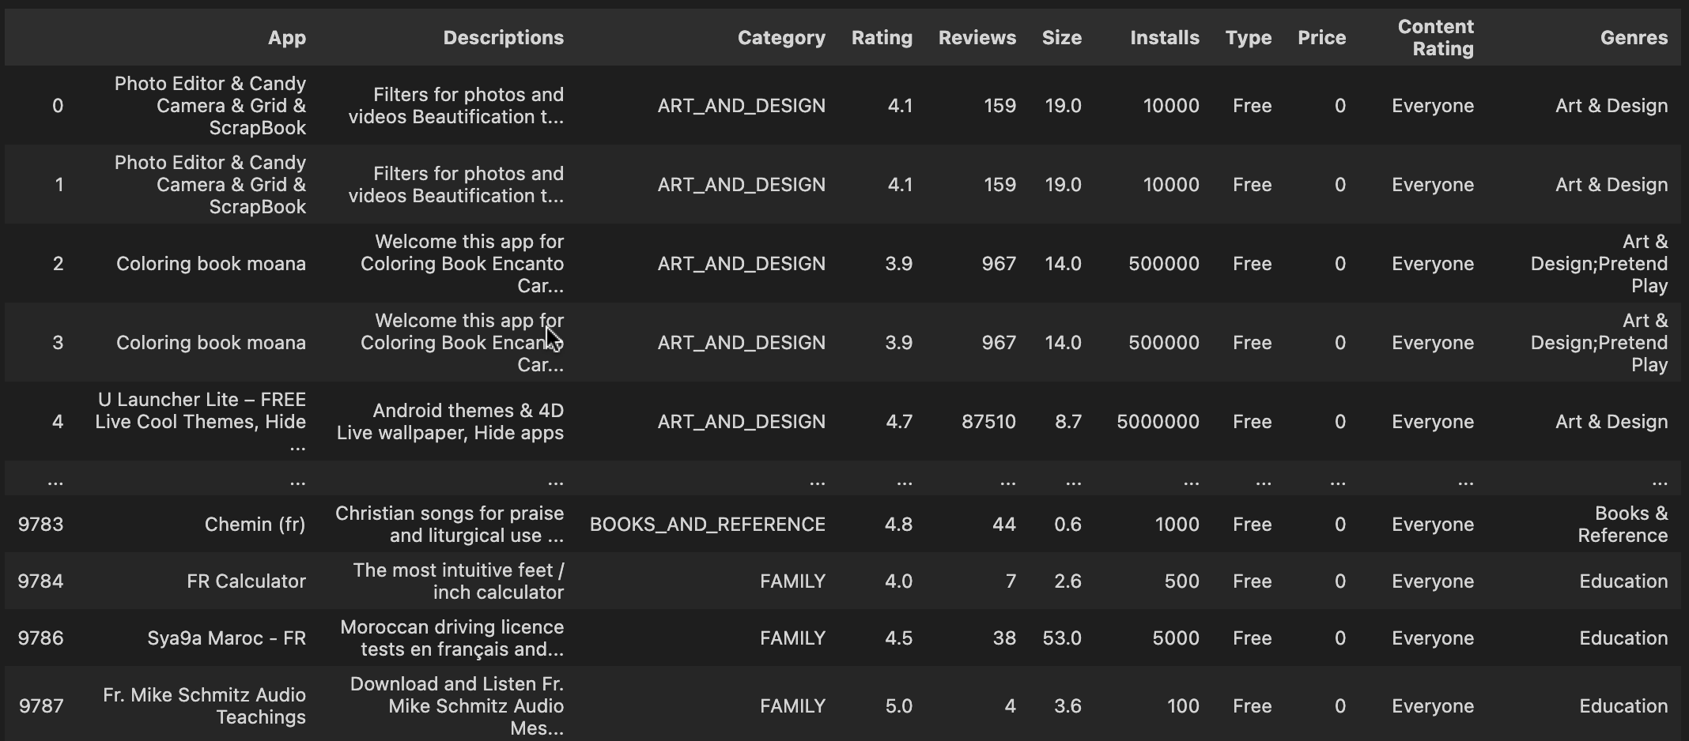
Merged Dataset based on App Name

Slide 8
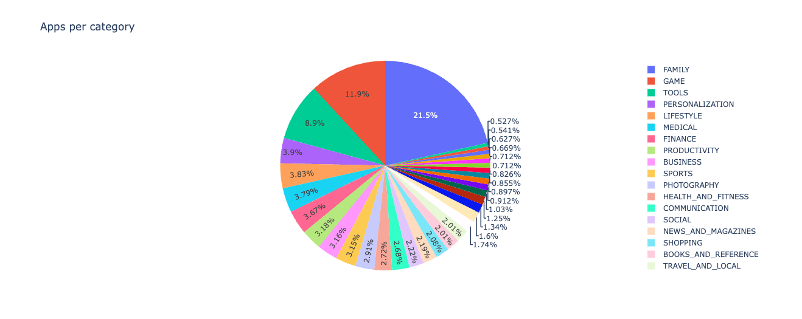
App Category Segregation

Slide 9
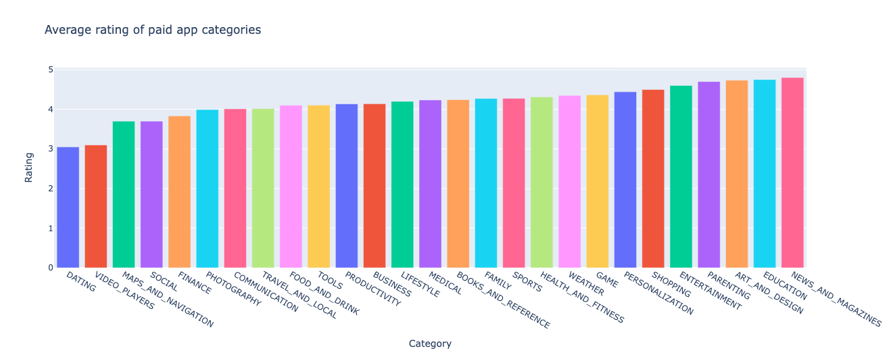
Ratings of Paid Apps per category

Slide 10
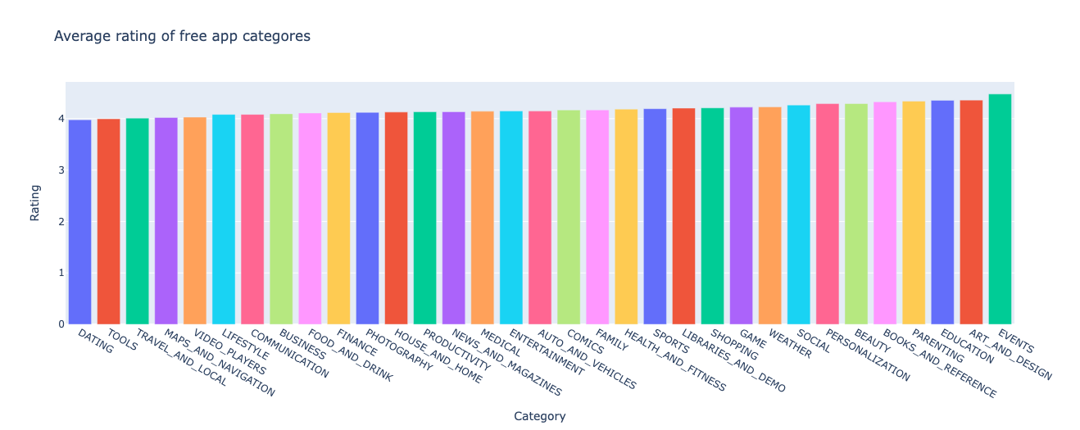
Ratings of Free Apps per category

Slide 11
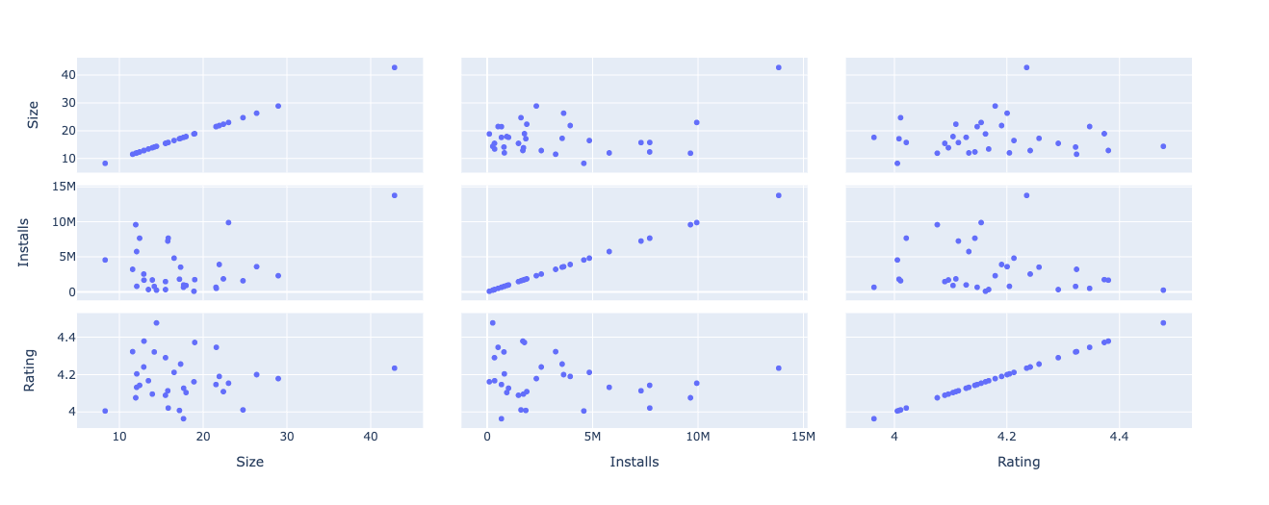
Attribute correlations

Slide 12
Machine Learning Algorithm Used
SGD Classifier
The SGD classifier is a commonly used algorithm for text-based classification tasks. It is known for its efficiency, scalability, and ability to handle large datasets. Many natural language processing applications, such as sentiment analysis and spam filtering, have achieved good results using the SGD classifier.
Advantages:
The SGD classifier is efficient for text-based classification tasks.
It can handle large datasets and has a low memory footprint.
The algorithm is easily scalable for high-dimensional feature spaces.
The SGD classifier achieves good performance in natural language processing applications.
Some of these applications include sentiment analysis, spam filtering, and document classification.

Slide 13
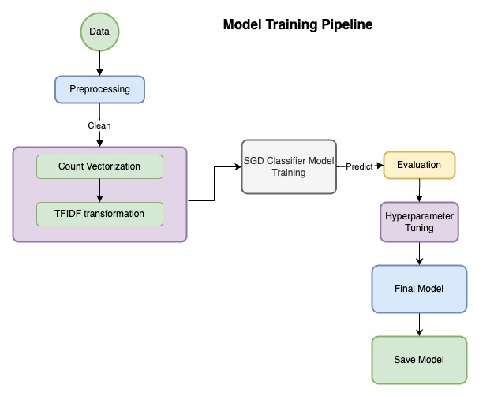
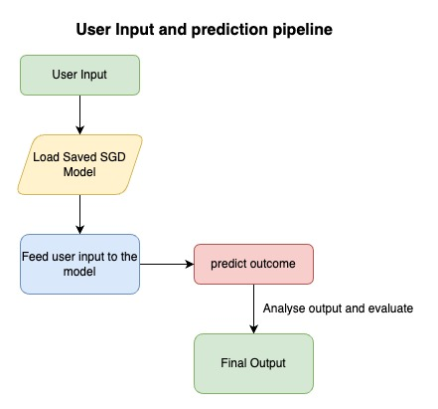
Machine Learning Pipeline

Slide 14
User Interface
Allows users to input app details for analysis.

Slide 15
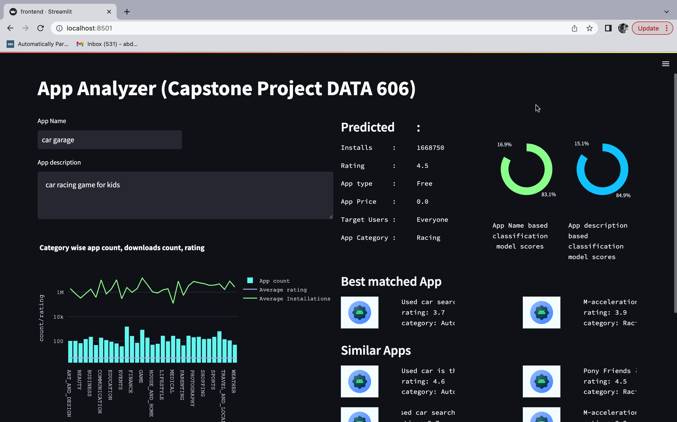

Slide 16
Outcomes
Predicted count of downloads/installs
Predicted app rating.
Predicted age group of the users
Predicting app type (free or paid)
Predicting price of the app if user wants to make the app a paid service
list of top 5 competing apps in the same category of the app

Slide 17
Conclusion
Our solution provides insights and recommendations for developers to improve their app's user experience, functionality, and regular updates. With these insights, developers can create more accessible, engaging, and higher quality apps that meet users' needs and ultimately achieve greater success in the Android app market.

Slide 18
References
Google Play Store Data – Kaggle
https://www.kaggle.com/datasets/yassershrief/goggle-play-data
Statista. (2021). Number of apps available in leading app stores as of 1st quarter 2021. https://www.statista.com/statistics/276623/number-of-apps-available-in-leading-app-stores/
Statista. (2020). Global app uninstall rate 2020, by region. https://www.statista.com/statistics/1090254/global-app-uninstall-rate/

Slide 19
Thanks!
Any questions?

