Slide 1
Taxi Fare Prediction

Slide 2
Background Information
A fare is the cost that a person pays to use a public transportation system, such as a train, bus, or cab.
The system in place to decide how much each individual passenger utilizing a transit vehicle at any particular moment is required to pay is known as the fare structure.
The total fare depends upon various attributes like distance, day of week, hour, duration etc

Slide 3
Problem statement
Giving user an interactive page to provide source and destination information. Predicting the appropriate fare for the ride using machine learning model and reverting back to the user with fare display in USD.

Slide 4
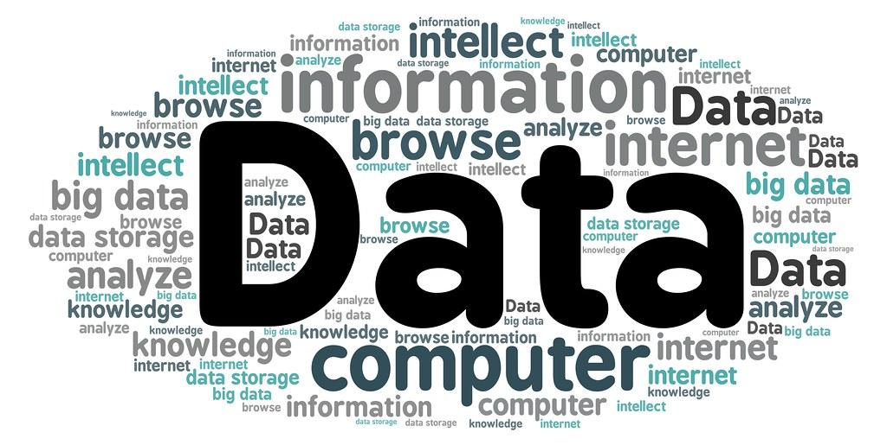
About Data
Total files: 12 (each file represents each month of 2022)
Size : 25 - 65 MB
Rows: 3 M (All files together)
Columns: 28
Source: OpenData.DC.gov
https://opendata.dc.gov/documents/2b61c28adfbd431587ec728829cceb6e/explore

Slide 5
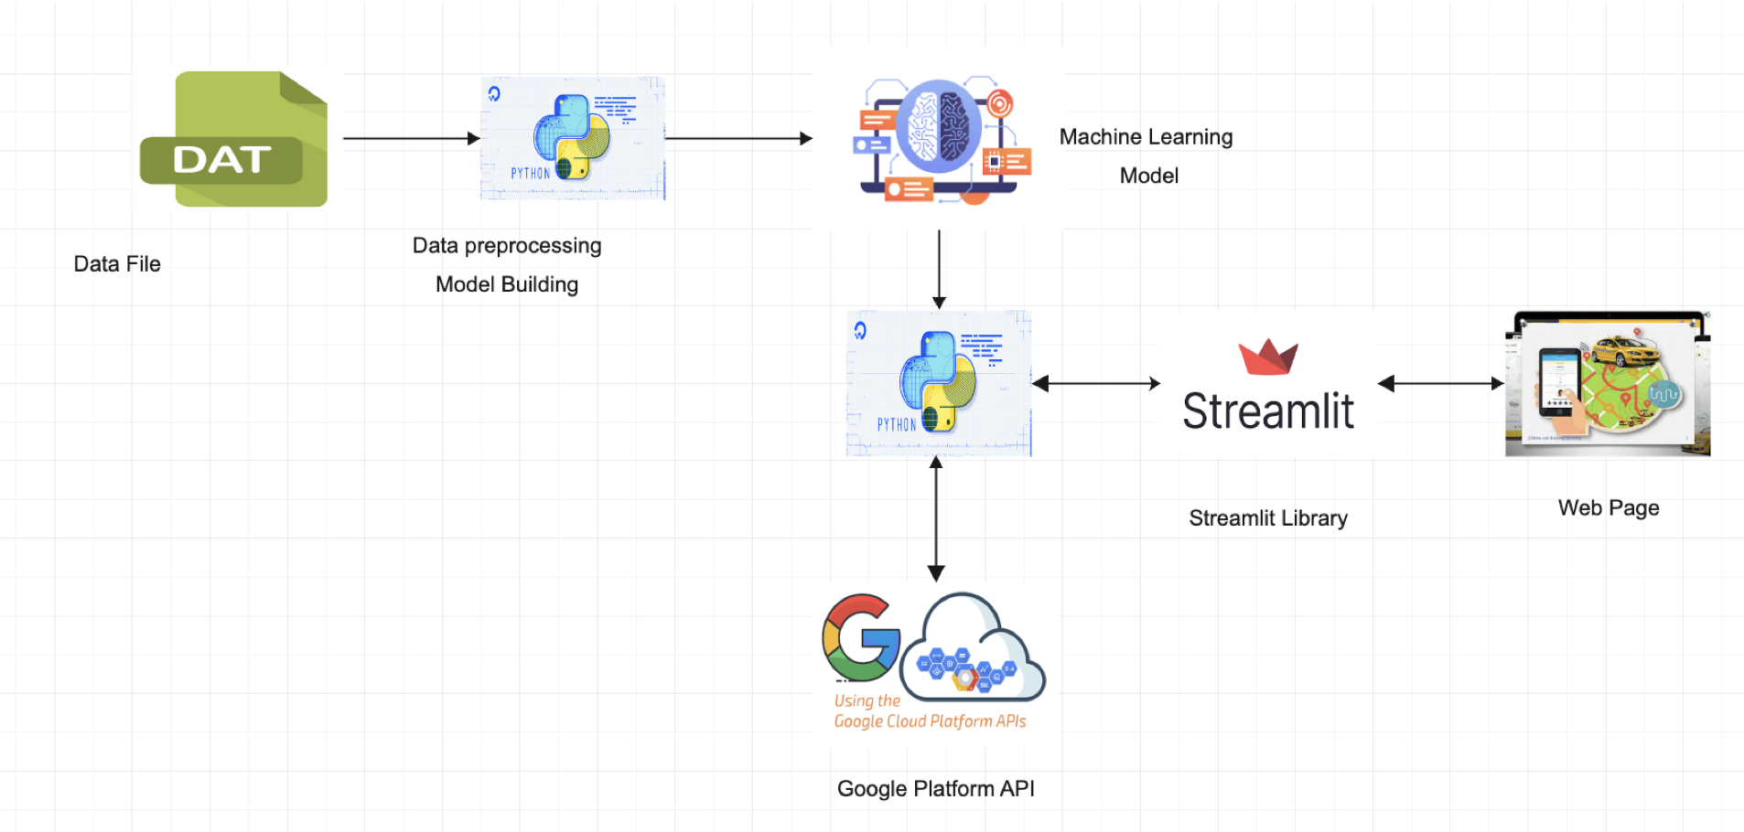
WorkFlow

Slide 6
Data Preprocessing
Handled missing values using various techniques like replacing by average value of column
Casting data type
Created new features with existing features
Identified and removed outliers using visualization techniques

Slide 7

Model
Used Xboost for model building
Used Xboost for model building.
Acquired an accuracy of 0.81 after training.
Saved the model using pickle file

Slide 8

Streamlit is an open-source Python library that makes it easy to create and share beautiful, custom web apps for machine learning and data science
It helps in the project to create a web page and communicate with model for prediction

Slide 9

Google Maps Platform API
Used Google Maps Platforms directions api to get real time values for distance and duration
Used the real time values for the prediction through model

Slide 10
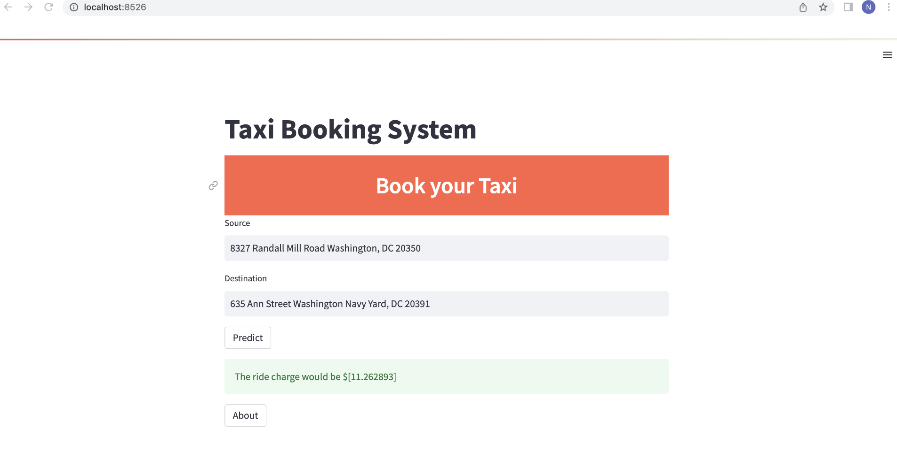
Web Page

Slide 11
Thank You

