Slide 1

Data 606 project Sreekanth Reddy Kypa(ni33739)
Masters Admission Prediction

Slide 2
Introduction:
Masters-Admission-Prediction is a Machine Learning based web application. This application was built with the purpose of helping students in shortlisting universities with their profiles. The predicted output gives them a fair idea about their chances for a particular university.
Context : This app is created for the prediction of Graduate Admissions from an Indian perspective.
Content : The dataset contains several parameters which are considered important during the application for Masters Program

Slide 3
Issue of interest And Why it is important:
Getting graduate admission in a well suited college is highly important for every aspiring student. I would like to represent an extensive proposal about the admission prediction of their graduation.
For any student whose goal is to do masters, this application gives a fair idea about their chances for a particular university.

Slide 4
Data Set And The parameters included are:
The Data Set Contains 9 columns and 400 rows. The Data Set Contains numerical and floating Data types.
GRE Scores ( out of 340 )
TOEFL Scores ( out of 120 )
University Rating ( out of 5 )
Statement of Purpose Strength ( out of 5 )
Letter of Recommendation Strength ( out of 5 )
Undergraduate GPA ( out of 10 )
Research Experience ( either 0 or 1 )

Slide 5
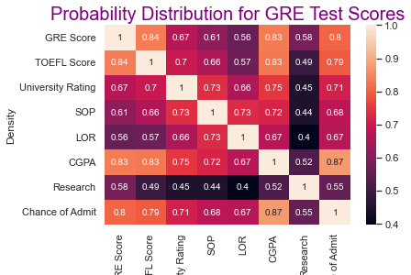
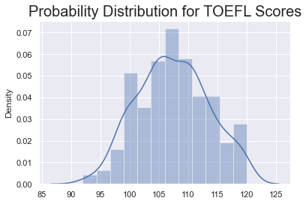
Explanatory Data Analysis:

Slide 6
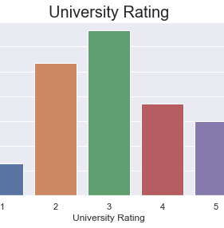
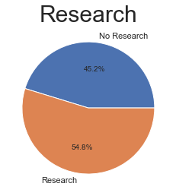
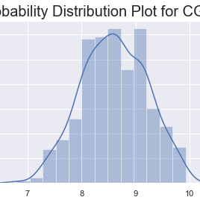
Explanatory Data Analysis:

Slide 7
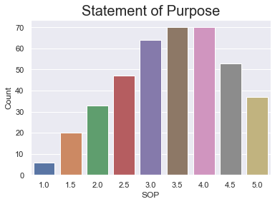
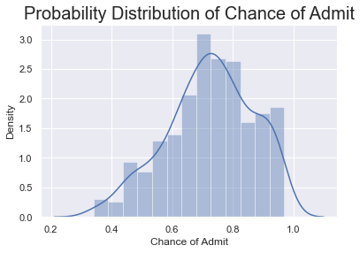
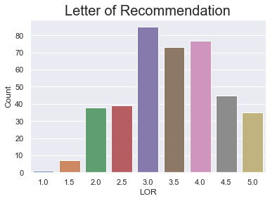
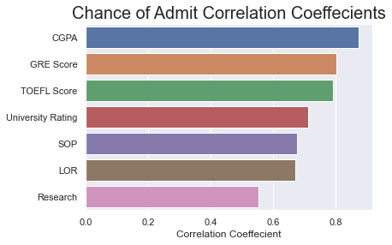
Explanatory Data Analysis:

Slide 8
Regression And Classification Models:
LinearRegression
SVR
RandomForestRegressor
GradientBoostingRegressor
LogisticRegression
svm
KNeighborsClassifier
RandomForestClassifier
GradientBoostingClassifier

Slide 9
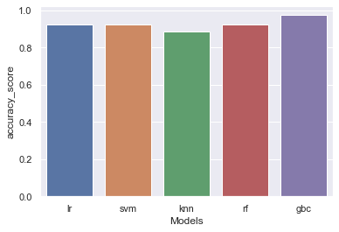
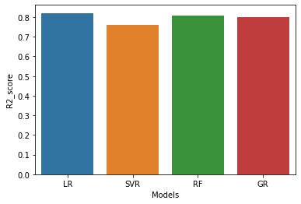
Machine Learning Models and Their Accuracy Score:

Slide 10
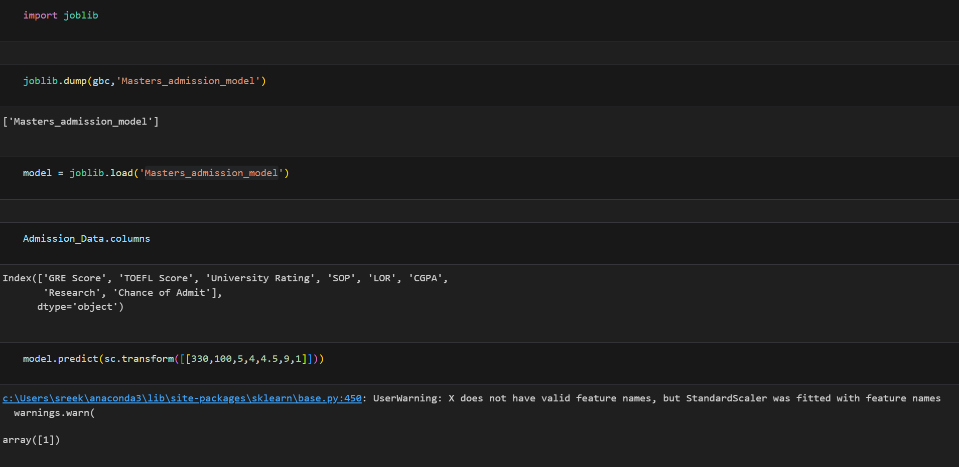
Saving The Best Model:
The Gradient Booster Classifier is said to be the best model and the model is saved to perform the prediction.

Slide 11
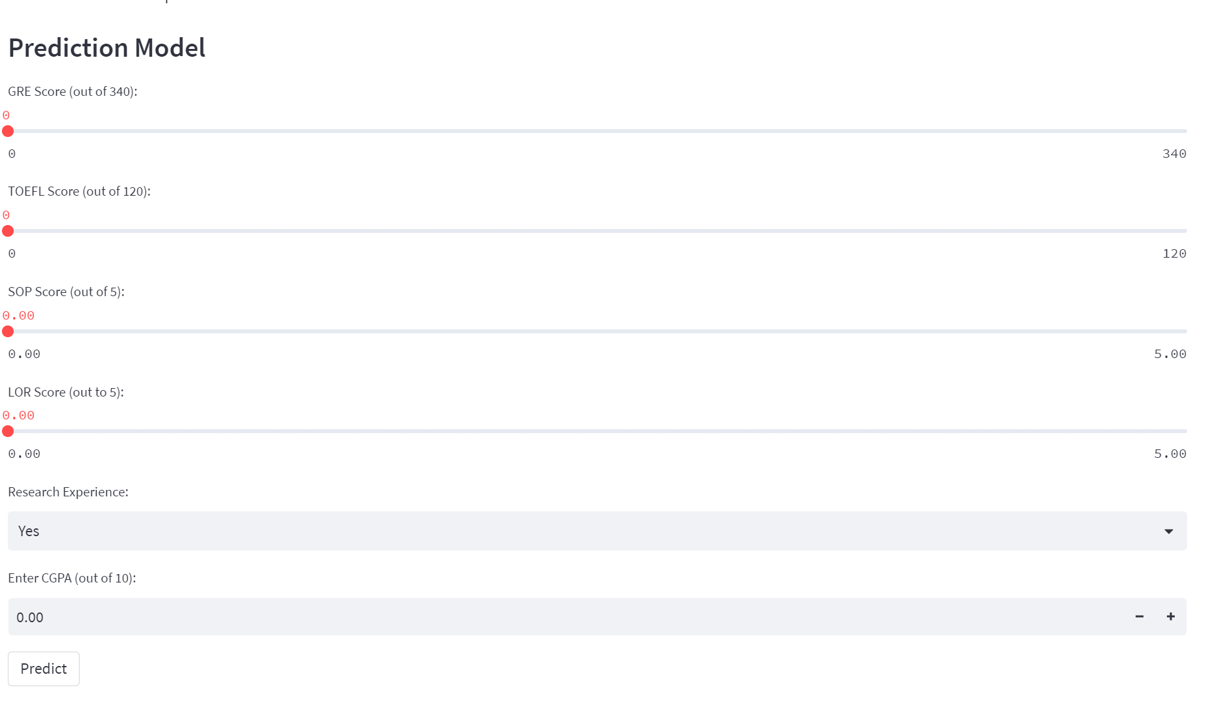
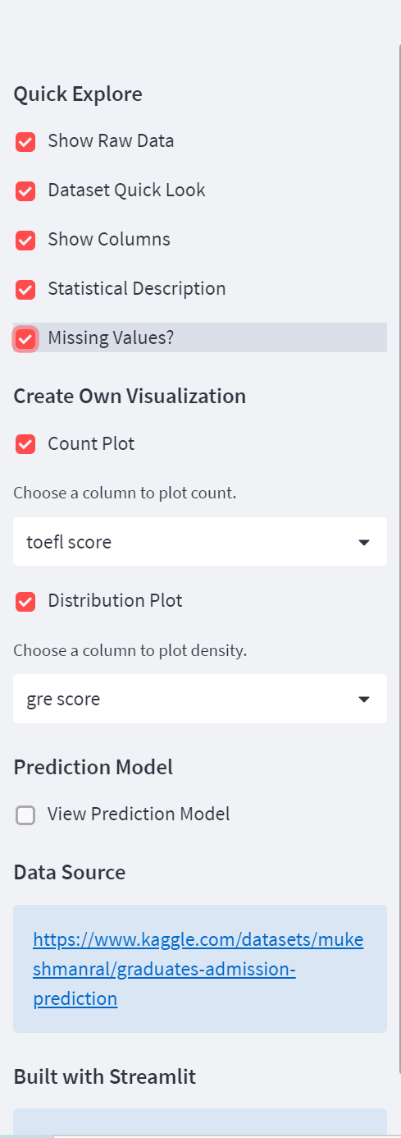
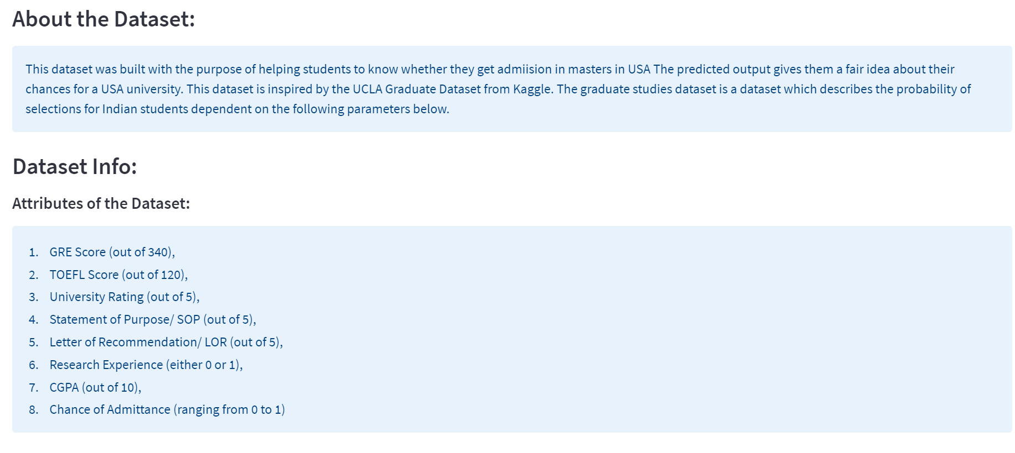
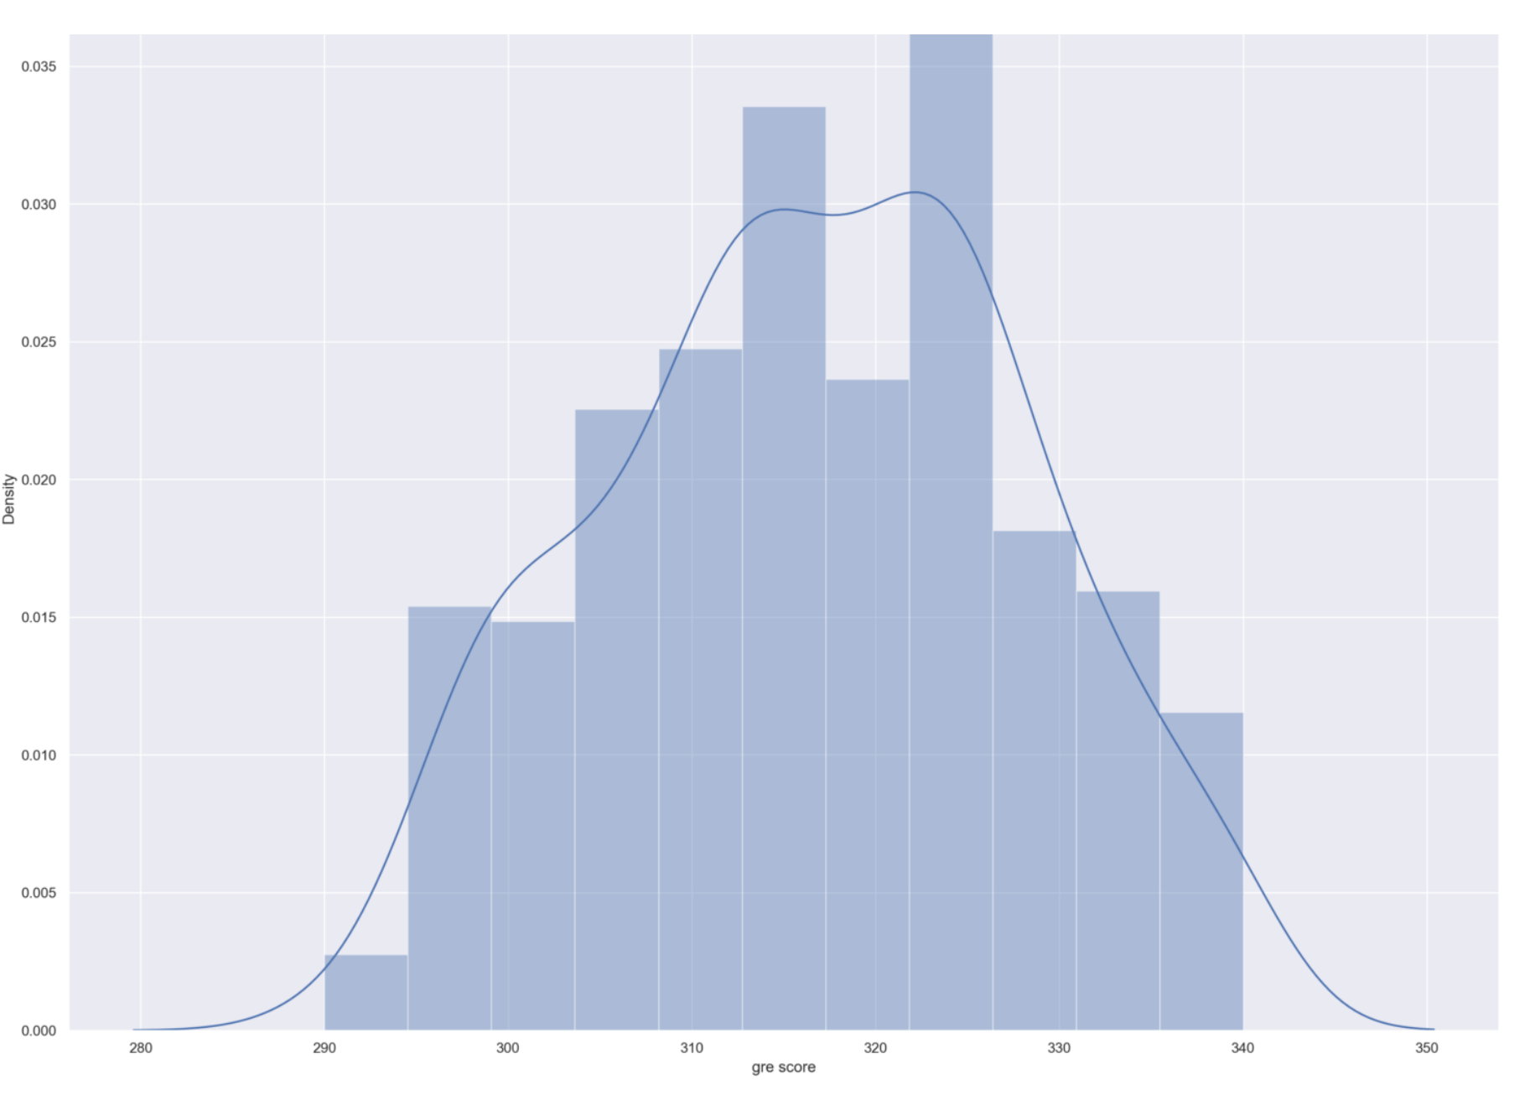
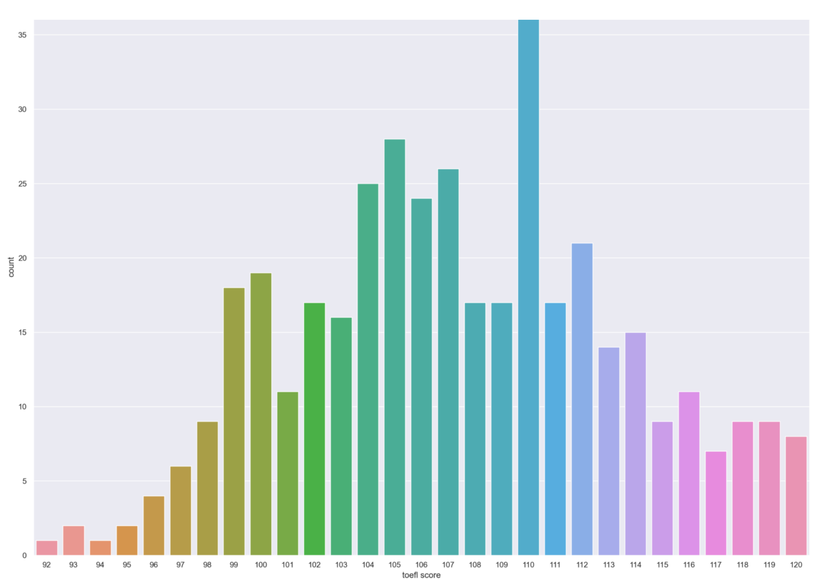

Creating Website Using Stream lit:
Graduate admission Prediction model

Slide 12

Thank You
Any Questions ?

