Slide 1
BREAST CANCER PREDICTION
CAPSTONE PROJECT
SUBMITTED TO
CHAOJIE WANG

Slide 2
OUTline of the presentation
Introduction: Brief overview of the Wisconsin cancer dataset and the purpose of the presentation.
Data Exploration and Visualization: An exploration of the dataset and visualization of key features and relationships.
Data Preprocessing and Cleaning: Techniques used to preprocess and clean the dataset, such as handling missing values and scaling features.
Feature Selection and Engineering: Techniques used to select and engineer features that are relevant for predicting the diagnosis of a tumor.
Model Selection and Evaluation: An overview of different machine learning models used to predict the diagnosis of a tumor and techniques used to evaluate model performance.
Deployment: Deployment of the machine learnin and demonstration of its functionality.
Conclusion: Summary of key takeaways and opportunities for future research.

Slide 3
Introduction
The purpose of this presentation is to provide an overview of the Wisconsin cancer data set, as well as to showcase different machine learning models that can be used to predict whether a tumor is malignant or benign. The presentation will explore the different features in the data set, as well as different visualizations and statistical analyses that can be used to gain insights into the data. Additionally, the presentation will provide an overview of various machine learning models and their performance on the data set

Slide 4
Overview of the dataset
The Wisconsin cancer data set is a collection of diagnostic data on breast cancer patients, including information on various characteristics of their tumors.
The data set was created by researchers at the University of Wisconsin Hospitals and contains 569 instances with 30 features each.
The diagnosis column contains the target variable, which classifies a tumor as either benign or malignant. The other columns contain features that can be used to predict the diagnosis of a tumor based on its characteristics

Slide 5
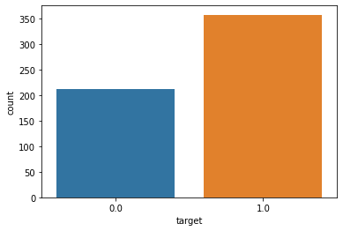

Slide 6
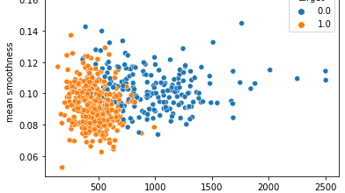
Mean Area

Slide 7
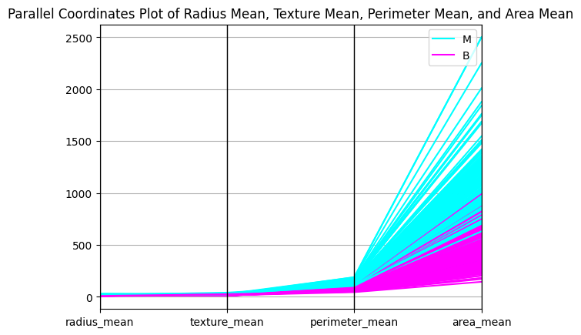

Slide 8
TRIAN & TEST
The Wisconsin cancer dataset contains a total of 569 samples, each with 30 features. These features include various measurements of cell nuclei, such as radius, texture, and smoothness.
Splitting the data refers to dividing the dataset into two separate subsets: one for training the machine learning model and the other for testing its accuracy.
'test_size' is what is the size of the test data which is 15% of the whole data.

Slide 9
LOGISTIC REGRESSION
Logistic regression is a statistical method used to model the relationship between a binary dependent variable and one or more independent variables. It is used to predict the probability of the dependent variable being 1 given a set of input variables. The model fits a logistic function to the data, which transforms the input variables into a probability value between 0 and 1. It is commonly used in machine learning and statistical analysis for binary classification problems.

Slide 10
GRADIENT BOOSTING
Gradient boosting is a machine learning technique that builds an ensemble of decision tree models to make predictions. It works by training multiple weak models sequentially, where each subsequent model learns to correct the errors of the previous model. The models are combined by taking a weighted average of their predictions. Gradient boosting is effective at handling complex and noisy data and is commonly used for regression and classification problems. It is a powerful technique that has achieved state-of-the-art results in many machine learning applications.

Slide 11
K- NEAREST NEIGHBOUR
K-nearest neighbors (KNN) is a machine learning algorithm used for classification and regression. It works by finding the K closest training examples in the feature space to a given test example and using their labels or values to make a prediction for the test example. The choice of K is an important hyperparameter that can be tuned to balance between overfitting and underfitting. KNN is simple, non-parametric, and can handle non-linear decision boundaries, but it can be computationally expensive for large datasets.

Slide 12
LIGHTGBM
Light GBM (Gradient Boosting Machine) is an open-source machine learning framework that uses gradient boosting to train ensemble models for classification and regression problems. It is designed to be highly efficient and scalable, with a focus on reducing training time and memory usage while maintaining high accuracy. Light GBM uses a histogram-based approach to approximate the gradients and can handle large datasets with high-dimensional features. It has become a popular choice for many machine learning applications, especially in the fields of natural language processing, image processing, and recommender systems

Slide 13
RANDOM FOREST CLASSIFIER
Random forest classifier is an ensemble learning method that combines multiple decision tree models to improve the accuracy and stability of predictions. It works by randomly sampling the input data and features to create multiple decision trees, and then aggregating their predictions through voting or averaging. The randomization helps to reduce overfitting and make the model more robust to noisy or irrelevant features. Random forest classifier is a popular machine learning algorithm for classification problems and has been used in many applications, including image recognition, bioinformatics, and finance.

Slide 14
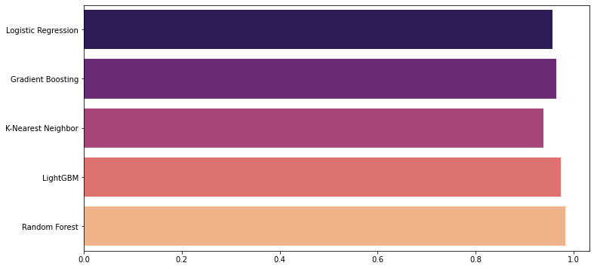
VOTING CLASSIFFIER

Slide 15
THANK YOU

