Slide 1
Credit Card Fraud Detection
Using Machine Learning Models and Neural Networks
By: Sruthi Batchala
Campus id: OH34738

Slide 2

Topic: credit card fraud detection
Understand the distribution of the data taken
Scaling the Data columns
Create a sub dataframe of fraud and not-fraud transactions
Checking for Outliers and eliminating them
Determine which classifier works best for classifying the data
Also, Tried to implement Artificial Neural Network and compare the accuracy to the best classification model.

Slide 3
Introduction
Credit Card Fraud Detection is the process of identifying and preventing fraudulent transactions made using credit cards. It involves the use of various techniques such as statistical analysis, data mining and machine learning to detect unusual patterns and behaviors that indicate potential fraud.
The importance of Fraud Detection for Credit Card companies cannot be overstated, as fraud can result in significant financial losses for both the card issuer and the cardholder. It can also damage the reputation of the credit card company, resulting in a loss of customer trust and loyalty. Therefore, it is essential for credit card companies to have effective fraud detection systems in place to protect their customers and themselves. Such systems can help prevent fraudulent transactions before they occur, minimize financial losses, and ensure the integrity of the payment system.

Slide 4
Data Description
Acquired the data from data.world.com the link to the source is as follows: https://data.world/vlad/credit-card-fraud-detection
The data is highly imbalanced, hence I'd like to see how it can be used for analysing this real time problem.
the size of the data is 150MB.
Attributes include time, V1, V2, … V28 principal components obtained with PCA, Amount and target class (284807,31).

Slide 5
Problem Statement
Aim:
Use classification, regression algorithms to identify how well the Model is predicting fraudulent transactions
Along with this, using Artificial Neural Networks to help develop analyzing fraud transactions automatically without human intervention
Target Class:
“0” : Non fraudulent cases
“1” : Fraudulent cases

Slide 6
Exploratory Data Analysis
Distribution of the data: the graph shows that the distribution of data is skewed

Slide 7
Exploratory Data Analysis
Handling null values: there are no null values in the dataset
Sub-dataframe: since the original dataset is imbalanced, used random under sampling which basically consists of removing data in order to have a more balanced dataset and thus avoiding our model to overfitting.
Imbalanced dataset
Balanced dataset

Slide 8
Confusion Matrix: Identifying the important features in the dataset
Imbalanced data
- correlation matrix
Sub-dataframe
correlation matrix
(Most important features include
v11, v2, v4, v19)

Slide 9
Positive correlation

Slide 10
Outliers! Outliers!
Checked for outliers : it is observed that the data consists of errors or inconsistencies highlighting the need for better quality control measures.

Slide 11
It is observed that the data is skewed, i.e certain data is highly aligned towards the very bottom end of the graph as shown previously.
Since the Amount and time features are the only ones which are highly skewed
Have used random under sampling , TSNE and Truncated SVD to reduce the dimensionality of the skewed columns or features.

Slide 12
Implementing ML Algorithms
Have used both regression and classification algorithms to determine which model works best for the given dataset.
Regression Models used:
Random Forest - accuracy: 93%
Linear Regression - accuracy: 88%
Bagging Regressor - accuracy : 89%
Decision Tree Regressor - accuracy: 93.5%

Slide 13
Classification Models Used:
Logistic Regression - accuracy:95%
Random Forest Classifier - accuracy: 94%
Decision Tree Classifier. - accuracy: 85%
Ensemble Model. - accuracy:93%
From all the models that were used to predict whether a particular transaction Is fraudulent or not, the best model turned out to be Logistic Regression.
The weird case of using Random forest without fine tuning parameters - this model overfit the data as it was highly imbalanced and automatically aligned itself towards the higher class.
Logistic Regressioin

Slide 14
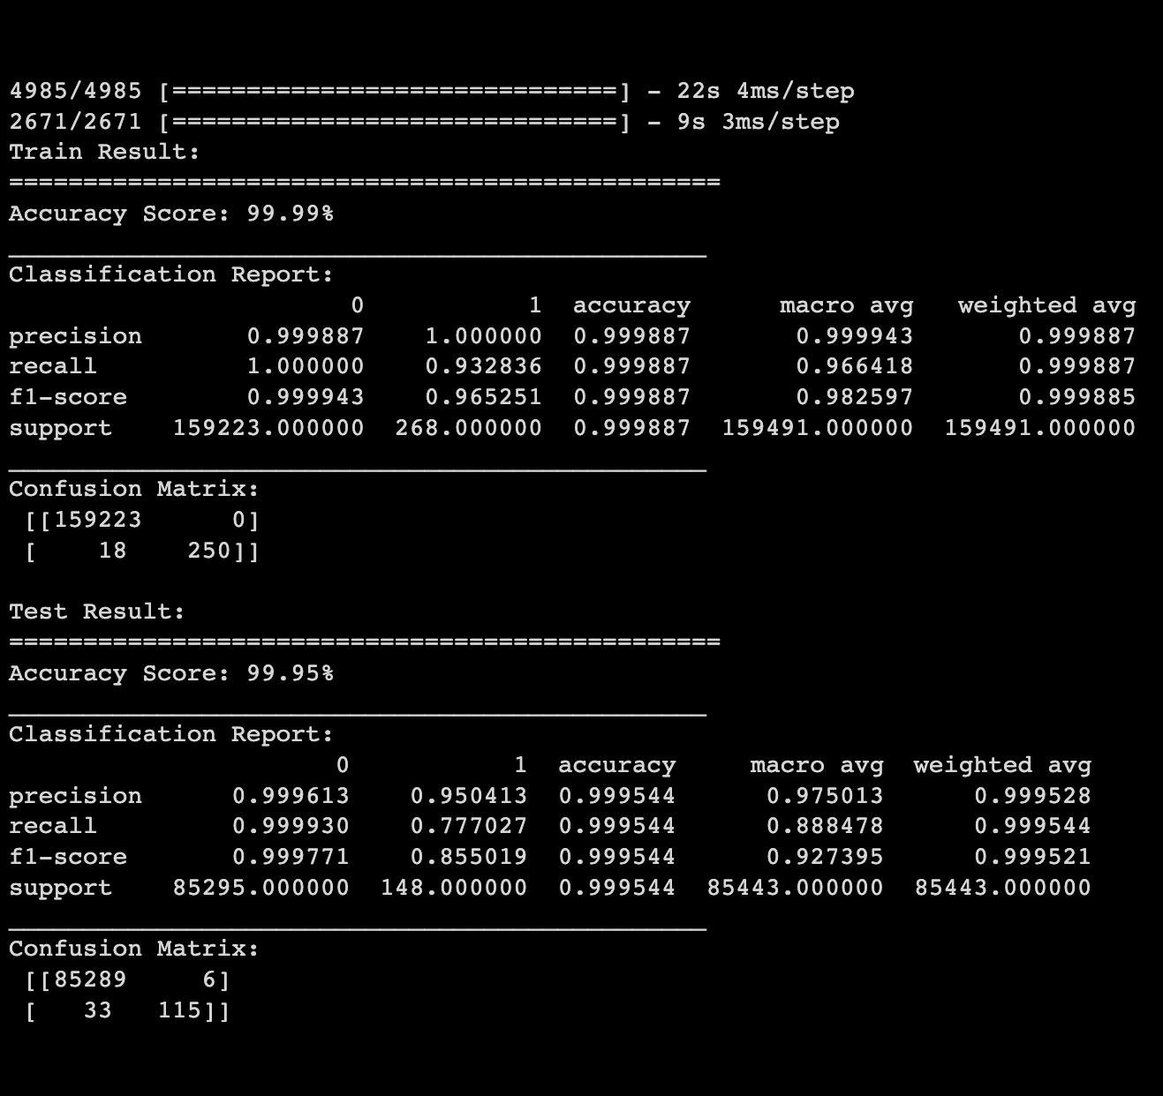
Implementing Neural Networks
Have implemented Artificial Neural Networks to check how well the AI model is going to perform for this data
Have used activation functions like relu and sigmoid for a sequential analysis and as expected the Artificial Neural Networks work way better than any of the ML models
With accuracy being more than 98% for both train and test datasets.
It is concluded that ANN’s work best for detecting frauds during credit card transactions.

Slide 15
Learnings
Firstly, it was very hard to deal with imbalanced Data along with the actual feature names being hidden for confidential reasons.
Choose algorithms based on the data you use.
Try solving the problem with the simplest algorithms and gradually increase complexity.
What is the best model - Consider two critical factors ? Obviously, consider the results and metrics. Also consider how important the accuracy is, what difference does an improvement of 0.1% make ? Specifically in-case of highly imbalanced classification problems, consider the minority classes.
Highly imbalanced case - overall accuracy has very less weightage compared to the individual accuracies of the minority classes.

Slide 16
References
https://medium.com/mlearning-ai/credit-card-fraud-detection-2527ca04c3de
https://medium.com/@adityas03/a-beginners-guide-to-credit-card-fraud-detection-using-machine-learning-bee556426951
https://medium.com/@fatihfidan/credit-card-fraud-detection-f268c10658a4
https://medium.com/analytics-vidhya/credit-card-fraud-detection-with-machine-learning-fd2223c23648
https://www.geeksforgeeks.org/ml-credit-card-fraud-detection/

Slide 17
THANK YOU!

