Slide 1

Crops and Livestock data Analysis
Presented by
P Sushanth Kumar
UMBC

Slide 2
Introduction:
The Food and Agriculture Organization (FAO) is a specialized agency of the United Nations that is dedicated to eradicating hunger, malnutrition, and poverty. FAO works to improve agricultural productivity, enhance food security, and promote the sustainable use of natural resources.
There are 2 data sets we will be working in this Project, this data sets with combined size of 300.2 are acquired from the Food and Agriculture Organization of the United Nations (FAO) and Department of Economic and Social Affairs, Population Division.
Fist one is from FAO which records crop and livestock statistics for 278 products in various categories, including primary and processed crops, live animals, and primary and processed livestock.
The second data set is the population data from UN which is the empirical data which show revised estimates of various demographic components (population, mortality, migration) for different countries or regions for the period of 1950-2021.
In this project, we will be extracting the numerous insights and its effects on an crop and livestock data with respect to population and will be discovering the algorithms which can accurately analyse and the understand the data.
UMBC

Slide 3
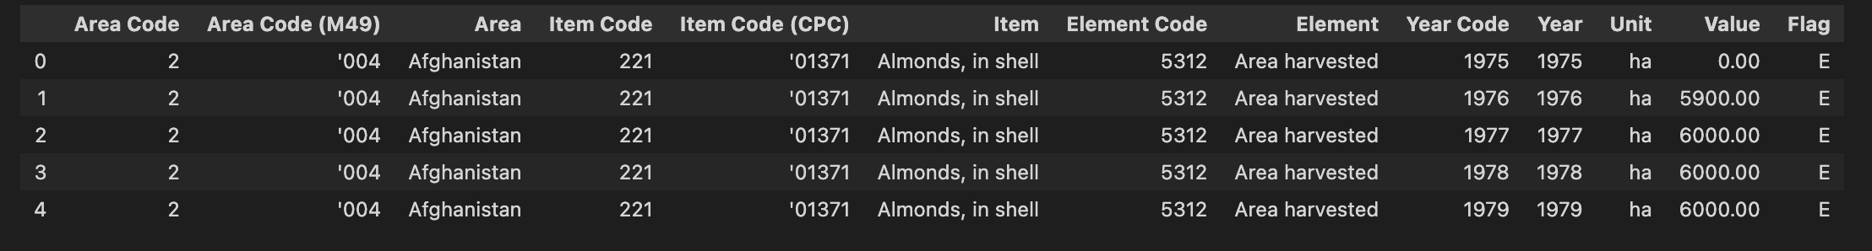
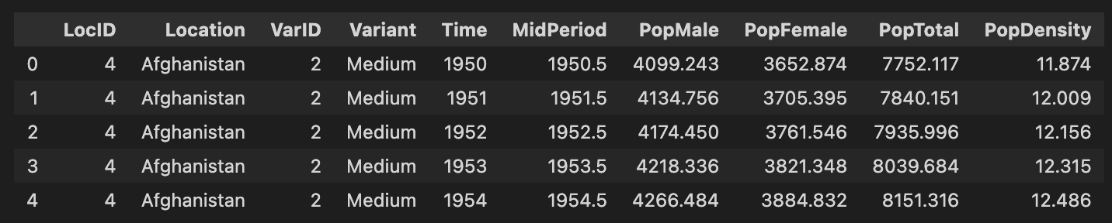
Data Sets:
Crop and Livestock Data:
Population Data:
UMBC

Slide 4
Framework of the Project:
Setup and Install necessary packages
Import the datasets
Basic Cleaning of Data
Preprocessing the Data
Implementing Prediction Models
Selecting Features
Gaining insights on the data w.r.t its features
Continues Data
Discrete Data
Visualizing the data
Finding the best model of analysing that case
Finding the best model of analysing that case
UMBC

Slide 5
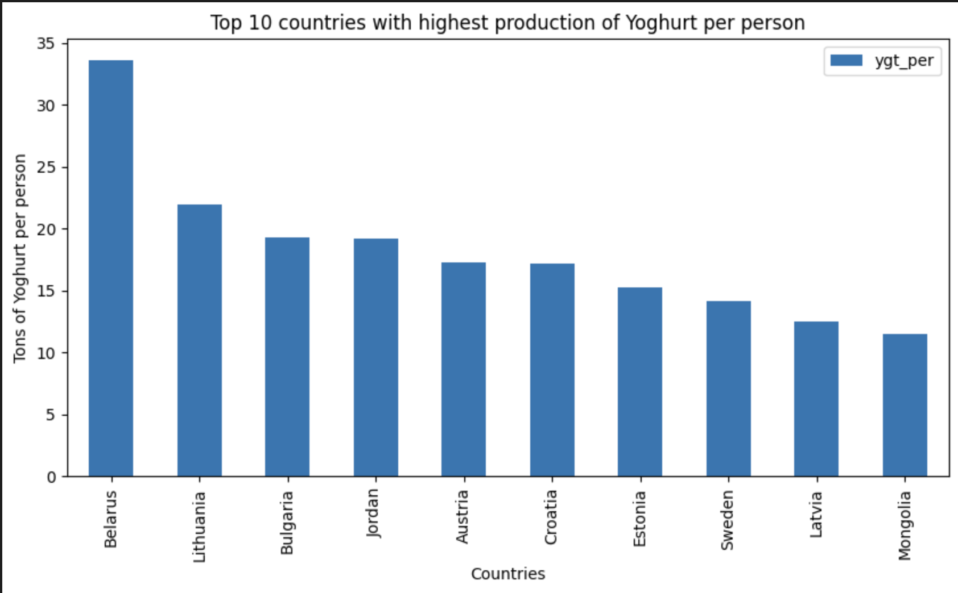
Insights:
This graph represents top countries where Yoghurt production per person is highest.
As you can see small countries with low population density is highest like Belarus.
UMBC

Slide 6
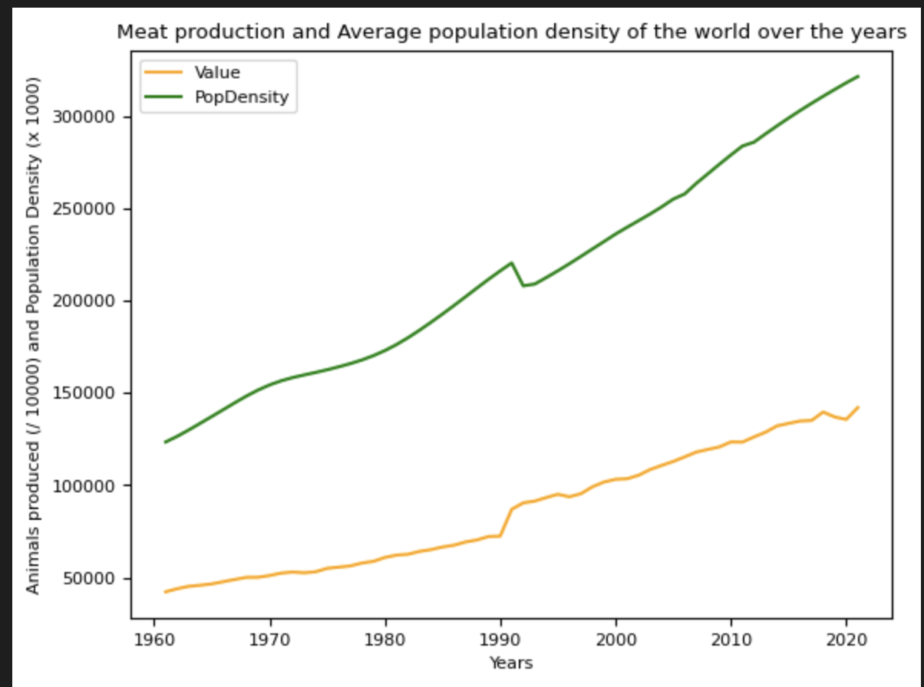
Insights:
This Graph represents the meat production of countries with respect to Population density over the years.
We can see an increase of both production and population density in between 1990 and 2000.
UMBC

Slide 7
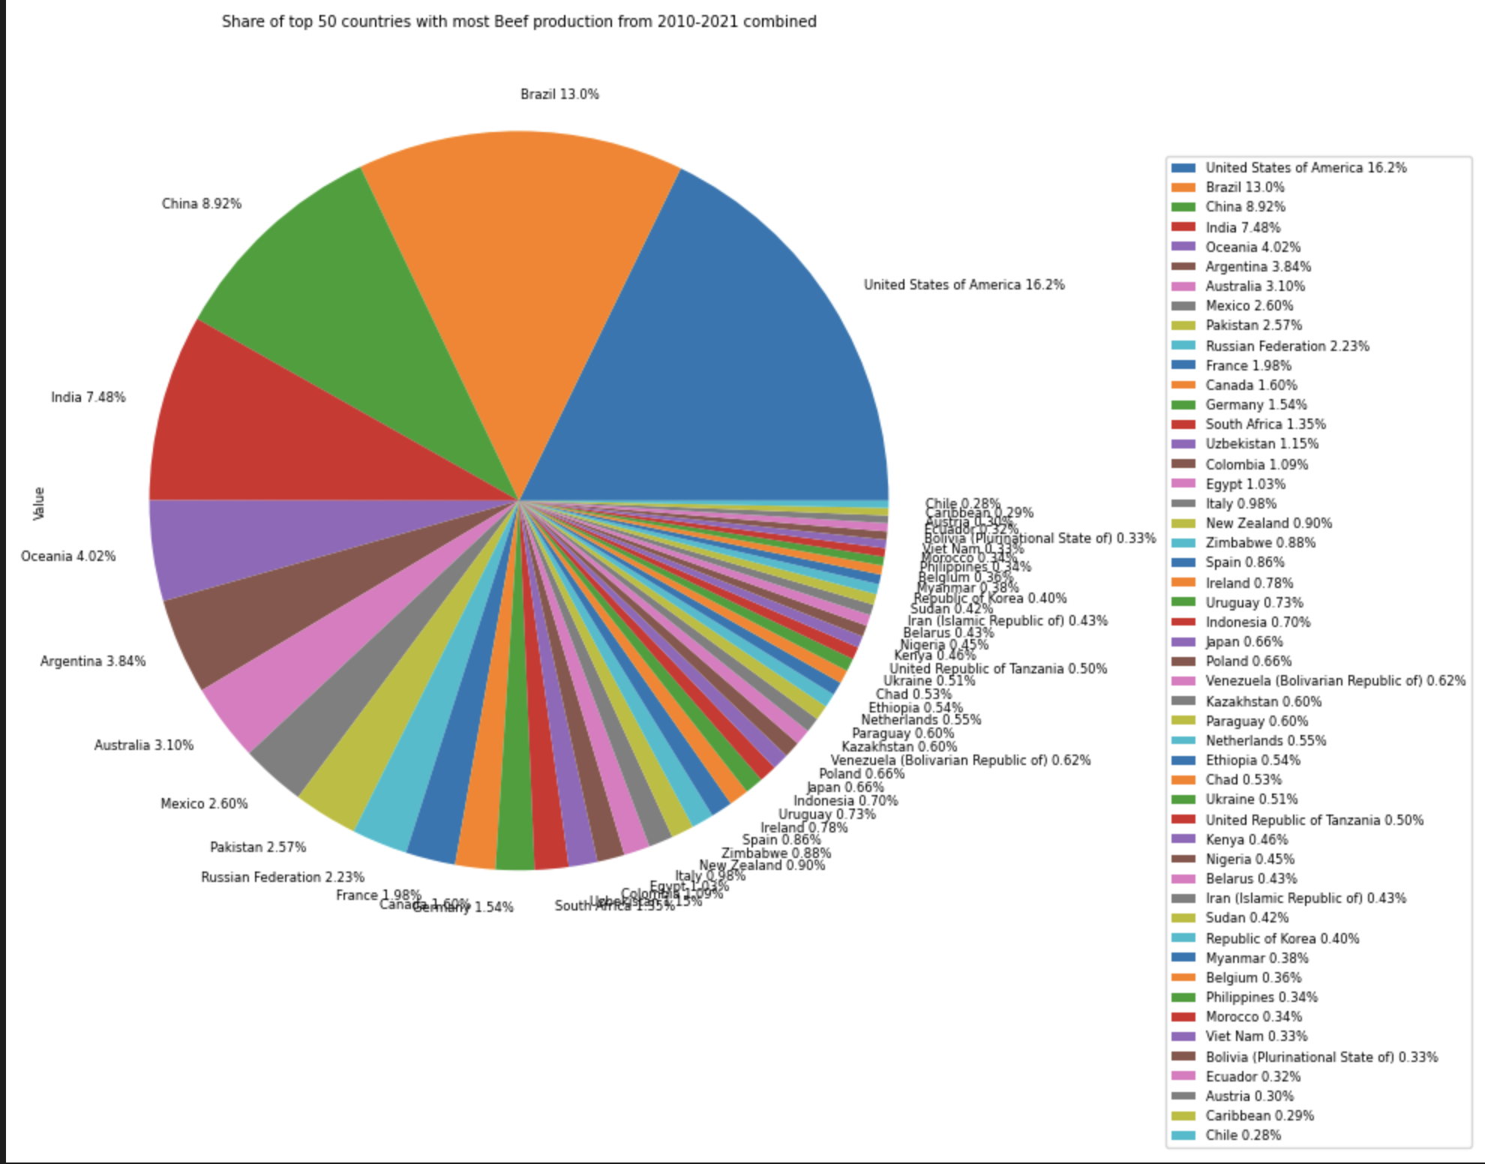
Insights:
This Graph represents the quantity of beef produced by each country from the years 2010 to 2021.
We can see a unique case of Brazil, which even with less population is producing as much beef or more so than USA and China.
UMBC

Slide 8
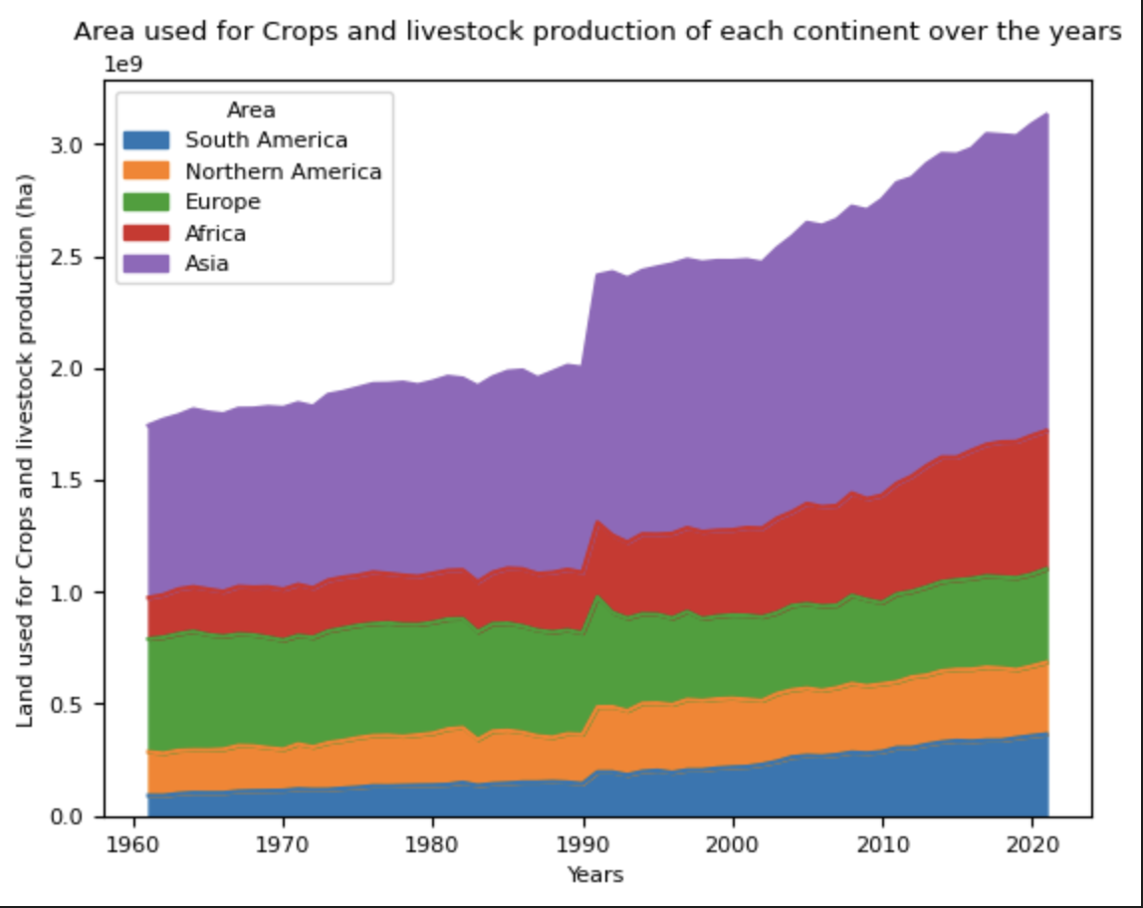
Insights:
This Graph represents the area used for Crops and Livestock production over the years from different continents.
We can see a sudden increase in area usage 1990’s and the unique case of Europe where area has decreased over years.
UMBC

Slide 9
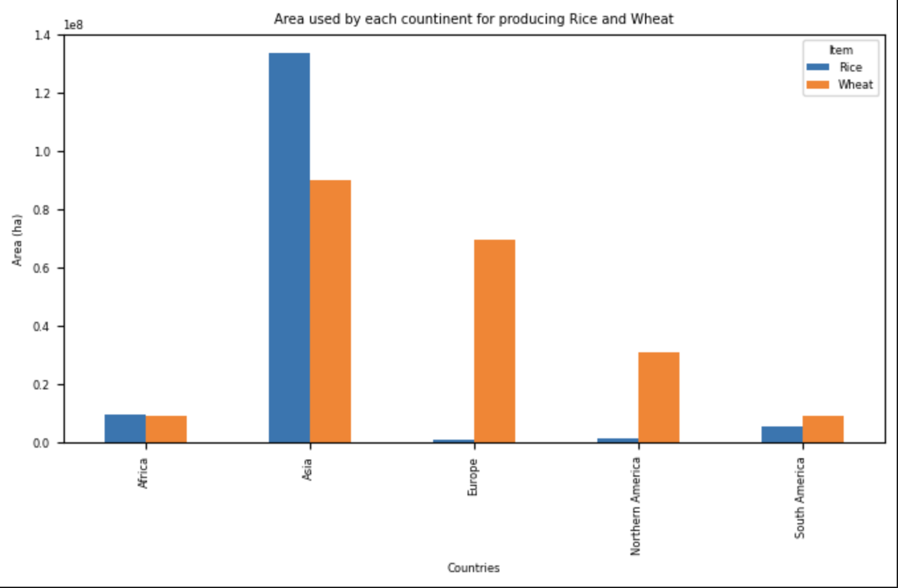
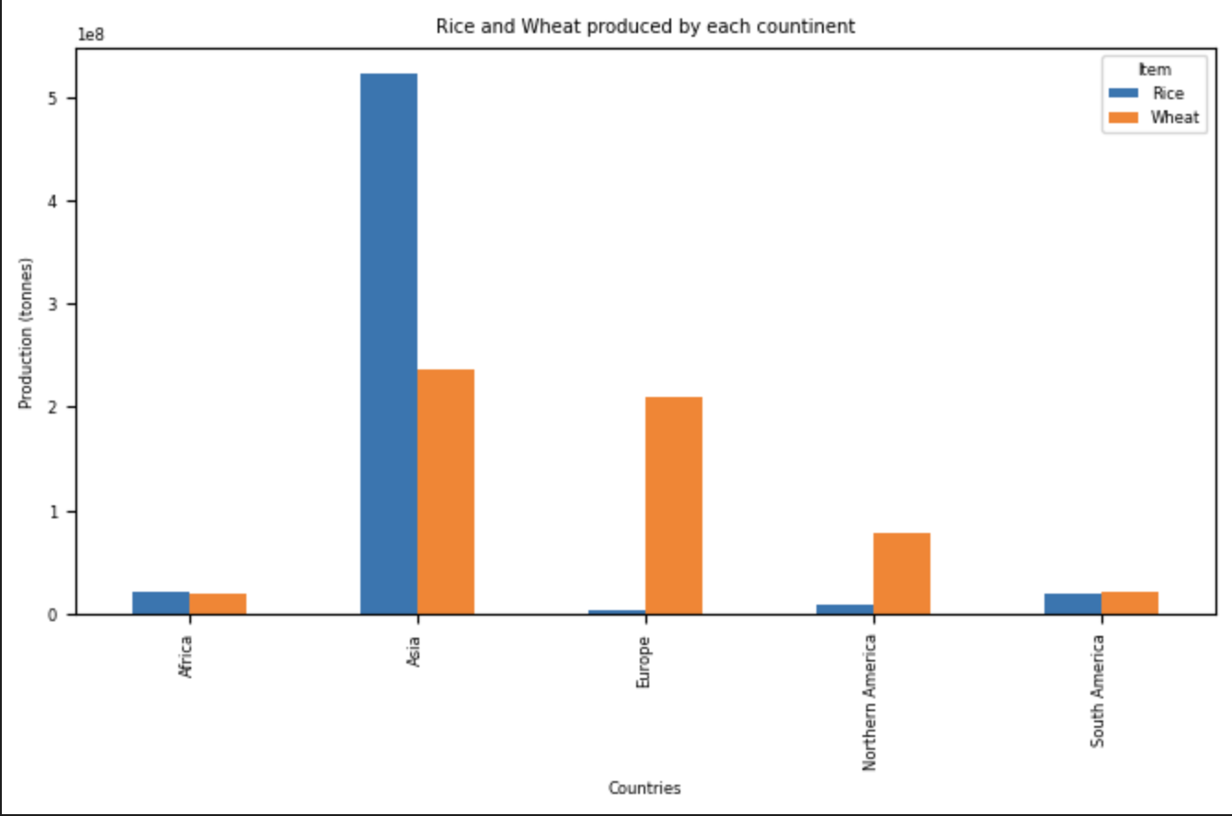
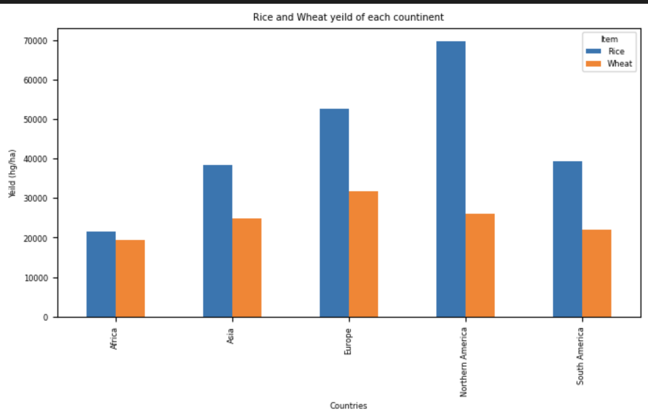
Insights:
These Graphs represents the area, Production and Yield produced by each continent.
We can see that Asia has high quantity of Rice cultivation, but the yield is not high as even Europe.
UMBC

Slide 10
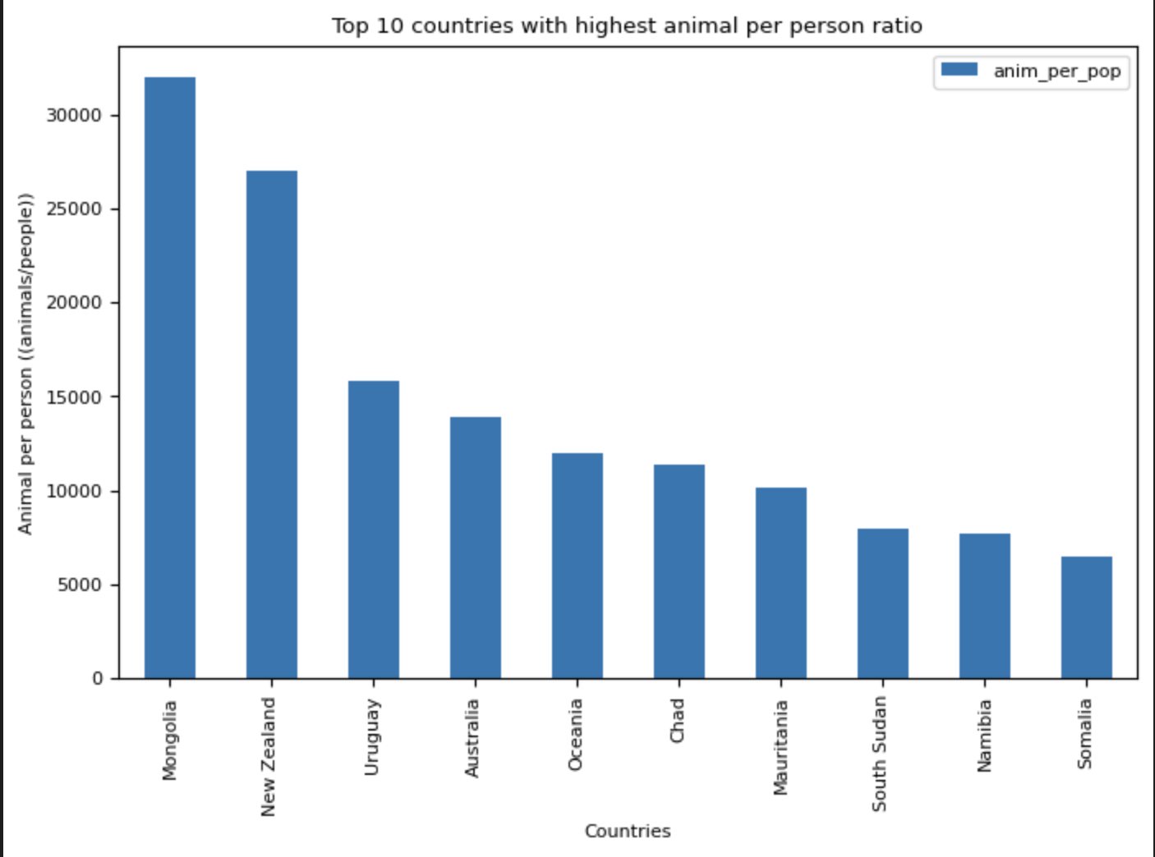
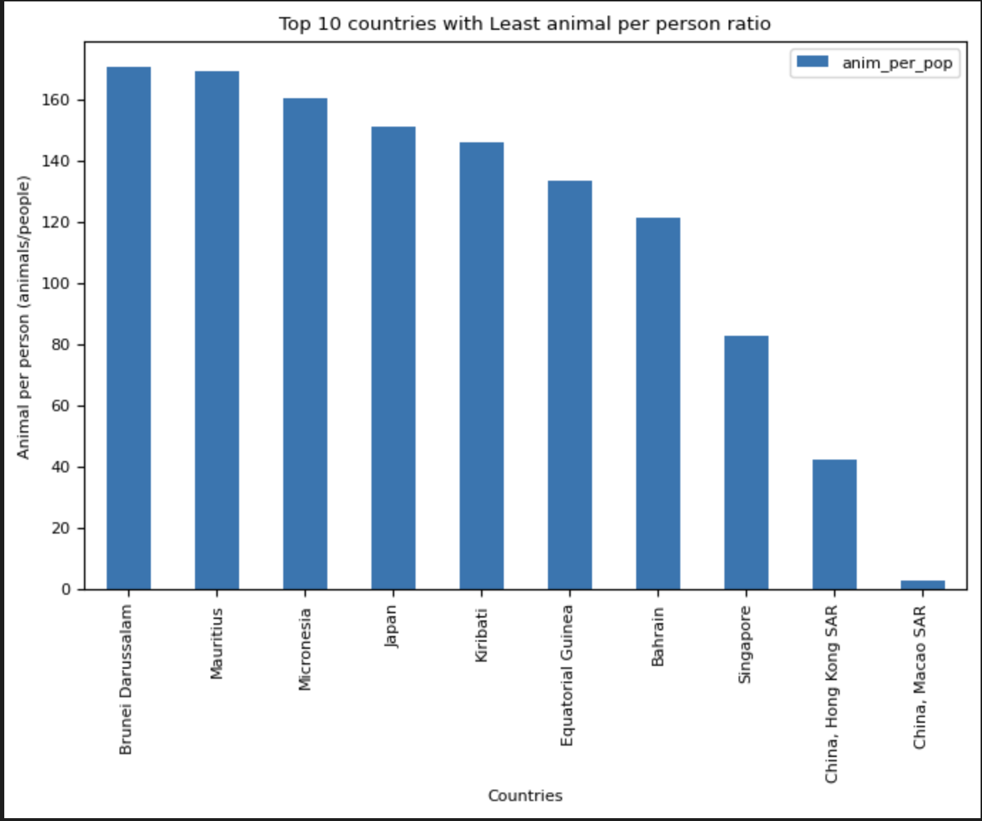
Insights:
These graphs represents highest and lowest countries with livestock animals per person ratio.
As we can see a unique case of Japan which is not city state such as Singapore and Hong Kong is in the list of countries with lowest ratio.
UMBC

Slide 11
Machine Learning Frame work:
Case 1: Population Density (Discrete Data)
Merging Data
Feature Selection
Logistic Regression
Basic Cleaning
Preparing Data
Handling Imbalances (SMOTE)
Best Model based on Accuracy
K-Neighbors Classifier
Splitting data
Encoding
(Data Disintegration)
Decision Tree Classifier
Exploratory Data Analysis
(Correlation, Box Plot)
Case 2: Area (Continues Data)
Feature Selection
Logistic Regression
Finding Outliners
Preparing Data
Best Model based on Accuracy
Decision Tree Classifier
Removing Outliners
Splitting data
Random Forest Regression
UMBC

Slide 12
Machine Learning: Results for Case 1:
From the results we can say that K-Neighbors Classifier is best model for this case.
We can say that model’s accuracy has improved after SMOTE on the train and test data.
Model
Logistic Regression
K-Neighbors Classifier
Decision Tree Classifier
Accuracy
55.60%
81.90%
70.59%
Model
Logistic Regression
K-Neighbors Classifier
Decision Tree Classifier
Accuracy
52.45%
86.09%
73.98%
UMBC

Slide 13
Machine Learning: Results for Case 2:
From the results we can say that Random Forest is the best model for this case study.
Random Forest Regression has an accuracy of 98.8%.
Logistic Regression
Decision Tree Regression
Random Forest Regression
Accuracy
97.76%
98.80%
UMBC

Slide 14

UMBC

