Slide 1
Credit Card Fraud Detection Using Machine Learning
Yashwanth Reddy Gadepally
DATA - 606 Capstone Project
ID – FH44254

Slide 2
Agenda
Introduction
Dataset
Overview and Design
Machine Learning Models
Summary

Slide 3
Introduction
In this era of online payment the chances of fraud credit card transactions is very high due to lost or leak of credit card details.
Such problems can be tackled with Data Science and its importance, along with Machine Learning.
The Credit Card Fraud Detection Problem includes modelling past credit card transactions with the data of the ones that turned out to be fraud.
This model is then used to recognize whether a new transaction is fraudulent or not. Our objective here is to detect 100% of the fraudulent transactions while minimizing the incorrect fraud classifications.
In this process, we have focused on analysing and pre-processing of data sets as well as the deployment of multiple anomaly detection algorithms.

Slide 4
Dataset
The dataset we have used is from kaggle with 148 mbs of size, with 213 columns.
The datasets contains transactions made by credit cards.
Feature importance was done and project experiment design was implemented.

Slide 5
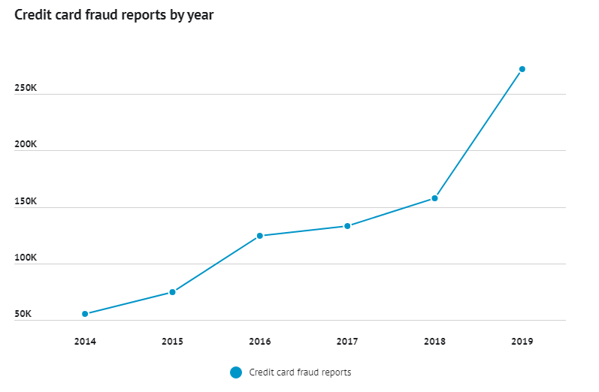
Overview

Slide 6
Design
We have used the dataset mentioned previously and applied machine learning techniques on it.
We checked the data for null values and missing values.
We have divided the dataset into test and train samples using test/train split method .
80% transactions of the above dataset are as the training dataset, and the rest as the testing dataset.
We have applied Standard Scaler on test and train samples of the dataset

Slide 7
Machine Learning Models
Looking at the accuracy scores and classification reports for each model, it appears that the logistic regression, random forest, and support vector machine (SVM) classifiers all have the same accuracy score of 94.54%. These three models correctly predict 1627 out of 1721 observations in the test set.
However, when looking at the classification reports, we see that logistic regression and SVM models have a precision of 0 for the positive class (class 1).

Slide 8
This means that these models did not correctly predict any of the positive cases in the test set, indicating that they may not be the best choice for this particular problem.
Overall, it appears that the Random forest classifier is the best model for this particular problem as it has a non-zero precision for the positive class and a relatively high accuracy score.

Slide 9
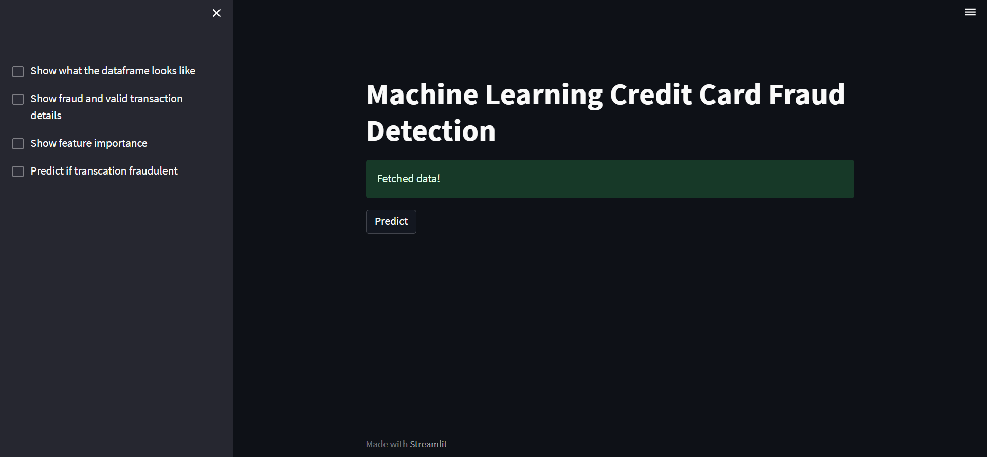
How UI looks!

Slide 10
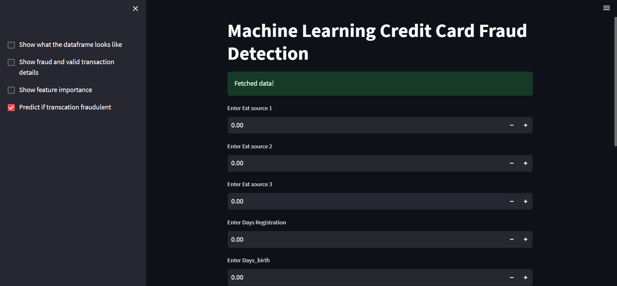

Slide 11


Slide 12
Summary
It is important to note that the specific metrics and evaluation criteria may vary depending on the specific problem and domain, so it's always a good idea to consider multiple models and evaluation methods before making a final decision.

Slide 13
Thank you
- Yashwanth Reddy Gadepally

