Slide 1
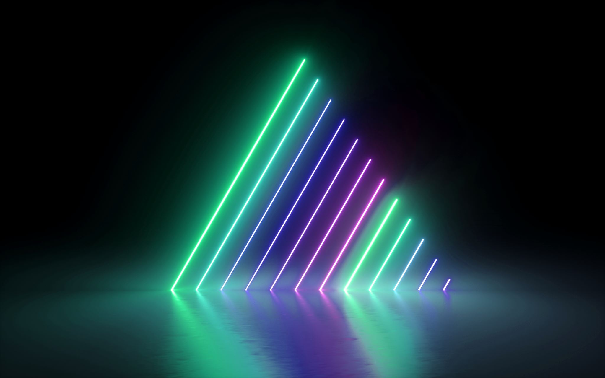
Image Caption Generator
Author: Dikshitha Kavali
VL68371
dkavali1@umbc.edu

Slide 2
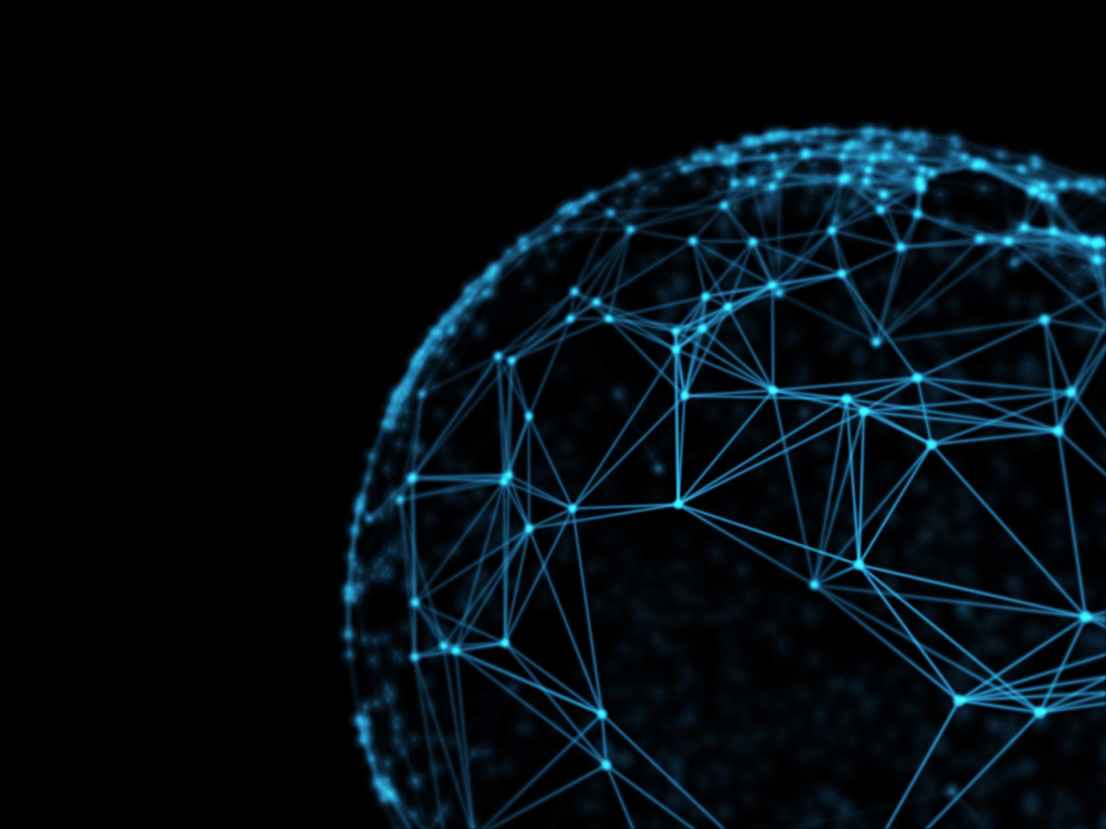
What is an image caption generator?
An image caption generator is a deep learning model that generates natural language captions for images. The goal of image captioning is to teach a machine to describe the content of an image in a way that is understandable and relevant to humans. Image caption generators typically use convolutional neural networks (CNNs) to extract features from the image and a language model such as a recurrent neural network (RNN) or transformer to generate a caption. This technology has many potential applications, such as improving accessibility for people with visual impairments, enhancing search engine functionality, and improving social media content.

Slide 3
Dataset
Multiple Sources(Kaggle, OpenSource etc)
Dataset Size ~ 9 GB
Kaggle: https://www.kaggle.com/datasets/hsankesara/flickr-image-dataset
This dataset has 8K images and had the description CSV file which holds 5 descriptions for each image. This Dataset will be cut down as it is very high in memory and will divide into test and train datasets with 80% data in train and 20% data in test folders.

Slide 4
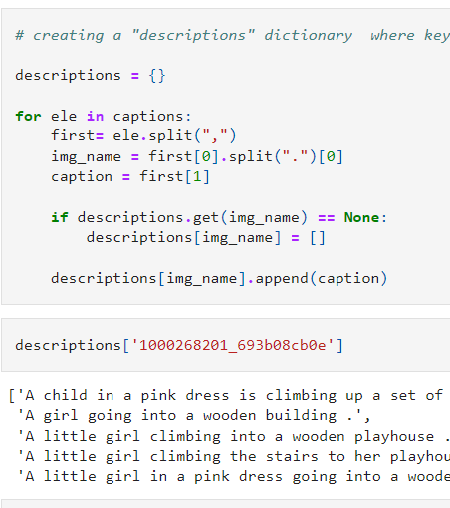
Understanding the Dataset
Explored the dataset using Python pandas and NumPy libraries.
Each image has 5 descriptions related to it.

Slide 5
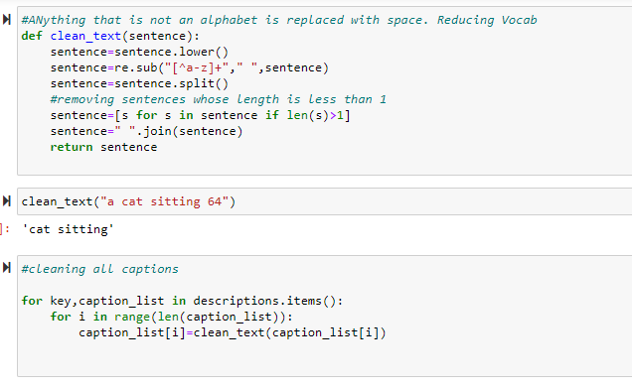
Data Preprocessing
Cleaning the dataset descriptions. Replacing everything which is not an alphabet with a space.

Slide 6
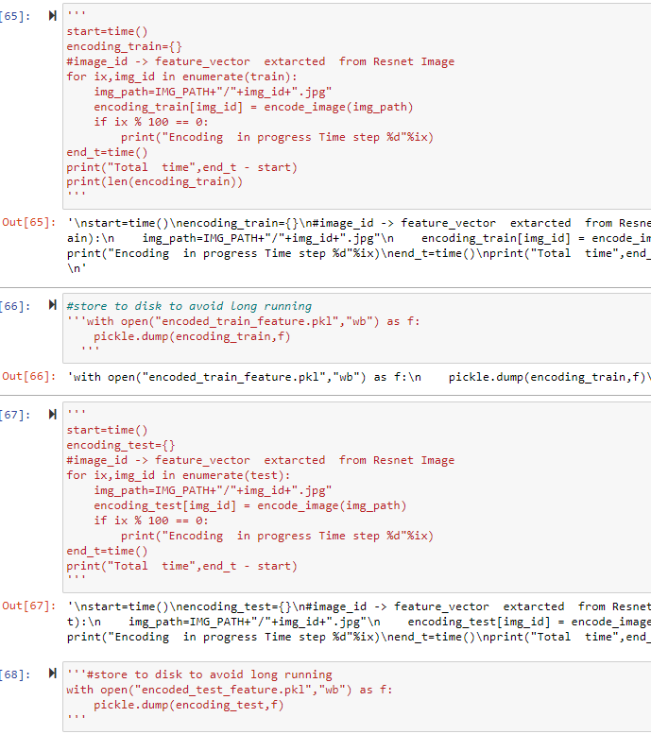
Encoding training and testing image sets
Full dataset is made into 80-20 split. Training and testing data set is encoded and then stored in a pickle object.

Slide 7
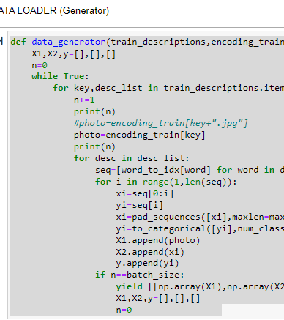
For each input-output pair, the function pads the input sequence to max_len length using pad_sequences function from Keras, converts the output token to one-hot encoded vector using to_categorical function, and appends the input sequence, encoded image feature, and output vector to the corresponding lists X1, X2, and y.

Slide 8
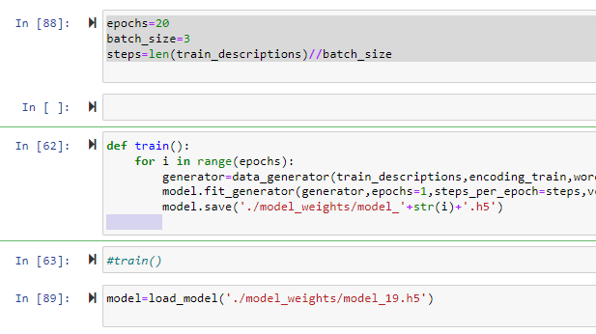
Model Training

Slide 9
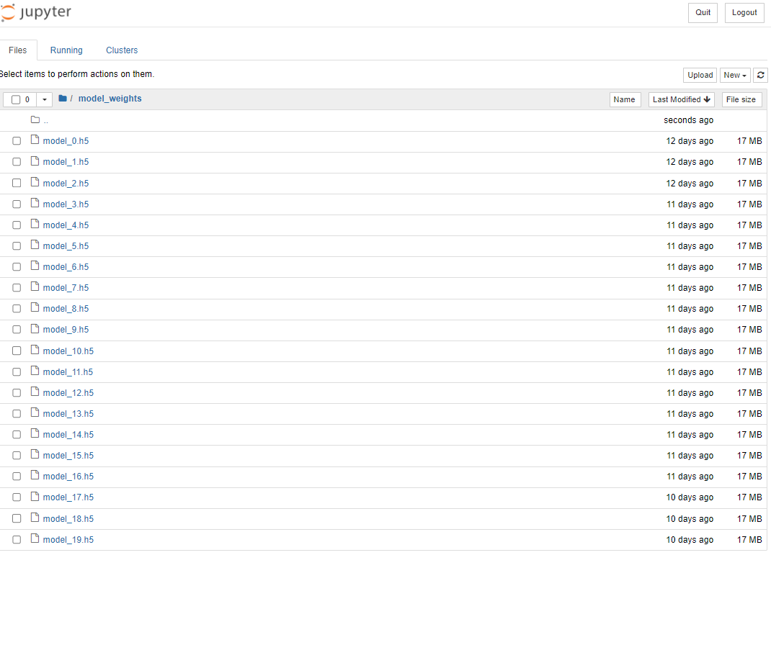
This code trains a deep-learning model for image captioning for a specified number of epochs (here, 20). The train function uses a data_generator function to generate batches of training data for the model. The data_generator function takes in the following parameters:
train_descriptions: A dictionary containing image names as keys and corresponding lists of captions as values.
encoding_train: A dictionary containing image names as keys and corresponding image feature vectors as values.
word_to_idx: A dictionary mapping each word in the vocabulary to a unique integer index.
max_len: The maximum length of the captions, after which they will be truncated.
batch_size: The number of samples per batch.
The train function initializes a generator object using the data_generator function and then fits the model to the data for one epoch. After each epoch, the model is saved to a file in the model_weights directory with a unique file name based on the epoch number. This allows the model to be restored at a later time and continue the training from where it left off.

Slide 10
Model
The input for the model will be the Image and the Label/Output is the description of the image. The model will be trained using Resnet 50 model.
ResNet-50 consists of 50 layers, including convolutional layers, max-pooling layers, and fully connected layers. The key innovation in ResNet-50 is the use of residual connections, which allow the network to learn residual mappings instead of trying to fit an exact mapping between inputs and outputs.

Slide 11
How does an image caption generator use ResNet 50 model work?
An image caption generator using ResNet 50 model typically involves the following steps:
Data collection: Gather a large dataset of images with corresponding captions.
Data pre-processing: Resize and normalize the images and tokenize the captions.
Model training: Fine-tune the ResNet 50 model on the image-caption pairs using a language model to predict the captions.
Caption generation: Pass an image through the trained ResNet 50 model and generate a caption using the language model.

Slide 12
Applications of image caption generator using ResNet 50 model
Image caption generator using ResNet 50 model has many potential applications, such as improving accessibility for people with visual impairments, enhancing search engine functionality, and improving social media content.
Companies such as Google, Facebook, and Microsoft are using image captioning technology to improve their services.

Slide 13
Creating an Application using Flask
What is Flask?
Flask is a popular web framework for Python that is used to build web applications and APIs. It provides a lightweight and flexible framework for building web applications that can be easily customized and extended.
What is a Flask app for an image caption generator?
A Flask app for an image caption generator is a web application built using the Flask web framework and a pre-trained image captioning model. The app allows users to upload an image and generates a caption for the uploaded image using the pre-trained model.

Slide 14
What are the key components of a Flask app for an image caption generator?
The key components of a Flask app for an image caption generator include:
A pre-trained image captioning model
A Flask app to handle user requests and generate responses
A form to upload an image
A view to process the uploaded image and generate a caption
A template to display the uploaded image and its caption

Slide 15
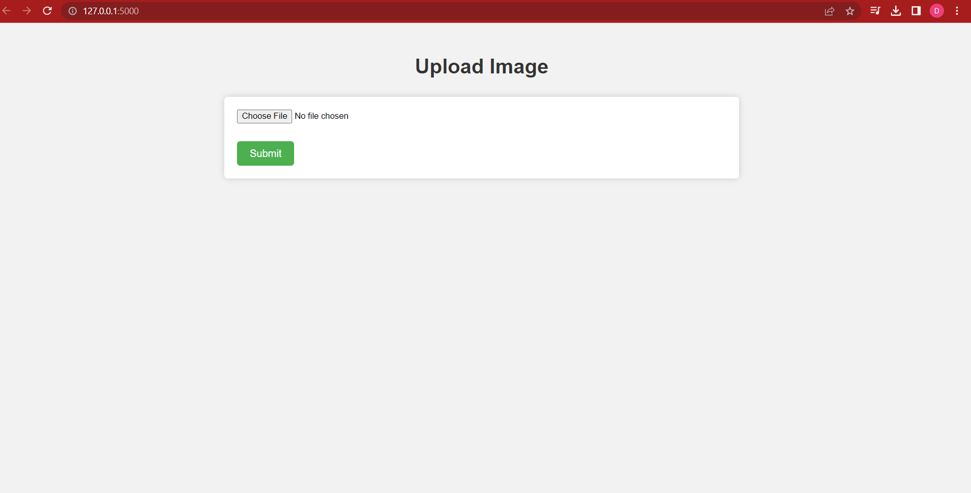
Flask App

Slide 16
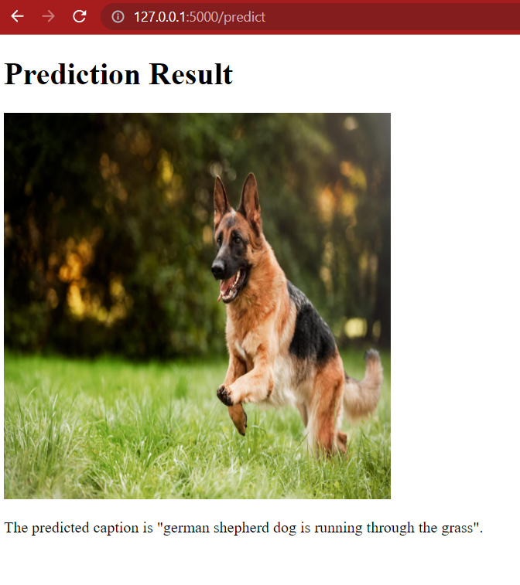
Result

Slide 17
Any Queries?
Thank You ☺

