Slide 1

Capstone Project Data-606 Credit Card Approval Prediction
-By
Name: Yaswanth Bagam
Id: QF19336
Email: B221@umbc.edu

Slide 2
Contents
overview
About Database
Data collection
Merged Dataset
Category Distribution
Attribute Correlations
Machine learning
User Interface
Outcome and challenges
Conclusion

Slide 3

Overview
Even if cash is more valuable than anything else, using a credit card has become the preferred way to pay and make purchases in recent years.
Credit cards are a common risk management tactic in the financial industry, and most individuals use them since they're convenient and safe to use.
Some of them find it simple to keep tabs on their spending and earn better rewards without increasing their budgets.
To estimate the likelihood of future defaults and credit card borrowing, it uses the personal information and data provided by credit card applicants.
The bank has the authority to choose whether to give the applicant a credit card. The degree of risk can be accurately measured by credit scores. Those scores later be used in purchase of houses, cars and other required items.

Slide 4
Dataset
There are two datasets: the application record (54.34MB), which has 438557 observations and 18 variables, and the credit record (15.37MB), which contains 1048575 rows and 3 columns.
The client's personal and financial information is included in the application record.
Information about a client's credit card usage makes up their credit record.

Slide 5
Data Collection
Application record:
The size of the dataset is 54.34MB contains 438558 records and 18 variables.
Dataset Columns:
ID - Client number
CODE_GENDER Gender
FLAG_OWN_CAR Is there a car
FLAG_OWN_REALTY Is there a property
CNT_CHILDREN Number of children
AMT_INCOME_TOTAL Annual income
NAME_INCOME_TYPE Income category
NAME_EDUCATION_TYPE Education level
NAME_FAMILY_STATUS Marital status
NAME_HOUSING_TYPE Way of living
DAYS_BIRTH Birthday
DAYS_EMPLOYED Start date of employment
FLAG_MOBIL Is there a mobile phone
FLAG_WORK_PHONE Is there a work phone
FLAG_PHONE Is there a phone
FLAG_EMAIL Is there an email
OCCUPATION_TYPE Occupation
CNT_FAM_MEMBERS Family size
Credit Record:
The size of the dataset is 15.37MB contains 1048576 records and 3 variables.
Dataset Columns:
ID Client number
MONTHS_BALANCE Record month
STATUS Status

Slide 6
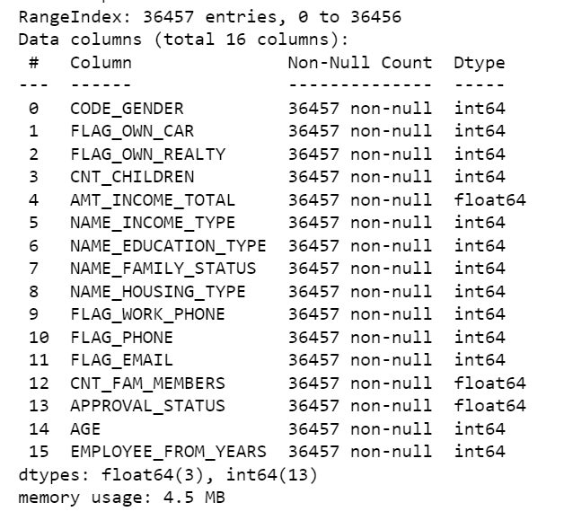
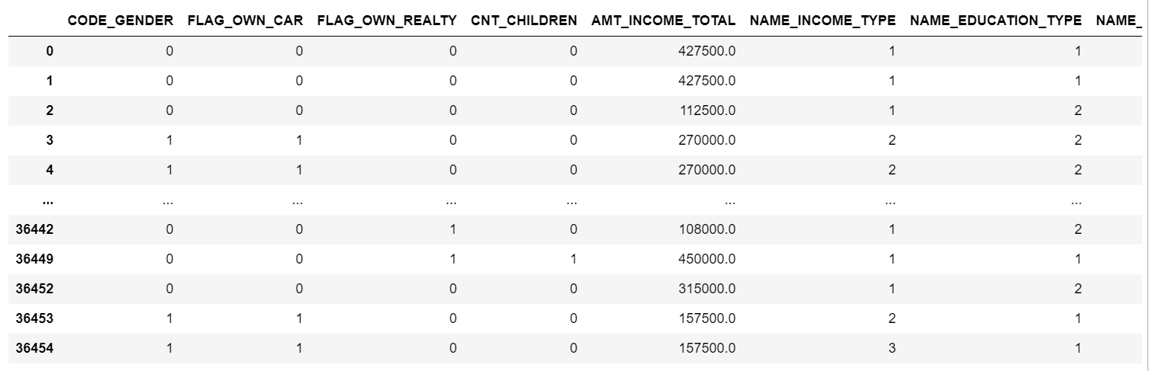
Merged Dataset

Slide 7
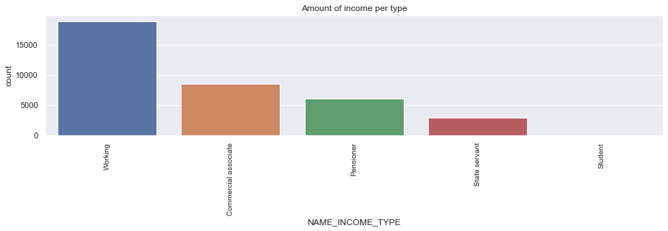
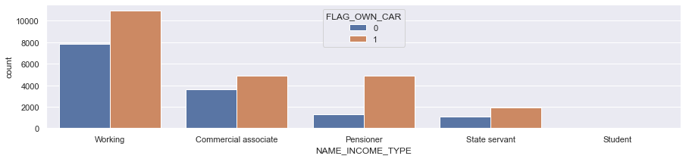
Category Distribution

Slide 8
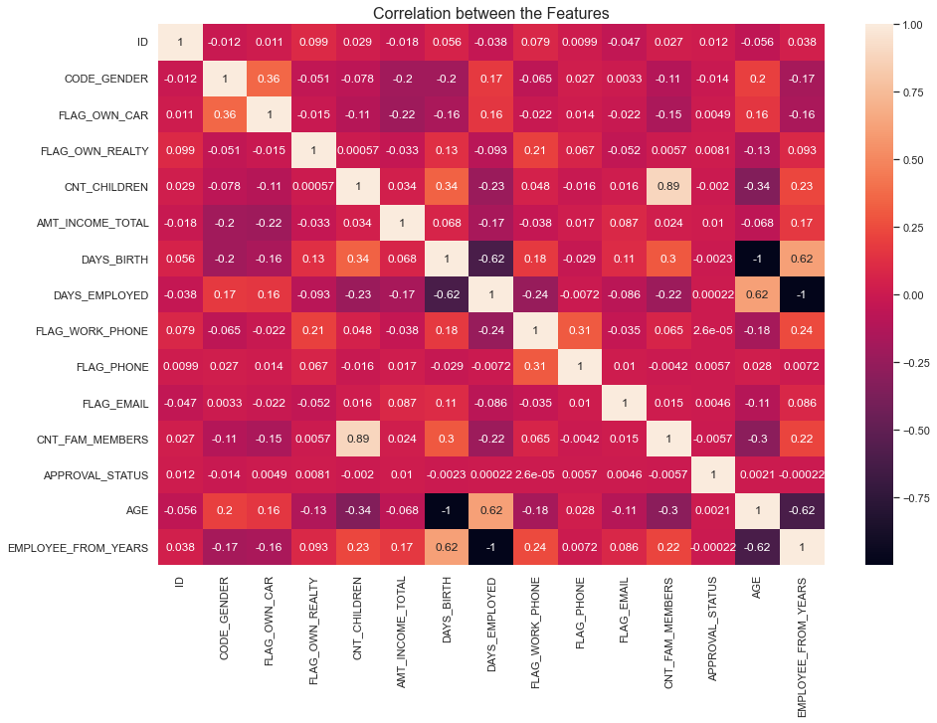
Attribute Correlations

Slide 9
Machine Learning Algorithms Used
KNN Classifier
KNN is a simple, non-parametric algorithm for classification. It identifies the k nearest training data points based on a distance metric and assigns the majority class label to the new observation. It works well for large datasets and nonlinear decision boundaries and is often used as a baseline for complex models.
The KNN classifier is used for credit card prediction by training the model on a dataset of past credit card applications and their outcomes, and then using the model to predict whether a new credit card application is likely to be approved or rejected.
Advantages:
Simple and easy to implement
Non-parametric and versatile
Robust to noisy data
High accuracy with sufficient data
No training phase required

Slide 10
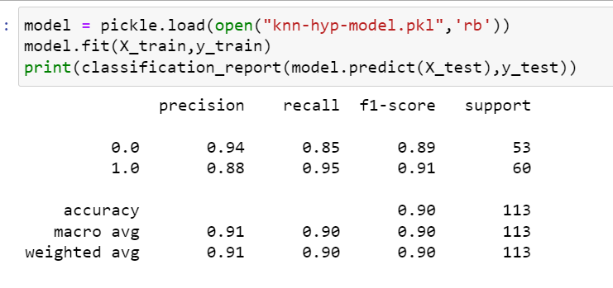
Machine Learning Classification Report

Slide 11
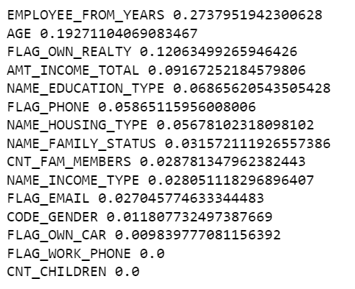
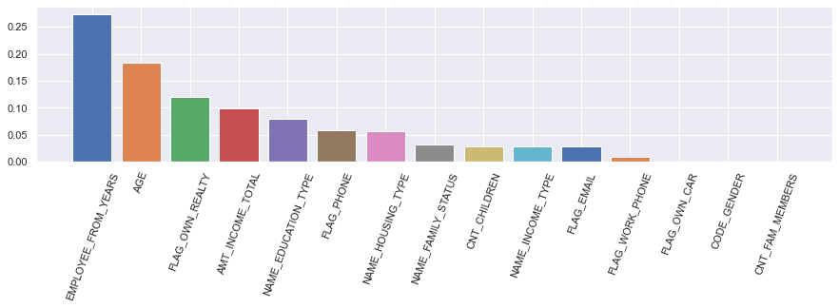
Feature Importance

Slide 12

User Interface

Slide 13
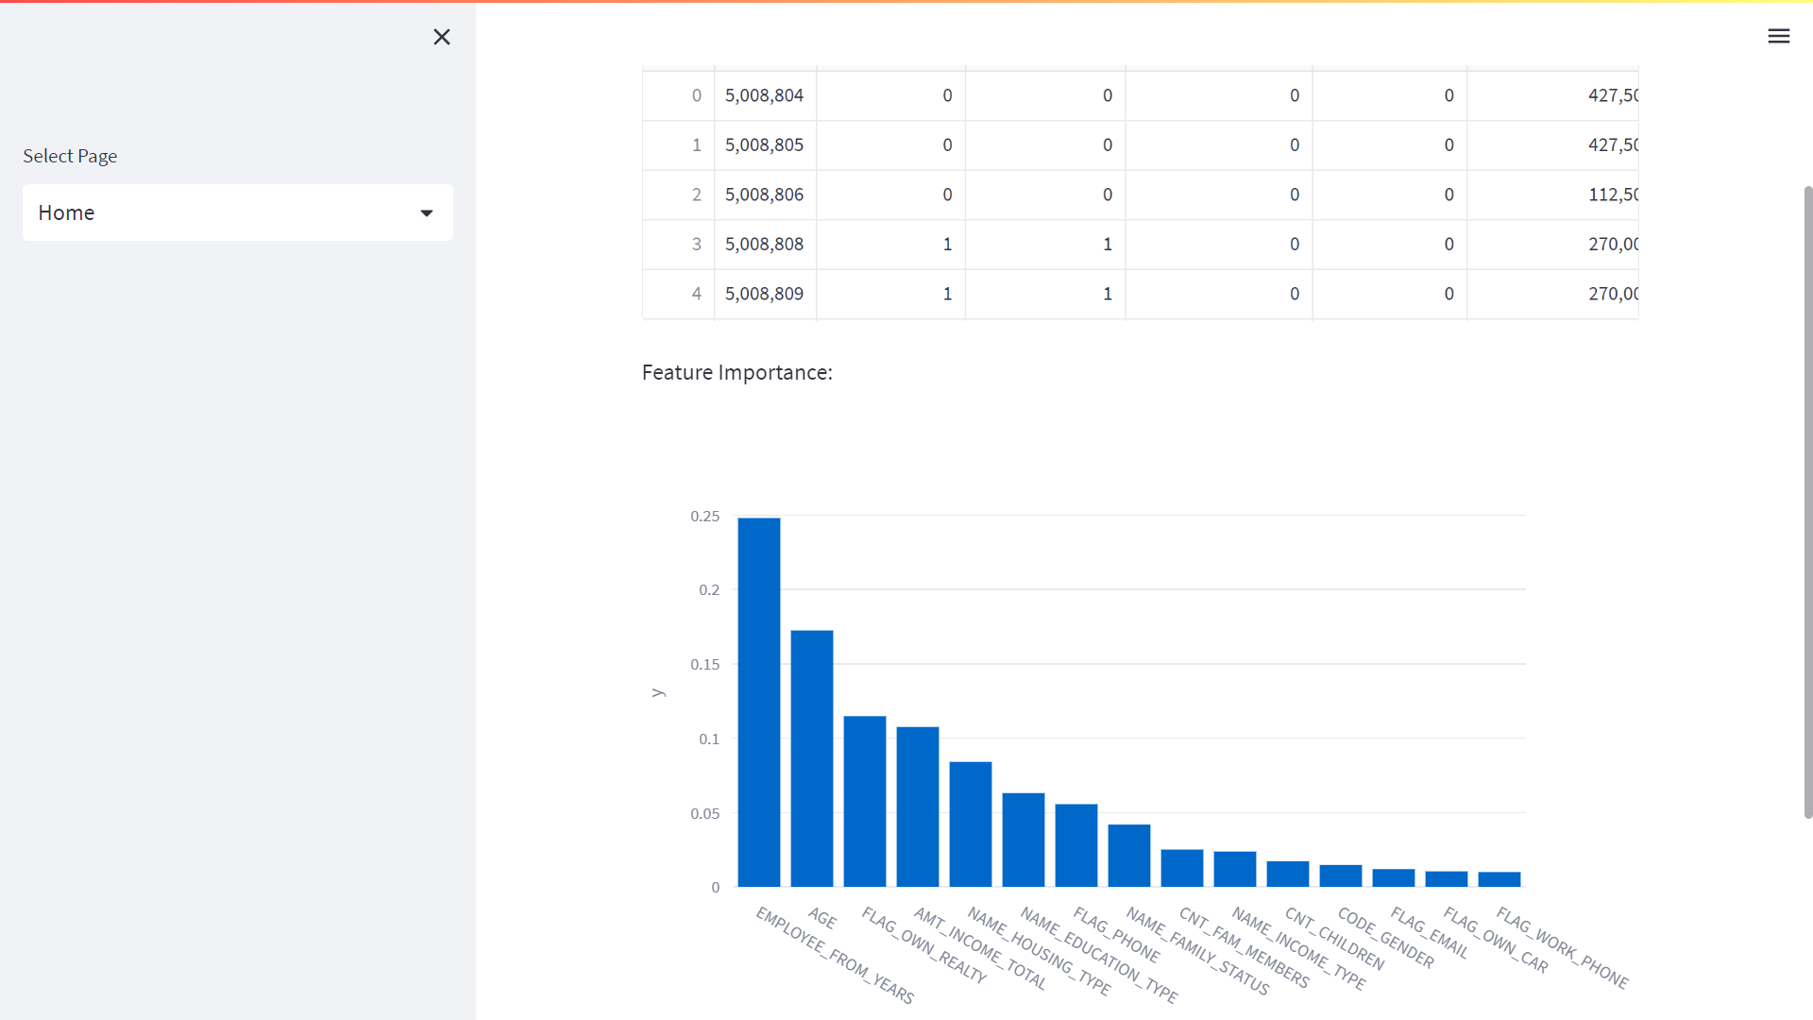

Slide 14
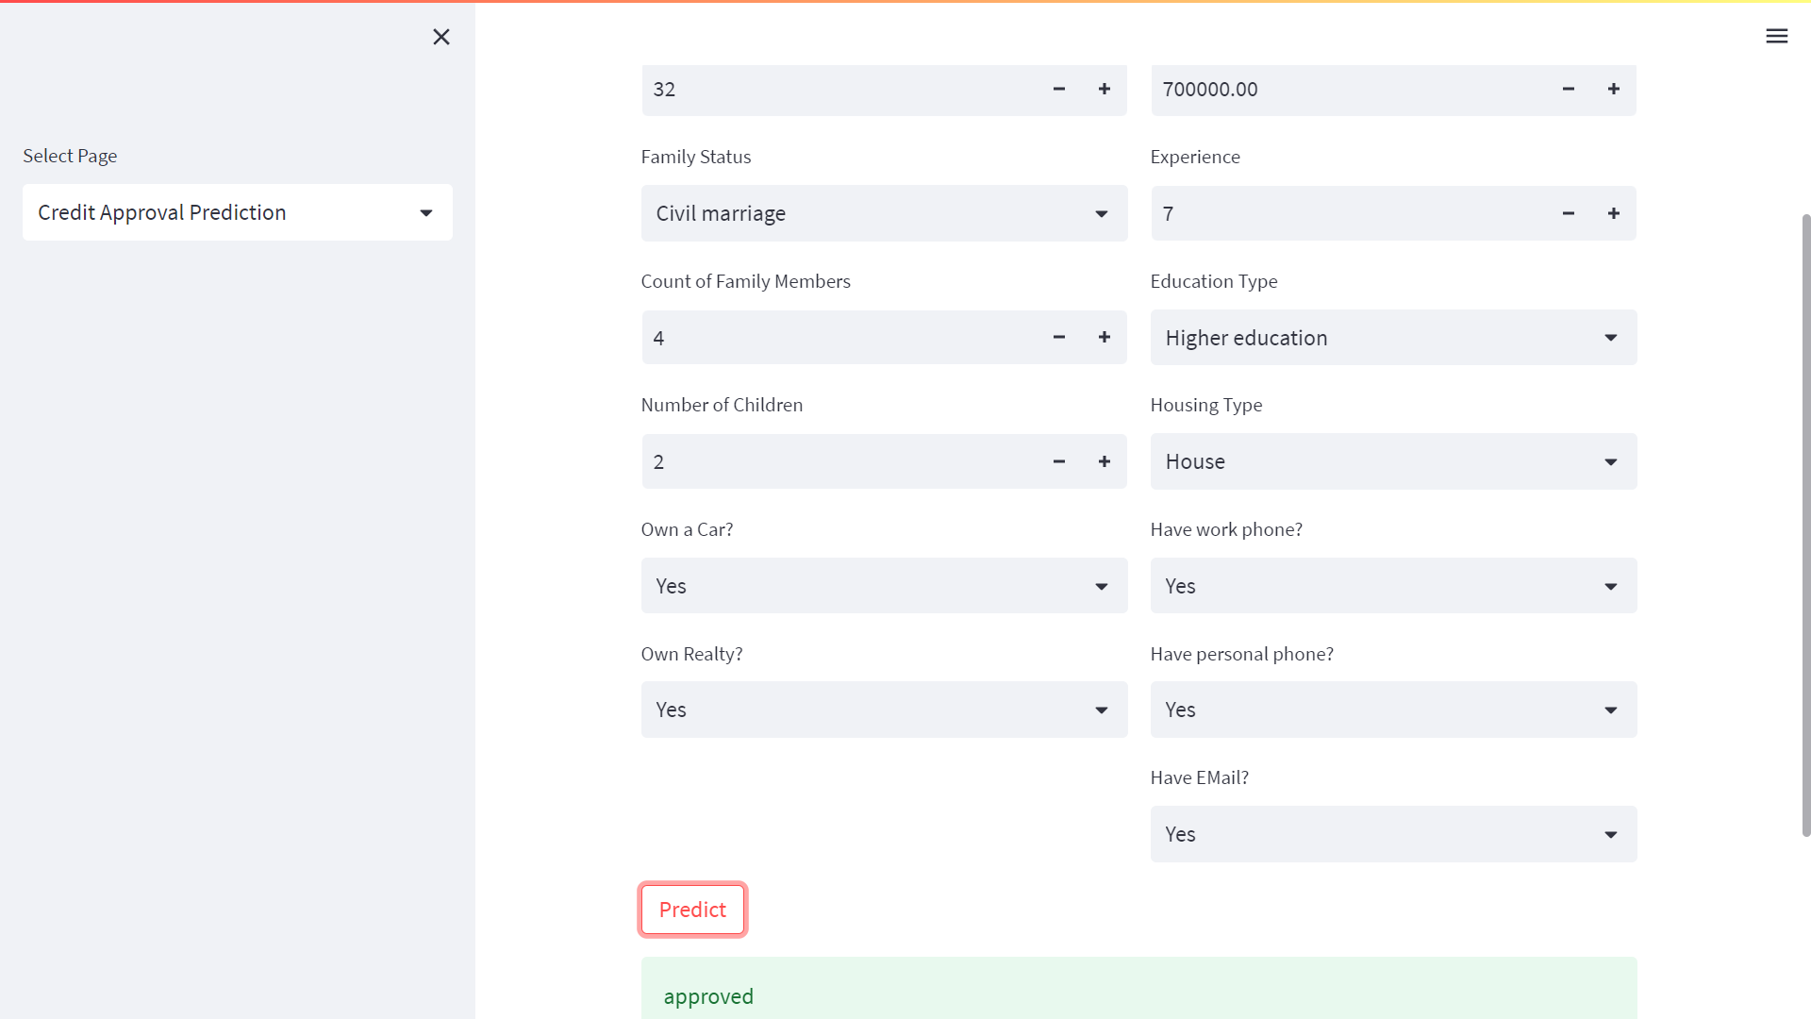

Slide 15
Outcomes
Based on the given user inputs like education, degree, family status ,assets, income value and experience the algorithms determines whether to approve or reject the credit card.
Challenges
Understanding the data
Data pre-processing
Feature selection
Modelling, finding the best model to improve the accuracy of the prediction.
hyperparameter tuning
Data Quality

Slide 16
Conclusion
In summary, a credit card approval machine learning project using KNN classifier can effectively predict credit card approval or denial. By optimizing the KNN classifier model through feature selection, hyperparameter tuning, and evaluating performance using appropriate metrics, high accuracy can be achieved to assist financial institutions and lenders to make informed decisions and reduce risk of default. However, it is crucial to ensure that the data is representative and unbiased, and that different hyperparameter values are experimented with to find the optimal configuration for the dataset. Overall, a credit card approval machine learning project using KNN classifier has the potential to provide valuable insights for data-driven decision making.

Slide 17

Thanks!

