Slide 1

Prediction of Car Prices – Regression
Under the Guidance :
Dr. Chaojie Wang
Presented By :
Abdul Junaid Mohammed

Slide 2
Introduction/Problem
Buying a used car can be a difficult task, especially when you are new to the country and don’t know the market value of the cars.
To address this issue, I have undertaken a project to predict the prices of used cars using various data sources and regression algorithms.
The project aims to help users get an estimate of the price of a car by providing basic details such as year, model, company, miles driven, etc.
Through my analysis, I aim to identify useful insights and patterns that can help users make informed decisions when purchasing a used car.

Slide 3
Dataset
The dataset is a collection of data scraped from the well-known website Craigslist. Dataset has been acquired from Kaggle.
It has 426880 Rows and 26 columns. It has all the useful features which will be required for the purchase of used car. Here the Target Variable will be the Price Column.
Of course not all the columns are going to be useful, but I found a good amount we can use.

Slide 4
Attributes/Characteristics
Some of the few important attributes from 26 columns are
Attribute | Data Type | Description
PRICE | Integer Type | The Price of the used cars from the craigslist website
YEAR | Integer Type | The year in which car was manufactured
MANUFACTURER | String Type | The Car manufacturers such as Ford, Honda, Gmc
CONDITION | String Type | The Condition of a Car such as excellent, fair, new
CYLINDERS | String Type | The Cylinder type a car have such as four, six, eight cylinders
ODOMETER | Integer Type | The Odometer reading such as miles of a car driven
TYPE | String Type | The type of a car such as Sedan, Suv, Hatchback

Slide 5
Data Wrangling
Dropping Redundant Columns - County, Id, Lat, Long, region, VIN, etc. and once removed those columns, they were left with around 14 attributes.
Handling Missing values - Imputation(Mean – Numerical Columns, Mode- Categorical Columns), dropna(More than 75% Nan values)
Removal of Duplicates records
Outlier Treatment - Inter Quartile Range(IQR) – For columns Odometer, Price
Categorical Encoding – Label Encoding – For categorical columns
Data Scaling - Normalization (MinMaxScaler()) – In the range of 0 to 1.

Slide 6
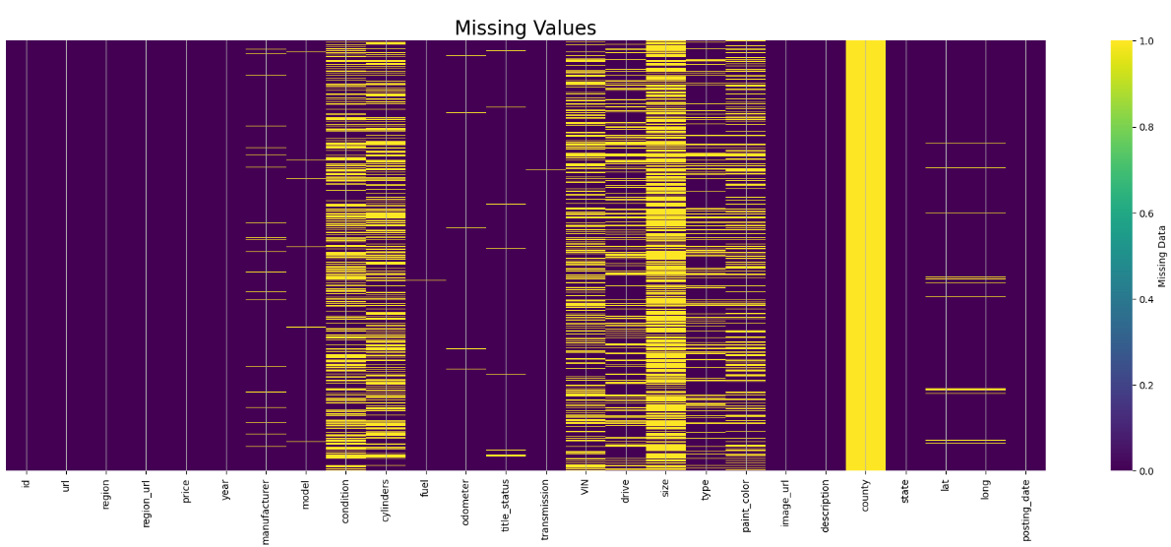
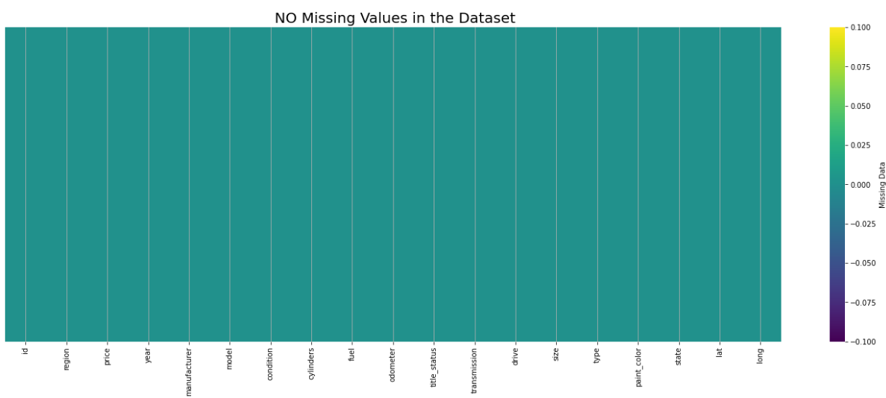
Data – Before and After

Slide 7
Potential Modeling Features

Slide 8
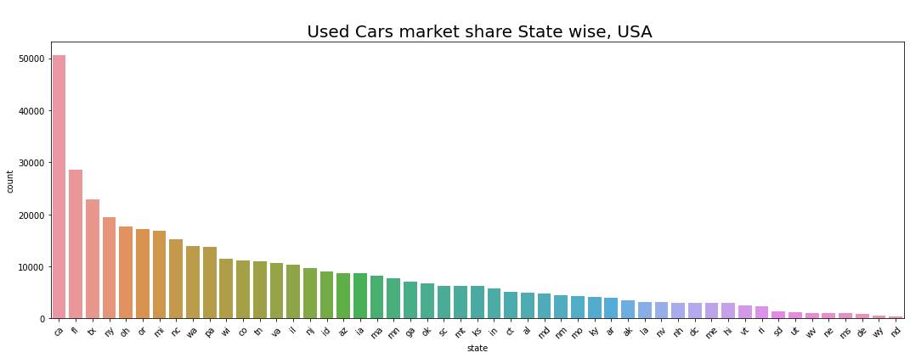
States

Slide 9
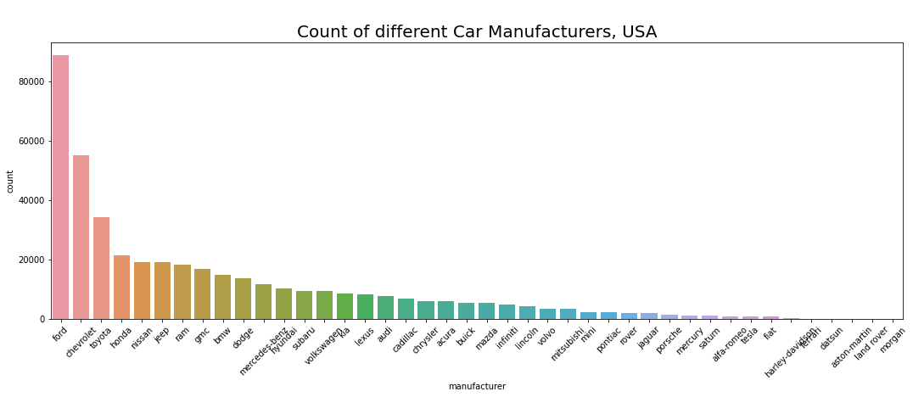
Car Manufacturers

Slide 10
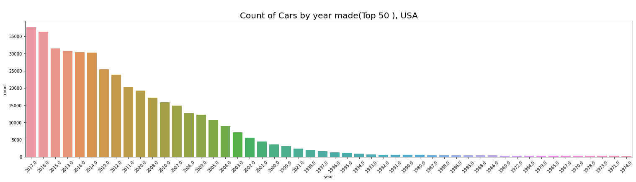
Year Make

Slide 11
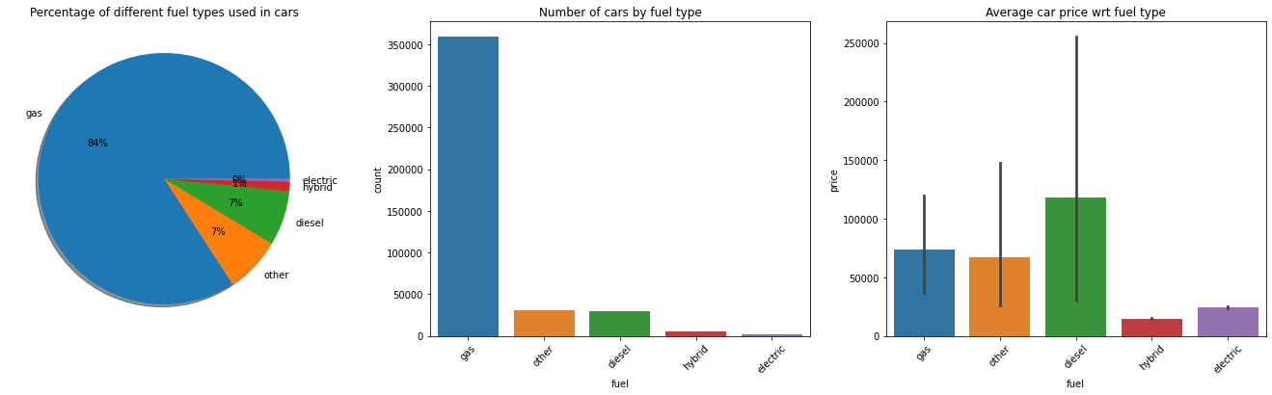
Fuel Type

Slide 12
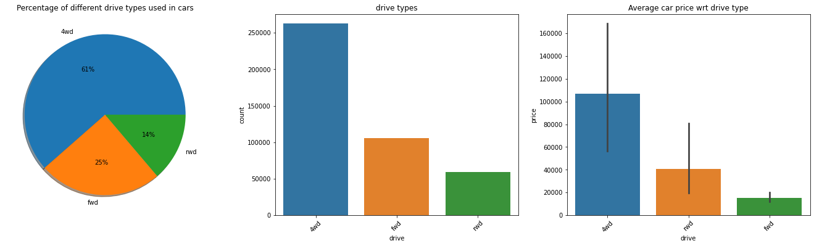
Drive

Slide 13
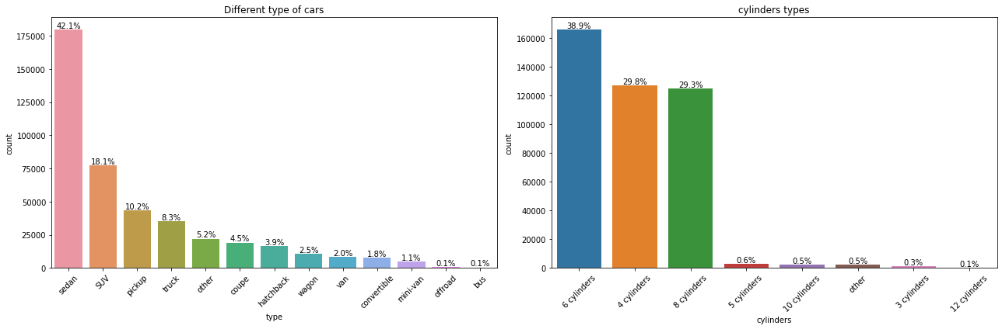
Different type of cars and Cylinders types

Slide 14
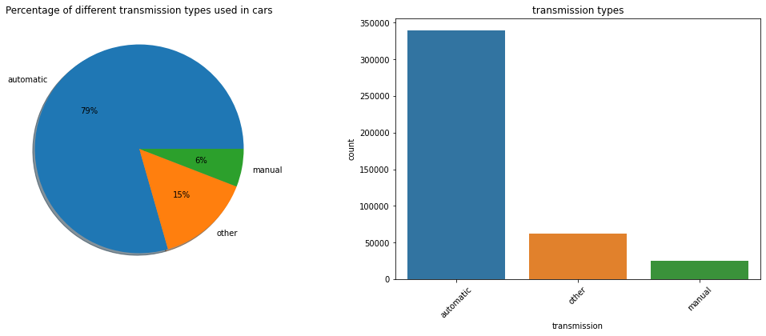
Transmission

Slide 15
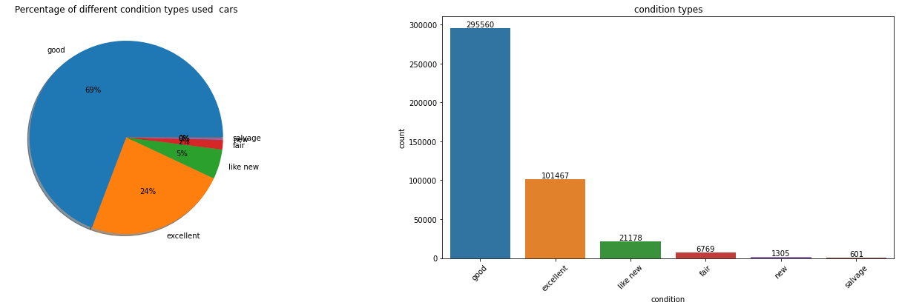
Condition

Slide 16
Models
Linear Regression
XG Boost Regressor
Random Forest Regressor
Decision Tree Regressor
Lasso Regression

Slide 17
Model Building and Deployment Steps
Splitting data into :
Label Encoding of categorical Columns
First built models with default parameters
Hyperparameter Tuning – Randomized SearchCV - To improve the Accuracy
Study models for any Underfitting or Overfitting
Used the Random Forest model with best accuracy score as – R**2 (Coefficient Of Determination) – 86%.
Best Model is saved as Pickle file.
Used Streamlit for deploying the model as WebApp.
Train = 70 % | Test = 30 %

Slide 18
Results
Model | Accuracy | MAE | MSE | RMSE
Random Forest Regressor | 86.78 | 2382.29 | 21701516.81 | 4658.48
XGBoost Regressor | 80.78 | 3466.68 | 31542312.17 | 5616.25
Decision Tree Regressor | 73.90 | 3008.64 | 42549793.55 | 6523.02
Lasso Regressor | 41.52 | 7326.61 | 96013084.67 | 9798.62
Linear Regressor | 41.51 | 7325.84 | 96015990.90 | 9798.77

Slide 19
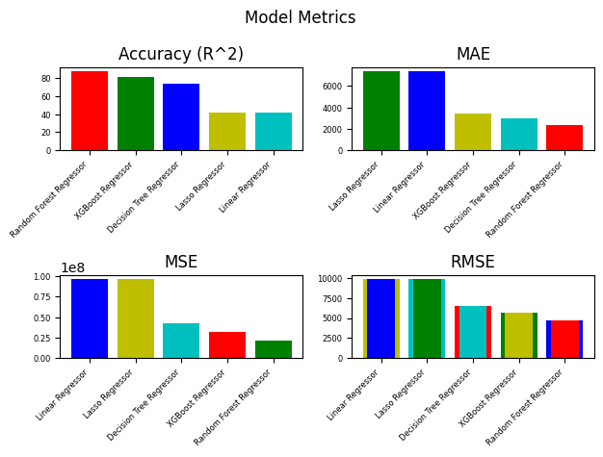

Slide 20
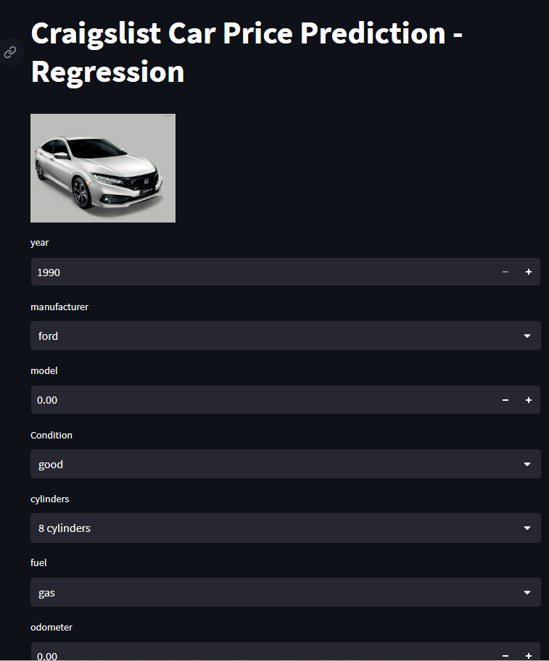
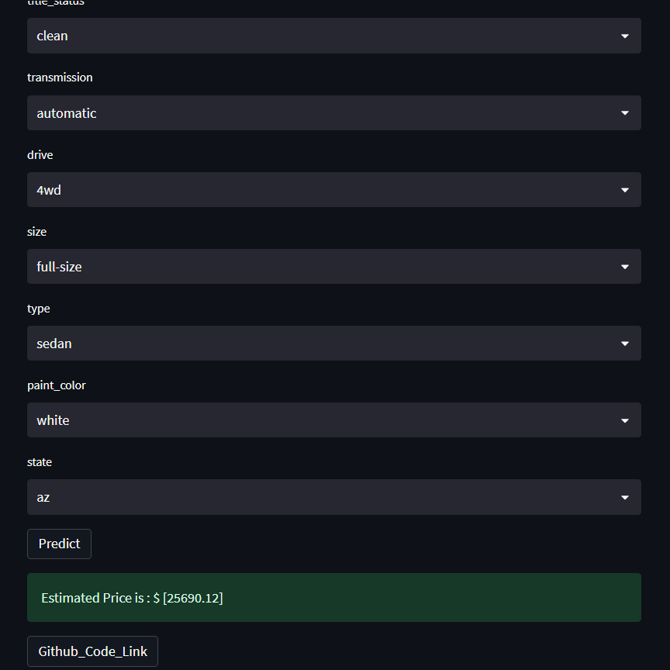
Graphical User Interface

Slide 21
References
https://www.census.gov/quickfacts/CA
https://dagshub.com/blog/ci-cd-for-machine-learning-test-and-and-deploy-your-ml-model-with-github-actions/
https://towardsdatascience.com/what-and-why-behind-fit-transform-vs-transform-in-scikit-learn-78f915cf96fe
https://washingtondc.craigslist.org/

Slide 22
Thank You!

