Slide 1

H1-B Visa Status Prediction Analysis

Slide 2
Questions
Can we predict H1B visa status using applicant information?
Which employers send the most H1B visa applications?
What is the percentage ratio of rejections and acceptance?
What are the year-wise trends for H1B visa applications and employers?
Which factors play a significant role in the acceptance of the H1B visa lottery system?
How does wage impact the H1B visa case status?

Slide 3
Purpose
The purpose of this project is to develop a prediction model that can accurately predict the outcome of an H1B visa application.
The model will use machine learning algorithms to analyze data related to previous H1B visa applications and predict the likelihood of approval or denial for new applications.

Slide 4
Dataset Used:
Dataset has data based on 6 year H1-B application data.
It has 3002458 rows and 11 columns
Columns used are:
CASE_STATUS (Target Column), EMPLOYER_NAME, SOC_NAME, JOB_TITLE, FULL_TIME_POSITION, PREVAILING_WAGE, YEAR, WORKSITE, lon, lat

Slide 5
Target column Data
CERTIFIED 2615623 CERTIFIED-WITHDRAWN 202659 DENIED 94346 WITHDRAWN 89799 PENDING QUALITY AND COMPLIANCE REVIEW - UNASSIGNED 15 REJECTED 2 INVALIDATED 1

Slide 6
Data Cleaning Methods
Imputation data cleaning method is used to replace the NaN values with a suitable value such as the mean, median, or mode of the column.
For string columns, same method is used to replace them with a string value such as "unknown" or "missing".
Used string matching to clean up the 'SOC_NAME' column in the given dataframe replace the values with the department names such as IT, Agriculture, Management, Marketing etc.

Slide 7
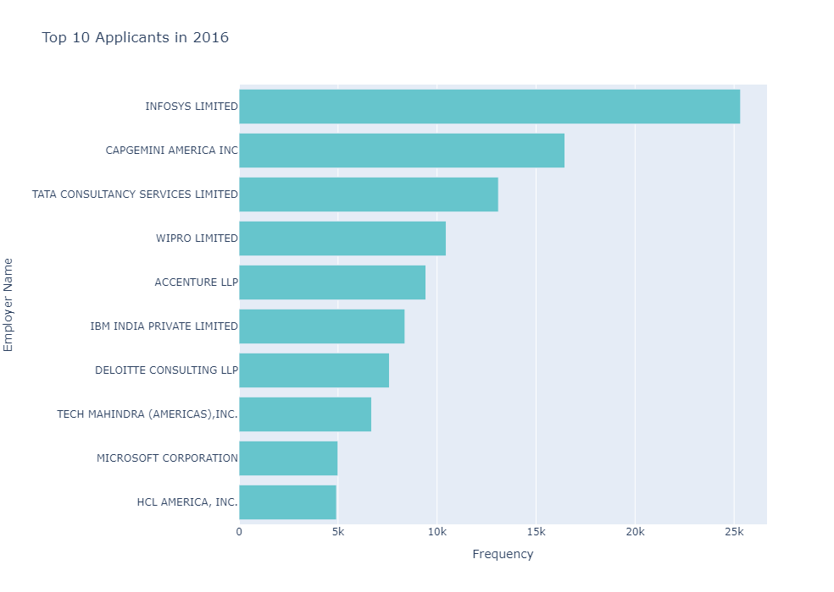
2016 Top 10 Employers

Slide 8
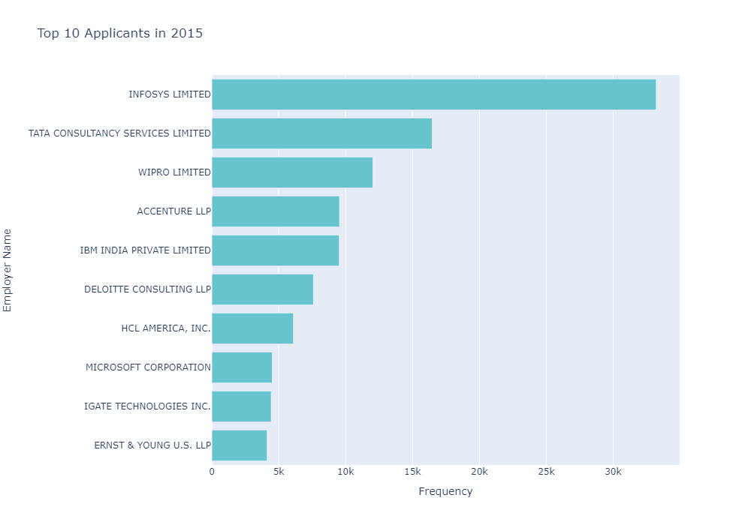
2015 Top 10 Employers

Slide 9
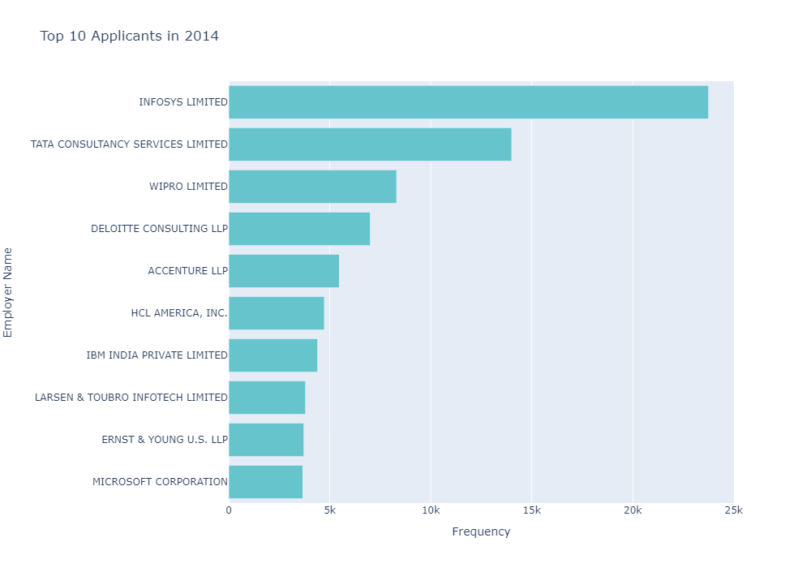
2014 Top 10 Employers

Slide 10
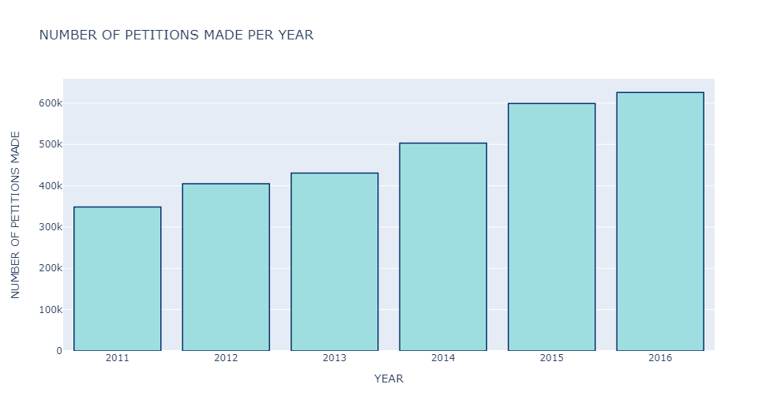
Number of applications each year

Slide 11
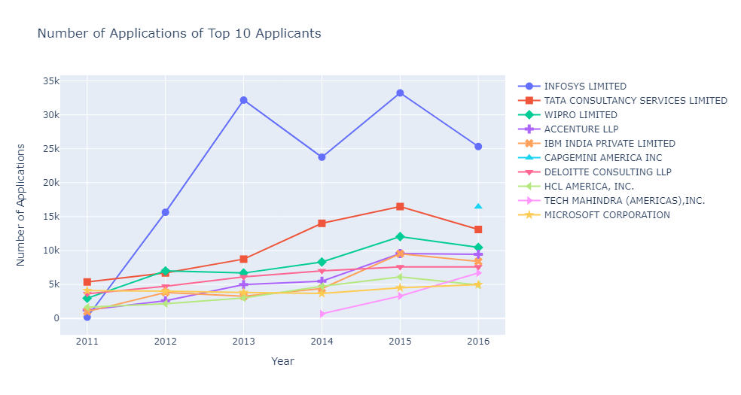
Number of Applications of Top 10 Applicants

Slide 12
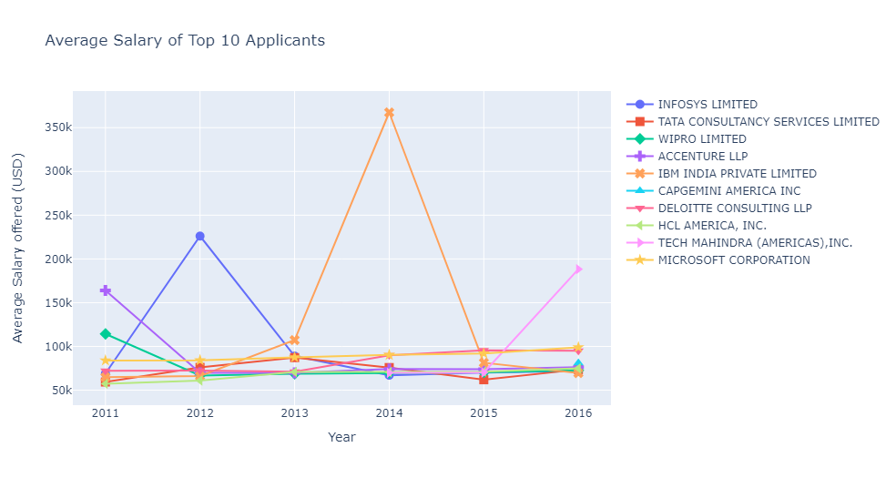
Average Salary of Top 10 Applicants

Slide 13
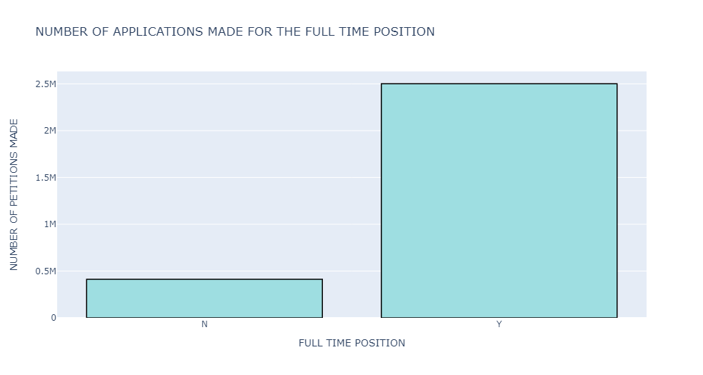
Full Time Positions: 'N' and 'Y'

Slide 14
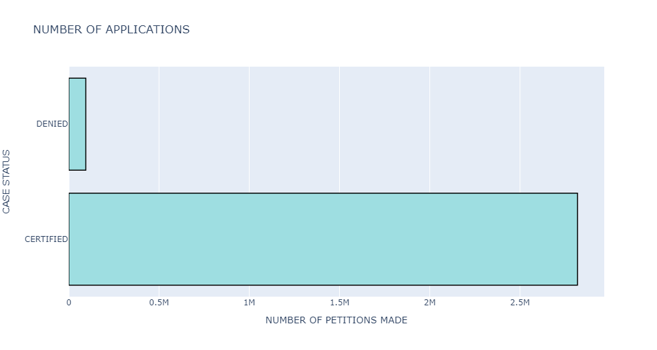
Certified Vs Denied

Slide 15
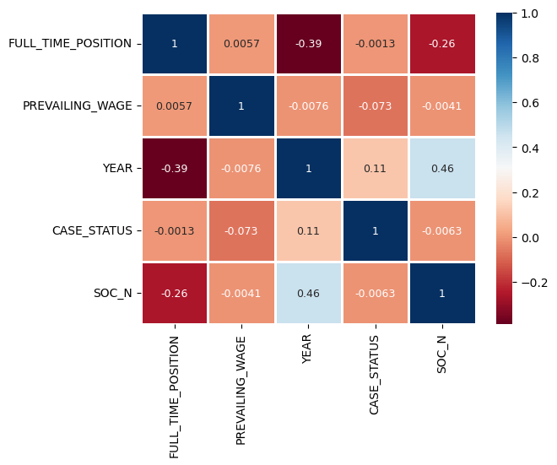
Seaborn Heat Map to understand the positive and negative correlation

Slide 16
Removing Outliers
Method Used: Z-score
Before applying : 0.9679485418826776
After Applying: 0.9685945068204025
There is increase of approximately 0.001% accuracy with Logistic Regression

Slide 17
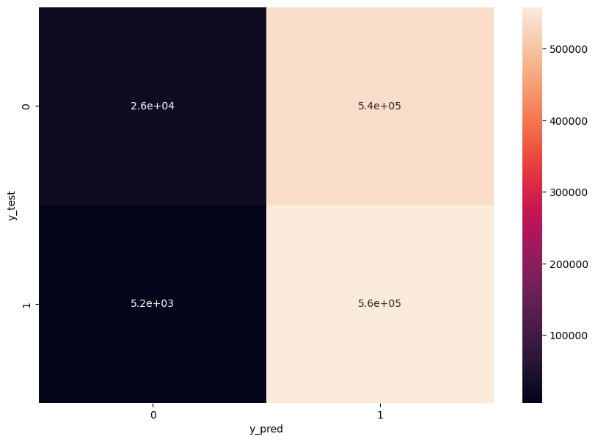
Data is highly imbalanced
Initial Confusion Matrix:
array([[ 42, 18064], [ 0, 557080]], dtype=int64)
Later Confusion Matrix:
array([[ 26376, 537496], [ 5163, 558283]], dtype=int64)
After Upsampling:
precision recall f1-score support 0 0.84 0.05 0.09 563872 1 0.51 0.99 0.67 563446

Slide 18
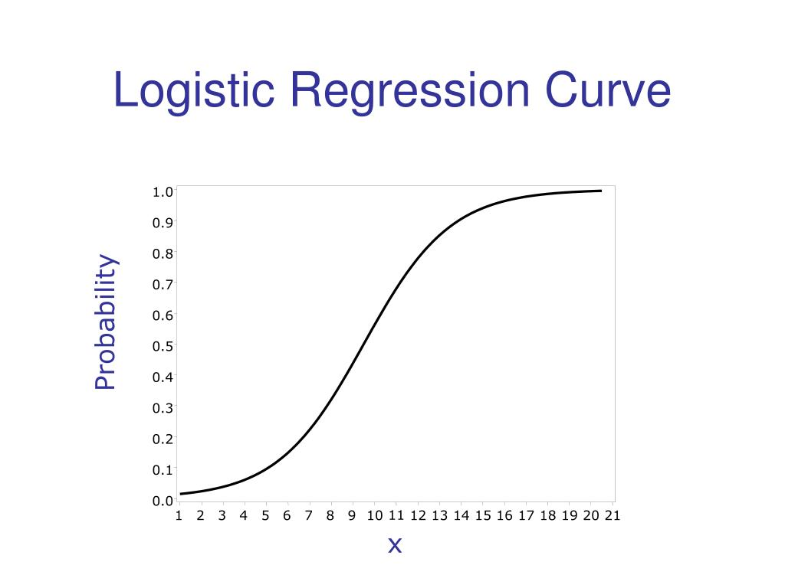
Logistic Regression
precision recall f1-score support 0 0.84 0.05 0.09 563872 1 0.51 0.99 0.67 563446 accuracy 0.52 1127318 macro avg 0.67 0.52 0.38 1127318 weighted avg 0.67 0.52 0.38 1127318

Slide 19
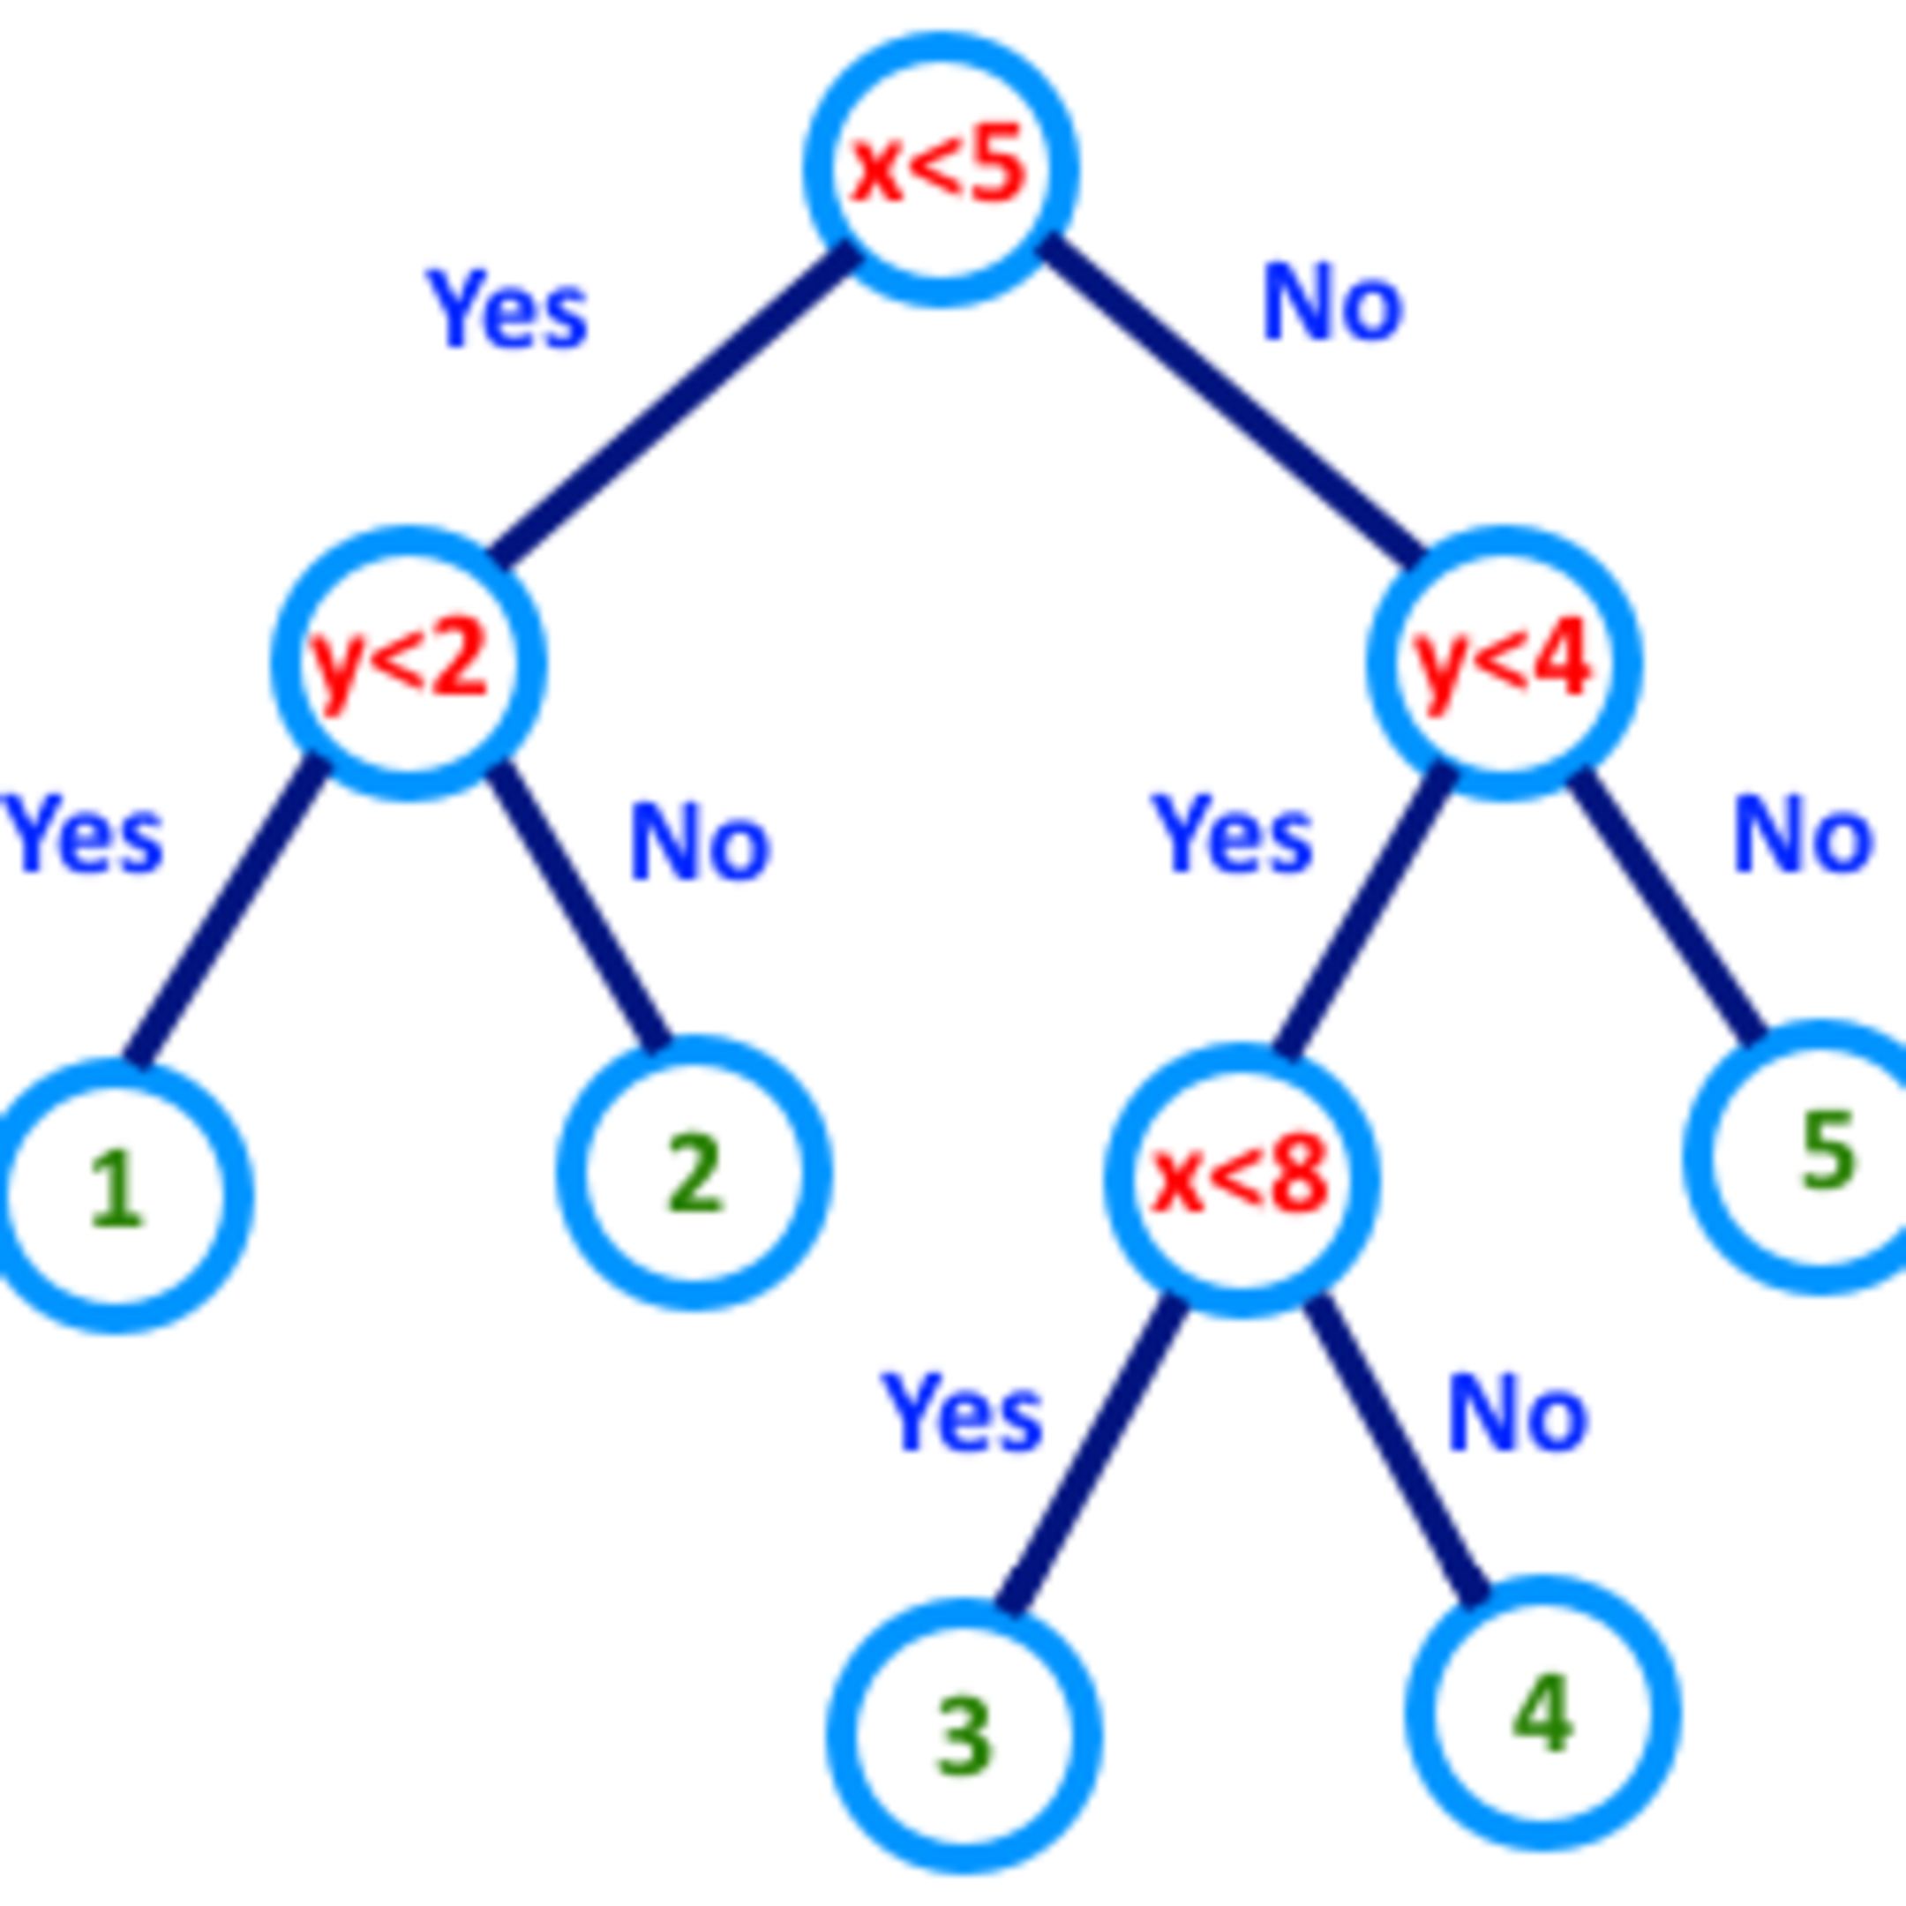
Decision Tree Classifier
precision recall f1-score support 0 0.81 0.80 0.80 563872 1 0.80 0.81 0.81 563446 accuracy 0.81 1127318 macro avg 0.81 0.81 0.81 1127318 weighted avg 0.81 0.81 0.81 1127318

Slide 20
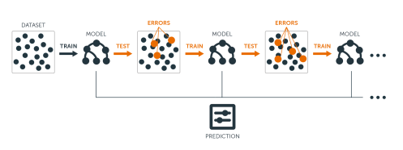
Gradient Boosting Classifier
precision recall f1-score support 0 0.71 0.61 0.66 563872 1 0.66 0.75 0.70 563446 accuracy 0.68 1127318 macro avg 0.69 0.68 0.68 1127318 weighted avg 0.69 0.68 0.68 1127318

Slide 21
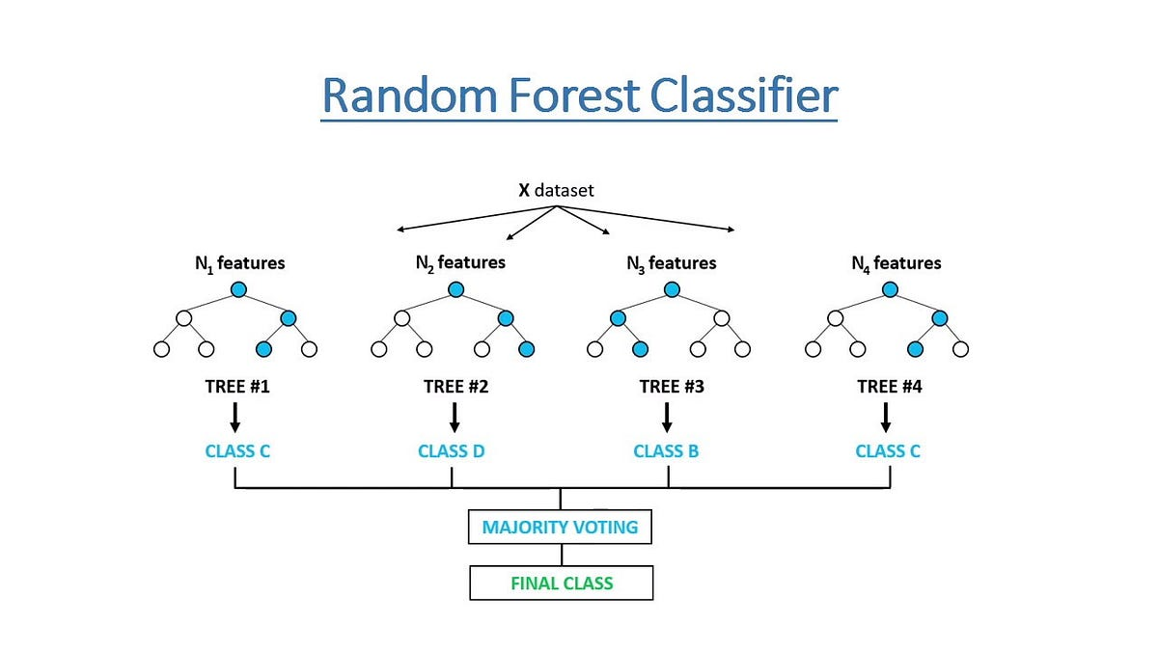
Random Forest
precision recall f1-score support 0 0.81 0.80 0.80 563872 1 0.80 0.81 0.81 563446 accuracy 0.81 1127318 macro avg 0.81 0.81 0.81 1127318 weighted avg 0.81 0.81 0.81 1127318

Slide 22
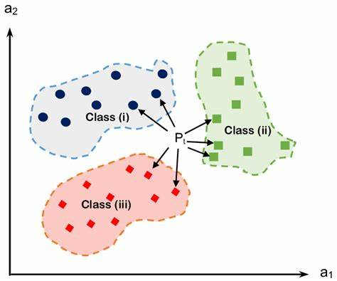
K Neighbors Classifier
precision recall f1-score support 0 0.77 0.79 0.78 563872 1 0.78 0.76 0.77 563446 accuracy 0.77 1127318 macro avg 0.77 0.77 0.77 1127318 weighted avg 0.77 0.77 0.77 1127318

Slide 23
Gaussian NB
precision recall f1-score support 0 1.00 0.02 0.04 563872 1 0.50 1.00 0.67 563446 accuracy 0.51 1127318 macro avg 0.75 0.51 0.35 1127318 weighted avg 0.75 0.51 0.35 1127318

Slide 24
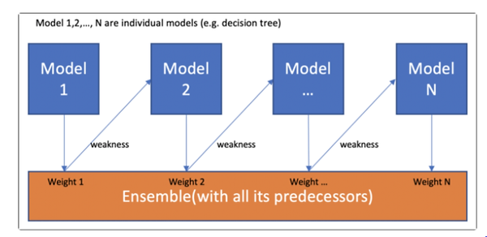
AdaBoost Classifier
precision recall f1-score support 0 0.71 0.61 0.66 563872 1 0.66 0.74 0.70 563446 accuracy 0.68 1127318 macro avg 0.68 0.68 0.68 1127318 weighted avg 0.68 0.68 0.68 1127318

Slide 25
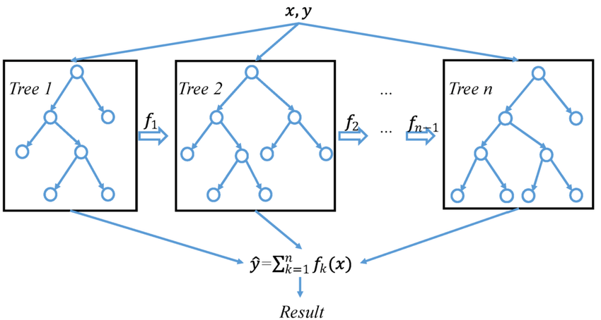
XGBoost Classifier
precision recall f1-score support 0 0.71 0.66 0.68 563872 1 0.68 0.73 0.70 563446 accuracy 0.69 1127318 macro avg 0.69 0.69 0.69 1127318 weighted avg 0.69 0.69 0.69 1127318

Slide 26
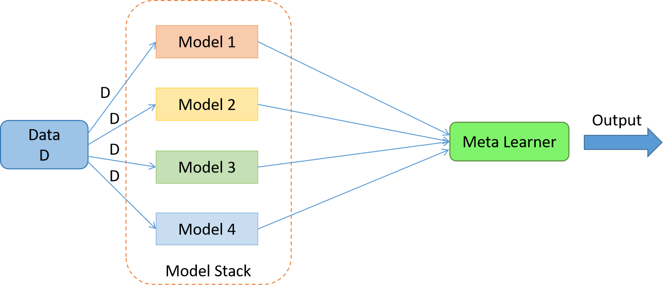
Stacking
The key idea behind Stacking is to leverage the strengths of each individual model and to reduce their weaknesses by combining their predictions. This can lead to a more accurate and robust predictive model than any single model on its own.
Models considered: Decision Tree, Random Forest and XGBoost
Accuracy: 67%

Slide 27


Thank You!
To all the international students here,
Good Luck with your H1-B lottery in future.

