Slide 1
DATA 606 Capstone in Data Science (06.7464) SP2023
Final submission:
Baltimore City crime rate and safety level statistics.
- Singireddy Karthik Reddy
TP48091.

Slide 2
Introduction:
Many causes are contributing to the rise in crime in today's globe. If we look closely, most crimes of a particular type tend to occur in the same locality, possibly due to the individuals that live there.
We are working on a model that assesses which areas are prone to specific types of crimes, allowing us to assess the area's safety. This will benefit the US Department of Homeland Security. Also, for those who are looking to start a new life in the city.

Slide 3
Dataset:
We are using a dataset from the Open Baltimore database of the United States Government for the city of Baltimore.
The dataset contains crime details like crime code, description, location of the event, date and time of report, etc.
The dataset provides information about all the crimes that were reported in the city of Baltimore.

Slide 4
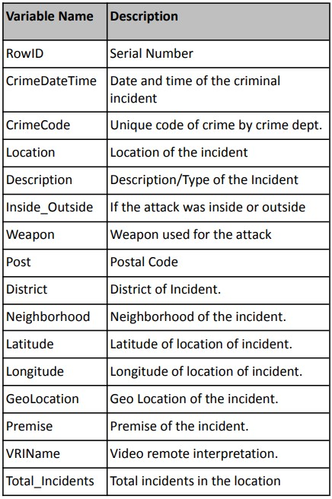
Description of the dataset:

Slide 5
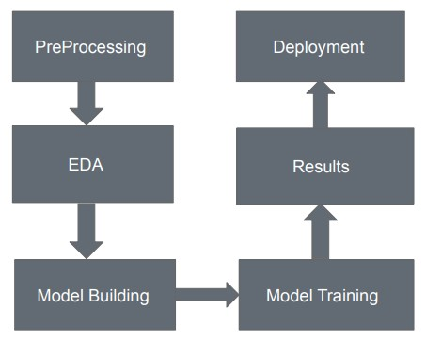
Project Framework:

Slide 6
Preprocessing:
Removed null values.
Dropped unwanted columns like location and latitude.
Target column: Level (obtained from the description).
Indexed the target column using a string indexer.
Low : 0 (Larceny, Burglary, Auto Theft).
Medium: 1 (Robbery, Assault).
High: 2 (Shooting, Rape, Arson, Homicide).
Libraries used:
Matplotlib.
Numpy.
StreamLit.
Pandas.

Slide 7
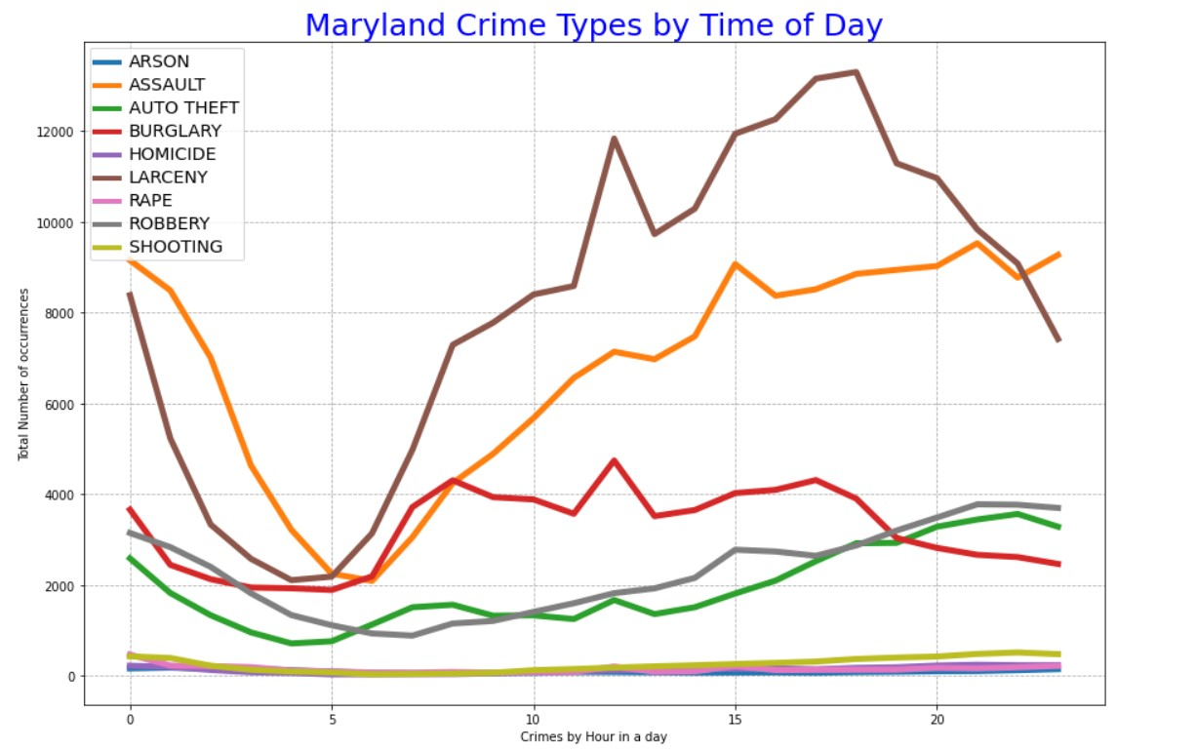
Exploratory Data Analysis:
Hypothesis:
Line Plot of occurrences of crimes through the hour of the day.
From this graph, we can see that Crime is high from 10:00 AM to 18:00 PM.

Slide 8
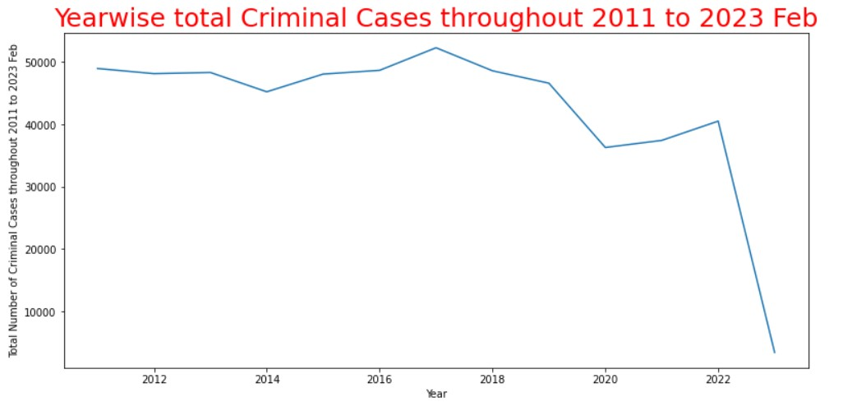
Hypothesis:
We see a decrease in the number of attacks after the covid-19 Pandemic.
Notes:
E: Collected labels of cats and dog
T: Classifying a new example of a cat/dog image
P: Accuracy of the classification, recall metric, precision etc.

Slide 9
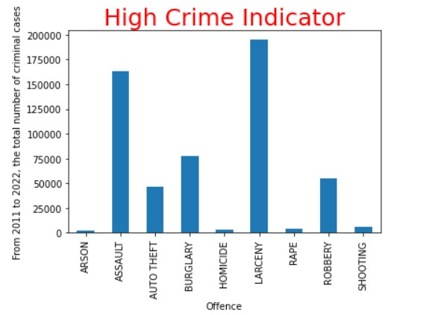
Hypothesis:
We see the highest cases were reported for Larceny, followed by Assault, burglary, Robber, etc.

Slide 10
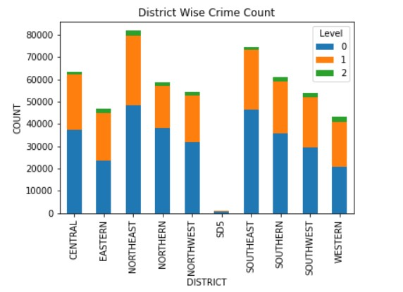
Hypothesis:
We see the highest cases were reported in the Northeast district followed by the Southeast.

Slide 11
Implementing Machine learning models:
To develop machine learning models, we implemented 2 approaches:
2-way classification.
3-way classification.
Random Forest classification:
The random forest consists of a large number of individual decision trees that operate as an ensemble.
Each individual tree in the random forest spits out a class prediction and the class with the most votes becomes our model’s prediction.

Slide 12
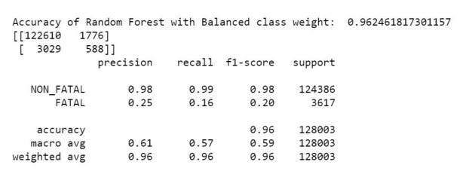
Random Forest Classification (2-way Classification)

Slide 13
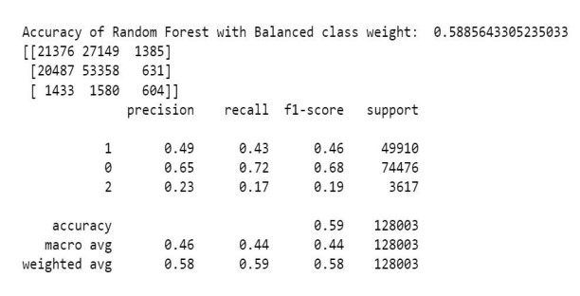
Random Forest Results (3-way Classification)

Slide 14
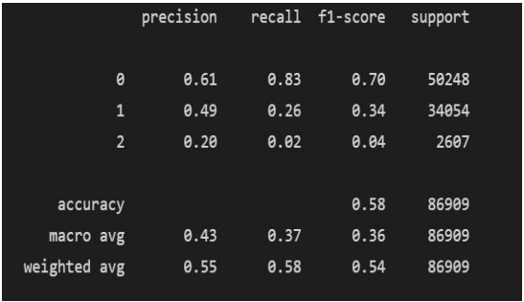
K-Nearest Neighbor:
The KNN algorithm assumes that similar things exist in proximity.
K-nearest neighbor or K-NN algorithm basically creates an imaginary boundary to classify the data.
When new data points come in, the algorithm will try to predict that to the nearest boundary line.
KNN Results
(3-way Classification) →

Slide 15
Future work: As part of Future work, In the User Interaction interface (StreamLit) we are planning to introduce the ‘drop the pin on the map’ option to fetch the address of the location the user is planning to visit. In the future, we try to acquire more data and build a model which can classify the different types of crime.

Slide 16
References
Alkesh Bharati1, Dr. Sarvanaguru RA.K2,” Crime Prediction and Analysis Using Machine Learning”, International Research Journal of Engineering and Technology (IRJET).
O. Llaha, “Crime Analysis and Prediction using Machine Learning,” 2020 43rd International Convention on Information, Communication and Electronic Technology (MIPRO), 2020, pp. 496-501.
W. Safat, S. Asghar, and S. A. Gillani, "Empirical Analysis for Crime Prediction and Forecasting Using Machine Learning and Deep Learning Techniques," in IEEE Access, vol. 9, pp. 70080-70094, 2021, doi: 10.1109/ACCESS.2021.3078117.
https://data.baltimorecity.gov/datasets/part1-crime-data/explore?location=39.304390%2C-7 6.624118%2C10.97&showTable=true

Slide 17
Thank you!

