Slide 1
DATA 606 Capstone in Data Science
Final Submission
Cancellation prediction of Hotel booking
- Manoj Kumar Boyapati
DS25779.

Slide 2
Introduction:
Advance reservation systems are extremely beneficial to hotels. This may be both a positive and a terrible thing for hotels.
Reservations are cancelled at a rate of 24% on average. Cancellations have an impact on the hotel's revenue since they lose prospective revenue consumers who do not cancel.
As part of the project, my task involves analyzing booking data from Microtel BWI and developing a model to predict the likelihood of a reservation being canceled. By accurately forecasting future cancellations, the hotel can better anticipate its revenue and adjust room pricing accordingly for maximum profitability.

Slide 3
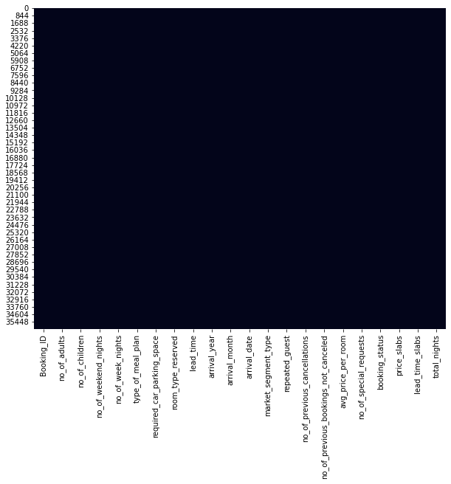
Dataset:
No. of rows – 36,275
No. of columns – 19
Total number of values - 689,225
This dataset has no null values, which is quite unusual for a dataset in the actual world. I requested this dataset from Microtel BWI.

Slide 4
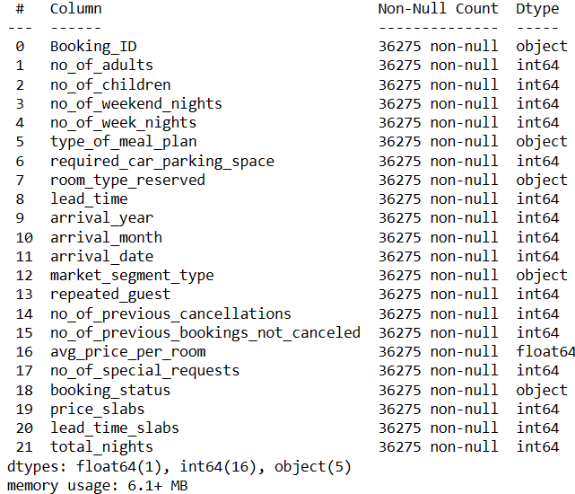
Description of the dataset:

Slide 5
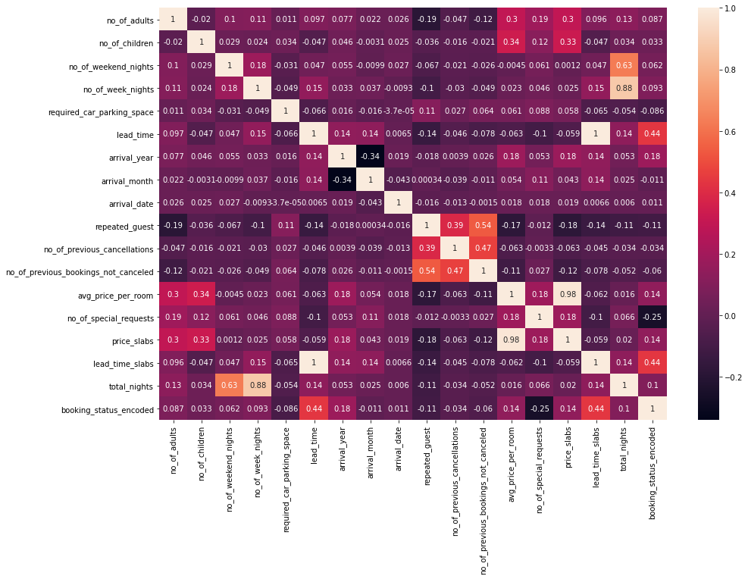
Correlation among the columns:
I have added a new column called "booking_status_encoded" to be used in the correlation heatmap.
Upon analysis, I have found that there is a strong correlation between the booking status and lead time. Specifically, as the lead time increases, the likelihood of a booking being cancelled also increases.

Slide 6
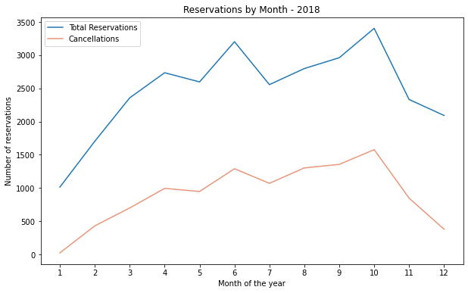
Cancellations WRT months
As anticipated, there is an uptick in bookings during the summer months, while reservations decline during the winter.
Interestingly, there was also a notable increase in reservations for the month of October at this particular hotel.
Additionally, it is apparent from the graph that cancellations fluctuate along with the number of reservations.

Slide 7
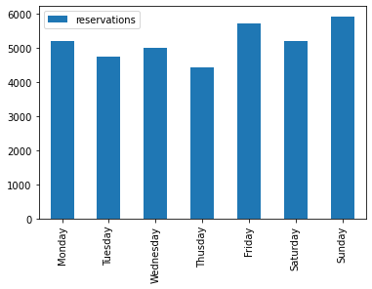
Reservations WRT day of the week
As expected, booking activity tends to be highest on weekends and lowest on weekdays.
Specifically, Friday and Sunday have the highest number of reservations

Slide 8
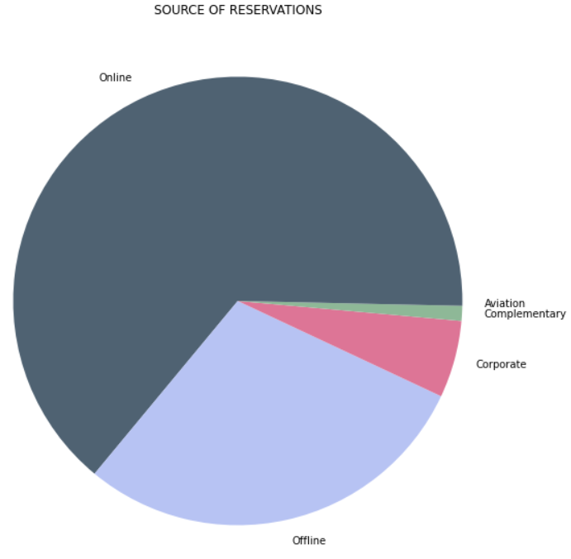
Source of reservations
The primary source of reservations for Microtel is online booking, followed by offline reservations.
This trend can be attributed to the convenience and attractive deals offered by online booking companies.

Slide 9
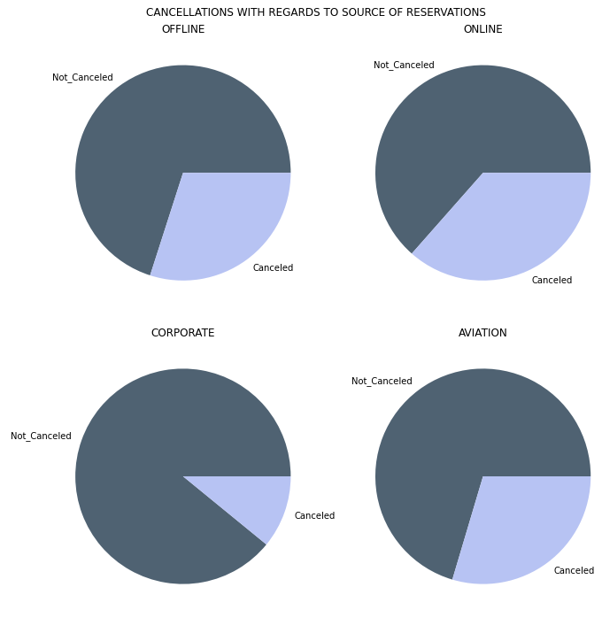
Cancellations WRT Source of reservations
Online booking sites typically offer users a convenient cancellation policy, allowing them to cancel reservations with ease.
As a result, online bookings tend to have a higher cancellation ratio compared to offline and aviation bookings.
However, corporate bookings have a relatively lower cancellation rate.

Slide 10
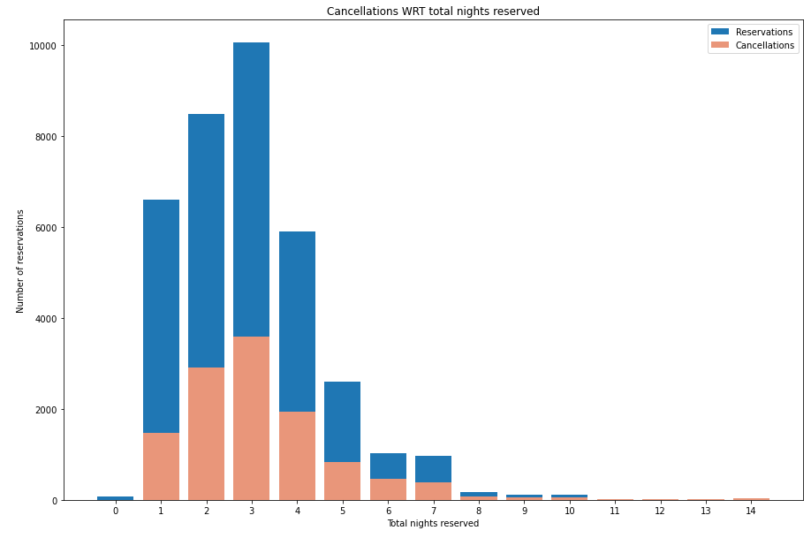
Cancellations WRT Total nights
Most of the guest chose to stay for 3 nights.
There is no good information for cancellations as the cancellations are higher when the reservations are high.

Slide 11
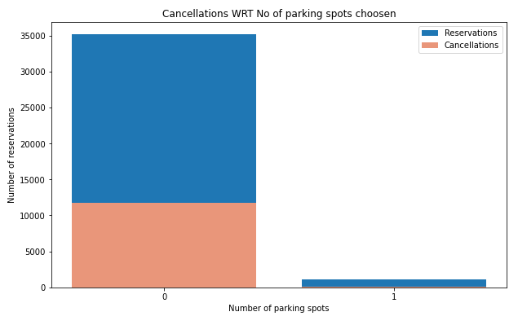
Cancellations WRT no. of parking spots chosen
Based on the data, it appears that guests who choose to reserve a parking spot are less likely to cancel their reservation compared to those who do not reserve a parking spot.
Specifically, guests who do not reserve a parking spot have a higher likelihood of canceling their reservation.

Slide 12
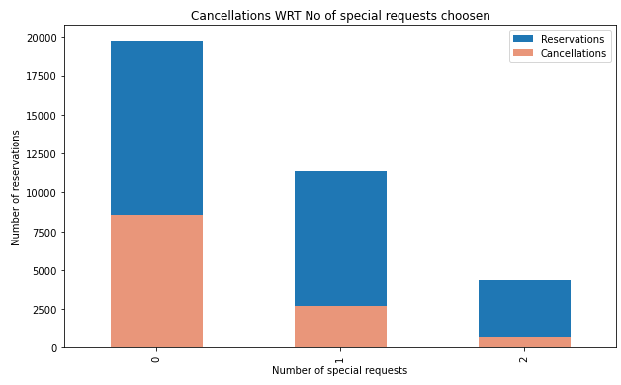
Cancellations WRT no. of special requests made
Online bookings often include an option for guests to make special requests for their stay at the hotel.
This suggests that the guest is committed to their stay and has specific needs or preferences.
According to the graph, there appears to be a negative correlation between the number of special requests made and the likelihood of a booking being canceled.

Slide 13
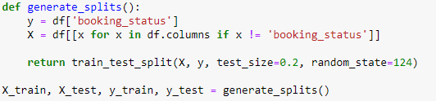
Splitting the data & Preprocessing pipeline

Slide 14
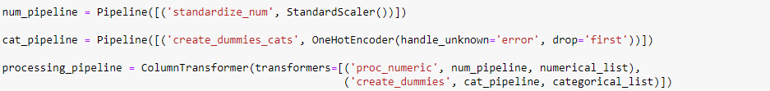
Splitting the data & Preprocessing pipeline
Training examples: 29,020
Test examples: 7,255

Slide 15
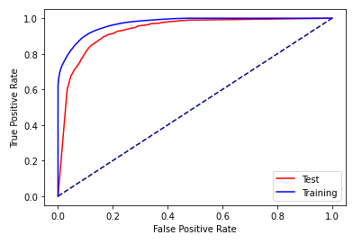
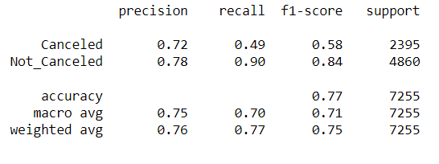
Classification – Logistic regression

Slide 16
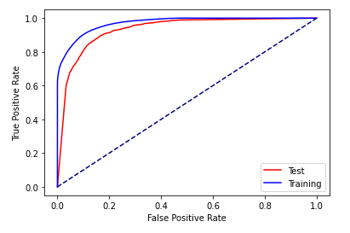
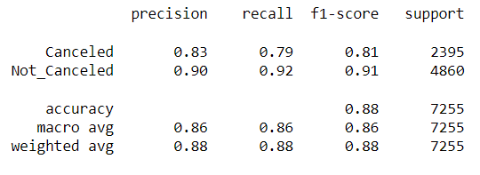
Classification – Decision Tree

Slide 17
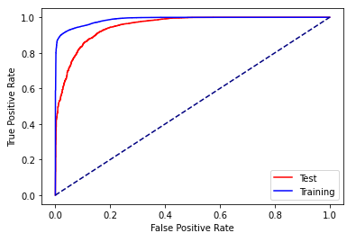
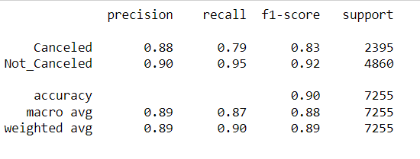
Classification – Random Forest

Slide 18
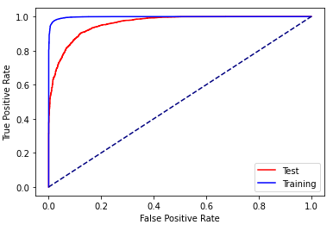
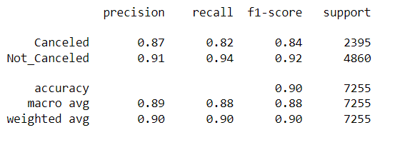
Classification – Gradient Boosting

Slide 19
Conclusion
In conclusion, hotel reservations can be canceled for various reasons regardless of the price. Based on the findings, it seems that guests who make special requests or book a parking spot are more committed to their stay and have a lower likelihood of canceling their reservation.
Additionally, among the classification algorithms used, it was determined that the Random Forest algorithm was the most effective for this dataset.

Slide 20
Thank you!

