Slide 1
Heart Disease Prediction
CAPSTONE Project 606
BY Sri Bhanu Gundu

Slide 2
PROBLEM STATEMENT
Cardiovascular diseases are responsible for the highest number of deaths globally, claiming an estimated 17.9 million lives annually, which makes up 31% of all deaths worldwide
One of the common outcomes of Cardio Vascular diseases is heart failure
Individuals who have cardiovascular disease or are at a high risk of developing it are particularly vulnerable.

Slide 3
DATASET DESCRIPTION
The dataset is taken from the UCI website "https://archive.ics.uci.edu/ml/datasets/Heart+Disease" of three databases with datasets of Cleveland, Hungarian and Switzerland are taken.
age, sex, chest_pain_type, resting blood pressure, cholesterol and fbs_over_120.

Slide 4
Data Mining Process
Data Preparation
EDA & Visualization
Machine Learning Modeling
Step 1
Data Preparation
Step 2
EDA & Visualization
Step 3
Machine Learning Modeling

Slide 5
DATA PREPARATION
Raw encoded data in the form of “.data” is taken from the website.
The raw data converted to semi structured data are analyzed.
The columns in data are labelled as per the information in the UCI website.
The data from three countries with different data types are unified.
Replaced special characters with null values and handled based on the target variable.
Merged all the data sets and prepared the data for further analysis.

Slide 6
Exploratory Data Analysis
Duplicate rows.
Outliers detection.
Skewness detection.
Handling of Missing values.

Slide 7
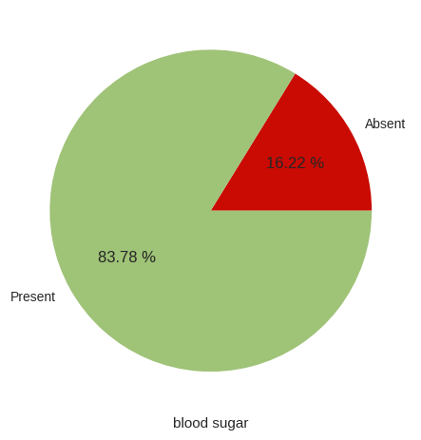
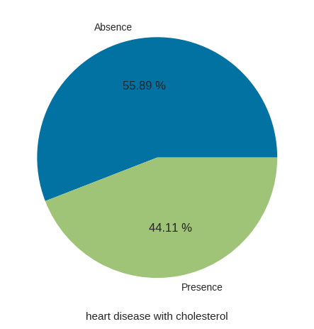
Data Visualization
Presence of blood Sugar with heart disease Presence of Heart Disease with cholesterol

Slide 8
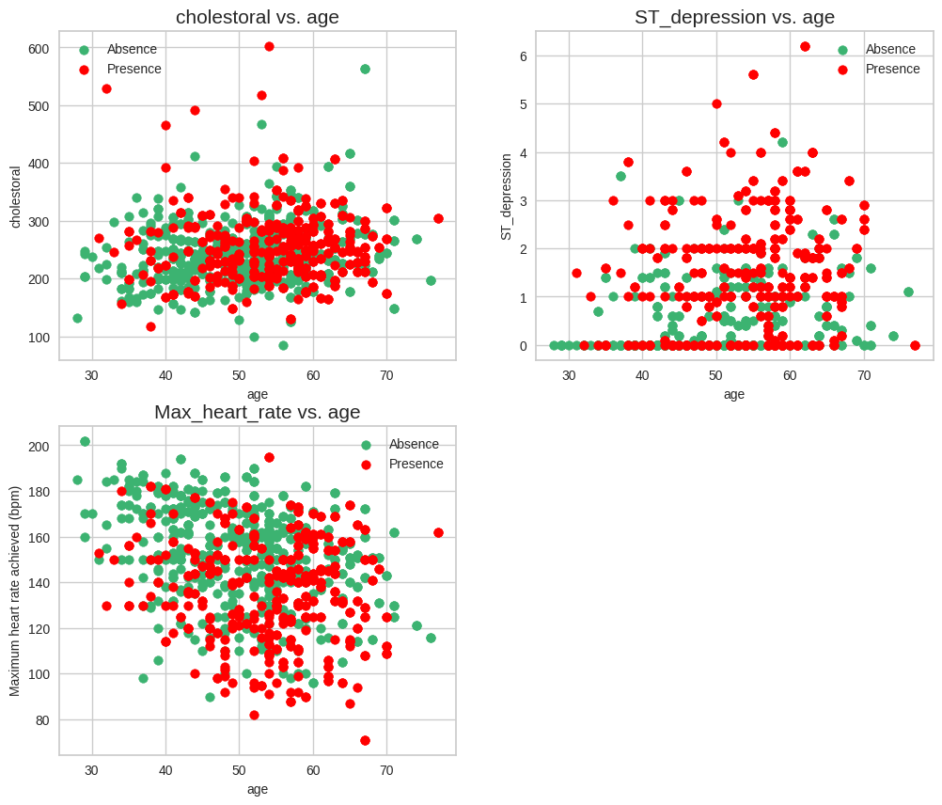
Data Visualization

Slide 9
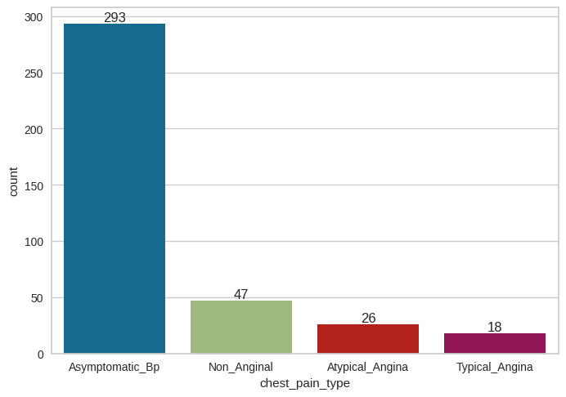
Data Visualization
Presence of heart disease is mostly with patients of Asymptomatic_Bp chest pain type

Slide 10
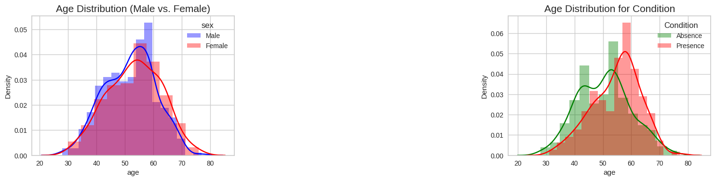
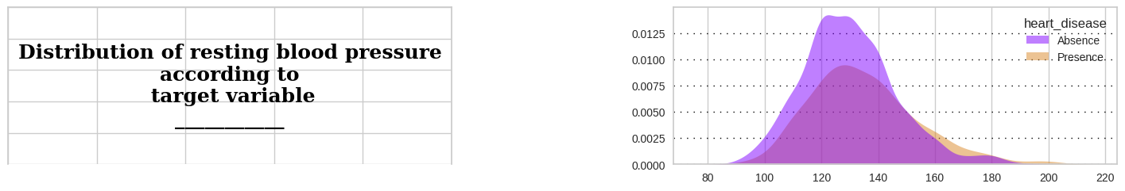
Data Visualization

Slide 11
Insights from Data Analysis (EDA & Data Visualization)
The heart diseases observed are highest in Males.
Patients after 50 years are more prone to heart diseases.
Patients more than 200 mg of Cholesterol are more prone to the risks of heart failure.
Presence of fasting blood sugar, and resting blood pressure more than 120 (120-140) had higher chances of heart diseases.
Some other parameters are Asymptomatic Blood pressure and slope_of_st with Downsloping/Upsloping and ST_depression between 0 to 2 is in the category of patients facing the problems of heart diseases.

Slide 12
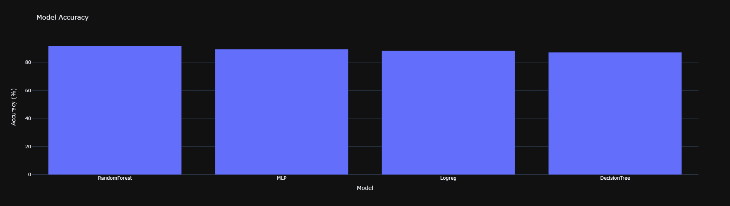
Machine Learning Modeling
Accuracy comparison of Machine learning models of random Forest, Logistic regression, Decision tree and ANN(MLP)

Slide 13

Machine Learning Modeling
Recall comparison of Machine learning models of random Forest, Logistic regression, Decision tree and ANN(MLP)

Slide 14
Comparison of Models
Classifier | Accuracy | Recall | Precision | Roc_auc
Logistic Regression | 88.33% | 89.32% | 87.99% | 95.25%
Decision Tree | 87.22% | 88.60% | 87.22% | 89.68%
Random Forest | 92.22% | 93.02% | 91.74% | 97.32%
MLP Classifier | 88.89% | 90% | 88.62% | 89.68%
From overall observations of metrics with Accuracy, Recall, precision and roc_auc score, it is clear that Random Forest model is performing well for prediction with highest accuracy of 91.67%, and Recall 92.56%

Slide 15
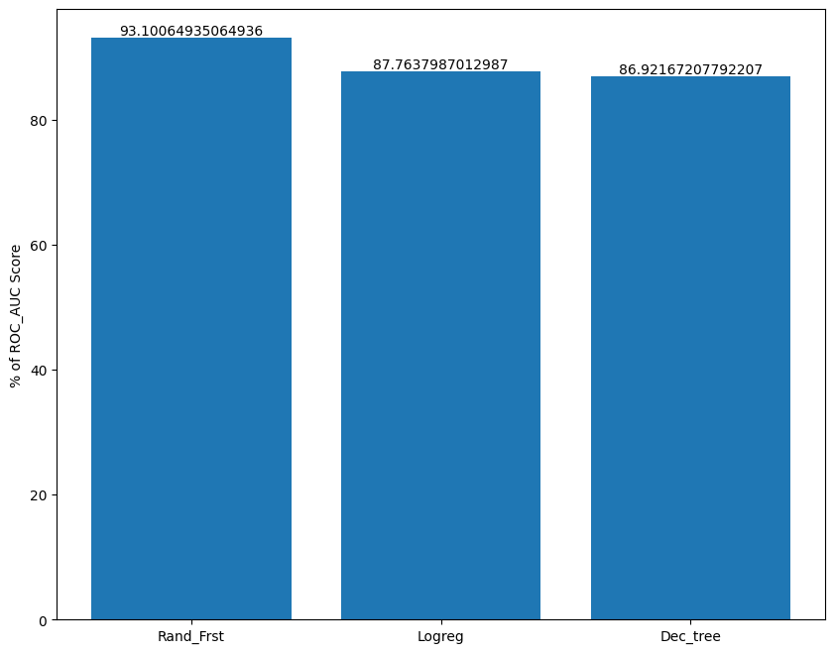
Hyper tuning
After Performing hyper tuning with Grid Search CV, then comparing the models,

Slide 16
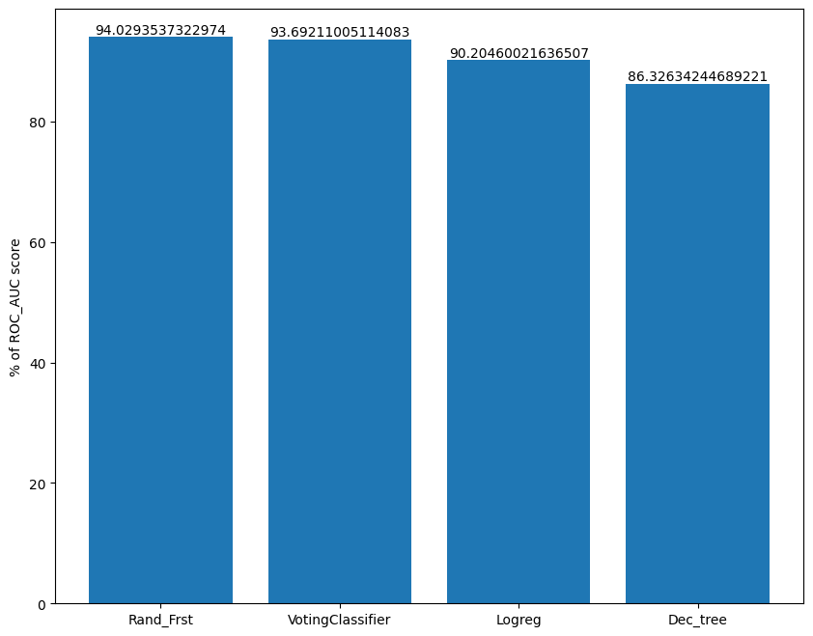
Voting Classifier
Performing Ensemble and comparing classifiers with all the ensembles.

Slide 17
STREAMLIT WEB DEPLOYMENT
From the above modeling, Random Forest is used for predicting the presence of heart disease.
Implemented web application with stream lit.

Slide 18
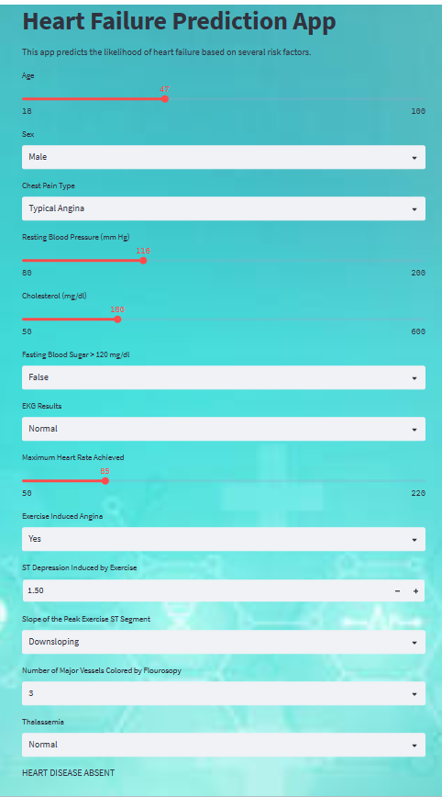
ABSENCE OF HEART DISEASE
The following parameters entered in the application, predicted the absence of heart failure.

Slide 19
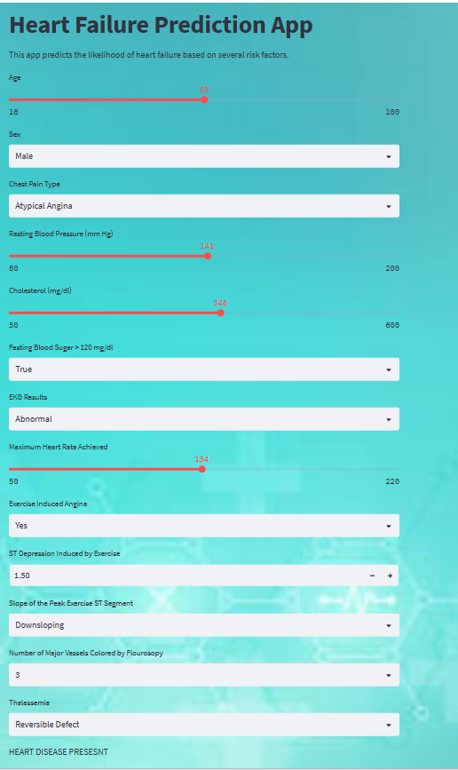
PRESENCE OF HEART DISEASE
The following parameters entered in the application, predicted the presence of heart failure.

Slide 20
CONCLUSION
The heart failure prediction model developed in this project has demonstrated the potential to predict the likelihood of heart failure in patients based on their medical history other factors.
This model can be a useful tool for healthcare professionals to identify patients who are at high risk of heart failure and provide them with appropriate preventive measures and treatments.
The accuracy and reliability of the heart failure prediction model depends on the quality and completeness of the data used to train it.
Further research is necessary to validate its performance on larger and more diverse datasets.

Slide 21
THANK YOU

