Slide 1
DATA 606 Capstone in Data Science SP2023
Earth Quake Prediction
- B.V.Sumanth Teja
KT99571.

Slide 2
Introduction:
Natural disasters like earthquakes can do a lot of damage and kill a lot of people. Precise expectation of quakes is fundamental for growing early advance notice frameworks, fiasco arranging, risk appraisal, and logical examination.
There are around 18 earthquakes of magnitude 7.0 or higher every year worldwide. Since 1968, actual yearly numbers have ranged from lows of 6-7 incidents each year.
But earthquakes do have a distinct geographical patterns which can help to identify locations and magnitudes of certain future major earthquakes that are going to be produced, even though we are unable to anticipate individual earthquakes.
90% of earthquakes are naturally occurring and the consequence of tectonic action. 10% of the remaining traits are connected to volcanism, human-caused effects, or other factors.

Slide 3
Dataset:
The dataset is taken from Northern California Earthquake website. It contains information
about earthquakes in California, United States, with a magnitude of 3.0 or greater.
The dataset contains Earthquake details like Latitude, Longitude, Magnitude, Depth, Time, Azimuthal gap etc.
The Data set contains 18030 rows and 14attributes.

Slide 4
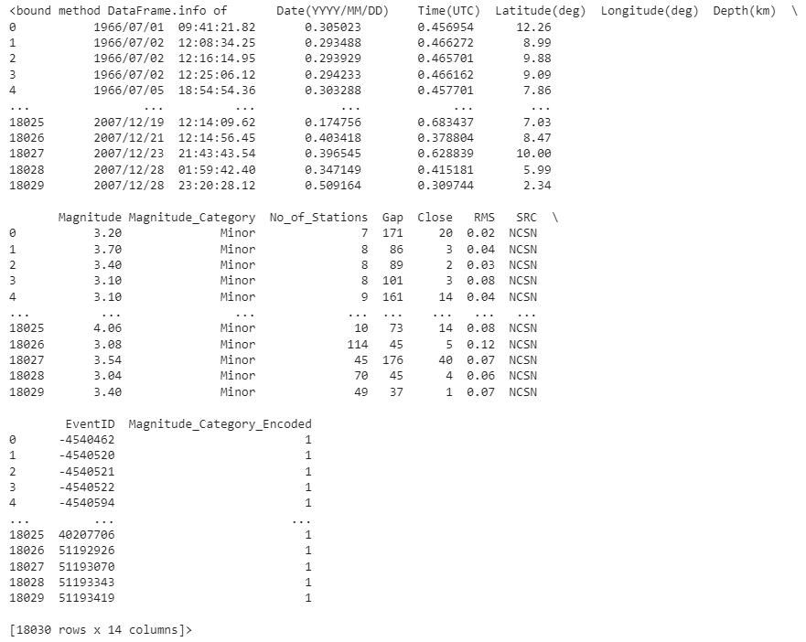
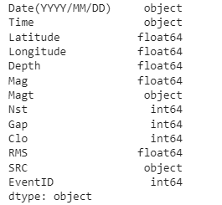
Description of the dataset:

Slide 5
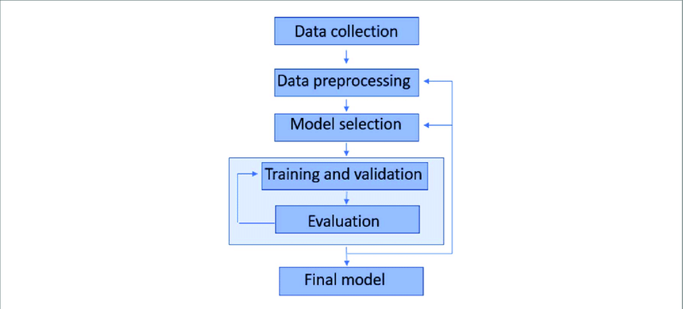
Project Framework:

Slide 6
Preprocessing:
Removed null values.
Dropped all unnecessary unwanted columns.
Libraries used:
Matplotlib.
Numpy.
Basemap.
Pandas.
Seaborn.

Slide 7
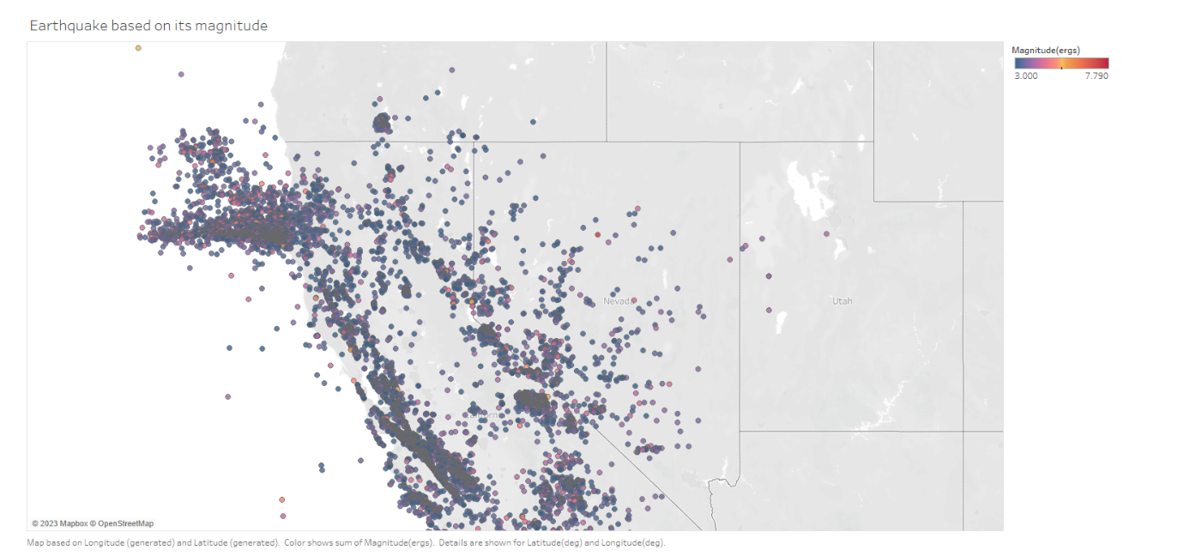
Data Visualization :
Hypothesis:
Blue color in the map represents the areas where the frequency of earthquake is less and the red color in the map shows frequency of the earthquake is more.

Slide 8
Machine Learning Model
Random Forest Model
Naive Bayes Model
SVM (Support Vector Machine)

Slide 9
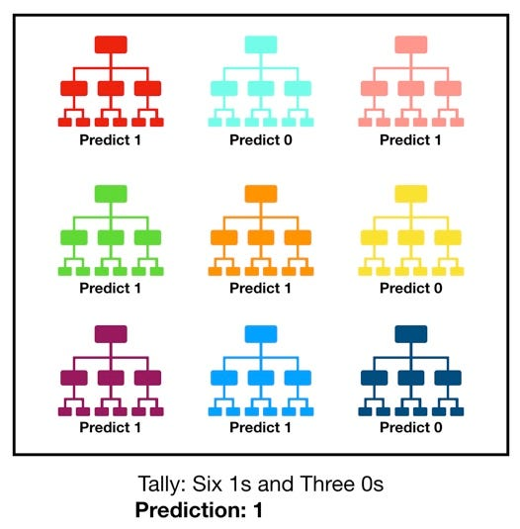
Random Forest Model
Random Forest Classifier is an ensemble learning algorithm that combines multiple decision trees to make accurate predictions and reduce overfitting.
It is effective for handling large datasets with high dimensionality and is less prone to overfitting compared to other models like Decision Trees.

Slide 10
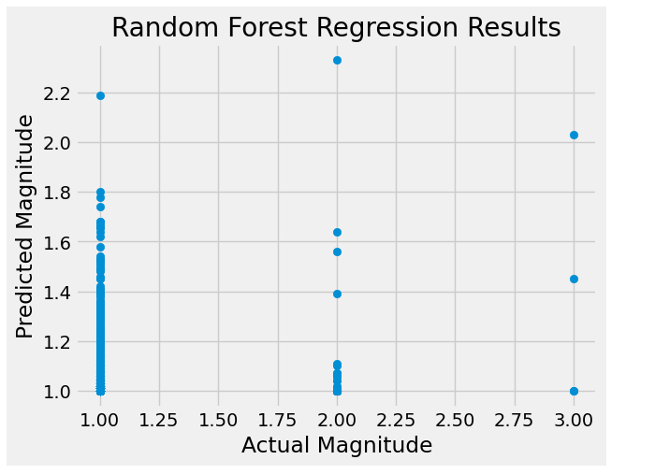
Random Forest Model
Based on the latitude, longitude, depth, and number of monitoring stations, we predicted earthquake magnitudes with the random forest algorithm.
The random forest model was trained on the training data, and its performance on the test data was evaluated using the mean squared error (MSE) and R-squared (R2) score.
The data were divided into training and testing sets.

Slide 11
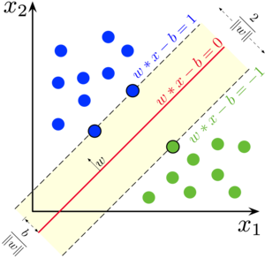
SVM (Support Vector Machine)
SVM is a powerful machine learning algorithm used for both classification and regression tasks.
It works by finding the hyperplane that best separates the data into different classes, maximizing the margin between the classes.
SVM is effective in handling high-dimensional datasets and is less prone to overfitting compared to other algorithms.

Slide 12
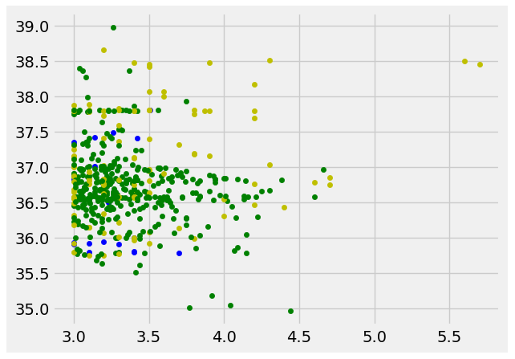
SVM Regression
It can handle both linear and non-linear data by using different kernels, such as linear, polynomial, and radial basis function (RBF) kernels.
It can be used to predict the magnitude of a new earthquake given its features, which can be useful for predicting earthquakes in real-time and understanding the factors that contribute to earthquake occurrence.

Slide 13
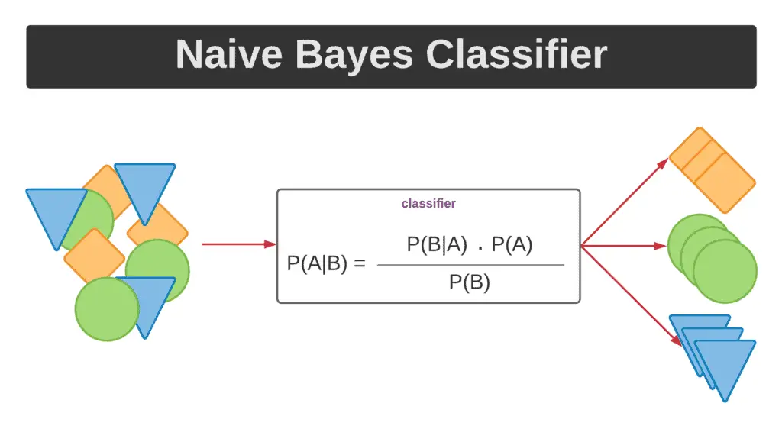
Naïve Bayes
Naive Bayes classifier is a simple probabilistic algorithm that is commonly used for classification tasks. It is based on Bayes' theorem, which describes the probability of an event occurring given some prior knowledge or evidence.
In the context of classification, Naive Bayes classifier calculates the probability of a data point belonging to a particular class given its features.

Slide 14
Naïve Bayes Classification
Based on the latitude, longitude, and number of monitoring stations, we predicted earthquake magnitude with the Naive Bayes classifier.
We split the information into preparing and testing sets, prepared the Innocent Bayes model on the preparation information, and assessed its exhibition on the test information utilizing the exactness score, disarray grid and characterization report

Slide 15
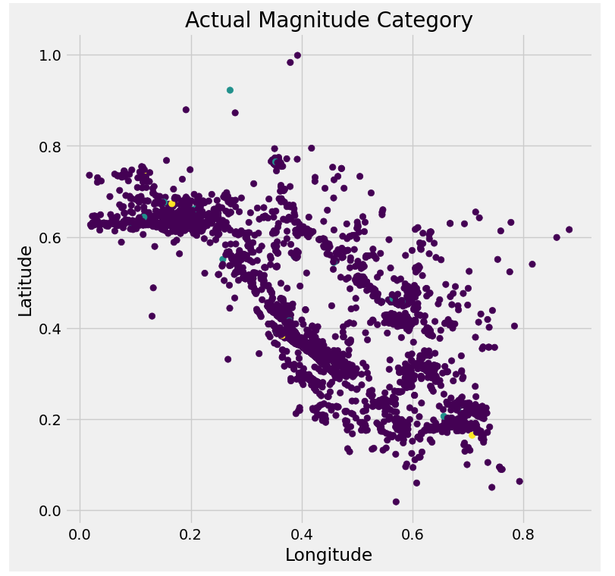
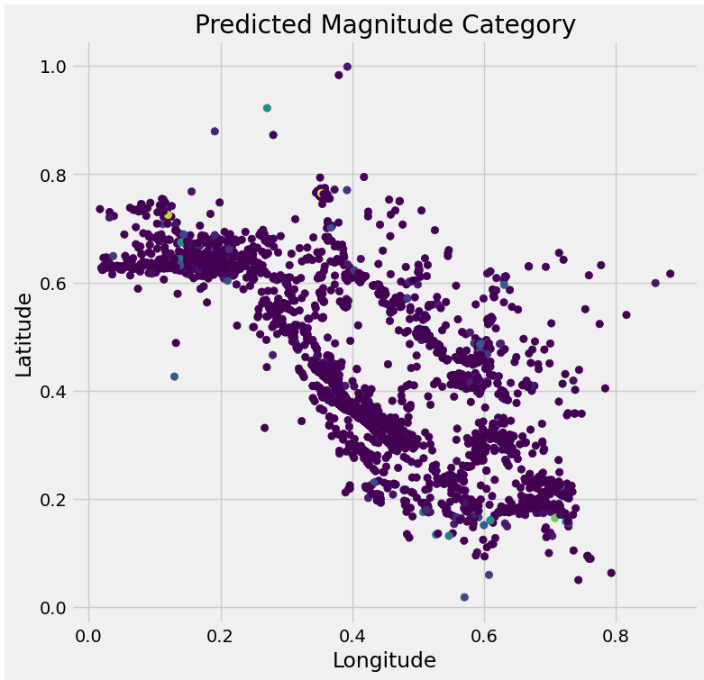
Actual and Predicted Magnitude Category

Slide 16
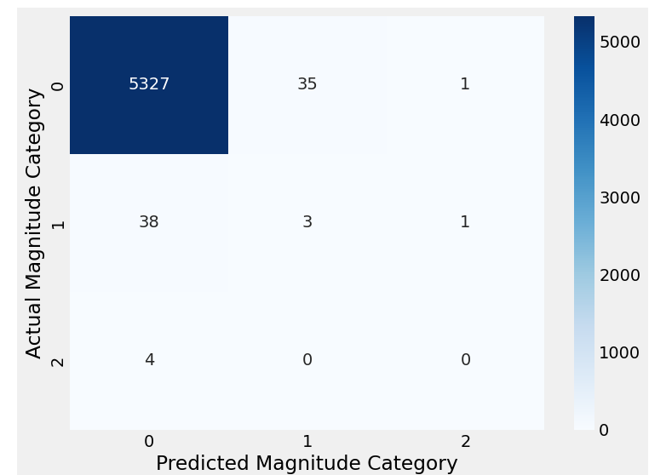
Heatmap of Confusion matrix

Slide 17
Accuracy and Results
When comparing models, both the mean squared error (MSE) and R-squared (R2) score can be used to evaluate the performance of the models.
The results obtained from the random forest model and SVM are as follows:
Model | Mean squared error | R-squared
Random Forest | 0.01287 | -0.18319
SVM | 0.69815 | -2.67320

Slide 18
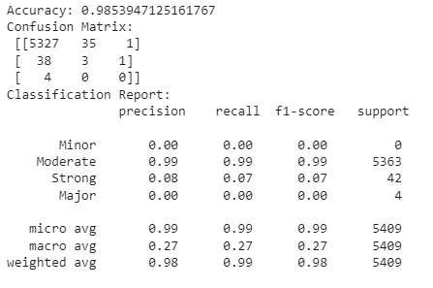
Accuracy and Results
The accuracy of the Naïve Bayes model is as follows:

Slide 19
Conclusion
One of the biggest challenges in earthquake prediction is the lack of reliable and consistent data. The occurrence of earthquakes is infrequent and unpredictable, and the data collected from sensors can be noisy and incomplete. Furthermore, earthquakes are influenced by a wide range of factors, including geological, atmospheric, and human factors, which makes it difficult to model the behavior of the system.
From the results of this project, we can conclude that random forest is the most accurate model for predicting the magnitude of Earthquake compared to all other models used in this project.

Slide 20
Thank you!

