Slide 1
DATA 606 Capstone in Data Science SP2023
Earth Quake Prediction
- B.V.Sumanth Teja
KT99571.

Slide 2
Introduction:
There are around 18 earthquakes of magnitude 7.0 or higher every year worldwide. Since 1968, actual yearly numbers have ranged from lows of 6-7 incidents each year.
But earthquakes do have a distinct geographical patterns which can help to identify locations and magnitudes of certain future major earthquakes that are going to be produced, even though we are unable to anticipate individual earthquakes.
90% of earthquakes are naturally occurring and the consequence of tectonic action.
10% of the remaining traits are connected to volcanism, human-caused effects, or other factors.

Slide 3
Dataset:
We are using a dataset from the Kaggle to predict the Earthquakes .
The dataset contains Earthquake details like Latitude, Longitude, Magnitude, Depth Error, Time, Horizontal Distance, Horizontal Error etc.
The Data set contains 23412 rows and 21 attributes.

Slide 4
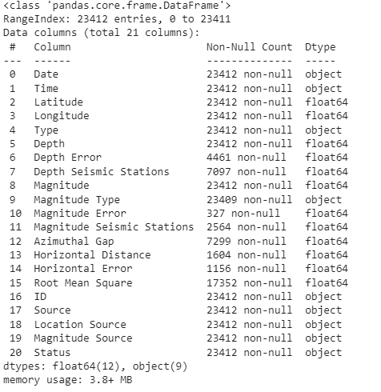
Description of the dataset:

Slide 5
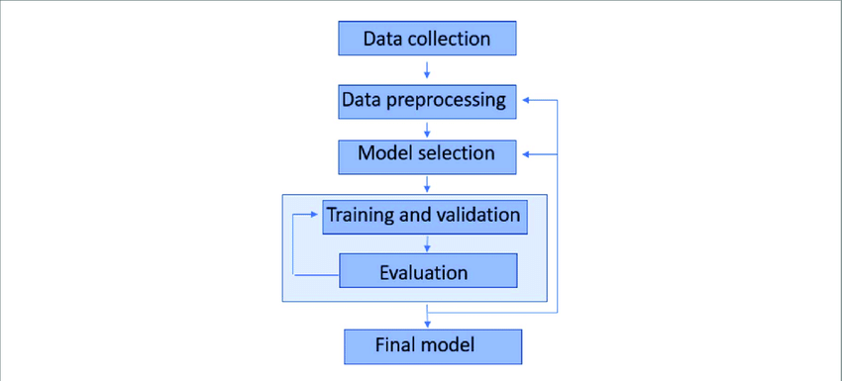
Project Framework:

Slide 6
Preprocessing:
Removed null values.
Dropped all unnecessary unwanted columns.
Libraries used:
Matplotlib.
Numpy.
Basemap.
Pandas.
Seaborn.

Slide 7
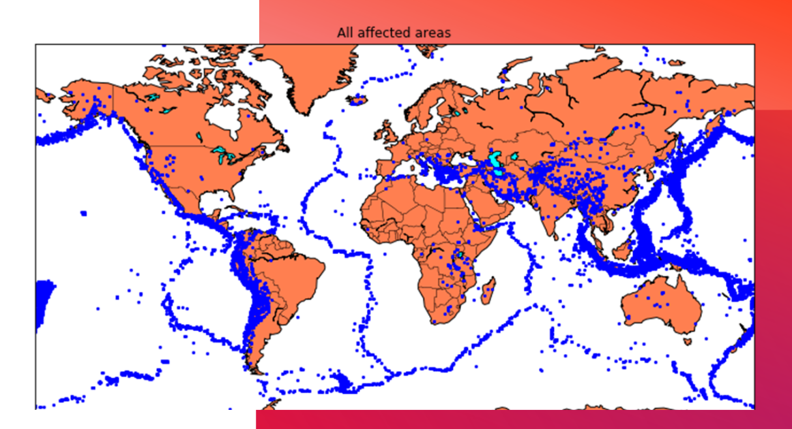
Exploratory Data Analysis:
Hypothesis:
Blue color in the map represents the areas where the frequency of earthquake is more.

Slide 8
Machine Learning Model
Random Forest
KNN (K- Nearest Neighbour)
SVM (Support Vector Machine)

Slide 9
Random Forest Model
Random Forest Classifier is an ensemble learning algorithm that combines multiple decision trees to make accurate predictions and reduce overfitting.
It is effective for handling large datasets with high dimensionality and is less prone to overfitting compared to other models like Decision Trees.
Random Forest Classifier is widely used in various industries such as finance, healthcare, and retail for tasks like fraud detection, disease diagnosis, and customer segmentation.

Slide 10
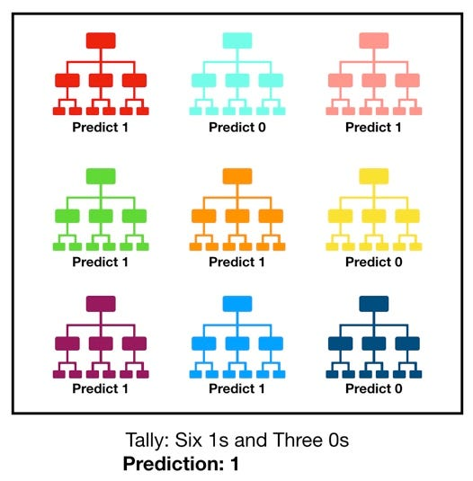
Random Forest Model
Random Forest Classifier is an ensemble learning algorithm that combines multiple decision trees to make accurate predictions and reduce overfitting.
It is effective for handling large datasets with high dimensionality and is less prone to overfitting compared to other models like Decision Trees.
Random Forest Classifier is widely used in various industries such as finance, healthcare, and retail for tasks like fraud detection, disease diagnosis, and customer segmentation.

Slide 11
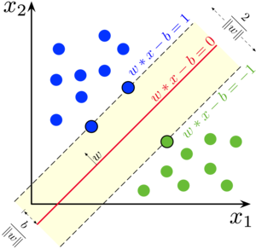
SVM (Support Vector Machine)
SVM is a powerful machine learning algorithm used for both classification and regression tasks.
It works by finding the hyperplane that best separates the data into different classes, maximizing the margin between the classes.
SVM is effective in handling high-dimensional datasets and is less prone to overfitting compared to other algorithms.

Slide 12
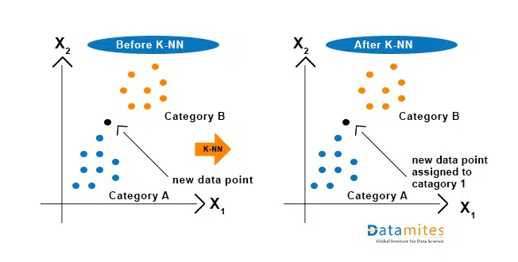
K-Nearest Neighbor
K-Nearest Neighbors (KNN) is a simple yet effective algorithm for classification and regression tasks.
It is a non-parametric algorithm that does not make any assumptions about the underlying data distribution.
The choice of k, the number of nearest neighbors to consider, can have a significant impact on the performance of the algorithm.

Slide 13
Thank you!

